Slide 1
SO 326:
POPULATION AND SOCIAL CHANGE
INTRODUCTORY LECTURE
What are the issues that are of central interest to demographers?
How does demography relate to other disciplines?
How can demography and sociology complement each other?

Slide 2
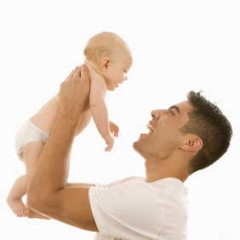
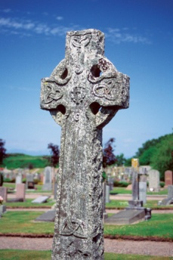

Population change
In-migration
Birth
Death
Out-migration

Slide 3
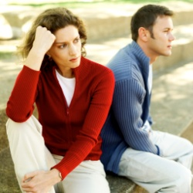

Household change
Separation

Slide 4
Nuptiality/marriage
(cohabitation)
Separation/ Divorce
Family/household
structure
Sexual behaviour/ ‘family planning’
Population
growth/decline
Fertility/births
Migration
Mortality/death
Age structure

Slide 5
What does sociology offer to demography?
Data (censuses, surveys,
vital registration, life
history data)
Qualitative data
Demographic trends
Explanation
Methods (rates, life
tables, standardisation
Sociological theories

Slide 6
The Interdisciplinary Nature of Demography/Population Studies
Sociology
History
Women’s/Gender Studies
Family/marital
therapy
Social Policy
Geography
Psychology
Demography/
Population Studies
Planning/
Urban studies
Epidemiology
(& genetics)
Actuarial science
Medicine
Economics
Development/
‘Third World’
Social Statistics
Law

Slide 7
Factors relevant to demographic explanation:
(e.g. with respect to ‘(future) fertility among the formerly married’)
Demographic (e.g. sex ratios)
Spatial
Cultural (e.g. social norms)
Economic (e.g. poverty)
Technological (e.g. contraception)
Legal (e.g. divorce laws)
Psychological
Political/ideological
etc., etc.

