Slide 1
Raymond Williams, EP Thompson and Stuart Hall and Cultural Studies
Day 3

Slide 2
Concerns about meanings of culture in post-war Britain
Thompson believed in a radical and influential way that
“culture involved a whole way of life and thus was not the privilege of any particular class or intellectual elite”
Williams on his part argued that in the modern world
“culture would be so complex that no individual could ever grasp it in its entirety... Culture would therefore always be fragmented, partly unknown and partly unrealized.”

Slide 3
Britain in the 1950s these standpoints challenged: - homogeneity of national culture - determined by elite - The working -class workers of the late 50s were derided in many quarters as ‘kitchen sink’ authors, their subject matter deemed a lapse of taste, a degeneration from some ideal of literary production. Against this view was Williams and Thompson’s argument that “culture is multi-faceted and includes the products of different class, ethnic and generational groups.”

Slide 4
Williams ‘view culture as plurivocal , a process, a shifting mass of signs rather than that could easily be categorized and examined . The same is true of CS that asks for questions instead of providing answers, hard to categorize. It crossed disciplinary boundaries and questioned assumptions about the validity of disciplines. It widened into different , often conflicting lines of enquiry. From the outset, it was to challenge the orthodoxies of the academic establishment. The Birmingham Centre embarked on a series of projects that went beyond the limits of the CANONICAL texts studied in Lit Departments.

Slide 5
Williams (1970s): Culture includes the organization of production, the structure of the family, the structure of institutions which express or govern social relationships, the characteristic forms through which members of the society communicate.
the culture of common people (working class culture) seen as more authentic than middle- and upper-class culture; derives from experience
interest in active appropriation of cultural forms & class struggle in the cultural arena
mass culture seen as ‘colonizing’ working class culture; packaged for passive absorption
working class intellectuals
against canonical élitism (high culture)

Slide 6
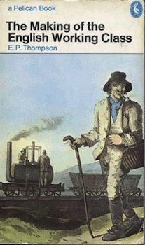
“I am trying to rescue the poor stockinger, the Luddite cropper, the “obsolete” hand-loom weaver, the “utopian” artisan, and even the deluded follower of Joanna Southcott, from the enormous condescension of posterity...
“The working class did not rise like the sun at an appointed hour. It was present at its own making.
I do not see class as a “structure”, nor even as a “category”, but as something which in fact happens (and can be shown to have happened) in human relationships...
Moreover, we cannot have two distinct classes, each with an independent being, and then bring them into relationship with each other. We cannot have love without lovers, nor deference without squires and labourers. (p.1)”
E.P. Thompson

Slide 7
Cultural Studies and Hegemony?
Study of relations between social relations and meanings (how social divisions are made meaningful)
Culture is terrain on which hegemony (ideological representations of class, gender, race) are enforced, and contested by social groups validating their experience
Hegemony operates in the realm of representations and consciousness; implies power inequality in different segments of society; naturalizes a class ideology and renders it in the form of common sense; it is exercised through ‘authority’not physical force; it operates through institutions (educational system, media and the family)
Cultural studies focus on analysis of cultural forms and their meaning in the context of power relations in society

Slide 8
Representation and Identity
A basic definition of representation: “to describe, or depict something; to call it up in the mind by description, portrayal or imagination. To represent also means to symbolise, to stand for, to be a specimen of or to substitute for (Davis 2009: 79).” Quite simply, a image and text has meaning ‘written’ into it.

Slide 9
Difference
Social groups categorised and classified
Who does this?
State, media for eg.
Major axes: Gender, race, class etc.
How does this come to be represented
With regard to the representation of difference: the portrayal by image and text applies to social groups and identities.

Slide 10
Stuart Hall – Key Theorist
Members of society, when making and communicating ordinary distinctions between groups and identities, rely on a specific ‘difference scheme’ in order to do so (i.e. The cultural contingency of identity).
Stuart Hall (1997) calls this the “representational regime of difference.” This entails that all identity distinctions we ordinarily make are historically and culturally specific The media is of course a key site at which these representations are rendered and accessed.

Slide 11
Mass Media and Representation
Media representations are most commonly associated with the images and meanings disseminated at the level of mass, popular media.
Mass media source of much representation
How does the “representational regime of difference.” operate in the media?
Examples: Tiger Wood, Amir Khan etc.

Slide 12
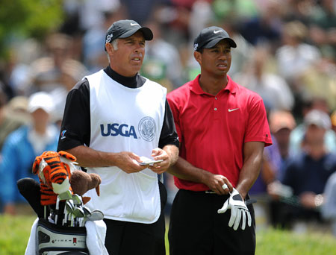
Woods was quoted on numerous occasions as wishing to identify as ‘Cablasian’. It was a term he himself concocted to honour his mixed-heritage. More importantly, he was trying to avoid the media pressure for him to identify as black.
The only problem being that there is no such distinction scheme available in contemporary America which allows for such an identification.
See also the recent furore concerning his former caddy, Williams, who made a reference to Woods as “ that Black arsehole”. Why not “that Cablasian Arsehole.”

Slide 13
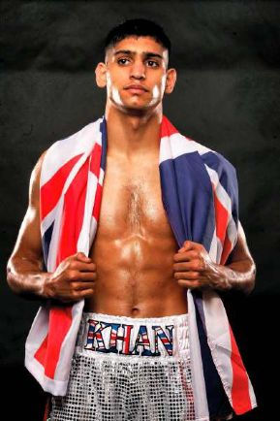
Amir Khan and British Identity
Amir Khan: Was reluctant to get involved in statements about identity; but from the very outset, discussions in the media continuously defined him as Muslim. By extension, a debate ensued in the press about whether he is British or not (identity wise).
Thereupon, Khan is forced to carefully manipulate his public image in order to address this difficult media climate to the best of his interests.
Both of these people do not fit into the scheme of
‘working class’ culture when it is white

Slide 14
Difference and power
If differences as apparent at the level of representation ‘precede’ us, is this necessarily a problem?
Difference ceases to be benign when it becomes apparent that power imbalances shapes the quality and content of the distinction being represented.
When distinctions rely on binary logics/oppositions such as Black/White, Male/Female, Straight/Gay (with two poles representing the respective extremes), one pole is privileged; in terms of the positive associations that pole enjoys.

Slide 15
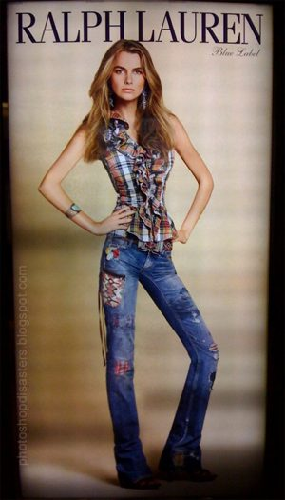
The male body becomes neutral/invisible. It is not worthy of (much) comment when contrasted to the type of stress and visibility placed upon the female body.
A telling back-story to this image: http://www.youtube.com/watch?v=DQ9p0MxqQAQ&feature=related

Slide 16
Stereotype
It is now easier to grasp what is meant by stereotype with regard to representation.
The privileged role/type/identity becomes the normative ideal (high status and also neutral), whilst the latter becomes a stereotype (an often caricatured, grossly simplistic, fixed and constricting representation of the relevant identity/group).
But what is the purpose of stereotype/the negative representation?
Why does it materialise in the first place?
Only can be understood within the context of inequality.
Negative representations do not emerge of themselves and/or arbitrarily.

Slide 17
Hegemony
Stereotypes/negative representations serve, in what is known in Gramscian terms, a hegemonic end.
With regard to hegemony, stereotypes allow for current inequities to be excused through reference to the meanings which emanate from those negative representations.
For example, if certain groups are commonly represented as inferior in terms of mental ability or as fundamentally lazy, it becomes easier to explain(rationalise/legitimise) why that group is at at the bottom of the social ladder.
Even the group represented in this negative mode might subscribe to this representation and thereby rationalise their lower social position. For instance, Fanon(1952) argued that the black masses subject to colonial rule ‘internalised’ the many derogatory meanings associated with black people. They believed in their own inferiority (their limited rational faculties) and were thereby less hostile to their oppression.

Slide 18
Critique of Williams and Thompson
Class is not primary issue
Because working class culture of Williams and Thompson is racist and sexist
Paul Gilroy
Áin’t no Black in the Union Jack
Stuart Hall
Race and Gender are lived realities of class difference

Slide 19
Conclusion
It is the representational regime (the repertoire of difference/ the sense-making scheme available to us as members of a particular society) that allows us in our everyday lives to make certain distinctions in our ordinary concerning identity.
But this is not say that we are passive, docile beings (recall hypodermic syringe metaphor) entirely subservient to these standards and the power relationships which they rely upon. Instead, there are strategies which individuals and groups, both intentionally and unintentionally, mobilise which ensure that representations are critiqued, subverted and transformed.
Key Terms: Representational Regimes,, roles, hegemony, normative, stereotype, binary oppositions, neutral, appropriation.

