Slide 1
Gramsci, Hegemony and Subaltern culture

Slide 2
Marx’s analysis of culture
The economic base, the ‘forces and relations of production’ ‘determine’ the cultural ‘superstructure’ of a society
  Forces and relations are mainly the technology and economic class relations that define an economic system
  Slave/owner in an ancient agricultural system
  Lord/serf in an advanced agricultural system, technology allowing for shared farming
  Bourgeoisie/proletariat in a capitalist system with the development of mechanization and factory production

Slide 3
Marx’s approach
Marx was most concerned with identifying the laws of social change based on the historical development of societies’ technological and economic systems
His work on the superstructure presents a fairly mechanical reflection of the power held in the base
  Though some argue that he simply did not have enough time to articulate a more sophisticated relationship
Control over the media, for example, allows the powerful to provide a nearly uniform ideological presentation across the entire society

Slide 4
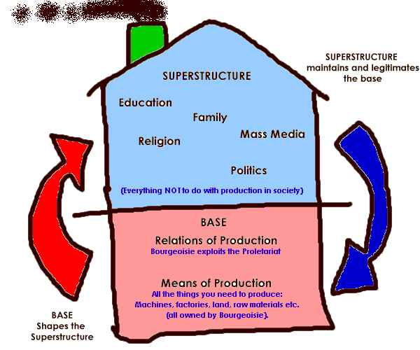

Slide 5
Ideology
Mostly imposed from above, with little attention to the actions of the oppressed classes
Acceptance is fairly uniform, with the mind another terrain of oppression
Elite ideologists are either members of the bourgeois class or employed by the class
  Though there are certain forms of conflict within the class, they are resolved when an issue of consequence for interclass relations emerges

Slide 6
Determination
For Marx, “false consciousness”
  The false beliefs about their real conditions that workers subject to elite ideology have
  False consciousness forestalls the development of “class consciousness,” the learned beliefs/knowledge that allow the class member to see from the true perspective of his/her class
  Class consciousness leads to revolution or “revolutionary consciousness” as the classes are forced to recognize the irreconcilable conflict of their positions
‘’superstructure is a reflection of the real social driver, not a driver itself. The system ideology is generated through the working of the economic structure. The ideology reflects and supports that structure. But the driving force is the “forces and relations of production” which define the kind of culture a society will develop.

Slide 7
Class consciousness
It is the role of the intelligentsia to lead the working class into class consciousness
Only through training and exhortation can workers break through their false consciousness
Inherent contradictions in the working of the base lead to crises, representing opportunities for the development of class consciousness

Slide 8
Issues for later theorists
(neo-Marxists)
The nature of false consciousness
Antonio Gramsci
  Hegemony
  Subaltern classes take part in their own deception
  Hegemony partial, conflicted, always in flux
    Must constantly be won
    Always in danger of being undermined
  Hegemony not a uniform, leaden ideology representing elite interests
  Natural, ‘common sense’

Slide 9
Antonio Gramsci and “hegemony”
Gramsci argued that diverse social groups attained “hegemony” at different times through inducing the consent of the majority of subordinate groups
In this sense, Gramsci’s hegemony relates to how the ruling class turn their ideologies into common sense and natural and how they preserved that status quo

Slide 10
Antonio Gramsci and “hegemony” continued…
According to Gramsci, the establishment of hegemony requires active and willing consent
  Common sense, suggests Geoffrey Nowell-Smith, is 'the way a subordinate class lives its subordination' (cited in Alvarado & Boyd-Barrett 1992: 51)
Gramsci also emphasized struggle in his conceptualization of hegemony
  'common sense is not something rigid and immobile, but is continually transforming itself' (Gramsci, cited in Hall 1982: 73)
Consent must be constantly won and re-won, peoples’ material and social experiences remind them of their subordination, this causes a threat to the dominant ideology

Slide 11
Antonio Gramsci and “hegemony” continued…
Gramsci pointed out that while the unity of the prevailing groups is usually created through the state and violent institutions (American revolution, the establishment of the Turkish Republic, police, military etc.), civil society institutions play an important role in establishing and maintaining hegemony as well (schools, religion, media etc.)
Later, the French Marxian thinker Louis Althusser defined these civil society institutions as ideological state apparatuses

Slide 12
Applying the hegemony theory
Hegemony theory of Gramsci involves both analysis of current forces of domination, the ways in which these forces achieved hegemonic authority and the delineation of counter hegemonic forces that could contest the existing hegemony
‘It is this question of counter hegemony where culture becomes essential

Slide 13
Later theorists
Cultural Marxists work off Gramsci’s analysis
  Ideology
    Entire worldview (Chomsky)
    Active structure for apprehending the world—processing of new information according to rules that seem natural or commonsensical but in fact represent certain interests
    Connotative definition of language (Hall)

Slide 14
Superstructure
The cultural superstructure is the legal system, educational system, ideology, art, media, etc.
Althusser outlined a number of Ideological State Apparatuses (ISAs) that served to “reproduce the conditions of production” that is, the teach workers their place in the world and reproduce them as a factor in production
But cannot be just a reflection of the base, rather works alongside forces of production

Slide 15
Theory of Cultural Studies
Cultural studies situated culture within a theory of social production and reproduction, specifying the ways that cultural forms served either to further social domination or to enable people to resist and struggle against domination.
It analyzed society as a hierarchical and antagonistic set of social relations characterized by the oppression of subordinate class, gender, race, ethnic, and national strata.
Employing Gramsci's model of hegemony and counterhegemony, it sought to analyze "hegemonic," or ruling, social and cultural forces of domination and to seek "counterhegemonic" forces of resistance and struggle.

Slide 16
Method
In the context of cultural studies, the idea of a text not only includes written language, but also films, photographs, fashion or hairstyles: the texts of cultural studies comprise all the meaningful artifacts of culture.
Similarly, the discipline widens the concept of "culture".
"Culture" for a cultural studies researcher not only includes traditional high culture (the culture of ruling social groups) and popular culture, but also everyday meanings and practices.

Slide 17
Amilcar Cabral
“The value of culture as an element of resistance to foreign domination lies in the fact that culture is the vigorous manifestation on the ideological or idealist plane of the physical and historical reality of the society that is dominated or to be dominated. Culture is simultaneously the fruit of a people’s history and a determinant of history, by the positive or negative influence which it exerts on the evolution of relationships between man and his environment, among men or groups of men within a society, as well as among different societies. Ignorance of this fact may explain the failure of several attempts at foreign domination--as well as the failure of some international liberation movements.”
Source: Amílcar Cabral. 1970 (Syracuse University). “ History is a Weapon: National Liberation and Culture”. http://historyisaweapon.com/defcon1/cabralnlac.html

Slide 18
Franz Fanon
“For Fanon, being colonized by a language has larger implications for one's consciousness: "To speak . . . means above all to assume a culture, to support the weight of a civilization" (Wretched of the Earch17-18). Speaking French means that one accepts, or is coerced into accepting, the collective consciousness of the French, which identifies blackness with evil and sin.
How can class consciousness develop when hegemony is racialised?

Slide 19
Application of Gramsci
‘If I speak, they will kill me, to remain silent is to die’: Poetry of Resistance in General Zia’s Pakistan (1977-88) Virinder Kalra and Waqas Butt
On whose door shall I knock, carrying the corpse of thought
If I speak they will kill me, to remain silent is to die.
Silently swallowing my tears, I endured the ridicule of the world
Searching for my destination, I walk into the dark night, all alone
Striving, I may not reach the end, but it will be closer
If I speak they will kill me, to remain silent is to die.
Sauchaan di miat noon cha key, hun main kehrey ghar jawan gah
Jey baulan te maar dain gey, naan baulan te mar jawan gah
Chup chapetey athroo peetey, mehnai jag dey paa ke palai
Raat henari kalam kalai tureya janaan manzal waley
Pawen sara penda naan sahei kujh na kujh te kar jawan gah
Jey baulan te maar dain gey, naan baulan te mar jawan gah (Zahoor, H. Z .(1998), Kaurey Ghut, Ameer Publishers, Urdu Bazaar, Lahore (1998: 47)

Slide 20
Cultural analysis
Forms of resistance
Deviant cultures/subcultures
  Williams
  Dominant culture
  Residual culture
    Retained from earlier, effective, accepted practices replaced by newly effective cultural practices
  Emergent culture
    “new meanings and values, new practices, new signficances and experiences, are continually being created”
    “no dominant culture, in reality exhausts the full range of human practice, human energy, human intention”

Slide 21
Cultural analysis
Gradual move away from class as the defining category of all social position
  Race
  Gender
  Sexual preference
  Defining the “other”

Slide 22
Resistance
More recent work has focused on resistance, on the development of cultural ‘spaces’ within which the oppressed can resist, fight back, reclaim their subjectivity
Hebdige (Subcultures)
  Style as a form of resistance
  However, style and other forms of resistance are drawn back into the dominant culture
    Development of a market for style—commodification

Slide 23
Style as resistance
“the challenge to hegemony which subcultures represent is not issued directly by them. Rather it is expressed obliquely, in style. The objections are lodged, the contradictions displayed (and, we shall see, ‘magically resolved’) at the profoundly superficial level of appearances: that is, at the level of signs”

