Slide 1
Theories and Practices of Popular Culture
Day 2: Frankfurt School

Slide 2
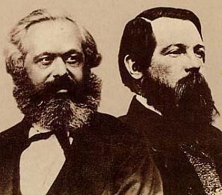
Marxist
Ideas are the production of social class and institutions
Ideas reflect the economic position of the promoters and developers of these ideas
Karl Marx
1818-1883
Frederick Engels
1820-1895

Slide 3
After Marx
No real mass media
Revolution takes place in Soviet Union but not as predicted by Marx
Workers welfare increases
New kind of social arrangements
So different responses to why the revolution does not take place
Gramsci
Frankfurt School

Slide 4
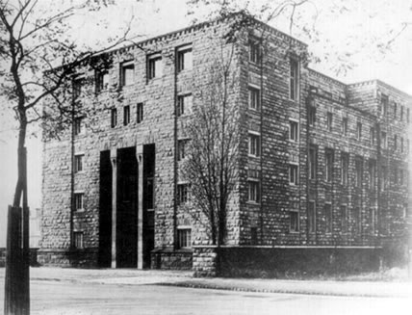
Background to the Frankfurt School
Frankfurt Institute for Social Research (1923) (Critical theory):
Key figures – Adorno, Horkheimer, Marcuse
Marginal figure – Walter Benjamin

Slide 5
Historical context significant:
German-Jewish, left writers
Rise of Nazis and Fascism in Europe 1930s
World War II – exile to USA
USA ‘democracy’, capitalist consumer culture

Slide 6
Problem
Against economic determinism of Marxism: Materialism → Culture & Ideology
What you have economically determines your social views, your consumption and your beliefs
So each class has different set of beliefs
One dominant ideology that of the bourgeoisie
Different ideology of the masses should lead to conflict and revolution

Slide 7
Big Problem
Capitalism created relative stability
Less (class) conflicts and no sign of proletarian revolution
Why?
For Frankfurt School thinkers
Role of mass media

Slide 8
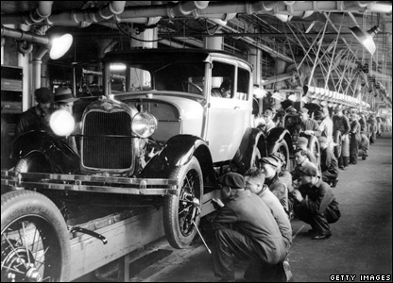
From mass production to mass culture
‘The way to make automobiles is to make one automobile like another automobile, to make them all alike, to make them come through the factory just alike; just as one pin is like another pin when it comes from a pin factory, or one match is like another match when it comes from a match factory’ (Henry Ford, 1903)

Slide 9
‘You can have any colour you like as long as it’s black’
(Henry Ford, talking about the new model T Ford Cars)

Slide 10
Mass society
Middle of 19th century onwards
Industrialisation, standardisation, urbanisation
Democracy and universal education
Population densely located spatially but distant socially
Individuals vulnerable to manipulation and persuasion as no force of tradition

Slide 11
Mass Communication
End of 19th century
Cinema and radio broadcasting, telephone
Relied on urban density
Even now on trip to London no mobile phone signal (O2)
Not confuse ‘mass’ with universal

Slide 12
From mass culture to the culture industries
People working in industry, consume cultural products
But these cultural products are not work of inspiration or high art, rather also commodities like the model T Ford
Culture industries

Slide 13
Mass culture = mass production of standardised cultural goods for mass consumption
Culture Industry produces mass culture imposed on people through media. Art, TV, film, music etc commercialised / industrialised
https://www.youtube.com/watch?v=4YGnPgtWhsw

Slide 14
‘Movies and radio need no longer pretend to be art. The truth that they are just business is made into an ideology in order to justify the rubbish they deliberately produce. They call themselves industries; and when their directors’ incomes are published, any doubt about the social utility of the finished product is removed’
(Adorno and Horkheimer 1944)

Slide 15
Ideology
Mass culture – deceives and manipulates, ie present an ideology
Not concerned with material conditions (ie poverty or true needs) but pacified by images of consumption
True needs are to be creative, autonomous and independent (ie enlightenment man)

Slide 16
Marcuse
Marcuse: false needs are created by advertising and standardised, repetitious media objects
No space for audience to think and critique – the logic of capitalism is absorbed into their minds
‘One dimensional man’ (Marcuse)

Slide 17
Adorno on culture industry
Ideology that creates a product that is seen as unique but comes out of a standard production system (the studio)
Culture industry is all powerful and masses powerless.
Creates conformity and lack of critical awareness of society
Audiences are infantilised by media (and correspondingly by society)

Slide 18
Mass Society and Media
‘gullibility, fickleness, herd-prejudice, lowness of taste and habit (Raymond Williams, The Long Revolution,1961: 289)
Negative connotations
Listeners, viewers, readers are ‘dupes’
Couch potatoes, ie passive acceptance
Examples of opening broadcast
Model of media: ‘hypodermic syringe’

Slide 19
Mass Media
Less to do with nature of broadcast – to large population
More about the way that the audience is perceived
‘no masses; there are only ways of seeing people as masses’ (Raymond Williams, The Long Revolution,1961: 289)

Slide 20
Critique
Is capitalism so smooth?
Super elitist
Only intellectual can see ‘truth’
Where is ‘culture’ of resistance

Slide 21
Walter Benjamin (1892-1940)
Adorno and Horkheimer’s culture industry essay was a reply to Benjamin’s 1936 ‘The Work of Art in the Age of Mechanical Reproduction’
Benjamin expressed a more participatory view of popular culture - mass reproduction makes art accessible

Slide 22
Aura
Key aspects that Adorno says are good about art; uniqueness, authenticity, individuality
For Benjamin these are associated with an aura that seeks to hide rather than illuminate
Mass production breaks individuality by making things reproducible and therefore accessible
Ultimately photography and film completely demystify painting (high art)
These forms not require specialist knowledge to interpret

Slide 23
Film in contrast
Film particularly good at capturing ‘real life’ and allows masses to contemplate and analyse it
Positive for people to view art as ‘work’, as an industry and activity like any other
Allows us to partake in the ‘collective experience’ of producing and consuming art
Everyone can be an ‘expert’ / critic

Slide 24
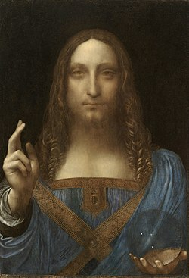
Painting and Film
Film clip – Toy Story 3
Why grossed - £682 Million globally
http://www.youtube.com/watch?v=JcpWXaA2qeg&feature=related
Worth: $450 million in November 2017

Slide 25
Contemporary Culture
No distinction between commercial and culture
Very little aspect of art not commoditised
Even amateurs are valorised: Britain’s Got Talent, X- Factor
Reality TV
But not so new
Begins in 1950s with new era – of mass consumption

