Slide 1
Ansal Academic Enhancment Programme 2019| Welcome
Professor Abhinay Muthoo, Dean of Warwick in London
Jo Hart, Head of Student Experience, Warwick in London
Helen Knight, Administrative Officer, Warwick in London

Slide 2
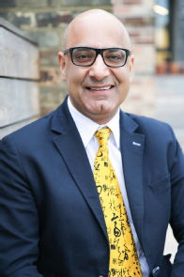
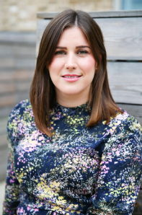
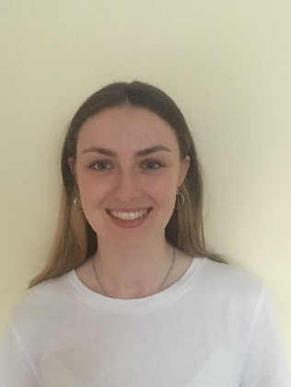
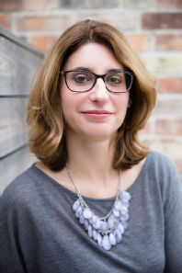
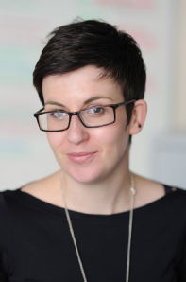
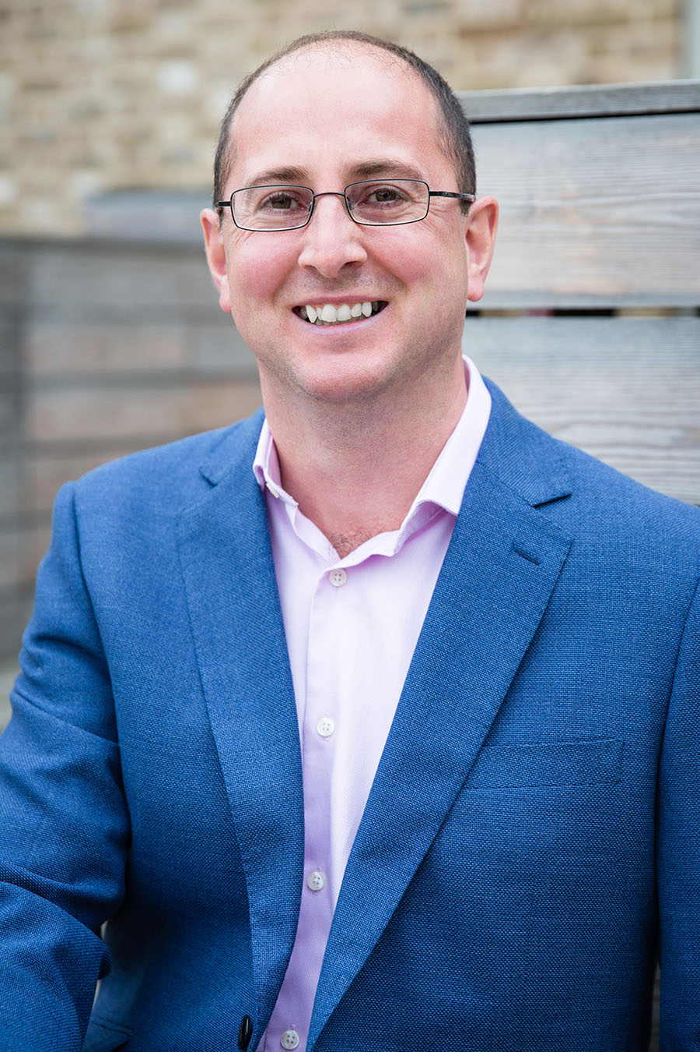
The Programme Team
Abhinay Muthoo | Jo Hart | Rachael Brogan | Helen Knight | Janine Powell | Mike McFarthing

Slide 3
Your Student Ambassadors
Ciara (PPE)
Rob(Maths)

Slide 4
Welcome
Your Induction Programme: Monday 4 June
11:00 Introduction to the Course (H0.51)
12.00 Lunch (on campus)
13:00 Campus Tour (from the Piazza) and Optional Sports Centre Induction
15:00 Free Time
19:00 Welcome Dinner (Chancellors Suite, Rootes Building)

Slide 5


Slide 6
Your Timetable
A copy of your timetable was included in your Induction Pack – UG and PG version.
Classes will take place in Humanities (please note room changes where necessary)
Your teachers will be Professor Abhinay Muthoo, Nadia Olivero, Stefania Paredes-Fuentes, Sinem Hidir

Slide 7
The Handbook
Please read the online handbook carefully. This contains all of the information you will need during your time here:
https://warwick.ac.uk/about/london/study/ansalenhancementprogramme/online_handbook
Check your emails regularly (at least daily) – we will communicate all important messages and reminders by email in the first instance. You will receive a daily email reminding you what is coming up next.

Slide 8

The Warwick ID Card
This card will give you swipe access to necessary teaching buildings as well as campus facilities such as the library, sports centre, and chaplaincy.
You will need to use this card to print and to use the photocopying facilities.
Eating at Warwick - you can also use your ID card to pay for food and drink in all retail outlets on campus. Using your ID card to pay in this way will entitle you to a 10% discount (excluding purchases made at Rootes Grocery Store). Simply top up your card online at: www.warwick.ac.uk/services/retail/eating

Slide 9
Facilities
Library
Open 24hrs, swipe card access.
You will be able to print and photocopy in the Library by buying printer credits. More information on printer credits can be found here: printercredits.warwick.ac.uk
Sports Centre
Monday-Friday (07.00am-10.00pm) and Saturday-Sunday 07.00am-09.30pm
Chaplaincy
See the website for details of events

Slide 10
Eating on Campus
You are able to purchase food and drink on campus from a variety of eating outlets, including:
The Dirty Duck
The Terrace Bar
Café Library
Curiositea Café
The Bread Oven
Fusion Bar
Varsity
NAIC
Café Nero (Sports and Wellness Hub)
Please see the Warwick Retail website for further information, including locations and opening times: https://warwick.ac.uk/services/retail/

Slide 11
Catering
The following catering is included:
All breakfasts – each day in Rootes restaurant
Seven lunches - £70 on Eating at Warwick/ID card
Welcome dinner, curry and quiz and farewell dinner
See timetable for reminders
We requested all dietary requirements before arrival, let us know ASAP if you didn’t inform us

Slide 12


Slide 13
Shopping
There is a convenience store – Rootes Grocery Store near the piazza
The largest and closet supermarkets are Aldi and Tescos at Cannon Park
Cannon Park also has a Post Office, Opticians, Boots, Iceland, Sports Direct, Wilkinsons, Subway, New Look, Greggs and a beauty salon, Drycleaners and more
Cannon Park is just 10 minutes walk
www.cannonparkshopping.co.uk

Slide 14
Local Area
Coventry and Birmingham are the nearest cities
Bus to Coventry takes about 20 minutes, No 11 or 12
The train to Birmingham is only 20 minutes from Coventry station and only costs a few £s
Warwick, Leamington and Kenilworth are all close by and worth visiting
Warwick Castle is a major tourist attraction and just 8 miles away

Slide 15


Slide 16
The Social Programme
WEEK ONE
MONDAY - Formal welcome dinner
WEDNESDAY – curry and quiz night (Chancellors’ Suite in the Rootes Building)
FRIDAY - Day trip to Stratford - free time
SATURDAY – Day trip to London – free time
WEEK TWO
MONDAY – Pizza lunch and guest speaker
TUESDAY - Day trip to Oxford – free time
WEDNESDAY – Farewell dinner and certificate giving

Slide 17
The Guest Lecture Programme
We have arranged 2 guest speakers for our guest lecture programme.
Professor Daniel Sgroi
Professor Nadia Olivero
All lectures are part of the teaching programme so please ensure you attend.

Slide 18
Practical Information
Where to get help:
Teachers as first point of call, they will escalate to the Warwick team if needed. Ambassadors also in Halls.
Health & Safety:
In case of fire, go to the fire meeting point outside the Arts Centre
Emergency Contact:
Contact Security in the first instance. Non-emergency number: 024 7652 2083 (extension 22083).
In the event of an incident requiring the emergency services (ambulance, police or fire and rescue), telephone 22222 (internal) or 024 7652 2222 (external).

Slide 19
Questions?

Slide 20
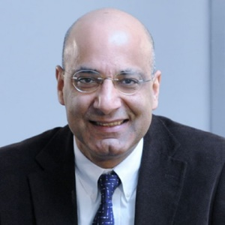
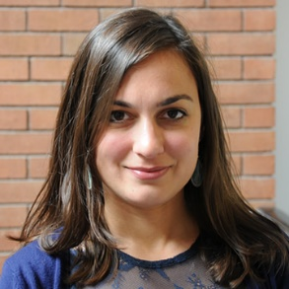
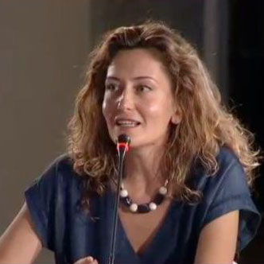
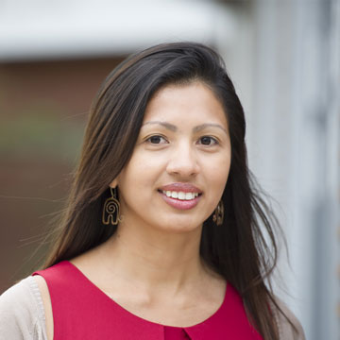
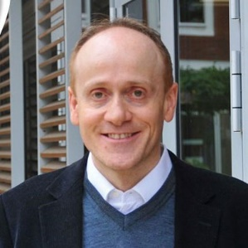
The Teaching and Guest Lecture Team
Abhinay Muthoo | Sinem Hidir | Nadia Olivero | Stefania Paredes Fuentes | Daniel Sgroi

