Slide 1

Introduction to Game Theory For Ansal University students, September 2019 Sinem Hidir University of Warwick Slides #2: Adverse Selection, Lemons Problem.

Slide 2
Outline:
Introduction to asymmetric information: lemons problem.
Adverse selection in used car market, labour and insurance
markets.

Slide 3
Information Economics:
Information economics deals broadly with the presence of
asymmetric information in markets, and ways to overcome the
inefficiencies caused by these informational frictions through
institutions or design of contracts.

Slide 4
Some products, i.e. coca cola, are identical everywhere in the
world: brand ensures quality.
However, in many cases sellers offer a product or service whose
quality cannot be easily judged before purchase.
Informational distortions are costly: when the buyer doesn’t
have enough information, he will be hesitant to buy.
May mean the markets cannot function properly=> leads to
market failure.

Slide 5
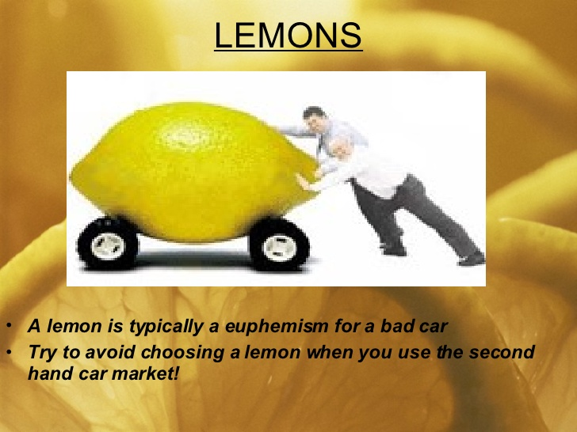
Lemons problem : used car market
The term was first defined in Akerlof (1970) ``The Market for Lemons’’, who later won the Nobel prize for his famous work in 2001.

Slide 6
A potential buyer of a used car has very little knowledge about the car, and
any potential problems. On the other hand, the seller knows a lot about the car!
Owners of cars having invisible defects are expected to be more willing to sell.
Adverse Selection arises when an informed individual’s trading decision
depends on privately held information in a way that adversely affects other
uninformed market participants.

Slide 7
In presence of adverse selection, uninformed traders will be wary of
any informed trader who wishes to trade with them, and their
willingness to pay for the product will be low.
As a result, first-best (efficient) trade cannot be achieved!

Slide 8
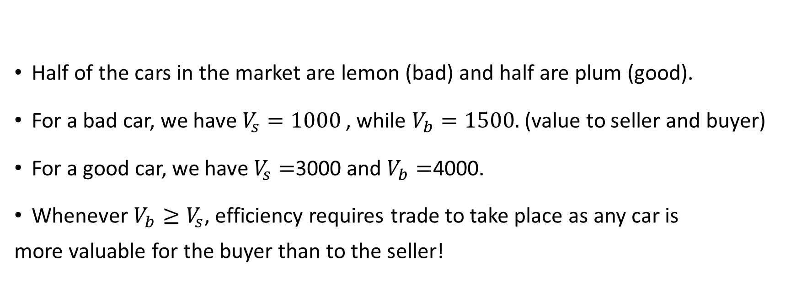
Used car exercise 1:
Half of the cars in the market are lemon (bad) and half are plum (good).
For a bad car, we have $V_{s}=1000$, while $V_{b}=1500.$(value to seller and buyer)
For a good car, we have $V_{s}=$3000 and $V_{b}=$4000.
Whenever $V_{b}≥V_{s}$, efficiency requires trade to take place as any car is
more valuable for the buyer than to the seller!

Slide 9
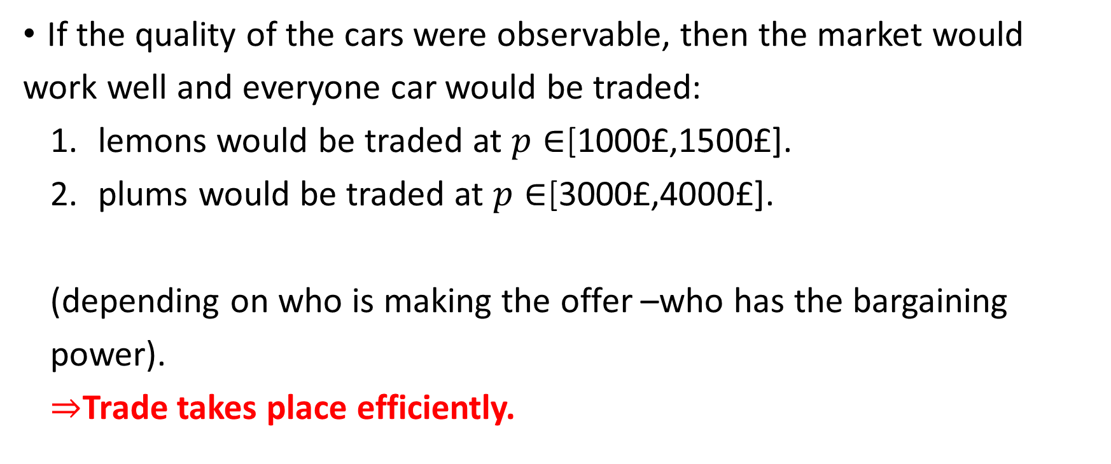
1. Perfect information:
If the quality of the cars were observable, then the market would
work well and everyone car would be traded:
lemons would be traded at $p∈$[1000£,1500£].
plums would be traded at $p∈$[3000£,4000£].
(depending on who is making the offer –who has the bargaining
power).
$⇒$Trade takes place efficiently.

Slide 10
2. Asymmetric information:
The buyer cannot observe the quality of the car while sellers know its
quality.
Solve by backward induction: first find the buyer’s willingness to
pay, then find which types of the seller are willing to sell, finally verify
that the buyer indeed wants to buy at the equilibrium price!

Slide 11
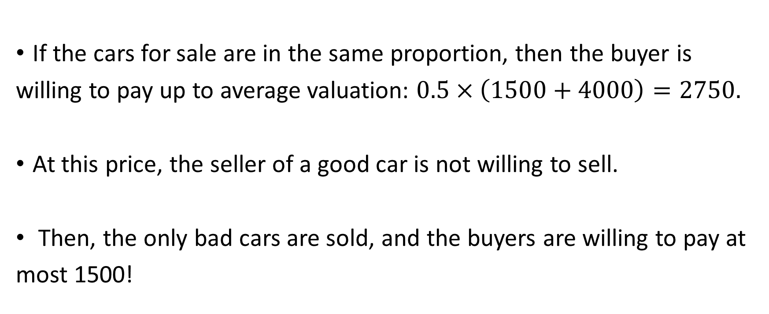
If the cars for sale are in the same proportion, then the buyer is
willing to pay up to average valuation: $0.5×\left(1500+4000\right)=2750.$
At this price, the seller of a good car is not willing to sell.
Then, the only bad cars are sold, and the buyers are willing to pay at
most 1500!

Slide 12
Market failure:
Due to the asymmetry of information, sellers cannot sell the high
quality products at high prices even though the buyers would be willing
to pay more if they could verify the quality of the car.

Slide 13
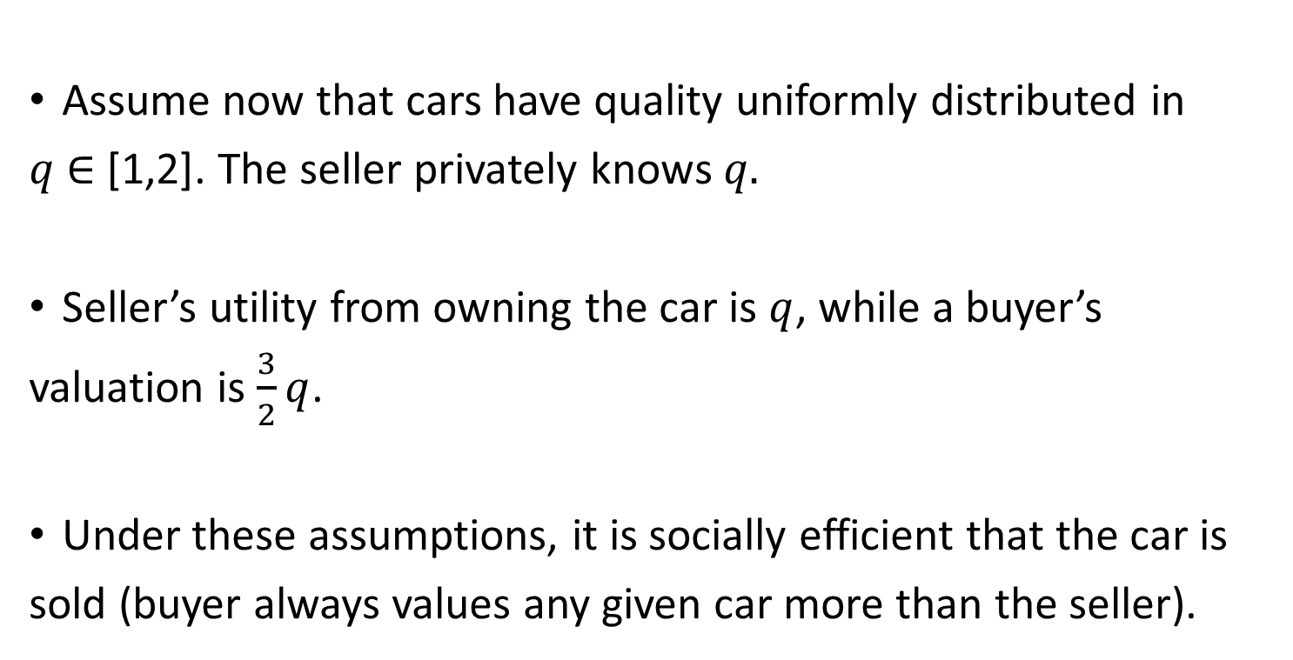
Used car exercise 2:
Assume now that cars have quality uniformly distributed in
$q$ $∈$ [1,2]. The seller privately knows $q.$
Seller’s utility from owning the car is $q$, while a buyer’s
valuation is $\frac{3}{2}q$.
Under these assumptions, it is socially efficient that the car is
sold (buyer always values any given car more than the seller).

Slide 14
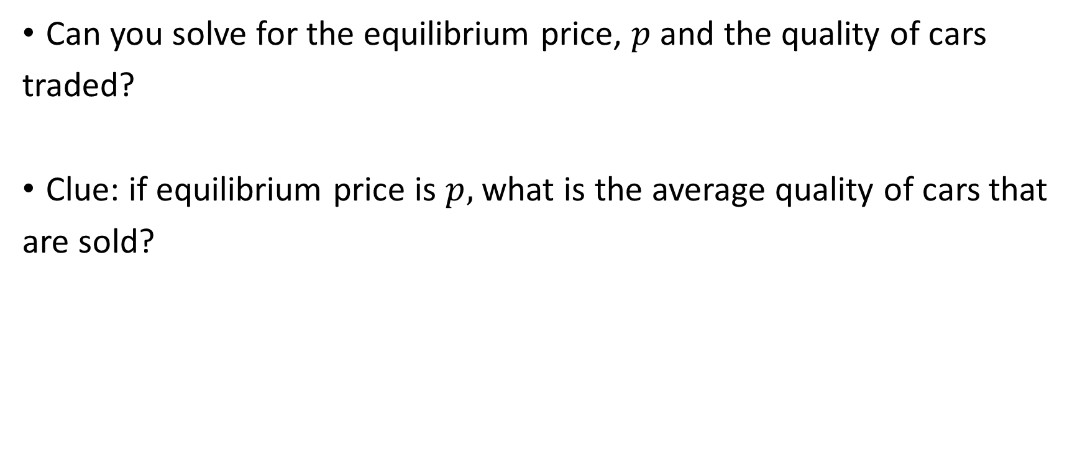
Can you solve for the equilibrium price, $p$and the quality of cars
traded?
Clue: if equilibrium price is $p,$what is the average quality of cars that
are sold?

Slide 15
The equilibrium is such that there is a critical value of quality
below which cars are sold, and higher quality cars owners will
quit the sales market:
``market unravelling’’
The distribution of cars that are actually for sale are worse than
the distribution of cars in the population.
As buyers are rational, they take this into account and discount
the value of cars that are up for sale.

Slide 16
When adverse selection is present…
Buyers or sellers would, on average, be better off trading with someone selected at
random from the population than with those who volunteer to trade.
Bad quality products are overpriced and good quality products are under priced.
Good quality products are crowded out from the market.
Buyers anticipate that the sellers who are eager to trade are those who have bad quality.
When unravelling is extreme: no trade at all can happen!

Slide 17
Labor market exercise:
Consider a competitive market where half of the job
seekers are skilled, while half are unskilled.
Employers value skilled workers at 6, unskilled ones at 2.
Skilled workers would earn 3 while unskilled workers
would earn 1 by instead working at home.
If only workers know their type, what would be the market outcome?

Slide 18
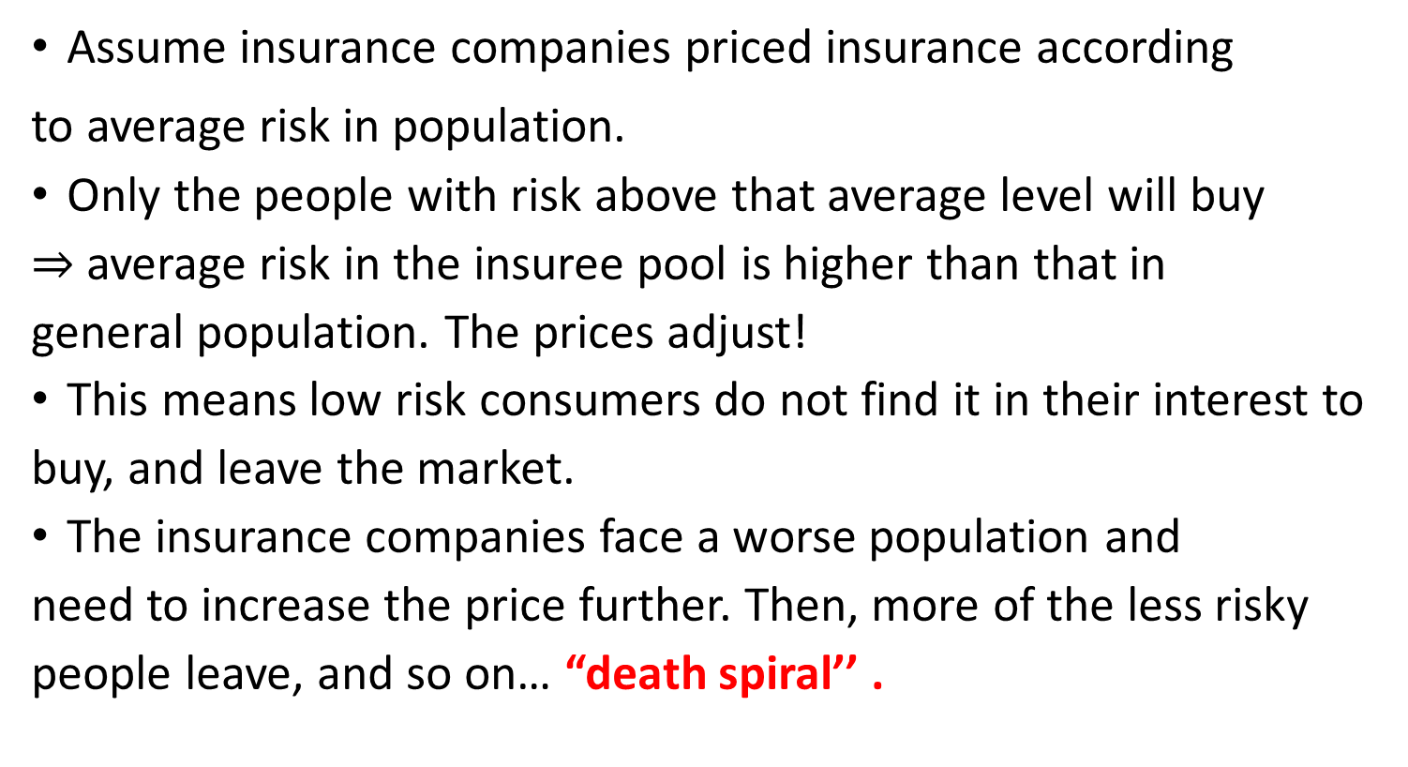
Adverse selection in insurance market:
Assume insurance companies priced insurance according
to average risk in population.
Only the people with risk above that average level will buy
$⇒$ average risk in the insuree pool is higher than that in
general population. The prices adjust!
This means low risk consumers do not find it in their interest to
buy, and leave the market.
The insurance companies face a worse population and
need to increase the price further. Then, more of the less risky
people leave, and so on… “death spiral’’ .

Slide 19
Insurance market exercise:
Consider a pool of demanders of health insurance in a competitive
market where insurance is priced fairly and individuals privately know
their risk type.
(Assume that companies can only offer a single price and single
insurance level.)
Assume there are 3 risk types of individuals in population, in equal
proportion. The expected health costs per year of each type is 15000,
6000 and 0. Solve for the market outcome.

Slide 20
Overcoming adverse selection:
Markets have evolved to find ways to alleviate adverse selection, and market
trade does take place at different prices:
Electronics: warranties.
Before buying a house: paying for a buyer’s survey.
In car insurance: the buyer’s previous claim history.
In health insurance: Group insurance plans- employers. Affordable care act
(Obama care)
In used car market:
Warranties, Glass’s guide, Service history, mileage, MOT history.
Internet reviews! Tripadvisor, amazon, ebay…

Slide 21
There are ways for privately-informed individuals to self-
select, i.e. to credibly reveal their private information.
Key idea: price varies with some other observable
component of the transaction.

Slide 22
Signalling: informed party moves first to credibly reveal information about the private type (by using costly signals!)
Screening: uninformed party makes contract offers which will lead to self selection by the informed party.
When both methods are available, which one is used depends on the
historical, cultural or institutional context of the transaction.

Slide 23
Summary of the lecture:
Sources of the lemons problem and how it leads to adverse
selection.
How adverse selection leads to market failure.
Examples of adverse selection in markets.
Signalling and screening as a way to overcome adverse
selection.

