Slide 1

Introduction to Game Theory For Ansal University students, September 2019 Sinem Hidir University of Warwick Slides #4: Screening.

Slide 2
What is screening?
Screening is a way to overcome adverse selection by the side
that has less information.
The uninformed party (principal) (she) proposes a contract
with several options to the informed party (agent) (he) who will
choose the most attractive option.
When the principal prepares the contract as a function of agent
types, the contract choice reveals agent’s private information.

Slide 3
Examples:
1. Price discrimination: Buyer knows her valuation, seller
doesn’t. Seller offers different qualities at different prices.
2. Insurance: Insuree knows her risk, insurer doesn’t. Insurer
offers several packages with different premium and deductibles.
3. Employment: Employee knows ability, employer doesn’t.
Employer offers different packages with varying wages, bonuses,
etc.

Slide 4
Price discrimination:
The classic and most common example of screening: a monopolist faces
different types of consumers and cannot observe the type. What is the best
price schedule according to quantity, quality, etc.?
First models: Mussa, M. and S. Rosen (1978)
Although monopoly is the most common example, similar results hold in
other screening models.

Slide 5
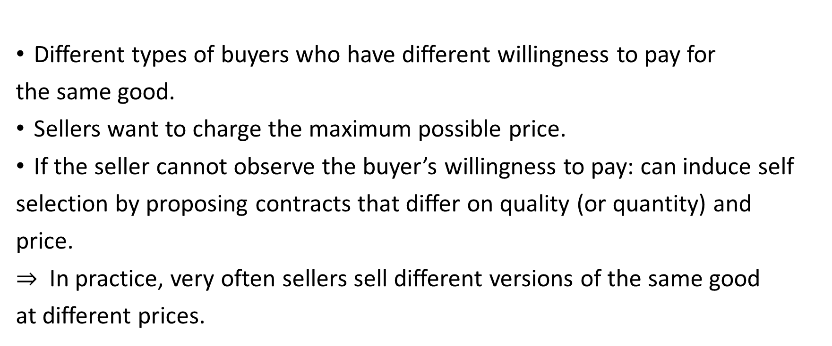
Different types of buyers who have different willingness to pay for
the same good.
Sellers want to charge the maximum possible price.
If the seller cannot observe the buyer’s willingness to pay: can induce self
selection by proposing contracts that differ on quality (or quantity) and
price.
$⇒$ In practice, very often sellers sell different versions of the same good
at different prices.

Slide 6
Examples:
plane: time of departure, choosing seats.
time of purchase: books, clothes, supermarkets.
``limited edition’’ products.
personalised discount vouchers.
quality differentiation: ``taste the difference’’ vs. essential products.
versioning in software products.
time of delivery.

Slide 7
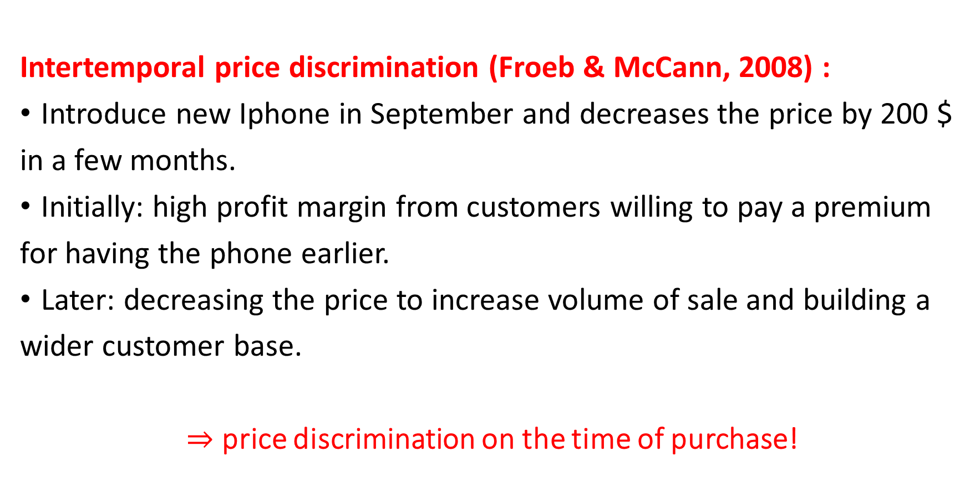
Apple:
Intertemporal price discrimination (Froeb & McCann, 2008) :
Introduce new Iphone in September and decreases the price by 200 $
in a few months.
Initially: high profit margin from customers willing to pay a premium
for having the phone earlier.
Later: decreasing the price to increase volume of sale and building a
wider customer base.
$⇒$ price discrimination on the time of purchase!

Slide 8
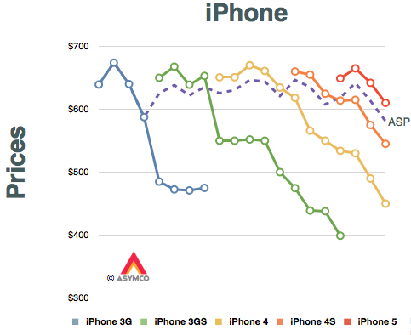

Slide 9
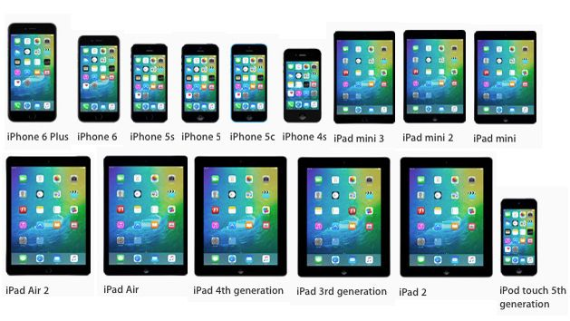
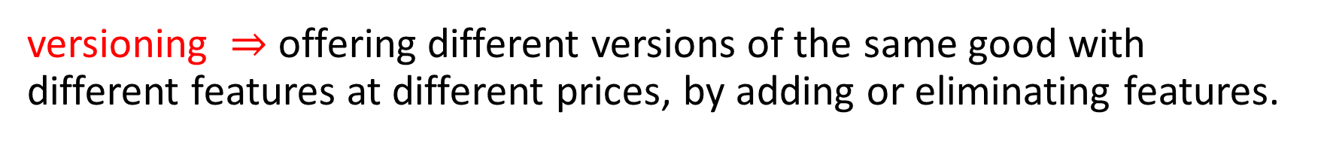
versioning $⇒$ offering different versions of the same good with different features at different prices, by adding or eliminating features.
iphone vs iphone s, ipad air vs ipad pro…. So many versions, but are there big differences?

Slide 10
Computer software:
Producers of computer software offer a lite (student) version
with fewer features and lower price:
Windows 10 Home: 119$
Windows 10 Pro:199$
Production cost is very low and the producer wants to cater to
those willing to pay less while charging more to those who can
pay more.

Slide 11
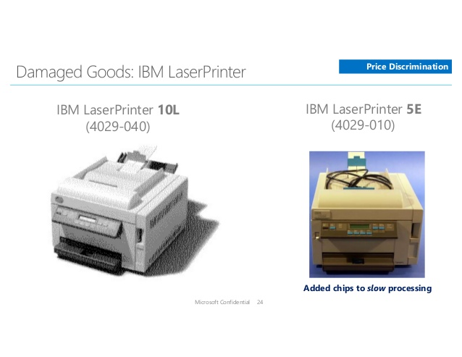
IBM (Mcafee 2008):

Slide 12
In 1990, IBM introduced a slow version of its laser printer: E version 5
pages per minute, while fast version printed 10 paper per minute,
at a price of 200$ more.
To obtain the E version: IBM added a chip in the firmware that slowed
down printing.
Why is it profitable for IBM to incur cost to produce a less efficient
version?

Slide 13
Consider two types of consumers:
James has a home office and uses the printer for his work.
John is a student who occasionally uses the printer at home.
James John Cost
Laser
1000 | 600 | 300
500 | 400 | 325
E version

Slide 14
James John Cost Profit from James Profit from John
1000 | 600 | 300 | 700 | 300
500 | 400 | 325 | 175 | 75
Laser
E-version
First degree price discrimination: if IBM could charge different price to different customers…. No need for E version! This also maximizes total surplus= first best.
In reality: cannot really observe and charge according to customer’s type. If asked, consumers wouldn’t be truthful!
If you want to sell both qualities, should price in a way that James buys the laser version while John buys e-version.

Slide 15
When type is not observable, there are 3 possibilities:
Offer only E- version- charge 1000 or 600.
Offer only Laser version- charge 500 or 400.
Offer both quality at different prices.
But any type of buyer is free to choose any item!

Slide 16
What would be the price if IBM wants to sell both types of
printers but cannot price according to customer type?
James John Cost
1000 | 600 | 300
500 | 400 | 325
Laser
E version

Slide 17
Offering both qualities:
Only optimal to offer both qualities if both are sold!
find prices at which James buys laser and John buys e-version.
(Incentive compatibility conditions!)

Slide 18
The user with higher valuation gets information rents given to
induce buying the advanced product (laser) while he could as well
buy the basic one!
In order to induce this type of self selection, the contract should
provide a certain surplus to dissuade the advantaged type from
mimicking a lower type.

Slide 19
Selling both products means:
need to leave surplus to the high valuation customers.
trade off between increasing the customer base vs leaving
information rents.

Slide 20
No hidden information: first best contract (perfect price
discrimination). Principal can extract the whole surplus.
Private (hidden) information: second best contracts. Principal leaves
information rents to the advantaged type if he serves the whole
market!

Slide 21
Conclusions:
A contract is incentive compatible if it induces the agents with hidden
types to self select and thus can screen the agents based on their
types.
When selling to agents who privately know their types, principal
leaves information rents to dissuade high value types from mimicking
the lower value types: trade-off between efficiency and information rents.

