Slide 1
Lecture Slides 6
Cheap Talk
Bayesian Persuasion

Slide 2
Outline:
Ways that (strategic) information can be transmitted:
1. Cheap talk.
2. Bayesian Persuasion.

Slide 3
1. Cheap Talk (Strategic Communication)
When information is unverifiable and signalling or contracts are not
feasible, can we still convey information via direct communication
despite conflicts of interest?
The sender has access to information while the receiver is the one
who will take a decision.
Why “cheap talk’’: Providing and receiving information is completely
free. There are no direct costs to lying.
=> A costless signalling game!

Slide 4
Applications:
Project manager communicating to a CEO about a project’s profitability.
An entrepreneur communicating to potential investors about his
innovation’s value.
A supervisor giving information about an employee to a manager.
Lobbyist advising to a politician about the expenditure on a public
project.
Salesman advising a customer about a product's quality.
Important feature: ``bias’’ i.e. conflict of interest.
Information is not verifiable.

Slide 5
Communication is trivial when interests are aligned!
When interests are misaligned, only noisy (imperfect) information can be
communicated!
The more biased the sender is, the more noisy communication.
Then, the question is whether informative communication equilibria exist?

Slide 6

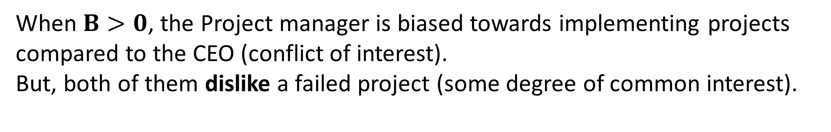
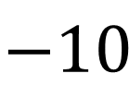


CEO and division manager
CEO
Division manager
Success Failure
Success Failure
Yes
No
$$5$$
$$−10$$
5+B
$$−10$$
0
0
0
0
When $B>0$, the Project manager is biased towards implementing projects compared to the CEO (conflict of interest).
But, both of them dislike a failed project (some degree of common interest).

Slide 7
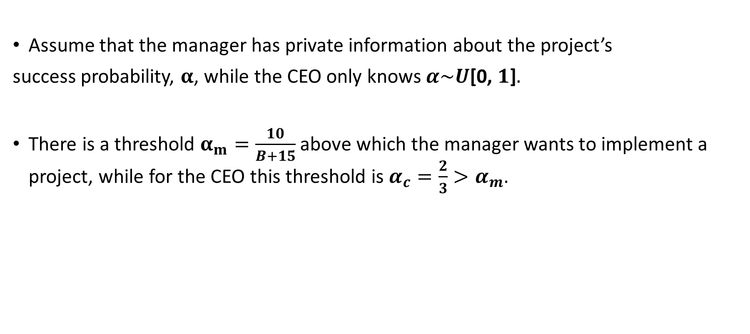
Assume that the manager has private information about the project’s
success probability, $α$, while the CEO only knows $α\sim U$[0, $1$]$.$
There is a threshold $α_{m}=\frac{10}{B+15}$ above which the manager wants to implement a project, while for the CEO this threshold is $α_{c}=\frac{2}{3}>α_{m}$.

Slide 8
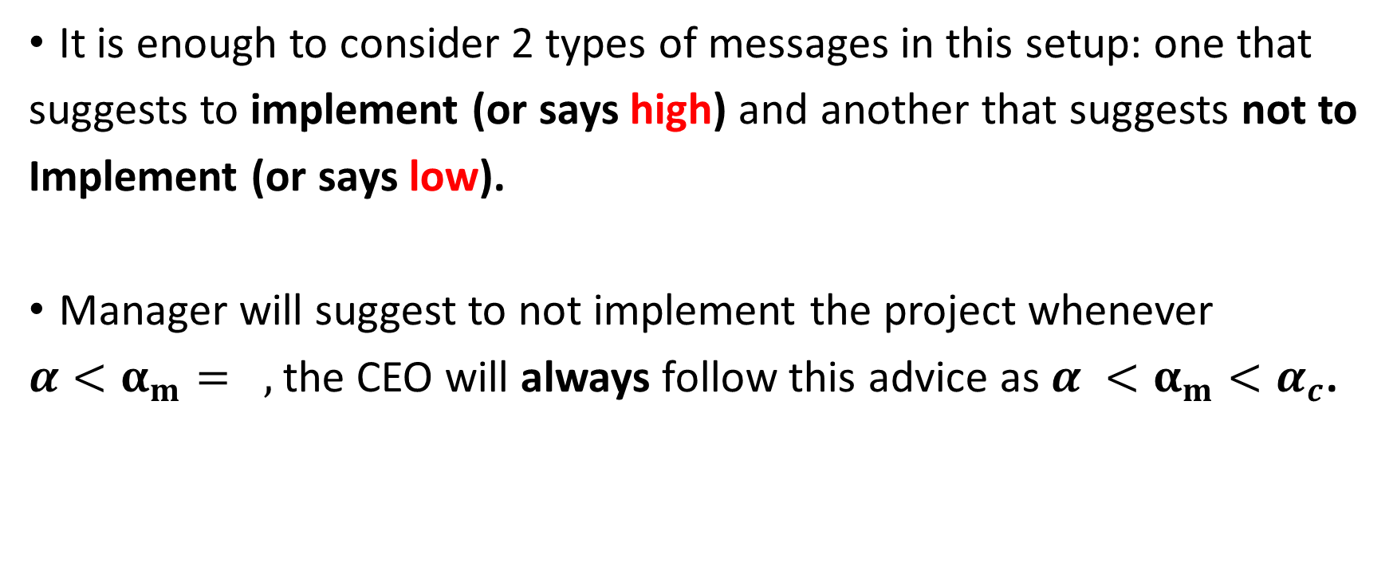
A communication equilibrium:
It is enough to consider 2 types of messages in this setup: one that
suggests to implement (or says high) and another that suggests not to
Implement (or says low).
Manager will suggest to not implement the project whenever
${α<α_{m}=}_{},$the CEO will always follow this advice as $α <α_{m}<α_{c}$.

Slide 9
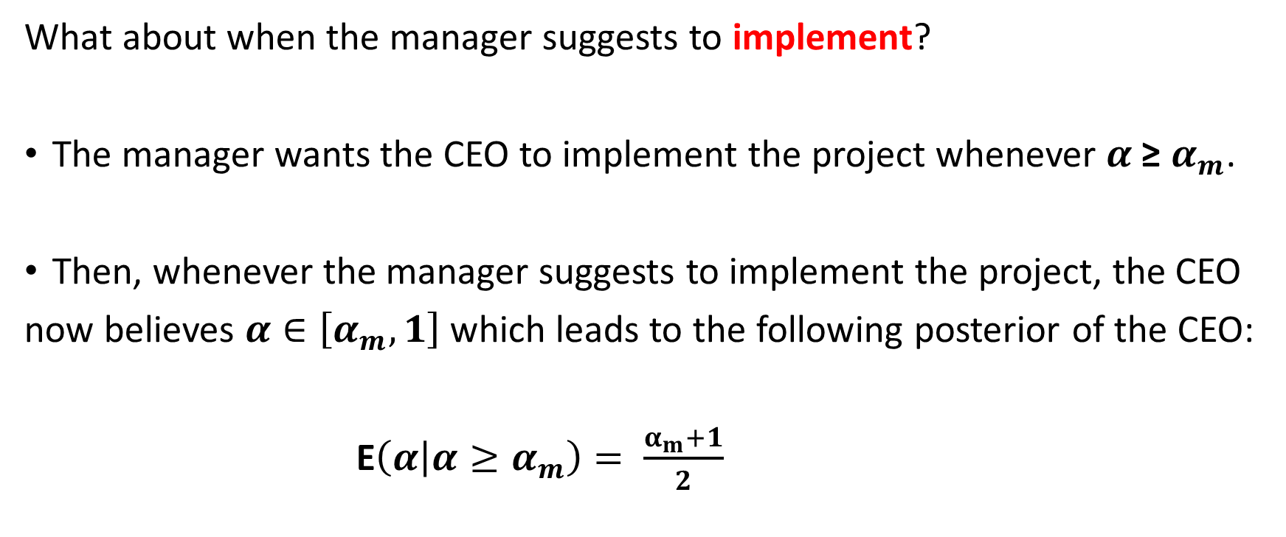
What about when the manager suggests to implement?
The manager wants the CEO to implement the project whenever $α$≥ $α_{m}$.
Then, whenever the manager suggests to implement the project, the CEO
now believes $α∈\left[α_{m},1\right]$ which leads to the following posterior of the CEO:
E$\left(α | α≥α_{m}\right)= \frac{α_{m}+1}{2}$

Slide 10
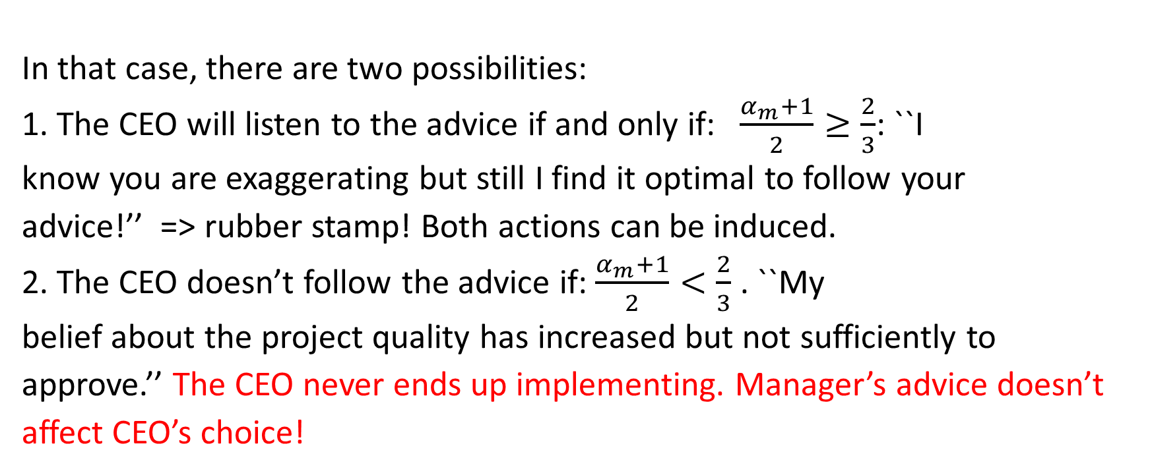
In that case, there are two possibilities:
1. The CEO will listen to the advice if and only if: $\frac{α_{m}+1}{2}≥\frac{2}{3}$: ``I
know you are exaggerating but still I find it optimal to follow your
advice!’’ => rubber stamp! Both actions can be induced.
2. The CEO doesn’t follow the advice if: $\frac{α_{m}+1}{2}<\frac{2}{3}$ . ``My
belief about the project quality has increased but not sufficiently to
approve.’’ The CEO never ends up implementing. Manager’s advice doesn’t
affect CEO’s choice!

Slide 11
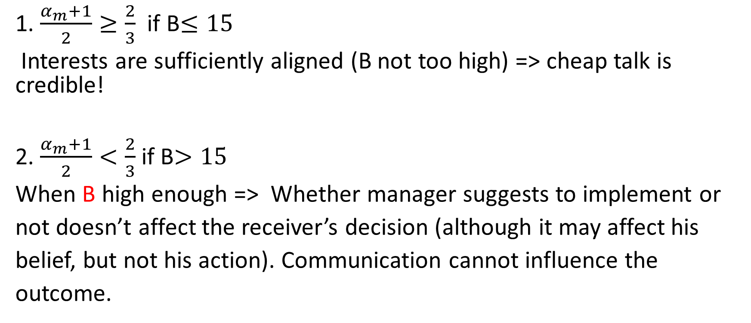
1. $\frac{α_{m}+1}{2}≥\frac{2}{3}$ if B$≤15$
Interests are sufficiently aligned (B not too high) => cheap talk is credible!
2. $\frac{α_{m}+1}{2}<\frac{2}{3}$ if B$>15$
When B high enough => Whether manager suggests to implement or
not doesn’t affect the receiver’s decision (although it may affect his
belief, but not his action). Communication cannot influence the
outcome.

Slide 12

A buyer seller relationship:
Could be a salesman and a buyer. The salesman knows the quality of his product.
If the real quality of the product is v the buyer would be willing to pay p=v,
whereas the seller wants to make the buyer believe it is v+b.
b cannot be too high as the buyer may come back to the shop and fight!
No truth telling equilibrium:
seller always exaggerates.
Then, the buyer discounts every
claim that the seller makes.
The extent of exaggeration (b)
depends on if customer is a
regular one or just a passer-by!

Slide 13
As b (bias) increases, less number of credible claims: more conflict of
interest leads to less effective (more noisy) communication.
When b is above a threshold => no meaningful communication at all!
``babbling equilibrium’’:
The seller always says this is the best meat you can find!
The buyer thinks: I don’t care what you say, as you always say the same
thing!

Slide 14
Conclusions
Cheap talk studies a communication game in which there is a degree
of conflict of interest, but also some alignment of preferences.
The main assumption is that the sender has access to information for
free, communication has no direct cost and there is
no room for contracts!
There is meaningful communication if and only if the bias (conflict of
interest) is sufficiently low.
The truthfulness of communication decreases in the bias parameter.

Slide 15
References: (for further interest).
Canonical: Crawford and Sobel (1982), ``Strategic Information Transmission’’.
Recent Survey: Sobel (2013), ``Giving and Receiving Advice’’.
Organizational Design: Dessein, W. (2002), ``Authority and Communication in Organizations’’.
Alonso and Matouschek (2008). ``Optimal Delegation’’.
Alonso, Dessein and Matouschek (2008). ``When Does Coordination Require Centralisation’’.

Slide 16
2. Bayesian Persuasion
Strategic communication between two people: a sender and a
receiver.
There is an underlying truth, about which the two initially share
a common prior.
The sender is trying to persuade the receiver to take a certain action, regardless
of the state of the world. The receiver only wants to take that action if a certain
state of the world is realised.
The sender announces and commits to a signalling strategy, without any further
information about the state. The receiver observes the information (a signal
realisation) and then takes an action.

Slide 17
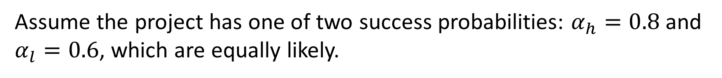

CEO and division manager
CEO
Division manager
Success Failure
Success Failure
Yes
No
$$5$$
$$−10$$
$10$
$$−10$$
0
0
0
0
Assume the project has one of two success probabilities: $α_{h}=0.8$and
$α_{l}=0.6$, which are equally likely.

Slide 18
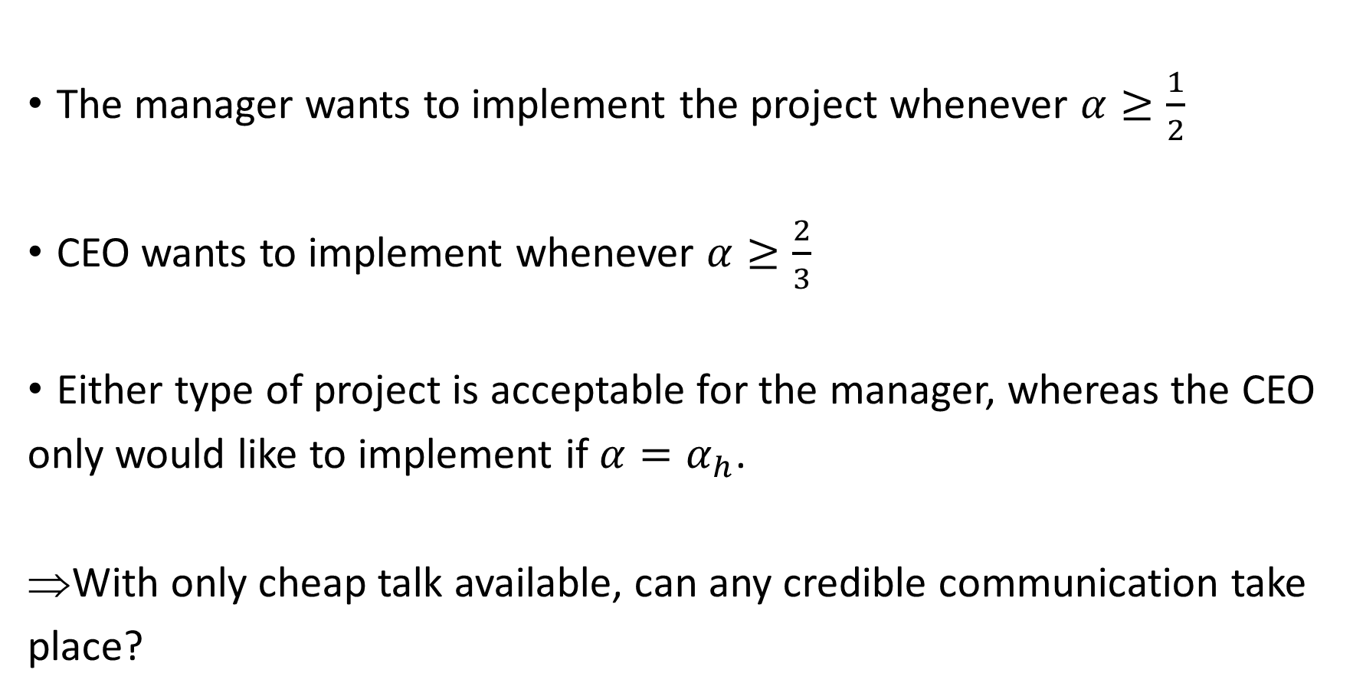
The manager wants to implement the project whenever $α≥\frac{1}{2}$
CEO wants to implement whenever $α≥\frac{2}{3}$
Either type of project is acceptable for the manager, whereas the CEO
only would like to implement if $α=α_{h}$.
With only cheap talk available, can any credible communication take
place?

Slide 19
Question: How often can the Manager make the CEO accept a low
success project?
Let’s say Manager can be ``partially truthful’’ as opposed to cheap
talk only.

Slide 20
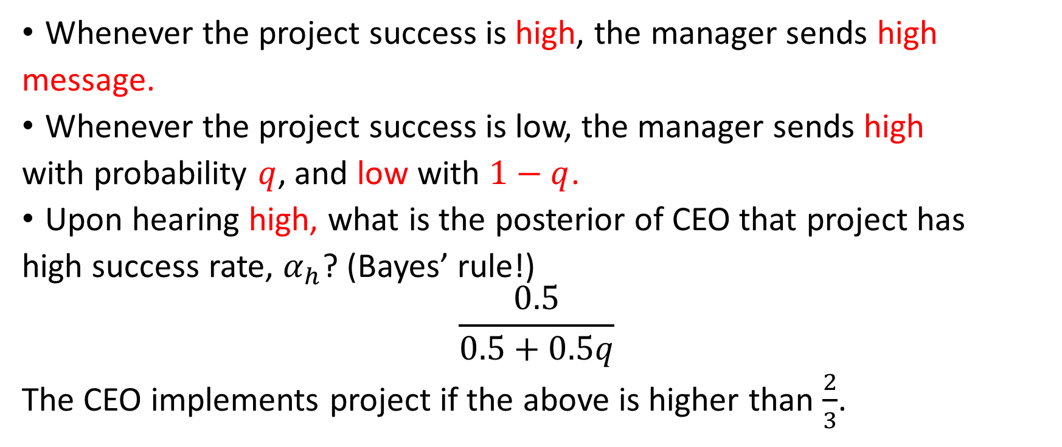
The manager commits to a revelation strategy:
Whenever the project success is high, the manager sends high
message.
Whenever the project success is low, the manager sends high
with probability $q$, and low with $1−q$.
Upon hearing high, what is the posterior of CEO that project has
high success rate, $α_{h}$? (Bayes’ rule!)
$$\frac{0.5}{0.5+0.5q}$$
The CEO implements project if the above is higher than $\frac{2}{3}$.

Slide 21
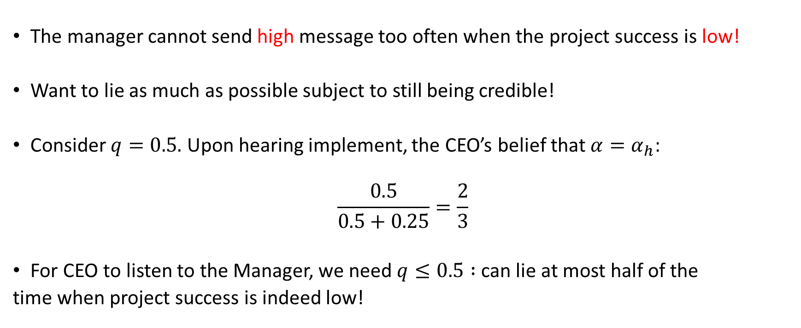
The manager cannot send high message too often when the project success is low!
Want to lie as much as possible subject to still being credible!
Consider $q=0.5.$ Upon hearing implement, the CEO’s belief that $α=α_{h}$:
$$\frac{0.5}{0.5+0.25}=\frac{2}{3}$$
For CEO to listen to the Manager, we need $q≤0.5 :$ can lie at most half of the
time when project success is indeed low!

Slide 22
Reference:
Kamenica and Gentzkow (2010), ``Bayesian Persuasion’’.

