Slide 1

Introduction to Game Theory For Ansal University UG students, September 2019 Abhinay Muthoo University of Warwick Slides #1: Key Concepts and “Simultaneous-Move” Games with Examples.

Slide 2
What is Game Theory?
Powerful Set of Tools
Applicable to (almost) any situation, be it economic, commercial, social or political.
Involving two or more “players”, where a “player” can be an individual, a firm, any other organization or a country.
Strategic Decision Making

Slide 3
.
The Classic Economic Example:
Buyer-Seller Exchange
One Buyer and One Seller
Mutually Beneficial Trade (Cooperation)
Terms of Trade – At What Price? (Conflict)
Will they reach a deal or not? [Efficiency?]
And if they do, what the agreed terms? [Distribution?]

Slide 4
.
Definition: A “game” is any situation involving two or more “players” in which the “fate” of each player depends not only on her “actions” but also on the actions of the other players.
Notes:
1. A “situation” can be economic, commercial social or political, etc.
2. A “player” can be a person or a group such as a firm, a political party, a school, a country etc.
3. The “fate” of a player is what she cares about such as profit, happiness, winning an election, growth, money etc.
4. An “action” is a choice or a strategy.

Slide 5
.
Main Ingredients of a Game:
1. Who are the players?
2. What strategies does each player have?
3. What are the payoffs to each player?

Slide 6
.
Prisoners’ Dilemma
(A classic game, with many applications; two players, each of whom has two strategies)
C = Cooperate
D = Don’t Cooperate
Bob:
C D
C
Alice:
D
5, 5 | 0, 8
8, 0 | 1, 1

Slide 7
.
Price Competition
L = Low Price
H = High Price
Pepsi:
L H
L
Coke:
H
2, 2 | 5, 1
1, 5 | 4, 4

Slide 8
.
Battle of Sexes
C = Colosseum
B = Ballet
Romeo:
C B
C
Juliet:
B
2, 3 | 0, 0
0, 0 | 3, 2

Slide 9
Nash Demand Game
Two Players: A and B.
Strategies: Each player chooses – or demands - how much of the £100 she wants – so states a number between £0 and £100.
Choices are made “simultaneously”.
Payoffs: If the sum of the two demands exceeds £100, each player gets nothing. But if the sum of the demands is less than or equal to £100, then each gets what they respectively demanded.

Slide 10
Nash Equilibrium
John F. Nash – Nobel Prize in Economics, 1994.
Beautiful Mind - 2001 Blockbuster movie
What is the Nash Equilibrium (NE)?
Captures a notion of stability – stable outcomes. In what sense “stable”?:
An outcome is a Nash Equilibrium if no player has an incentive to cheat.
More precisely, an outcome is a Nash Equilibrium if no player can unilaterally deviate (from it) and be strictly better-off.

Slide 11
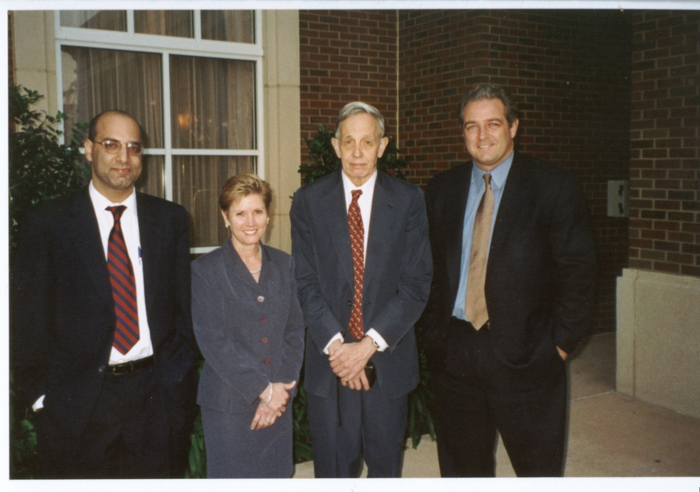
Nash and Muthoo:

