Slide 1
Lecture 1: Introduction to the Economics of Happiness
6th WBS Summer School, 26th-29th June 2018
Professor Nick Powdthavee
Behavioural Science Group
Email: nattavudh.powdthavee@wbs.ac.uk

Slide 2



Our Sponsors
The International Association for Research in Economic Psychology
www.iarep.org
The SABE/IAREP conference, 2018
https://economics.mdx.ac.uk/sabe-2018/
The Journal of Economic Psychology
www.journals.elsevier.com/journal-of-economic-psychology/

Slide 3


1993: London School of Economics
The first Economics of Wellbeing conference was held. Two central people were Andrew Clark, who was a PhD student there at the time, and Andrew Oswald, who is now a Professor of Economics at Warwick.

Slide 4

1993: 1st Conference on the Economics of Wellbeing at London School of Economics
The conference at 10.30am before it filled up.

Slide 5
1993: 1st Conference on the Economics of Wellbeing at London School of Economics
The conference at 10.30am before it filled up.
The conference at 11.30am after it filled up.

Slide 6
10 people came.
Unfortunately, that included the international speakers who had been asked to give keynote addresses.

Slide 7
Please open another browser (on your smartphone, iPad, or laptop) and join the session at
http://responseware.eu
by typing in the session ID: Summer1
You can log in anonymously.

Slide 8
In this first lecture
Why economics of well-being (or happiness)?
  The historical context of well-being research
How to measure people’s well-being directly?
  Three main well-being measures: cognitive, affective, and eudemonic
How valid are these indicators?
  Physiological and objective confirmations of subjective well-being measures

Slide 9
Some useful readings
Di Tella, R. and MacCulloch, R., 2006. Some uses of happiness data in economics. Journal of Economic Perspectives, 20(1), pp.25-46.
Kahneman, D., Krueger, A.B., Schkade, D.A., Schwarz, N. and Stone, A.A., 2004. A survey method for characterizing daily life experience: The day reconstruction method. Science, 306(5702), pp.1776-1780.
Kahneman, D., Wakker, P.P. and Sarin, R., 1997. Back to Bentham? Explorations of experienced utility. Quarterly Journal of Economics, 112(2), 375-406.
Kahneman, D. and Krueger, A.B., 2006. Developments in the measurement of subjective well-being. Journal of Economic Perspectives, 20(1), pp.3-24.

Slide 10

Let us begin with:
How satisfied are you with your life overall?

Slide 11
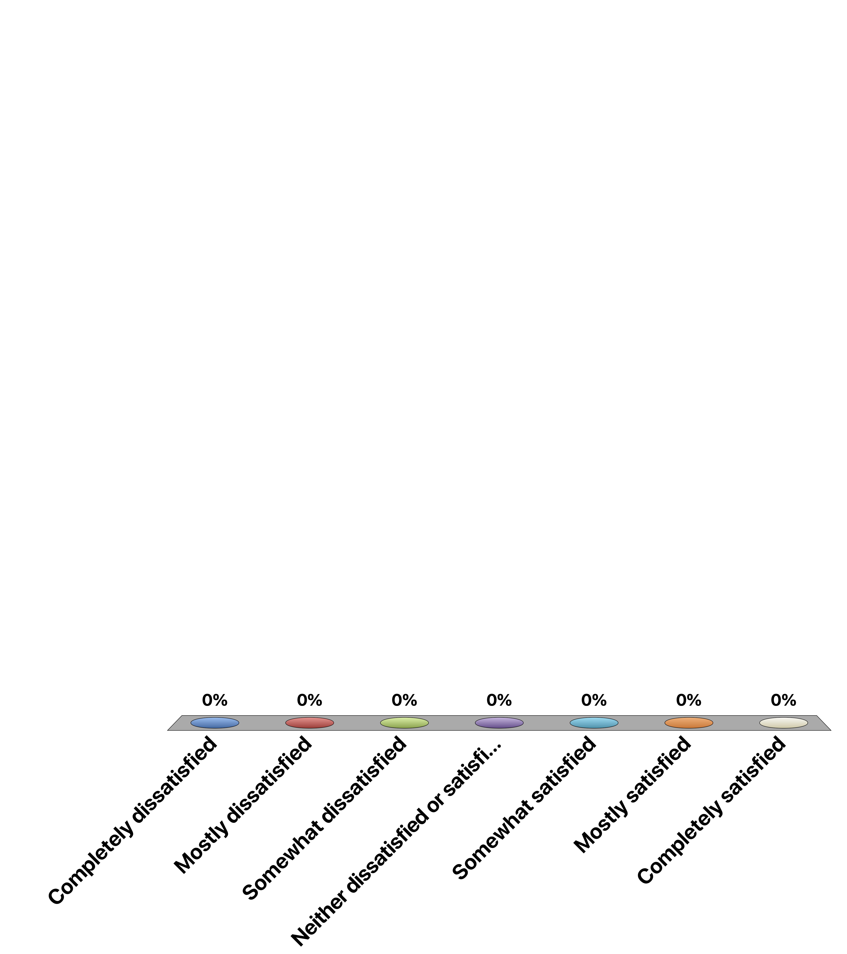
How satisfied or dissatisfied are you with your life overall? On a 7-point scale where 1 = completely dissatisfied, …, 7 = completely satisfied
Completely dissatisfied
Mostly dissatisfied
Somewhat dissatisfied
Neither dissatisfied or satisfied
Somewhat satisfied
Mostly satisfied
Completely satisfied

Slide 12

My guess is that the majority of people in this room would have scored fairly high on the life satisfaction scale

Slide 14

So, knowing these numbers, can we perhaps learn how to make whole countries happier?
But before we come to that…

Slide 15
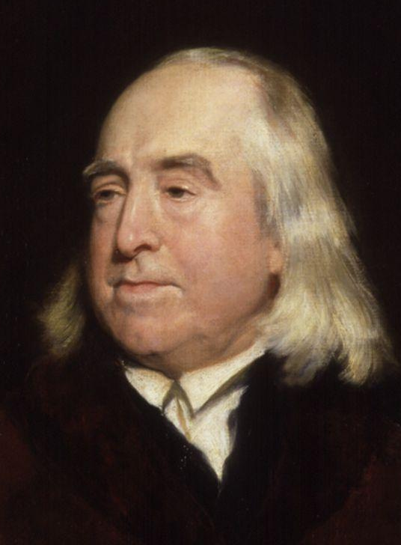
Jeremy Bentham (1748-1832)

Slide 16
Jeremy Bentham’s “Felicific Calculus”
Utilitarianism
  “An action is right in so far as it promotes happiness, and that the greatest happiness of the greatest number should be the guiding principle of conduct”
Felicific calculus
  An algorithm proposed by Bentham to work out the total sum of “pleasure minus pain” in a society
    Intensity (how strong is the pleasure/pain?)
    Duration (how long is the pleasure/pain?)
    Certainty (how likely is it that the pleasure/pain will occur?)
    Extent (how many people will be affected?)
    Remoteness (how soon will the pleasure/pain occur?)

Slide 17
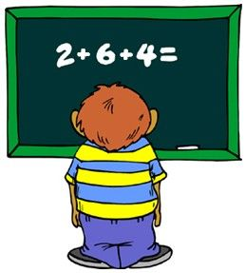
The general principle is that human happiness should be added together and maximized.

Slide 18
But can – and should – self-reported happiness be measured and aggregated?

Slide 19
Some issues with measuring happiness
Interpersonal comparability
  Is my happiness score of “4” higher than your happiness score of “2”?
Bounded scales
  On a 10-point scale of happiness, if people report 10, does that mean that life can’t get any better for them?
Social desirability bias
  People’s tendency to exaggerate their ratings to “conform” with the norms

Slide 20
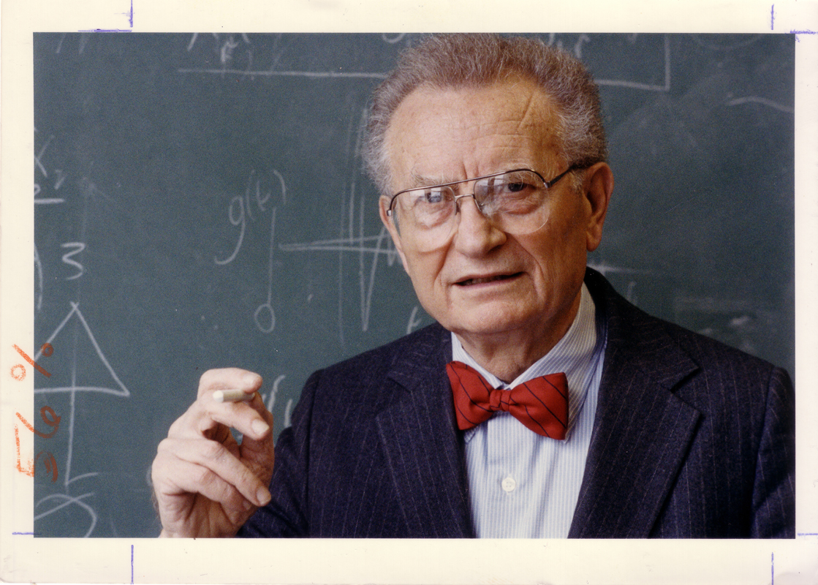
Revealed Preference Theory
Paul Samuelson (1915-2009)

Slide 21
Key assumption: Humans are “rational” decision makers
  I.e. humans have stable preferences, are forward-looking and have complete information about their choices, and are utility maximisers
For example, we know that the preferences of a rational decision-maker are
  Transitive
    if A is preferred to B and B to C, then A is preferred to C
  Complete (be able to compare all alternatives, with no difficulty of discriminating between alternatives)
  Such a decision-maker can be described as if she assigned a score (utility) to each alternative and choses the alternative with the highest score (utility)

Slide 22



The choices of a rational decision-maker should also satisfy independence of irrelevant alternatives (IIA)
To explain this, suppose that a decision-maker can be described as if she assigned a score (utility) to each alternative and choses the alternative with the highest score (utility).
Suppose you can choose between
Suppose you then can choose between
u = 88
u = 88
u = 101
u = 15
u = 101
And suppose
you select:
You do NOT
select:

Slide 23
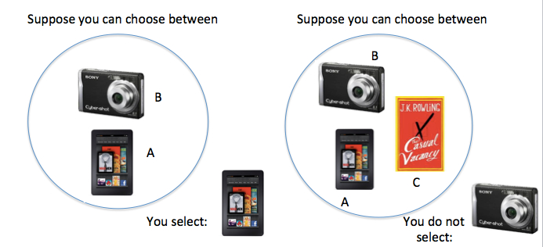
Independence of irrelevant alternatives (IIA):
Definition: If you choose A, when you can choose from A and B, you do not select B, when you can choose from a larger choice set where both A and B are available
Many (Luce, Arrow, Tversky) have argued that rational choice, defined as utility-maximizing, should satisfy IIA.
Possible objections:
Preferences shift (But does rational choice predict anything then?)
Learn / infer something when you see that alternative C is also available:
Suppose a restaurant serves Steak with Chips (A) and Mussels (Moules) Marinieres (B). You select Steak, uncertain about whether the restaurant can do Mussels well.
If you find out that the restaurant also serves Coq au Vin (C), you may select the Mussels (B) because you now believe the restaurant is good at French dishes

Slide 24
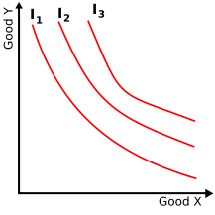
Another example of the reveal preference theory
An indifference curve (IC) connects different trade-off points between different quantities of two goods that a consumer is indifferent
  I.e. the consumer has no preference for one combination or bundle of goods over a different combination on the same curve
Key axioms
  Higher ICs represent higher utility levels (as there are more quantities of both goods on higher ICs)
  Two ICs cannot intersect as more of either (or both) good is equally preferred to no increase

Slide 25
So many economists have argued that, with the development of the reveal preference theory, there is absolutely no need to try and measure people’s well-being anymore…
In other words, if people prefer A to B, then it can be assumed that A makes them happier than B
…until “some” psychologists turning that idea on its head in the early 1970s

Slide 26
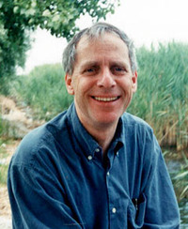
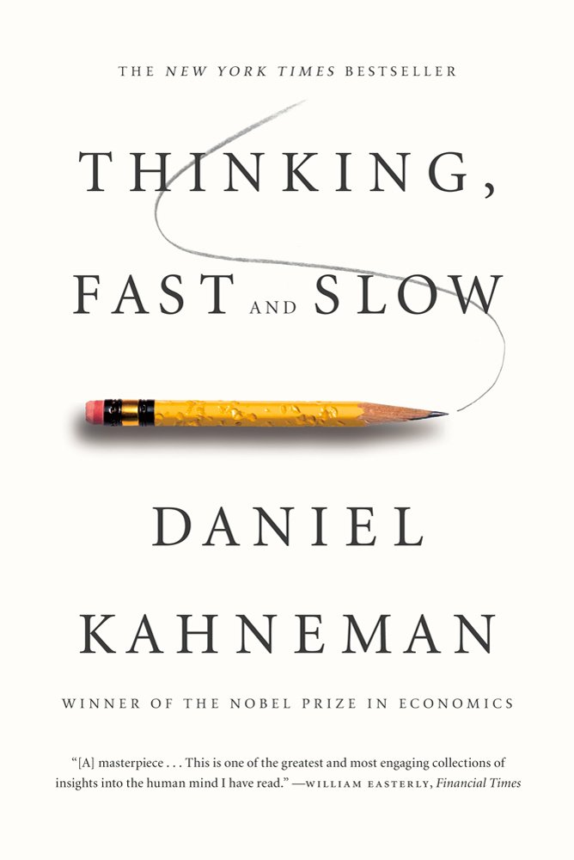



The rise of behavioural economics

Slide 27
The central tenet of behavioural economics is that human beings share cognitive biases that lead them to behave in systematically erroneous manner
Context dependent choice is one example of a violation of the reveal preference theory

Slide 28
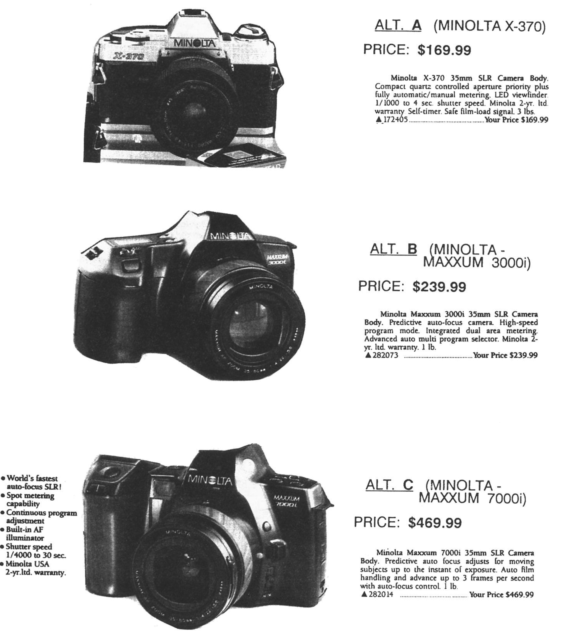
Percentage
choose
50%
50%

Slide 29
Percentage
choose
22%
57%
21%
Simonson, I., & Tversky, A. (1992). Choice in Context:

Slide 30
The compromise effect
(Extremeness Aversion)
A
Quality
C
Quality
C
B
B
Economy
Economy
B most commonly chosen
C most commonly chosen
Introducing an extreme alternative, A, makes people more likely
to choose what is now the compromise (middle) alternative C

Slide 31

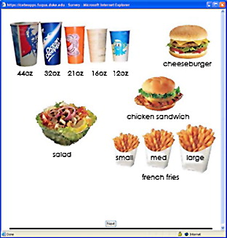

Has marketing implications:
1. Add an extreme option
to increase sales of another option
2. Add upgrades, to increase sales of prior upgrades

Slide 32
Can significantly impact consumption
15% more consumption!
Sharpe, K. M., Staelin, R., & Huber, J. (2008). Using extremeness aversion to fight obesity: Policy implications of context dependent demand. Journal of Consumer Research, 35, 406-422.

Slide 33
Endowment Effect
One group of students received 5 medium priced ball point pens, while the other group of students received $4.50
They were then made a series of offers which they could accept or reject
For example, someone who had been given the pens would be asked if she would give up one of the pens for a dollar
Someone who had been given money would be asked how much she would be willing to pay for one pen

Slide 34
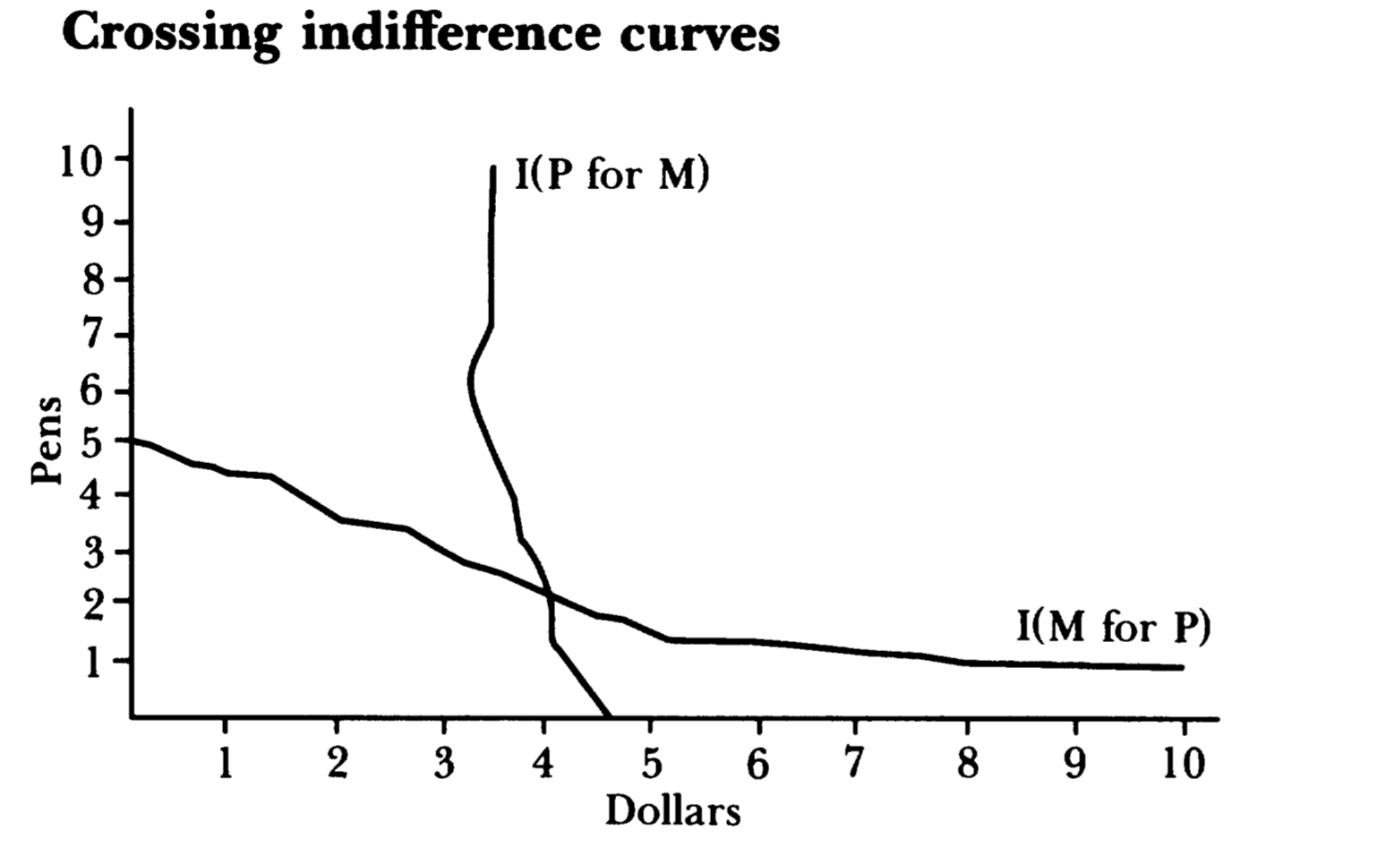
Endowment Effect
Results: The pens were worth more money to those subjects who started with pens than to those who started with money
  The indifference curves intersect!!
Endowment effect: the hypothesis that people ascribe more values to things merely because they own them
Kahneman, D., Knetsch, J., & Thaler, R. (1991). Anomalies: The endowment effect, loss aversion, and status quo bias. Journal of Economic Perspectives, 5(1), 193-206.

Slide 35
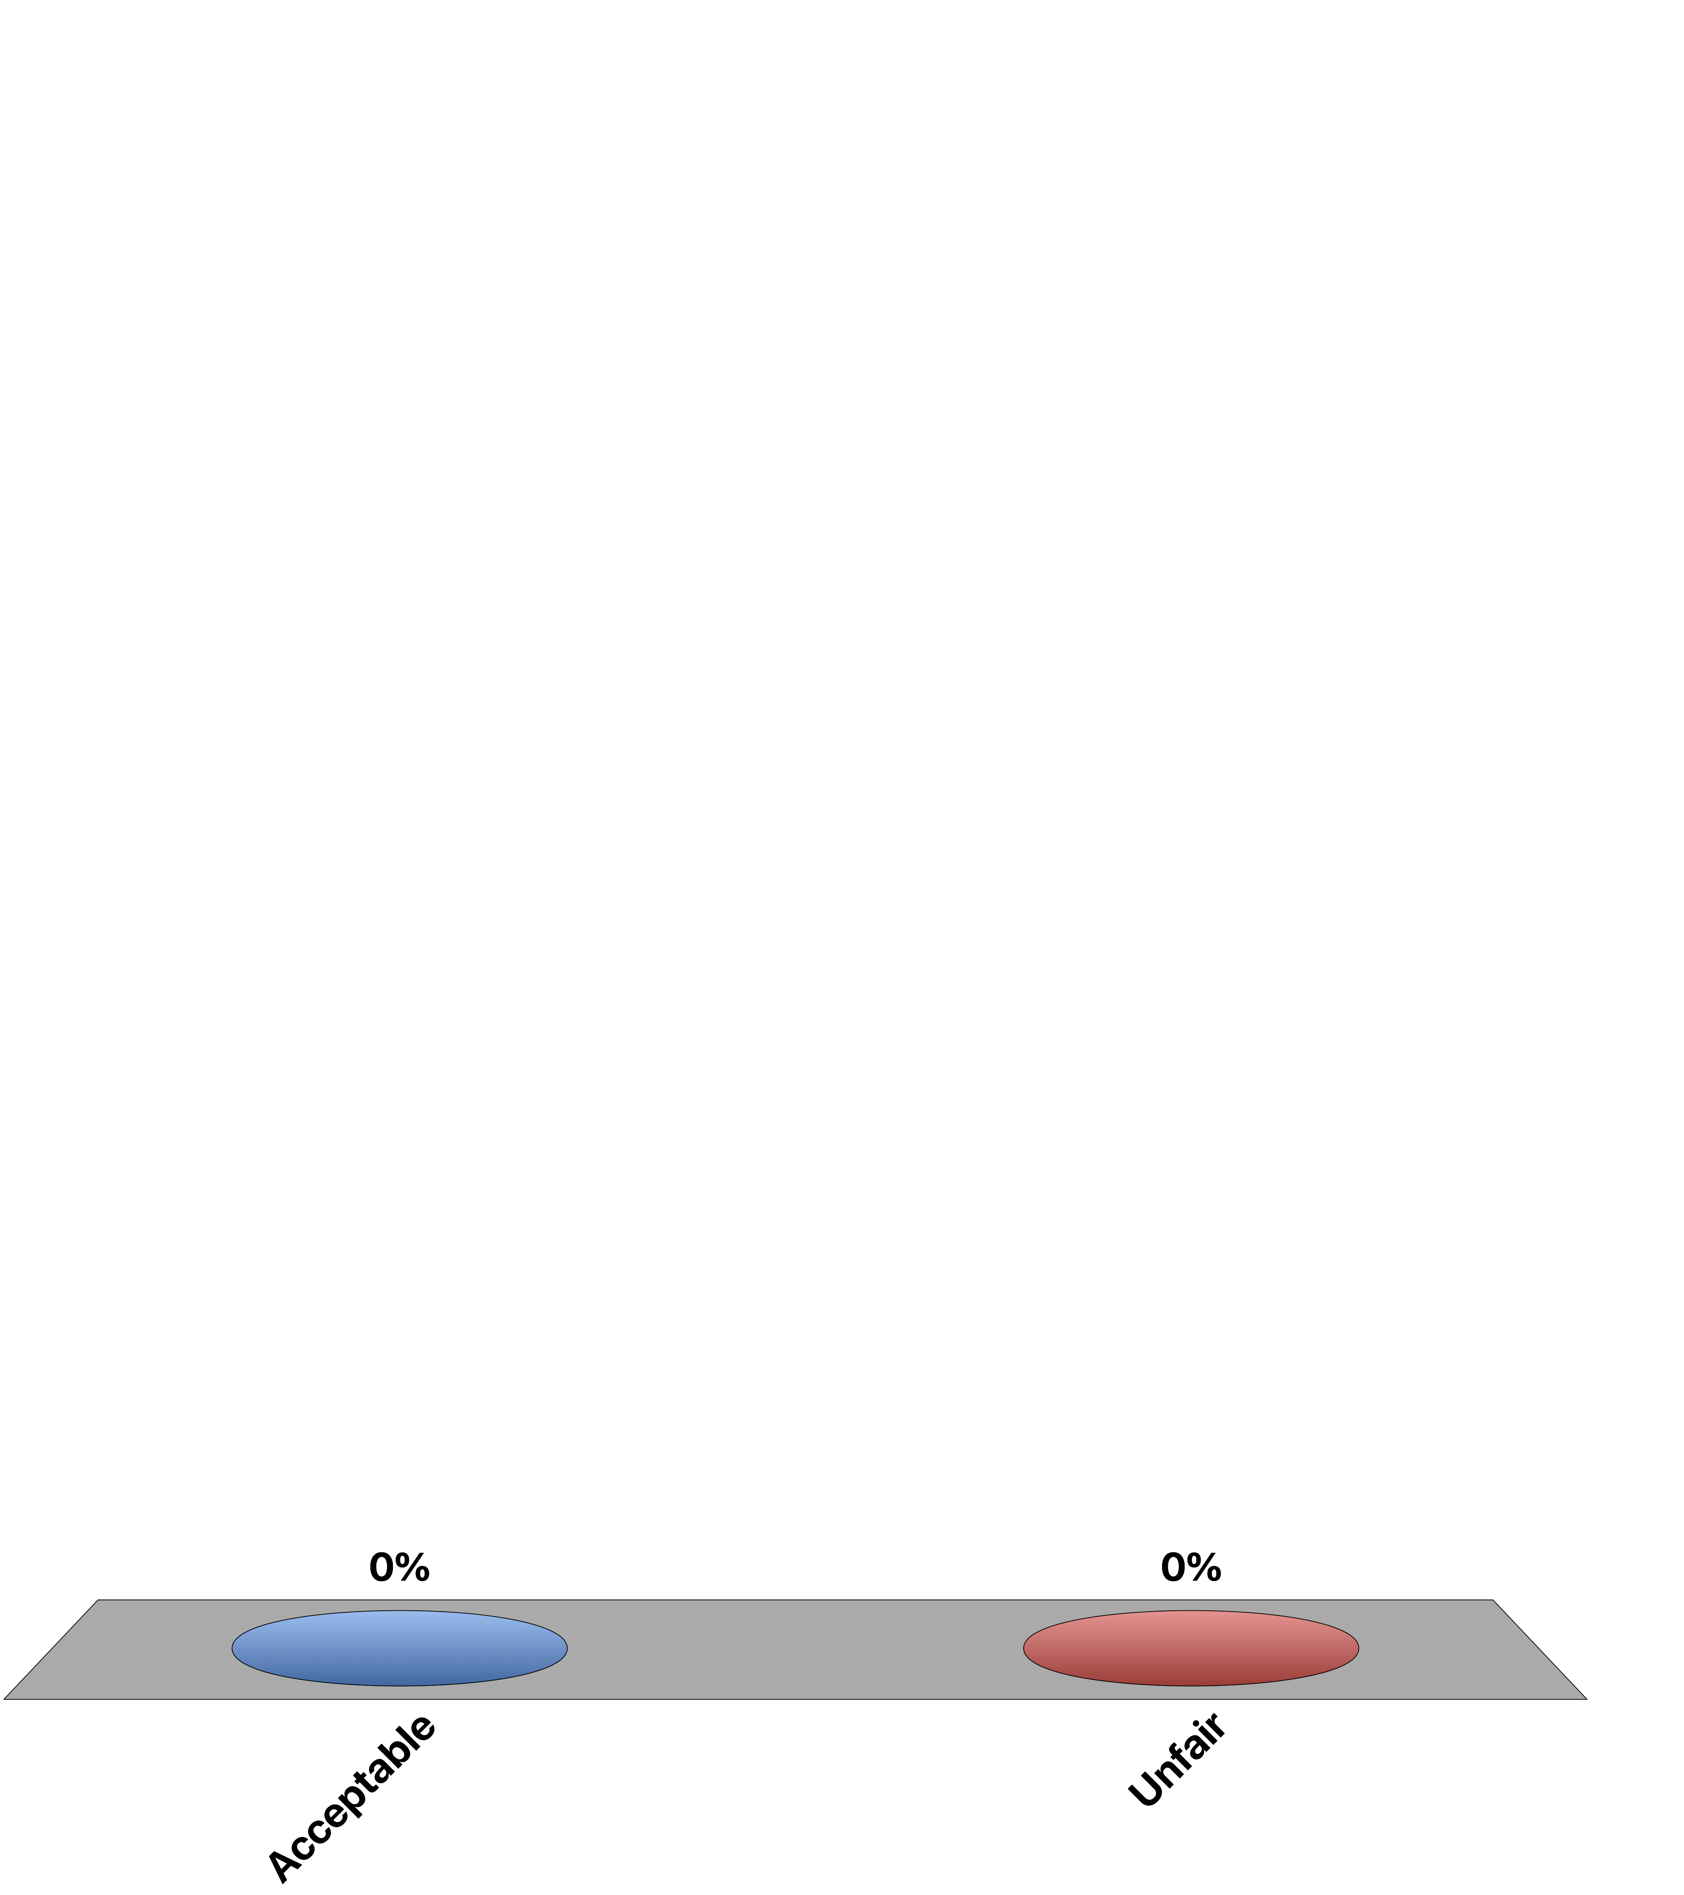
A landlord rents out a small house. A higher rent would mean the tenant would have to move. Other small rental houses are available. The landlord’s costs have increased substantially over the past year and the landlord raises the rent to cover the cost increase when the tenant’s lease is due for renewal.
Acceptable
Unfair

Slide 36
A landlord rents out a small house. When the lease is due for renewal, the landlord learns that the tenant has taken a job very close to the house and is therefore unlikely to move. The landlord raises the rent $40 per month more than he was planning to do.
Acceptable
Unfair

Slide 37
Back to Bentham?
According to Daniel Kahneman and colleagues, utility can be further distinguished into two types
  Decision utility (ex ante)
  Experienced utility (ex post)
Decision utility: also known as “wantability”. It is inferred from how people make choices, e.g., if people choose to study law and not business, then law must reflect what they really want to do
Experienced utility: hedonic experience derived from having made the choice, e.g., if people choose to study law and not business, then law must make them happier than business
Kahneman, Wakker, and Sarin (1997)

Slide 38
If our choice produces the experience we expected to get when we were making that choice (i.e., decision utility = experience utility), then we would have no problems
But, as behavioural economists have demonstrated, many of our decisions are unlikely to produce the kind of experiences we expect to get
This calls for a direct measure of experienced utility

Slide 39

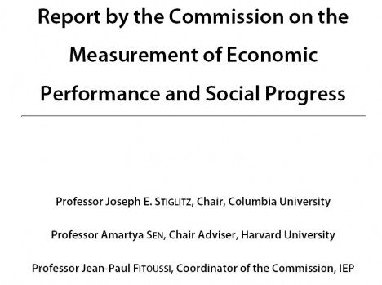
The Stiglitz Commission’s ideas to measure people’s well-being

Slide 40

Stiglitz Report 2009:
“Measures of .. objective and subjective well-being provide key information about people’s quality of life. Statistical offices [worldwide] should incorporate questions to capture people’s life evaluations, hedonic experiences … in their own survey.” P.16. Executive Summary of Commission Report.

Slide 41
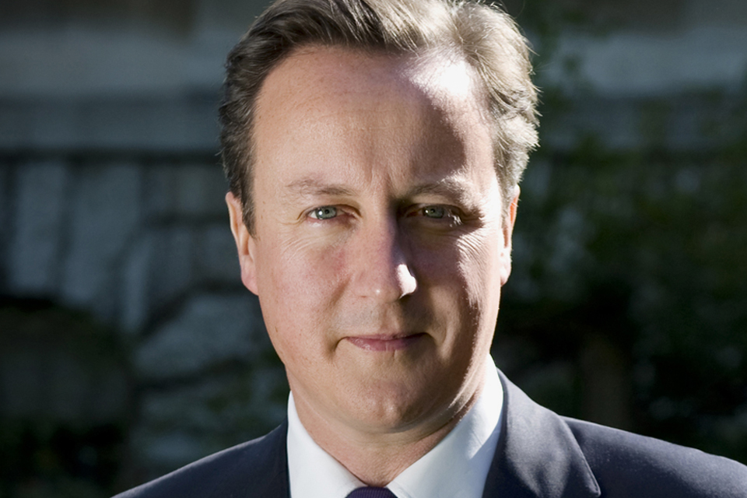
Prime Minister Speech (20th Nov 2010)
I am excited about this, because it’s one of those things you talk about in opposition, and say that this is something we ought to try and measure, get right, and understand, and people think ‘well, of course, you say these things in opposition, but when you get into government you’ll never actually do anything about it’. But here we are, and today the government is asking the Office of National Statistics to devise a new way of measuring wellbeing in Britain. And so from April next year, we’ll start measuring our progress as a country, not just by how our economy is growing, but by how our lives are improving; not just by our standard of living, but by our quality of life.

Slide 42
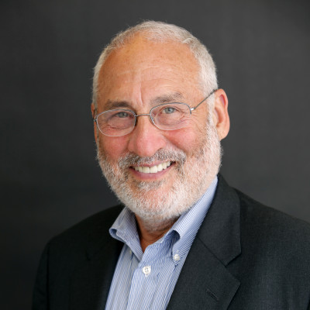
“What you measure affects what you do. If you don’t measure the right thing, you don’t do the right thing.”
-Joseph Stiglitz,
Nobel Laureate in Economics

Slide 43

Also, if molecules could talk
Would physicists refuse to listen?
Notes:
Play a bit with font size and colour

Slide 44
Questions
Is well-being unidimensional?
How do we measure it?
How valid are these measures in capturing people’s true well-being?

Slide 45
Three Dimensions of Well-Being
Cognitive well-being
  Information-based appraisal of one’s life for which people judge the extent to which their life so far measures up to their expectations and resembles their ‘ideal’ life
  E.g., life satisfaction; domain satisfaction, etc.
Affective well-being
  The presence of positive affects and the absence of negative affects on a day-to-day basis
  E.g., how often smile today; number of days spent worrying last week, etc.
Eudaimonic well-being
  The idea of “virtue living”, “human flourishing”, and doing “what is meaningful”
  E.g. , purpose, feeling worthwhile, meaningfulness, etc.

Slide 46
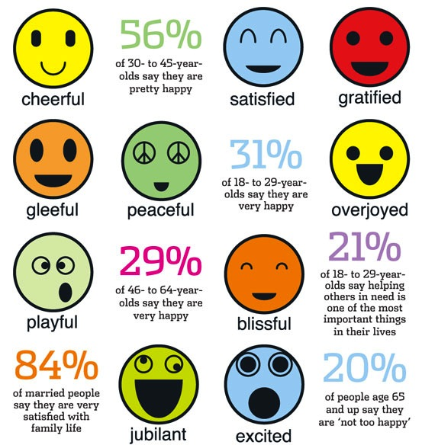
We’ve already measured your life satisfaction, which is the cognitive component of our well-being
Let us now try to measure the other two components of well-being

Slide 47
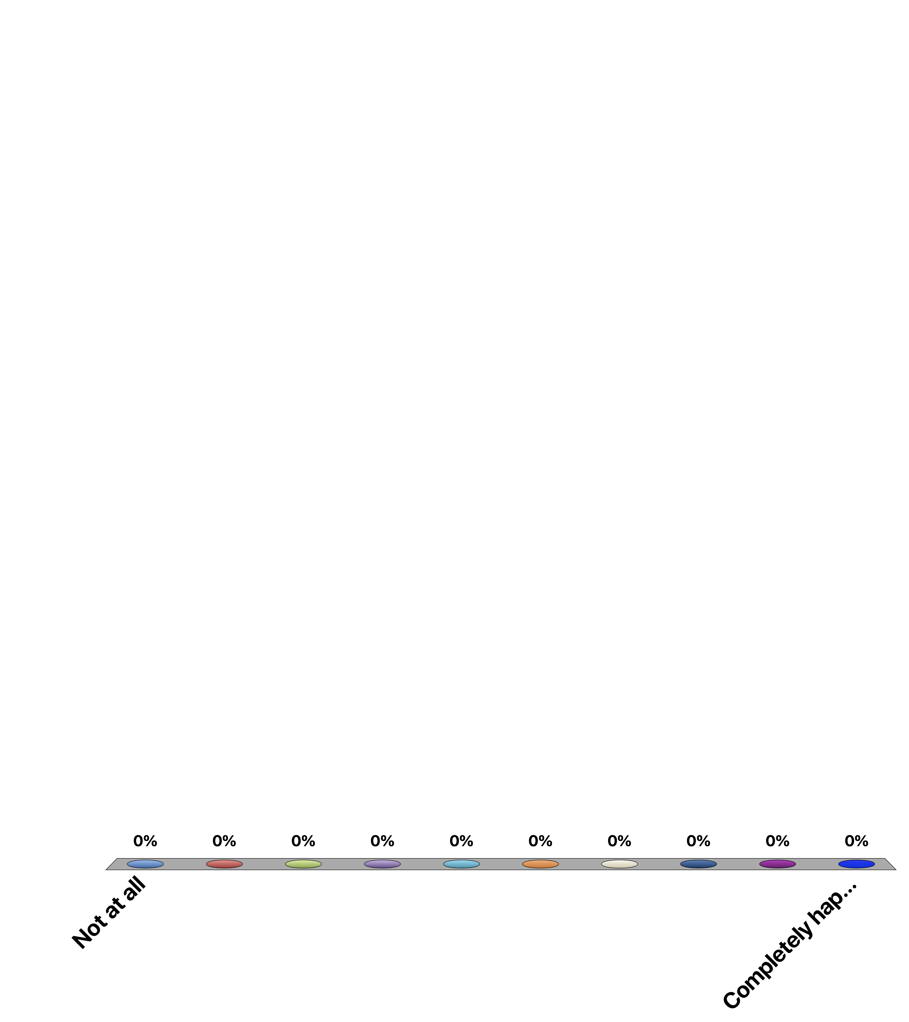
Overall, how happy did you feel yesterday?
Not at all
Completely happy

Slide 48
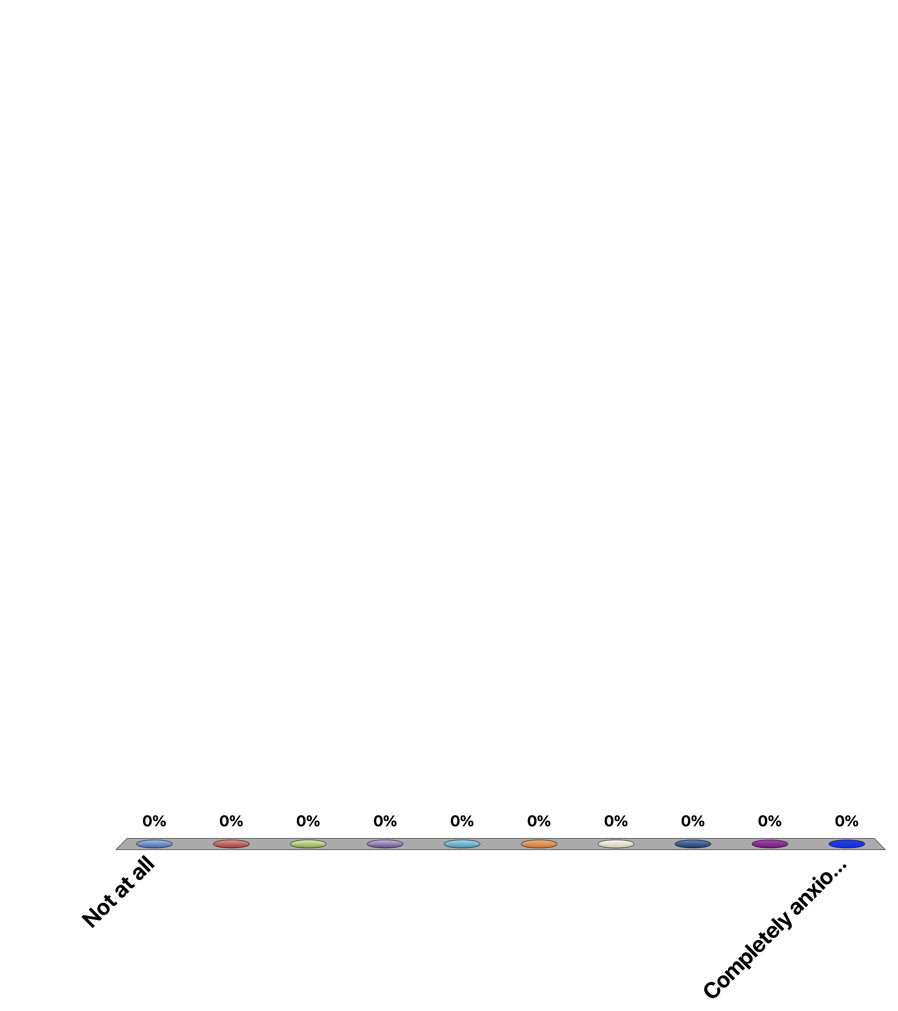
Overall, how anxious did you feel yesterday?
Not at all
Completely anxious

Slide 49
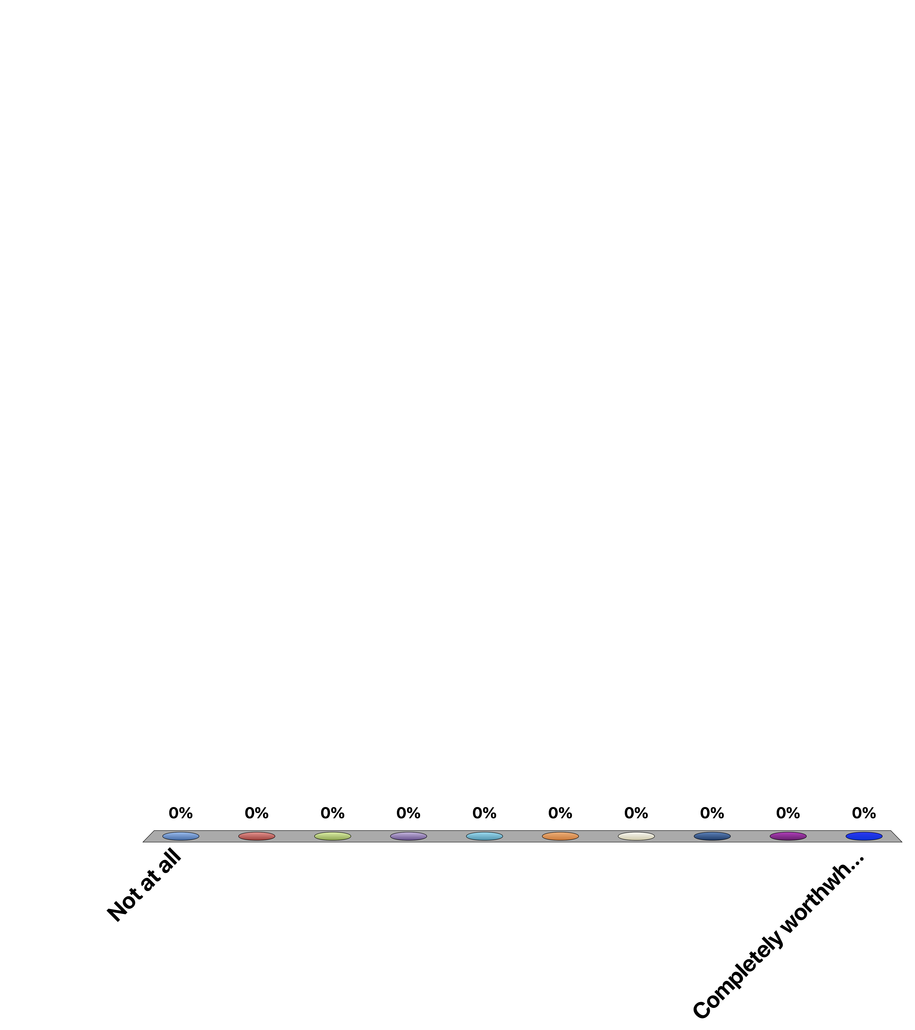
Overall, to what extent do you feel the things you do in your life are worthwhile?
Not at all
Completely worthwhile

Slide 50
The UK Office of National Statistics (ONS) has been measuring people’s well-being since 2010
There are four ONS questions on personal well-being
  “Overall, how satisfied are you with your life nowadays?”
  “Overall, to what extent do you feel the things you do in your life are worthwhile?”
  “Overall, how happy did you feel yesterday?”
  “Overall, how anxious did you feel yesterday?”
  The responses range from 0 “Not at all” to 10 “Completely”, i.e., 11-point scale

Slide 51
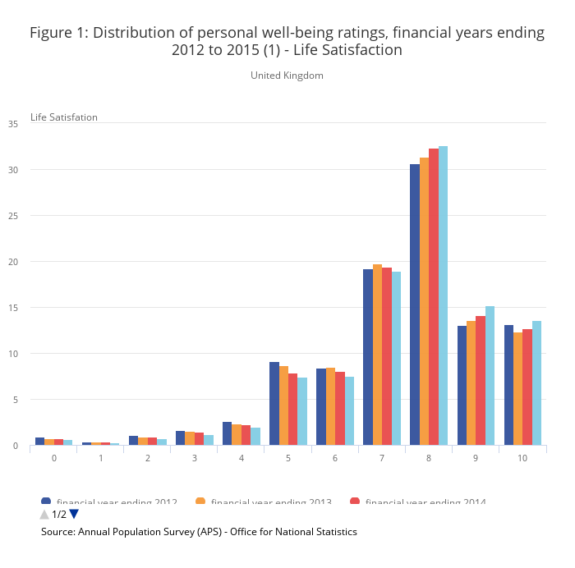
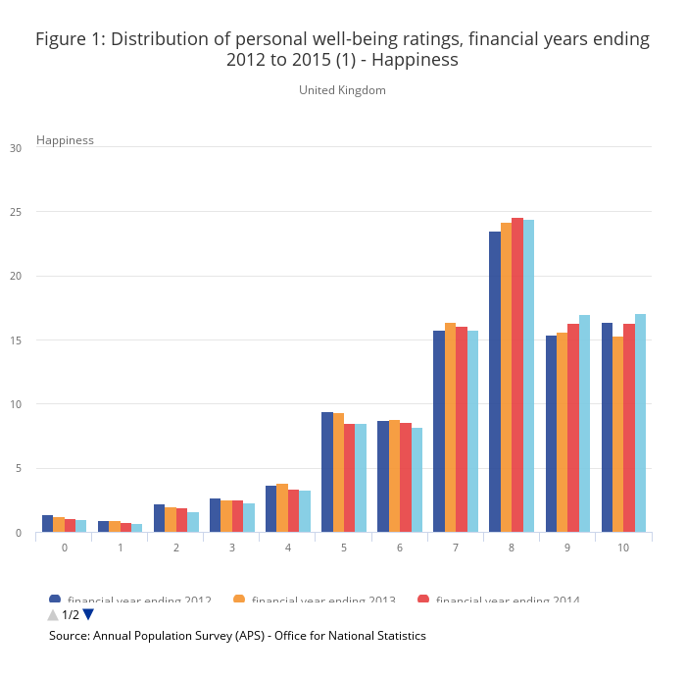
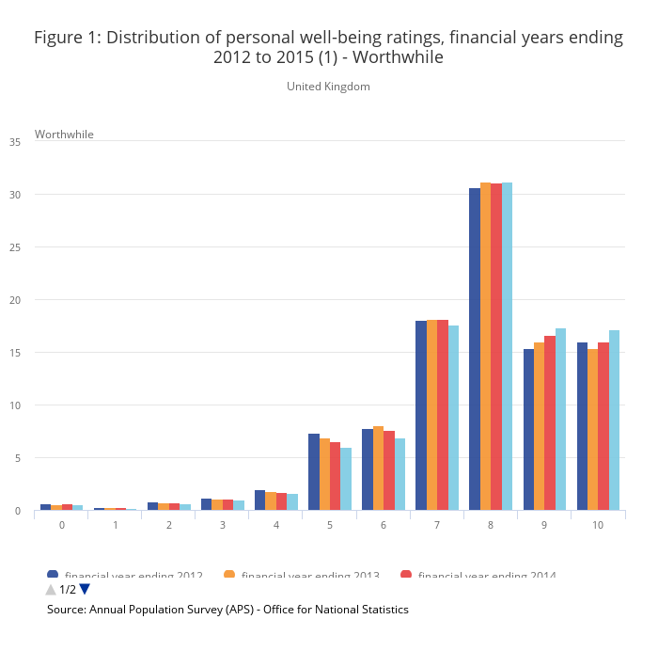
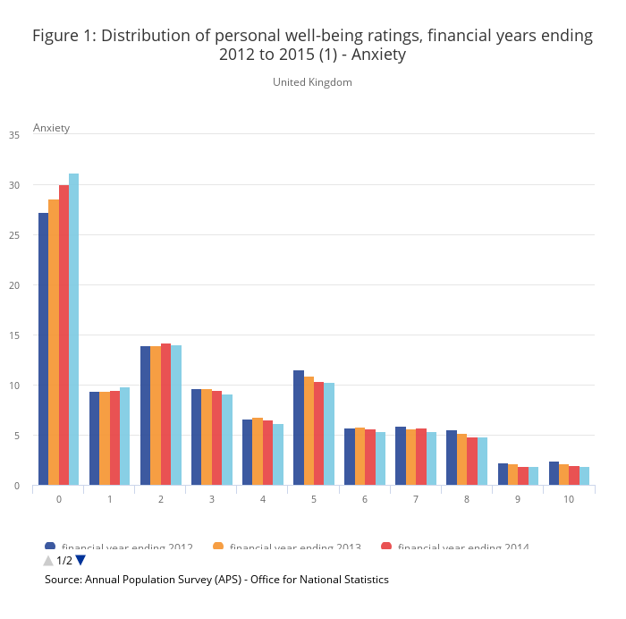

Slide 52
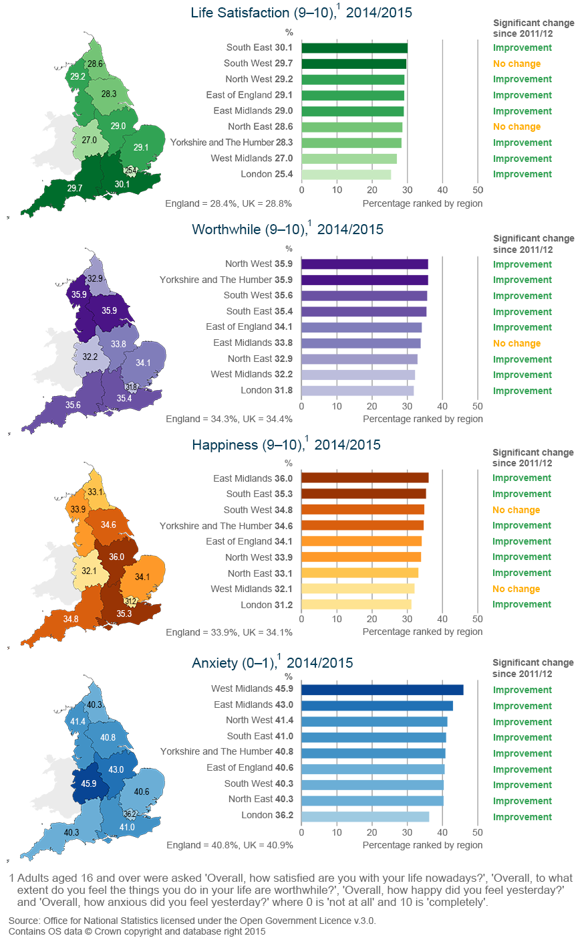
The ONS well-being data has been used for the government to track changes in people’s well-being in different part of the British Isle
Percentages rating personal well-being at highest levels: by English region for financial year ending 2015 and change since financial year ending 2012

Slide 53
Other types of statistical sources
General Social Survey of the USA
British Household Panel Study (BHPS)
German Socioeconomic Panel
Australian HILDA Panel
Eurobarometer Surveys
Labour Force Survey from the UK
World Values Surveys
National Child Development Study 1958 cohort
British Cohort Survey 1970
Gallup World Poll

Slide 54
From the U.S. General Social Survey (sample size 40,000 Americans approx.)
“Taken all together, how would you say things are these days - would you say that you are very happy, pretty happy, or not too happy?”

Slide 55
From the U.K. British Household Panel Survey (a sample of 10,000 individuals each year)
“How satisfied or dissatisfied are you with your life overall? On a 7-point scale where 1 = very dissatisfied, …, 7 = very satisfied”

Slide 56
Typical GHQ mental-strain (or affects) questions have been used to capture affective well-being
Have you recently:
Lost much sleep over worry?
Felt constantly under strain?
Felt you could not overcome your difficulties?
Been feeling unhappy and depressed?
Been losing confidence in yourself?
Been thinking of yourself as a worthless person?
Been able to enjoy your normal day-to-day activities?

Slide 57
An alternative of affective well-being is the Daily Reconstruction Method (DRM) approach
A study by Daniel Kahneman and his colleagues on 1,000 working women in Texas (see Kahneman et al, 2004)
These women were asked to divide the previous day into 15 episodes. They were then asked what they were doing in each episode, and who were they doing it with.

Slide 58
Happiness in Different Activities

Slide 59
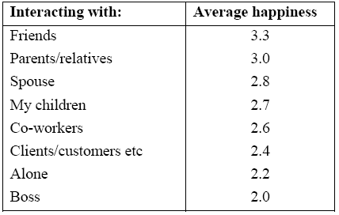
Happiness while Spending Time with
Different People
The average reported feelings across 1,000 people correspond well with activities predicted to be good for us, as well as activities predicted to be bad for us

Slide 60
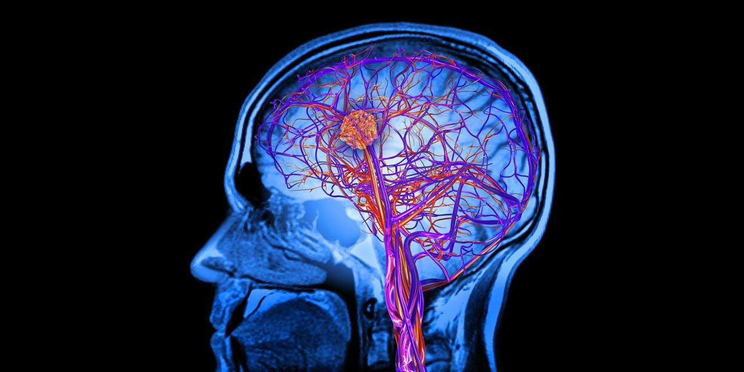
Can we objectively see happiness in our brains?

Slide 61
Happy and Sad Pictures

Slide 62
The Brain Responses to Two Pictures
(MRI Scan)
Source: Richard Davidson, University of Wisconsin

Slide 63
Reported happiness data have been demonstrated to be correlated with
  The person’s recall of positive versus negative life events
  Assessments of the person’s happiness by friends and family members
  Assessments of the person’s happiness by his or her spouse
  Duration of authentic or so-called Duchenne smiles

Slide 64
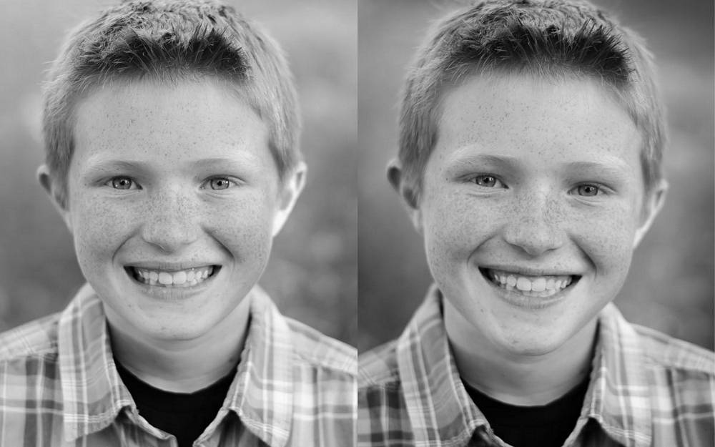
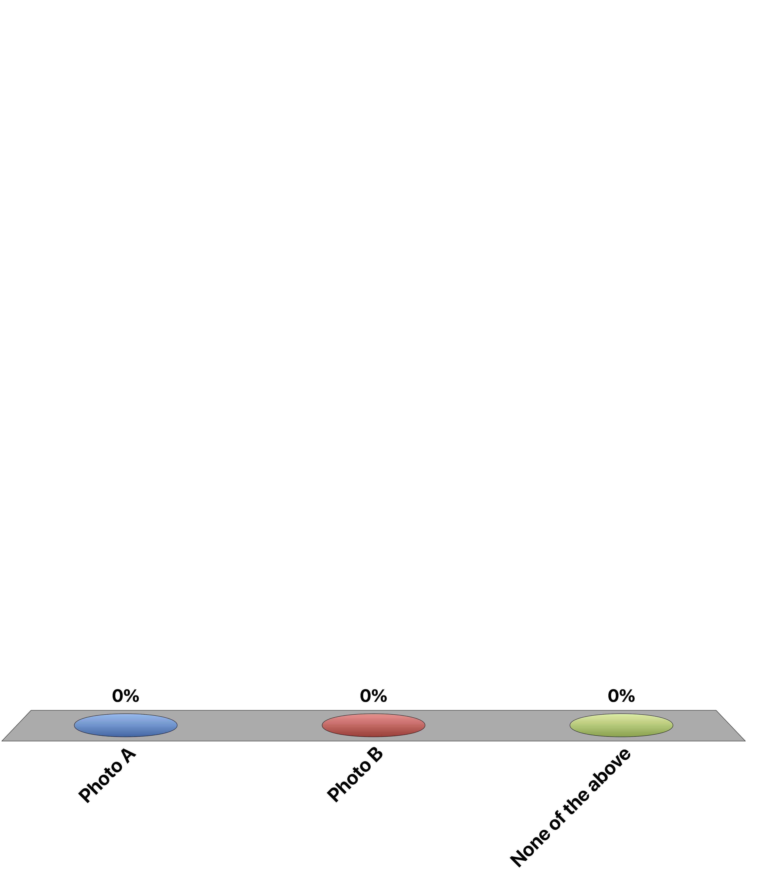
Which photo shows the boy’s genuine smile?
A
B
Photo A
Photo B
None of the above

Slide 65
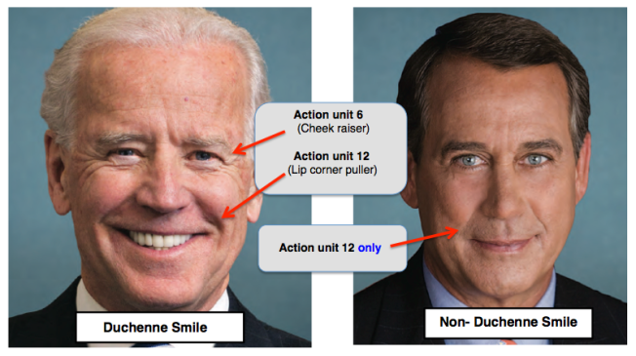
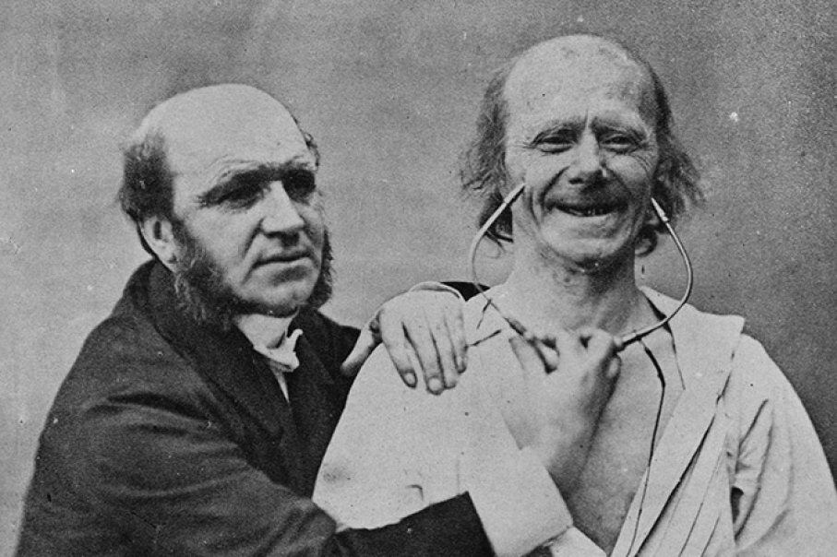
Duration of authentic or so-called Duchenne smiles (a Duchenne smile occurs when both the zygomatic major and obicularus orus facial muscles fire, and human beings identify these as ‘genuine’ smiles)
Dr. Guillaume Duchenne de Boulogne, a French physician and a pioneer in electrophysiology, demonstrating the appearance of laughter by electrical muscle stimulation.

Slide 66
To clinicians
High blood pressure is potentially a sign of mental strain and low well-being

Slide 67
Across nations, hypertension and happiness are inversely correlated
(Blanchflower and Oswald, 2008 Journal of Health Economics)

Slide 68
Author(s): Ebrecht M, Hextall J, Kirtley LG, Taylor A, Dyson M, Weinman J
PSYCHONEUROENDOCRINOLOGY
Volume: 29 Issue: 6 Pages: 798-809 Published: JUL 2004

Slide 69

“Every subject received a standard 4mm-punch biopsy, and the healing progress was monitored via high-resolution ultrasound scanning.”

Slide 70
Ebrecht et al 2004
The overall results showed a significant negative correlation between speed of wound healing and GHQ scores (r = -.59; p < .01)

Slide 71

In other words, happier human beings heal more quickly.

Slide 72
Also
There is some evidence that happiness seems to make you live longer.

Slide 73
The ‘Nuns Study’
Journal of Personality and Social Psychology, 2001

Slide 74

“Positive emotions in early life and longevity: Findings from the nun study.” By Danner, Deborah D.; Snowdon, David A.; Friesen, Wallace V.
Journal of Personality and Social Psychology, Vol 80(5), May 2001, 804-813.

Slide 75
Handwritten autobiographies from 180 Catholic nuns, composed when participants were a mean age of 22 years, were scored for emotional content and related to survival during ages 75 to 95.

Slide 76
One of the nuns wrote:
“God started my life off well by bestowing upon me grace of inestimable value… The past year which I spent as a candidate studying at Notre Dame has been a very happy one. Now I look forward with eager joy to receiving the Holy Habit of Our Lady and to a life of union with Love Divine”

Slide 77
Whilst another nun wrote:
“I was born on September 26, 1909, the eldest of seven children, five girls and two boys… My candidate year was spent in the motherhouse, teaching chemistry and second year Latin at Notre Dame Institute. With God’s grace, I intend to do my best for our Order, for the spread of religion and for my personal sanctification.”

Slide 78
After joining the order their lives were almost exactly the same - same food, same work, same routine
But not the same life expectancy…
Among the less-positive nuns, 65% died before their 85th birthday. Among the happy nuns, 90% were still alive.

Slide 79
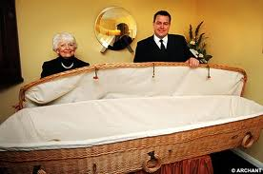
A strong inverse association was found between positive emotional content in these writings and risk of mortality in late life (p < .001).

Slide 80
The Problem:
Biological data only validate well-being scores in so far as they are unambiguously measures of utility or ‘happiness’.

Slide 81
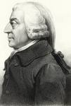
To convince more traditional economists, could we then exploit neo-classical economic theory to assess the validity of well-being data?

Slide 82

Think not about people but about places.

Slide 83
Joint work between Andrew Oswald and Steve Wu published in Science
New data from the Behavioural Risk Factor Surveillance System (BRFSS)
1.3 million randomly sampled Americans
2005 to 2008
Life satisfaction
Oswald, A.J. and Wu, S., 2010. Objective confirmation of subjective measures of human well-being: Evidence from the USA. Science, 327(5965), pp.576-579.

Slide 84
The paper then go to the compensating-differentials literature dating back to Adam Smith, Sherwin Rosen, Jennifer Roback, etc.

Slide 85

Gabriel painstakingly takes data on
Precipitation
Humidity
Heating Degree Days
Cooling Degree Days
Wind Speed
Sunshine
Coast
Inland Water
Federal Land
Visitors to National Parks
Visitors to State Parks
Number of hazardous waste sites

Slide 86
and
Environmental Regulation Leniency
Commuting Time
Violent Crime Rate
Air Quality-Ozone
Air Quality-Carbon Monoxide
Student-teacher ratio
State and local taxes on property, income and sales and other
State and local expenditures on higher education, public welfare, highways, and corrections
Cost-of-living

Slide 87
Then there are 2 ways to measure human well-being or ‘utility’ across space.
Subjective and objective

Slide 88
We assign a 1 to the state with the highest imputed quality-of-life, and 50 to the state with the lowest.
So we need to uncover a negative association – in order to find a match.

Slide 89
One Million Americans’ Life Satisfaction and Objective Quality-of-Life in 50 States

Slide 90
To conclude across US states:
There is a close match between life-satisfaction scores and the quality of life calculated using (only) non-subjective data.

Slide 91
Although well-being is multidimensional, we will focus more of our attention in our lectures on the cognitive dimension of well-being (with some occasional mentions of the other two dimensions)
Why?
Measures of cognitive well-being like life satisfaction are fairly comprehensive – they refer to the whole of a person’s life these days
They are clear to the reader - they involve no process of aggregation (unlike measures of affects that include positive and negative dimensions)
They are democratic – they allow individuals to assess their lives on the basis of whatever they consider important to themselves

Slide 92
Some notes to end…
Economists rely on people’s behaviours (“revealed preferences”) to draw conclusions about what makes people happy
Behavioural economists have shown that choices that we make do not often produce the experiences that we may have been expecting to get. This calls for a new way to directly measure people’s experience
Well-being data have been shown to be correlated with physiological indicators, as well as other objectively-measured data

Slide 93
But…
In an experiment where students were asked first
  “How happy are you with your life in general?”
And then were asked second
  “How many dates did you have this month?”
  The correlations between the answers to these questions was -0.012 (and not statistically significantly different from 0)

Slide 94
But…
In an experiment where students were asked first
  “How many dates did you have this month?”
And then were asked second
  ““How happy are you with your life in general?”
  The correlations between the answers to these questions was 0.66 (and statistically significantly different from 0)
Strack, F., Martin, L.L. and Schwarz, N., 1988. Priming and communication: Social determinants of information use in judgments of life satisfaction. European journal of social psychology, 18(5), pp.429-442.

