Slide 1

Exchanging cents for seconds:
The happiness benefits of choosing time over money
Ashley Whillans, PhD
Assistant Professor, Harvard Business School
Notes:
“THANKS”

Slide 2

Gallup, 2011
Notes:
Time & money are two of life’s most valuable resources. Indeed, most North Americans today report feeling increased pressed for both time and money.

Slide 3

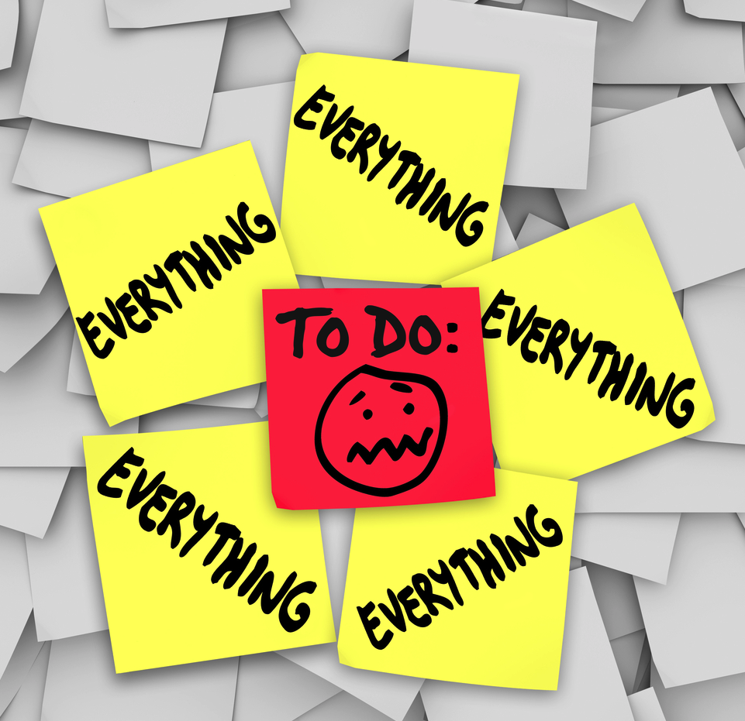

“Modern Time Famine” & the “Loneliness Epidemic”
Pew Research Centre, 2016; Wilson & Moulton, 2010
Notes:
As I mentioned at the outset of my talk, nationally representative surveys suggest that Americans are feeling increasingly pressed for time—the majority of Americans—both with and without children—report wishing that they had more time to spend with friends and family. And these same individuals often report feeling overwhelmed by the demands of work and life. Indeed, trying to keep up with the tasks of daily life, such as shopping and doing the laundry can chip away at the time we might otherwise spend engaging in the kids of activities that endow life with happiness.

Slide 4

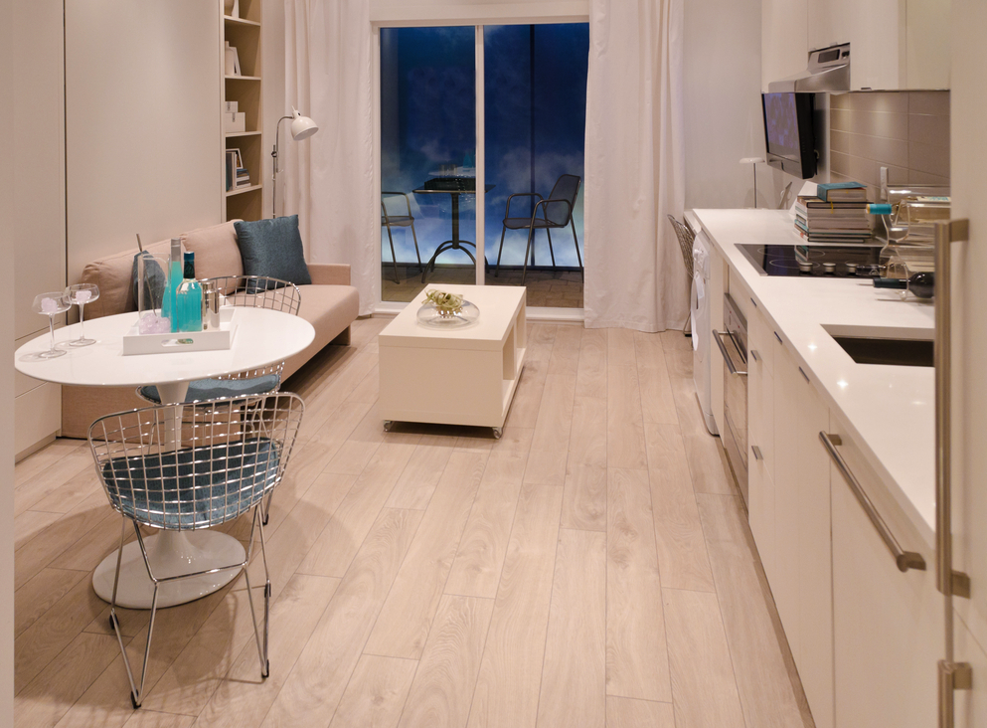
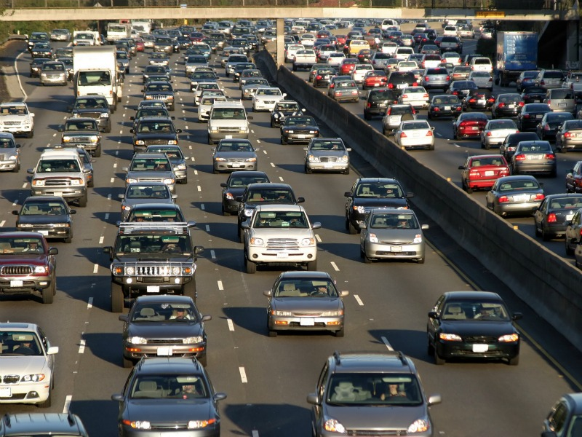
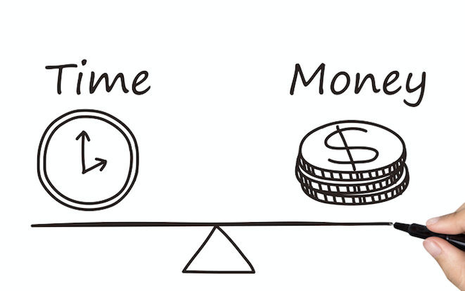
Can giving up money for free time promote happiness?
Notes:
Although people want both more time and more money, there are typically very few opportunities to simultaneously gain in both. For example, taking more time for oneself often cuts into time and earning more money often cuts into time.
On a daily basis, we might have to make the decision to take a direct flight that will save time over an indirect flight that will save money, or we might have to make the decision to choose a more expensive apartment that is closer to our place of employment, or a cheaper apartment that is further from our place of employment, but saves us commuting time each and every day.
Across each day and many years, the decisions that we make about having more time at the expense of having less money may hold important implications for happiness. Thus, in my talk today, my research looking at how using money to change the way that we spend our time might promote happiness.

Slide 5
Wealth does not always translate into greater well-being
Daily Happiness
Income
Kahneman & Deaton, 2010
Notes:
This question is important to address in light of research suggesting that wealth does not necessarily translate into greater well-being. Indeed, the relationship between money and happiness is weaker than many people assume—richer people are happier than poorer people and not by much, and once people’s basic needs are met the amount of money people make no longer predicts the amount that they laugh or smile on a daily basis—leaving open the possibility that what we do with our money may play as important a role in happiness as how much money we make.

Slide 6




Wealth does not always translate into greater well-being
Rate your current level of happiness with life in general on a 1-10 scale.
$1-2 M
$2-5 M
$5-10 M
$10 M+
NET WORTH (2000+ millionaires)
Donnelly et al., 2018
Notes:
They looked at 4 groups, ranging from your low-end millionaires, with net worth of about 1-2million dollars, all the way up the hard core millioanres with $10M. They asked all these people their current happiness with life in general on a scale from 1-10. Can you predict what they found? So, based on traditional economic thought, we’d assume that more money should translate into more happiness, perhaps with some diminishing marginal returns, so each of these groups should be a bit better off than the last.
But what they actually found was that there were no differences between the first 3 groups, and only a very slight uptick for people with over $10 M. So, somoene with 8 milion was no happier on average than someone with a measly million. Interesting though, most people in all 4 groups predicted that they would be happier if they had more money.
Details: Over 2000 millionaires rated their current happiness with life in general on a scale from 1 to 10.

Slide 7
What we do with our money plays as important a role in happiness as how much money we make

Slide 8

Wealth is linked to greater time stress
Kahneman, 2006; Perlow, 1999; Robinson & Godbey, 1997
Notes:
Furthermore, despite rising incomes, people are experiencing more stress at work and even more stress during leisure activities. Survey data suggests that wealthy people actually spend more time engaging in activities that are, on average, rated as less enjoyable such as working, commuting and shopping, and in turn, time stress is related to reduced well-being—even for people who are probably like most of us in this room and say that they prefer being busy.

Slide 9

Wealthier individuals do not always spend their time in happier ways
They spend more time working, commuting, & shopping*
*Except the very wealthy:
Smeets, Whillans, Bekkers & Norton, under review

Slide 10
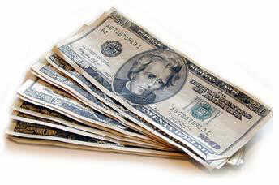

Can using money to ‘buy time’ improve well-being and social connection?
Time Stress
Connection
Well-being
Free Time
Notes:
Given that wealth does not always translate into better time-use or greater well-being, it is critically important to understand whether and how making trade-offs between time and money into greater well-being and in particular, to explore whether spending money to buy time can transform greater wealth into great well-being, potentially in part by reducing the negative impact of time stress on happiness. In doing so, this work will shed light on the broader and more fundamental question of whether, when, and why increased wealth may or may not translate into greater well-being.

Slide 11
Guiding Questions
How do the trade-offs that people make between time and money shape well-being and social connection?
How can we encourage people to choose time over money?
Notes:
In the first part of my talk, I will present initial evidence examining the link between choosing time over money and well-being. I will then use this work to set the stage for the new work (3 studies) that I am excited to share today—focusing on one specific instantiation of using money to buy time—choosing time over money by using time-saving services and delegating tasks to others. In Studies 1 & 2, I will provide descriptive evidence to help improve the predictive validity of how using money to buy time might improve well-being. In Study 3, I will use these studies to draw conclusions about a causal link between buying time and subjective well-being.
I will discuss research looking at how we might be able to encourage optimal time and money trade-offs.
In doing so, this work sheds light on the fundamental question of whether, when, and why increased wealth may or may not translate into well-being.

Slide 12
Guiding Questions
How do the trade-offs that people make between time and money shape well-being and social connection?
How can we encourage people to choose time over money?
Notes:
In the first part of my talk, I will present initial evidence examining the link between choosing time over money and well-being. I will then use this work to set the stage for the new work (3 studies) that I am excited to share today—focusing on one specific instantiation of using money to buy time—choosing time over money by using time-saving services and delegating tasks to others. In Studies 1 & 2, I will provide descriptive evidence to help improve the predictive validity of how using money to buy time might improve well-being. In Study 3, I will use these studies to draw conclusions about a causal link between buying time and subjective well-being.
I will discuss research looking at how we might be able to encourage optimal time and money trade-offs.
In doing so, this work sheds light on the fundamental question of whether, when, and why increased wealth may or may not translate into well-being.

Slide 13
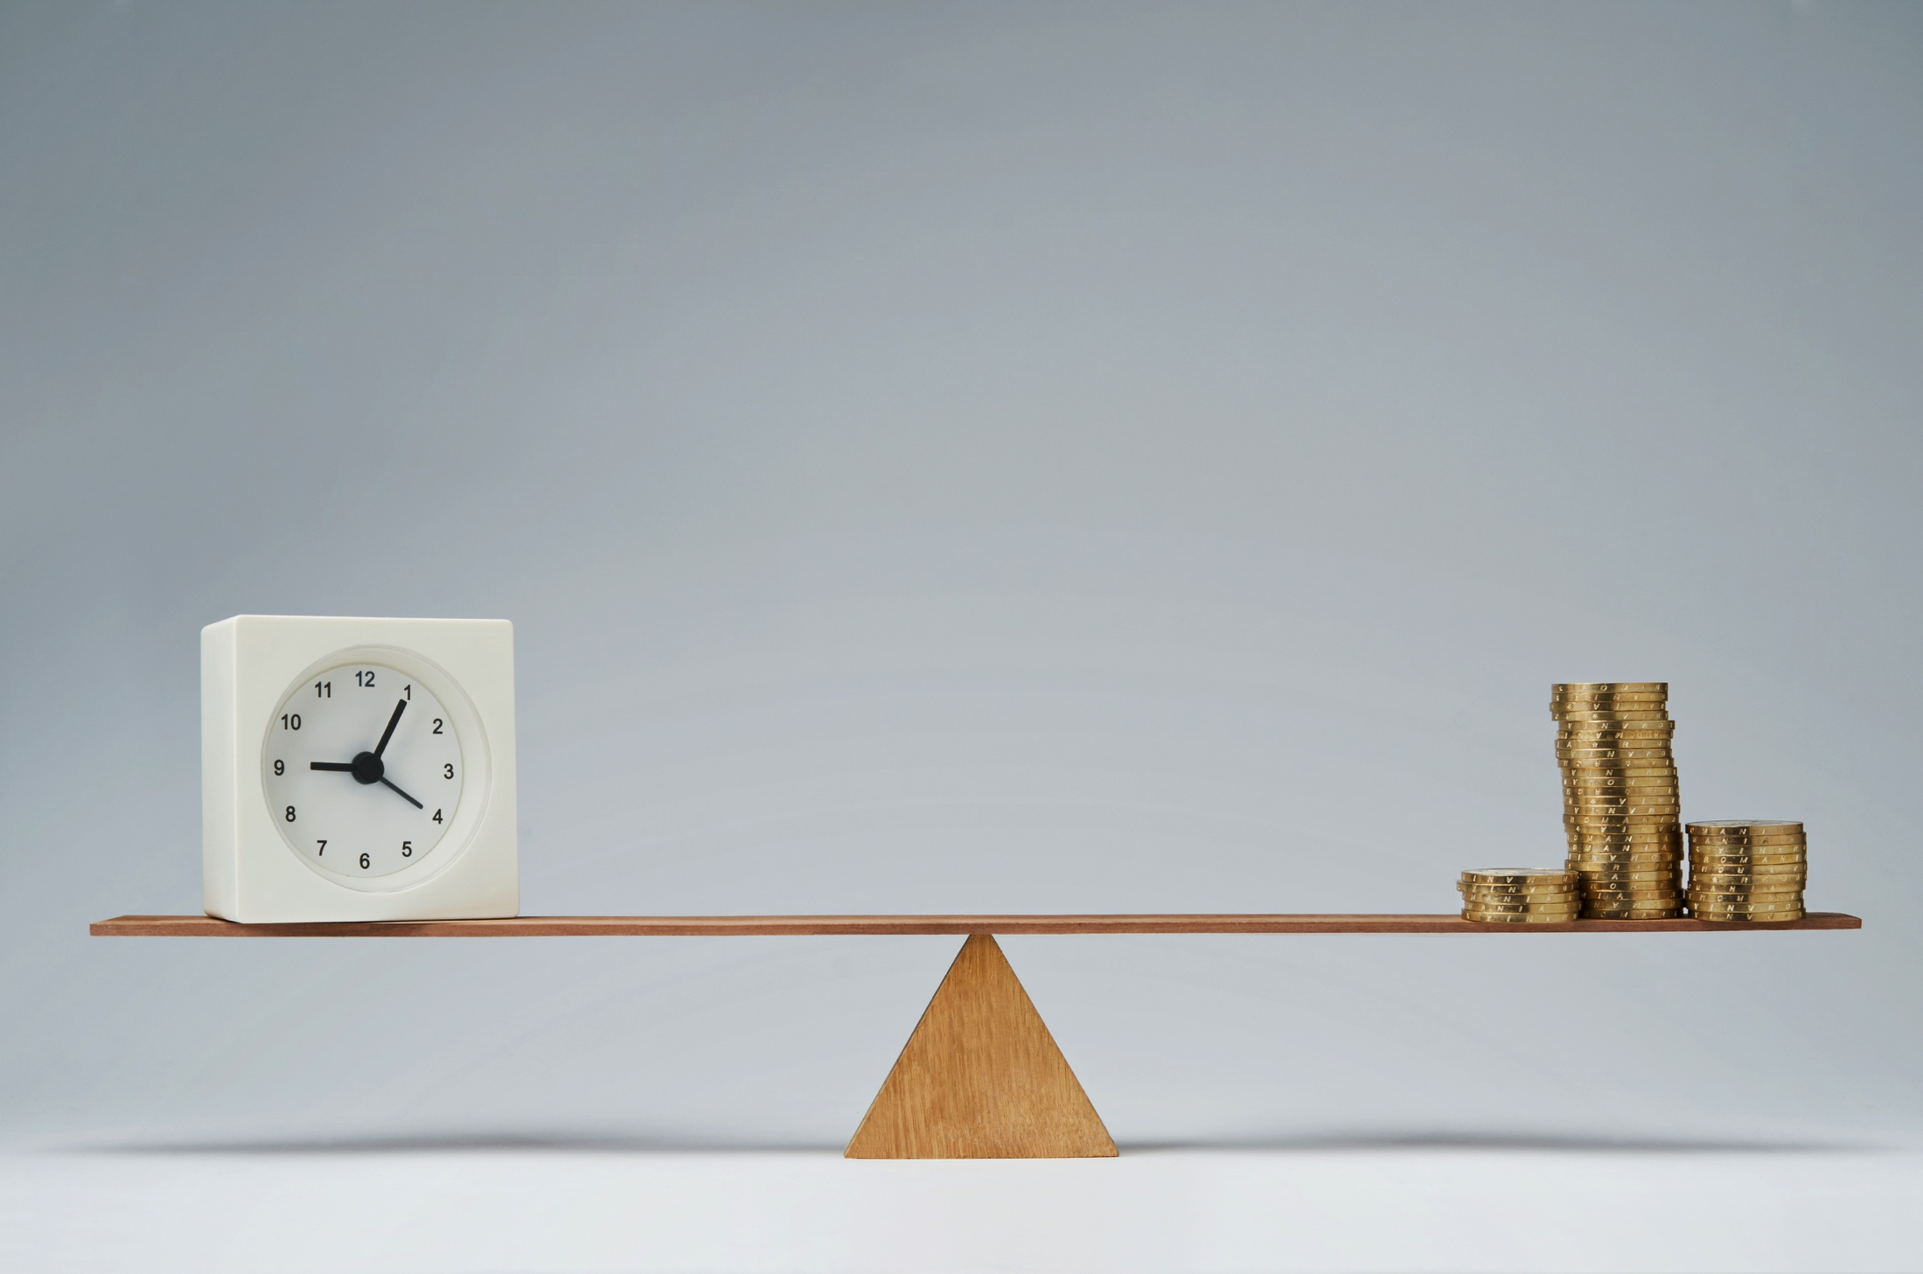
More time or more money?
Tina values her time more than her money. She is willing to sacrifice her money to have more time.
Maggie values her money more than her time. She is willing to sacrifice her time to have more money.
6 studies, N=4,690; Whillans, Weidman & Dunn, 2016
Social Psychological & Personality Science
Notes:
I first sought to provide an initial test of the question of whether broadly prioritizing having more time at the expense of having less money was linked to well-being. To examine this idea, I recruited nearly 5,000 participants—including a nationally representative sample of Americans, working adults in Canada, and college students—and I asked them one simple question—are you more like Tina or more like Maggie (they were gender matched of course, but this is an example). Think for yourself for a moment, are you more like Tina or are you more like Maggie. Tina values her time more than her money, she is willing to sacrifice her money to have more time. For example, she would be willing to work fewer hours and have more free time. Maggie values her money more than her time. She is willing to sacrifice her time to have more money. For example, she would be willing to work more hours and have less free time.

Slide 14
Do people choose time or money?
Money
Time
Notes:
What we found is that across all of the people that we studied, there was about a 50-50 split with a slight preference for time.

Slide 15
Resource Orientation Measure
2 week
88%
3 months
82%
Notes:
STABLE OVER TIME

Slide 16


Choosing time predicts decision-making
VS.
Real Choice, N=518
Notes:
This simple measure does a pretty good job predicting how people behave. For example, people who reported valuing time over money were more likely to choose a housecleaning service that would buy them a couple of additional hours on the weekend vs. receiving a cash prize, as an incentive for participation in our study.

Slide 17


Choosing time predicts decision-making
Spend fewer hours per week working
Spend more time per week volunteering
N=1,265; Representative sample of Working Americans
Notes:
I first sought to provide a test of the question of whether broadly prioritizing having more time at the expense of having less money was linked to greater well-being. To examine this idea, I recruited nearly 5,000 participants—including a nationally representative sample of Americans, working adults in Canada, and college students—and I asked them one simple question—are you more like Tina or more like Maggie (they were gender matched of course, but this is an example). Tina values her time more than her money, she is willing to sacrifice her money to have more time. Maggie values her money more than her time. She is willing to sacrifice her time to have more money. What I found was fairly even split across our studies, with a slight preference for time.

Slide 18
Choosing time promotes subjective well-being
d = 0.14
Life Satisfaction
d = 0.09
Positive Affect
d = -0.08
Negative Affect
Holds controlling for time and material affluence, materialism, age, gender, income, # of kids at home, # of hours worked
Notes:
Perhaps most critically to the idea that valuing time over money may promote greater well-being, upon meta-analyzing the effects across the 6 studies that I conducted, I found that people who said they prioritized time over money reported greater life satisfaction, greater positive affect, and less negative affect. Of course, because this research is correlational, it is important to rule out other factors that might have otherwise accounted for these results. In this study, we found that these results held controlling for factors such as how much money people had, how materialistic people were, people’s income, and how pressed for time and money people felt in the moment. Together, these findings provide initial evidence that the broad willingness to trade discretionary income to have more time can promote well-being—perhaps by influencing people’s daily and major decisions.

Slide 19



Choosing time promotes well-being
Notes:
Perhaps most critically to the idea that valuing time over money may promote greater well-being, upon meta-analyzing the effects across the 6 studies that I conducted, I found that people who said they prioritized time over money reported greater life satisfaction, greater positive affect, and less negative affect. Of course, because this research is correlational, it is important to rule out other factors that might have otherwise accounted for these results. In this study, we found that these results held controlling for factors such as how much money people had, how materialistic people were, people’s income, and how pressed for time and money people felt in the moment. Together, these findings provide initial evidence that the broad willingness to trade discretionary income to have more time can promote well-being—perhaps by influencing people’s daily and major decisions.

Slide 20

And social connection?
3 studies, N=741; Whillans & Dunn, 2018
Journal of Social & Personal Relationships, Conditionally Accepted
Notes:
Perhaps most critically to the idea that valuing time over money may promote greater well-being, upon meta-analyzing the effects across the 6 studies that I conducted, I found that people who said they prioritized time over money reported greater life satisfaction, greater positive affect, and less negative affect. Of course, because this research is correlational, it is important to rule out other factors that might have otherwise accounted for these results. In this study, we found that these results held controlling for factors such as how much money people had, how materialistic people were, people’s income, and how pressed for time and money people felt in the moment. Together, these findings provide initial evidence that the broad willingness to trade discretionary income to have more time can promote well-being—perhaps by influencing people’s daily and major decisions.

Slide 21
Study 1a: Valuing Time Over Money
+ Social Connection
“In the past 7 days, how much time have you spent socializing with students you have met since becoming a UBC student?”
Tina values her time more than her money. She is willing to sacrifice money to have more time.
Maggie values her money more than her time. She is willing to sacrifice time to have more money.
“In the past 7 days, how much time you have spent working for pay, in class, or studying outside of class?”
Notes:
Socializing. Participants who prioritized time over money on the ROM spent more time in the last 7 days interacting with students who they had met since becoming a student at [BLINDED INSTITUTION] (M=24.45%, SD=18.76) than students who prioritized money over time (M=15.72%, SD=14.37), t(118.29)=2.95, p=0.004, 95%CI [2.87, 14.59], d=0.52. Reporting these results in the regression framework, prioritizing time over money was a significant predictor of the amount of time that students spent socializing with peers who they had met at [BLINDED INSTITUTION], β=0.24, p=0.007; these results were unchanged when we included current feelings of time pressure, extraversion, conscientiousness, age, gender, and ethnicity into the model as covariates, β=0.26, p=0.006. See Table 2 for the final regression model including covariates. The ROM did not predict the amount of time that students spent socializing with people they had met prior to coming to [BLINDED INSTITUTION], p=0.662. These findings suggest that valuing time over money was specifically associated with students’ willingness to invest time interacting with new peers.
Working vs. Socializing. We then created a difference score between the percentage of time students spent attending class, working, or studying and the percentage of time that they socialized with new friends; on this measure, higher numbers signify a greater percentage of time spent working vs. socializing with new peers. Since the participants’ primary occupation was being a student, “working” was comprised of working for pay, studying, and going to class. As expected, students who valued time more than money spent less time working vs. socializing with new peers (M=28.47%, SD=38.14) as compared to students who valued money more than time (M=48.28%, SD=29.34), t(117)=3.01, p=0.003, 95%CI [-32.87, -6.76], d=0.58. Reporting these results in the regression framework, prioritizing money over time was a significant predictor of the amount of time that students spent working vs. socializing, β=-0.27, p=0.003; these results were unchanged when we included time pressure, extraversion, conscientiousness, age, gender, and ethnicity into the model, β=-0.29, p=0.002. See Table 3 for the regression model including covariates. See Table 4 for the mean differences reported across each time-use outcome. As evidenced in Table 4, after using the Bonferroni correction to adjust for multiple comparisons, participants who valued time over money spent more time socializing with students they had met since becoming a [BLINDED INSTITUTION] student. Participants who valued time over money also spent more time socializing with new peers vs. working (Table 4). There were no other reliable differences in self-reported time use for students who valued time vs. money

Slide 22
Valuing Time Over Money
+ Social Connection
Socializing with new peers
d = 0.52
d = 0.58
Socializing vs. “working.”
N = 127 students
Valuing Time
Holds for gender, extraversion, time-pressure, and SES
Notes:
Socializing. Participants who prioritized time over money on the ROM spent more time in the last 7 days interacting with students who they had met since becoming a student at [BLINDED INSTITUTION] (M=24.45%, SD=18.76) than students who prioritized money over time (M=15.72%, SD=14.37), t(118.29)=2.95, p=0.004, 95%CI [2.87, 14.59], d=0.52. Reporting these results in the regression framework, prioritizing time over money was a significant predictor of the amount of time that students spent socializing with peers who they had met at [BLINDED INSTITUTION], β=0.24, p=0.007; these results were unchanged when we included current feelings of time pressure, extraversion, conscientiousness, age, gender, and ethnicity into the model as covariates, β=0.26, p=0.006. See Table 2 for the final regression model including covariates. The ROM did not predict the amount of time that students spent socializing with people they had met prior to coming to [BLINDED INSTITUTION], p=0.662. These findings suggest that valuing time over money was specifically associated with students’ willingness to invest time interacting with new peers.
Working vs. Socializing. We then created a difference score between the percentage of time students spent attending class, working, or studying and the percentage of time that they socialized with new friends; on this measure, higher numbers signify a greater percentage of time spent working vs. socializing with new peers. Since the participants’ primary occupation was being a student, “working” was comprised of working for pay, studying, and going to class. As expected, students who valued time more than money spent less time working vs. socializing with new peers (M=28.47%, SD=38.14) as compared to students who valued money more than time (M=48.28%, SD=29.34), t(117)=3.01, p=0.003, 95%CI [-32.87, -6.76], d=0.58. Reporting these results in the regression framework, prioritizing money over time was a significant predictor of the amount of time that students spent working vs. socializing, β=-0.27, p=0.003; these results were unchanged when we included time pressure, extraversion, conscientiousness, age, gender, and ethnicity into the model, β=-0.29, p=0.002. See Table 3 for the regression model including covariates. See Table 4 for the mean differences reported across each time-use outcome. As evidenced in Table 4, after using the Bonferroni correction to adjust for multiple comparisons, participants who valued time over money spent more time socializing with students they had met since becoming a [BLINDED INSTITUTION] student. Participants who valued time over money also spent more time socializing with new peers vs. working (Table 4). There were no other reliable differences in self-reported time use for students who valued time vs. money

Slide 23
Valuing Time Over Money
+ Social Connection
Tina values her time more than her money. She is willing to sacrifice money to have more time.
“In the past 7 days, how much time have you spent socializing with colleagues about work & non-work related matters?”
“In the past 7 days, how much time you have spent working (vs. socializing)?”
Maggie values her money more than her time. She is willing to sacrifice time to have more money.

Slide 24
Valuing Time Over Money
+ Social Connection
Socializing about non-work
d = 0.31
d = 0.38
Socializing vs. working
N = 298 working adults
Valuing Time
Holds for gender, hours worked, and job status (pre-registered)
Notes:
As predicted, employees who prioritized time over money on the ROM spent more time in the last 7 days interacting with colleagues about non-work-related matters (M=16.15%, SD=11.74) than employees who prioritized money (M=12.77%, SD=10.09), t(298) = 2.66, p=0.008, 95% CI[0.88, 5.88], d=0.31. Reporting these results in the regression framework, prioritizing time over money was a significant predictor of the amount of time that employees spent socializing with colleagues about non-work-related matters, β=0.15, p=0.008; these results were unchanged when including hours worked in the last 7 days into the model as a covariate, β=0.14, p=0.013 and when only including respondents who said that their job involved talking with colleagues ( N=283), β=0.16, p=0.008. These results were also unchanged when we included the number of hours respondents worked in the last 7 days and job title in the model as covariates, β=0.12, p=0.036. The ROM did not significantly predict the amount of time that employees discussed work-related matters with colleagues or work and non-work-related matters with clients/customers, ps > 0.351. Valuing time over money was specifically associated with greater willingness to invest time interacting with colleagues about non-work-related matters. Working vs. Socializing. We then created a difference score between the percentage of time that employees spent working and the percentage of time that they reported socializing with colleagues about non-work-related matters in the last 7 days; on this measure, higher numbers signify a greater percentage of time spent working vs. socializing with colleagues about nonwork-related matters. As expected, employees who valued time more than money spent less time working vs. socializing with their colleagues (M=31.03%, SD=14.33) as compared to employees Page 15 of 39 http://mc.manuscriptcentral.com/jspr Journal of Social and Personal Relationships 123456789 10 11 12 13 14 15 16 17 18 19 20 21 22 23 24 25 26 27 28 29 30 31 32 33 34 35 36 37 38 39 40 41 42 43 44 45 46 47 48 49 50 51 52 53 54 55 56 57 58 59 60 For Peer Review TIME & SOCIAL CONNECTION 16 who valued money more than time (M=36.78%, SD=15.95), t(298) = 3.19, p=0.002, 95%CI [2.20, 9.31], d=0.38. Reporting these results in the regression framework, prioritizing money (vs. time) was a significant predictor of the amount of time that employees spent working vs. socializing, β=-0.18, p

Slide 25


Valuing Time Over Money
+ Social Interactions
“You will be in charge of deciding whether to keep going or whether to stop after each question.”
Get to know you questions:
“Who would you like to have dinner with, if you could have dinner with anyone in the world?”
Valuing time
(3 months before lab visit)
Notes:
As predicted, employees who prioritized time over money on the ROM spent more time in the last 7 days interacting with colleagues about non-work-related matters (M=16.15%, SD=11.74) than employees who prioritized money (M=12.77%, SD=10.09), t(298) = 2.66, p=0.008, 95% CI[0.88, 5.88], d=0.31. Reporting these results in the regression framework, prioritizing time over money was a significant predictor of the amount of time that employees spent socializing with colleagues about non-work-related matters, β=0.15, p=0.008; these results were unchanged when including hours worked in the last 7 days into the model as a covariate, β=0.14, p=0.013 and when only including respondents who said that their job involved talking with colleagues ( N=283), β=0.16, p=0.008. These results were also unchanged when we included the number of hours respondents worked in the last 7 days and job title in the model as covariates, β=0.12, p=0.036. The ROM did not significantly predict the amount of time that employees discussed work-related matters with colleagues or work and non-work-related matters with clients/customers, ps > 0.351. Valuing time over money was specifically associated with greater willingness to invest time interacting with colleagues about non-work-related matters. Working vs. Socializing. We then created a difference score between the percentage of time that employees spent working and the percentage of time that they reported socializing with colleagues about non-work-related matters in the last 7 days; on this measure, higher numbers signify a greater percentage of time spent working vs. socializing with colleagues about nonwork-related matters. As expected, employees who valued time more than money spent less time working vs. socializing with their colleagues (M=31.03%, SD=14.33) as compared to employees Page 15 of 39 http://mc.manuscriptcentral.com/jspr Journal of Social and Personal Relationships 123456789 10 11 12 13 14 15 16 17 18 19 20 21 22 23 24 25 26 27 28 29 30 31 32 33 34 35 36 37 38 39 40 41 42 43 44 45 46 47 48 49 50 51 52 53 54 55 56 57 58 59 60 For Peer Review TIME & SOCIAL CONNECTION 16 who valued money more than time (M=36.78%, SD=15.95), t(298) = 3.19, p=0.002, 95%CI [2.20, 9.31], d=0.38. Reporting these results in the regression framework, prioritizing money (vs. time) was a significant predictor of the amount of time that employees spent working vs. socializing, β=-0.18, p

Slide 26
Social Interactions
**
t(290.50)=2.70, p = 0.007, 95%CI [0.43, 2.73], d = 0.29
Holds for gender, year in college, extraversion, time stress, SES

Slide 27
Social Interactions
People who valued time spent 18% more time socializing
*
t(338)=2.59 p=0.010, 95%CI [00:02, 02:40], d = 0.33
Holds for gender, age, extraversion, time stress, SES
Notes:
(M=10:25minutes, SD=5:17) as compared to participants who valued money more than time (M=8:54minutes, SD=5:29), t(338)=2.59, p=0.010, 95%CI [0:00:21, 0:02:40], d=0.33.

Slide 28
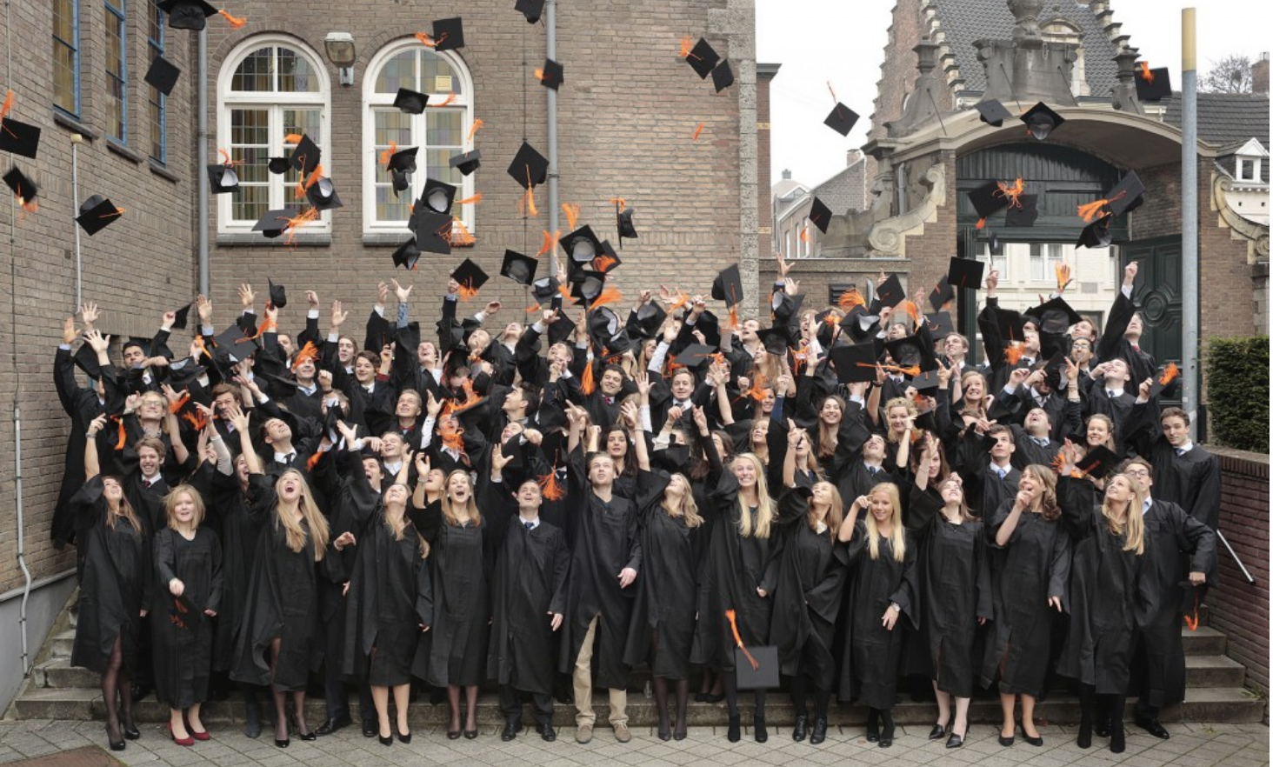



Choosing time predicts long-term trajectories of happiness
Year 1
Year 2
Year 2 and 3
N=1,200 graduating students
Whillans & Dunn, Submitted

Slide 29
Can using money to buy time promote happiness and social connection?
Notes:
While I see initial evidence that prioritizing time over money is linked to greater happiness, these initial studies are unable to examine the specific mechanisms by which using money to buy time may promote happiness. Thus, in the next studies, I hone in on one specific instantiation of choosing time over money—using money to buy time by using time-saving services and delegating tasks to others. Studies 1 & 2, I will provide descriptive evidence to help improve the predictive validity of how using money to buy time might improve well-being. In Study 3, I will use these studies to draw conclusions about a causal link between buying time and subjective well-being.

Slide 30
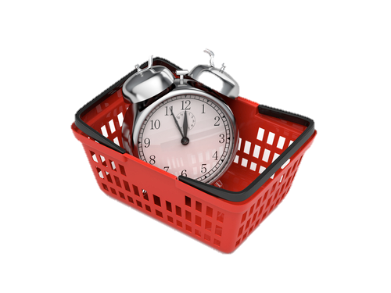
Can ‘buying time’ promote happiness?
Products that simply shave time off are worthwhile only if they eliminate the dreaded minutes of our day
“Do you spend money to outsource any tasks that you dislike doing?”
Kahneman et al., 2006
Notes:
Across most of these studies, I constrained my conceptual definition of using money to buy time by delegating our disliked tasks to others. This choice was based on my theorizing based on past work, suggesting that using money to buy time might have the greatest benefit when it allows people to remove the most dreaded moments of their day. Thus, this first study, I focused on using money to buy time by delegating our disliked tasks to others.

Slide 31
Data collection strategy
Study | Description | Country | Method | HH Inc. (M) | N
1 | Mturk | US | Panel Survey | $30K to $35K | 366
2 | Employed | Canada | Public Places | $60K to $75K | 326
3 | Older Adults | Denmark | Panel Survey | kr. 300K to 499K | 467
4 | Employed | US | Representative | $60K to $75K | 1,260
5 | Employed | Netherlands | Representative | €37,500 | 1,232
6 | Millionaires | Netherlands | Dutch Bank | €2,375,905 | 818
7 | Employed* | US | Panel Survey | $60K to $75K | 1,802
 |  |  |  |  | 6,271
Whillans, Dunn, Smeets, Bekkers & Norton, 2017;
Proceedings of the National Academy of Science

Slide 32
Buying time is linked to life satisfaction
Variable | β | B | SE | P-value | F-value | P-value | R²
Buying time (1=Yes) | 0.14 | 0.77 | 0.55 | <0.001
 |  |  |  | F(1, 1262)=24.39 |  | <0.001 | 0.06
Notes:
In the representative sample of employed adults living in the US, people who used money to buy time reported greater life satisfaction. For people who said they used money to buy time they experienced a 0.77 increase in life satisfaction on a 10 point scale as compared to people who did not use money to buy time.

Slide 33
Buying time is linked to life satisfaction
Variable | β | B | SE | P-value | F-value | P-value | R²
Buying time (1=Yes) | 0.12 | 0.48 | 0.14 | <0.001
Household Income | 0.20 | 0.09 | 0.02 | <0.001
Age | 0.15 | 0.02 | 0.01 | <0.001
Number of Kids | -0.02 | -0.02 | 0.05 | 0.667
Married (1=Yes) | 0.18 | 0.72 | 0.14 | <0.001
Self-Employed (1=Yes) | -0.03 | -0.26 | 0.25 | 0.298
Gender (1=Female) | 0.07 | 0.23 | 0.12 | 0.075
Hourly-Wage (1=Yes) | -0.05 | -0.17 | 0.12 | 0.170
 |  |  |  | F(8, 1133)=18.27 |  | <0.001 | 0.16

Slide 34
Buying time buffers against time stress
β = -0.18***
Time Stress
Life Satisfaction
β = -0.03
Time Stress
Life Satisfaction
N=1,504
Z = 3.85, p < 0.001
Holds controlling for age, gender, income, marital status, # of kids at home, # of hours worked
Notes:
Across studies, there was a significant positive association between subjective feelings of time pressure and using money to buy time.
These findings suggest that people who reported greater time pressure were also more likely to report using money to buy time. Interestingly, using money to buy time promoted happiness in part by protecting people from the negative impact of time pressure on well-being.
Across each study, the negative relationship between time pressure and well-being was significantly attenuated for people who reported using money to buy time as compared to people who did not. These results held controlling for our key demographic variables. These studies point to the possibility that using money to buy time promotes happiness in part by protecting people from the deleterious effects of time stress on subjective well-being.

Slide 35
Interim Summary
Spending money to delegate disliked tasks is linked to greater life satisfaction, meaning, and social connection
Spending money to delegate disliked tasks promotes well-being by protecting against feelings of time stress
Notes:
In a representative sample of employed American adults (and replicated in several other samples of working adults), people who used money to buy time reported greater life satisfaction, greater meaning, and even greater feelings of social connection. We saw that the well-being benefits of using money to buy time were due in part to the fact that using money to buy time protected people from the negative impact of time stress on life satisfaction.
While Study 1 provides initial evidence for a link between using money to buy time and well- being, this study focused on the broad relationships between these constructs and is not able to examine how using money to buy time might shape daily happiness.

Slide 36

Can buying time affect daily happiness?
American Time Use Survey
Day Reconstruction Method
Asked about the last 24 hours
50% Weekday, 50% Weekend
How happy are you feeling right now?
How stressed are you feeling right now?
Notes:
Thus, to examine this question, I assessed the relationship between using money to buy time (through time-saving services) and daily happiness using the American Time Use Survey. The American Time Use Survey asks respondents about the activities they have completed in the last 24 hours using the Day Reconstruction Method.
After reconstructing their day participants are asked to rate how happy and stressed that they felt during three randomly selected activities that occurred throughout the day. These measures will provide the key measures of interest in this work. They are also asked how in pain they are and these will remain outside the scope of the
investigation.

Slide 37

Buying time & daily happiness
People who used time-saving services on the weekend
Spent 30min more minutes with family and friends***
Enjoyed social time significantly more***
***p<0.001
β = 0.11*
β = 0.10*
Happiness in the last 24 hours
β = 0.15*
Used time-saving services (1=Yes)
β = 0.09†
p<0.10, * p<0.05
Effect=0.05, SE=0.03, 95% CI [0.03, 0.13]
Notes:
I then conducted follow-up analyses to examine why this might be the case. What I found is that as compared to individuals who did not use time-saving services on the weekend, individuals who used time-saving services on the weekend spent more time socializing with friends and family. Upon entering this variable into a regression model, I see that using time saving services predicted greater happiness in the last 24 hours, in part because doing so enabled people to spend more time socializing with friends and family.
Now it is interesting to point out here, that the direct effect is still significant, suggesting that there could be other explanations for these well-being benefits. In addition to *objectively* providing people with time that they can then spend in happier ways (like socializing), it is possible that people are gaining benefit from using time-saving services due to a psychological mechanism—for example, delegating on the weekend might reduce perceived goal conflict (what I should be doing vs. what I want to be doing) thereby promoting greater happiness. Relatedly, the opportunity costs of *not* delegating might be higher on the weekend, and thus giving up money to have more time might have more subjective benefit.
On the weekend, you might be faced with cleaning the house and doing the laundry instead of spending an afternoon having a long lunch. On the weekend the opportunity costs of staying in and cleaning the house (vs. socializing) are higher—you could have had leisure time that you might not otherwise enjoy. Thus, in making the decision to use time-saving services on the weekend—you might gain more benefit because you are also more aware of the costs of not doing so.

Slide 38


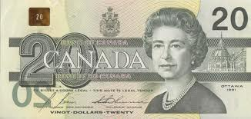
          Within subject, counterbalanced
          Please spend this payment in a way that will give you more free time
          Please spend this payment on a material purchase for yourself
          Science World, Vancouver BC
Notes:
*This study was a within subject study, with a counterbalanced order, and I recruited participants from Vancouver, Canada.
*We pre-registered our methods, given the time and financial cost of this study.
*Participants were either given a payment of $40 to spend on a way that would give them time or to spend on a material purchase for themselves (because this is how people typically spend discretionary income).
**We wanted people to make any time or material purchase, because it is important that people feel like they have choice to reap the benefits of spending decisions. Furthermore, it is important that people’s purchases map on to a broader spending category (time-saving) vs. a specific expenditure (housecleaning) to maximize external validity.

Slide 39
Material Purchase
Clothes Books Wine Board Games
Time-Saving Purchase
Grocery Delivery Lawn-mowing Service Housecleaning Pre-made Meals
0 minutes saved***
(85% 0 minutes)
2 hours saved***
(60% 1-3 hours)
***p < 0.001
Notes:
**People in this study, complied with study instructions.
**People in the material condition bought clothes, books, wine and board games**
**People in the time-saving purchase condition bought grocery delivery, lawn-mowing, housecleaning, and remade meals.
**Consistent with the instructions, the time-saving purchases saved people ~2 hours, and the material purchases saved participants 0 hours, on average.

Slide 40
Time-saving purchases improve happiness
**
paired sample, t(59) = 2.57, p = 0.007, 95% CI [0.10, 0.48]
Notes:
Consistent with our hypothesis, we saw that people were happier at the end of the day on weeks where they made a time-saving purchase as compared to weeks where they made a material purchase.

Slide 41
Time-saving purchases reduce time stress
**
paired sample, t(59) = 2.76, p = 0.004, 95% CI [0.29, 1.18]
Notes:
We also saw that people felt less pressed for time at the end of the day on weeks where they made a time-saving purchase as compared to weeks where they made a material purchase.

Slide 42
Interim Summary
Using time-saving services promotes happiness on the weekends when people spend more time socializing
What we do with our time may play an important role in catalyzing the benefits of using money to buy time
Smeets, Whillans, Bekkers & Norton, Working Paper
Notes:
To summarize the findings from the American Time Use Survey, I see that using time services promotes happiness on the weekends, especially when people spend time socializing with friends/family.
We also see evidence that what we do with our time may play an important role in catalyzing the benefits of using money to buy time. Indeed, this general idea is consistent with some recent work my colleagues and I have conducted showing that having more leisure time isn’t enough— people also have to spend that leisure time in more active ways (volunteering etc) in order to reap the well-being rewards.

Slide 43
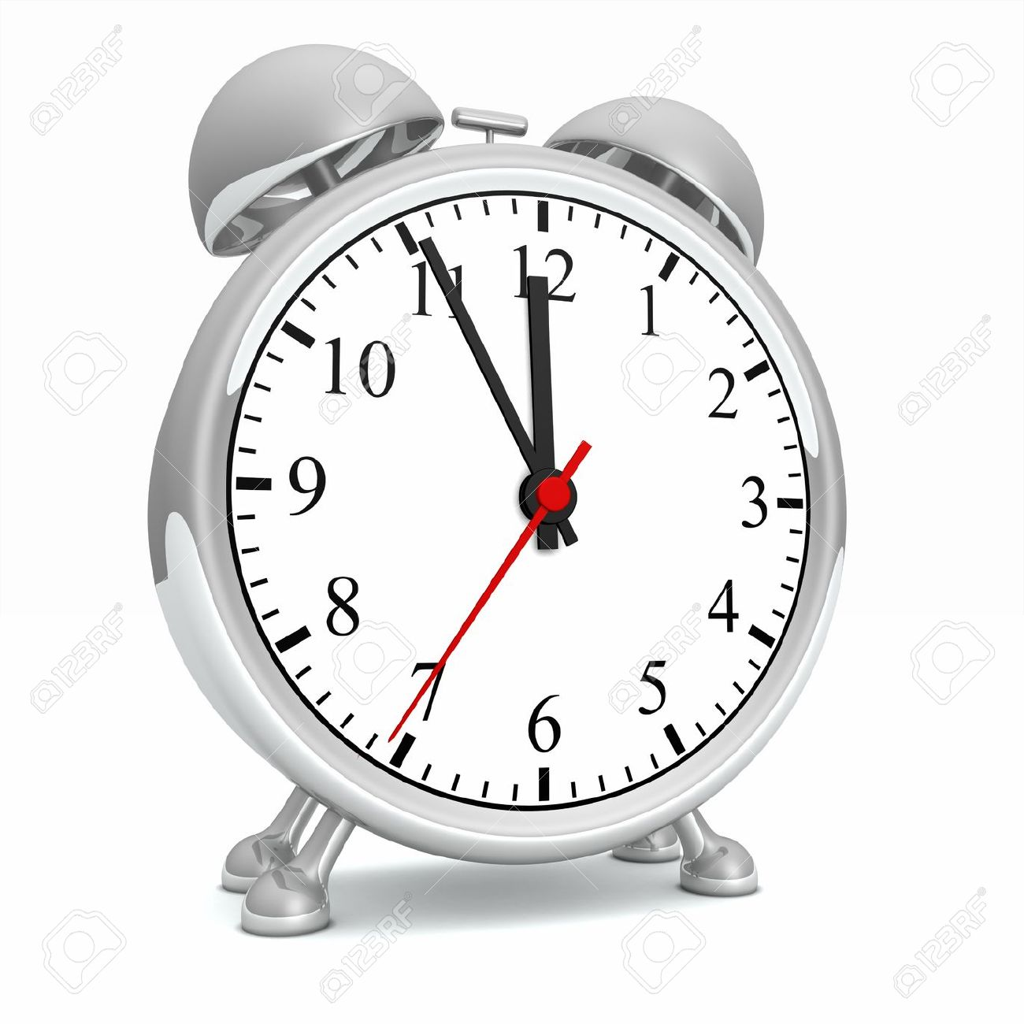
Purchases, happiness & time stress
β= -0.22*
β= -0.75**
Time Stress
End of Day Positive Affect
Time-Saving
Purchase
Indirect Effect: 0.13(0.07), 95% CI [0.03, 0.29]
Within Subject Mediation, Montoya & Hayes, 2016
Notes:
We also saw that people felt less pressed for time at the end of the day on weeks where they made a time-saving purchase as compared to weeks where they made a material purchase, which in turn predicted greater end of day happiness.

Slide 44

Buying time promotes relationship satisfaction
“In a typical month, do you and your partner spend any money with the primary intention of saving time?”
9 studies, N=3,606
Whillans, Pow & Norton, Working Paper
Notes:
We also saw that people felt less pressed for time at the end of the day on weeks where they made a time-saving purchase as compared to weeks where they made a material purchase, which in turn predicted greater end of day happiness.

Slide 45
Buying time promotes relationship satisfaction
d = 0.29***
Relationship Satisfaction
Time Saving Purchases (1=Yes)
Holds controlling for age, gender, income, wealth, # of kids at home, # of hours worked, social support received and provided
N = 1,048 working, ‘married’ adults
Notes:
In this initial investigation, I chose to constrain my conceptual definition of using money to buy time to spending money to outsource one’s disliked tasks to others. This decision was based on my current theorizing that people should derive the greatest benefits from using money to buy time when doing so allows people to remove the most dreaded moments of their day (e.g., Kahneman et al., 2006).
Consistent with the idea that using money to buy time can promote happiness, found evidence that people who reported using money to buy time—by delegating disliked tasks to others, experienced greater happiness, greater social connection, and greater meaning in life.

Slide 46
Buying time promotes relationship satisfaction
β = 0.19***
Relationship Satisfaction
Time Saving Purchases (1=Yes)
Holds controlling for age, gender, income, wealth, # of kids at home, # of hours worked, social support received and provided
N = 193 dyads, “married” adults
Notes:
In this initial investigation, I chose to constrain my conceptual definition of using money to buy time to spending money to outsource one’s disliked tasks to others. This decision was based on my current theorizing that people should derive the greatest benefits from using money to buy time when doing so allows people to remove the most dreaded moments of their day (e.g., Kahneman et al., 2006).
Consistent with the idea that using money to buy time can promote happiness, found evidence that people who reported using money to buy time—by delegating disliked tasks to others, experienced greater happiness, greater social connection, and greater meaning in life.

Slide 47
Buying time promotes relationship satisfaction
Study 2: Buying time vs. social support
Variable | β | B | SE | P-value
Buying time (1=Yes) | 0.15 | 0.37 | 0.12 | 0.003
Social Support Received | 0.20 | 0.69 | 0.11 | < 0.001
Social Support Provided | 0.22 | 0.60 | 0.10 | < 0.001
Number of Kids | -0.05 | -0.04 | 0.04 | 0.405
HH Income | 0.01 | 0.001 | 0.03 | 0.863
Experiential (1=Yes) | 0.24 | 0.69 | 0.21 | 0.002
Material (1=Yes) | -0.01 | -0.04 | 0.28 | 0.896
Age | 0.05 | 0.06 | 0.07 | 0.367
Hours Worked/Week | 0.05 | 0.10 | 0.09 | 0.278
 |  |  |  | Intercept = 1.07 |  | <0.001
Notes:
This relationship held controlling for other variables that could otherwise explain this relationship such as age, income, the number of kids at home and whether or not people were married.
First, looking at income, for every unit increase in income (for every $2500 increase in this model) there was an 0.09 increase in life satisfaction on a 10-point scale, holding constant all other variables in the model.
Next, looking at using money to buy time, people who used money to buy time, reported 1⁄2 a point on a 10 point scale of life satisfaction as compared to people who did not report using money to buy time.
So, we can see that using money to buy time was linked to greater life satisfaction independent of the effects of income—and that saying you were the kind of person who used money to buy time—resulted in happiness gains that were similar to making $13,000 more of household income/year.
Slide 87 & 88 = the quadratic effect finding.

Slide 48

Buying time vs. social support
Study 2: Buying time vs. social support
Study 2: Buying time vs. social support
At low levels of support, time-saving was related to greater relationship satisfaction, β = 0.29***
At high levels of support, time-saving was not related to greater relationship satisfaction, β = 0.06, ns
Support X Time-Saving Purchases, β = -0.28, p = 0.005
Notes:
This relationship held controlling for other variables that could otherwise explain this relationship such as age, income, the number of kids at home and whether or not people were married.
First, looking at income, for every unit increase in income (for every $2500 increase in this model) there was an 0.09 increase in life satisfaction on a 10-point scale, holding constant all other variables in the model.
Next, looking at using money to buy time, people who used money to buy time, reported 1⁄2 a point on a 10 point scale of life satisfaction as compared to people who did not report using money to buy time.
So, we can see that using money to buy time was linked to greater life satisfaction independent of the effects of income—and that saying you were the kind of person who used money to buy time—resulted in happiness gains that were similar to making $13,000 more of household income/year.
Slide 87 & 88 = the quadratic effect finding.
β = 0.06, B = 0.19 (0.14), p = 0.145

Slide 49
Buying time protects against work-life stress
Buying time protects against work-life stress
β = -0.14***
Work Life Conflict
Relationship Satisfaction
N=659
β = -0.03
Work Life Conflict
Relationship Satisfaction
N=389
Z=3.96, p<0.001
N = 1,048 working, ‘married’ adults
Holds for age, gender, income, # of kids at home, # of hours worked, experiential and material purchases made

Slide 50
Buying time encourages quality time together
Quality Time
B = 0.51**
B = 0.41**
Relationship Satisfaction
B = 0.28*
Time Saving
Purchases (1=Yes)
β = 0.04, ns
p<0.10, * p<0.05
Effect=0.21, SE=0.05, 95% CI [0.08, 0.35]

Slide 51
Reflect on the last time you spent. . .
          You spent $40 together with your partner in a way that gave you more free time AND you spent this time together
          You spent $40 together with your partner in a way that gave you more free time AND you did not spend this time together

Slide 52
Example
“We purchased a nice takeout meal that we could eat together at home.”
“This reduced the stress of having to cook dinner and clean up, allowing us to have a relaxing meal together.”

Slide 53
Quality time is the critical ingredient
F(1, 399) = 61.82, p<0.001
Notes:
We also saw that people felt less pressed for time at the end of the day on weeks where they made a time-saving purchase as compared to weeks where they made a material purchase.

Slide 54
Interim Summary
Buying time causes improved daily happiness
To the extent that time-saving purchases reduce time stress these purchases promote happiness
Time saving purchases enable people to spend more quality time together with their loved ones

Slide 55



When to Buy Time vs. Experiences
Time-Saving as “Problem-Focused Coping”
Best when faced
w/ controllable stressors
Best when faced
w/ uncontrollable stressors
Park, Folkman, & Bostrom, 2001; Chan & Mogilner, 2017
Notes:
In this initial investigation, I chose to constrain my conceptual definition of using money to buy time to spending money to outsource one’s disliked tasks to others. This decision was based on my current theorizing that people should derive the greatest benefits from using money to buy time when doing so allows people to remove the most dreaded moments of their day (e.g., Kahneman et al., 2006).
Consistent with the idea that using money to buy time can promote happiness, found evidence that people who reported using money to buy time—by delegating disliked tasks to others, experienced greater happiness, greater social connection, and greater meaning in life.

Slide 56
Reflect on the last time you spent . . .
          You spent $40 together with your partner in a way that gave you “more free time”
          You spent $40 together with your partner in a way that gave you more free time AND you did not spend this time together
          You spent $40 together with your partner to “acquire a life experience”
Notes:
Thus, this comparison allows us to examine when time-saving purchases—which buy couples out of negative experiences—may provide similar post-purchase closeness as compared to experiential purchases—which buy couples into positive experiences.

Slide 57
In the 7 days before making the purchase did you experience any of the following?
How controllable were each of these stressors?
1=Not at all, 5=Extremely
Overload at home
Overload at work
Family demands
Transportation Problems
Financial Problems
Interpersonal Problems w/ Spouse
Interpersonal Problems w/ Child
Interpersonal Problems w/ Other Person
Other: ____________
Notes:
Thus, this comparison allows us to examine when time-saving purchases—which buy couples out of negative experiences—may provide similar post-purchase closeness as compared to experiential purchases—which buy couples into positive experiences.

Slide 58

Time-saving vs. Experiential
β = -0.08*
Stressor Controllability
Relationship Closeness
β =0.23**
Stressor Controllability
Relationship Closeness
N = 953; working ‘married’ adults
Z=4.39, p < 0.001

Slide 59
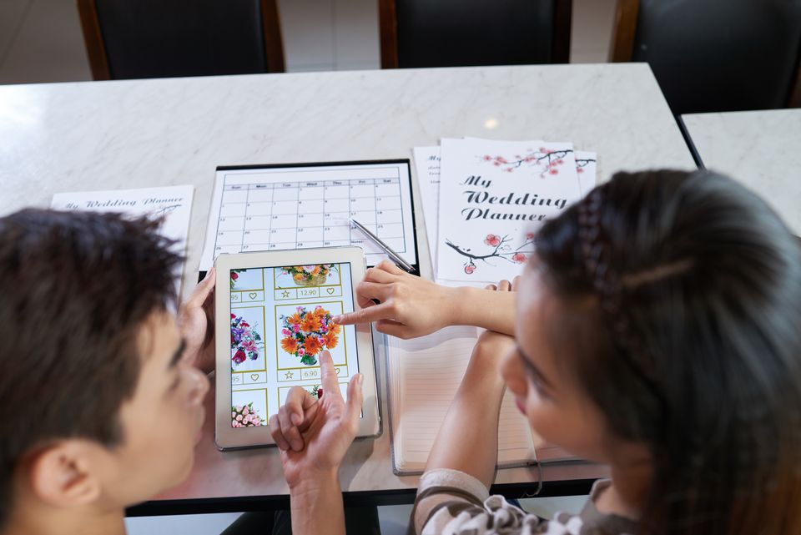
Replication: The Wedding Planners
Notes:
These data therefore allowed us to examine whether time-saving purchases were more likely to promote relationship satisfaction when couples dealt with a specific, important, and controllable event—wedding planning.

Slide 60
Summary & Ongoing Research
Summary & Ongoing Research
Buying time promotes relationship satisfaction
Buying time “buffers” against relationship stress
Time-saving vs. experiential purchases are a form of problem focused coping
When do partners “buy” each other time?
Notes:
This relationship held controlling for other variables that could otherwise explain this relationship such as age, income, the number of kids at home and whether or not people were married.
First, looking at income, for every unit increase in income (for every $2500 increase in this model) there was an 0.09 increase in life satisfaction on a 10-point scale, holding constant all other variables in the model.
Next, looking at using money to buy time, people who used money to buy time, reported 1⁄2 a point on a 10 point scale of life satisfaction as compared to people who did not report using money to buy time.
So, we can see that using money to buy time was linked to greater life satisfaction independent of the effects of income—and that saying you were the kind of person who used money to buy time—resulted in happiness gains that were similar to making $13,000 more of household income/year.
Slide 87 & 88 = the quadratic effect finding.

Slide 61
Guiding Questions
How do the trade-offs that people make between time and money shape well-being and social connection?
How can we encourage people to choose time over money?
Notes:
In the first part of my talk, I will present initial evidence examining the link between choosing time over money and well-being. I will then use this work to set the stage for the new work (3 studies) that I am excited to share today—focusing on one specific instantiation of using money to buy time—choosing time over money by using time-saving services and delegating tasks to others. In Studies 1 & 2, I will provide descriptive evidence to help improve the predictive validity of how using money to buy time might improve well-being. In Study 3, I will use these studies to draw conclusions about a causal link between buying time and subjective well-being.
I will discuss research looking at how we might be able to encourage optimal time and money trade-offs.
In doing so, this work sheds light on the fundamental question of whether, when, and why increased wealth may or may not translate into well-being.

Slide 62
Guiding Questions
How do the trade-offs that people make between time and money shape well-being and social connection?
How can we encourage people to choose time over money?
Notes:
In the first part of my talk, I will present initial evidence examining the link between choosing time over money and well-being. I will then use this work to set the stage for the new work (3 studies) that I am excited to share today—focusing on one specific instantiation of using money to buy time—choosing time over money by using time-saving services and delegating tasks to others. In Studies 1 & 2, I will provide descriptive evidence to help improve the predictive validity of how using money to buy time might improve well-being. In Study 3, I will use these studies to draw conclusions about a causal link between buying time and subjective well-being.
I will discuss research looking at how we might be able to encourage optimal time and money trade-offs.
In doing so, this work sheds light on the fundamental question of whether, when, and why increased wealth may or may not translate into well-being.

Slide 63
Reluctance to choose time over money
99%
17%
Wanted to spend money to buy time
Spent money to buy time
N=1,265 Representative Sample of Employed Americans
Notes:
This is particularly important in light of my research showing that people do not always give up money to have more ,me—even when maybe they should. In a representative sample of employed Americans, 99% reported that they could easily think of a task that they would like to spend to get someone else to do—but only 17% actually spent money in this way.

Slide 64
Even among millionaires!
99%
52%
Wanted to spend money to buy time
Spent money to buy time
N=829 millionaires with €2.5M in the bank
Notes:
Now an obvious explanation for these results is that people in our study simply could not afford this expense. However, in a sample of millionaires, with over 2.5 million euro in the bank, just over half of the participants in this study reported using money to buy time—suggesting there may be psychological barriers that prevent people from spending money in ways that promote happiness.

Slide 65
N=98; Working Adults
Notes:
Now, of course, an obvious explanation for these results is that the people in our study simply could not afford it. However, in a sample of millionaires, with over 2.5 million euro in the bank, I saw that only just only half of participants reported using money to buy time (even though this sample could clearly afford it).

Slide 66
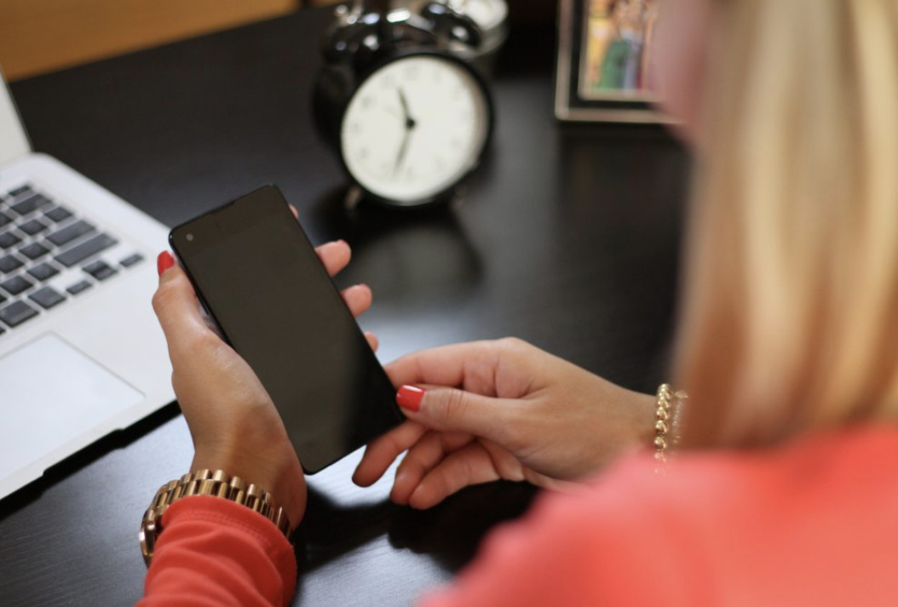
Busyness as a ‘status symbol’

Slide 67
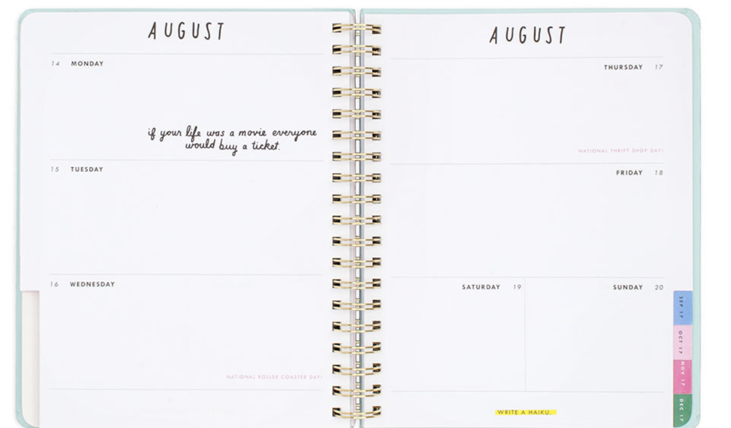
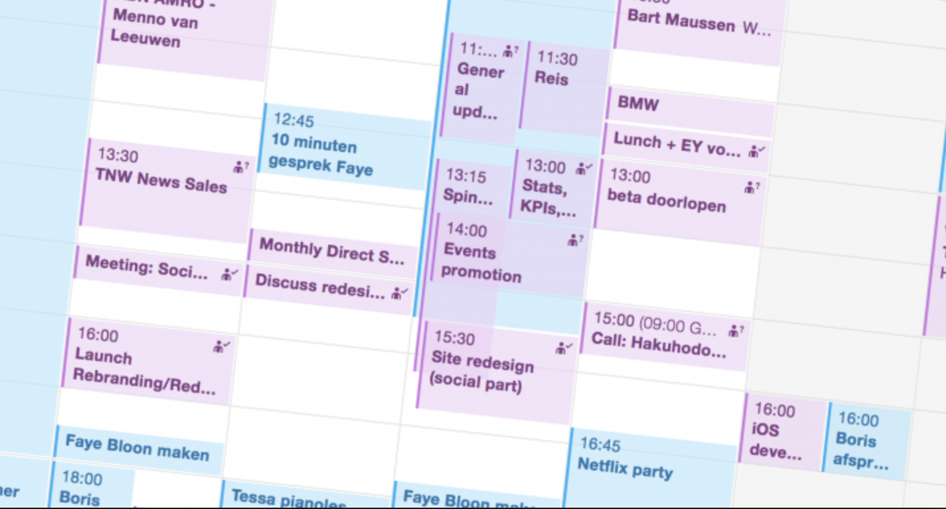
Future Time Slack

Slide 68

How to encourage ‘buying time’?
N=79,627 – Emailed on Thursday morning
Subject Line: Want more free time with friends and family?
Subject Line: Want more free time?
Subject Line: Want 2 more hours of free time next Thursday?²
Whillans, Dunn & Norton, 2018; Social Influence
Notes:
To test this idea, I worked with a major company in the US who is part of the sharing economy (Task Rabbit).
In this initial data, I really wanted to know whether there was *anything* we could do to encourage people to buy time.
Thus, I chose two levers – making time feel more concrete (via specific units of time) and making the future feel more similar to the present (reminding people about a specific day exactly one week in the future).
In the other two control conditions, I asked people to think that the service would save them time (to control for the fact that people often overlook opportunity costs when making decisions about time/money).
In the experimental condition, I asked people to think about having 2 more free hours exactly one week in the future—a technique that has been used to make the future feel more similar to the busy present.
I then assessed whether people *opened* the email and whether they clicked a link to go to a website where they could purchase a Task Rabbit service.

Slide 69
How to encourage ‘buying time’?
N=79,627
***
***
***p< 0.001
Notes:
what I found, consistent with the notion that reminding people that they will be as busy tomorrow as they are today should encourage people to use money to buy time, I found that people were more significantly more likely to open the email when they were reminded about the busyness of their future time.

Slide 70
How to encourage ‘buying time’?
How to encourage time choices
N=12,605
***
***
***p<0.001
Notes:
Furthermore, people were much more likely to click to a website to intend to make a purchase (contnbgnent on opening the emails)

Slide 71
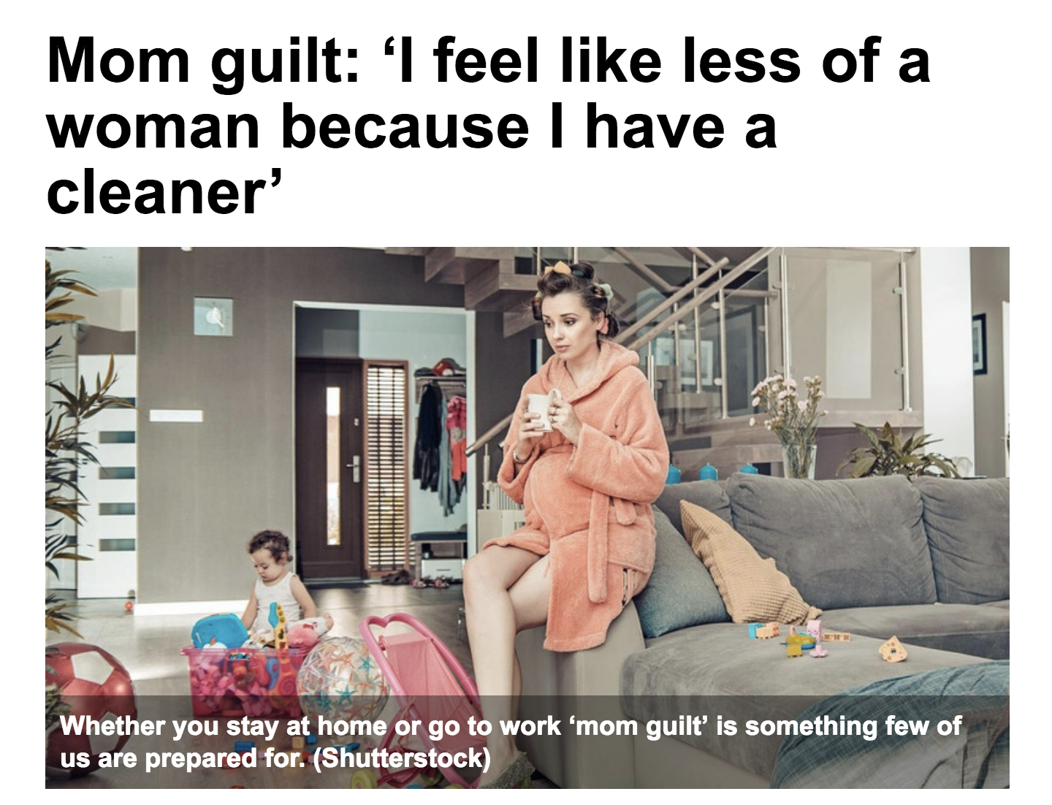
Feelings of Guilt

Slide 72
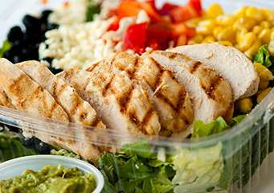

Guilt as a barrier to buying time
Buying time (help is invisible)
Buying time (help is visible)
Whillans & Dunn, Under Review

Slide 73
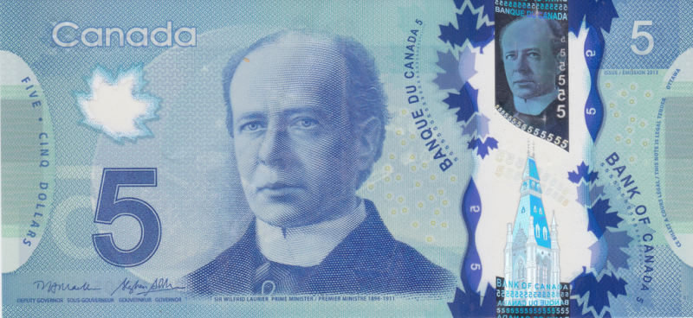
Guilt undermines happiness
Guilt
Happiness
1=Delegate to others
Indirect Effect: -0.70 (0.49) 95% CI [-2.25, -0.10]
Between Subject Mediation

Slide 74
Ongoing Research
Exploring other levers to encourage people to buy time
  E.g., highlighting the benefits for the service provider
  E.g., highlighting the benefits to our partners
Encouraging employees to value non-cash rewards
  E.g., Putting a “price” on non-monetary incentives changes how employees perceive these rewards

Slide 75
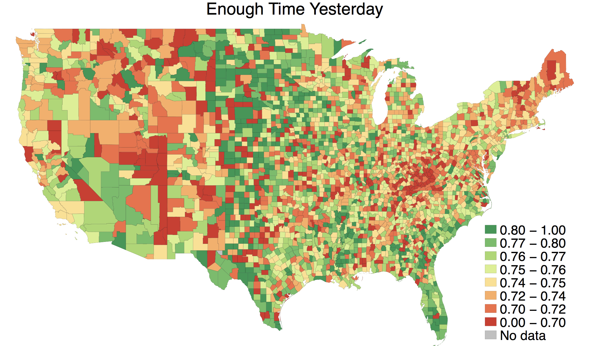
Ongoing Research – How local norms of busyness shape time stress and well-being

Slide 76
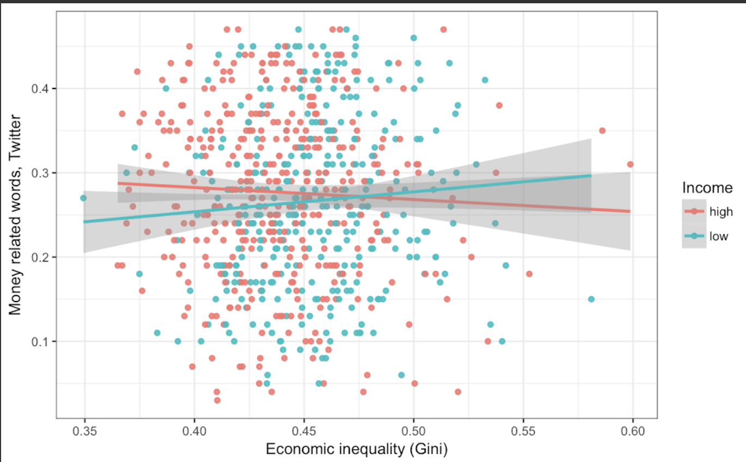
Ongoing Research – How inequality shapes time use and happiness
Notes:
- we have replicated our results on the World Value Survey showing that inequality decreases preference for leisure time, especially for low income individuals (inequality*income -> leisure time).

Slide 77
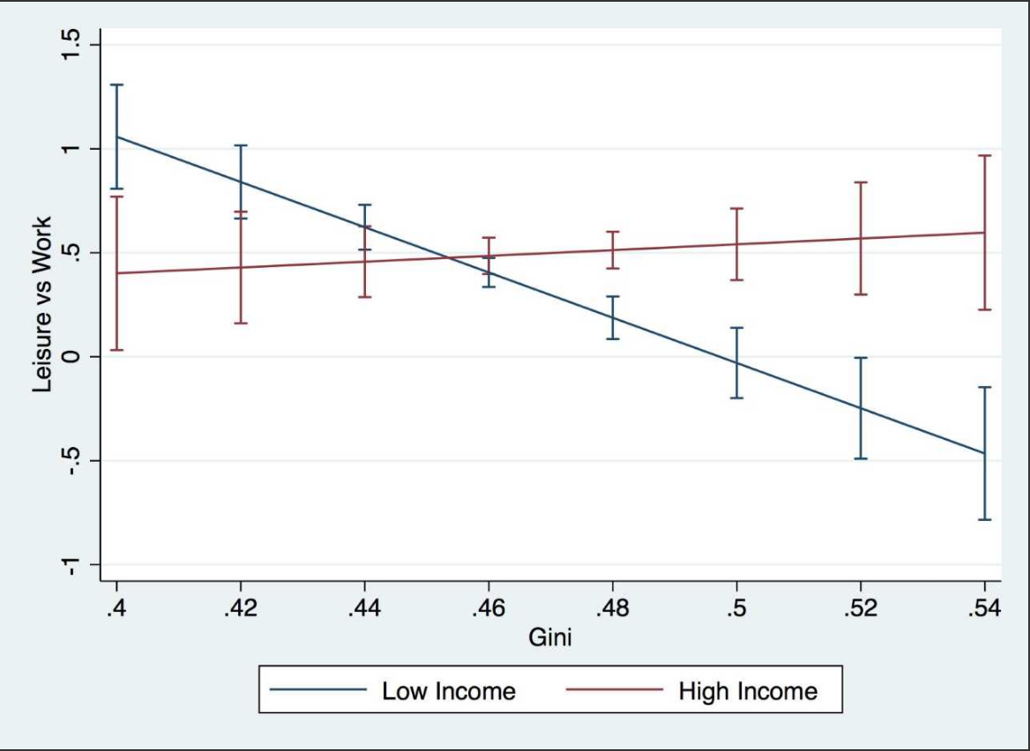
Ongoing Research – How inequality shapes time use and happiness
Notes:
- we have replicated our results on the World Value Survey showing that inequality decreases preference for leisure time, especially for low income individuals (inequality*income -> leisure time).

Slide 78
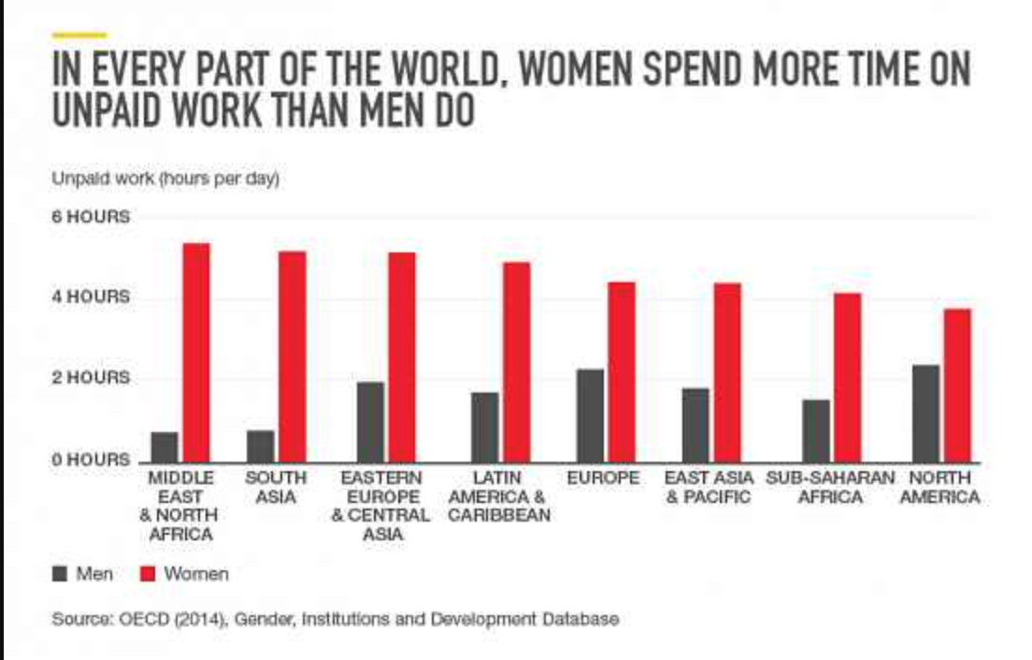
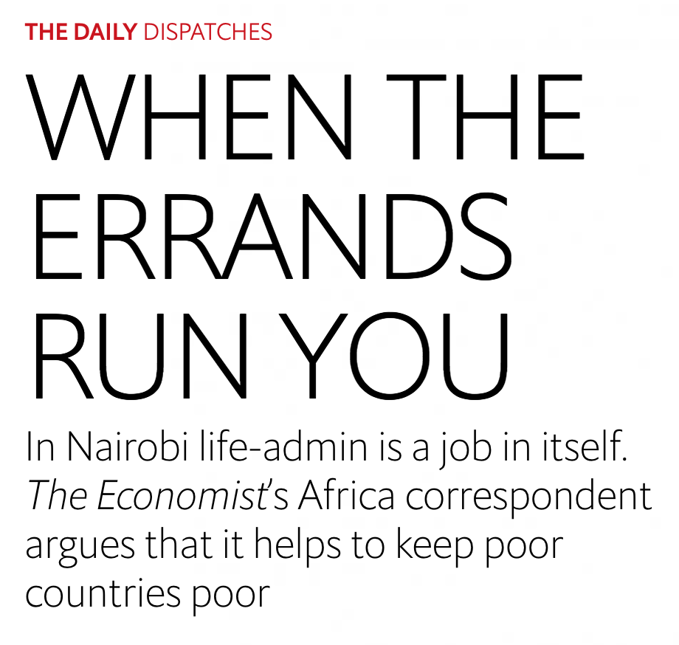
Ongoing Research – Field Experiments in Kenya on ‘time-saving’ vouchers

Slide 79
To promote happiness, we should use money to change the way that we spend our time
Notes:
My research points to the idea that in our daily lives—and over the course of our lives, it may be worth taking the direct flight and the more expensive apartment in order to maximize the happiness we experience each day and over the course of our lives.

Slide 80
Thank you – Collaborators
Rene Bekkers – VU Amsterdam
Hanne Collins – Harvard Business School
Liz Dunn – University of British Columbia
Eugene Caruso – UCLA School of Management
Sally Dickerson – University of California, Irvine
Ryan Dwyer – University of British Columbia
Jon Jachimowicz – Columbia University
Ken Madden – University of British Columbia
Michael Norton – Harvard Business School
Jessie Pow – University of British Columbia
Gillian Sandstrom – University of Essex
Paul Smeets – Maastricht University
George Ward – MIT
Aaron Weidman – University of Michigan
Colin West – UCLA School of Management

Slide 81


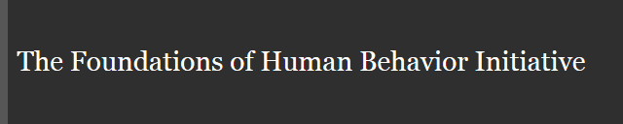

Thank you – Funding for this work

Slide 82
Ashley Whillans
Assistant Professor
Harvard Business School
awhillans@hbs.edu

