Slide 1
Behavioural Economics and SWB
Warwick SWB Summer School
Anke Plagnol
Anke.plagnol.1@city.ac.uk

Slide 2
What is behavioural economics?
Applies psychological insights into human behaviour to investigate how people make economic decisions under various conditions of constraint (e.g., time and knowledge) and influence (e.g., social pressure)
Relatively recent field in economics/psychology (e.g., Kahneman and Tversky 1979, Thaler 1980)
But many of the ideas are actually quite old
Descriptive/positive economics

Slide 3
Why do we need behavioural economics?
“I believe that for the last 50 or 60 years, economists have devoted themselves to studying fictional creatures . . . They may as well be studying unicorns.”
(Richard Thaler, quoted in The Psychologist, 2017)

Slide 4
Economics is not perfect
The 2007–2008 global financial crisis
Alan Greenspan before the Congressional Committee on October 23, 2008:
“Those of us who have looked to the self-interest of lending institutions to protect shareholder’s equity – myself especially – are in a state of shocked disbelief.”
And referring to his free-market ideology:
“I have found a flaw. I don’t know how significant or permanent it is. But I have been very distressed by that fact.”

Slide 5
Homo economicus
Is perfectly rational
Makes choices that consistently maximize some stable set of preferences (utility)
Has full information
Has good memory
Has good mathematical skills
Has perfect will power
-> assumptions of mainstream (neoclassical) economics

Slide 6
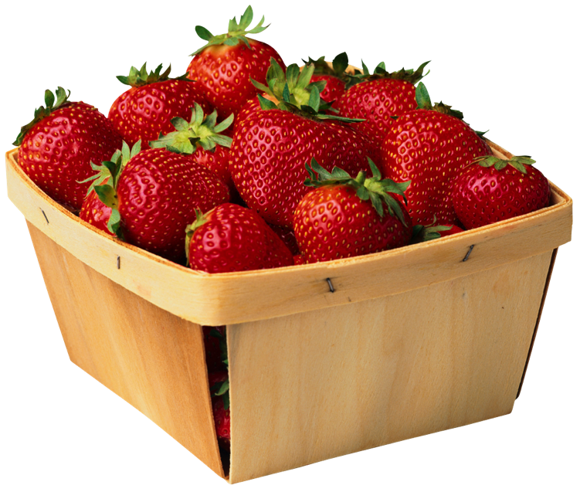

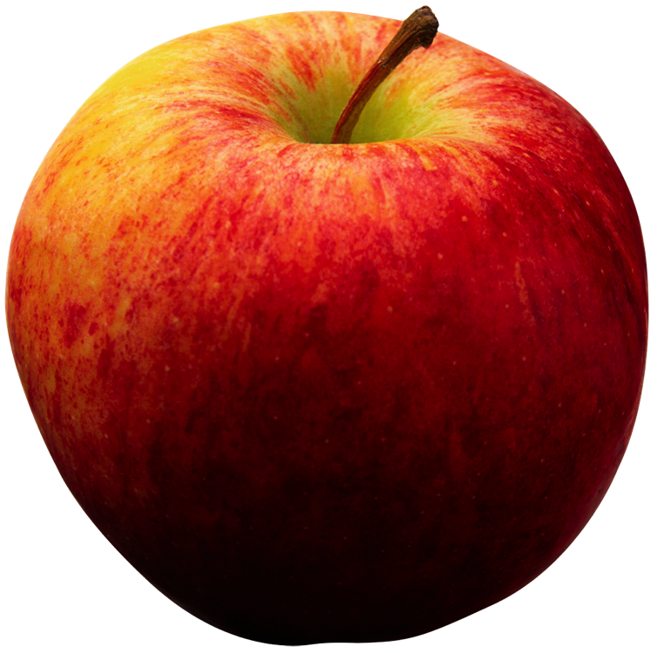
Standard model of rationality
Axioms/Assumptions (e.g., Wilkinson & Klaes 2012):
Completeness: Individuals entertain a preference ordering across all alternative courses of action

Slide 7
Standard model of rationality
Axioms/Assumptions
Transitivity: Individuals make consistent choices. If A is preferred to B, and B is preferred to C, then a rational individual will prefer A to C.

Slide 8
Rational choice
These assumptions ensure that individuals are able to pick at least one preferred option
Simple model is good for decisions under certainty
Rational decision-making model in neoclassical economics aims to be descriptive (how people behave) and normative (how they should behave to achieve a certain objective)
But: people often deviate from rational behaviour (thus not descriptively adequate) -> systematic errors and biases

Slide 9
People misbehave
We don’t keep New Year’s resolutions
We pay to not go to the gym
We procrastinate
We experience preference reversal
We are influenced by ‘SIFs’ (supposedly irrelevant factors, Thaler)
  E.g. drive across town to save £10 on a cheap radio but not to save £10 on an expensive TV set
We fall prey to many biases (a long list!)
We often use mental shortcuts (heuristics)

Slide 10
NYC taxi drivers
Heuristic:
set daily income target and stop working when the target is reached
Consequence:
drivers work less on busy days, when marginal salaries are highest
Would earn more if they worked the same hours every day
Camerer, C., Babcock, L., Loewenstein, G., & Thaler, R. (1997).
Labor supply of New York City cabdrivers: One day at a time. The Quarterly Journal of Economics, 112(2), 407–441.

Slide 11
Homo psychologicus (human)
Uses mental shortcuts to make decisions
Heuristics (rules of thumb) and cognitive biases
Behaviour is affected by constraints (e.g., time and knowledge)
Bounded rationality (cognitive limitations in terms of acquiring and processing information)
Can be altruistic

Slide 12
Homo economicus vs homo psychologicus
A bat and a ball cost £1.10 in total. The bat costs £1 more than the ball. How much does the ball cost?
Answer: 5p
However, many people (even economists) say 10p
Example of how we typically replace a difficult problem with a simpler one.
One explanation: we seem to non-consciously substitute the ‘more than’ statement in the problem (i.e., the bat costs £1.00 more than the ball) with an absolute statement (the bat costs £1.00).

Slide 13
Choice under uncertainty: Lose money
Would you choose to lose £500 for sure or to lose £1000 with probability 0.5?
Please choose one:
Lose £500 for sure
Lose £1000 with probability 0.5
Most people choose to lose £1000 with probability 0.5
Suggests “risk-loving” behavior with respect to losses
People like to avoid losses

Slide 14
Choice under uncertainty: Receive money
Would you choose to receive £500 for sure or to receive £1000 with probability 0.5?
Please choose one:
Receive £500 for sure
Receive £1000 with probability 0.5
Most people choose to receive £500 for sure
Suggests “risk-averse” behavior with respect to gains

Slide 15
What would standard economic theory predict?
Choices should be qualitatively the same in both situations
People prefer to avoid losses (loss aversion)
Behavioural economics: “reference-dependent” preferences
  Evaluation of outcomes not based on absolute amounts
  But relative to some reference point
  Reference point differs depending on gains or losses scenario

Slide 16
Loss aversion
“Pain [. . .] is, in almost all cases, a more pungent sensation than the opposite and corresponding pleasure. The one almost always depresses us much more below the ordinary, or what may be called the natural state of our happiness, than the other ever raises us above it.”
(Adam Smith, 1759)
-> losses tend to loom larger than equivalent gains (Tversky & Kahneman, 1984)
-> the pleasure of gaining £10 is less than the displeasure of losing £10

Slide 17
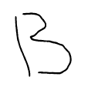
What is this?

Slide 18
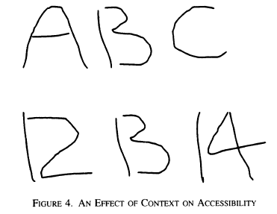
Context matters
Kahneman 2003, Figure 4 (AER, December)

Slide 19

Reference dependence
Kahneman 2003, Figure 5 (AER, December)

Slide 20
Reference dependence
Perceived brightness (temperature) depends on reference value
Current and prior context matters

Slide 21
Framing effects
Imagine that the United States is pre-paring for the outbreak of an unusual Asian disease, which is expected to kill 600 people. Two alternative programs to combat the disease have been proposed.
If Program A is adopted, 200 people will be saved.
If Program B is adopted, there is a one-third probability that 600 people will be saved and a two-thirds probability that no people will be saved.
If Program A is adopted, 400 people will die
If Program B is adopted, there is a one-third probability that nobody will die and a two-thirds probability that 600 people will die

Slide 22
What would standard economic theory predict?
Assumption that preferences are not affected by inconsequential variations in the description of outcomes (invariance – Tversky and Kahneman, 1986)
However, framing matters!
Save scenario – most people prefer Program A (risk aversion)
Die scenario – most people prefer Program B (risk seeking)
Certainty of saving people is good, certainty of death is not (Program A)
Value is always defined with respect to a reference point which can shift by framing the outcome as losses versus gains

Slide 23
Prospect theory
Formal descriptive theory of choices that people make (Kahneman and Tversky, 1979)
Not a normative model (how people should behave)
Loss aversion can explain “endowment effect” (Thaler, 1980)
  Observation that people want to sell consumption goods at higher prices than they would be willing to pay for them
  Experiment with mugs (Kahneman et al, 1990)

Slide 24
Prospect theory
a one unit gain (e.g., moving from A to B in Figure 4.1)
leads to a smaller change in value (utility) than a one unit loss

Slide 25
Why do we behave like this?
Cognitive psychology: dual processing theory
Two major systems of cognitive and affective processing
System 1 | System 2
fast | slow
superficial | effortful
nonconscious | controlled
emotional | systematic reasoning
automatic | reflective
biased
(e.g., Kahneman, 2003, 2011)

Slide 26
Any practical applications?
A growing body of evidence demonstrates that behavioral science insights – research findings from fields such as behavioral economics and psychology about how people make decisions and act on them – can be used to design government policies to better serve the American people . . . .
(Obama, 2015)

Slide 27
Applications of behavioural economics
Commercial applications in marketing, web design, etc. when businesses want to influence behaviour
Frequent use of framing, use of anchors (e.g., prices)
Policies can be used to “nudge” people
use of default options
  e.g. organ donors

Slide 28
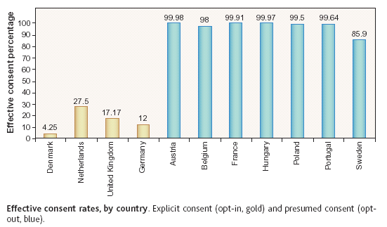
Defaults: organ donations
Johnson & Goldstein, Science, 2003

Slide 29
MINDSPACE
Messenger
Incentives
Norms
Defaults
Salience
Priming
Affect
Commitments
Ego
A summary of non-coercive principles of behaviour change
A framework to aid the application of behavioural science to the policymaking process -> Behavioural Insights Team (link)
(Dolan et al., 2010)

Slide 30
Nudges
A very gentle nudge: Odenplan metro station (link)
But how do we decide which outcomes are desirable?

Slide 31
Standard economic model:
Rational choice
(homo economicus)
Behavioural economics:
Insights from psychology
Bounded rationality
(homo psychologicus)
Welfare implications:
Subjective
well-being

Slide 32
Welfare implications
Central topic of economics is how economic behaviour and institutions affect well-being
Do people make the economic choices that give them the greatest utility?
Economists often derive well-being from “unquestioned-rationality revealed preference” (Kőszegi and Rabin 2008)
Fully rational individuals choose best options to maximise their utility
However, choices are often dependent on the choice set (available options) and subject to biases

Slide 33
Anticipating future well-being
Affective forecasting/hedonic forecasting
-> the prediction of one’s emotional reaction (affect) to future events (Wilson and Gilbert, 2003, 2005)
Example: people overestimate the effects of a lottery win
People don’t consider:
  Hedonic adaptation (habituation)
  Social comparison
  Changes in aspirations
-> again idea of reference dependence (happiness is relative)

Slide 34
Public policy
People are bad at predicting the outcome of their choices
Shall we nudge people to make choices that will be good for their well-being?
Best candidates for nudging?
  Maybe policies that target life domains in which long-term improvements in well-being can be achieved and sustained
We need to decide how to measure that policies are welfare-enhancing
  Measure SWB before and after intervention?
Many policy prescriptions are presented as libertarian paternalism or light/soft paternalism

Slide 35
Libertarian paternalism
Thaler & Sunstein advocate paternalism which does not involve any coercion -> libertarian paternalism
Aims to steer people’s choices in the direction that promotes their welfare without limiting their choices (does not impose costs)

Slide 36
Examples
Present food choices in a cafeteria in a way, so that people are more likely to choose healthy options
E.g., put fruit in front of candy
-> choice architecture
Choice architect/planner decides which choice is best for people
Automatic enrolment in retirement plans with opt-out option
Save more tomorrow plans

Slide 37
Why do framing, default options and anchoring have such large effects on people’s choices?
People who are uncertain about choices often follow one of two heuristics:
  Do what most people do
  Do what informed people do
Why do people stick to default options?
  Belief that default option is best for most people
  Status quo bias
  Procrastination, inertia (even when costs of switching options are trivial)
  Endowment effect -> default rule allocates initial endowment to people; they value it more
  Ill-formed preferences: no strict preference for an option

Slide 38
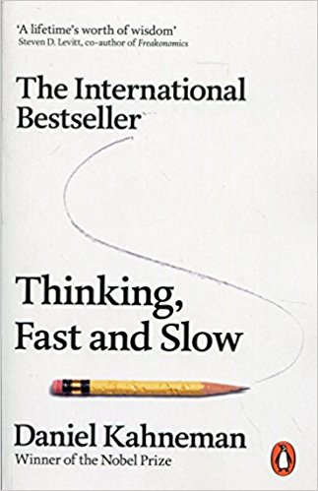
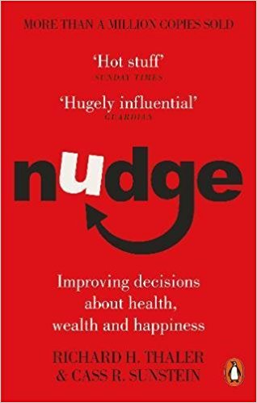
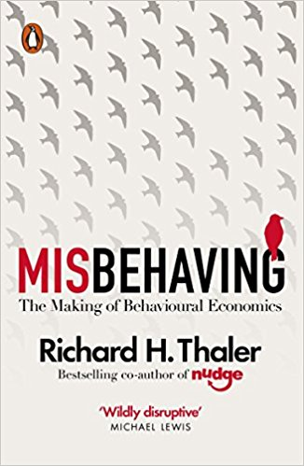
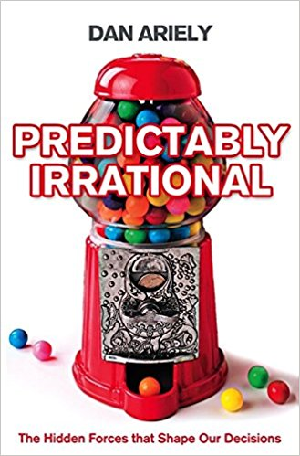
Suggestions for summer reading
Check out our BE glossary: https://www.behavioraleconomicsbasics.net/be-glossary

Slide 39
Behavioural Economics:
The good, the bad and the ugly a panel discussion with:
Prof Wändi Bruine de Bruin, Leeds University Business School
Prof Colin F. Camerer, California Institute of Technology
Prof Eric J. Johnson, Columbia University
When: Wed 18 July 2018, 5-7pm
Where: A130, College Building, City, University of London
Email me if interested: anke.plagnol.1@city.ac.uk
(free event but sign up necessary, link)

Slide 40
City, University of London
Northampton Square
London
EC1V 0HB
United Kingdom

