Slide 1

Climate change risk perceptions and feelings: Results from a construal experiment
Ann Bostrom, Adam Hayes, and Kate Crosman
Evans School of Public Policy & Governance
and Susan Joslyn, School of Psychology
WBS Behavioural Science Group 7th Summer School
Climate Change and Behaviour 25 June – 28 June 2019

Slide 2
Many have argued that climate change is perceived as abstract and remote, i.e., as psychologically distant (e.g., Leiserowitz, 2005); because it affects remote places and future generations rather than oneself in the here and now, it lacks personal relevance.

Slide 3
Many have argued that climate change is perceived as abstract and remote, i.e., as psychologically distant (e.g., Leiserowitz, 2005); because it affects remote places and future generations rather than oneself in the here and now, it lacks personal relevance.
This lack of perceived relevance is regarded by some as one reason for public lack of engagement and inaction (Lorenzoni & Pidgeon, 2006; Moser, 2010; Weber, 2006).

Slide 4
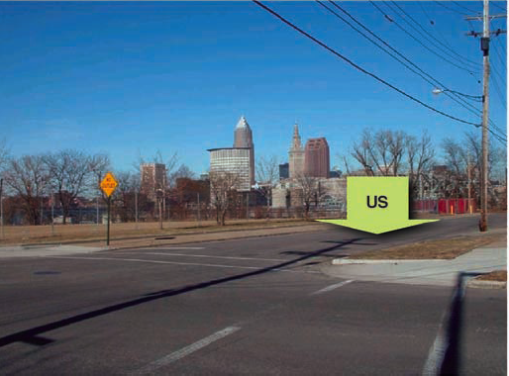
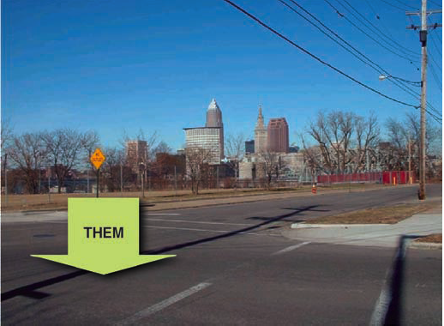
Mindset findings
(construal level theory)
Abstract thinking (high-level construal): focus on morals, values or desirability
Concrete thinking (low-level construal): focus on feasibility (Liberman et al 2002)
Mindsets highly correlated with perceived (psychological) distance on four dimensions: temporal, spatial, social, and uncertainty (hypotheticality).
Abstract thinking corresponds to perceptions of an event or object being uncertain, far away in time and space, and affecting others (not oneself).

Slide 5
Construal level theory
Abstract thinking correlates with increased psychological distance:
The more abstract [climate change] seems, the more distant [climate change] is on four dimensions: time, space, uncertainty, and social distance (Trope & Liberman 2010; White et al., 2017).
The abstraction hypothesis predicts:
Increased support for mitigation with concrete (HOW), as opposed to abstract (WHY) thinking,
through increased concern about outcomes, as opposed to assignment of responsibility to individuals.
However, distant climate change impacts are perceived as more severe than local impacts, while attitudes toward climate change mitigation are more positive when people consider social, rather than personal, aspects of climate change (e.g., Spence & Pidgeon, 2010).
Does thinking concretely increase psychological proximity? Increase policy support?

Slide 6
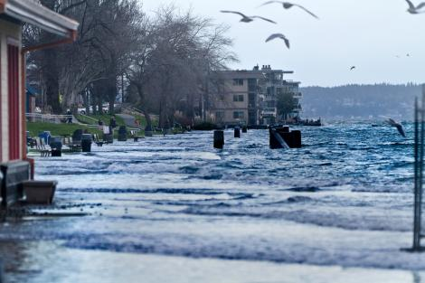
Research questions
New IPCC reports and US Climate Change assessments describe climate change as here and now. Who else does?
“How?” questions promote a concrete mindset.
“Why?” questions promote an abstract mindset.
Will pre-conditioning a concrete (or abstract) mindset change perceptions of the immediacy or uncertainty of climate change, or influence policy support?

Slide 7
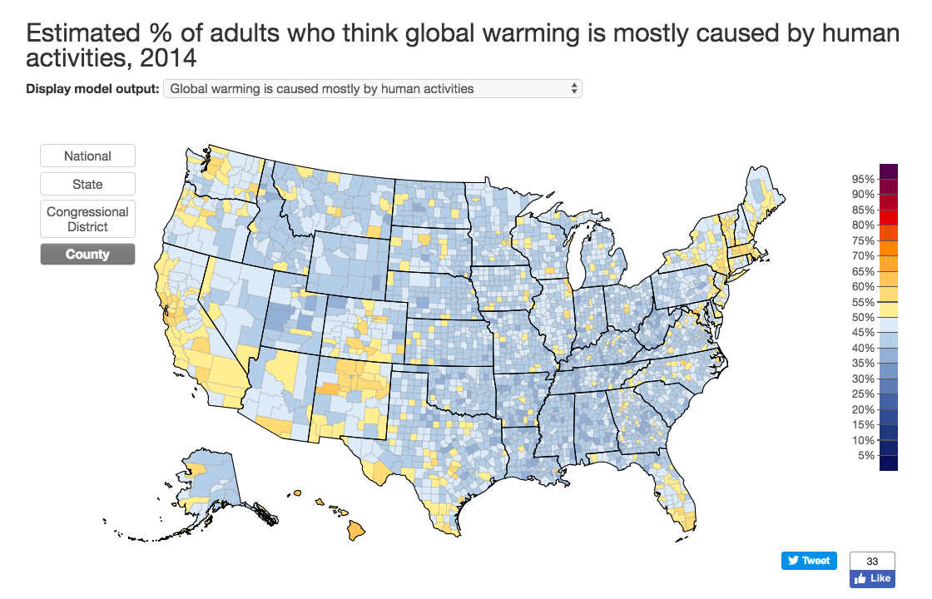
Notes:
48% of adults in the U.S. in 2014 thought global warming was mostly caused by human activities.

Slide 8
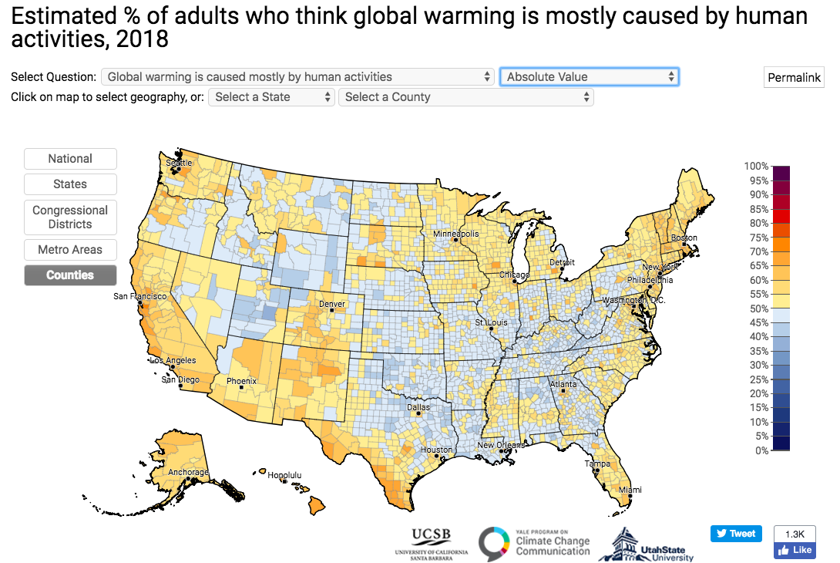
Notes:
57% thought this in 2018. 55% in April 2019.

Slide 9
Notes:
Bowman et al.’s 2016 summary of poll results on climate change/global warming.

Slide 10
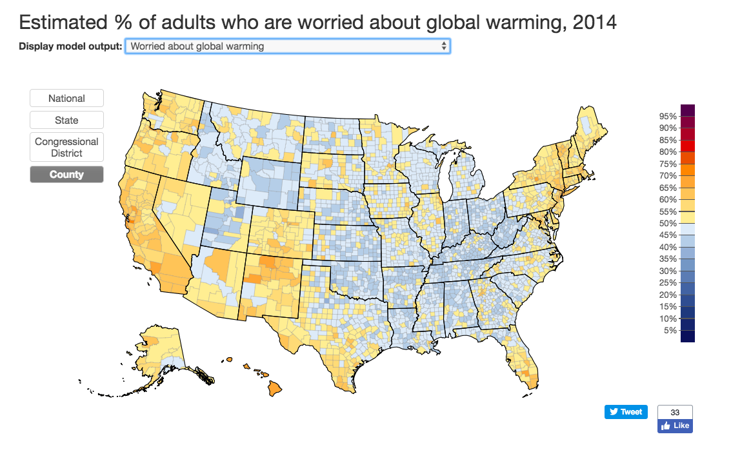
Notes:
52% of adults were worried about global warming in 2014

Slide 11
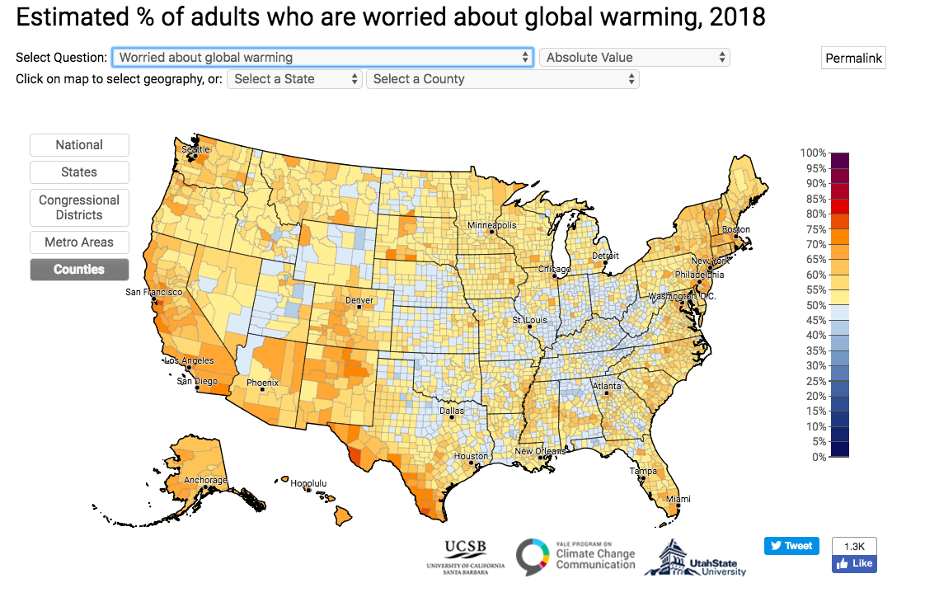
Notes:
61% were worried about global warming in 2018.
62% are worried about global warming as of April 2019.

Slide 12
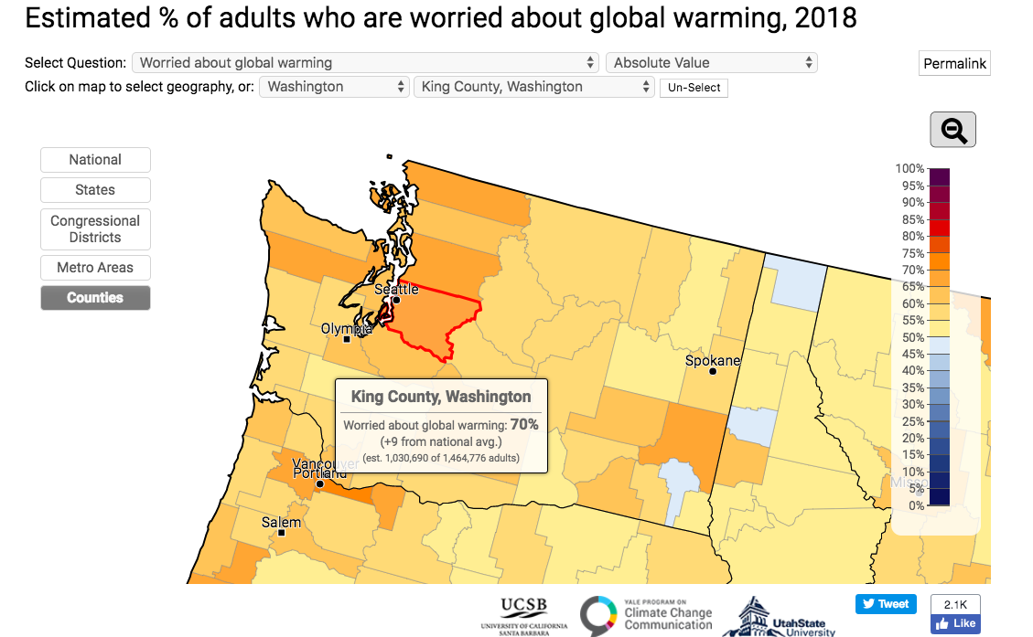
Notes:
70% of those of us who live in ecotopia were worried about global warming in 2018. But we still didn’t vote to pass 1631 last fall, which was for a tax on carbon.
While this could be because the Western States Petroleum Association poured more than $20M into the state by to defeat 1631, about 4 times as much as pro 1631 raised and spent, one still wonders when we’ll see action on climate change mitigation.

Slide 14
U.S. national survey experiment
GfK panel, representative of national adult population of the U.S.
Survey taken either on smart phone or computer (device provided if they don’t have one).
Target sample size N=1800 in the first wave, February-March 2017.
Second wave includes repeat questions for repeat respondents, plus a fresh sample of 500.
Randomly assigned to one of three conditions: How, Why, What (control) treatments.
Policy support question immediately follows treatment.

Slide 15
Outline of questions
Construal-level treatment
How much do you support or oppose reducing climate change by reducing carbon emissions?
Psychological distance measures:
How likely do you think it is that human actions have changed global climate?
When, if at all, do you think that the United States will start feeling the effects of climate change?
How much do you think climate change harms [you personally] / [others in the United States] / [people around the world]?
Emotions:
How concerned, if at all, are you about climate change?
When you think of climate change and everything that you associate with it, how strongly do you feel each of the following? [hope, fear, anger, responsibility, sadness, worry, interest]
Efficacy
How easy or hard would it be for the [United States government] to [take this action]
What effect would the [United States government] taking [this action] have on global warming?

Slide 16
Construal-level treatment (adapted from Freitas et al, 2006)
How → Concrete mindset Why → Abstract mindset
How do people try to slow or stop climate change?
Slow or stop
climate change
extinction
How?
Why?
Significantly increase temperature around the earth
Pollution from cars
Why?
To slow the rise of Co2 in our Atmosphere
Changing emissions
Why?
Change fuels double-up ride together
Slow or stop
climate change
Why do people try to slow or stop climate change?
Notes:
Freitas, A. L., Gollwitzer, P. M., & Trope, Y. (2004). The influence of abstract and concrete mindsets on anticipating and guiding others’ self-regulatory efforts. Journal of Experimental Social Psychology, 40, 739–752.
[superordinate rated +1, subordinate rated -1, neither rated 0; Why’s produced superordinate goals (M=3.19), How’s produced subordinate (M=-3.39) (concrete means)

Slide 17
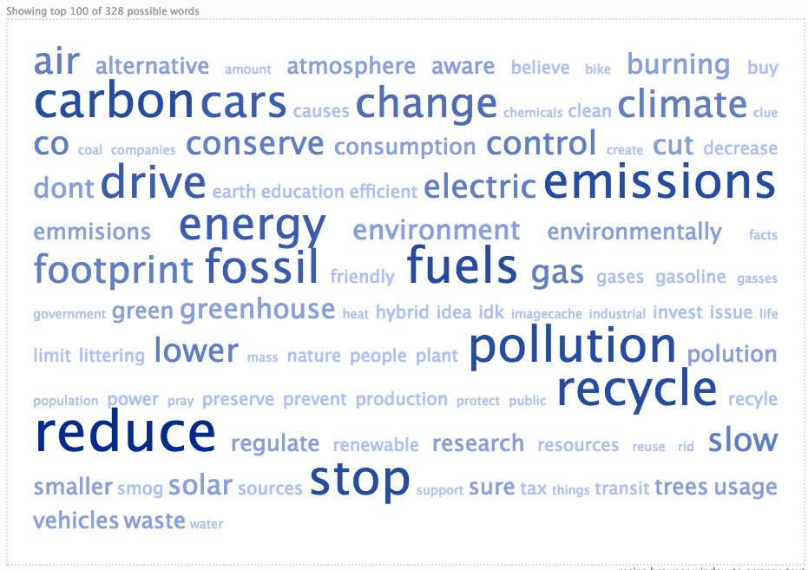
How do people try to slow or stop climate change?

Slide 18
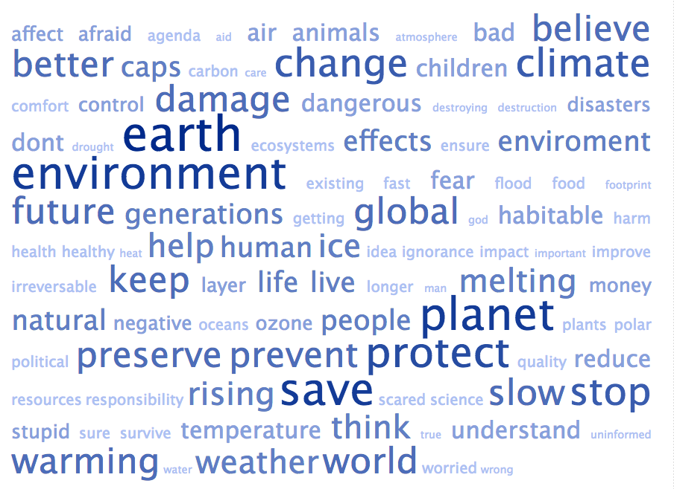
Why do people try to slow or stop climate change?

Slide 19
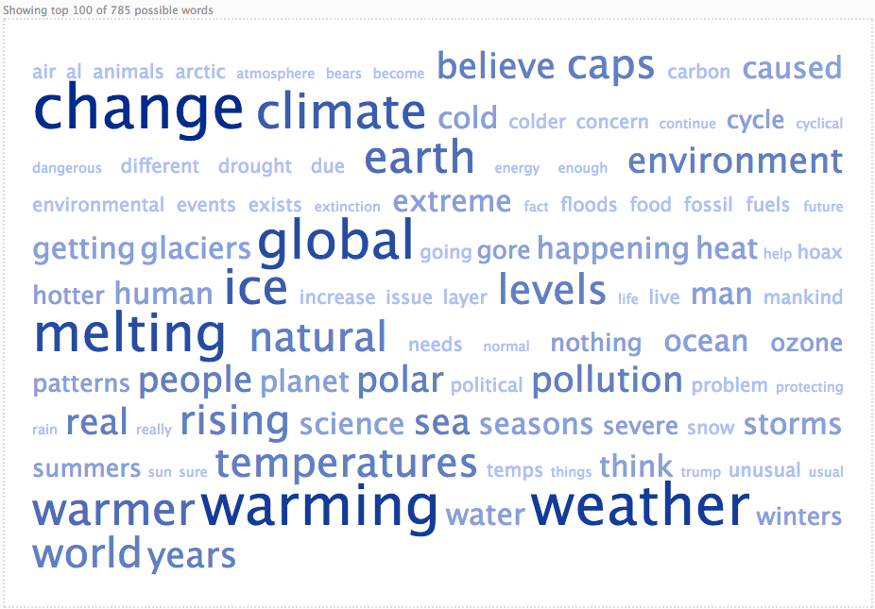
What comes to mind when you think of climate change?

Slide 20
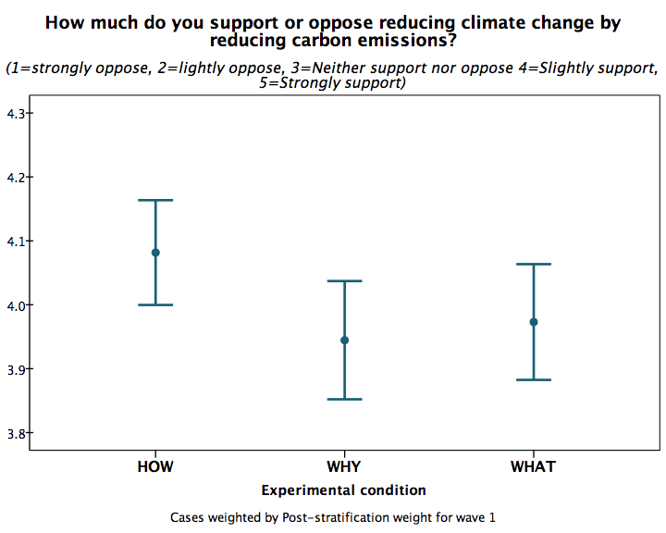
(Weak) support for policy, for construal level theory
⬆
More supportive
Slightly support
Less supportive
⬇
HOW respondents more supportive of policy (weakly) F_{(2, 1848)}=3.14, p=0.077
Notes:
Cases weighted by post-stratification weight for wave 1, Q2 Reversed (wave)

Slide 21
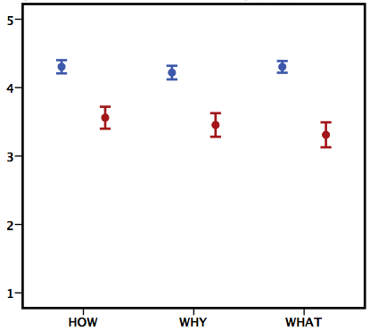
Almost all the action is among the conservatives.
Political ideology (conservatives, liberals/moderates) (p=0.01), and the interaction of treatment and ideology (p=0.04) are significant, but not the main treatment effect.
Strongly support
Slightly support
Neither support
nor oppose
Slightly oppose
Strongly oppose
Notes:
Cases weighted by post-stratification weight for wave 1: Q2 reverse coded.

Slide 22
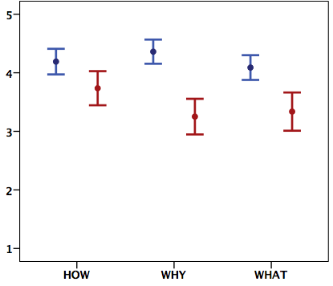
The second wave fresh sample (N=539) responds similarly. The HOW treatment boosts support (a little) for emissions reduction among conservatives.
Strongly support
Slightly support
Neither support
nor oppose
Slightly oppose
Strongly oppose
Notes:
For overall treatment effect (not controlling for pol ideology) F2,528=3.18, p=0.042,
When pol ideology is included, pol ideol F1,528=31.955, p=0.03, pol ideology X treatment F2,528=2.337, p=0.098, treatment main effect insignificant.

Slide 23
Does psychological distance change?
Liberals/Moderates Conservatives
Yes, treatment effect F_{(2,1567)}=3.227, p=0.04, on psychological distance index
Political ideology (conservatives vs others) F_{(1,1547)}, p<0.001
No significant interaction with political ideology.
← More distant Closer →

Slide 24
Does psychological distance change?
Liberals/Moderates Conservatives
Yes, treatment effect F_{(2,1567)}=3.227, p=0.04, on psychological distance index
Political ideology (conservatives vs others) F_{(1,1547)}, p<0.001
No significant interaction with political ideology.
← More distant Closer →

Slide 26
A majority of conservatives think it is equally likely and unlikely, or less.
No significant difference by construal treatment (p=0.499)
A majority of liberals and moderates think it is likely to extremely likely.

Slide 27
No significant difference by treatment, but WHY mean is consistently higher.

Slide 28
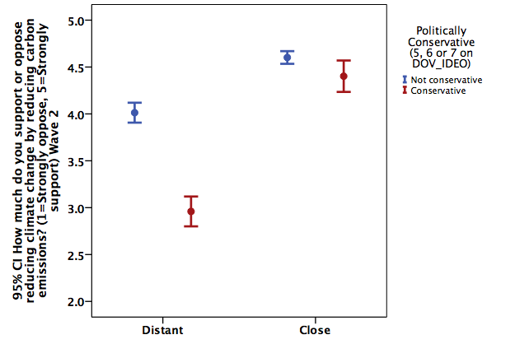
Policy support by perceived proximity of risk
Strongly support
Slightly support
Neither support nor oppose
Slightly oppose
I Moderates/Liberals
I Conservatives
How much do you support or oppose reducing climate change by reducing carbon emissions?
Perceived proximity of climate change risk
Notes:
In this graph policy support is plotted by political ideology and a median split on perceived proximity of risk. On the left are those who perceive climate change risk as more distant, Here’s the well-known ideological gap in policy support for those who see climate change risk as more distant on our index of the four dimensions. On the right I'll show those who see it as more proximate.

Slide 29
The closer climate change risk is perceived in wave 1, the more support for policy to reduce emissions in wave 2, and more so for conservatives (r=0.71, p<0.001) than liberals/moderates (r=.45, p<0.001).
Strongly support
Slightly support
Neither support nor oppose
Slightly oppose
I Moderates/Liberals
I Conservatives
How much do you support or oppose reducing climate change by reducing carbon emissions?
Perceived proximity of climate change risk
Notes:
Perceived proximity of risk is associated with stronger support of reducing climate change by reducing carbon emissions, AND it closes the ideological gap on policy support. A little less than a third of conservatives fall into this category, 10% of the entire sample.
Also, the closer climate change risk is perceived (wave 1), the more support for policy to reduce emissions (wave 2); more so for conservatives (r=0.71, p<0.001) than liberals/moderates (r=.45, p<0.001).

Slide 30
When you think of climate change and everything that you associate with it, how strongly do you feel each of the following?
5=Very strongly
4=Strongly
3=Moderately
2=A little
1=Not at all
Emotions
Worry
Fear
Hope
Hope
Worry
Fear

Slide 31
When you think of climate change and everything that you associate with it, how strongly do you feel each of the following?
5=Very strongly
4=Strongly
3=Moderately
2=A little
1=Not at all
Emotions
Worry
Fear
Hope
Hope
Worry
Fear

Slide 32
Mean strength of emotion
Notes:
We asked people how strongly they felt hope, anger, fear, sadness, responsibility, worry and interest. The order of presentation was randomized. People felt somewhere between a little and moderate hope, less anger and fear, and only interest approached even a moderate strength.

Slide 33
Very Strongly
Strongly
Moderately
A Little
Not at all
Mean strength of emotion
Notes:
And controlling for conservatism reveals that with the exception of hope, which is low regardless of political ideology, conservatives feel even weaker emotions about climate change than do liberals, and liberals barely cross the “moderate” bar.

Slide 34
Emotions by political ideology and knowledge (28-item scale)

Slide 35
How much do you support or oppose reducing climate change by reducing carbon emissions?
(95% confidence interval) by
Responsibility

Slide 36
What effect would the United States government taking this action […] have on global warming?
If everyone in the United States collectively took this action […], what effect would it have on global warming?
Little discrimination between potentially effective and ineffective.
Response Efficacy
CAA
TAX
AER
CAA
AER
TAX
GEO
GEO

Slide 37
What effect would the United States government taking this action […] have on global warming?
If everyone in the United States collectively took this action […], what effect would it have on global warming?
Little discrimination between potentially effective and ineffective.
Response Efficacy
CAA
TAX
AER
CAA
AER
TAX
GEO
GEO

Slide 38
Estimating perceived proximity of risk and response efficacy
Political ideology
Response Efficacy
Perceived proximity
Policy Support
Treatment
Emotion
Cost
Notes:
Finally the models. The first two models estimate the treatment effects on perceived proximity and response efficacy, respectively, taking into account perceived costs, political ideology, and other factors.

Slide 39
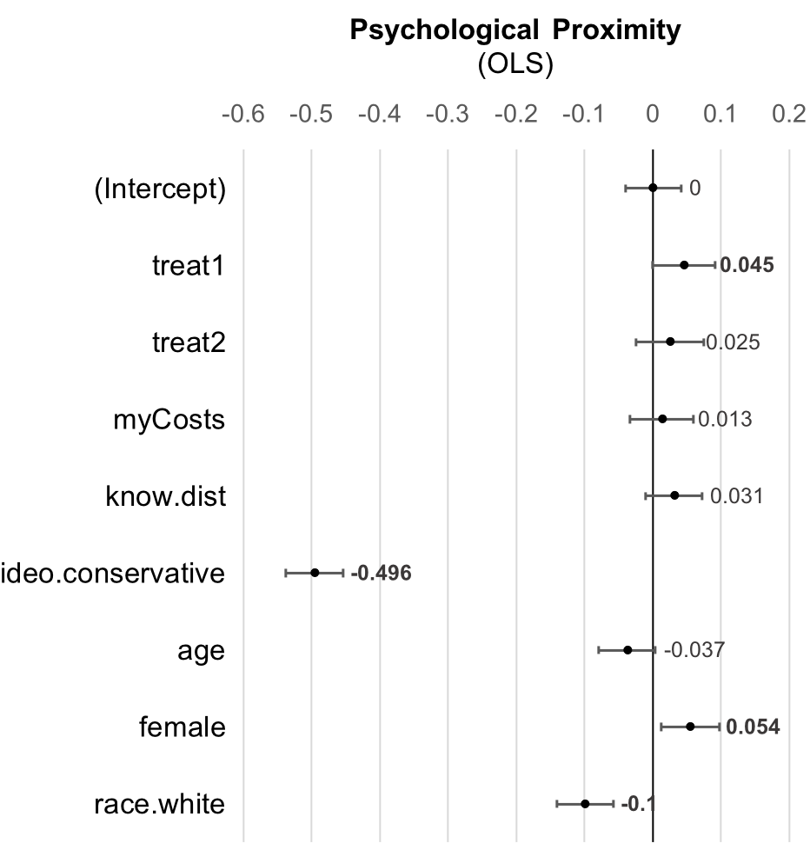
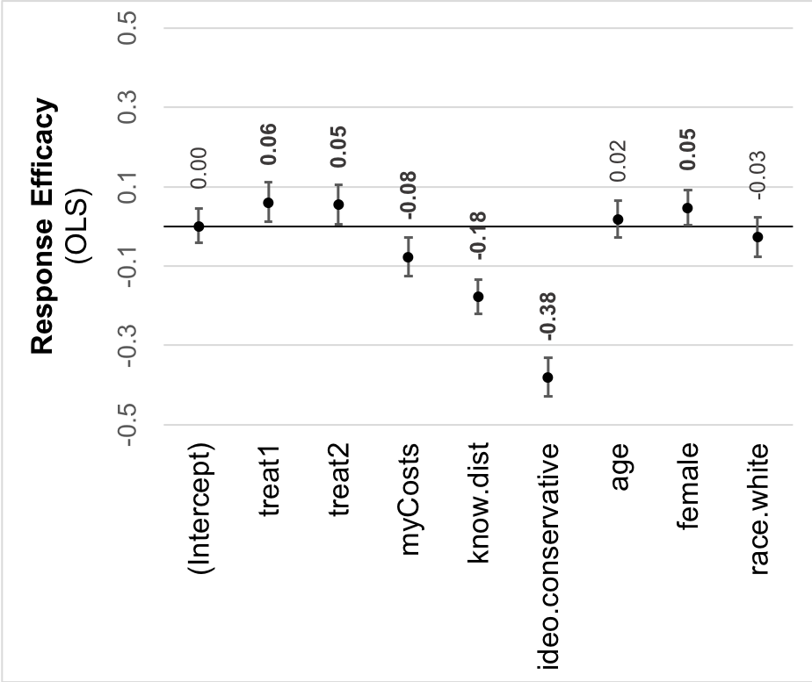






Stuff here
How
Why
How
Why
Notes:
Variables are standardized in these analyses, so focus on directionality – to the left of the zero line is a negative influence, to the right a positive influence – focus also on the relative sizes of the estimated coefficients, shown here with 95% confidence intervals. Predictors that achieve standard levels of statistical significance are bolded and highlighted.
As the earlier analyses showed, the (1) how treatment increases perceived proximity, but only by a hair. Much stronger – but also not news -- is (2) the negative correlation between conservatism and perceived proximity of risk. (3) Women tend to see the risk as more proximate, whites as less proximate than others.
(4) Somewhat surprisingly, (5) both How and why treatments have small positive effects on response efficacy. (6) Perceived costs have a small negative association with response efficacy, controlling for other variables. Knowledge distance is an index of how distant the respondents’ beliefs are from the scientifically correct responses to over two dozen true-false items, from prior mental models research. So the less one knows, the lower the assessment of government and collective response efficacy. Women's assessments of response efficacy are slightly higher than men's, controlling for everything else.

Slide 40
Do perceived proximity or response efficacy influence emotions like concern, or hope?
Political ideology
Efficacy
Perceived proximity
Policy Support
Treatment
Emotion
Cost
Notes:
We estimated pathway variables first – (resp eff, perc prox) – now we’ll estimate their associations with two emotions, first concern, then hope,

Slide 41
Do perceived proximity or response efficacy influence emotions, like concern, or hope?
And do any of these influence policy support?
Political ideology
Efficacy
Perceived proximity
Policy Support
Treatment
Emotion
Cost
Notes:
And then the effects of all of these on policy support, controlling for political ideology, costs and other factors.

Slide 42
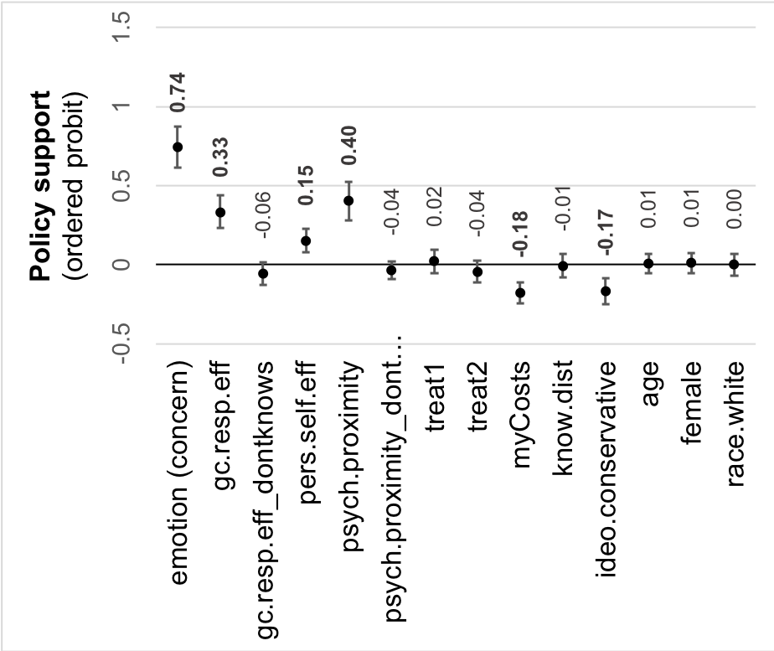
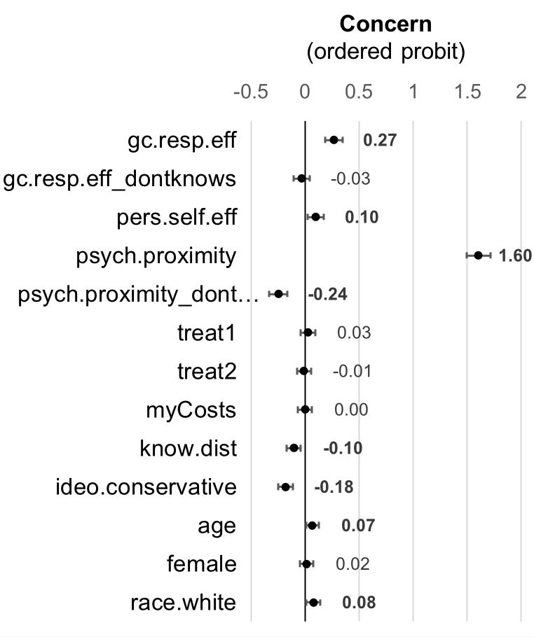













How
Why
How
Why
Notes:
First concern. Both (1) government response efficacy and personal self-efficacy are positively associated with concern in this ordered probit regression, as expected, but far more influential is (2) perceived proximity, and the (3) more uncertainty one reports on those dimensions, the less concerned one is, all else equal. (4) Knowing less is associated with being less concerned, as is self-reported conservatism. Controlling for these other variables, (5) older people and whites are slightly more concerned.
(6, 7) Concern is a strong predictor of policy support, and does not (8) mediate the effect of response or self-efficacy on policy support, but does partly mediate (9) the effect of perceived proximity. The greater the (10) perceived costs, the weaker the support for policy, though this is a relatively small effect after taking into account the other factors in the model. (11) Conservatism has a similar effect.

Slide 43
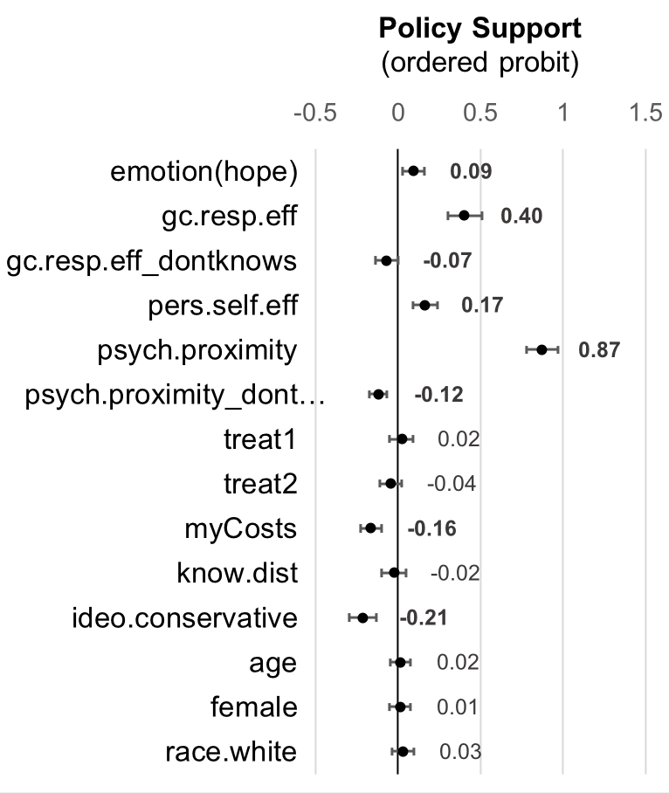
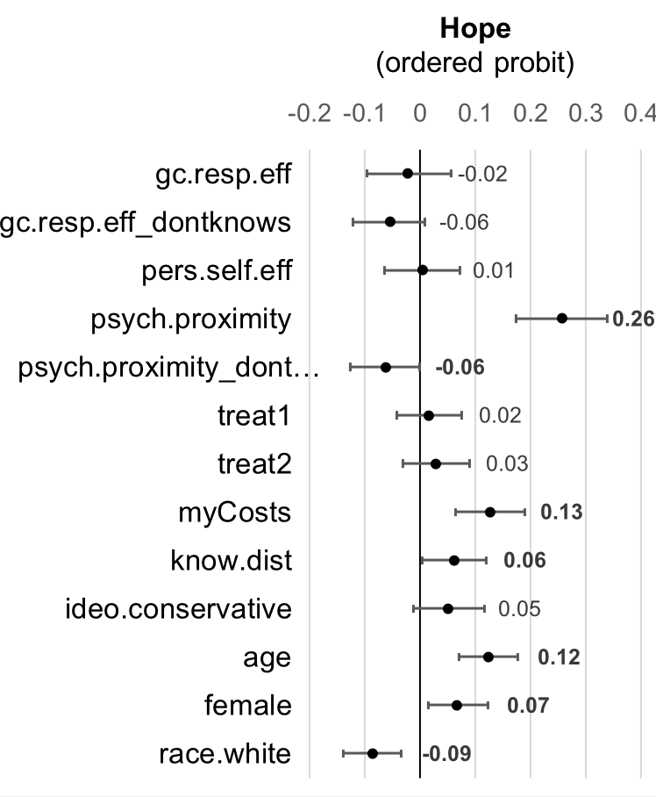















How
Why
How
Why
Notes:
Somewhat surprisingly, the estimates in the hope model contradict my colleague’s intuition that higher assessments of response efficacy should be associated with more hope.
(1) Perceived proximity of risk again matters, and has a positive association with hope. Uncertainty in the form of don’t knows , is again associated with decreased hope. And here also, the treatments are completely mediated by perceived proximity and efficacy.
And though it is a small effect, (2) the less one knows, the more one hopes
Demographics matter – (3) older, female, non-whites are slightly more hopeful. As shown earlier, political ideology does not predict hope.
However, (5,6) hope has only a small effect on policy support, much smaller (7) than response efficacy, or (8) perceived proximity, and does not mediate the effects of response efficacy or perceived proximity. Note again that perceived proximity of climate change risk is an important predictor of policy support. Higher perceived costs and conservatism are associated with less policy support, as also seen in the concern model.

Slide 44
Emotions and efficacy beliefs are associated with policy support
Political ideology
Efficacy
Perceived proximity
Policy Support
Treatment
Emotion
Cost
Notes:
In sum, the (1) How treatment (concrete) increases perceived proximity of risk a small amount, (2) perceived proximity of risk increases concern and hope, and (3) increases policy support, (4) both directly and indirectly.
Both How and Why treatments increase (5) response efficacy a bit; higher (6) response efficacy is associated with more concern, and stronger policy support, but not with more hope.
Perceived proximity of climate change risk is more strongly associated with policy support than is response efficacy, both directly and indirectly.
(7) The higher the perceived costs, the lower the support for policy, but the effects are smaller than those of response efficacy and perceived proximity of climate risk, and of concern. Conservatism is also similarly associated with lower policy support.
In a mediation analysis incorporating the pathway variables, concern mediates the effect of the how treatment via proximity of risk on policy support, but hope doesn’t.

Slide 45
Conclusions: Weak emotions, uncertainty about response efficacy
Although people perceive climate change as happening now,
Emotions are tepid, and with the exception of hope (which is low), they vary by political ideology and by level of knowledge.
Climate change risks have yet to capture public attention and imagination in the U.S.
There is considerable uncertainty about and lack of discrimination between the effectiveness of possible actions to mitigate climate change. And those beliefs influence policy support.

Slide 46
Perceived proximity of risk, response and self-efficacy, and emotions appear to drive policy support
Our results support the abstraction hypothesis: the less abstract climate change is perceived to be, the stronger the support for policy (a little), via concern.
  The closer the perceived proximity of climate change risk, the stronger the concern, and both lead to stronger support for policy.
  The closer the perceived proximity of climate change risk, the stronger the hope, as well, but hope is associated with only a weak increase in policy support,
The influence of perceived costs of climate change mitigation on policy support is dwarfed by perceived proximity of risk, perceived response efficacy, and emotions (concern, not hope).
Notes:
Rearrange to follow slide order and order of model…

Slide 47

Implications for risk communication:
Focus on efficacy and proximate risk
Getting people to think about how to slow or stop climate change appears likely to increase support for policies to do so, and may shrink polarization.
Designing contexts and strategies that make personal actions easier could increase perceived ease of action, and strengthen support for public policies.
Spurring engagement and debate about the effectiveness of strategies to mitigate climate change and the risks it poses remains a critical challenge for risk communicators.
Notes:
In addition to the obvious – that people could use more help sorting out the effects of policies and practices on greenhouse gas emissions – two implications for risk communication emerge.

Slide 48
Thank you!
With thanks to NSF (Award 1430781) the C3 team
especially Whitney Fleming, Max Mossler, and Patricia Moy, and to my Bergen Research Group colleagues.
Background data:
Bowman, K. E. O’Neill and H. Sims (May, 2016). Polls on the Environment, Energy, Global Warming, and Nuclear Power. Public Opinion. American Enterprise Institute. The data in this report come from the archive of public opinion polls at AEI and from the Roper Center for Public Opinion Research’s iPOLL Databank
Yale climate opinion maps by Marlon et al, see Howe, P., Mildenberger, M., Marlon, J.R., and Leiserowitz, A., “Geographic variation in opinions on climate change at state and local scales in the USA,” Nature Climate Change. DOI: 10.1038/nclimate2583
Notes:
King tide, Alki point.
Slides put together by A. Bostrom December 2018

Slide 49
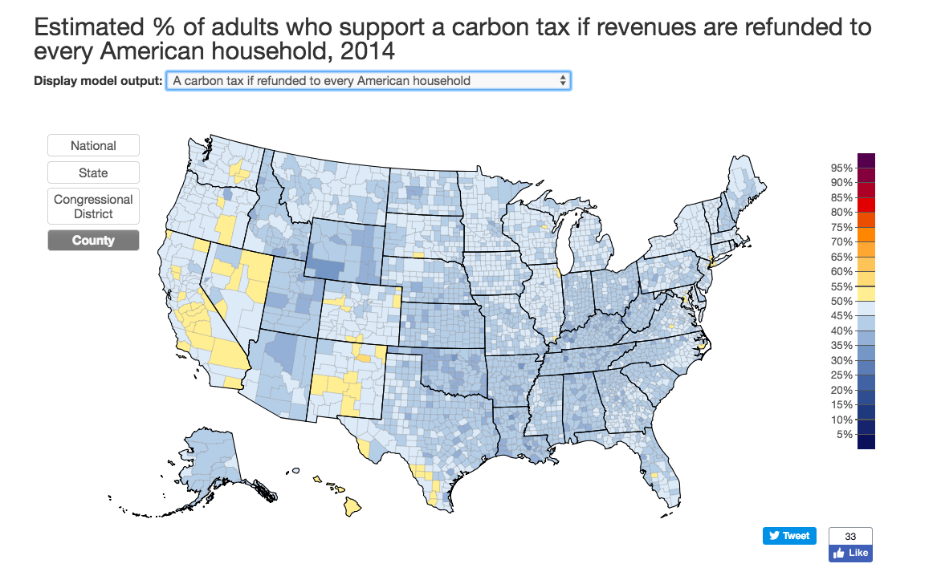

Slide 50
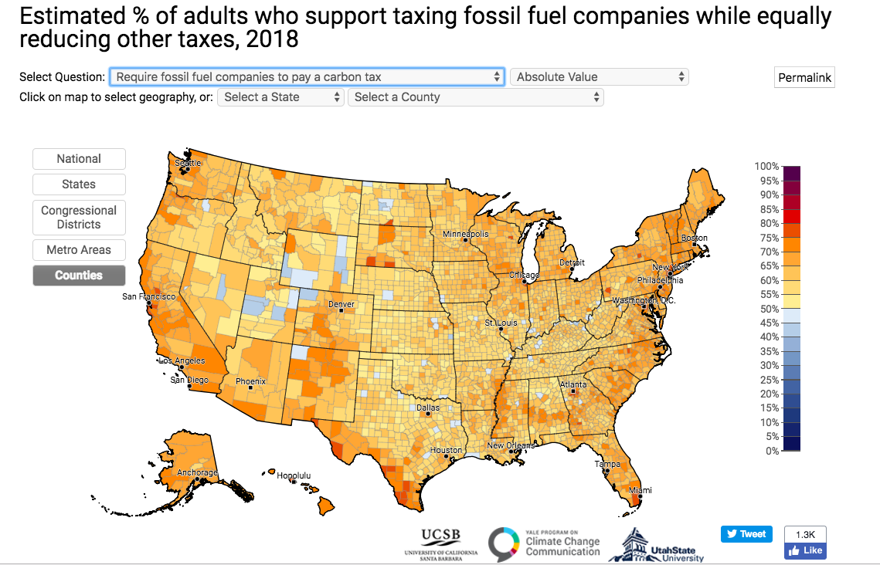

Slide 51
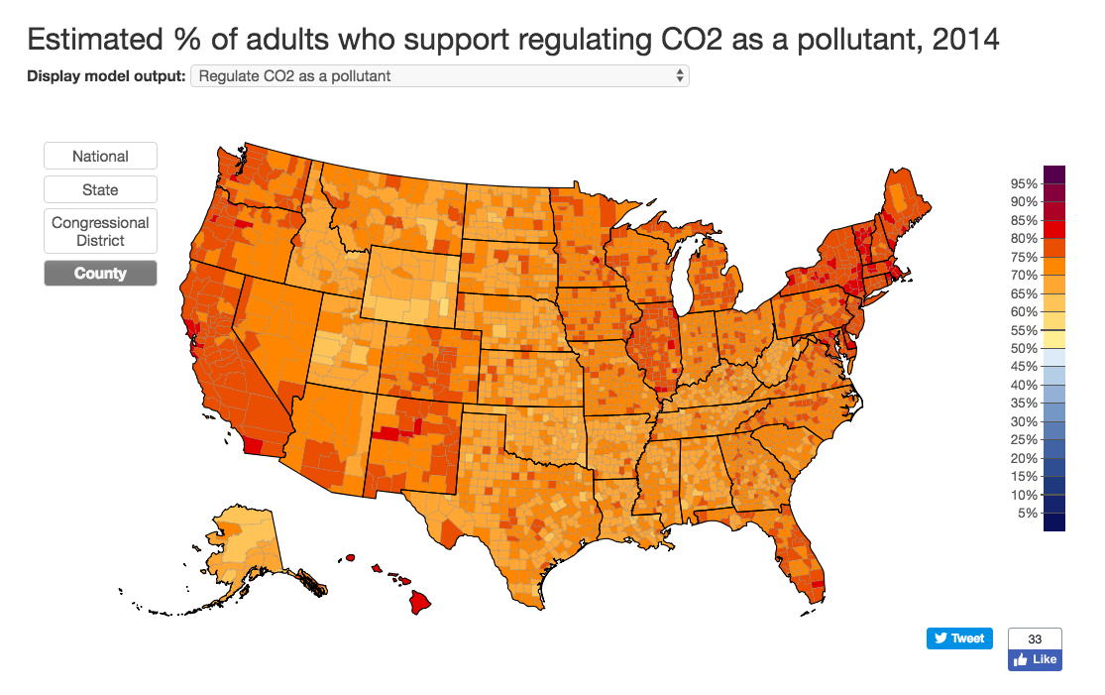

Slide 52
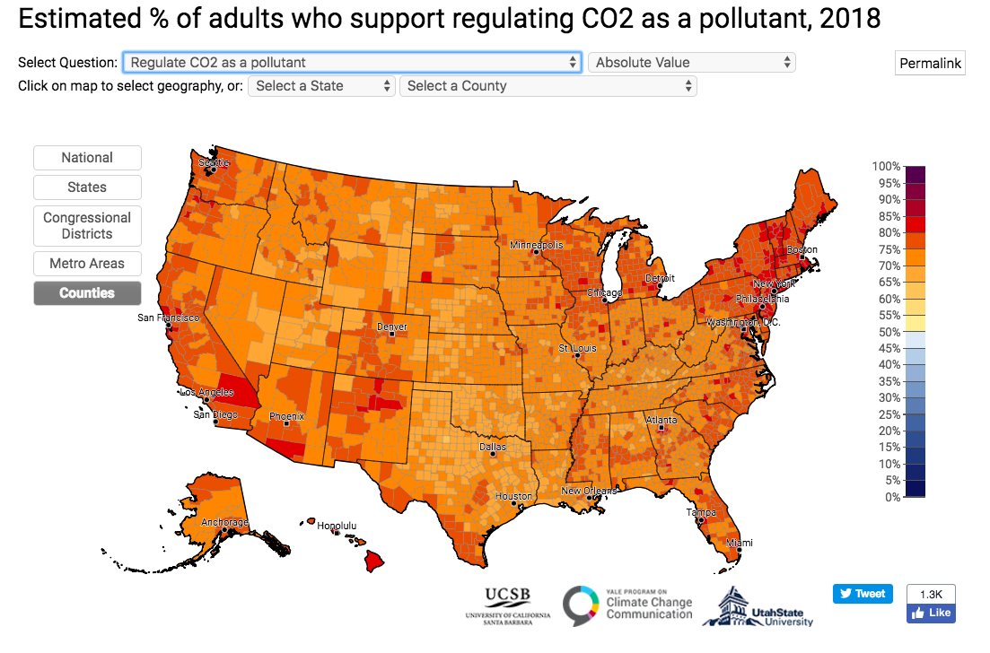

Slide 53
Additional hypotheses (from proposal)
People do not believe that climate change is occurring, i.e. they distrust climate change projections. As a result, they do not believe that mitigative action is necessary.
People believe that climate change is occurring, but they are not sufficiently concerned about it to take mitigative action.
People believe that climate change is occurring, but they do not believe that their actions will make a difference, either because they believe that they are not able to take actions that would make a significant difference or they believe that climate change is not anthropogenic.
People believe that climate change is occurring, but they inadvertently support and/or engage in mitigative strategies that are ineffective.

Slide 54
FEAR
Liberals and moderates: W1 mean=2.8, W2 mean=2.6 (p<0.001, paired t-test)
Conservatives: W1 mean=1.9, W2 mean=1.9 (p=0.906, paired t-test)

Slide 55
And 18% report that they don’t know what effect enforcing air pollution control standards in CAA would have on global warming.
(regardless of political ideology)
20% don’t know effect of taxing fossil fuels more.
41% don’t know effect of geoengineering (SRM).
21% don’t know effect of stopping aerosol spray can use.

Slide 56
Ordered probit mediation model:
Does worry mediate effects of construal on policy support?
No effect of construal treatment after controlling for psychological distance.
Worry partially mediates psychological distance (see personal harms).
The closer climate change is psychologically, the more worry, the more support for policy.
Government response efficacy and personal self-efficacy associated with both worry and policy support (stronger direct effect on policy support).

Slide 57
Ordered probit mediation model:
Does hope mediate effects of construal on policy support?
No effect of construal treatment after controlling for psychological distance.
Hope does not mediate effects of psychological distance (much). Policy support increases with hope, a little.
The closer climate change is psychologically, the more support for policy.
Policy support increases directly with government response efficacy and personal self-efficacy. Hope does not mediate efficacy.
The less one knows, the more one hopes.

Slide 58
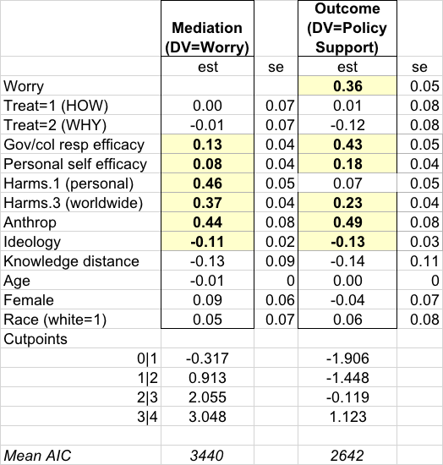
Ordered probit mediation model:
Does worry mediate effects of construal on policy support?
Psychological distance as measured here is associated with policy support: the closer, the more supportive
Worry partially mediates psychological distance (personal harms)
No effect of construal treatment after controlling for psychological distance
Government response efficacy and personal self-efficacy associated with both worry and policy support (stronger direct effect on policy support)

Slide 59
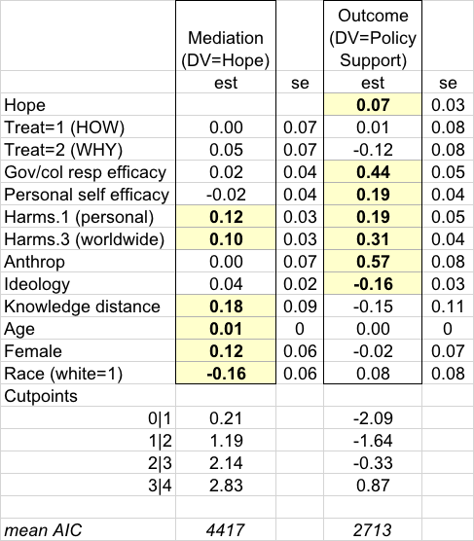
Ordered probit mediation model:
Does hope mediate effects of construal on policy support?
The more hope, the more policy support; but hope does not mediate effects of psychological distance, nor of efficacy, as measured here.
Psychological distance: the closer, the more supportive of policy
No effect of construal treatment after controlling for psychological distance.
Government response efficacy and personal self-efficacy associated with policy support (not with hope).
The less one knows, the more one hopes.

