Slide 1


Constraints on the Social Discount Rate Derived from Ethical Ambiguities and Uncertainty about Future Climate Change
Stephan Lewandowsky
University of Bristol, UK CSIRO Oceans and Atmosphere, Hobart University of Western Australia @STWorg
Mark C. Freeman
University of York, UK
Michael E. Mann
Penn State University
stephan.lewandowsky@bristol.ac.uk

Slide 2
Uncertainty as Knowledge
Stephan Lewandowsky
University of Bristol, UK CSIRO Oceans and Atmosphere, Hobart University of Western Australia @STWorg
Mark C. Freeman
University of York, UK
Michael E. Mann
Penn State University
stephan.lewandowsky@bristol.ac.uk

Slide 3
Today: Competing Construals of Uncertainty
Public misconstrual
wishful thinking
persuasive use
Normative construal
uncertainty as source of knowledge
impetus for mitigation
Using uncertainty to obtain social discount rate

Slide 4
Today: Competing Construals of Uncertainty
Public misconstrual
wishful thinking
persuasive use
Normative construal
uncertainty as source of knowledge
impetus for mitigation
Using uncertainty to obtain social discount rate

Slide 5
Public Misconstruals of Uncertainty: Wishful Thinking and Optimism
Uncertainty often invites wishful thinking (Markowitz & Sharif, 2012)
Majority of people think they are above average …
drivers (Svenson, 1981)
managers (Camerer & Lovallo, 1999)
Notes:
said to have been the boyhood home of Garrison Keillor, who reports the News from Lake Wobegon on the radio show A Prairie Home Companion.
Majority of people think their risk exposure is lower than that of others
health risks (Weinstein, 1982)
environmental risks (Pahl et al., 2005)

Slide 6
Public Misconstruals of Uncertainty: Wishful Thinking and Optimism
Majority of people think their risk exposure is lower than that of others
health risks (Weinstein, 1982)
environmental risks (Pahl et al., 2005)
Greater optimism about the world associated with lower pro-environmental attitudes (McElwee & Brittain, 2009)
Notes:
Australian Environment Foundation's exec director Max Rheese, who is also exec director of the Australian Climate Science Coalition, http://www.independentaustralia.net/2011/environment/the-ugly-landscape-of-the-guardians/

Slide 7
Public Misconstruals of Uncertainty: Wishful Thinking and Optimism
“Positive” events are judged more likely to occur than “negative” events (Lench, 2009)
Greater variance and greater uncertainty lead to more wishful thinking (Lench et al., 2014)
People’s response to uncertainty and their inherent optimism provides a fertile staging ground for persuasive use of uncertainty.
Notes:
Australian Environment Foundation's exec director Max Rheese, who is also exec director of the Australian Climate Science Coalition, http://www.independentaustralia.net/2011/environment/the-ugly-landscape-of-the-guardians/

Slide 8
Public Misconstruals of Uncertainty: Persuasive Use
“There is so much we don’t know about the climate, we cannot possibly know enough to act”
Countless media commentators and politicians, ca. 2000-2035, paraphrased
“… if we're not certain that the problem's there, then we … shouldn’t take actions…”
Chairman of Australia’s Future Fund, David Murray

Slide 9
Public Misconstruals of Uncertainty: Persuasive Use
Scientific Certainty Argumentation Methods (SCAMs), Freudenburg et al. (2008)
lead in gasoline
tobacco
asbestos
Postulate a criterion of certainty (“proof”) that can never be met
3.5 times as many lobbyists needed to make “something happen” in U. S. Congress than to prevent action (McKay, 2012)

Slide 10
Today: Competing Construals of Uncertainty
Public misconstrual
wishful thinking
persuasive use
Normative construal
uncertainty as source of knowledge
impetus for mitigation
Using uncertainty to obtain social discount rate

Slide 11
Normative Role of Scientific Uncertainty in Climate Change (e.g., Lewandowsky, Risbey, Smithson, Newell, & Hunter, 2014)
Are there “hard” (or at least harder) constraints arising from scientific uncertainty that can help decision makers and the public?
Damage cost and scientific uncertainty
Using uncertainty to deliver exact policy parameters

Slide 12
(Equilibrium) Climate Sensitivity
Ultimate global surface temperature increase in response to doubling of CO₂
Notes:
It is usually given as a °C change per W/m² forcing. A standard experiment to determine this value in a climate model is to look at the doubled CO₂ climate, and so equivalently, the climate sensitivity is sometimes given as the warming for doubled CO₂ (i.e. from 280 ppm to 560 ppm). The forcing from doubled CO₂ is around 4 W/m² and so a sensitivity of 3°C for a doubling, is equivalent to a sensitivity of 0.75 °C/W/m².
Knutti15 on commitment and reversability. Mathews13.

Slide 13
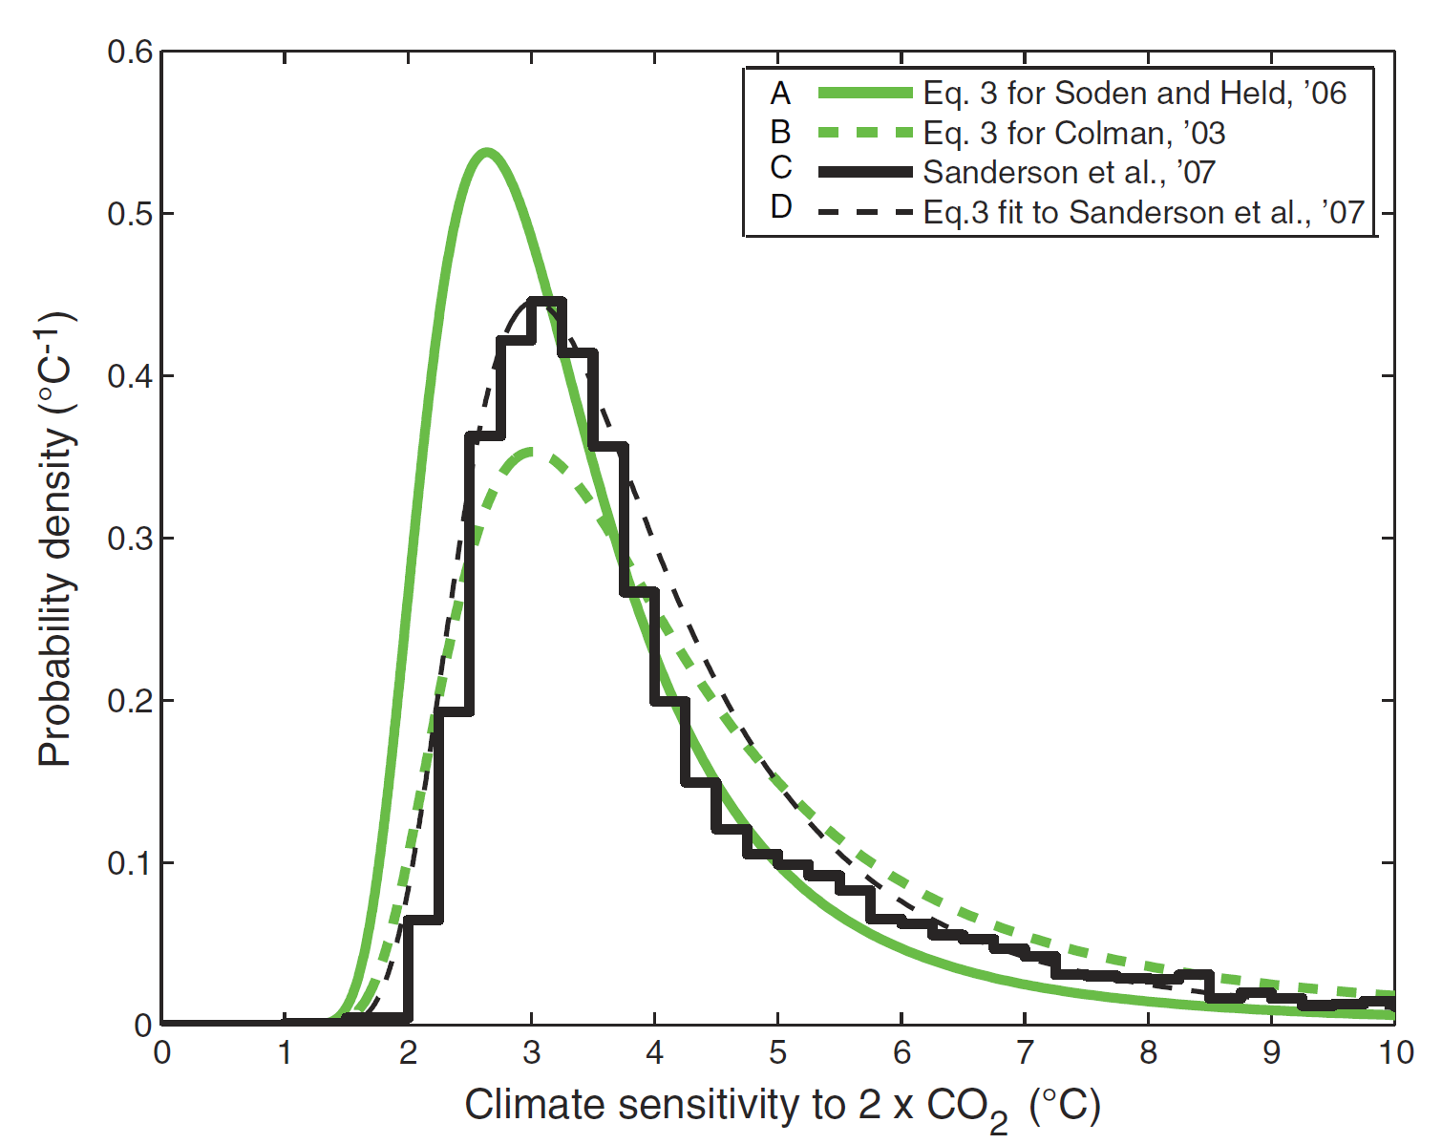
(Equilibrium) Climate Sensitivity
(Roe & Baker, 2007)
Uncertainty = σ (climate sensitivity)
Notes:
“First-order" uncertainty (cf. Walley, 1991)
Unavoidable error surrounding the (single) estimate of a parameter

Slide 14
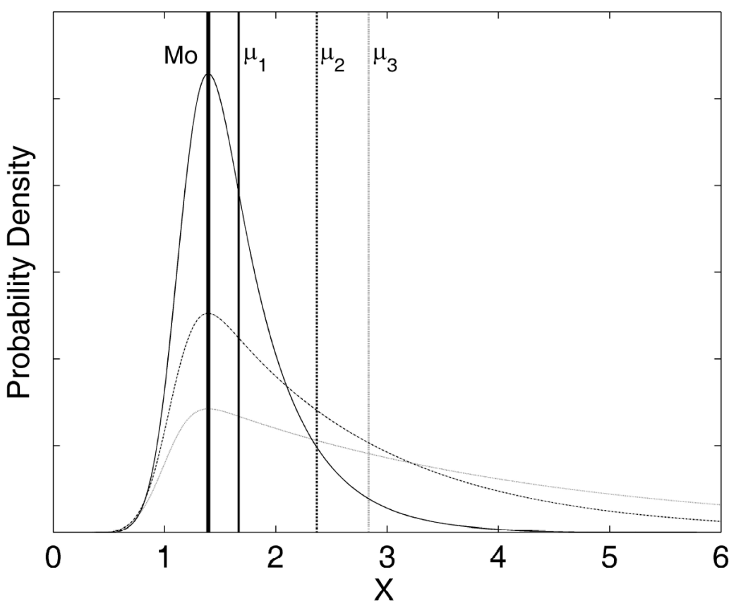
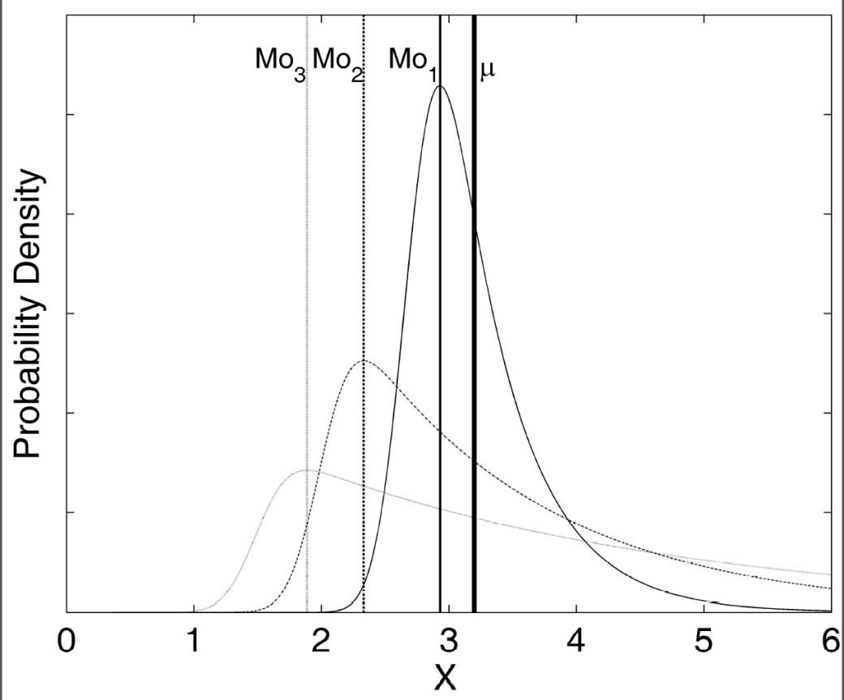
How to Examine Uncertainty
Mean-preserving examination of uncertainty common in finance (e.g., Hartman, 1972)

Slide 15
Jensen’s Inequality (1906)
“The expected value of a convex transformation of a random variable is at least the value of the convex function at the mean of the random variable.”

Slide 16
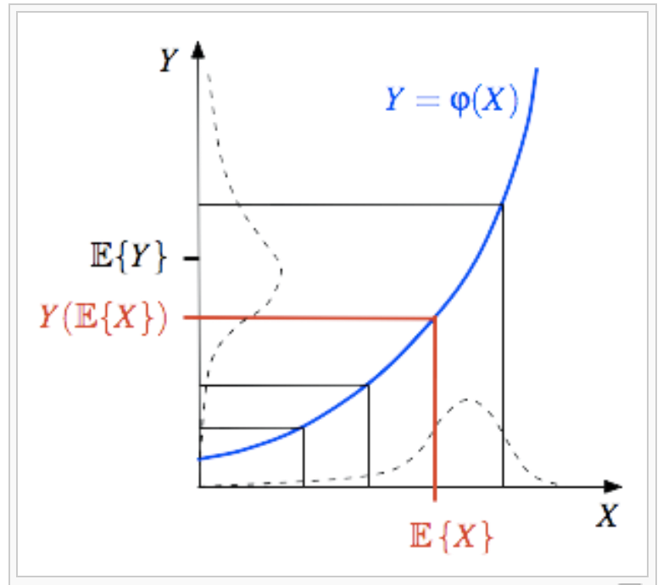
Jensen’s Inequality (1906)
“The expected value of a convex transformation of a random variable is at least the value of the convex function at the mean of the random variable.”
As σ(X) increases, E(Y) also increases
(e.g., Ruel & Ayres, 1999)

Slide 17
Jensen’s Inequality (1906) and Climate
All existing economic modelling of the damages arising from climate change uses a convex cost function relating the extent of global warming to costs of climate damage
Jensen’s inequality applies
Notes:
As σ(ECS) increases, mean damage also increases

Slide 18
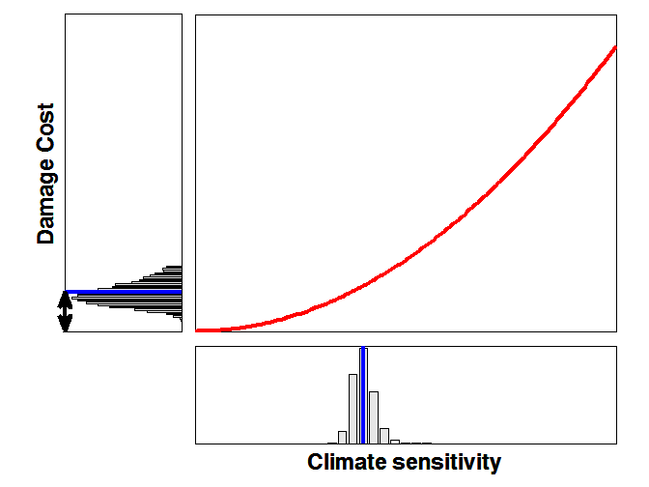
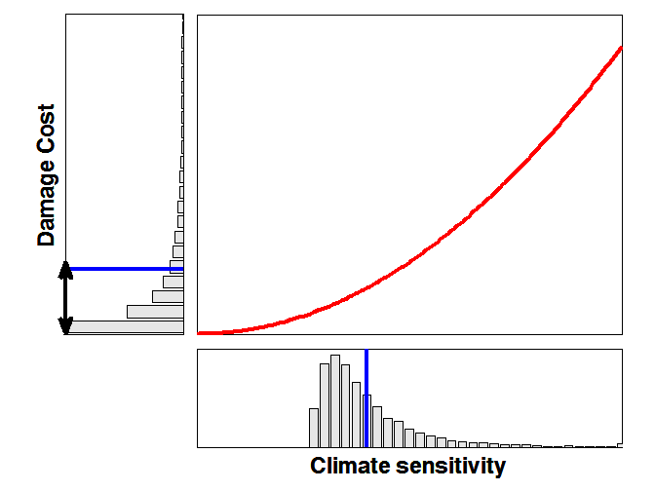
= 3.0
σ = 0.5
= 3.0
σ = 2.5
M = 9.24
M = 15.11
Greater uncertainty = greater damage cost
Caveat: (near) risk neutrality (η = 0)

Slide 19
Robust Ordinal Constraint
Uncertainty can never be too great for us to worry—because greater uncertainty should make us worry even more (Lewandowsky et al., 2014a, 2014b).
Notes:
http://www.capradio.org/news/npr/story?storyid=213894792

Slide 20
Robust Ordinal Constraint
Shape of damage function invariant with discount rate (Tomassini et al., 2005)
convexity retained
Same result obtains with outcome measures other than mean of the damage distribution
consequences associated with crossing certain thresholds of sensitivity
Transcends assumptions about mean of sensitivity distribution
Long upper tail not necessary to produce result

Slide 21
Policy Implications
If uncertainty isn’t your friend … reduce uncertainty.

Slide 22
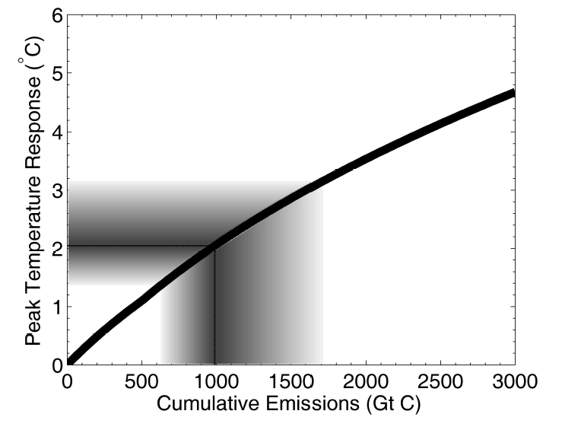
Cumulative Emissions and Warming
“safe” carbon budget
Notes:
https://www.carbontracker.org/carbon-budgets-explained/

Slide 23
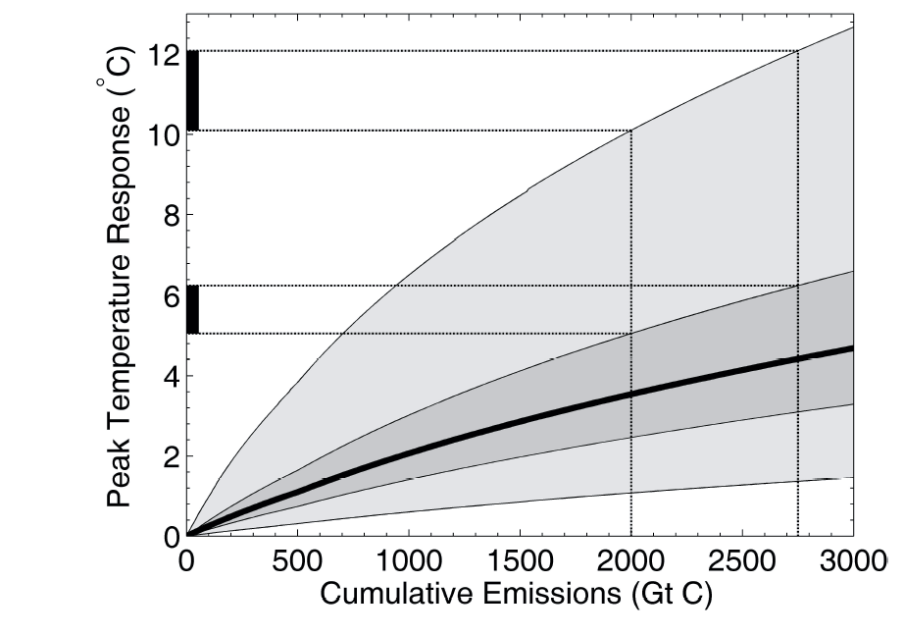
Reducing Emissions Reduces Uncertainty
Notes:
CS=2.75, 5-95th percentile, darker = sd=.52; lighter= sd = 1.66

Slide 24
More Specific Policy Implications: Sea level rise (SLR)
Removes convexity assumption from analysis
Does not require (near) risk neutrality
Permits examination of impact of uncertainty on specific policy choices
Permits quantification of adaptation cost

Slide 25
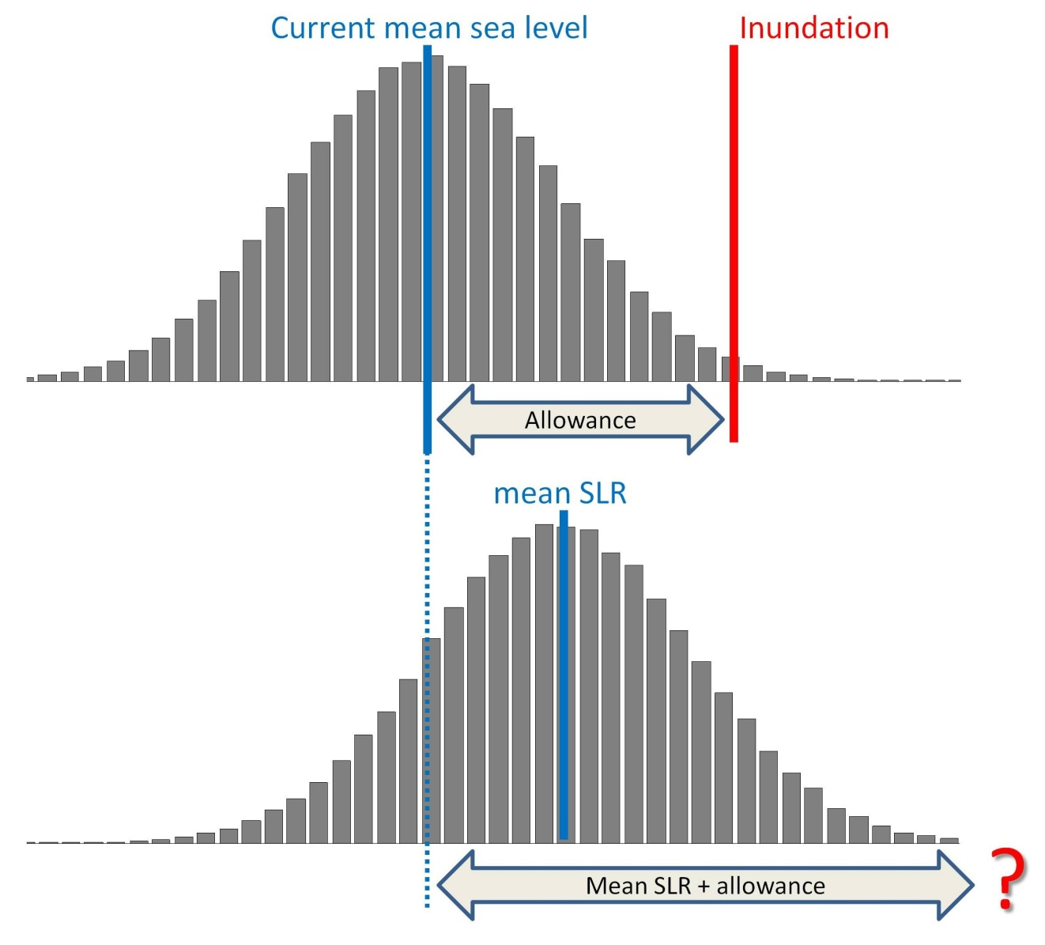
Allowing For Sea Level Rises (SLR)
Present
Future

Slide 26
Allowing For Sea Level Rises (SLR)
Present
Future
.5 m SLR requires .5 m + X “countermeasures” to keep likelihood of inundation constant
(Hunter, 2012)

Slide 27
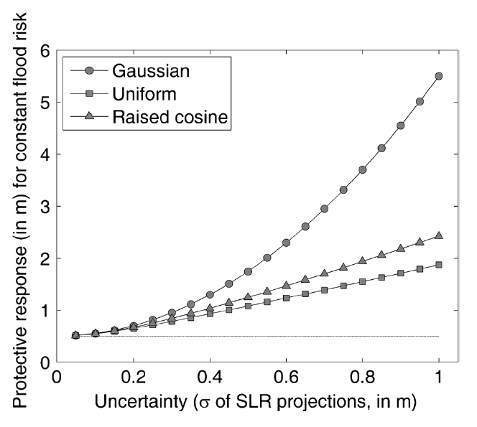
Allowance for SLR and Uncertainty
.362 m
(Nicholls et al., 2011)
.5 m SLR

Slide 28
Uncertainty as Knowledge?
Some policy-relevant specifics
adverse effects of uncertainty about warming are leveraged by greenhouse gas emissions
hence uncertainty is reduced by cutting emissions
but thus far, the analysis has been at an ordinal level
Move beyond ordinal constraints to point estimates

Slide 29
Today: Competing Construals of Uncertainty
Public misconstrual
wishful thinking
persuasive use
Normative construal
uncertainty as source of knowledge
impetus for mitigation
Using uncertainty to obtain social discount rate

Slide 30
Climate Change as Risky Choice
Scientific Consensus
(i.e., GHG warming with adverse consequences)
Correct
Incorrect
Unnecessary expense of decarbonizing the economy
Cut Emissions
Continue to emit
Damages from climate change (e.g., sea level rise)

Slide 31
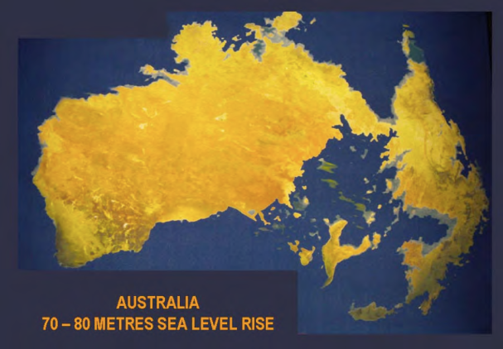
Problem: Today’s Mitigation Costs vs. Tomorrow’s Damages
Scientific Consensus
Correct
Incorrect
Unnecessary expense of decarbonizing the economy
Today
Cut Emissions
Damages from climate change (e.g., sea level rise)
Continue to emit
2200+

Slide 32
Enter the Discount Rate …
The future is less important than the present
£250 today is worth more than £300 in 10 years (even after adjusting for inflation)
Mixture of factors
pure (psychological) time preference for the present
uncertainty about future (e.g., death)
economic variables (future generations will be wealthier)

Slide 33
Enter the Discount Rate …
If the discount rate is 1%:
£1,000,000 in 300 years = £50,500 today.
If the discount rate is 5%:
£1,000,000 in 300 years = £0.44 today.
Mitigate
Business as usual
When people discount (e.g., Thaler, 1981)
£15 right now vs. X a month from now
X ≅ £20
annualized discount rate of 345%

Slide 34
Enter the Discount Rate …
“the biggest uncertainty … in the economics of climate change is … which interest rate to use for discounting.”
Weitzman (2007, p. 705)

Slide 35
Gamma Discounting (Weitzman, 2001)
Uncertainty operationalized: discount rate could be 1% or 7% with equal probability
Use average discount rate of 4%?
No—average discounted values instead

Slide 36
Gamma Discounting of £1,000
 | Candidate discount rates |  |  | Certainty-Equivalent Declining Discount Rate
time (t) | 1% | 7% | MEV | Forward | Spot
1 | 990.05 | 932.39
10 | 904.84 | 496.59
50 | 606.53 | 30.20
51 | 600.50 | 28.16
100 | 367.88 | 0.91
Average
Notes:
continuous interest $1K * exp(-r*t), where r is in proportions

Slide 37
Gamma Discounting of £1,000
 | Candidate discount rates |  |  | Certainty-Equivalent Declining Discount Rate
time (t) | 1% | 7% | MEV | Forward | Spot
1 | 990.05 | 932.39 | 961.22
10 | 904.84 | 496.59 | 700.71
50 | 606.53 | 30.20 | 318.36
51 | 600.50 | 28.16 | 314.33
100 | 367.88 | 0.91 | 184.40
Ratio
Notes:
continuous interest $1K * exp(-r*t), where r is in proportions

Slide 38
Gamma Discounting of £1,000
 | Candidate discount rates |  |  | Certainty-Equivalent Declining Discount Rate
time (t) | 1% | 7% | MEV | Forward | Spot
1 | 990.05 | 932.39 | 961.22 | 3.94%
10 | 904.84 | 496.59 | 700.71 | 3.13%
50 | 606.53 | 30.20 | 318.36 | 1.28%
51 | 600.50 | 28.16 | 314.33 | 1.26%
100 | 367.88 | 0.91 | 184.40 | 1.01%
Can be applied with 100% certainty having taken uncertainty into account
Notes:
continuous interest $1K * exp(-r*t), where r is in proportions

Slide 39
Gamma Discounting of £1,000
 | Candidate discount rates |  |  | Certainty-Equivalent Declining Discount Rate
time (t) | 1% | 7% | MEV | Forward | Spot
1 | 990.05 | 932.39 | 961.22 | 3.94% | 4.03%
10 | 904.84 | 496.59 | 700.71 | 3.13% | 3.62%
50 | 606.53 | 30.20 | 318.36 | 1.28% | 2.32%
51 | 600.50 | 28.16 | 314.33 | 1.26% | 2.30%
100 | 367.88 | 0.91 | 184.40 | 1.01% | 1.71%
From t=0 to t
Notes:
continuous interest $1K * exp(-r*t), where r is in proportions

Slide 40
Simulation Experiment: What is the “correct” Discount Rate?
Consider several sources of uncertainty and ambiguity
ethical ambiguities
scientific uncertainty
policy uncertainty
Combine them via Gamma discounting into a single certainty-equivalent social discount rate
Create knowledge from uncertainty

Slide 41
The Discount Rate and Ethics
Discounting periods in climate change economics span multiple generations
is our generation(s) worth more than subsequent generations?
are subsequent generations worth more than our generation(s)?

Slide 42
The Discount Rate and Ethics
Can “ought” be inferred from “is”?
can people’s empirical preference for the present be used to determine fate of future generations?
do present-day asset markets and surveys constitute a legitimate source of knowledge for discounting over the next few centuries?
Resolve “empirically” within Ramsey framework

Slide 43
The Ramsey (1928) Framework
𝜌_{𝑠}= 𝛿+ 𝜂 × 𝑔
Pure time preference (impatience)
Personal desiderata (e.g., risk of death)
If 𝛿 > 0, future generations devalued
Stern (2007) 𝛿 = 0.1% (extinction risk)

Slide 44
The Ramsey (1928) Framework
𝜌_{𝑠}= 𝛿+ 𝜂 × 𝑔
Pure time preference (impatience)
But if 𝛿 ≈ 0, we must save 97% for our children (and they must save 97% for theirs)
Impoverish each generation for next one

Slide 45
The Ramsey (1928) Framework
𝜌_{𝑠}= 𝛿+ 𝜂 × 𝑔
Pure time preference (impatience)
But if 𝛿 ≈ 0, preventive war becomes more likely (e.g., Schub, 2017)
Future spoils of war outweigh current costs of warfare

Slide 46
The Ramsey (1928) Framework
𝜌_{𝑠}= 𝛿+ 𝜂 × 𝑔
Pure time preference (impatience)
Survey of 200 experts (Drupp et al., 2016):
65% responded 𝛿 = 0%
35% responded 𝛿 = 3.15%
Used in our experiment

Slide 47
The Ramsey (1928) Framework
𝜌_{𝑠}= 𝛿+ 𝜂 × 𝑔
£100 is worth more to a poor student than to a millionaire
If future generations are wealthier, they can afford more damages
Future economic growth

Slide 48
The Ramsey (1928) Framework
𝜌_{𝑠}= 𝛿+ 𝜂 × 𝑔
Modulates the increase in utility from added wealth
𝜂 = 0.5
𝜂 = 2.2 (equal weighting)
Risk and inequality aversion
Notes:
Eta: the consumption elasticity of marginal utility (describing how fast marginal consumption decreases in consumption) “By how many percent does marginal utility change if consumption increases by one percent”

Slide 49
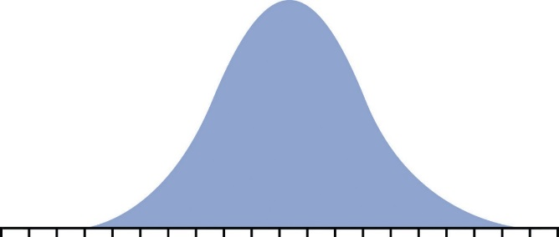






Ethical ambiguities
δ: 0%, 3.15%
η: 0.5, 2.2
Uncertainties about future growth
Model climate …
under different emissions policies
Observe effect on economic growth till 2100
Climate change
Emissions trajectory
Development pathway
$σ_{ESS}:$
0.26K → 1.66K
$$⊗$$
$$⊗$$
$$⊗$$
RCP 2.6 →
RCP 8.5
$$⊗$$
SSP3,
SSP5
Candidate social discount rates:
$$ρ_{s}= δ+ η×g$$
Via Gamma discounting
Certainty-equivalent declining social discount rate (CE-DDR)

Slide 50
Socio-Political Uncertainty: SSPs (Shared Socio-Economic Pathways)
Assumptions about population growth and global economic pathways (IPCC AR5 WG2)
SSP 3 - Fragmented World:
regions of extreme poverty
pockets of moderate wealth
SSP 5: Conventional Development
development oriented toward economic growth as the solution to social and economic problems

Slide 51
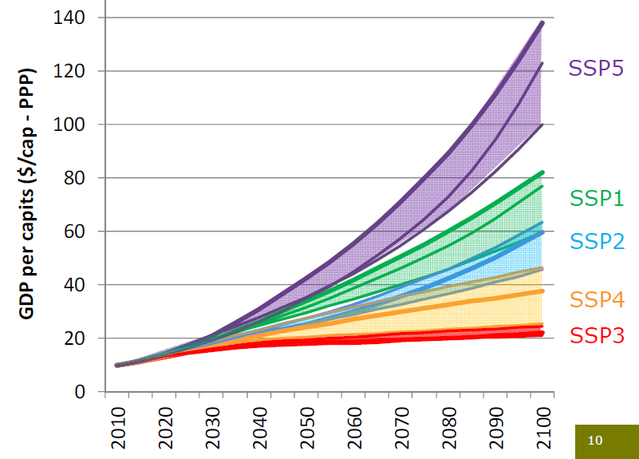
SSP Baseline Growth Projections

Slide 52
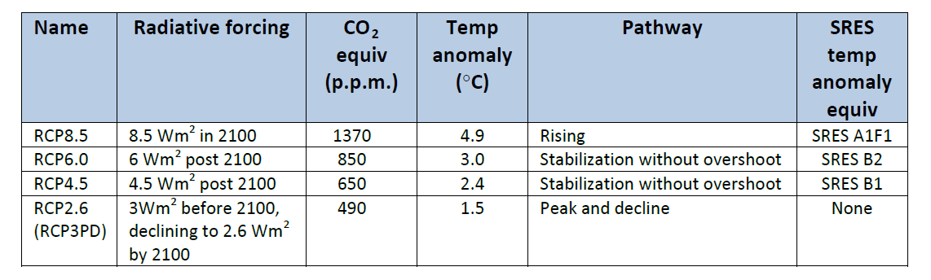
Political Uncertainty: RCPs (Representative Concentration Pathways)
Emissions pathways under various climate policies
Greater number means more emissions

Slide 53
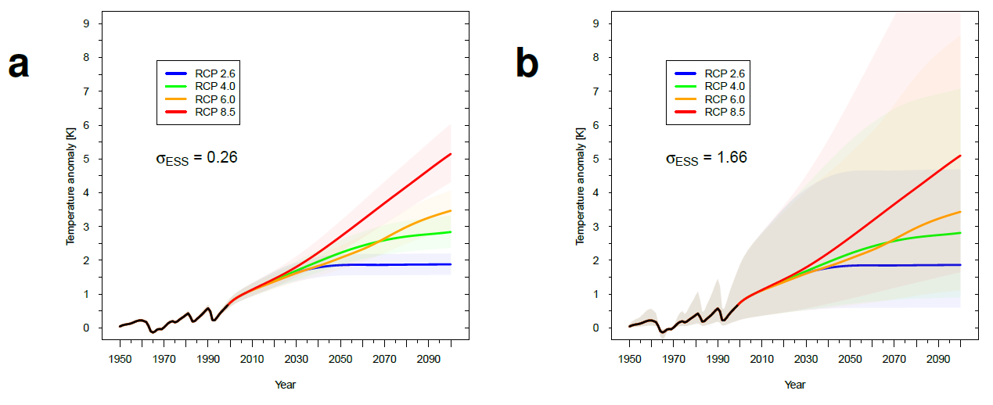
Projecting Global Temperatures under Scientific and Political Uncertainty
Emulator adapted from Raupach et al. (2011)

Slide 54
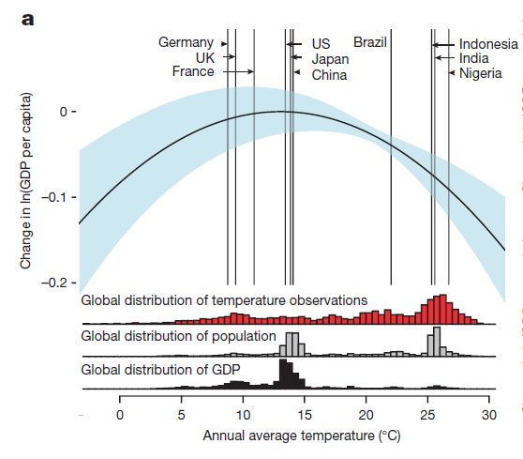
From Global Temperatures to Global Economic Growth
Robust empirical model (Burke et al., 2015)

Slide 55
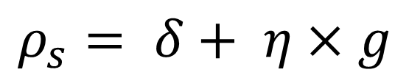
Integrate across 1,000 replications to form single growth trajectory for each cell of design
$$ρ_{s}= δ+ η×g$$

Slide 56
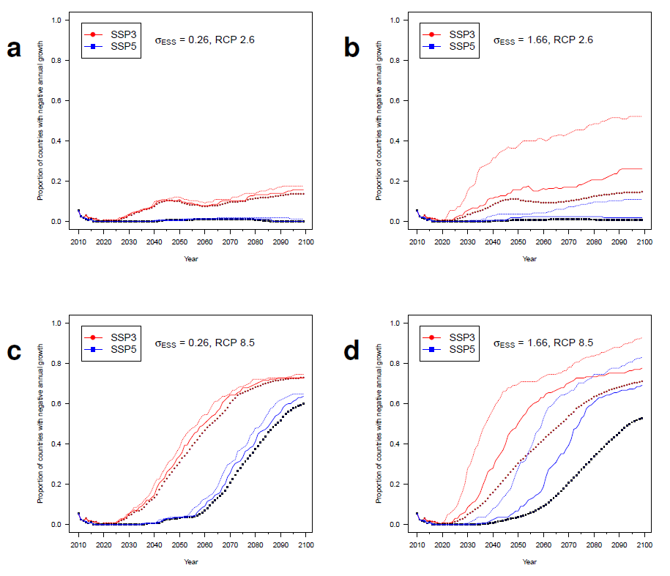
Results: Countries with Negative Growth
max
mean
Notes:
Plotting symbols represent mean trajectories across 1000 realizations of climate sensitivity, solid lines represent the 90th percentile of realizations, and the
dashed lines the maximum of the 1000 realizations.

Slide 57



Ethical ambiguities
δ: 0%, 3.15%
η: 0.5, 2.2
Uncertainties about future growth
Climate change
Emissions trajectory
Development pathway
$σ_{ESS}:$
0.26K → 1.66K
$$⊗$$
$$⊗$$
$$⊗$$
RCP 2.6 →
RCP 8.5
$$⊗$$
SSP3,
SSP5
Candidate social discount rates:
$$ρ_{s}= δ+ η×g$$
Via Gamma discounting
Certainty-equivalent declining social discount rate (CE-DDR)

Slide 58
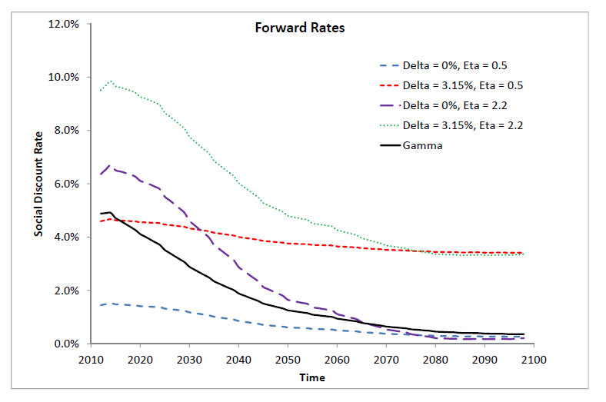
Results: CE-DDR (Forward)

Slide 59
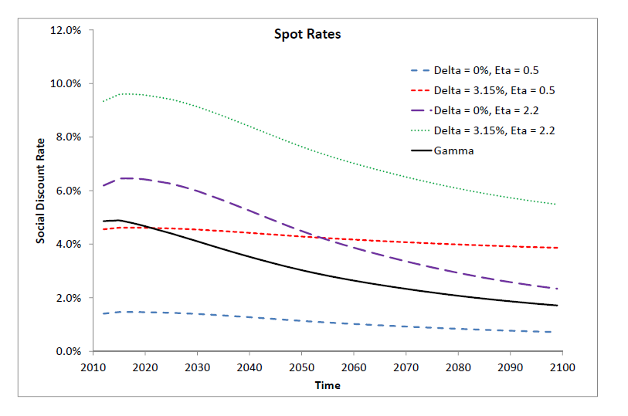
Results: CE-DDR (Spot)

Slide 60
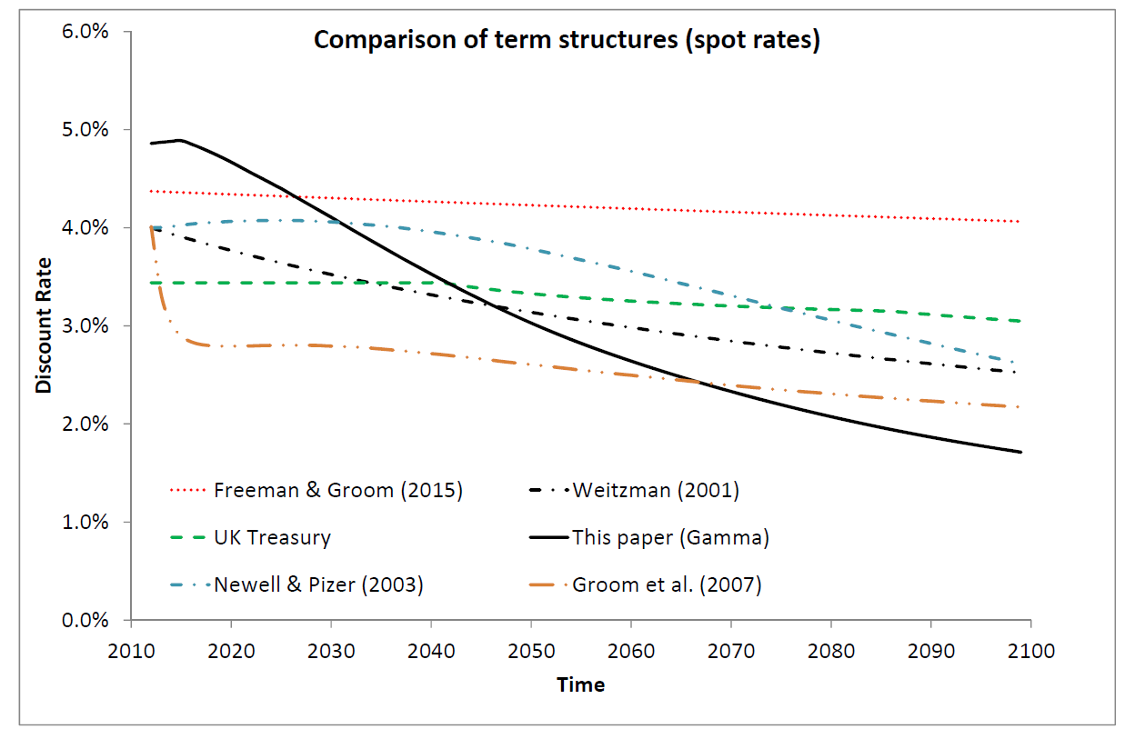
Results in Context: CE-DDR (Spot)

Slide 61
Conclusions
Empirical model of temperature-growth relationship yields more pessimistic picture of future growth than IAMs
Certainty-equivalent declining discount rate can be computed “empirically”
ethical ambiguities and other sources of uncertainty are considered
notwithstanding all those uncertainties a single policy-relevant CE-DDR can be computed

Slide 62
Thank You
Public misconstrual
wishful thinking
persuasive use
Normative construal
uncertainty as source of knowledge
impetus for mitigation
Using uncertainty to obtain social discount rate

Slide 63
THE END

Slide 64
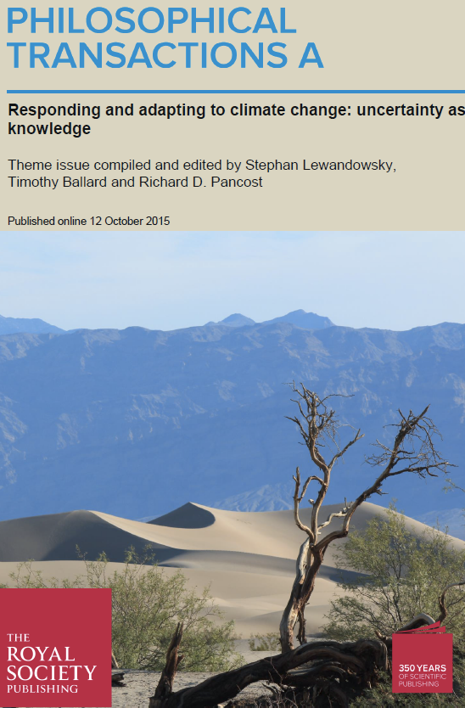
Unknown unknowns are almost knowable (Parker & Risbey)
Reducing the lower bound on climate sensitivity (2°C → 1.5°C) is bad news (Freeman et al.)

Slide 65
Today: Competing Construals of Uncertainty
Public misconstrual
wishful thinking
persuasive use
Normative construal
uncertainty as source of knowledge
impetus for mitigation
Using uncertainty to obtain social discount rate
Communicating uncertainty

Slide 66
http://sks.to/uhb
Corner, A., Lewandowsky, S., Phillips, M. and Roberts, O. (2015) The Uncertainty Handbook. Bristol: University of Bristol.

Slide 67

Being cautious, tentative and hesitant makes for good scientific practice…but bad public engagement.
Don’t apologise for gaps in knowledge – and be confident, stating areas of agreement first before focusing on uncertainties
On the basic questions – is it happening, what is causing it – the science is settled

Slide 68
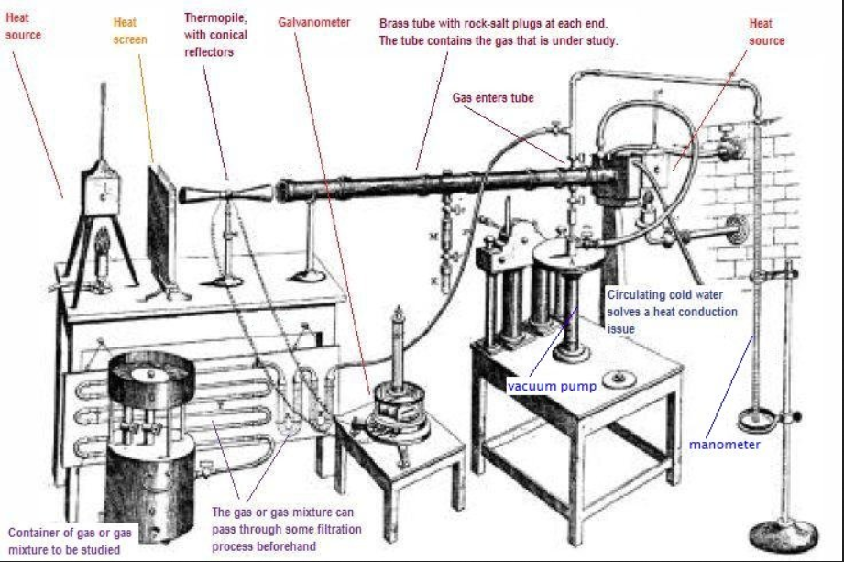
We have known for 150 years that CO₂ traps heat

Slide 69
“Was this flood caused by climate change?”… “Was this disease caused by a weak immune system?”
Attribution science is starting to provide accurate answers
People are starting to join the dots between extreme weather and climate change
Providing a narrative that individual weather events can slot into is crucial

Slide 70
High Impact, High Accuracy
Climate scientists predicted decades ago that we would see an increase in extreme weather events. We are now observing that increase.
Any weather event now has been put on steroids owing to climate change.
We know that climate change has stacked the deck so that this kind of event happens more frequently.
Is climate change worsening some recent extreme weather events like super storm Sandy? Yes.

Slide 71
Inspiring climate solutions: people like them because they are inspiring not because they are certain!
The single biggest uncertainty is how we collectively respond to climate risks: this is a story about us and where we get to decide the ending
Move climate change from a scientific to a social reality

Slide 72
Robustness Examined
Shape of damage function invariant with discount rate (Tomassini et al., 2005)
convexity retained
Same result obtains with outcome measures other than mean of the damage distribution
consequences associated with crossing certain thresholds of sensitivity
Transcends assumptions about mean of sensitivity distribution
Symmetrical pdf’s produce the same result

Slide 73
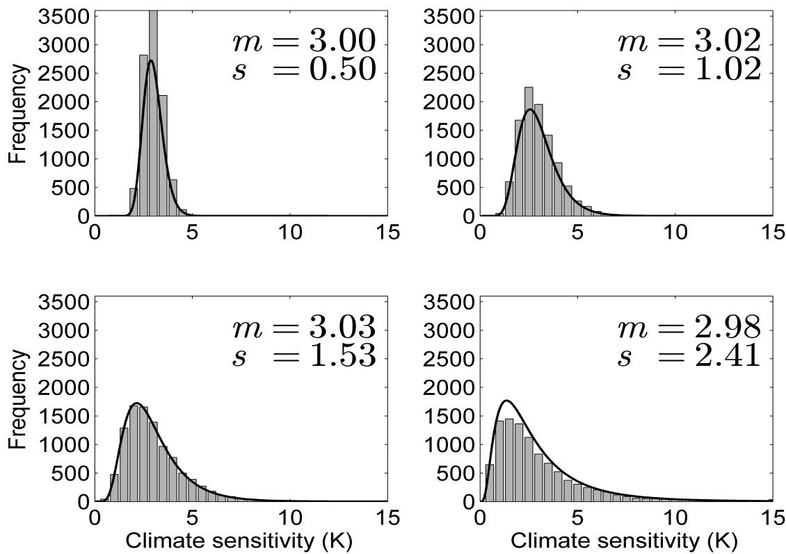
Scientific Uncertainty about Climate Change
Mean invariant manipulation of Climate Sensitivity

Slide 74
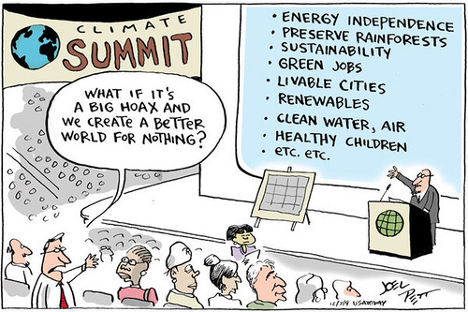
Climate Change as Risky Choice

Slide 75
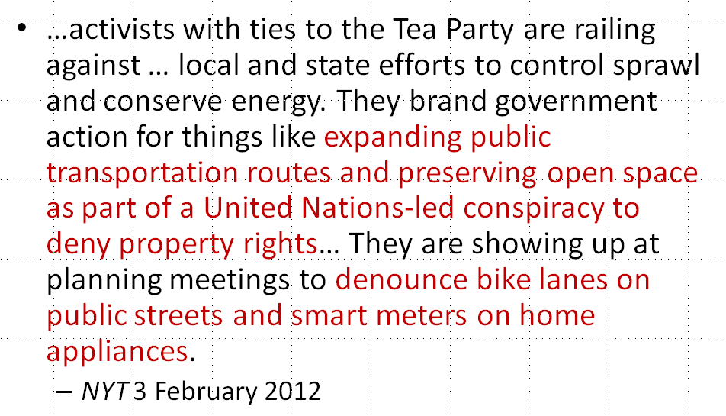
Subjectivity of Risk Perception
People’s “culture” (worldviews, ideology) affects their risk perception (e.g., Kahan et al., 2009)
Notes:
http://www.telegraph.co.uk/topics/weather/10635242/Lord-Lawson-denies-floods-are-linked-to-climate-change.html

Slide 76
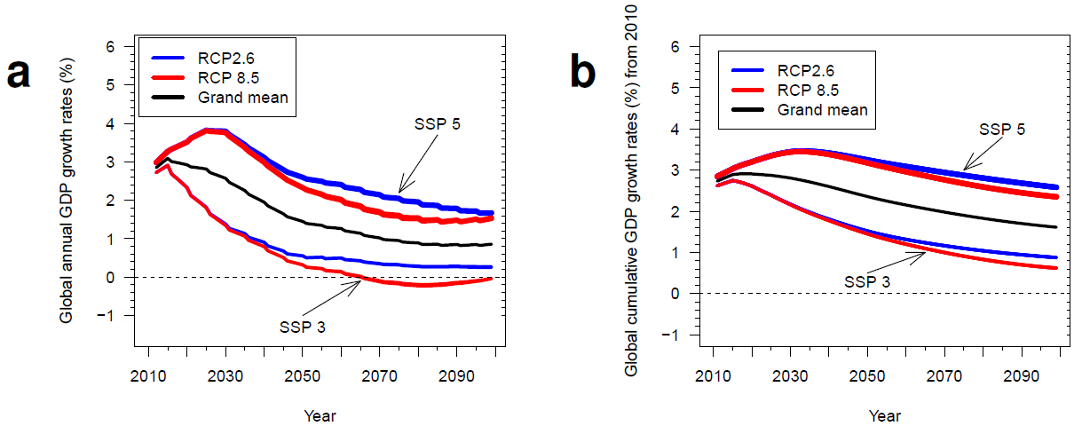
Results: Global GDP Growth Rates

Slide 77
Uncertainty as Knowledge?
Cost of seawalls increases with the square of height (Yohe et al., 1999)
U.S. prices for 1 linear m: $5,617 × m²
Greater uncertainty is known to increase adaptation cost considerably
even if the expectation of SLR remains unchanged

