Slide 1
Professor David Elmes
David.Elmes@wbs.ac.uk
27th June 2019
Behaviours, Sustainability and Energy
WBS 7th Summer School On Climate Change and Behaviour

Slide 2
Introduction & Agenda
This session takes a practical look at how behavioural science can help achieve goals for sustainability through the ways we use energy.
  We will use energy use here on the University of Warwick campus for hands-on examples
Addressing behaviours is an option that can be in competition with using technology to “do it for us” but there are now increasing cases where behavioural change is enabled by technology.
  So how can technology make it easy to make more sustainable choices
It’s not just the behaviour of you and I as customers and consumers, the energy we use and the emissions that come from it is determined by…
  How architects design buildings, how building engineers run them, how urban planning affects where we go and the transport we use, etc.
  How investors and company executives make investment choices that are more or less sustainable
The session will include a walking tour around the Warwick campus to see and discuss examples, concluding at the Cryfield Energy Centre.
  We will be walking around campus for 60-90 minutes so we have you have appropriate footwear and clothing!
Agenda
1400-~1500 Presentation by DE in 0.006
~1500-1700 Walking tour led by DE & David Chapman ending up at the Energy Centre

Slide 3
Are the parts of the Low Carbon Society falling into place?
Political Frameworks
Economic Instruments
Technology
Behavioural Change
Still climbing the hill…. but can we see the crest and imagine the other side?

Slide 4






Sources of emissions
Energy production remains the primary driver of GHG emissions
24%
14%
6.4%
21%
35%
Building
Sector
Agriculture,
forests and
other land uses
Industry
Transport
Energy Sector
2010 GHG emissions
AR5 WGIII SPM

Slide 5
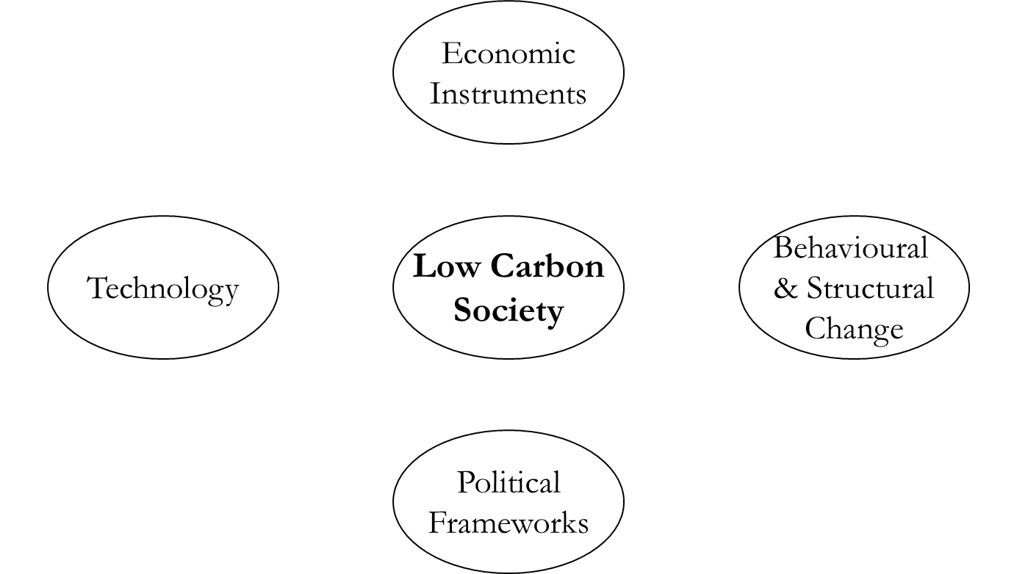
So here’s a conceptual framework for the “Low Carbon Society” developed in 2010
Source: Andrew Sentance (2010), WBS now PwC
Notes:
Source: Sentence A (2010) “Sustainability & the Low Carbon Economy” WBS Module Workbook
See also https://andrewsentance.com/

Slide 6
When proposed in 2010, these were the key steps to a Low Carbon Economy
“Decarbonisation” of power sector and transport
Big shift in energy efficiency of industry, buildings & appliances
Cutting non-energy emissions from agriculture, changes in land use & waste
Notes:
Source: Sentence A (2010) “Sustainability & the Low Carbon Economy” WBS Module Workbook

Slide 7
Notes:
From the initial SLCE module workbook in 2010

Slide 8
Influencing behaviours: the greatest challenge?
What will be the role of consumer behaviour?
  Changing attitudes to energy use and energy efficiency
  Offering more sustainable choices for travel
  Role of policy interventions versus attractive market propositions
How can we influence policy-making and investment behaviours?
  Profitability of investment choices
  Policy support low carbon choices in the market
  Investor risks: Stranded Assets and the Carbon Bubble
  Financial Regulator risks: system risks

Slide 9
Investor Behaviour

Slide 10
Disinvestment: from pressure groups to the mainstream
Early action was through NGOs and pressure groups placing the emphasis on long term environmental damage
This was then successfully targeted at investors more likely to be receptive to a long term, social message
  Foundations, Church investments, University endowment funds
The argument then shifted to the financial value of long term assets
  For example, the value of hydrocarbon reserves or investment in infrastructure requiring long payback periods (30-40 years)
Then it shifted to the duty of investment funds to challenge companies on the basis of investment risk
This expanded to include financial regulators concerned about risks to the financial system

Slide 11
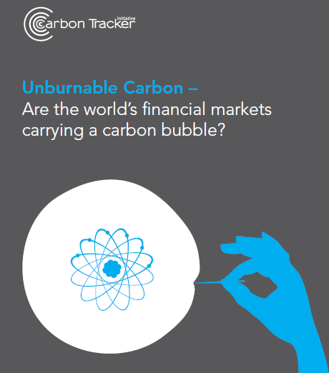
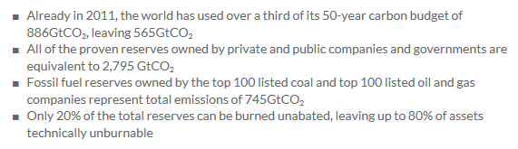
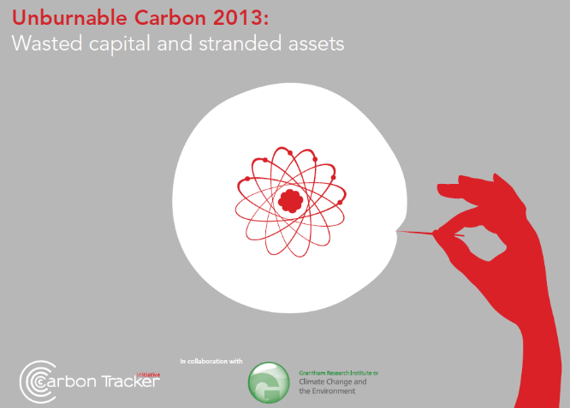
Influencing investment behaviours: are fossil fuel reserves unburnable?
Notes:
Source: Carbon Tracker (2012) see http://www.carbontracker.org/site/carbonbubble#
Already in 2011, the world has used over a third of its 50-year carbon budget of 886GtCO₂, leaving 565GtCO₂
All of the proven reserves owned by private and public companies and governments are equivalent to 2,795 GtCO₂
Fossil fuel reserves owned by the top 100 listed coal and top 100 listed oil and gas companies represent total emissions of 745GtCO₂
Only 20% of the total reserves can be burned unabated, leaving up to 80% of assets technically unburnable.
Subsequent report in 2013:
http://carbontracker.live.kiln.it/Unburnable-Carbon-2-Web-Version.pdf
Unburnable carbon 2013: Wasted capital and stranded assets has revealed that fossil fuel reserves already far exceed the carbon budget to avoid global warming of 2°C, but in spite of this, spent $674billion last year to find and develop new potentially stranded assets.
“Smart investors can see that investing in companies that rely solely or heavily on constantly replenishing reserves of fossil fuels is becoming a very risky decision. The report raises serious questions as to the ability of the financial system to act on industry-wide long term risk, since currently the only measure of risk is performance against industry benchmarks.” Professor Lord Stern

Slide 12
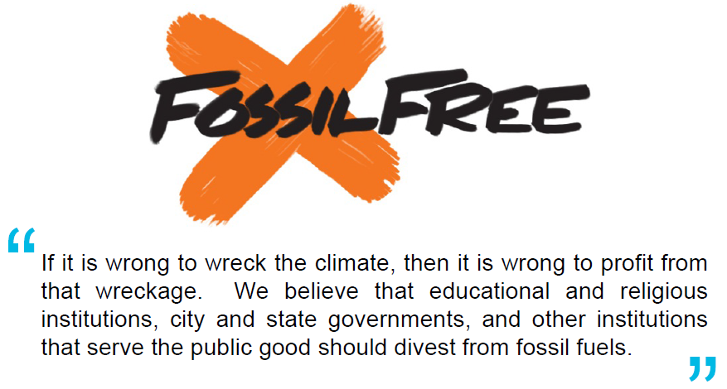
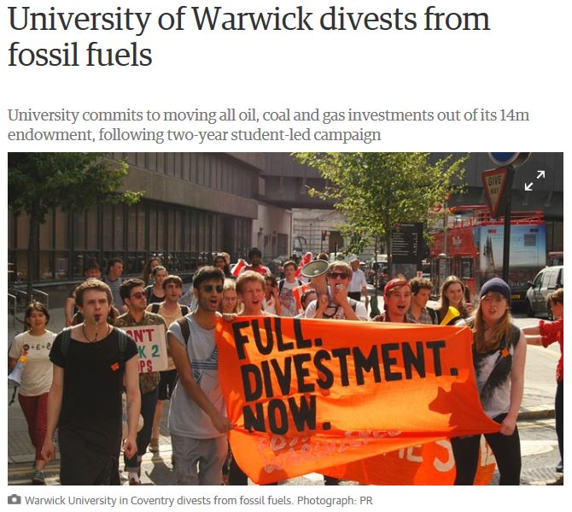
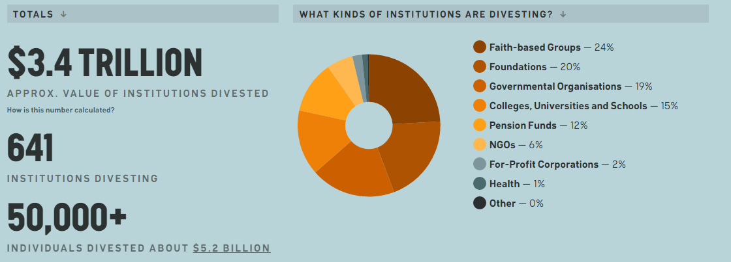
Notes:
Fossil Free Website: http://gofossilfree.org/uk/
The University of Warwick in Coventry has committed to divest from fossil fuels, saying it will move the £1m of its investments in coal, oil and gas from its £14m endowment as soon as possible.
Warwick followed Glasgow, Bedfordshire, SOAS, Oxford, Edinburgh and London School of Hygiene and Tropical Disease
Follows Universities (and colleges in the US), religious organizations, retirement funds, and other institutions, e.g., Stanford Uni, Rockefeller Trust, http://gofossilfree.org/commitments/
Motion passed committing the University of Warwick to replace existing funds with investments in fossil-free index related funds. They have pledged to move their money when such a fund becomes available. It is expected that fossil free funds will be available within a year.
http://www.theguardian.com/environment/2015/jul/08/university-of-warwick-divests-from-fossil-fuels

Slide 13
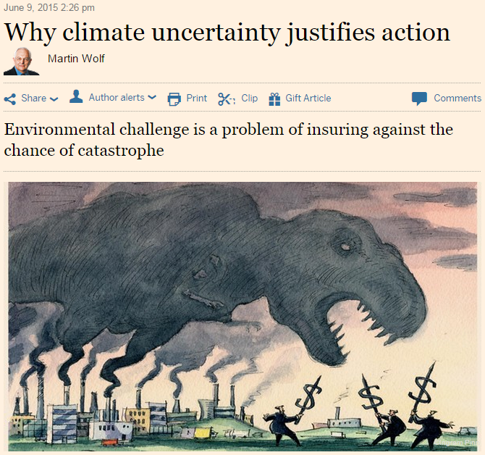
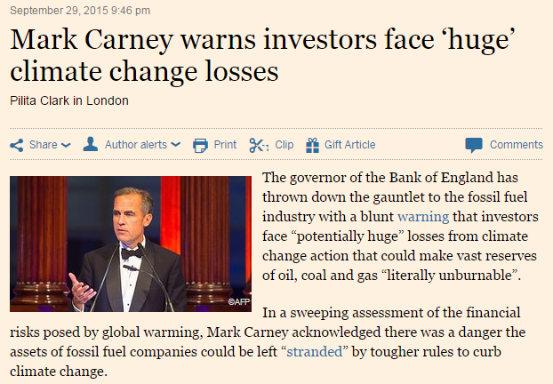

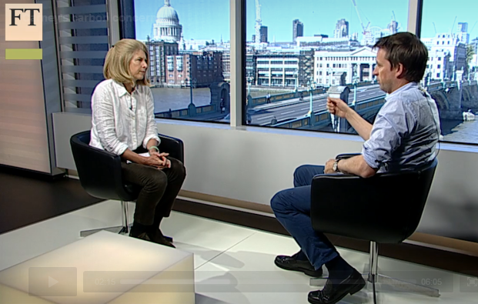
Viewing climate risk through an insurance perspective
Notes:
Sources: Main FT Article (June 2015) http://www.ft.com/cms/s/0/e144719e-0dcb-11e5-aa7b-00144feabdc0.html?siteedition=uk#axzz3d1wSSVnv
“Framing the challenge of climate change as a problem of insurance against disaster is intellectually fruitful. It also provides the right answer to sceptics. The question is not what we know for sure. The question is rather how certain we are (or can be) that nothing bad will happen. Given the science, which is well established, it is impossible to argue that we know the risks are small. This being so, taking action is logical. It is the right way to respond to the nature and scale of possible bad outcomes.
The authors suggest that the very least we need to do is impose a global price on emissions of CO2 at $40 a tonne (well above that delivered even by the EU Emissions Trading System). Now, however, the actual cost imposed on emissions is closer to minus $15 per tonne, because of vast subsidies to fossil fuel energy amounting to $550bn a year.
Hitherto, all the climate conferences have been almost Shakespearean — tales “told by an idiot full of sound and fury signifying nothing”. So could anything actually change our trajectory? It is increasingly evident that the answer has to be technological. Humanity is unwilling, possibly simply unable, to overcome the political, economic and social obstacles to collective action. The costs to current generations seem too daunting. So those costs have to fall.”
Mark Carney’s Speech to Lloyds Insurance, Sept 2015 http://www.ft.com/cms/s/0/622de3da-66e6-11e5-97d0-1456a776a4f5.html#axzz3n1gP8lLB
From the article: investors face “potentially huge” losses from climate change action that could make vast reserves of oil, coal and gas “literally unburnable”.
Full text of speech at http://www.bankofengland.co.uk/publications/Pages/speeches/2015/844.aspx#
FT Video: http://video.ft.com/4520690411001/Carneys-carbon-concerns/world

Slide 14
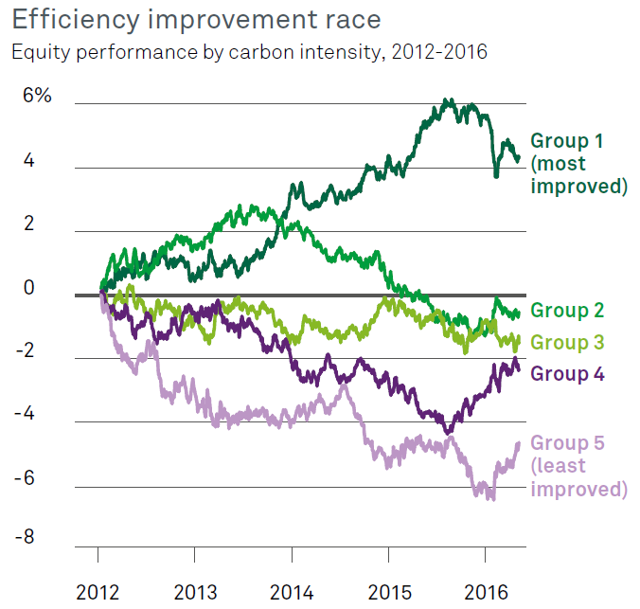
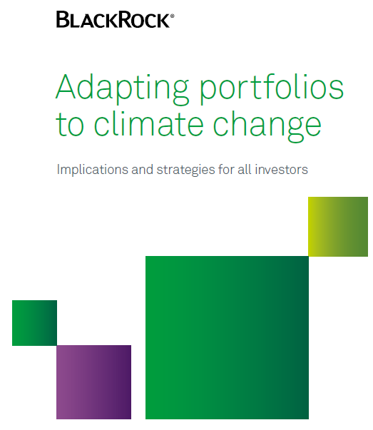
Major investors have started to see emissions as a factor to influence portfolio mix
Notes:
Source: https://www.blackrock.com/ca/institutional/en/insights/blackrock-investment-institute/climate-change

Slide 15
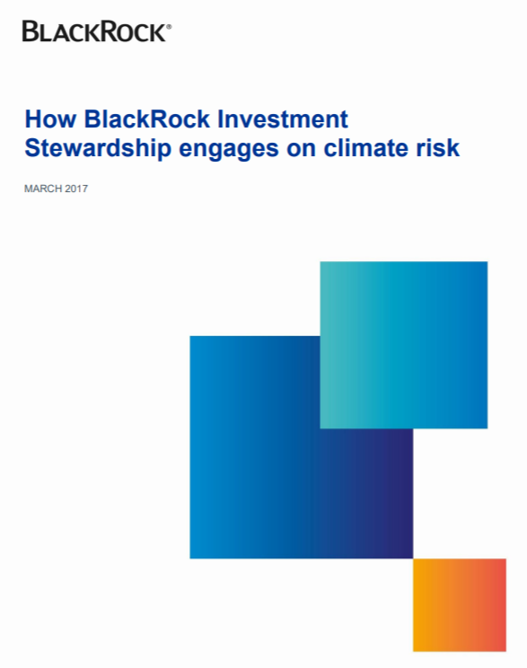

This has moved from pressure groups to major investors calling for transparency on climate change
Notes:
Sources:
https://www.blackrock.com/corporate/literature/market-commentary/how-blackrock-investment-stewardship-engages-on-climate-risk-march2017.pdf
https://www.chevron.com/-/media/shared-media/documents/climate-change-resilience.pdf

Slide 16
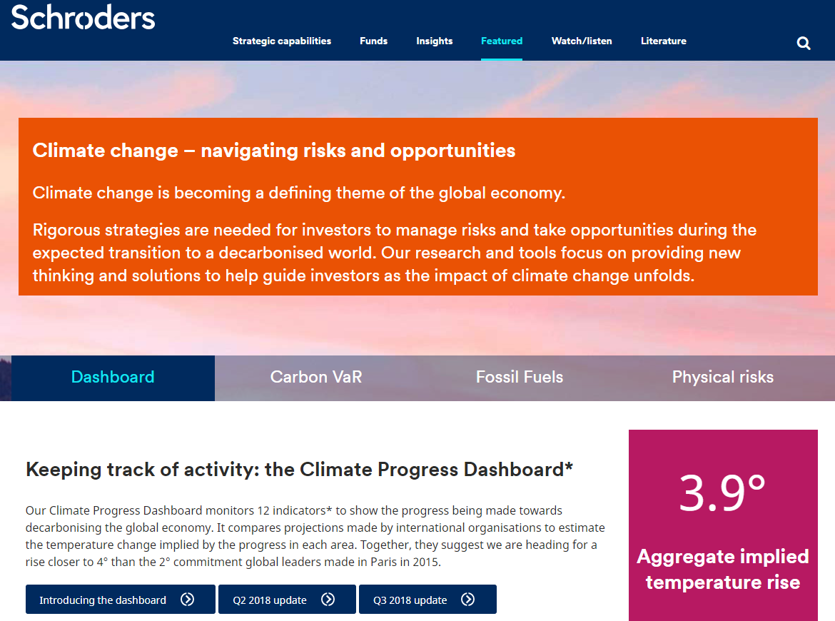
Notes:
Source: https://www.schroders.com/en/lu/professional-investor/featured/climate-change-dashboard/
Video https://youtu.be/jAt-z4NdDgg

Slide 17
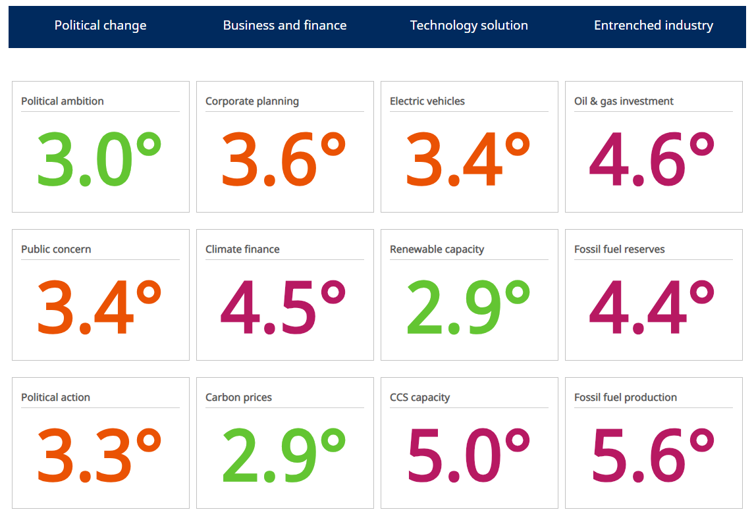
Notes:
Source: https://www.schroders.com/en/lu/professional-investor/featured/climate-change-dashboard/

Slide 18
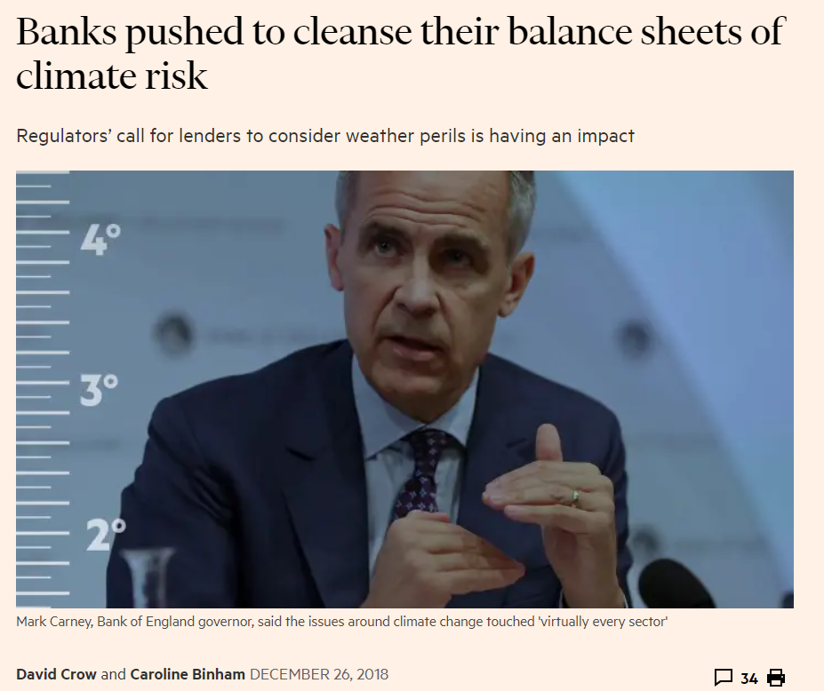

Slide 19

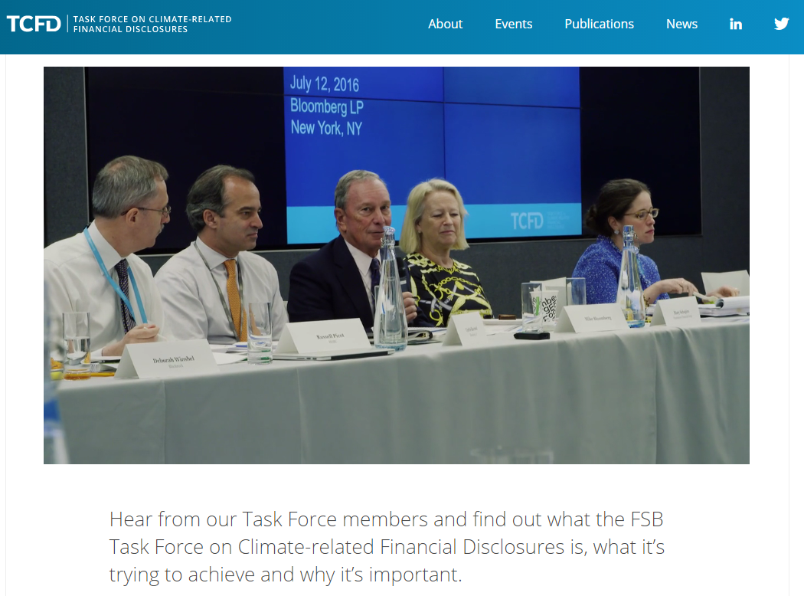
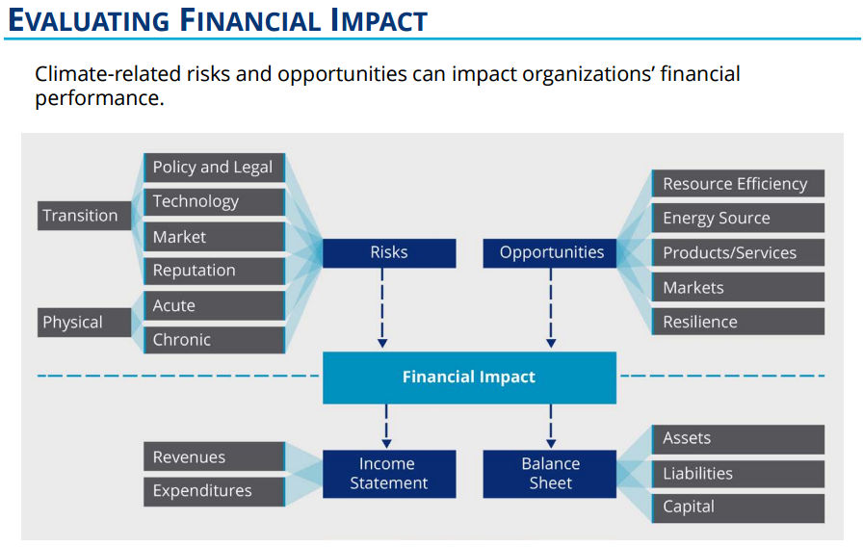
Notes:
Source for Report & Recommendations: https://www.fsb-tcfd.org/publications/recommendations-report/
Presentation at https://www.fsb-tcfd.org/wp-content/uploads/2016/12/TCFD-Report-Overview-Dec.-2016.pdf
Source for video: https://vimeo.com/181695412 also https://www.fsb-tcfd.org/about/

Slide 20
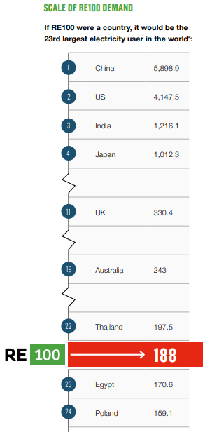
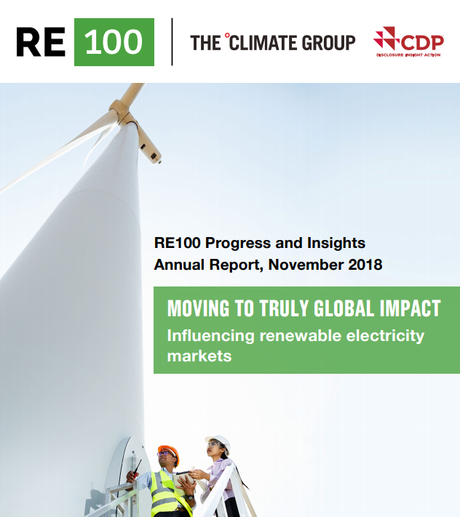
Influencing the behaviour of companies as consumers
Notes:
Source: http://there100.org/reports-briefings
Video: https://youtu.be/zLpUJqnEHE0

Slide 21
Policy-making Behaviour

Slide 22

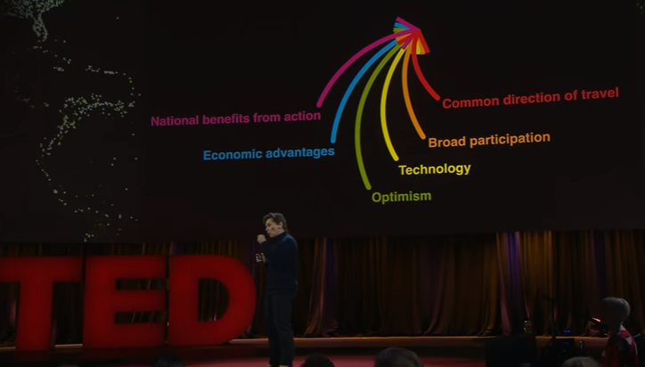
The INDC process and Paris Agreement – a change in political framework
A New Approach (Falkner, 2016)
  Primacy of domestic politics
  Bottom up
  Voluntary pledges
  Naming & shaming
  Ratchet mechanism
  Avoids distributional conflict
  But will “pledge & review” work?
Notes:
Sources:
TED Talk Vancouver Feb 2016: “The inside story of the Paris climate agreement” by Christiana Figueres see http://www.ted.com/talks/christiana_figueres_the_inside_story_of_the_paris_climate_agreement (4.00-10.00)
ROBERT FALKNER; The Paris Agreement and the new logic of international climate politics, International Affairs, Volume 92, Issue 5, 1 September 2016, Pages 1107–1125 Available via the library at https://academic.oup.com/ia/article/92/5/1107/2688148/The-Paris-Agreement-and-the-new-logic-of
See Also
TED Talk Vancouver Feb 2016: “Al Gore: The case for optimism on climate change“ see http://www.ted.com/talks/al_gore_the_case_for_optimism_on_climate_change

Slide 23
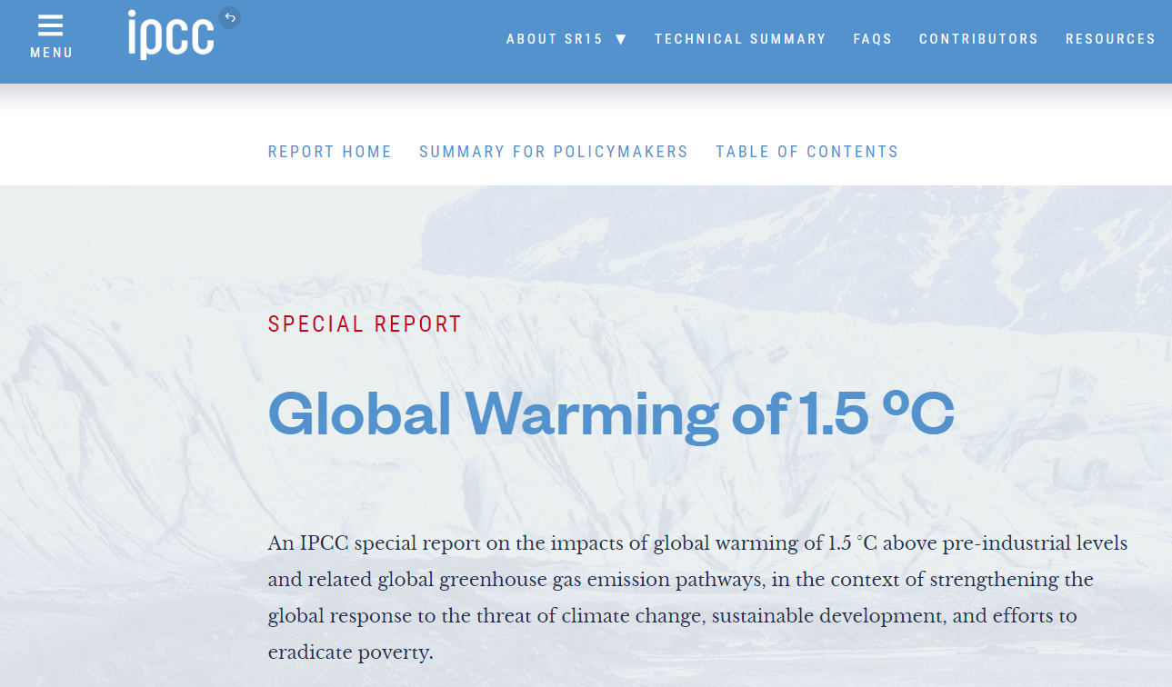

Slide 24
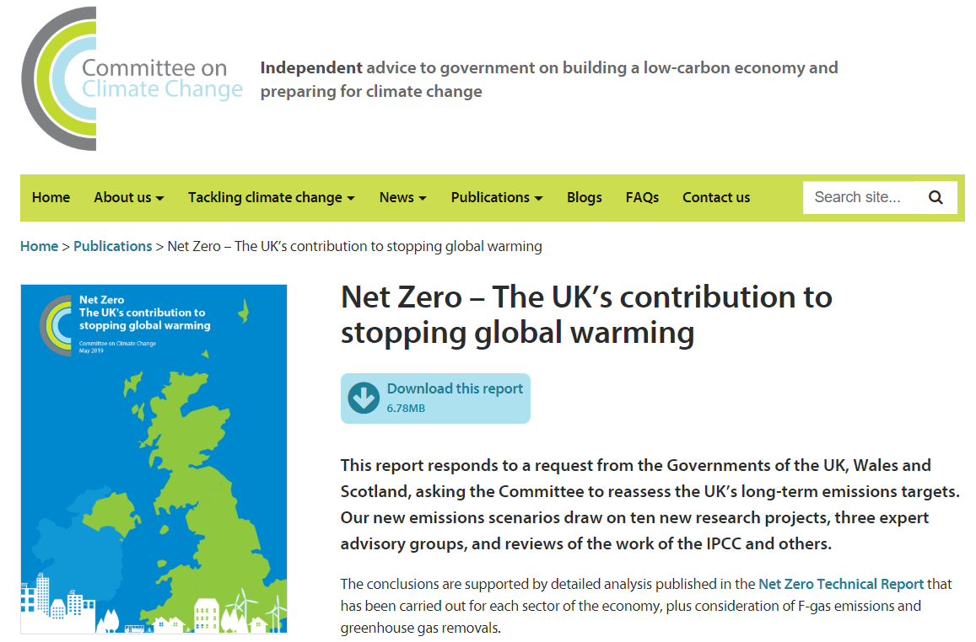

Notes:
Sources: https://www.theccc.org.uk/publication/net-zero-the-uks-contribution-to-stopping-global-warming/
https://www.theccc.org.uk/wp-content/uploads/2019/05/Net-Zero-Chris-Stark-Presentation.pdf

Slide 25
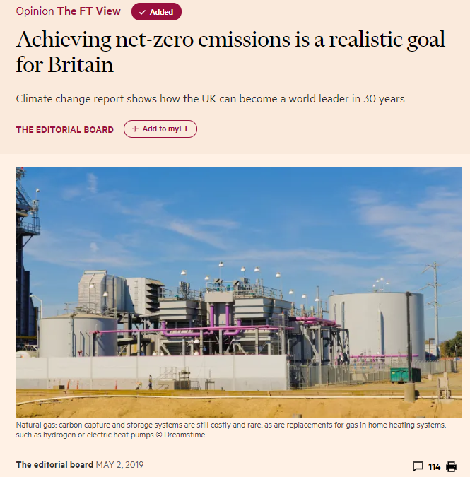


Slide 26
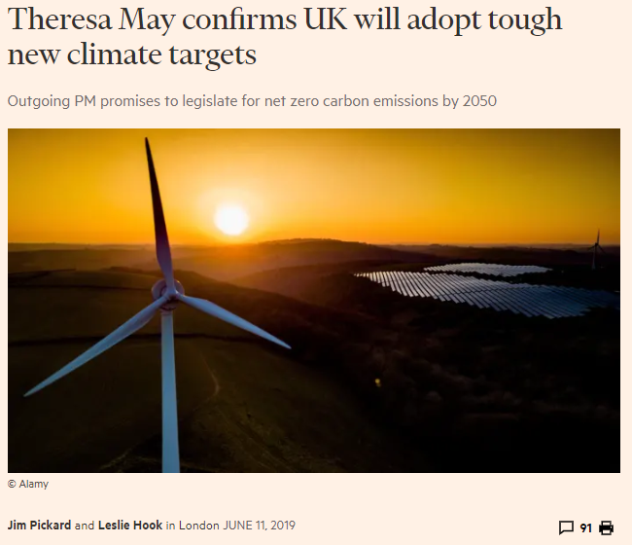

Slide 27
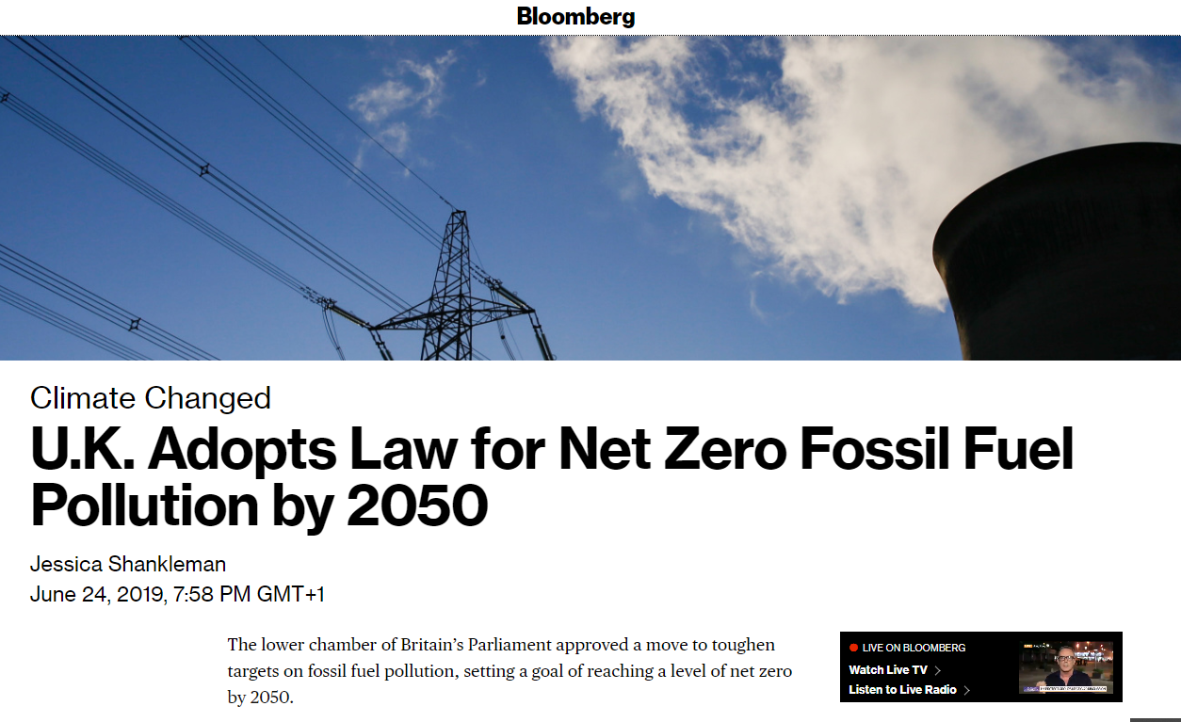

Slide 28
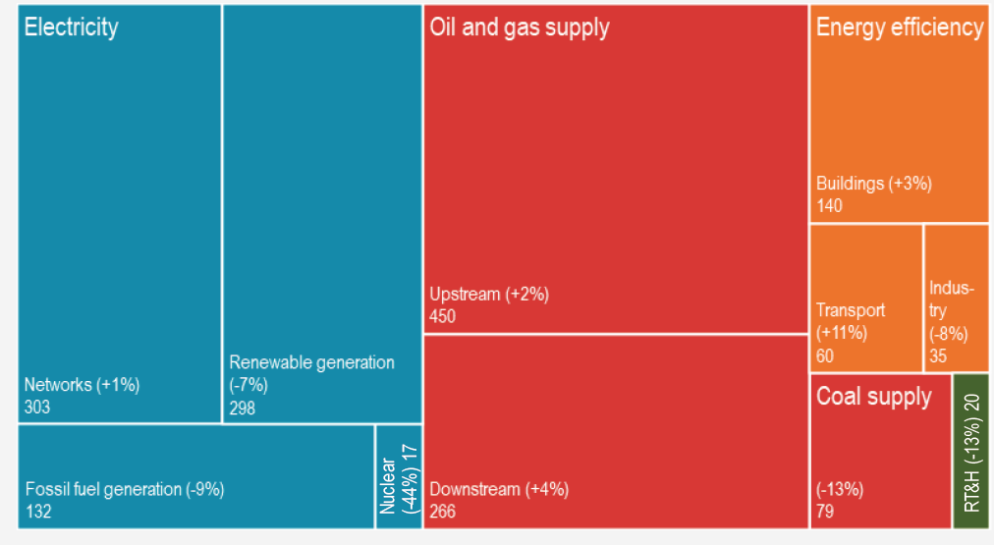
Global capital investment in the supply and use of energy has been persistently focused on more supply
Global Capital Investment in the Supply & Use of Energy ($1.8Tn in 2017)
Only 13% on Energy Efficiency
IEA, WEI (2018)
Notes:
If the traditional approach to energy has been to avoid any problems by ensuring more supplies, this has led to a pattern of investment where most of the capital that companies spend has focused on the supply side.
This is the International Energy Agency’s World Energy Investment data where they use reported capital investment by companies around the world. This is their 2018 report, see https://www.iea.org/wei2018/ RT&H stands for Renewable transport & heat and the Networks section includes battery storage.
Of the $1.8Tn invested, only 13% was spent on making buildings, transport and industry more efficient in the way they use energy (the orange section vs blue, red and green). Or looked at another way, the investment required to maintain and expand the supply of energy is vast in comparison.
But the IEA also prepares a forward forecast of investment in their annual World Energy Outlooks, see https://www.iea.org/weo/ These are based on committed policies and stated strategies and it’s interesting that the % investment in more efficient use of energy has been rising. It was 17% for the forecast in 2014, then 32%, 35%, 31% in subsequent years. The jump has partly been due to Paris commitments that shift investment, and partly the poor profitability of the supply side as a destination for investment. What these forecasts do suggest is that $Billions of investment are likely to shift from the supply side to the consumption side.
Sources: % investment in energy efficiency in 2017 (Actual, WEI), 2014-17 forecasts for future investment (WEO 2014-17)

Slide 29
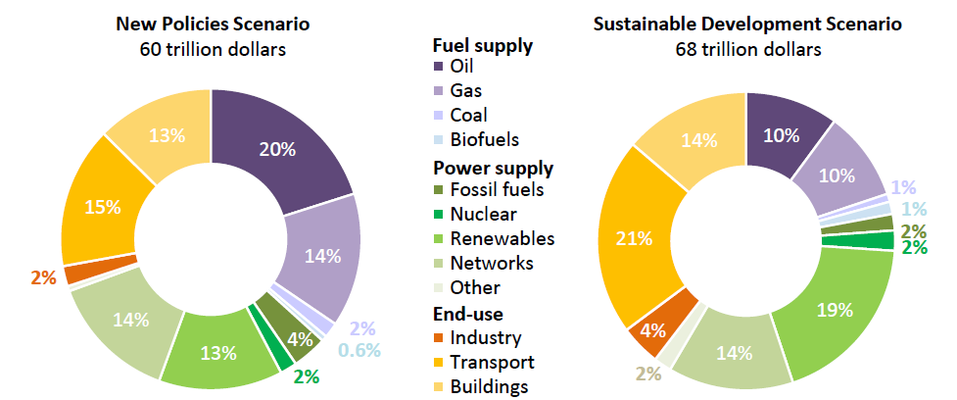
Looking ahead over 20 years, end use efficiency investment needs to rise to 30% or nearly 40% for a 1.5°C goal
Cumulative investment needs by sector in the IEA’s New Policies and Sustainable Development scenarios, 2018-2040
30% on Energy Efficiency
39% on Energy Efficiency
IEA, WEO (2018)
Notes:
Note: Other includes battery storage and CCUS

Slide 30
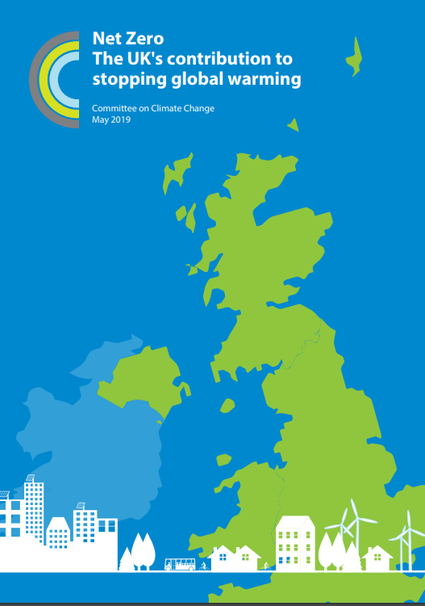
“Delivery must progress with far greater urgency”
Many current plans are insufficiently ambitious; others are proceeding too slowly, even for the current 80% target
2040 is too late for the phase-out of petrol and diesel cars and vans, and current plans for delivering this are too vague.
There is still no serious plan for decarbonising UK heating systems and no large-scale trials have begun for either heat pumps or hydrogen.
Carbon capture (usage) and storage, which is crucial to the delivery of zero GHG emissions and strategically important to the UK economy, is yet to get started.
Afforestation targets for 20,000 hectares/year across the UK nations (due to increase to 27,000 by 2025), are not being delivered.

Slide 31
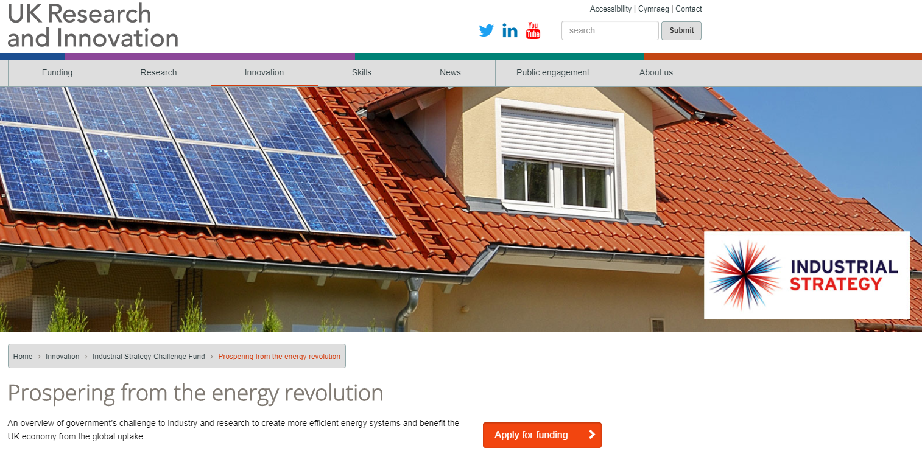

Slide 32


Slide 33
Consumer Behaviour
A look here at Warwick

Slide 34
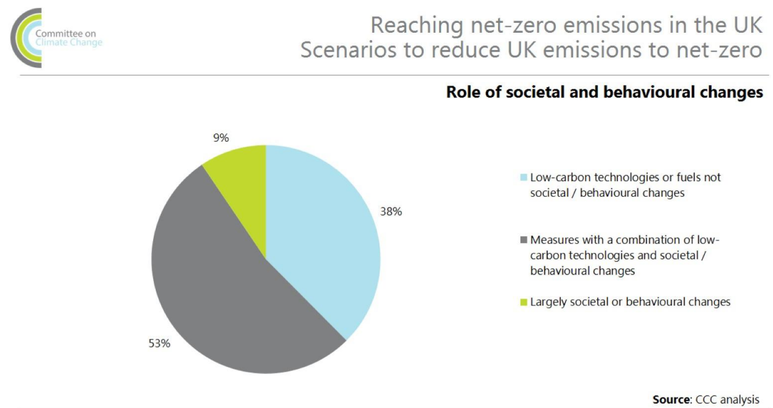
Notes:
Source: https://www.theccc.org.uk/wp-content/uploads/2019/05/Net-Zero-Chris-Stark-Presentation.pdf

Slide 35

Notes:
Sources: https://www.hivehome.com/discover-hive
Video https://youtu.be/ZSSuaRIGCUo

Slide 36
The University of Warwick’s campus is a nationally recognised local energy system
A 24/7/365 town of 30,000 people
290 hectares with over 150 buildings covering 560,000m²
Mix of residential, offices and light industry
19km heating/cooling network and we own the 11kV network
Self-generates at least 50% of heat and power needs with 8.6MWe electricity generation capacity from 6 gas CHP’s
-46% Carbon emissions per £1,000 income since 2005/6
54% increase in floorspace since 2005/6: overall emissions down 8%
Nominated for the Association of Decentralised Energy’s Public Sector Project of the Decade in 2017
A BEIS 2019 Heat Network Case Study

Slide 37




Nudgeathon: A behaviour-centred, design thinking approach to solving complex problems and its application to saving energy.

Slide 38
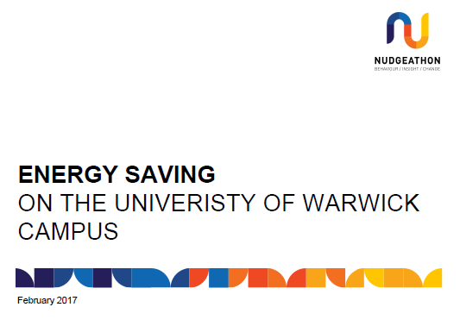


Refining Ideas: Lit Review & Feasibility Modelling
(April-June 2017)
Energy Saving Nudgeathon (February 2017)
Focus Group Discussions (July 2017)
Energy Reports
Halls Competitions
Signs at Radiators
Heat Maps
Temperature-Sensitive Plants
Shower Timers
Free Hoodies
Experimental Trial
(October – December 2017)

Slide 39
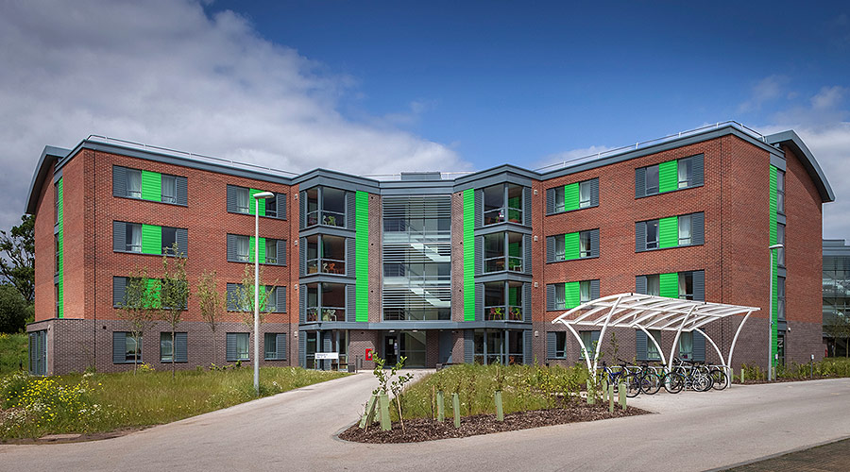
Sherbourne Halls of Residence
6 Blocks – 47 Flats – 527 Students
2 Terms; 4 test periods per term (2 weeks each)
Randomised at block level

Slide 40
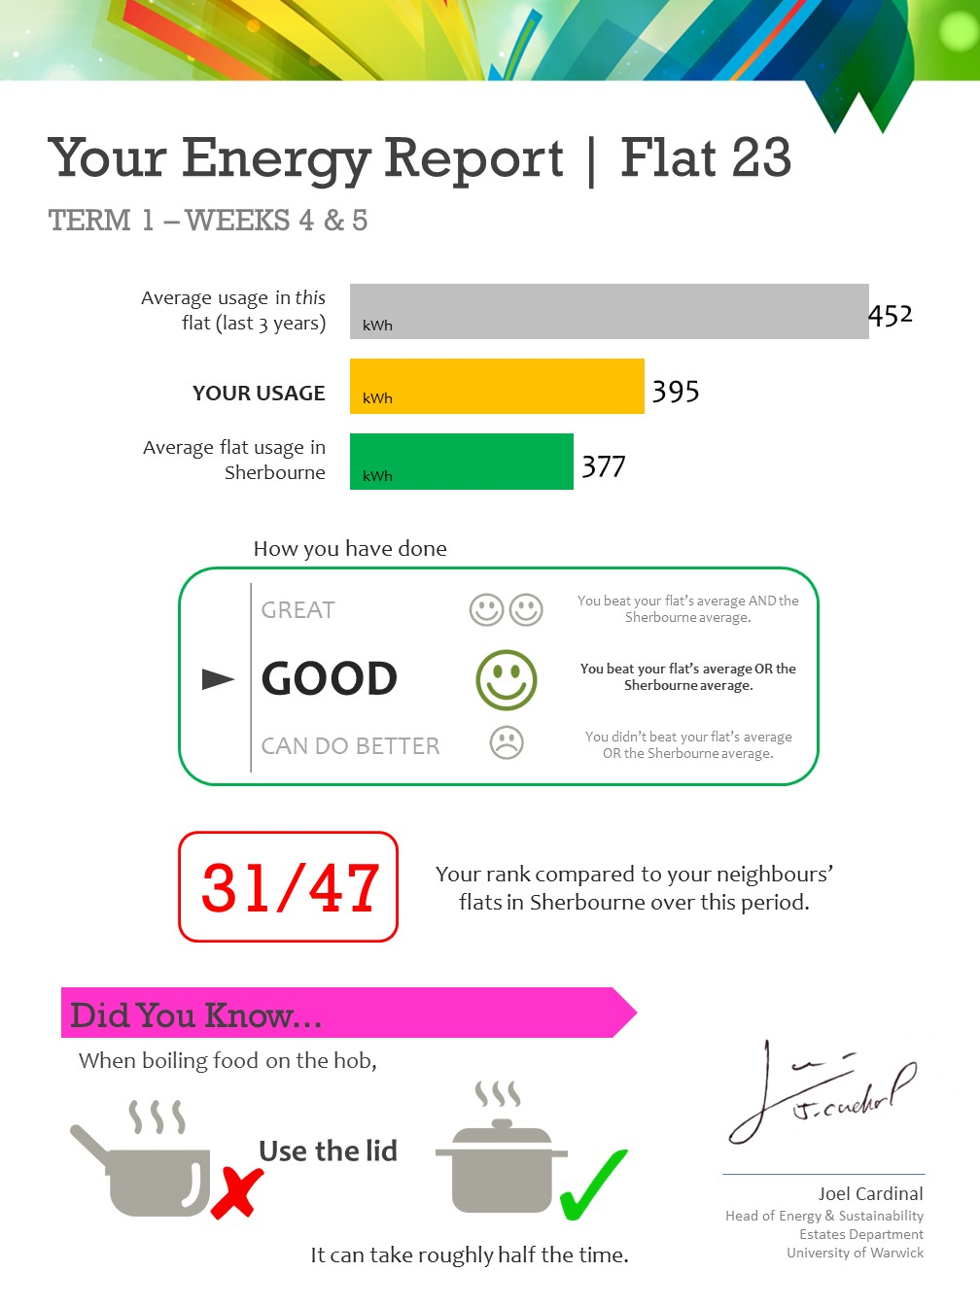
Energy Reports
Current Usage
Social Comparison
Historic Comparison
Grade
Rank
Fact
Signature of ‘Authority’

Slide 41
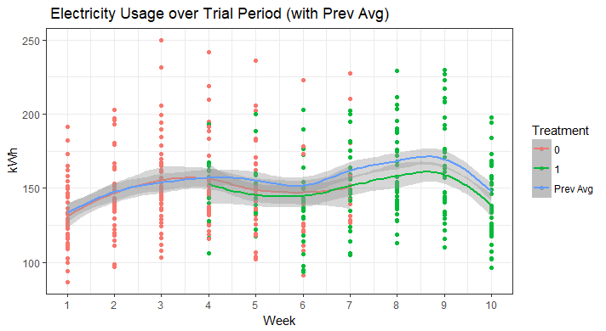
Results

Slide 42
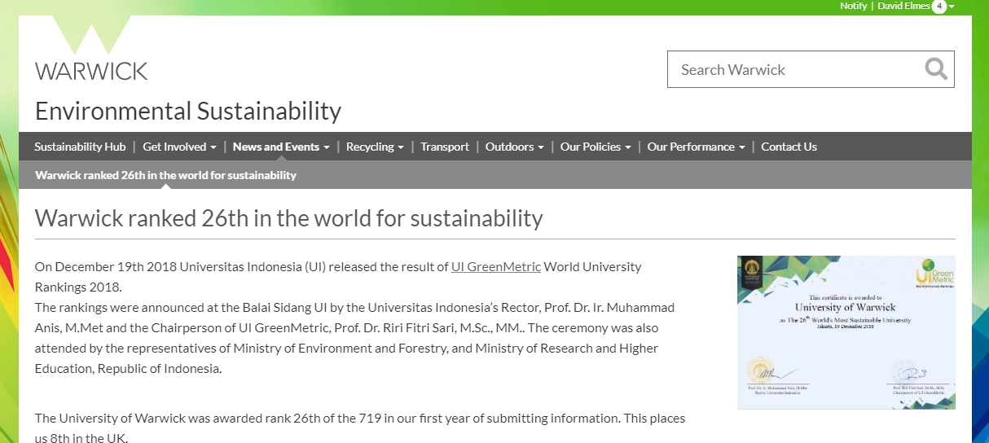

Slide 43
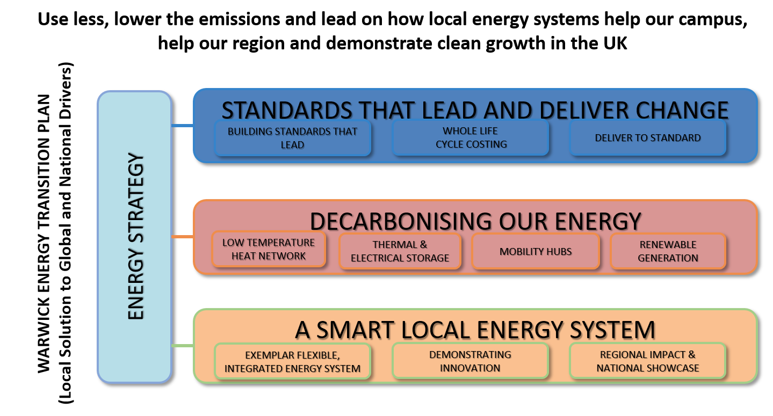
Our ambition to continue developing the campus as a Smart Local Energy System

Slide 44
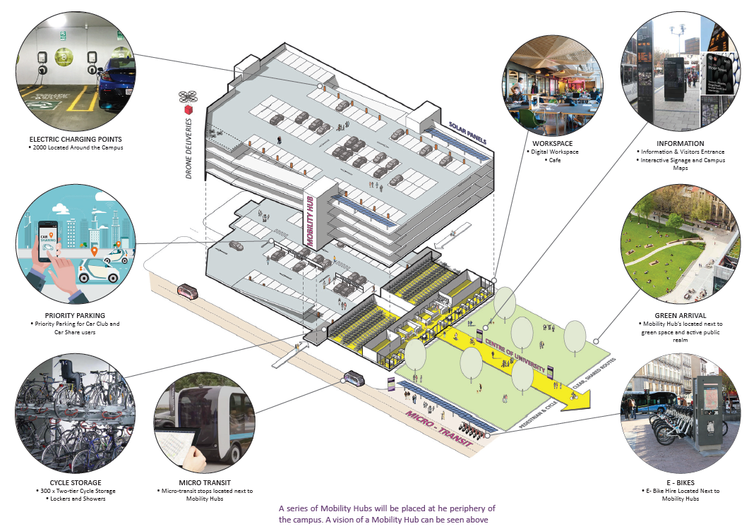

Slide 45
Walking the talk: our tour of campus
From WBS past the central energy centre
  CHP, heat networks and the behaviours of estates managers
NAIC’s roof
  Cross laminate timber and the behaviours of architects & the construction industry
The new Kirby Corner car park
  Yes, EV charging some mode transfer but it’s still a car park
Academic Square & the IIPSI/APC Building
  Smart building controls, green walls… the balance between technology and behaviour
Bit of a trek to… Sherbourne Student Accommodation
  Better building design and technology, plus behaviour experiments on energy reporting
Ending up at the Cryfield Energy Centre, next to the new Sports Hub
  Inside tour of a CHP system and concluding discussion/Q&A

