Slide 1
An Economic Model of Consensus on Distributed Ledgers
Hanna Halaburda, NYU Stern
Zhiguo He, Chicago Booth and NBER
Jiasun Li, George Mason

Slide 2






Byzantine Fault Tolerance (BFT) in blockchains
A classic problem
A resurgence of interest
Trusted $⇒$ adversarial environments
Notes:
We are taking an economics lens at this stuff and ask how it will affect the performance of the system in equilibrium

Slide 3
Byzantine Fault Tolerant (BFT) protocols
Classic problem in computer science (since Lamport, Shostak, Pease `82)
Distributed computer nodes communicate with each other to …
Reach consensus based on “local” information (no “global” knowledge)
Byzantine nodes behave arbitrarily
Stipulate “honest” strategies for non-Byzantine nodes
Widely used in tech companies to maintain distributed databases
  But inside a single organization, so incentives might not be an issue
  In future applications across organizations/parties?

Slide 4
Byzantine Fault Tolerant (BFT) protocols
Classic problem in computer science (since Lamport, Shostak, Pease `82)
Distributed computer nodes communicate with each other to …
Reach consensus based on “local” information (no “global” knowledge)
Byzantine nodes behave arbitrarily
Stipulate “honest” strategies for non-Byzantine nodes
Widely used in tech companies to maintain distributed databases
  But inside a single organization, so incentives might not be an issue
  In future applications across organizations/parties?
This paper (given that blockchains live in trustless environments)
Non-Byzantine nodes are rational
Ambiguity averse (Knightian uncertain) about Byzantine strategies

Slide 5
Consensus game
A game among a measure of n computer nodes:
Nature randomly selects one node as the leader;
  Denote all other nodes as backups;
Leader decides, for each backup, whether to send a message;
  e.g. new batch of transactions in a blockchain; problem.oblem.
Each backup receiving message from leader
  (if yes), for each other node, whether to forward message;
Each node then decides whether to commit to message
  based on its local information set.
For simplicity, we study one round of synchronous peer communication in a single view. Lamport, Shostak and Pease (1982) study f rounds. Castro and Liskov (1999) (PBFT) study two rounds of communication with view changes. We also assume adequately close message delivery speeds to justify simultaneous moves in each step.
Notes:
In our analysis, we use a simple model. We call it a consensus game.

Slide 6

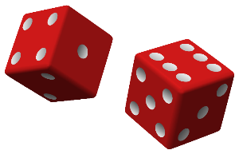
Consensus game
A game among a measure of n computer nodes:
Nature randomly selects one node as the leader;
  Denote all other nodes as backups;
Leader decides, for each backup, whether to send a message;
  e.g. new batch of transactions in a blockchain; problem.
Each backup receiving message from leader
  (if yes), for each other node, whether to forward message;
Each node then decides whether to commit to message
  based on its local information set.
For simplicity, we study one round of synchronous peer communication in a single view. Lamport, Shostak and Pease (1982) study f rounds. Castro and Liskov (1999) (PBFT) study two rounds of communication with view changes. We also assume adequately close message delivery speeds to justify simultaneous moves in each step.

Slide 7
Consensus game
A game among a measure of n computer nodes:
Nature randomly selects one node as the leader;
  Denote all other nodes as backups;
Leader decides, for each backup, whether to send a message;
  e.g. new batch of transactions in a blockchain;
Each backup receiving message from leader
  for each other node, whether to forward message;
Each node then decides whether to commit to message
  based on its local information set.
For simplicity, we study one round of synchronous peer communication in a single view. Lamport, Shostak and Pease (1982) study f rounds. Castro and Liskov (1999) (PBFT) study two rounds of communication with view changes. We also assume adequately close message delivery speeds to justify simultaneous moves in each step.

Slide 8
Consensus game
A game among a measure of n computer nodes:
Nature randomly selects one node as the leader;
  Denote all other nodes as backups;
Leader decides, for each backup, whether to send a message;
  e.g. new batch of transactions in a blockchain;
Each backup receiving message from leader
  decides, for each other node, whether to forward message;
Each node then decides whether to commit to message
  based on its local information set.
For simplicity, we study one round of synchronous peer communication in a single view. Lamport, Shostak and Pease (1982) study f rounds. Castro and Liskov (1999) (PBFT) study two rounds of communication with view changes. We also assume adequately close message delivery speeds to justify simultaneous moves in each step.

Slide 9

Consensus game
A game among a measure of n computer nodes:
Nature randomly selects one node as the leader;
  Denote all other nodes as backups;
Leader decides, for each backup, whether to send a message;
  e.g. new batch of transactions in a blockchain;
Each backup receiving message from leader
  decides, for each other node, whether to forward message;
Each node then decides whether to commit to message
  based on its local information set.
For simplicity, we study one round of synchronous peer communication in a single view. Lamport, Shostak and Pease (1982) study f rounds. Castro and Liskov (1999) (PBFT) study two rounds of communication with view changes. We also assume adequately close message delivery speeds to justify simultaneous moves in each step.

Slide 10

Two types of nodes
Measure f of Byzantine nodes, who may take arbitrary actions;
Measure n−f of rational nodes, who maximize utilities:
Consensus succeeds iff “almost all” (measure n−f) rational nodes commit
A dynamic game of imperfect info. w/ “cheap talk” &“coordination”
Solution concept:
perfect Bayesian eqm + multi-priors over Byzantine strategies
 | if consensus on message
 | Succeeds | Fails
Commit to message | R > 0 | -c < 0
Not commit to message | 0 | 0

Slide 11
Two types of nodes
Measure f of Byzantine nodes, who may take arbitrary actions;
Measure n−f of rational nodes, who maximize utilities:
Consensus succeeds iff “almost all” (measure n−f) rational nodes commit
A dynamic game of imperfect info. w/ “cheap talk” &“coordination”
Solution concept:
perfect Bayesian eqm + multi-priors over Byzantine strategies
?
 | if consensus on message
 | Succeeds | Fails
Commit to message | R > 0 | -c < 0
Not commit to message | 0 | 0
?
?
?

Slide 12
Two types of nodes
Measure f of Byzantine nodes, who may take arbitrary actions;
Measure n−f of rational nodes, who maximize utilities:
Consensus succeeds iff “almost all” (measure n−f) rational nodes commit
A dynamic game of imperfect info. (“coordination” & “cheap talk”)
Solution concept:
perfect Bayesian eqbm + multi-priors over Byzantine strategies
?
 | if consensus on message
 | Succeeds | Fails
Commit to message | R > 0 | -c < 0
Not commit to message | 0 | 0
?
?
?

Slide 13
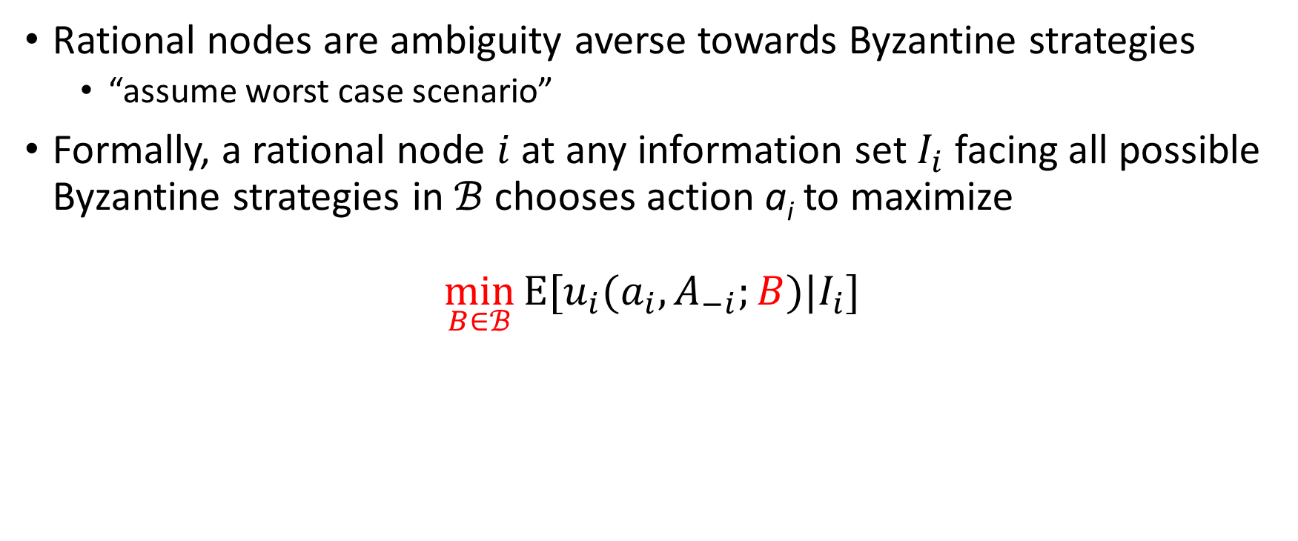
Ambiguity aversion
Rational nodes are ambiguity averse towards Byzantine strategies
  “assume worst case scenario”
Formally, a rational node $i$ at any information set $I_{i}$ facing all possible Byzantine strategies in $ℬ$ chooses action a_{i} to maximize
$$\min_{B∈ℬ}{Ε[u_{i}(a_{i}, A_{−i};B)|I_{i}]}$$
if $∃$ a Byzantine strategy profile consistent with $I_{i}$ such that a positive measure of rational nodes does not commit, then $i$ will not commit

Slide 14
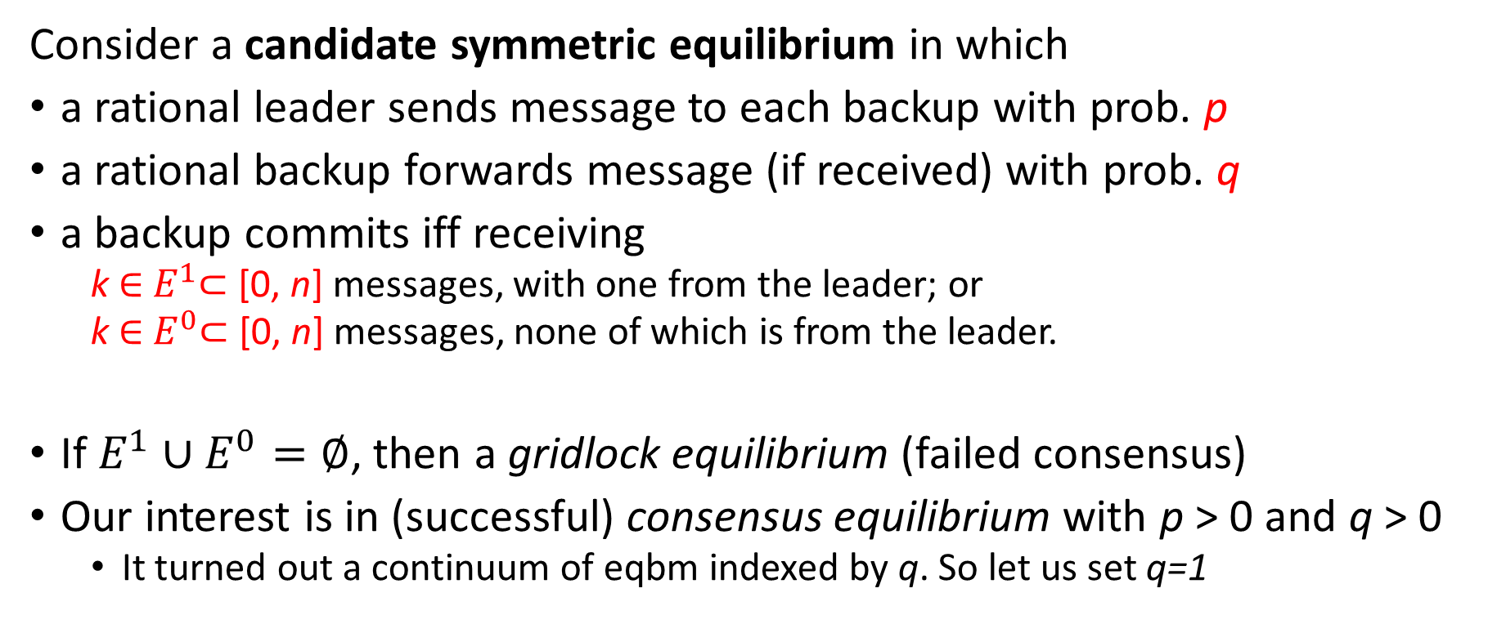
Characterizing all symmetric equilibria
Consider a candidate symmetric equilibrium in which
a rational leader sends message to each backup with prob. p
a rational backup forwards message (if received) with prob. q
a backup commits iff receiving
  k ∈ $E^{1}$⊂ [0, n] messages, with one from the leader; or
  k ∈ $E^{0}$⊂ [0, n] messages, none of which is from the leader.
If $E^{1}∪E^{0}=∅$, then a gridlock equilibrium (failed consensus)
Our interest is in (successful) consensus equilibrium with p > 0 and q > 0
  It turned out a continuum of eqbm indexed by q. So let us set q=1
Notes:
Our contribution here is interpreting blockchain BFT protocols withing economics framework, so that we can derive further insights and implications. First thing we do is to characterize all symmetric equilibria in this simple model. We start with what could be a candidate symmetric equilibrium, and then we pin down conditions under which it exists.

Slide 15






Inferences
about the leader
$$np$$
#msg a rational backup receives
$$\left(n−f\right)p$$
$$n$$
Notes:
In any candidate equilibrium, a node can make a couple of inferences from the # of messages it received

Slide 16

$$n$$
about other rational nodes
#msg another backup receives
$$np$$
#msg a rational backup receives
$$\left(n−f\right)p$$
$$n$$
Notes:
also, given the # of received messages, a node can make inferences about # other nodes received

Slide 17





$$n$$
about other rational nodes
$$f$$
if the leader is Byzantine
Byzantine nodes can coordinate:
Deliver any number of msgs in this range with perfect precision
#msg another backup receives
$$f$$
$$np$$
#msg a rational backup receives
$$f$$
$$\left(n−f\right)p$$
$$n$$
Notes:
Since Byzantine nodes can coordinate, all other rational nodes may get anywhere between -f and +f than me (with the constraint that the number of messages is between 0 and (n-f)q+f), and Byzantine nodes can deliver any number in that range with perfect precision

Slide 18



$$\left(n−f\right)q+f$$
if the leader is rational
$$fp$$
#msg another backup receives
$$f$$
$$\left(n−f\right)p+fp$$
#msg a rational backup receives
$$f$$
$$\left(n−f\right)p$$
$$n$$

Slide 19
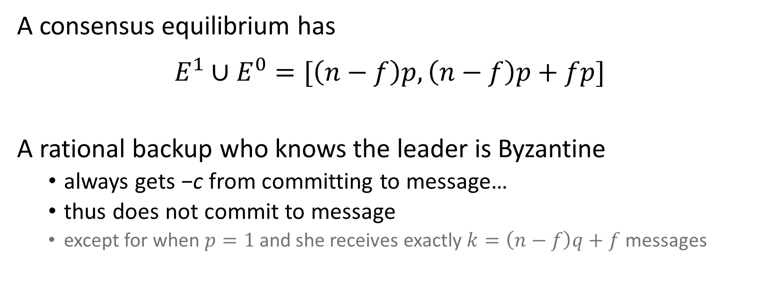
The properties of a consensus equilibrium
A consensus equilibrium has
$$E^{1}∪E^{0}=[\left(n−f\right)p,\left(n−f\right)p+fp]$$
A rational backup who knows the leader is Byzantine
  always gets −c from committing to message…
  thus does not commit to message
  except for when $p=1$ and she receives exactly $k=\left(n−f\right)q+f$ messages

Slide 20

)
$$np$$
#msg a rational backup receives
$$f$$
$$\left(n−f\right)p$$
$$n$$
Notes:
These inferences allow the nodes to make commit decisions.
We use iterated deletion of dominated strategies to find out.

Slide 21
)
$$np$$
#msg a rational backup receives
$$f$$
$$\left(n−f\right)p$$
$$n$$

Slide 22
)
$$np$$
#msg a rational backup receives
$$f$$
$$\left(n−f\right)p$$
$$n$$

Slide 23


)
)
$$np$$
#msg a rational backup receives
$$f$$
2$f$
$$\left(n−f\right)p$$
$$n$$

Slide 24
)
)
$$np$$
#msg a rational backup receives
$$f$$
2$f$
$$\left(n−f\right)p$$
$$n$$

Slide 25




…
$$\left(n−f\right)pq+f$$
)
$$\left(n−f\right)pq+fp$$
)
)
#msg a rational backup receives
$$f$$
2$f$
$$\left(n−f\right)pq$$
$$\left(n−f\right)q+f$$

Slide 26
$$\left(n−f\right)pq+f$$
)
$$np$$
)
)
#msg a rational backup receives
$$f$$
2$f$
$$\left(n−f\right)p$$
$$n$$

Slide 27
…
$$\left(n−f\right)pq+f$$
)
$$np$$
)
)
#msg a rational backup receives
$$f$$
2$f$
$$\left(n−f\right)p$$
$$n$$

Slide 28

??
$$np$$
#msg a rational backup receives
$$\left(n−f\right)p$$
$$n$$

Slide 29

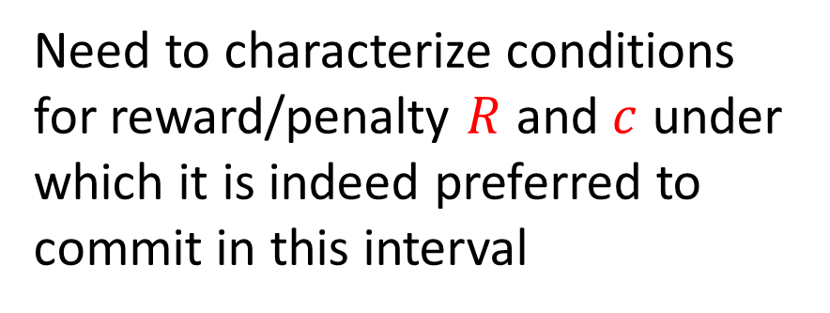
Need to characterize conditions for reward/penalty $R$ and $c$ under which it is indeed preferred to commit in this interval
$$np$$
#msg a rational backup receives
$$\left(n−f\right)p$$
$$n$$

Slide 30
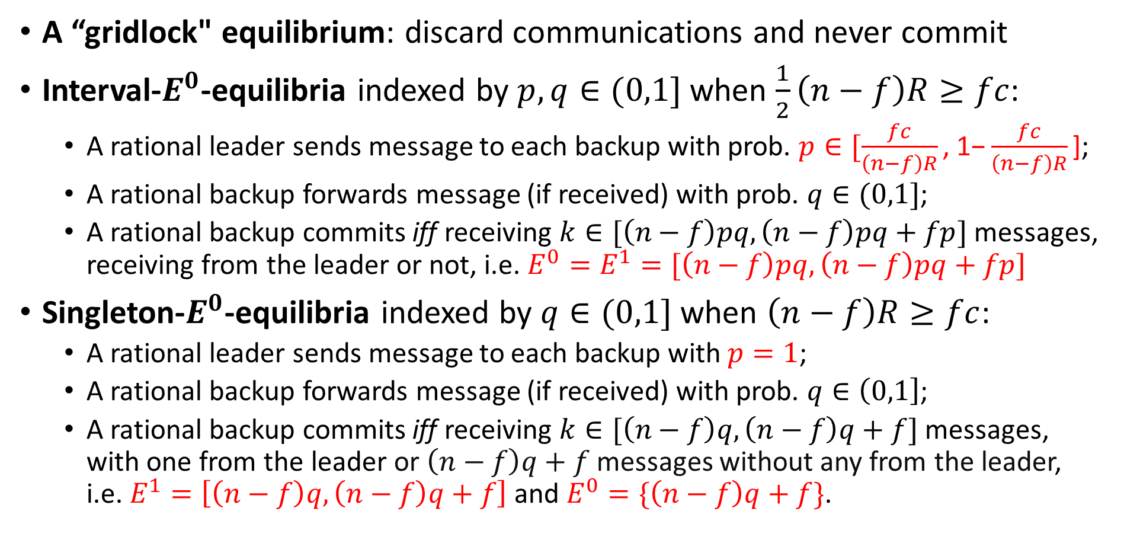
All symmetric equilibria
A “gridlock" equilibrium: discard communications and never commit
Interval-$E^{0}$-equilibria indexed by $p,q∈(0,1]$ when $\frac{1}{2}\left(n−f\right)R≥fc$:
  A rational leader sends message to each backup with prob. $p∈[\frac{fc}{\left(n−f\right)R}\text{, 1−}\frac{fc}{\left(n−f\right)R}\text{]}$;
  A rational backup forwards message (if received) with prob. $q∈(0,1]$;
  A rational backup commits iff receiving $k∈[\left(n−f\right)pq,\left(n−f\right)pq+fp]$ messages, receiving from the leader or not, i.e. $E^{0}=E^{1}=[\left(n−f\right)pq,\left(n−f\right)pq+fp]$
  Singleton-$E^{0}$-equilibria indexed by $q∈(0,1]$ when $\left(n−f\right)R≥fc$:
  A rational leader sends message to each backup with $p=1$;
  A rational backup forwards message (if received) with prob. $q∈\left(0,1\right]$;
  A rational backup commits iff receiving $k∈[\left(n−f\right)q,\left(n−f\right)q+f]$ messages, with one from the leader or $\left(n−f\right)q+f$messages without any from the leader, i.e. $E^{1}=\left[\left(n−f\right)q,\left(n−f\right)q+f\right]$ and $E^{0}=\{\left(n−f\right)q+f\}$.

Slide 31
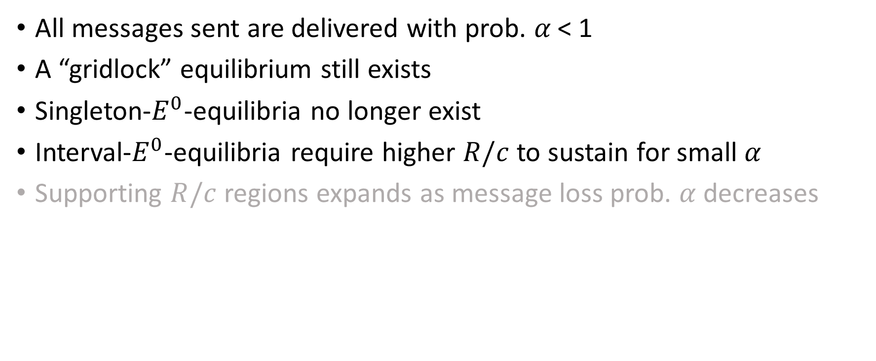
Message losses
All messages sent are delivered with prob. 𝛼 < 1
A “gridlock” equilibrium still exists
Singleton-$E^{0}$-equilibria no longer exist
Interval-$E^{0}$-equilibria require higher $R/c$ to sustain for small $α$
Supporting $R/c$ regions expands as message loss prob. $α$decreases

Slide 32
Implications
Operational success of any blockchain depends on its design.
Accounting for incentives in BFT consensus:
  All designs are subject to multiple equilibria concerns
    gridlock equilibria always exist ⇒ possibility of system stuck
  Small probability of message loss significantly affects equilibria
  Existence of consensus equilibrium depends on R and c
    R and c may be restricted by the environment
    … or can be within decision of the system designer

Slide 33
Relation to existing work
BFT in CS – info important but non-Byzantine nodes are honest
  Lamport, Shostak and Pease (1982), Catro and Liskov (1999)
in Econ, focus mostly on PoW or PoS (on top of consensus protocols)
  Budish (2018), Cong, He and Li (2021), Saleh (2021), etc.
Consensus problems in Econ – cost of sending messages
  Amoussou-Guenou, Biais, Potop-Butucaru and Tucci-Piergiovanni (2020), Auer, Monnet and Shin (2021)
Some general features of consensus problems
  Abadi and Brunnemeier (2021)

Slide 34
Our contribution
An economic framework to analyze incentives in BFT protocols
Guidance for maintaining reliable distributed ledgers among self-interested parties
Focus on information imperfection, rather than, say, operating costs
  Intrinsic to the challenges faced by distributed systems
Thank you!

