Slide 1
DeFiying Gravity? An Empirical Analysis of
Cross-Border Bitcoin, Ether and Stablecoin Flows
Raphael Auer, Ulf Lewrick, & Jan Paulick
Discussant:
Hossein Jahanshahloo
Alliance Manchester Business School

Slide 2
Discussion
Some statements although well known, must be supported by a source
  Cryptoassets are increasingly being integrated into exchange-traded funds, futures and other conventional financial instruments.
Numbers make it more tangible
  However, despite total market capitalisation exceeding that of large national stock markets…
Native cryptoassets → Native Tokens
Neither in data section nor in the introduction the reason for selectino of the sample period is stated.
The writing of the introduction is vague in some places.

Slide 3
Discussion
Sometimes writing very generally and not being specific does not make the reader very interested
  Building on a gravity framework as our analytical lens, we investigate various drivers to shed light on…
Footnote 1 mentions the “app” or “web trafiic”. It is clearer in the data section, but here it is confusing what the app refers to.
  What about VPNs?
    15% of the IP addresses associated with Bitcoin wallets in the US used VPN or TOR
The findings can be discussed in more details and interpreted beyond the initial numerical findings. For instance, the channels through which the drivers of crypto flow affect the flow can be further discussed
  Also these channels can be further analysed

Slide 4
Discussion
The findings can be discussed in more details and interpreted beyond the initial numerical findings. For instance, the channels through which the drivers of crypto flow affect the flow can be further discussed
  These channels can be further analysed
While the flow between exchanges could be due to flow of capital, crypto exchanges are not exactly exchanges.
  Arbitrage
  Lending and borrowing
  Short-term liquidity assurance (The case of ByBit)

Slide 5
Discussion
Low-value BTC payment
  “Moreover, high costs of remittance payments through traditional financial intermediaries are associated with significantly larger cross-border flows in stablecoins and low-value BTC payments from advanced economies to emerging market and developing markets.”
  Could these be due to arbitrage
  See Guo et al., (2025)
Off-chain transactions (e.g. through external channels like exchanges)
  P2P exchanges? Other transaction between the exchanges is recorded on the blockchain
Transaction Size
  How is it defined? How is it measured?
  Total input? Total Output? Is fee considered?
  What if someone puts 1000 BTC as an input but the actual output to is only 1 Satoshi?

Slide 6
Discussion
Some parts of the introduction include a complete LR to construct and discuss the RQ and some parts this is done is a footnote.
“Crypto exchanges account, on average, for about 80% of entity flows in BTC.”
  Is it inflow & outflow?
  Bitcoin Under the Microscope
  Detailed information on entities, their balances, and number of transactions
    158,430,411 Transactions to & from exchanges (201 wallets)
    1,214,672,598 Transactions to & from retail investors (404,890,866 wallets)

Slide 7
Discussion
The reported flows are very price dependent
  While price affects the value of flows, Figure A.1 is almost perfectly correlated with BTC price.
A graph would show the flow of crypto more visually informative
  Shows centrality
  More important nodes
  Allows to include smaller nodes

Slide 8
Discussion
There could be a more in-depth analysis and discussion of the flow maps
Authors mention the growth in crypto flow could be due to more expensive remittance. US and UK are not exactly the most expensive countries to transfer money between them. So why other countries are not discussed her.
China ban on crypto. Which one is being discussed here? 2017 or 2021?

Slide 9
Discussion
USDC flow map is not shown in the main text.
  USDC vs USDT
  One is active in the EU after MiCA and one is not
  Different usage & …
There could be a better justification for choosing the driving factors
  What is the underlying theory?
  Why are these factors chosen?
  What is the discussion based on?
Crypto assets, unbacked crypto assets, stable coins
  A bit confusing
  “Crypto assets for cross border payments”

Slide 10
Discussion
Why would Fed Rate affect BTC and ETH?
  It affects their $ value but they are traded in many other currencies?
  What about ECB or BOE rate?
  This point would be valid if it is shown majority of BTC and ETH is held by companies or individuals who their consumption currency is $.
Google Search
  Should be explained how it is measured
  Is it per country, combined, …
  How is it “standardised nationally”
  Why is it used as a binary variable when it can be used in a way that is comparable across countries and time

Slide 11
Discussion
Cross border crypto flow of BTC is $3.3M on average with a 90th percentile of $3.7M.
  It seems very low for a quarterly data
  The same holds for ETH, USDT, and USDC
  Why is the maximum not reported?
In discussion of the results, sometimes, coefficients’ magnitude and significance are compared with each other
  Are they tested to say one is more than another?
Table 5, in models 6 and 7, US Growth, switches sign
  Why? What is the interpretation? What drives this?

Slide 12
Discussion
Overall, the presentation of the results can significantly benefit from digging a bit deeper and going beyond just numbers and presenting the findings.
  What are the channels and reasons for these effects?
“A tightening of global monetary conditions is associated with a reduction in crossborder BTC transaction volumes.”
  What could be the reason for this?
    Could it be due to increased cost of arbitrage?
    Could it be because other assets become safer?
“BTC transaction volumes increase following periods of excess crypto market returns, with a positive, significant loading on the lagged market factor.”

Slide 13
Discussion
Table 6
  Why distance & common language have different impacts on USDC and USDT?
  Why Fed rate becomes insignificant when controlling for crypto market factors?
  Why US growth sign changes in table 5 but not in table 6 when controlling for crypto market factors?
    Do they have different impact on BTC and ETH?
  BTC-USD volatility coefficient is negative for stablecoins while it is positive for ETH and BTC.
    Shouldn’t they be the same sign if the flow is due to speculation or arbitrag?
    What does this mean?

Slide 14
Discussion
Table 7
  Why not to study the difference of these variables?
    If both countries have relatively the same level of awareness of cryptos, how, if any, would this affect the flow?
  The interaction between these terms could be interesting.
    Based on the current setting high and high are additive, while the interaction term could be negative which means the benefit is not additive.
“Our findings for USDC resonate with the attractiveness of stablecoins for international transactions among countries facing inflationary pressure”
  What is the explanation for this? Could this be because countries with higher inflation are also less developed and cost of international transaction is higher? Could it be due to sanction or lack of access to US$ payment system?

Slide 15
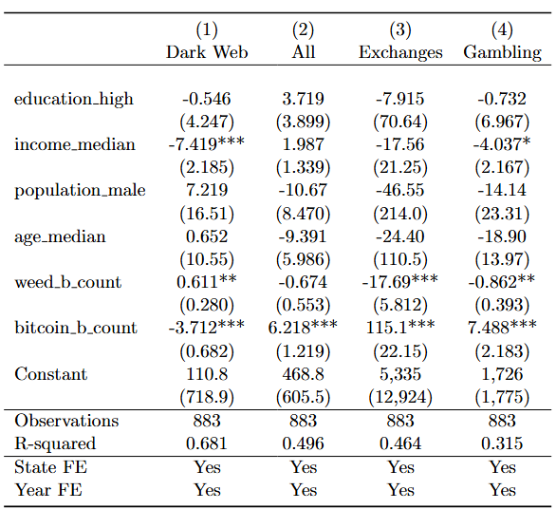
Public Awareness
Recreational Cannabis Legalisation
How is public awareness (Google Search) defined and measured?
What terms are included?
These significantly affect the findinsg.

Slide 16
Discussion
If Remittance is one of the main points of interest, why Ripple is not here?
Low-value BTC transactions
  There could be transactions with orders of magnitude higher but the actual volume being in the same range.
  What you are measuring here is lower balance addresses of wallets or less rich users.
  I would re-word this and would not call it "low-value". A billion transaction could be low value if the actual transaction volume is measured
  What about cc455ae816e6cdafdb58d54e35d4f46d860047458eacf1c7405dc634631c570d transaction?

Slide 17
Discussion
Impact of CFM on flow
  Do you consider whether the flow is to or from the country that has imposed the regulation
  Regulation should be studied based on the country of regulation and country of exchange HQ.
Deeper interpretation
Studying the channels that these effects are transmitted through
Clearer data and methodology explanation

