Slide 1
It’s not easy
being
Green

Slide 2
Understand your Energy Bill
&
Reflect on the Campus Cost of Utilities
Warwick Network
12th April 2010

Slide 3
Agenda
Understand your home Energy bills
  Why do we use Energy ? – What is comfort ?
  Is my bill double Dutch?
Benchmarks
  How am I doing compared to others?
  What is best in class?
Government targets
  Government Climate Change Act
  Housing regulations
  Energy efficiency and CO2 emissions reductions schemes
Home improvements
  Buy wise
  Reduce consumptions
University of Warwick Utilities budget
  How does the University compare to others?
  What is your department paying for?
We can make a difference
  Estates Office
  At home
  At the University

Slide 4
Agenda
Understand your home Energy bills
  Why do we use Energy ? – What is comfort ?
  Is my bill double Dutch?
Benchmarks
  How am I doing compared to others?
  What is best in class?
Government targets
  Government Climate Change Act
  Housing regulations
  Energy efficiency and CO2 emissions reductions schemes
Home improvements
  Buy wise
  Reduce consumptions
University of Warwick Utilities budget
  How does the University compare to others?
  What is your department paying for?
We can make a difference
  Estates Office
  At home
  At the University
4
Warwick Network 2010
Joel Cardinal

Slide 5
0 carbon is not 0 energy
Zero Carbon ~ zero Co2 emissions
  Do not confuse 0 carbon and 0 energy
  Green electricity can be “0 carbon”
    Wind turbines
    Wave energy
    Solar energy
Biomass
  Carbon emissions emitted by combustion are consumed again by re-growth of the plant
    Wood fuel (logs, chips, pellets)
    Plants (algae, straw…)
Note: nuclear power is “low” CO2 emissions but extraction of the Uranium and the entire process is complex and bears long term risks.
5
Warwick Network 2010
Joel Cardinal

Slide 6
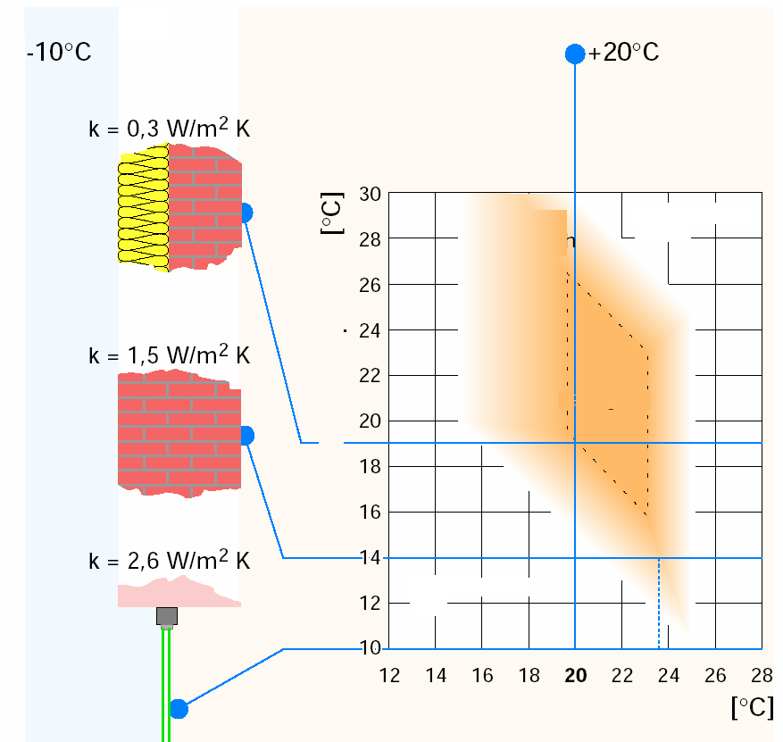
Energy bills and comfort factors
Comfort expectation has a direct impact on consumption
Heating the air is expensive
  because of the air leaks (air drafts – air infiltration)
Physiology for thermal comfort
Outside air:
Inside air:
surface temperature
still comfortable
Uncomfortably warm
comfortable
  Radiant surfaces at 21ºC + at 17ºC air achieve same comfort than air at 20ºC
  BUT
  1ºC less can save 10% of heating
uncomfortably cold
  Select “warm touch” material such as Wood, hemp, not metal
Warwick Network 2010

Slide 7
Agenda
Understand your home Energy bills
  Why do we use Energy ? – What is comfort ?
  Is my bill double Dutch?
Benchmarks
  How am I doing compared to others?
  What is best in class?
Government targets
  Government Climate Change Act
  Housing regulations
  Energy efficiency and CO2 emissions reductions schemes
Home improvements
  Buy wise
  Reduce consumptions
University of Warwick Utilities budget
  How does the University compare to others?
  What is your department paying for?
We can make a difference
  Estates Office
  At home
  At the University
7
Warwick Network 2010
Joel Cardinal

Slide 8
Benchmark - Energy
Warwick Network 2010
Typical dwelling energy consumption
  For reference only. A detached facing winds will use more energy than a terraced house
  Floor area is a key factor

Slide 9
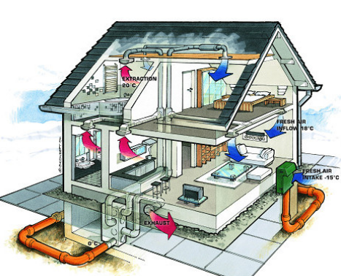
Benchmark - Energy
Best in class houses are super insulated and well ventilated
Fresh air intake = -15ºC
Extraction = 20ºC
Fresh air inflow = 18ºC
9
Warwick Network 2010
Joel Cardinal

Slide 10
Benchmark - Energy
Best in class houses achieve very low heating demand
Minergie®
Heating demand < 42 KWh/m²/year
Electrical demand < 15 KWh/m²/year
Minergy P® require
Heating demand < 30 KWh/m²/year
Electrical demand < 15 KWh/m²/year
Passive House
Heating demand < 15 KWh/m²/year
Typical UK house
Good 100 KWh/m²/year
Typical 250 KWh/m²/year
Bad 450 KWh/m²/year
10
Warwick Network 2010
Joel Cardinal

Slide 11
Benchmark - Energy
United Kingdom
Domestic energy consumption per household: by final use |  |  |  |  | Joel's bill | Passive House design
KWh | 1971 | 1981 | 1991 | 2001 | 2009 | 80 | m2
Space heating | 12,675 | 13,372 | 13,837 | 14,070 | 13,179 | 1,200 | 15 KWh/m2/a
Water | 6,047 | 5,581 | 5,349 | 5,233
Cooking | 1,279 | 1,047 | 814 | 581 | 1,605 | 3,488
Lighting and appliances | 1,744 | 2,442 | 2,791 | 2,907
Total | 21,744 | 22,326 | 22,675 | 22,791 | 14,784 | 4,688
Source: Building Research Establishment |  |  |  |  |  | -79%
£1,300 to £1,500 /annum
£1,300 to £1,500 /annum
£480 /annum
£480 /annum
Warwick Network 2010

Slide 12
Benchmark – CO₂
United Kingdom
Domestic CO2 emissions per household: by final use |  |  |  |  |  | Joel's bill | Passive House design
KgCO2 |  | 1971 | 1981 | 1991 | 2001 | 2009 | 80 | m2
Space heating |  | 2,345 | 2,474 | 2,560 | 2,603 | 2,438 | 222 | 15 KWh/m2/a
Water |  | 1,119 | 1,033 | 990 | 968
Cooking |  | 687 | 562 | 437 | 312 | 862 | 1,873
Lighting and appliances |  | 937 | 1,311 | 1,499 | 1,561
Total (KgCO2/annum) |  | 5,087 | 5,380 | 5,485 | 5,444 | 3,300 | 2,095
Total (tonnes CO2/annum) |  | 5.1 | 5.4 | 5.5 | 5.4 | 3.3 | 2
 |  |  |  |  |  |  | -62%
1KWh electrical = 0.537 KgCO2
1KWh heat = 0.185 KgCO2
Warwick Network 2010

Slide 13
Agenda
13
Warwick Network 2010
Joel Cardinal
Understand your home Energy bills
  Why do we use Energy ? – What is comfort ?
  Is my bill double Dutch?
Benchmarks
  How am I doing compared to others?
  What is best in class?
Government targets
  Government Climate Change Act
  Housing regulations
  Energy efficiency and CO2 emissions reductions schemes
Home improvements
  Buy wise
  Reduce consumptions
University of Warwick Utilities budget
  How does the University compare to others?
  What is your department paying for?
We can make a difference
  Estates Office
  At home
  At the University

Slide 14
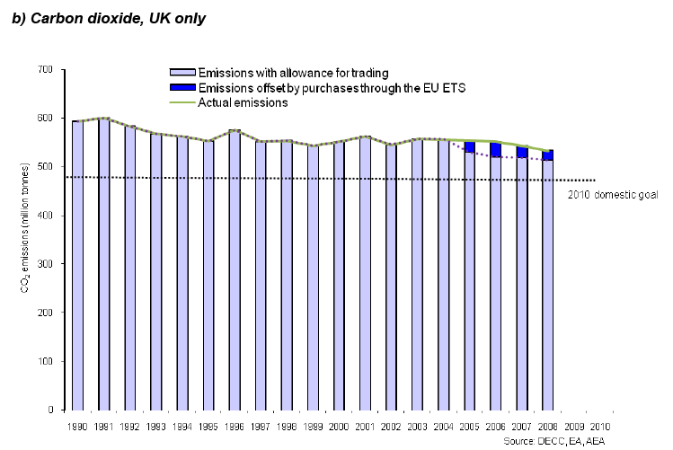
Government Target – CO2
Kyoto protocol is the driver
UK domestic emissions are not reducing as per Kyoto protocol targets
14
Warwick Network 2010
Joel Cardinal

Slide 15
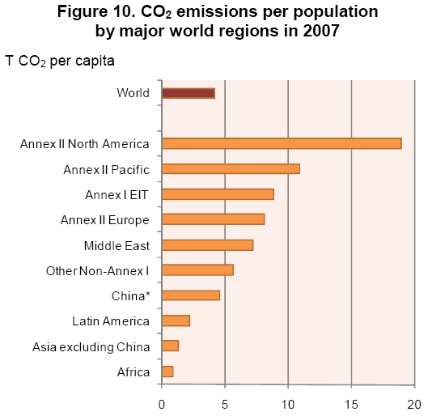
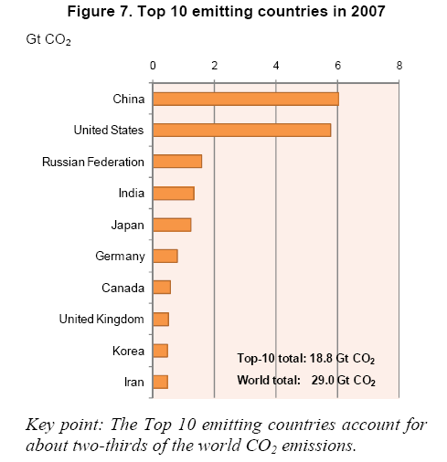
Government Target – CO2
Incl. UK
Acronyms / list of countries; refer to http://www.iea.org/co2highlights/ p42/124 of downloadable file
http://www.defra.gov.uk/sustainable/government/progress/national/index.htm
15
Warwick Network 2010
Joel Cardinal

Slide 16

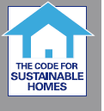
Government targets
Government’s call for all homes to be zero carbon by 2016
  Building Regulations, Energy efficiency requirements for new dwellings
    A forward look at what standards may be in 2010 and 2013 document
    Improvement on energy/carbon performance compared with Building Regulations 2006
  2010 = 25%
    This is level 3 in the Code for Sustainable Homes and can be achieved, the government says, through improving the building fabric and through heating and lighting efficiency.
  2013 = of 44%
    This is level 4 in the Code for Sustainable Homes and can be achieved through CHP at development level or solar hot water heating at the building level.
  2016 = Zero carbon
    This is level 6 in the Code for Sustainable Homes and will have to deliver net zero carbon over the year for all energy use in the home, including cooking, electric appliances, space heating, cooling, ventilation and hot water.
Warwick Network 2010

Slide 17
Government targets
Warwick Network 2010
Water consumption:
Government target is 130 litre/person/day (current UK average is 150 litre/person/day )
Electricity consumption: Government to deploy 100% smart meters by 2020
Home
HIP: all house sale to have home information pack including Energy Performance
RHI – Renewable Heat Incentive; support a range of technologies including for households with a rate of return of 12% on the additional cost of renewable. From April 2011. http://www.decc.gov.uk/en/content/cms/consultations/rhi/rhi.aspx
Insulation
Pay as you save; being tested in 500 household in the country; http://www.energysavingtrust.org.uk/corporate/Corporate-and-media-site/Media-centre/Latest-news/500-homes-to-pilot-Pay-As-You-Save-PAYS
Generate your energy
FIT (Feed In Tariff)
ROC (Renewable Obligation Certificate)
Micro CHP (micro Combined Heat and Power)

Slide 18
Agenda
18
Warwick Network 2010
Joel Cardinal
Understand your home Energy bills
  Why do we use Energy ? – What is comfort ?
  Is my bill double Dutch?
Benchmarks
  How am I doing compared to others?
  What is best in class?
Government targets
  Government Climate Change Act
  Housing regulations
  Energy efficiency and CO2 emissions reductions schemes
Home improvements
  Buy wise
  Reduce consumptions
University of Warwick Utilities budget
  How does the University compare to others?
  What is your department paying for?
We can make a difference
  Estates Office
  At home
  At the University

Slide 19
Home Improvements
How to improve?
  Reduce consumption
  Improve building
Why are the papers full of “smart meters”?
  You understand better what you can measure
  You can accept / reject exceptions and anomalies.
Some links to find out how to do it:
  http://www.carbonfootprint.com/energyconsumption.html
  Other example & explanations for electricity: http://www.esru.strath.ac.uk/EandE/Web_sites/01-02/RE_info/hec.htm
Warwick Network 2010

Slide 20
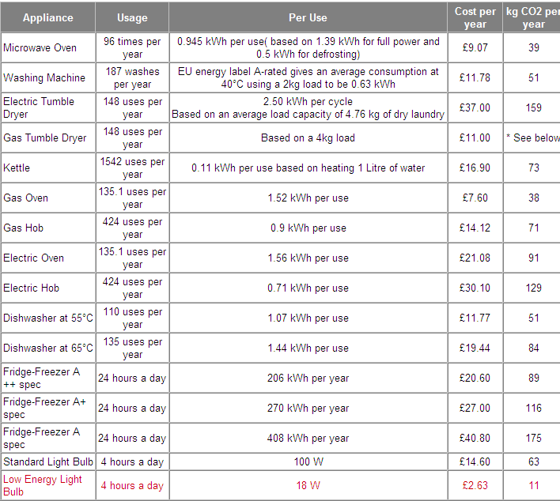
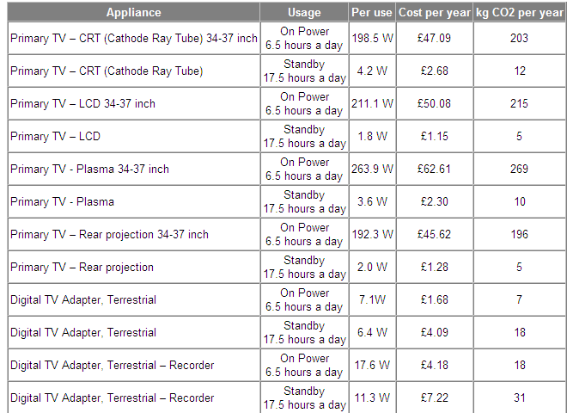
Home Improvements
Warwick Network 2010

Slide 21
Home Improvements
Always check that readings are accurate
  Avoid Estimates
  Provide your own read
You may not have the choice for your water supplier
  Market is liberalised in theory but there may be no offer.
Challenge your Gas and Electricity contracts
  Consult comparison sites such as :
  www.whichswitch.co.uk
  www.uswitch.com
  www.utilityswitch.com/
  www.gocompare.com/gas-and-electricity
Warwick Network 2010

Slide 22
Home Improvements
Reduce water costs
  Rates reductions apply when sufficient rain water are spread on site (not in foul)
  Water harvesting would reduce water supply charges but may not reduce sewage.
Improve insulation
  Check available grants
  www.energysavingtrust.org.uk
  The carbon trust
  Greenspec.co.uk
  The national Energy Foundation
Warwick Network 2010

Slide 23


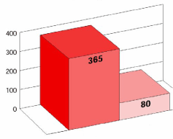
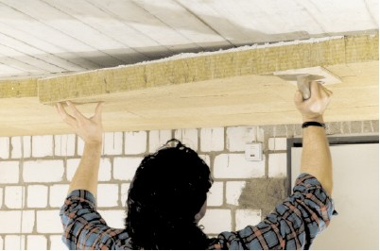
Home Improvements
Example of a
successful renovation
Before £1,635 / annum
After £ 358 /annum
kWh per m² and year
Assume 80m2 floor area
Assume 12p/KWh unit of electricity
Assume 4p/KWh unit of gas
Assume 80% energy used for heating (gas)
tomorrow
today
Warwick Network 2010

Slide 24

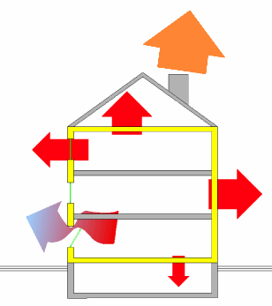
Example of renovation: 1950s building
external walls
pumice blockwork plastered on both sides
u = 1.3
window
wooden window single glazing
u = 5.2
top floor ceiling
concrete ceiling
no thermal insulation
plastered on underside
u = 3.0
basement ceiling
fitted carpet
flooring bonded screed
concrete ceiling
u = 2.0
Unused
heat energy
28%
Roof 17%
windows
12%
walls 16%
ventilation
20%
basement ceiling
7%
Warwick Network 2010

Slide 25
Agenda
25
Warwick Network 2010
Joel Cardinal
Understand your home Energy bills
  Why do we use Energy ? – What is comfort ?
  Is my bill double Dutch?
Benchmarks
  How am I doing compared to others?
  What is best in class?
Government targets
  Government Climate Change Act
  Housing regulations
  Energy efficiency and CO2 emissions reductions schemes
Home improvements
  Buy wise
  Reduce consumptions
University of Warwick Utilities budget
  How does the University compare to others?
  What is your department paying for?
We can make a difference
  Estates Office
  At home
  At the University

Slide 26
University of Warwick Utilities budget
University of Warwick Utilities budget 2008-9 =
£8,732,216
University of Warwick Utilities budget 2008-9 =
£8,732,216
~ £350 / person (FTE + staff)
~ £350 / person (FTE + staff)
~ 1.5 tonne CO2 / person
(FTE + staff)
Warwick Network 2010

Slide 27
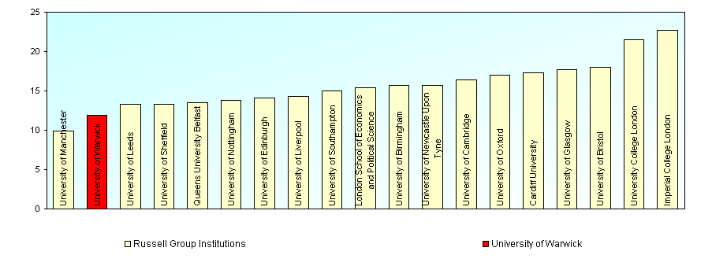
University of Warwick – CO2 emissions
Thanks to the UoW large Combined Heat & Power associated with a large district heating network the emissions are largely reduced.
Cost saving 20% (£1.8m)
CO2 saved by 36%
Energy costs (D31) psm GIA (D11) C1 (All data)
Source: EMS statistics 2007-8
Warwick Network 2010

Slide 28
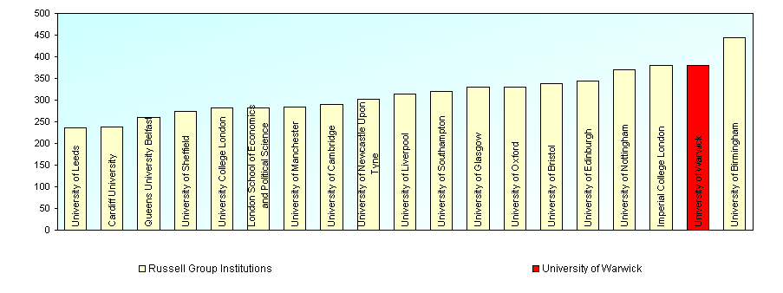
University of Warwick Utilities budget
UoW does not make efficient use of Energy generated - produced
Energy consumption kW/h (D38A) psm GIA (D11) C1 (All data)
387 KWh/m2/annum
Remember, UK typical household = 250 KWh/m2/ammum
UoW emissions are larger than UK household in proportion of floor space
38,499 tonnes CO2 emitted over 417,000m2
Floor space as large as 5,200 UK households
Emits as much CO2 as 7,100 UK household (+37%)
Source: EMS statistics 2007-8
Warwick Network 2010

Slide 29
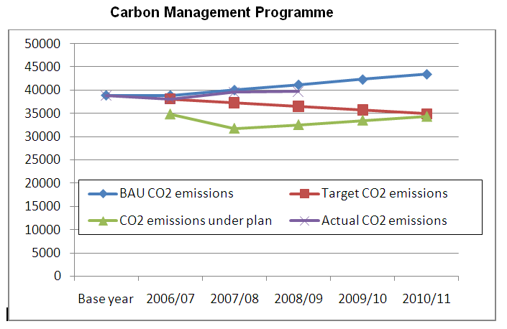
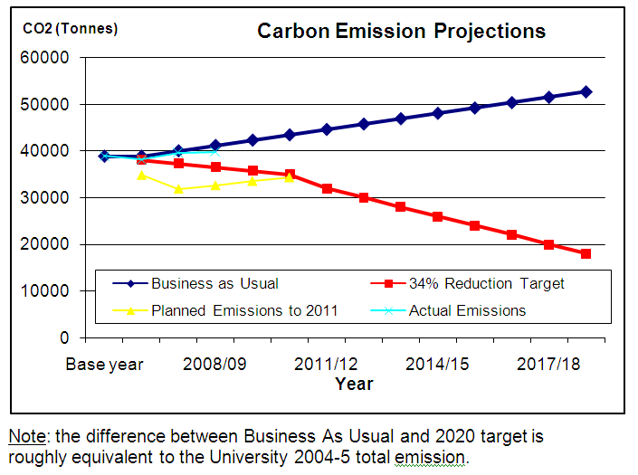
University of Warwick Utilities budget
UoW is not on track to reduce its carbon emissions
Warwick Network 2010

Slide 30
Agenda
Understand your home Energy bills
  Why do we use Energy ? – What is comfort ?
  Is my bill double Dutch?
Benchmarks
  How am I doing compared to others?
  What is best in class?
Government targets
  Government Climate Change Act
  Housing regulations
  Energy efficiency and CO2 emissions reductions schemes
Home improvements
  Buy wise
  Reduce consumptions
University of Warwick Utilities budget
  What is your department paying for?
  How does the University compare to others?
We can make a difference
  Estates Office
  At home
  At the University
30
Warwick Network 2010
Joel Cardinal

Slide 31
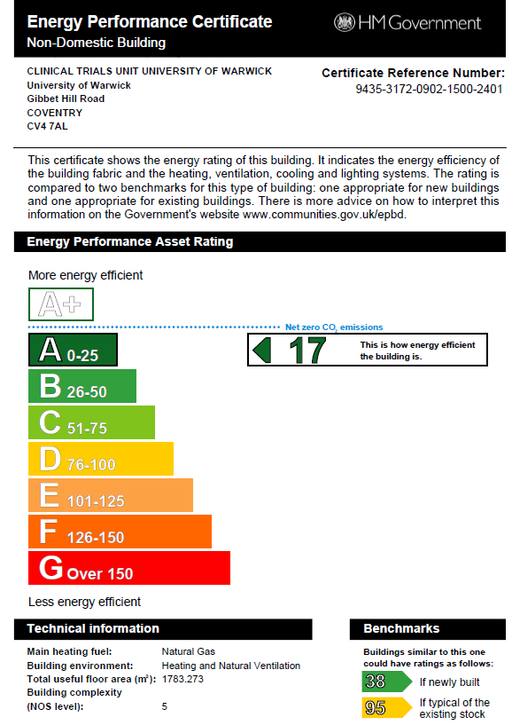
The Estates Office contribution
CTU building is “A” rated for Energy Performance Certificate
Warwick Network 2010

Slide 32

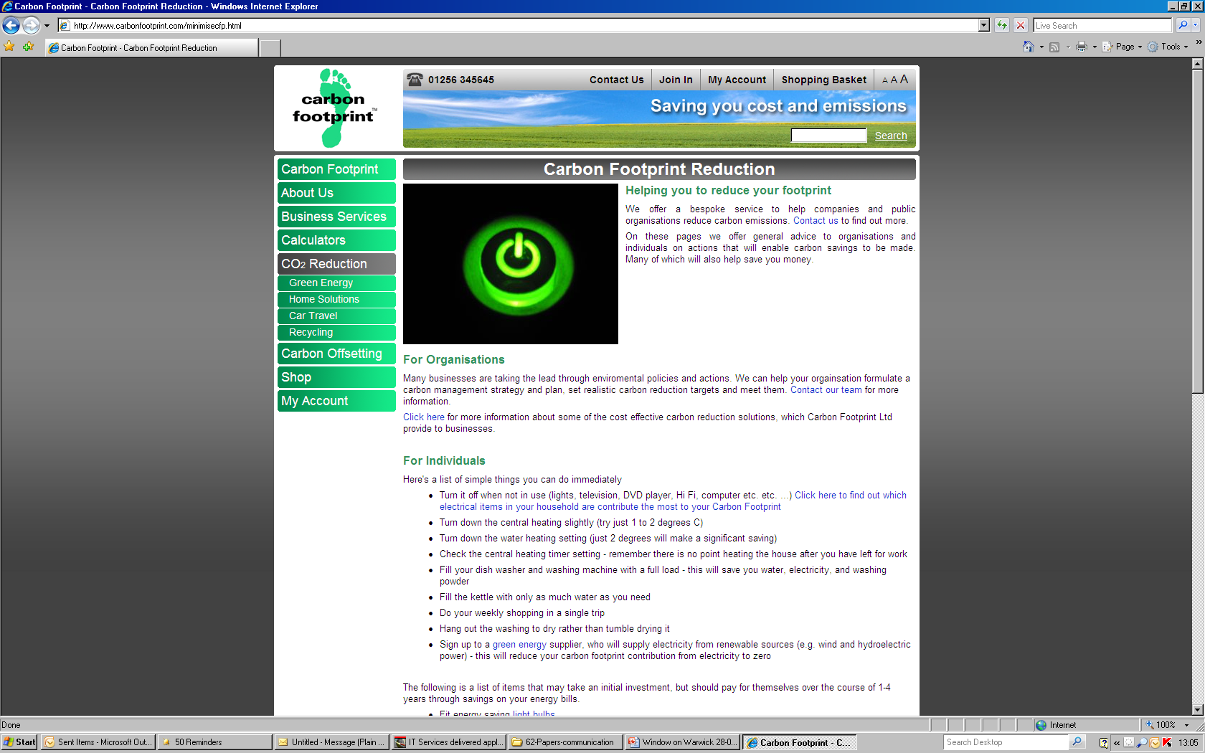
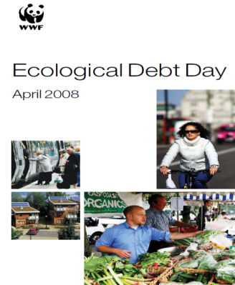
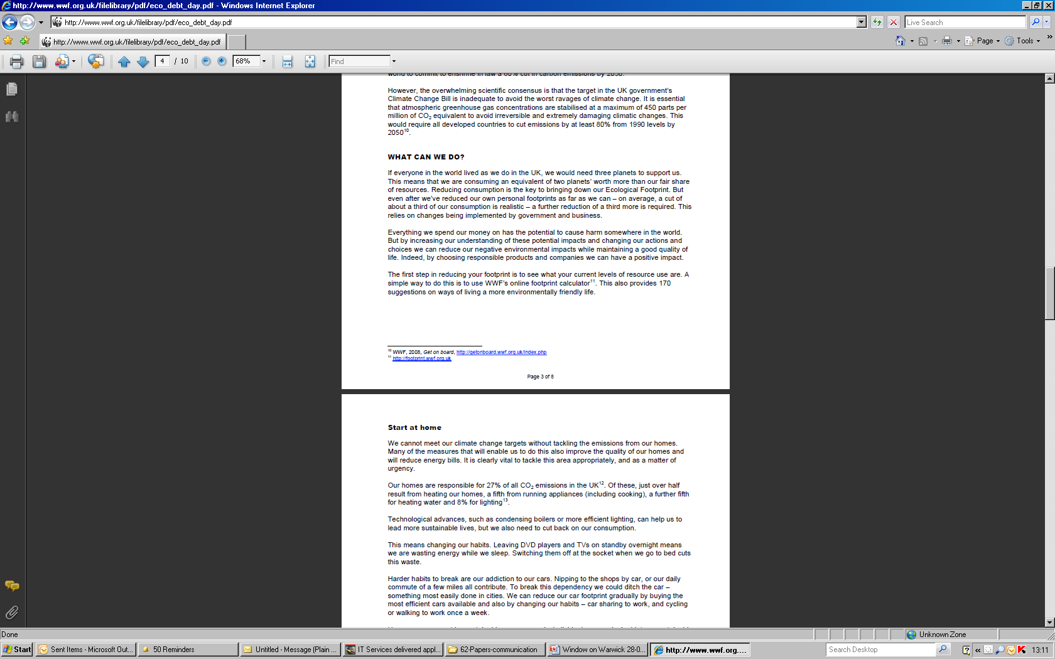
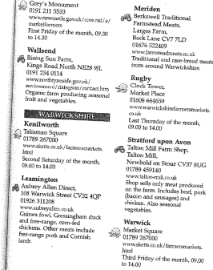
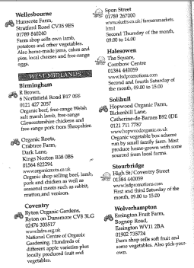
You can make a difference – at home
10 tips for home actions
http://ethicalandgreen.com/2007/10/10/top-tips-to-reduce-co2-emissions/
http://www.carbonfootprint.com/minimisecfp.html
www.wwf.org.uk/filelibrary/pdf/eco_debt_day.pdf
Buy local food (farmers markets – farm shops)
32
Warwick Network 2010
Joel Cardinal

Slide 33
You can make a difference – at work
33
Warwick Network 2010
Joel Cardinal
Vote with your feet
Would all of us accept larger tolerances?
  UK aim >= 19 in winter and <=26 in summer
  Then the University could adapt the settings for heating and cooling “get your jumper on”
  A/C is not always comfortable; cold spots and dry air
Most important
  Identify anomalies (drafts, leaks)
  Use less energy where possible

Slide 34
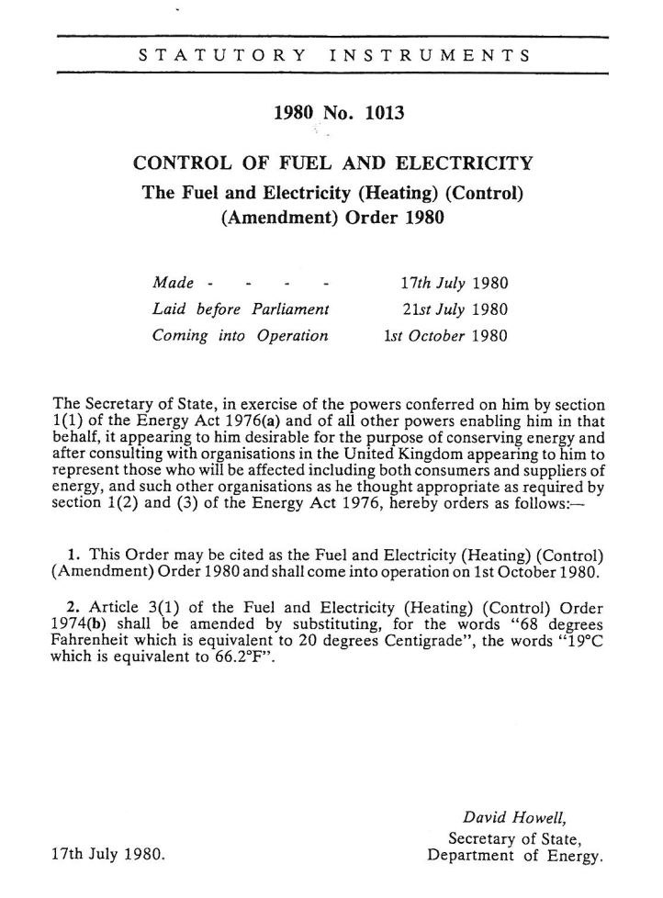
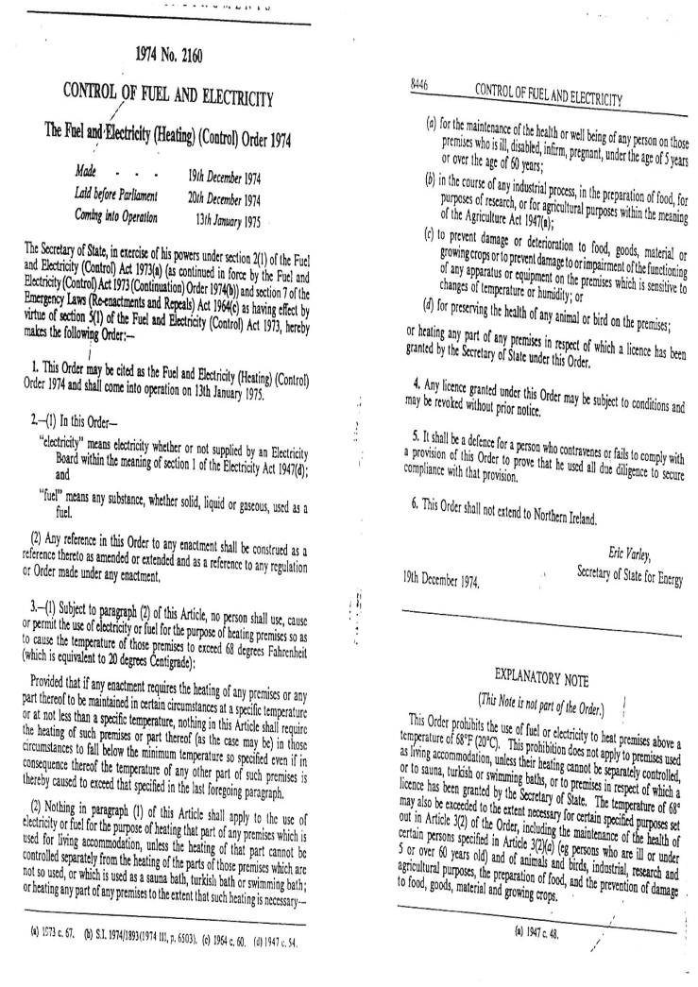
You can make a difference – at work
Prohibit the use of fuel to heat premises above 19 degrees
19 degrees
Warwick Network 2010

Slide 35
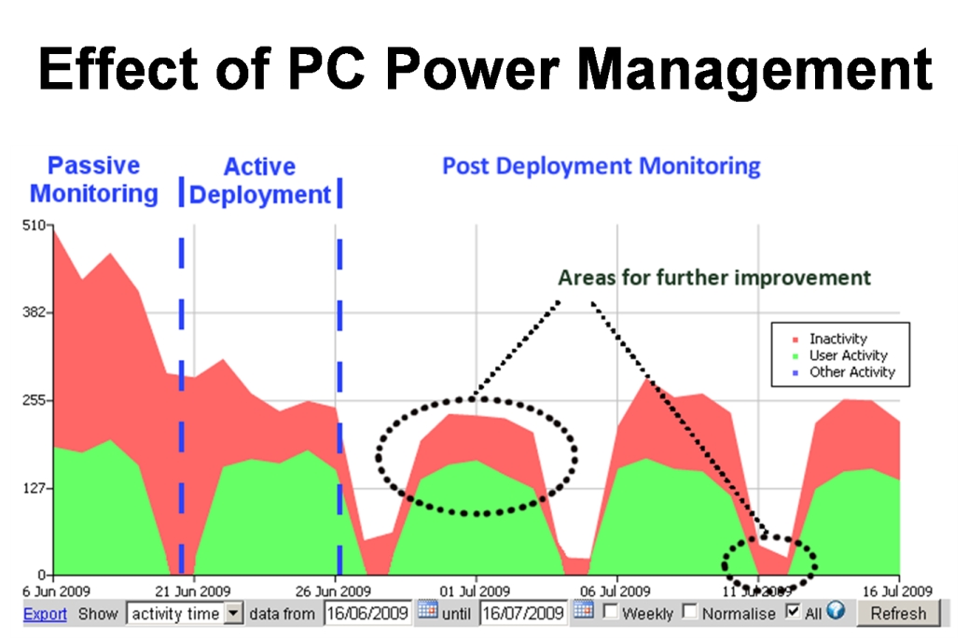
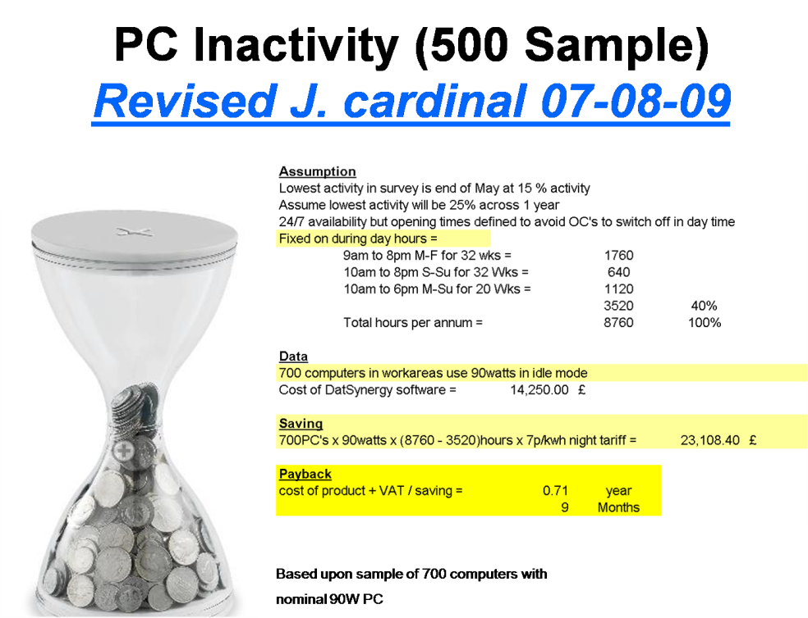
You can make a difference – at work
Be an actor of behavioural change
Switch off computer at evening and week end & day meeting can unlock large savings on electricity and cooling
Industry figures say 5-10% of staff PC remains on at night and weekend = up to £5,000 could be saved
Warwick Network 2010

Slide 36

You can make a difference - Campus
  “6.” “To make the Warwick campus into a representation of the University’s strength of ambition and quality of imagination, distinguished by environmental quality, the highest standards of design, and a supportive collegial atmosphere.
  “2.15. 2005 THES student poll” “…non-descript and low-key design, … failing both to create a sense of place and to declare its presence….” “The University … wishes to…create a better place to live, study and work…” a genuine campus community”
  “2.17” “Warwick is a socially responsible … to take an environmental lead by creating a “green” campus … All new buildings will be designed to the highest standards, including whole life cycle costing. Recycling and energy management will become even higher priorities. Sustainable transport … will be fostered.
  Functional and flexible low carbon developments
  Minimise environmental impact
  “7:” to pursue a sustainable future for the university and demonstrate long term stewardship of the environment by protecting and enhancing landscape
Warwick Network 2010

Slide 37
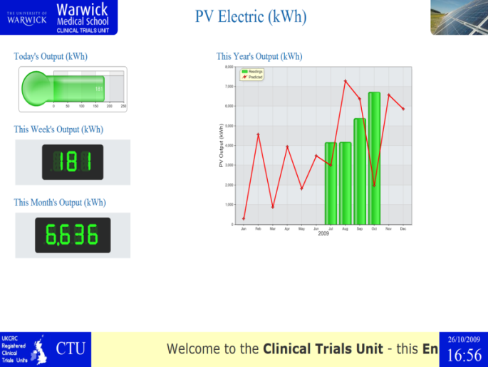
You can make a difference - Campus
Engage with staff and students
Energy Champion network
  Opportunities identified
  Last meeting request targets assignments to departments
    Papers are submitted for Energy Committee at board level
Build on students engagement
  Seek opportunities to travel and visit projects (not limited to buildings) such as WISE
  Benefit from international origin of students
  Run “sustainable council” to collect ideas and benchmark
http://www.uow-infodisplay.co.uk
Foster Warwick University leadership and reputation
  Use students skills and imagination power to develop innovative sustainable solutions
  Launch research and experiments projects from “sustainable council”
    I.e. : Inter seasonal heat storage project
  Seed new businesses, publish research results
    Warwick University should be the right place for good fun and save the planet
Warwick Network 2010

Slide 38
Tomorrow’s reality?
Warwick Network 2010
Encouraging green attitude
  Best way to learn sustainable & responsible life style
  Create a “green bonus scheme” to promote sustainable attitude
    carbon footprint per staff - student & flat with innovative “green” reward…
    Electricity and water meter per department / room
    Communicate a “per staff” “per student” energy usage via personal homepage + link to “Green bonus” to raise awareness and good practices.
Define and agree code of Living
  Use “Green Bonus” to create opportunities
  New sustainable equipments
  New research / experiences
Sustainability awareness
  Recommend / propose supply of organic food (agreement with local suppliers, cooking courses…)
  Support use of bicycle – Propose a rent & maintenance scheme (objective 6)
  Implement “green” transport scheme between city and university (objective 6)
    Biodiesel and or electrical buses
    Make ground for innovative transport research application (fuel cell)
  Propose Energy and “sustainable” lectures to residents / students – staff – public
  Extend offer to staff and members of the public

Slide 39
What about your office?
Calculate your footprint
  University consumptions
  Industry benchmarks
Adapt with your own behaviour
  Do you switch off your computer?
  Do you switch off light (office, corridor, meeting room)
  Do you let the water running when going to kitchen / toilets ?

Slide 40
Thank You
Presentation will be available on Intranet

