Slide 1

Business Process Review at Warwick
Nicola Owen
Academic Registrar

Slide 2

What is BPR/OE?
Business Process Review (BPR) or Operational
Excellence (OE) is a journey towards
‘…a philosophy, which aims to develop good practice in process/operations improvement based on a reduction of waste, improvement of flow and a better concept of customer and process, though a culture of continuous improvement involving everyone in the organisation.’
Notes:
Started in Engineering
Used increasingly in service sectors
Called many different things

Slide 3

BPR Objectives
Objectives of BPR at Warwick are:
To improve the customer experience
To reduce reliance on new staff posts and new IT systems implementation to resolve workload issues
To help improve job satisfaction in the long term by:
Focussing processes on the customer and streamlining them
Putting operational staff back in control by giving them a set of techniques and tools to improve processes
4. To embed BPR as a tool for achieving Vision 2015 objectives.

Slide 4

Where should I start?
Any process!
Pool of trained facilitators across the University
Rapid Improvement Workshops
1 day (shorter process = quick wins)
3 days
Over 50 ‘tools’ to help review any process
Team building and developing culture amongst operational staff

Slide 5
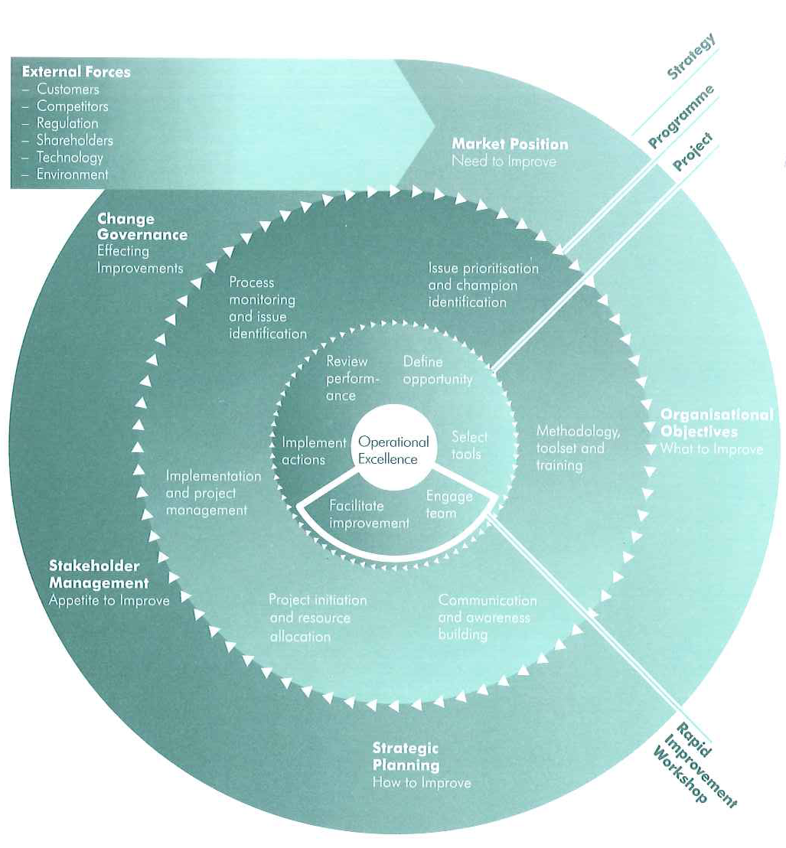
Improvement Journey
Notes:
An improvement journey happens at the start of a BPR event (the inner circle).
It maps the ‘as is’ process and defines the ‘to be’ process.
Requires operational staff participation and buy-in

Slide 6
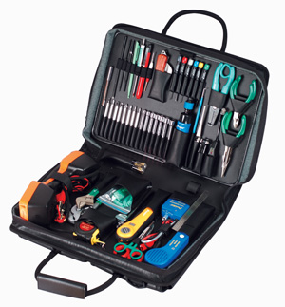
Typical tools?
SIPOC
(S)upplier (I)nput (P)rocess (O)utput (C)ustomer
A ‘must have’ for any review and stands apart from all others in the toolbox
Helps define boundaries of process under review by identifying start and end points
Service definition

Slide 7
E.g. SIPOC: New Course Approval
Supplier | Input | Process | Output | Customer
Lead academic | Academic proposal – Content and structure | Generate proposal | Course approved | Academic depts.
External academic | Course approval form | Consultation | Course spec | Potential students/ sponsors
Academic Registrar | Market research | Non-academic approval | SITS code and OMR | Academic Registrar teams
Department | Academic expertise | Academic approval | Application forms | Committees
Committees | Financial plan | Create code on SITS | Regs update
Finance | Admissions | Open course for applications | Fee structure
BUGS | Planning team |  | Site visit report
Notes:
Approved course open for applications example

Slide 8
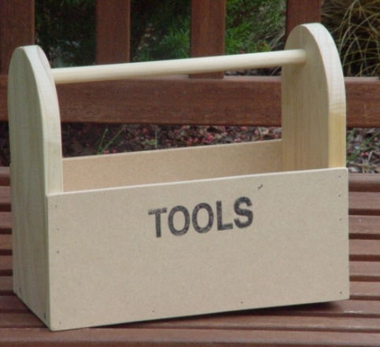
Typical tools (2)
Seven Wastes (physically mapping)
Helps calculate efficiency
Understand the process
Scope out the process
Optimise layout
Voice of customer
Identifies needs
Develops customer perspective
Classifies expectations
Notes:
Seven forms of waste that exist in a process:
· Waiting Time – time spent waiting between activities
· Transport – movement between activities
· Component design – effectiveness of the tool in meeting its intended purpose
· Inventory – number of items of work at each activity step
· Over Production – any effort or output that exceeds the customer expectation
· Motion – movement within each activity
· Defective goods – outputs that do not meet the customer expectation
The continuous identification and removal of waste is at the heart of continual improvement and
operational excellence. 7 wastes example of ‘transport’ waste
Take a ball of string and physically map out a process…
5 volunteers (just pick 5 people)
Process = Approval to appoint (in ARO)
FIRST PERSON DOESN’T LET GO!!
Person 1 = Person writing the spec and job description
Person 2 = Team leader
Person 3 = Finance link officer
Person 4 = Academic Registrar
Person 5 = Registrar
First person in the process takes the end of the piece of string and hands it on to person 2, who keeps hold and hands it to person 4 who hands it back to Person 2, who hands it to Person 3, then to 4 and then to 5 etc etc.
This would help identify that the Academic Registrar seeing it before and after Finance is a weak link….

Slide 9

Challenges
Staff engagement and buy-in
Administrative
Academic
Staff commitment for 3 whole days
Exhausting process
Review itself is only the beginning of a much longer implementation process
Notes:
Requires participants in improvement
At the end of a BPR, the team identifies commitments as on-going

Slide 10

Wider benefits
Release capacity for staff development and innovation
Informs decision-making
Empowers staff to control workloads
Challenge received wisdom on major operational processes
Improve job satisfaction
Please customers and grow market share
Engage staff more widely across the institution

Slide 11
Operational Excellence WBS

Slide 12
What have we done?
Secured Senior Management Team buy-in
Created a Steering Group (inclusive volunteers)
Sought expert advice/input
Trained our own internal facilitators
Run strategic ‘rapid improvement workshops’
Run tactical mini process improvement workshops
Developed communications strategy (website and visual management)
Created facilitator network

Slide 13
OE Successes– Examples of Process Improvements
Staff Appointment Process
Average lead time interview to offer reduced by 42%.
Invigilation
33% reduction in faculty invigilation sessions in 2009; predicted 50% reduction in 2010;
External Projects for PGs
>100% increase in external projects for postgrads;
62% increase in external projects take-up

Slide 14
OE, managers & organisational change - Achievements
Engagement
29% staff participating (50% of non-academics)
11 process reviews so far
30 facilitators trained (50% in WBS)
Heads and Directors now ‘own’ process improvement
Organisational Performance Benefits
Cross-functional ownership of processes
Facilitators as champions & catalysts
Erosion of silos, better institutional collaboration
We can absorb product growth & support development

Slide 15


Poster Sessions
Postgraduate Admissions
Submission of application – creation of student record
Before: 6% same day
After: 99% in 2 hours
WBS: Using OE tools locally
Reduction in faculty invigilation sessions
Before: 33% in 2009
After: 50% predicted reduction for 2010
Library: Re-shelving Revolution
Average time to re-shelve a book (March term)
Before: 61:53
After: 5:14

Slide 16

Learning Points from Poster Sessions
Over to you…
What did you find out?
Did you hear what you expected?
Any surprises?
Can you think of any areas where a BPR might be useful?

Slide 17

Want to find out more?
Visit the OE website@
http://www2.warwick.ac.uk/fac/soc/wbs/central/oe
Visit the BPR pages @
http://www2.warwick.ac.uk/services/aro/bpr/
Nicola Owen (nicola.owen@warwick.ac.uk)

Slide 18

Questions

