Slide 1
Student Careers and Skills – Context & Partnerships
Sue Bennett, Director
Stephen Ward, Head of External Relations

Slide 2
Information, Advice & Careers Guidance
Student Development
Warwick Volunteers
Employer Events
Warwick Advantage
Student Careers and Skills
Academic Discipline
Student Support Services
Student Support
Senior Tutor
Residential Life
Counselling
Disability Services
Mental Health

Slide 3
Adds to the distinctiveness of a Warwick education by providing opportunities for students to develop their personal, academic and career management skills. High quality, integrated service, based on demonstrable need, aligned to the curriculum with proven impact
Operations and Information – Thea Gibbs
Warwick Advantage –
Anne Wilson
Works across the division, contributing a central service to all units
A portal to help students make the most of their time at Warwick and enhance their employability. Works across the division, contributing to all activities
Student Development – Rachel Davis
Careers Consultancy –
Gill Frigerio
External Relations – Stephen Ward
Provides skill development for all students in order to enhance their employability and the quality of their life-choices
Works with students to enable them to manage their own careers and maintain sustainable employability
Develops relationships with external individuals and organisations to provide opportunities for Warwick students

Slide 4
Who are our partners?
Recruiters – 1500 in 12 months, 300 actively engaged, 30 in Recruiters Club
Face to face:
Fairs: (7500 student attendances)
Grad (73)
City & Finance (74)
Engg & Tech (63)
Law (72)
Careers Unlimited (32)
100+ Company presentations
Community and Voluntary Groups
1800 members, 20,000 hours, 40 community projects last year
Bath Place, Coventry Refugee Centre, Tocil Wood, Kidz Kamp…

Slide 5
Why are we in partnership with them?
To provide opportunities for Warwick students
Employment
Work shadowing
Volunteering
Alumni contacts
Outcomes and case studies
To feed back and improve what we do

Slide 6
From prospect to partner

Slide 7
What criteria do we use?
Of mutual benefit.
Adds to student experience.
Contributes to the University achieving its aims.
Breadth of sectors.
Scope: regional, national and international.
Size: SME to multinational.

Slide 8
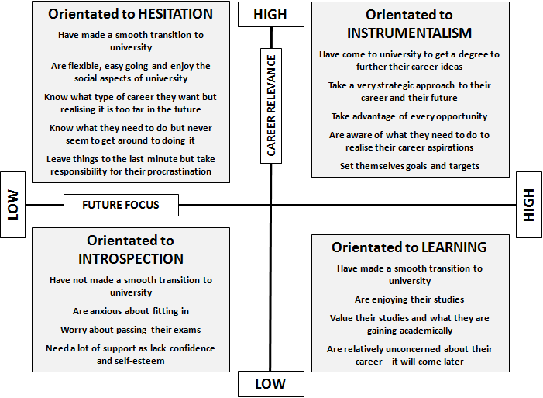
Adding to the student experience: in practical terms
External Relations provides opportunities for students to experience possibilities and options…
O’Regan, M. (2009) Career pursuit: towards an understanding of undergraduate students’ orientation to career
Unpublished PhD, University of Reading

Slide 9
What is the employer perspective?
In top three in High Fliers Survey.
Inner circle of City and Finance recruiters (Oxford, Cambridge, Imperial, LSE, UCL, Warwick).
Benchmarked in International Student Barometer as number two in the Russell Group and number three across the 123 reporting institutions (ISB Autumn 2009).

Slide 10
New
Virtual presentations & webinars – overseas employers
SMEs – In-Place graduate internships
Summer Fair
New recruiters – Unipart, RAF attending events
Introducing partnerships
Widening partnerships
Existing
New
Product/Service
Maintaining partnerships
Deepening partnerships
Market
MyAdvantage Services – online profiles
‘Sector’ Events
Alumni Events
30 in Recruiters Club
>300 fully engaged employers
Existing

Slide 11
The internal perspective – working across Warwick
DARO / Communications Office
International Office
Research Support Services
Student Recruitment
Centre for Lifelong Learning
Academic Departments
Students’ Union
Warwick Conferences
&..?

Slide 12
Thanks for listening and your participation. Please share perspectives (and questions) with us.
Sue Bennett, Director
Stephen Ward, Head of External Relations

