Slide 1
Warwick Sport Where now?
Department of Physical Education & Sport
Gemma Morris – Warwick Sport Manager
Lisa Infantino – Sports Development Co-ordinator

Slide 2
How much do you know about Sport at Warwick?
QUIZ?

Slide 3
Warwick Sport – The History
“Collaboration between the PE Department and the Students Union to provide a cohesive, cost-effective and user-friendly service to enable all staff and students to engage in sport at whatever their chosen level”.
Established in September 2005
Resulted in increased funding and opportunities for all members
Enables staff to benefit as well as students from increased opportunities
Leading the way in the HE Sport Sector.
Core Values:
Sport for all – encourage as many people to take part in sport or physical activity.
Community – to enhance the lives of the University of Warwick community through sport and physical activity.
Partnership – to work with all partners, within and outside the University to achieve our aims.
Ambition and drive – to be the best we can be in all we do.

Slide 4
Warwick Sport
Small annual charge for Warwick Sport Membership (£40 this year) which gives:
Access to all facilities apart from fitness suite, climbing wall and tennis centre.
Ability to join any of our 75 Sports Clubs (everything from swimming to archery and football to skydiving)
Access to a Sports Development Programme
Access to intra-mural leagues (Football, Netball, Cricket)
Insurance
Access to low cost Sports Courses Programme (Golf, Swimming, Squash, Climbing and Golf) Exercise to Music Classes, Sports Physiotherapy and Sports Massages
Subsidised coaching, refereeing, safety and first aid courses.
Full Sports Scholarship and Bursary Scheme

Slide 5
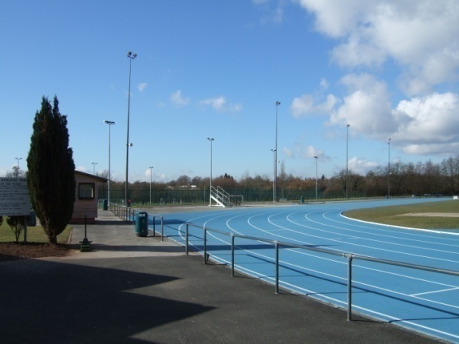
Facilities at Warwick
Ranked among the best in the Country, rated 5* according to the Times Higher Education Guide.
60 acres of outdoor playing fields (football, rugby, lacrosse, cricket, frisbee)
3 all weather floodlit pitches, one of which a rubber based synthetic grass pitch
Mondo 400m all weather running track
4 court indoor tennis centre

Slide 6
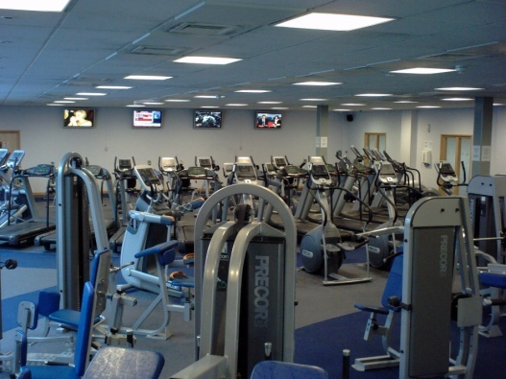
Facilities at Warwick
25m Swimming Pool
6 Squash Courts
Large Fitness Suite
Performance Weight Training Centre
Aerobics Studio
3 Sports Halls
Indoor Climbing Centre and Bouldering Room
Open from 7-15am-9.30pm daily

Slide 7
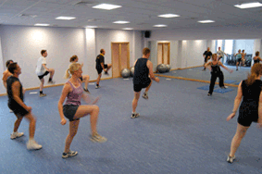
Fitness Suite and Exercise Classes
Fitness Suite:
Full range of cardiovascular equipment including rowers, treadmills, cross trainers, bikes and steppers
Fully air conditioned with 4 flat screen televisions
Full performance weights and conditioning room
Fitness Suite Staff will provide:
Inductions
Personalised fitness programmes
Spotting
General advice and Guidance
Personal Training
Fitness Classes:
Comprehensive class timetable available all year round both on main campus and at Westwood.
Classes to suit all abilities and interests e.g. Yoga, Step, Circuits, Zumba and Body Pump

Slide 8
Where now?
Imagine you work for Warwick Sport, what would you like to develop in the next 3-5 years?
Think about:
Facility investment
What would encourage you to become more active within Warwick Sport?
What would engage more staff members?
What initiatives do you think would have a positive impact on the University Community?

Slide 9
VISION 2015 A Strategy for Warwick Sport
“By 2015 Warwick Sport will have helped create the most active University community in the UK”.
Themes:
Be Active (5 x 30minutes of physical activity per week, health and wellbeing campaign, department sporting ambassadors)
Taking Part in Sports Clubs (clubs more accessible to staff, better marketing of clubs)
Reach Potential (high quality coaches, sport science support, fitness & nutrition guidance)
Support our Athletes (more scholarships & bursaries, support for high level athletes, develop Tennis Centre as centre of excellence & Warwick Endurance Academy)

Slide 10
Warwick Active
“Physical activity and sport will be at the heart of the promotion of health and wellbeing at the University”.
Look at the benefits of physical activity and health to individuals and to the University Community.
Become involved with National Projects/initiatives e.g. Change 4 Life (D of H), Let’s Get Moving (D of H), Think Fit (BHF) .
University wide project – incorporating support from SU, HR, Occupational Health, Medical School.
Look at what other HE institutions are doing.
Recruit department ambassadors
Launch the ‘Warwick Active’ brand

Slide 11
Warwick Active Launch Week
Sunday 20th June – Friday 25th June
Sunday 20th June – Warwick Active Fete
family day with Wii stations, hoola hooping, mini ‘sports’ day, inflatable's, aerobics sessions, themed dance classes
Monday 21st June – Healthy Eating/Nutrition Day
Seminars, weight loss programmes/advice, chef’s demonstrations, healthy recipes, hydration advice
Tuesday 22nd June – Health & Fitness Day
Free gym access/tours, gym challenges, fitness testing, heart screening, injury prevention & recovery advice, osteoporosis testing

Slide 12
Warwick Active Launch Week
Wednesday 23rd June – Team Sports Day
Inter-departmental tournaments in tennis, rounders, dodgeball, 5-a-side.
Thursday 24th June – Wellbeing Day
Smoking/alcohol advice, mental health awareness, managing stress, massage, holistic classes.
Friday 25th June – Back to School Day
‘Old School’ themed Sports Day
Other Events include – daily walks/runs, dance/aerobic sessions, sports club taster sessions, stairs challenge, gardening sessions.

Slide 13
QUESTIONS?

