Slide 1


A guide to saving energy and cash.
At home and at work.
Joel Cardinal, Energy Manager
Sam Boulby, Communications Projects Officer

Slide 2
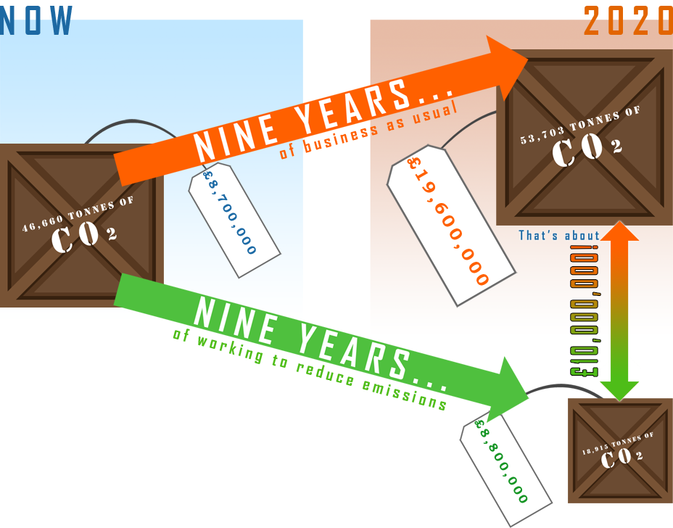
What’s the problem?
Government Target:
34% less than 1990
So that’s about:
60% less than 2006
For us.
Which is about:
35,000 tonnes a year
Less than now.
Which would save us about:
£10,000,000 a year
And is equivalent to
7,000 avg UK houses

Slide 3
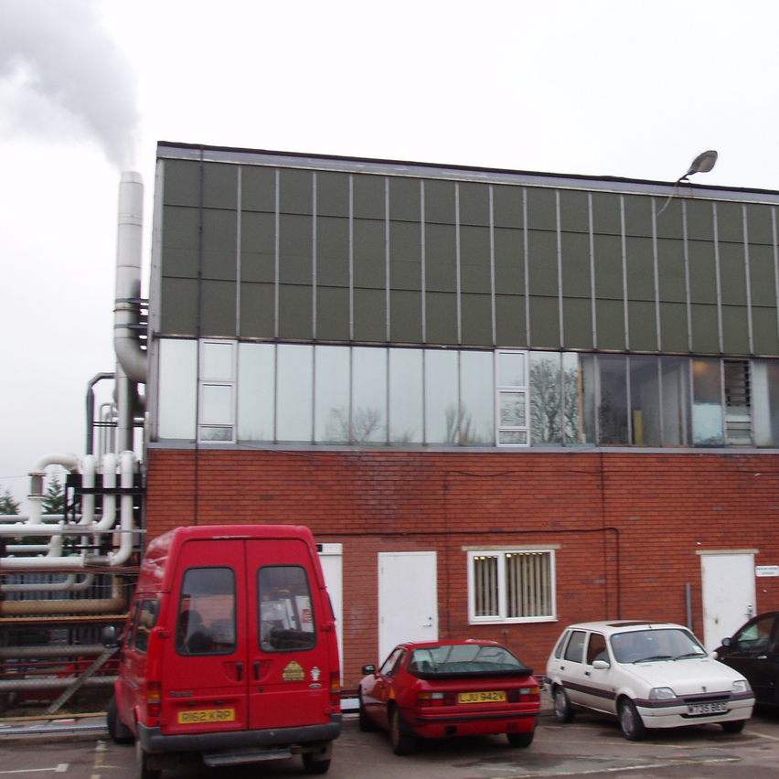
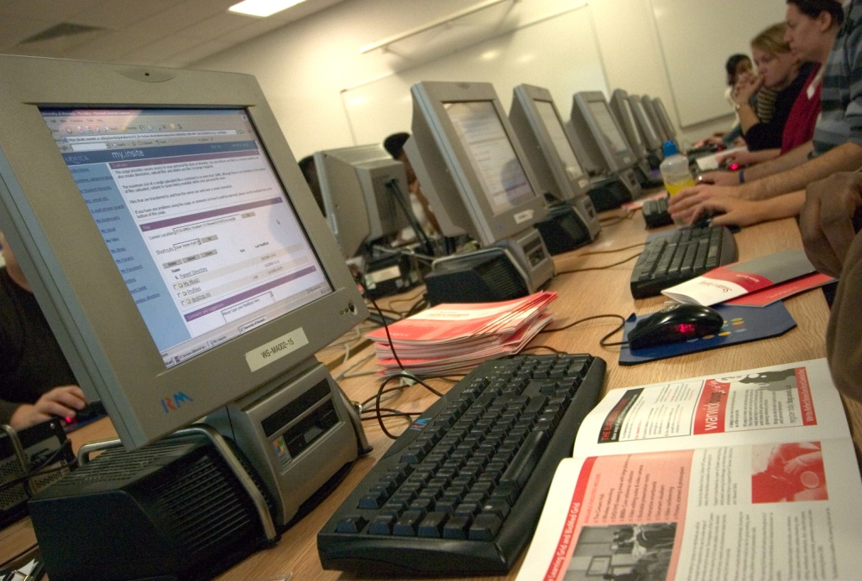
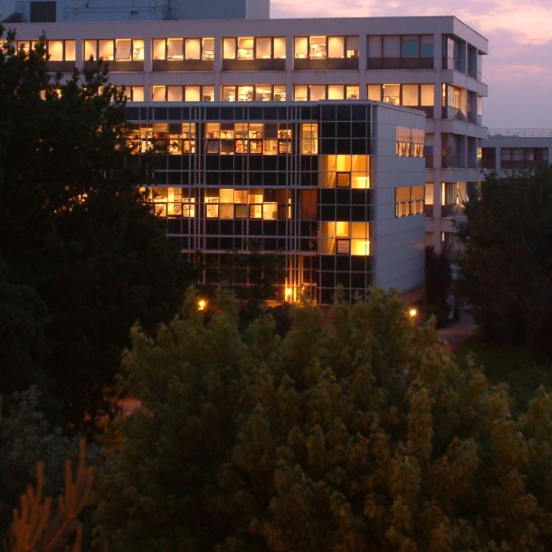
What’s Warwick doing about it?
This is just a few of the things…
Combined Heating and Power
IT Power Reduction
Efficient Lighting
We’re going to improve this. A lot.
Computers are power-hungry. We’ll see to that.
We’ve got to light campus up, but we can be more efficient about it.

Slide 4
How’s it going so far?
Using government grants and loans, we’ve so far achieved…
A 3,000 tonnes per year reduction
which means…
…we’re saving about
£410,000 per year.

Slide 5
No.
So I can relax then?
Just relax and let you guys take care of everything?

Slide 6
We can’t do this without you.
So I can relax then?
Just relax and let you guys take care of everything?

Slide 7
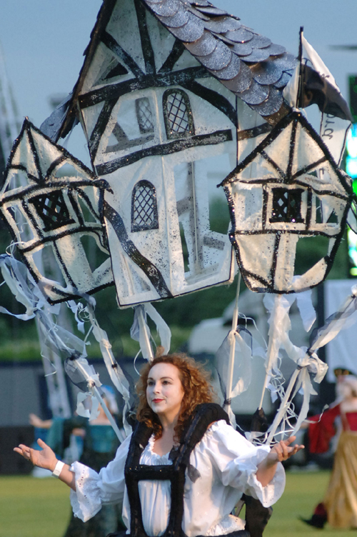

Our Problem is Your Problem
In two ways…
You probably live in a house or flat, with energy bills…
Warwick has energy bills too. Lots of them…
You probably also need to pay electricity bills. Those bills are going up for you the same as us.
If Warwick is spending an extra £10m on energy every year, just think of the sort of cut backs we’d have to make.

Slide 8
It’s the main point of this session, after all.
So let’s get saving
At home and at work.

Slide 9

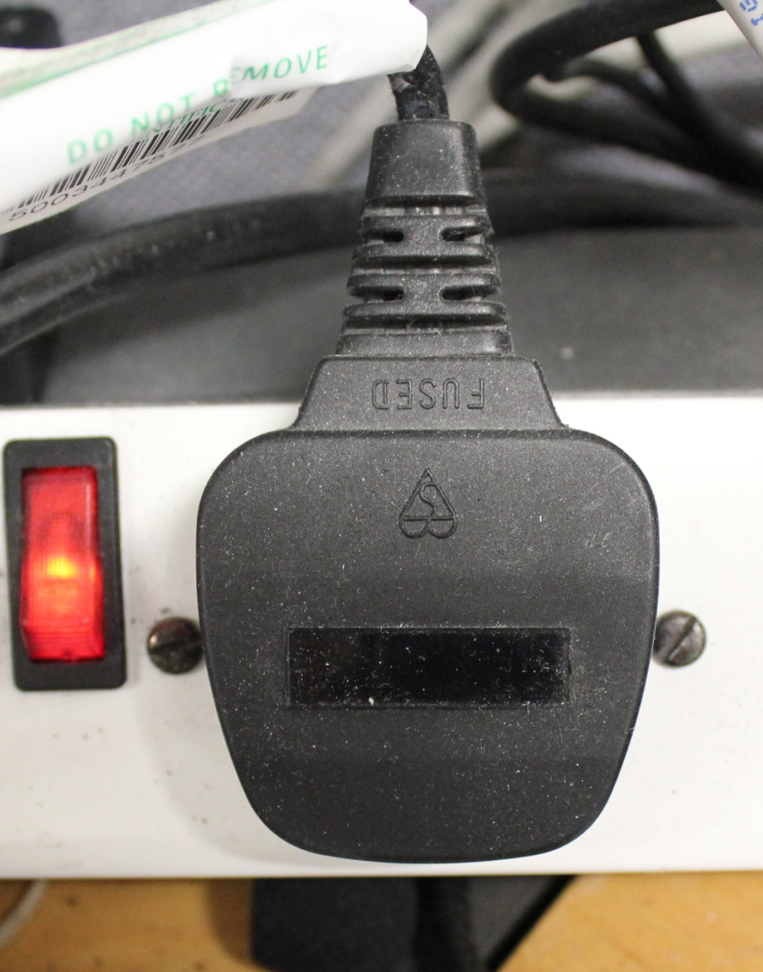



1: Turn stuff off
When you’re not using it.
Computers and laptops…
Switch them off at the plug.
Standby mode means it’s still guzzling up power. Why waste your cash on that?
Monitors…
Printers and photocopiers…
Lights…

Slide 10




2: Turn stuff down
As low as is comfortable.
Air conditioning…
Radiators and thermostats….
Lights you can dim…
Volume…

Slide 11
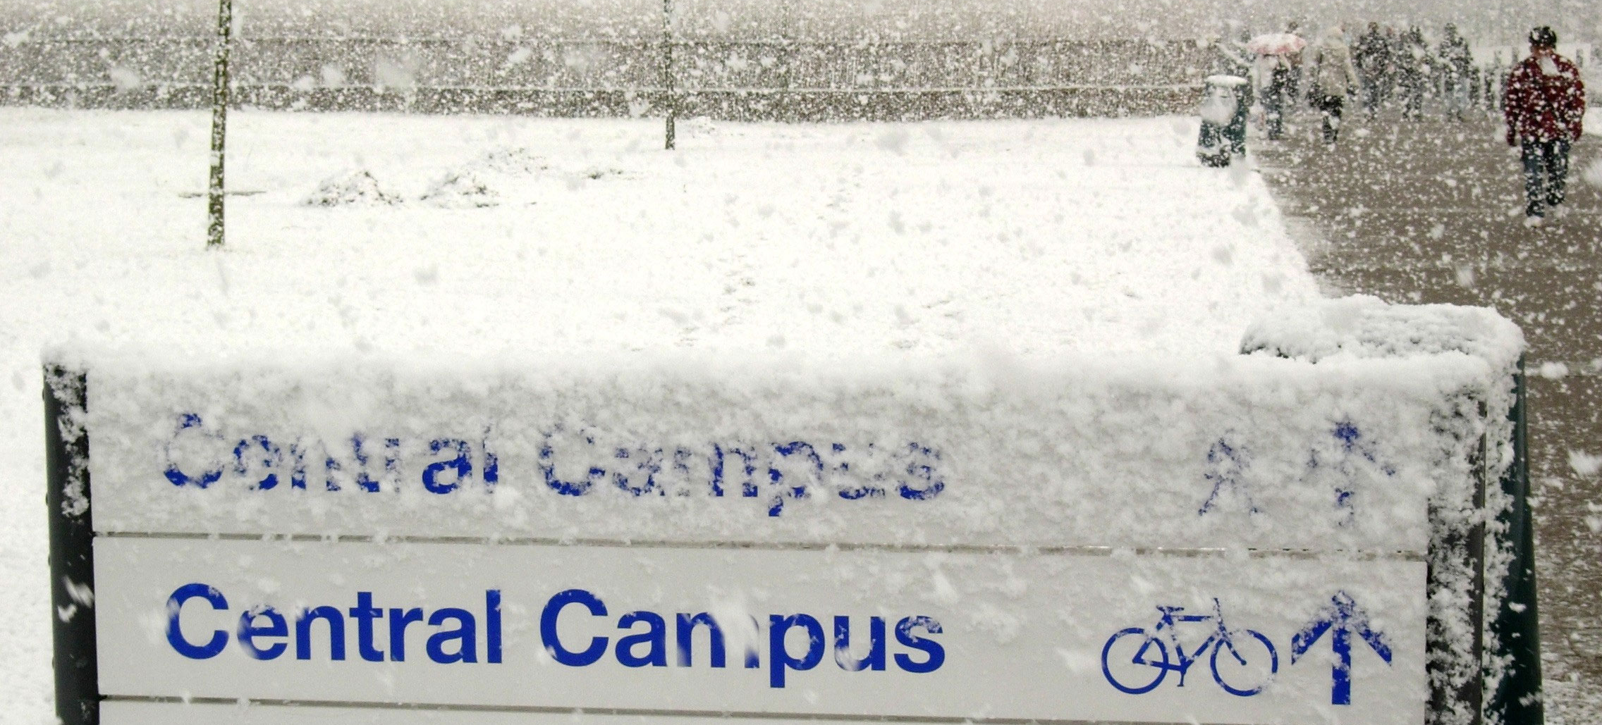
3: Wrap up warm
Don’t have to burn anything to do that…
Scientist generally acknowledge that putting on a jumper is cheaper than cranking up the heating.

Slide 12
4: Get Involved
There’s loads going on all over campus
WBS
WMG
Engineering
MBA in Global Energy
Prof. Sentence teaching Sustainability
Low Carbon Society
Metering & controls in IIPSI
Empowerment programme with UCL
PC power management project
Course on sustainability
Students working on feasibility studies
Social Sciences
Students
And Others
Psychological behaviour change project
Edward page’s carbon-related research
Request for green curriculum
Wind turbine project
Sciences city
Enterprises
Supplier partnerships
Biodiversity group & allotments
Knowledge in the Community
What’s happening around you that you can help with?
Do you have any ideas of your own?

Slide 13
But don’t let apathy in the face of mild inconvenience keep you from savings.
It might be a little inconvenient
You’ll actually have to do this stuff regularly.

Slide 14
So what now?
Here’s what you can do right away:
Become an Energy Champion
Fill in our questionnaire
Tell other people what you’ve heard today

