Slide 1
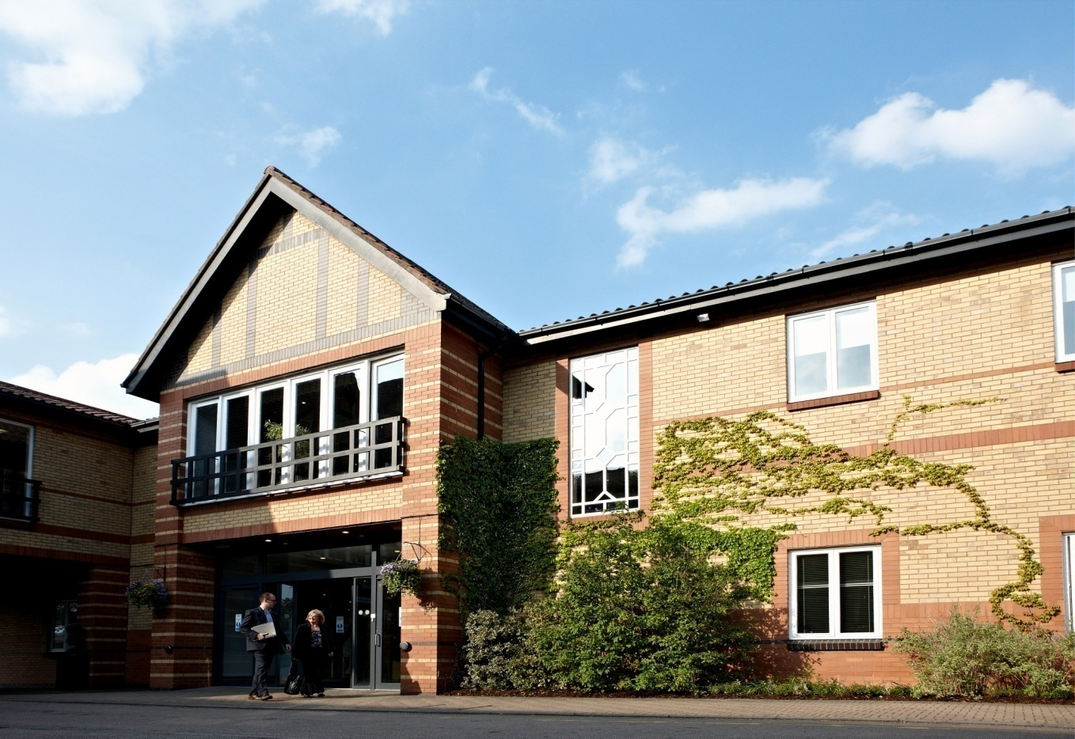
Eating at Warwick

Slide 2
Bars and Restaurants
Bar Fusion
Arts Centre
Gusto
Cafe Library
TCC Bars and Restaurants
University House Cafe
Rootes Bar

Slide 3
Banqueting for 4 to 500
Panorama
Scarman Private dining room, Lake view restaurant and courtyard
Radcliffe Private dining room
Arden Private dining room
Chancellors

Slide 4
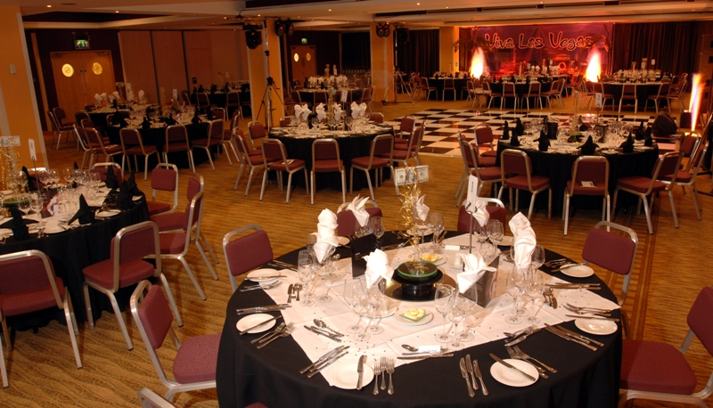
Panorama Suite Rootes Building

Slide 5
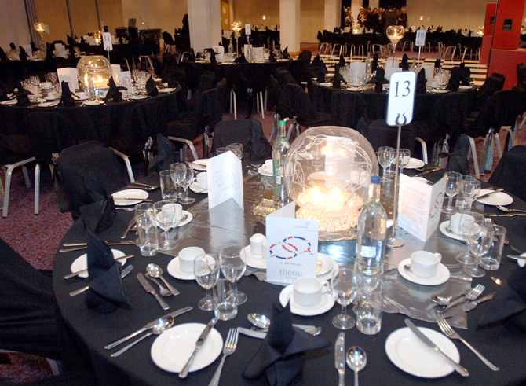

Slide 6
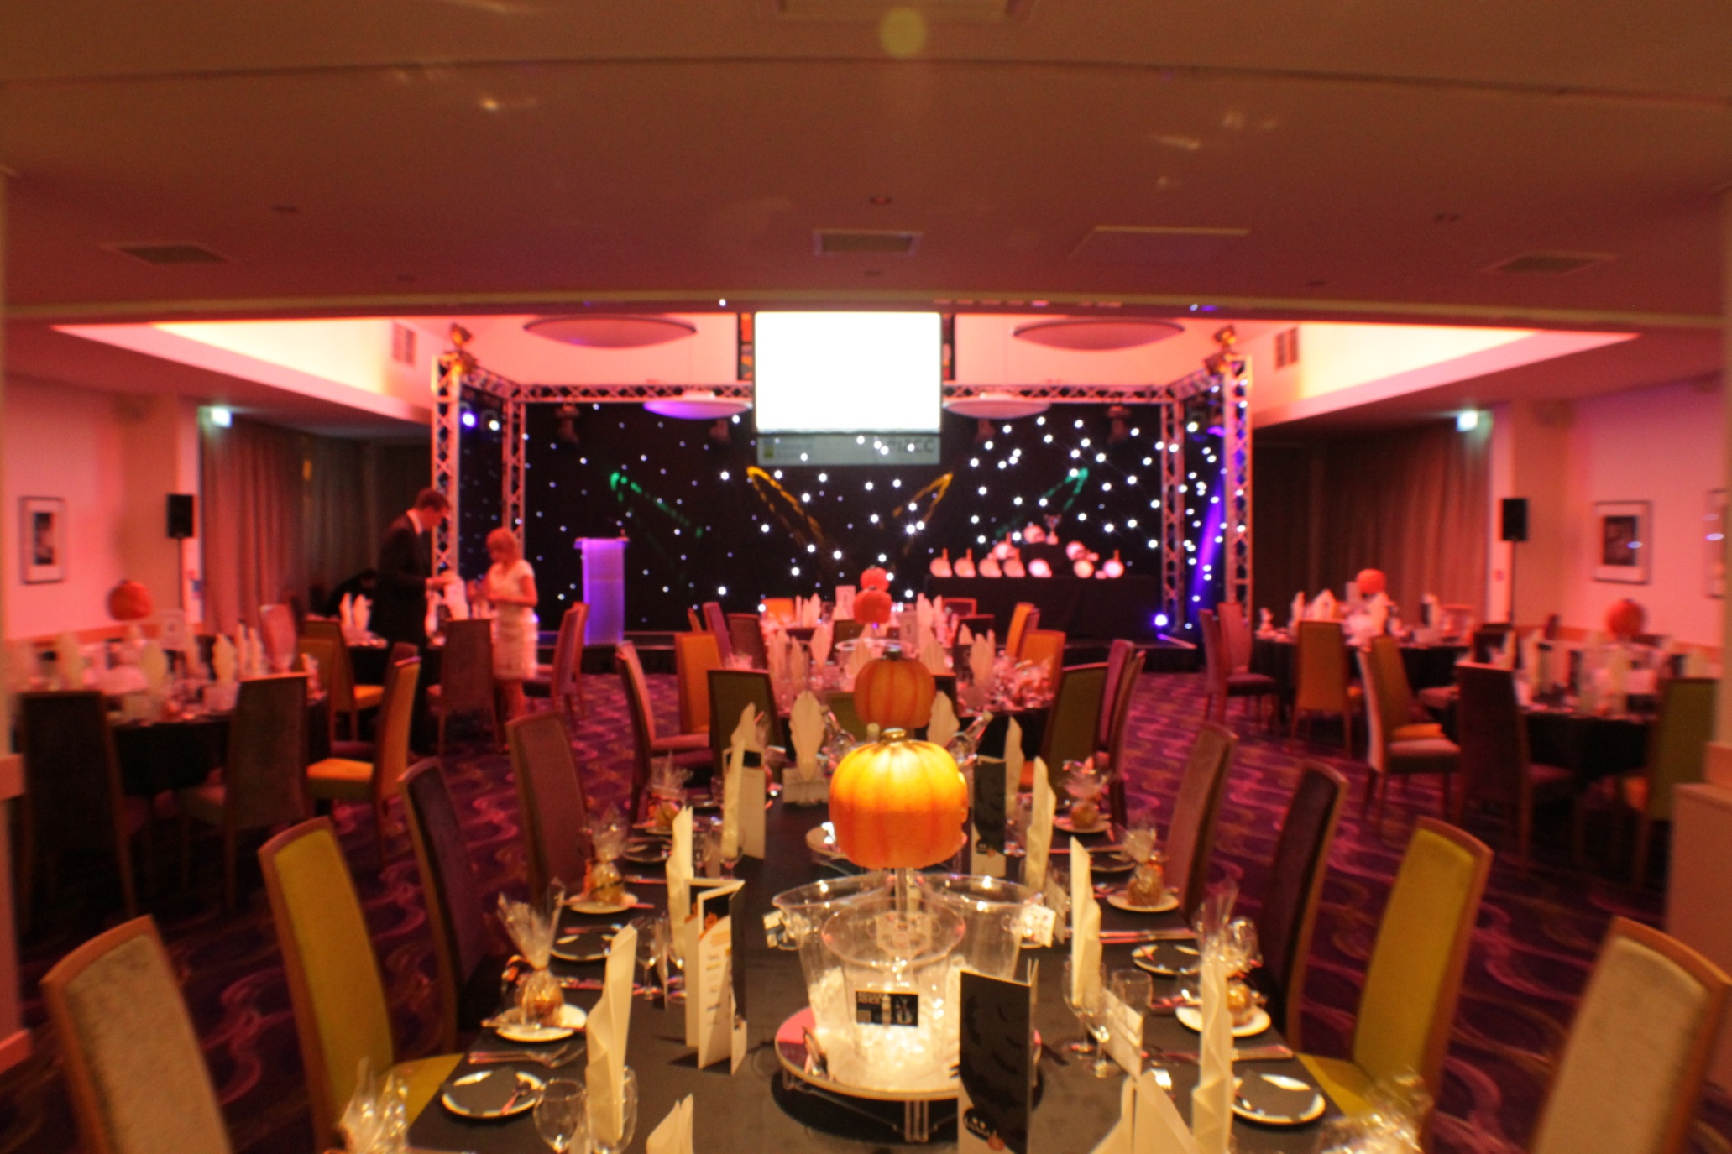
Warwick Conferences Scarman

Slide 7
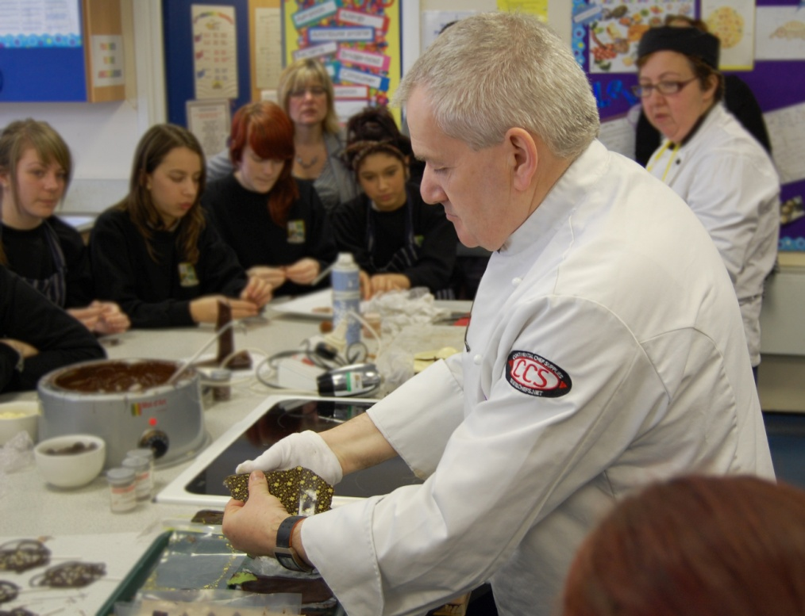
Chefs at Warwick, more than just cooking!

Slide 8
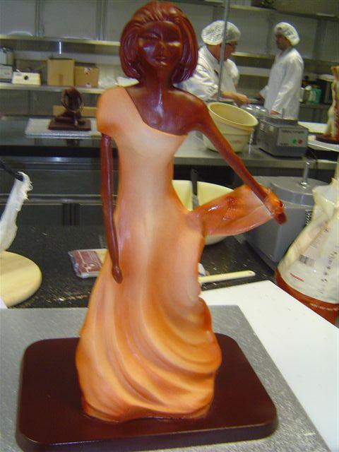
Warwick Chefs and Managers this year have been involved in many competitions
Hospitality 2011

Slide 9
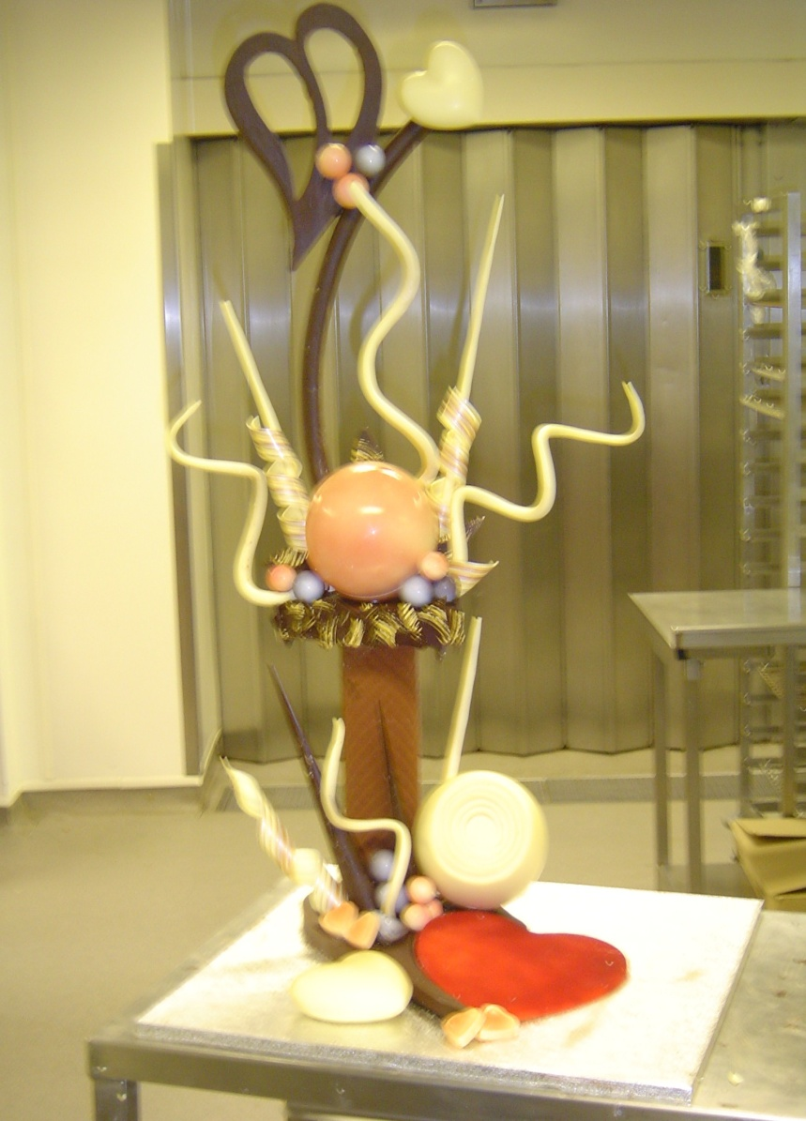
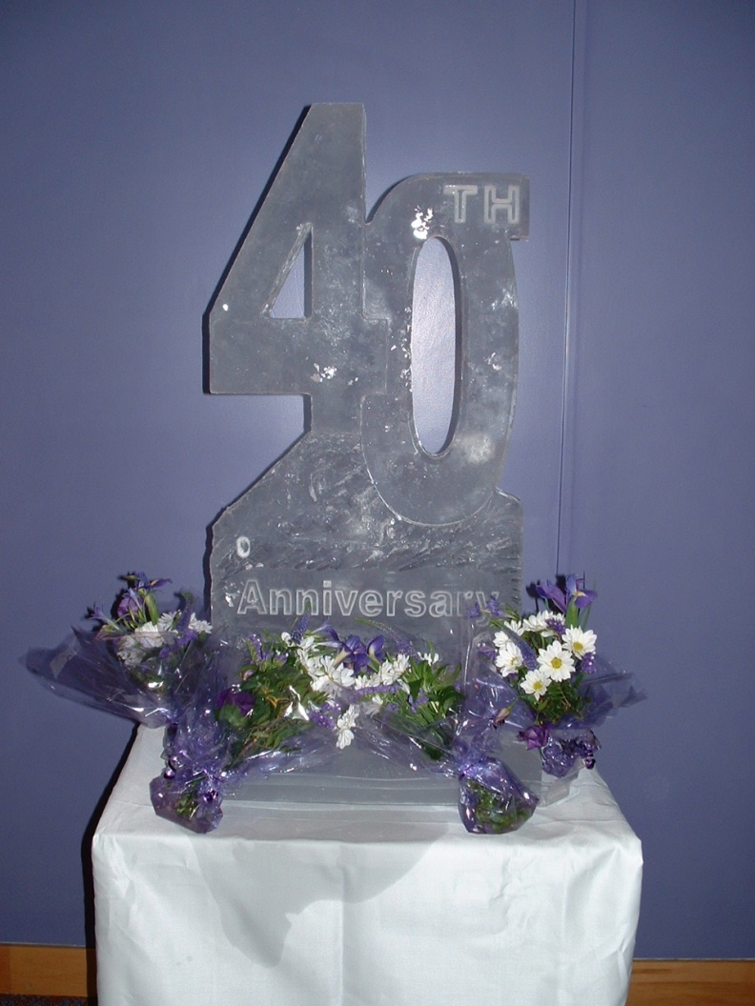

Slide 10
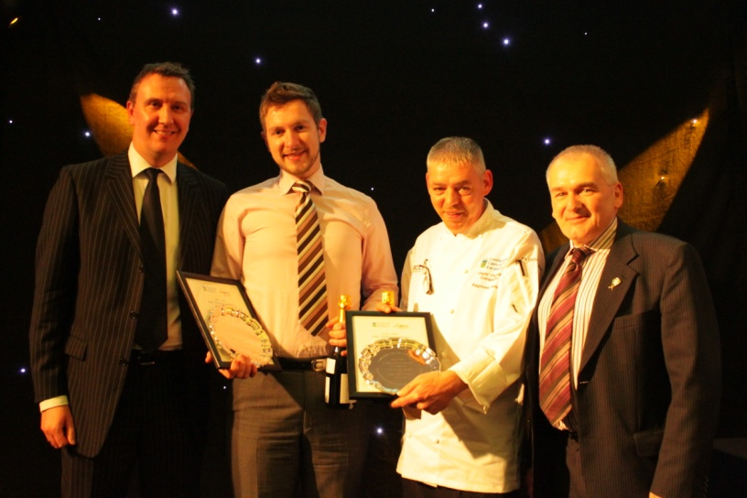
Conference Centres of Excellence Chefs and Food Service competition organised and hosted by Warwick
Graham Crump group Executive Chef and Chair of Judges with Richard Harrison General Manager Scarman and competition chair present the awards to the winners

Slide 11
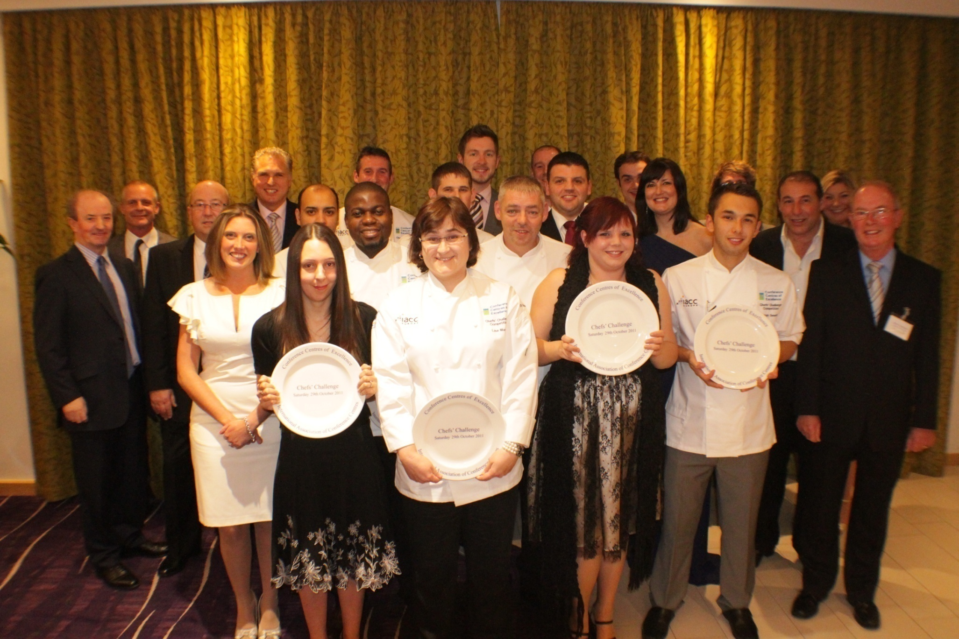
Contestants and sponsors at the awards dinner at Scarman

Slide 12
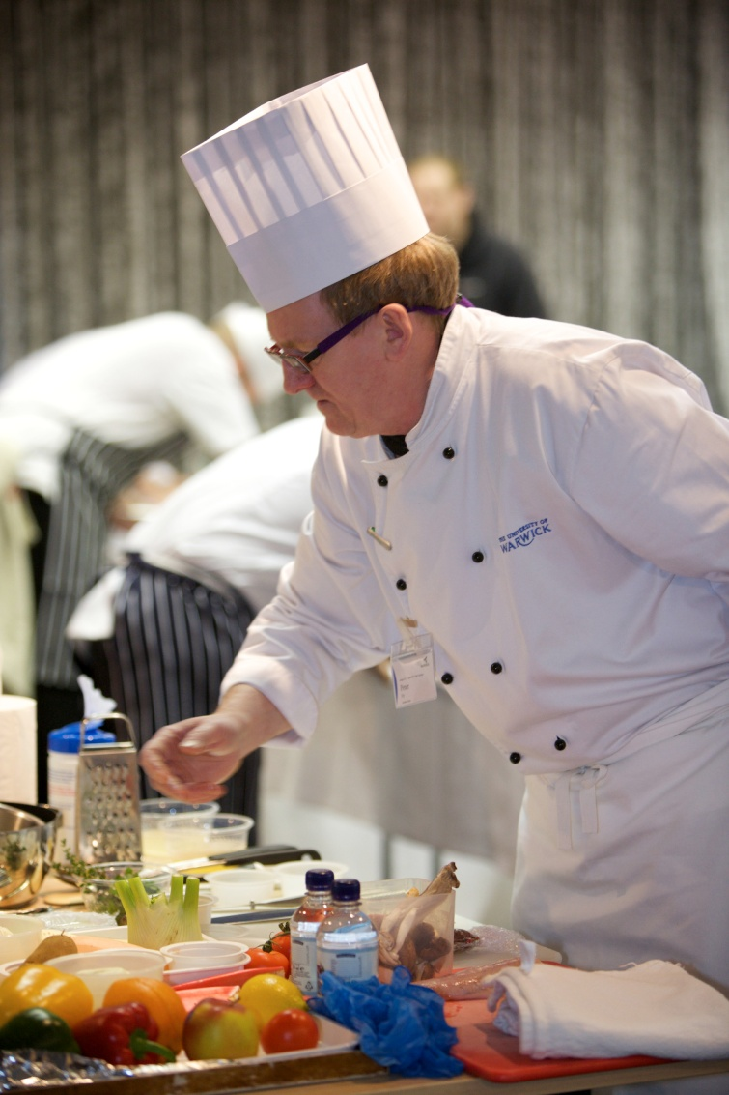
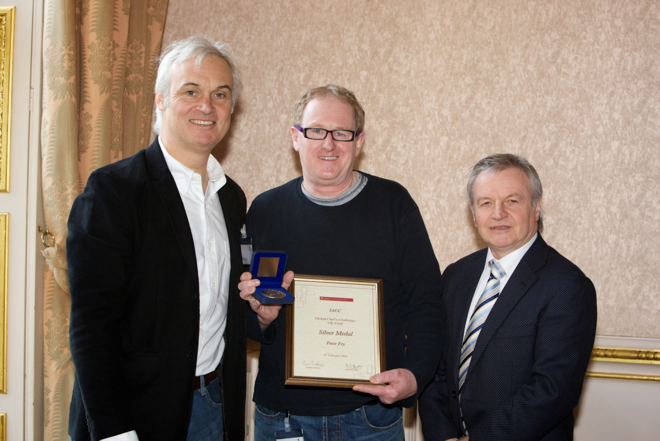
International Association of Conference Centres Copper Skillet Competition
Pete Fry Sous Chef at Rootes competing in the competition and Below receiving his silver medal.

Slide 13
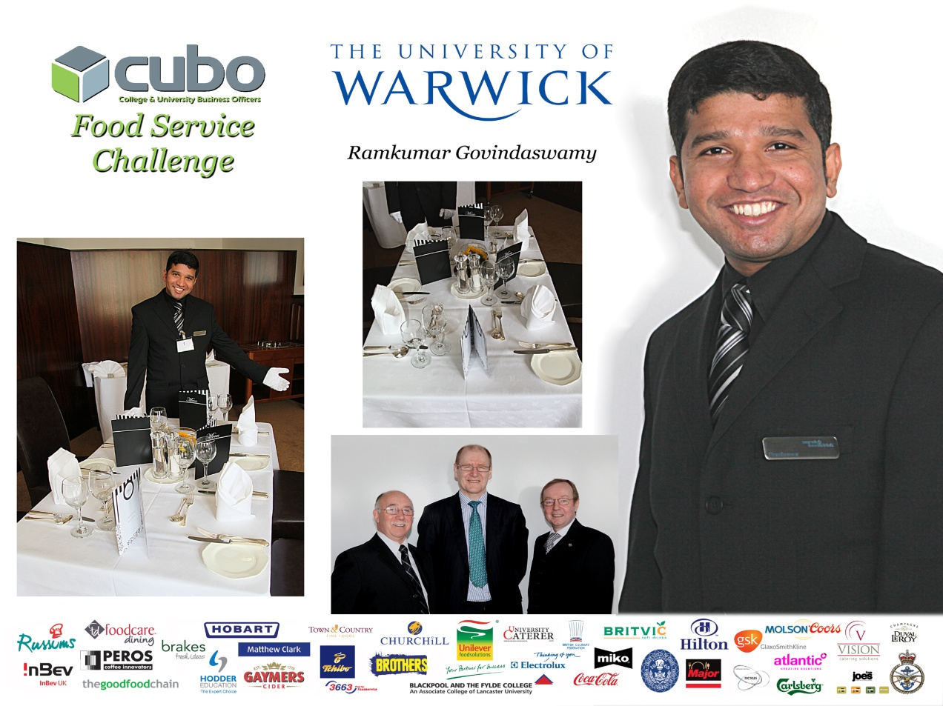
Ram Kumar wins the TUCO Food service competition

Slide 14
Warwick Chefs working with the community
Over 30 students on work experience in the last 12 months
Career workshops with local schools
Partnership program with the Devere academy getting young people into the catering industry
Apprentice scheme with Stratford upon Avon college
Cookery demonstrations for 1st year students

Slide 15

Graham Crump Warwick's Executive Chef gives a local school a demonstration on chocolate work

Slide 16
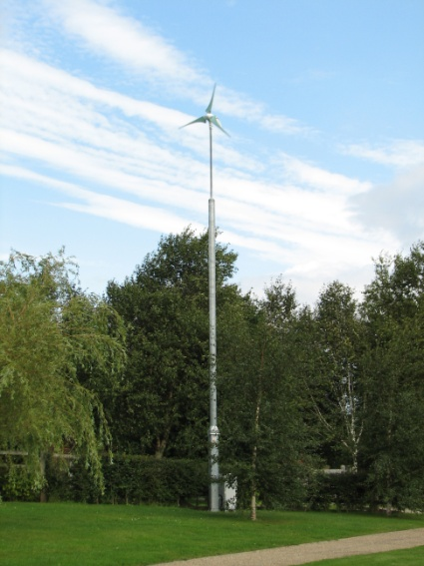

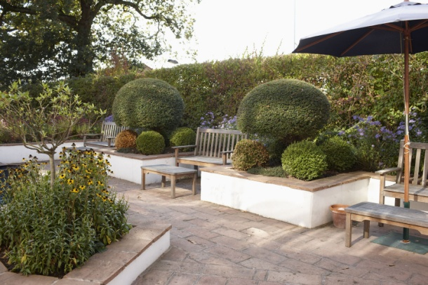
Reducing our environmental impact
Waste oil taken for Bio fuel
Paper and Card board recycling
Glass and tin recycling
Kitchen extraction controlled by movement and heat to reduce energy consumption
Herb Gardens on site

