Slide 1
Search Engine Optimisation (SEO)
Mat Mannion
Service Owner, Web Publishing Development, IT Services
Notes:
* Welcome to this presentation about Search Engine Optimisation, or SEO
* All about getting more people to see your website
* I'm Mat Mannion, Service Owner for the Web Publishing Development team in IT Services

Slide 2
A little bit about me
Worked in IT Services web team since 2005
Developed Sitebuilder, Warwick Search, Start.Warwick and other services
Currently Service Owner (Team Leader) for the web publishing development team
Very cynical about "paid-for" SEO
Notes:
* So here's a little about me
* I've worked in IT Services since 2005
* Worked extensively on developing Sitebuilder, Warwick Search, Start.Warwick and a number of other services in that time
* Currently I'm the Service Owner, which is the same as Team Leader, for the web publishing development team responsible for building these services
* One warning... I'm very cynical about "paid-for" SEO where you get external companies in to do the work

Slide 3
What is SEO?
"The process of improving the visibility of a website or web page in search engines via organic search results."
Wikipedia definition, "Search Engine Optimisation"
"Search engine optimisation is often about making small modifications to parts of your website. When viewed individually, these changes might seem like incremental improvements, but when combined with other optimisations, they can have a noticeable impact on your site's user experience and performance in organic search results."
Google, "Search Engine Optimisation Starter Guide"
Notes:
* The best place to start is to probably get a proper definition for SEO:
* "The process of improving the visibility of a website or web page in search engines via organic search results"
* "Often about making small modifications which might seem like incremental improvements, but when combined can have a noticeable impact on your site's user experience and performance in organic search results"

Slide 4
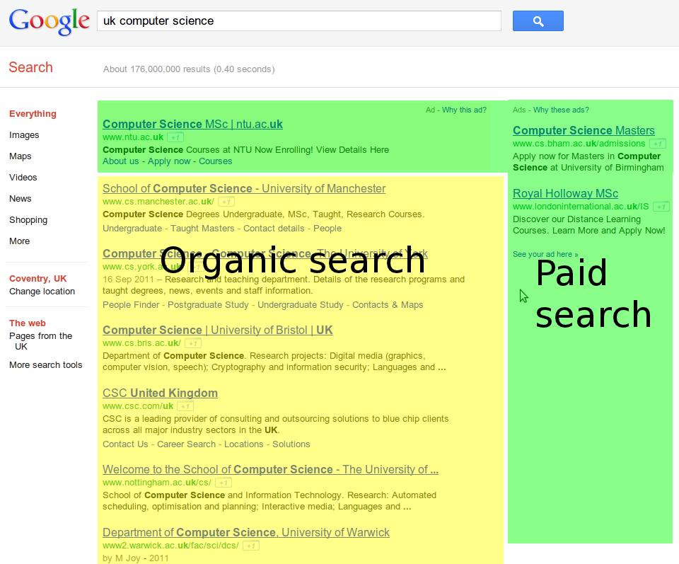
Notes:
* Here we can see an example results page
* Organic search results are results ordered by the search engine based on the page's relevance to your query (and social search, etc etc)
* The results highlighted green here are "Paid-for" search - adverts that have been targeted to specific search terms
* Experienced Internet users have something called "Banner blindness", where effectively their eyes ignore anything that looks like an advert - so the fact that the paid-for results are at the top might not mean that users read it that way

Slide 5
How does a search engine work?
Search engines "crawl" your website by following links and storing the pages in a database that can then be searched
Search engines rank pages on a number of factors, but most importantly:
How relevant your page title is to the query
How relevant your page content is to the query
  Section headings in your page's content count higher here
Whether your page's URL structure hints that it's relevant to the query
Whether there are links from other external websites to your page using search terms in the query
Most importantly, remember: A search engine is just a machine, and sometimes it needs help to understand your pages as a human would
Notes:
* A search engine works by crawling your website using a "spider" - this spider follows links and stores the pages in a databse
* When a user makes a search, the search engine looks through that database using a number of heuristics to rank the results, the most important factors being:
* How relevant your page title is to the query
* How relevant your page content is to the query - section headings in the content count higher here
* Whether your page's URL structure hints that it's relevant to the query; and
* Whether there are links from other external websites to your page using relevant search terms
* It's very important to remember that a search engine is just a machine, and sometimes it needs help to understand your pages as you'd intend

Slide 6
How people search
80% of searches are informational (looking for a specific fact or topic), 10% navigational (locating a specific web site), 10% transactional (looking for information related to buying a product or service)
Source: http://live.psu.edu/story/29879
The words you use to refer to your website might not be the same as your customers / clients use
Notes:
* A study by Penn State University: When people are searching, 80% are looking for a specific fact or topic (e.g. girl with the dragon tattoo book), 10% are looking for a specific website (e.g. Amazon), 10% are looking for information about buying a product or service (e.g. girl with the dragon tattoo review)
* The words that you use to refer to your website might not be the same as the ones your users use

Slide 7
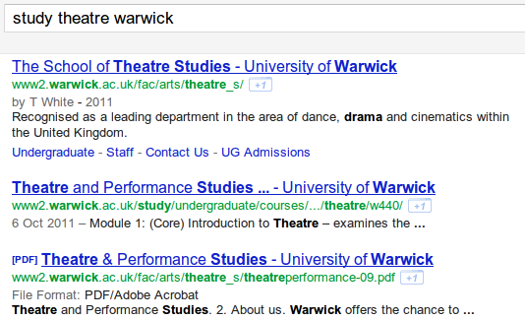
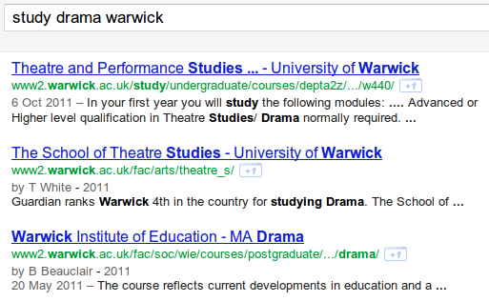
Getting the terms your users use
Notes:
It's possible that I have the wrong terminology here, but as an example here's two searches and note how the second one doesn't quite have results as good as the first

Slide 8
Highly relevant titles
Accurately describe the page's content
Give each page a unique title bar caption
Use brief, but descriptive titles
Non site-homepage titles should have the page's main focus at the start, then the site title (context) after
  c.f Undergraduate Study - University of Warwick
Remember that when people search, relevant keywords will be highlighted in their search result
Notes:
* The page title is what goes in the title bar of the page, in Sitebuilder it's called Title Bar Caption
* This is what the title of the search result will be in a search engine
* It needs to accurately describe the page content, be unique, and be brief, but descriptive
* The site homepage title is pretty obvious, but non site-homepage titles should convey some context after - so for the University's Undergraduate study page, you probably still want to make sure that in results it's explicitly for the University of Warwick
* It's important to remember that when people are searching, the terms that match will be highlighted - so a search for "Warwick Undergraduate" will pop out heavily because the page is obviously very relevant - search engines will take this into account

Slide 9
Highly relevant headers
Many search engines will analyse the content of your headers (Heading 2, Heading 3 etc) to distinguish sections of pages on your site
Use headers sparingly, make them succinct but descriptive - they are a visual cue that text is important
Create a hierarchical structure of text content on a page by using different heading sizes
Imagine that you're writing an outline of your page when placing headings
Notes:
* Search engines use the headings you use in your page to distinguish sections of content
* Header should be used sparingly, and be succinct but descriptive - they are a visual cue that the text is important
* You can create a hierarchical structure of text content on a page by using different heading sizes
- but make sure it makes sense - if you use "Heading 6" for large amounts of text just because it's important, search engines will penalise you for not having succinct headers, if text is important use some other graphical element, not a header - headers are for outlining your content
* Imagine you're writing an outline of your page when you're placing headers

Slide 10
Accurate, relevant page content
Write easy-to-read text that users can enjoy
  Avoid spelling and grammar mistakes and avoid embedding text in images (search engines can't see it, and your users can't copy and paste it)
Make sure your text is focussed around the topic
  Separate large amounts of text with paragraphs, subheadings and bullet points, break into logical chunks
Use relevant language, think about what a user might search for to find your content
  Users that are very knowledgable might use different terminology (such as acronyms) to users who aren't familiar with the area
Create fresh, unique content to keep your visitor base coming back
  Avoid rehashing or copying existing content that will bring little extra value to users and avoid having duplicate content across the site
Notes:
* The most important part of your page, bar none, is page content. It's important to make your content accurate and relevant to what people are looking for
* Write easy-to-read text that users can enjoy, avoiding spelling and grammatical mistakes, and avoid at all costs embedding text in images
* Make sure your text is focussed around the topic and broken into logical chunks - use paragraphs, subheadings and bullet points
* Use relevant language, thinking about what a user might search for you in your content - a very knowledgable user might use different terminology, such as acronyms, to users who aren't as familiar
* Create fresh, unique content that will keep your visitor base coming back, avoiding rehashing or copying the same content and avoiding duplicate content across the site

Slide 11
Optimising content - a warning
It can be tempting to rewrite large swathes of page content to make your page appear higher in search results
Never forget the reason you have a web site - you are providing useful information to your visitors and this should not be compromised
It doesn't matter how well optimised your page is for search if users can't get information when they get there
Notes:
At this point I think it would be prudent to give a warning about optimising your page content for search engines
* It can be tempting to rewrite large amounts of content so that your page appears higher
* But you should enver forget the reason for having a web site - you are providing useful information and services to your visitors and you should not compromise this
* It doesn't matter how well optimised your page is for search if users can't use it once they get there

Slide 12
If you only take one thing from today
The most important optimisation that you will ever do will be to create easy-to-read, relevant, fresh, unique content that your users can engage with and enjoy.
Notes:
If you only take one thing away from today, the most important optimisation that you will ever do will be to create easy-to-read, relevant, fresh, unique content that your users can engage with and enjoy.

Slide 13
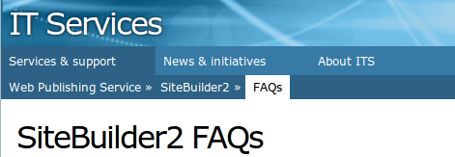
Descriptive, hierarchical navigation
Create a natural flowing hierarchy for your pages - so a search engine can have a sense of what role this page plays in the bigger picture of the site
  Specific topics tend to be further down the hierarchy; broader information closer to the top
Use mostly text for navigation
Use "breadcrumb" navigation where appropriate to convey structure
Use descriptive anchors (links) in page content, rather than "click here" or "more info" - make it descriptive and conscise
Notes:
* You should use a descriptive, hierarchical navigation structure to create a natural flowing hierarchy - that way a search engine can have a sense of what role your page has in the bigger picture of the site
* Specific topics tend to be further down the hierarchy with broader information above it
* Use mostly text for navigation - where you have images, make sure the "alt" text is descriptive
* Use breadcrumb navigation where it's appropriate to convey structure - Sitebuilder's ID6 design will do this for you with horizontal navigation, and with vertical navigation the tree structure conveys this
* Use descriptive anchors (links) in your actual page content - rather than the link being "click here" or "more info", make the link descriptive and conscise to describe the page that it's going to - this helps search engines work out why that content is relevant

Slide 14
Link reputation
One of the big factors in ranking pages is its "reputation", earned by other websites linking to your content using relevant keywords
The quality of these links is based on trust (the pages' own reputation), relevance (is the link from a page about the same topic) and authority (is it the most linked-to site on a particular topic)
Notes:
* One of the big factors in ranking pages is the concept of reputation - this is earned from a number of factors, mainly where other websites are linking to your content using relevant keywords
* The "quality" of a link to your site is based on trust (the page's own reputation), relevance (is the link from a page on the same topic) and authority (is this the most linked-to site on a particular topic)

Slide 15
The importance of social media
Engaging with clients / customers via social media encourages them to link to your content and increases reputation and authority
Some search engines will crawl social media outlets and encourages "social search" - pages liked by your social circle are ranked higher
Adding social media links (Google+ +1, Facebook Like, Tweet this) are sometimes ok - for distinct interesting pieces of content (articles) that users can share with their social circles
  But don't blanket your site with them - visual clutter
Notes:
* With link reputation, social media can become really important
* Engaging with your users via social media such as Facebook, Twitter and Google+ encourages them to link to your content and increases its reputation and authority
* Some search engines will crawl social media outlets and encourage "social search", where pages liked by your social circles are ranked higher
* Adding social media links such as +1, LIke and Tweet buttons is sometimes okay, when you have distinct interesting pieces of content (articles) that users may want to share with their social circles, but don't blanket them on your site because they cause visual clutter, and sometimes aren't relevant - users may want to "Like" your department, but they're unlikely to want to tweet a link to it

Slide 16


Keywords
Google (and most other search engines) will pay no attention to your page keywords, because it would be too easy to "spam" irrelevant content into results
  See YouTube's keyword system!
Keywords can still be useful though:
  The Warwick Search engine ranks pages on keywords as well as content
    It can be useful to restrict a search on a keyword
  You can create keyword-based navigation for your site (Table of Tags pages in Sitebuilder)
Notes:
* Keywords are a sticky subject here because Google and most other search engines will pay no attention to your page keywords - it's too easy to "spam" irrelevant content because the keywords don't have to appear on the page
* YouTube's keyword system is plagued by this - people put "Justin Bieber" as a keyword on every video to make it appear in those searches, and because they can't systematically analyse the content of videos, it works
* Keywords can still be useful though, particularly with the Warwick search engine - we use keywords to rank content because it comes from a "trustworthy" base, and you can use tools in Sitebuilder to restrict searches to a keyword or to provide a list of related pages on a keyword
* You can also create keyword-based navigation for your site using Table of Tags pages

Slide 17
Rank isn't everything!
A page that appears at the top of search results has only done half the job.
Search result presentation is important - the user still has to click the link ("impressions" vs. click-through)
This is even more important with paid-for search
Notes:
* It's important to remember that rank isn't everything - a page that appears at the top of search results has only done half the job
* The presentation of your pages in search results is important - the user still has to click the link to get to your site. When your site appears in results, that's an "impression", and when a user clicks on it it's a "click-through".
* This is even more important with paid-for search - you pay money just for the impression, then more money for the click-through, so the goal is for the search result to be displayed in such a way that everyone for whom it's relevant clicks it

Slide 18
Good search result presentation
The page title should be unique and accurate for each page, be succinct and include some relevant keywords - name, physical location, main focuses or offerings. Should be brief and informative - make good use of the space
The page description should be unique for each page and accurately summarise the page's content. Some search engines may use this instead of your page content, especially if the search doesn't match the actual content of the page.
Use a hierarchical structure of pages to make it easy for search engines (e.g. Google) to show the hierarchy of your site
Notes:
Some notes on good search result presentation:
* The page title should be unique and accurate for each page, be succinct and include some relevant keywords such as the name, physical location and main focuses or offerings. It should be brief and informative and make good use of the space
* The page description should be unique for each page and summarise the page's content, because some search engines might use this when displaying a result instead of the page's cotnent, especially if the search doesn't match the content of the apge
* Using a hierarchical structure of pages makes it easy for some search engines to show the hierarchy of your site in results

Slide 19
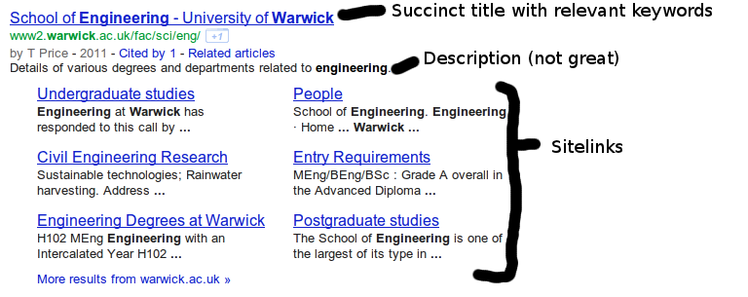
Anatomy of a search result
Notes:
You can see here the top search result for "warwick engineering" - with a succinct relevant title and sitelinks, and the page description shown instead of the page content here

Slide 20

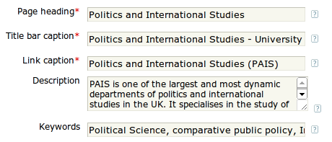
Embracing the tool
Sitebuilder helps you to structure your content and add metadata to maximise its ranking potential
Hierarchical navigation with descriptive URL structures - so your page is called "engineering", not a random ID string
When you create a page (or edit the properties) there are a number of fields to fill in:

Slide 21
Embracing the tool
When you're editing content, you can create headings using the dropdown in the editor
There are two tools - links checker and page checker that are designed to make sure your content is of a high quality
Sitebuilder inserts metadata into your pages (such as Google's "canonical" tag) to make sure the site is structured as well as possible
The www2.warwick.ac.uk domain has a huge amount of "domain authority" - so pages on there get extra ranking points
Sitebuilder can automatically link a Google Analytics account to every page on your site

Slide 22
...and if it still isn't working...
Analyse statistics with Google Analytics, what did my visitors search for? Did they find it? How long do people stay on the page, do they stay in the site or go elsewhere?
As a last resort, look into PPC (pay-per-click) paid search advertising using Google AdWords
Notes:
* The important thing to do once you've started to optimise your site is to review how it's going frequently.
* Use tools such as Google Analytics to analyse trends of usage over time, which keywords users are using to get to your site, how long they stay there
* If you have a business need for more users, as a last resort you can use PPC paid-for search advertising using Google AdWords or another service

Slide 23
Resources
Any questions?
This presentation: https://docs.google.com/presentation/d/10aphVDFPSL-TpK6DuTc2P4BT071z-YEthSkvjul-UsY/edit
Google SEO Starter Guide: http://www.google.co.uk/intl/en_uk/webmasters/docs/search-engine-optimization-starter-guide-en-gb.pdf
Google SEO Report Card: http://www.google.com/webmasters/docs/google-seo-report-card.pdf
M.Mannion@warwick.ac.uk
Notes:
And that's me - there's a couple of useful links here to Google's SEO starter guide and report card, where a lot of the specifics came from here
Are there any questions?

