Slide 1

Energy: Is there an energy crisis? 24 October 2012

Slide 2
Professor Pam Thomas (Department of Physics, Chair of the Board of the Faculty of Science) Introduction to Ideas Café and this evenings agenda

Slide 3
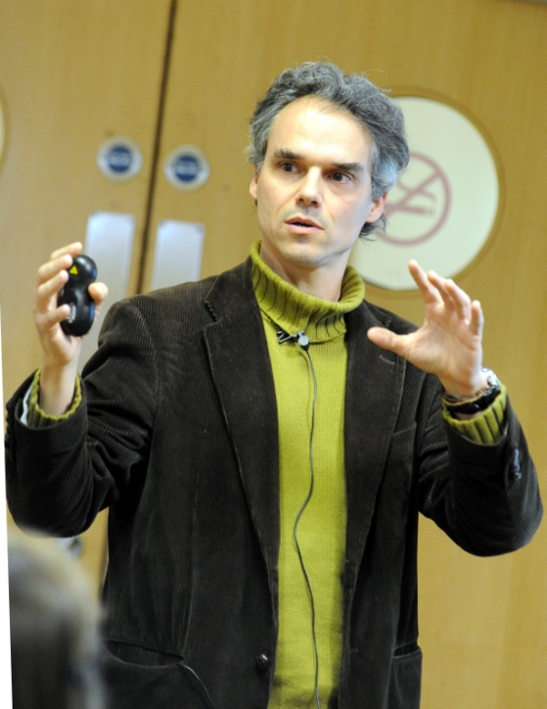

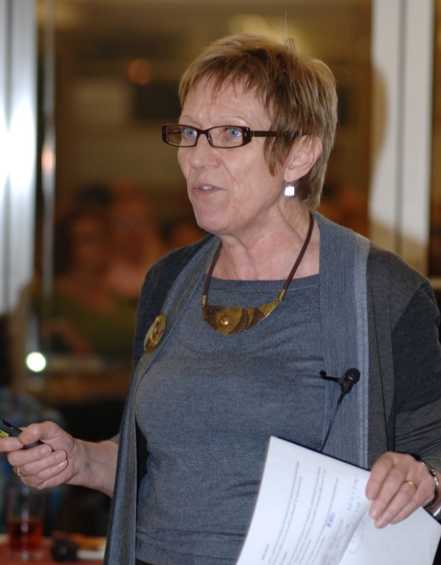
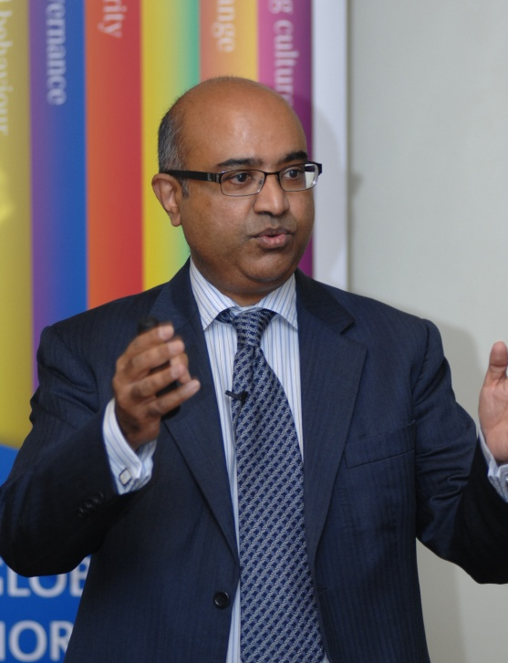


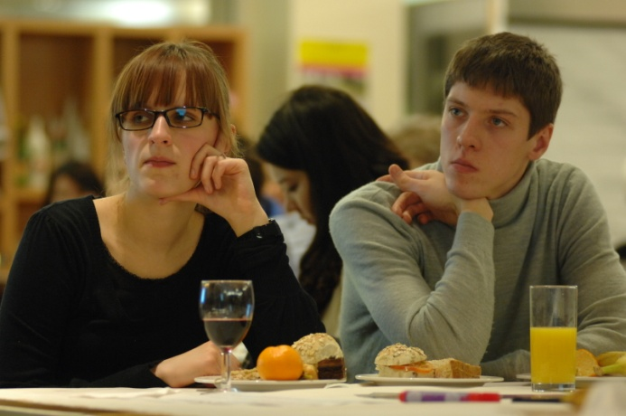

Slide 4
Energy: Is there an energy crisis?
Presentations
Professor Phil Mawby (School of Engineering, Energy GRP Lead)
Introduction to and overview of the Energy Global Research Priority
Professor David Elmes (Academic Director, Warwick Global Energy MBA )
The challenge that the global energy industry faces in meeting future supply and demand
Richard Smith (Head of Energy Strategy & Policy, National Grid)
An overview of UK energy futures
Professor Evan Parker (Department of Physics)
Developing new policy and approaches to geo-engineering
Jon Price (Director, Centre for Low Carbon Futures)
An overview of alternative options for low carbon energy and the difficulties they present
Group discussions
Address table questions and presentation points

Slide 5
Global Research Priorities:
Responding through research to global priorities
“Warwick’s world-class Global Research Priorities focus multi-disciplinary research on key areas of international significance, by bringing together scholarly expertise from across faculties and departments.”
Supporting and enhancing multidisciplinary and cross-departmental research
Demonstrating the impacts of research and engaging with key users
Generating research income through interdisciplinary research that addresses major global issues

Slide 6










Global Research Priorities

Slide 7
Professor Phil Mawby (School of Engineering, Energy GRP Lead) Introduction to and overview of the Energy Global Research Priority

Slide 8
The Energy GRP
Why Energy?
Arguably the single biggest challenge to mankind over the next 50 years – a truly global issue
Involves all sectors of the research community
Recognised by funding councils as major issue
Objectives of the energy GRP
Draw together Energy Research Community
Provide Critical Mass
Use the Campus as a living laboratory

Slide 9
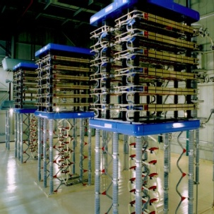
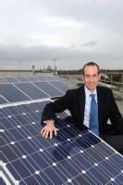
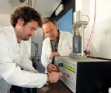


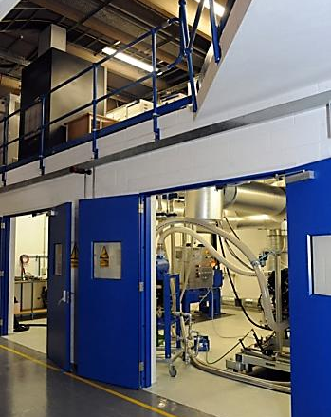
Main Themes
Energy GRP
Electrical
Energy
Solar
Energy
Thermal
Energy
Confined
Fusion
Energy
Energy
Management
Low
Carbon
Transport

Slide 10

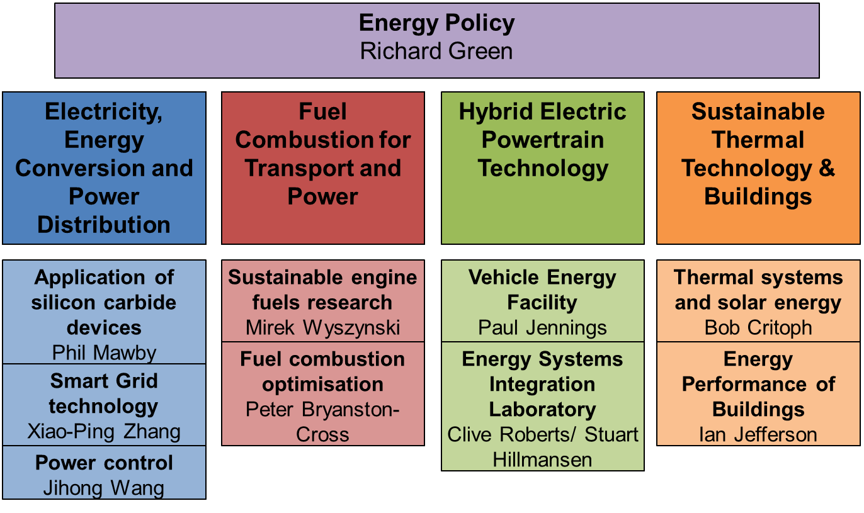
Energy Efficiency Project

Slide 11
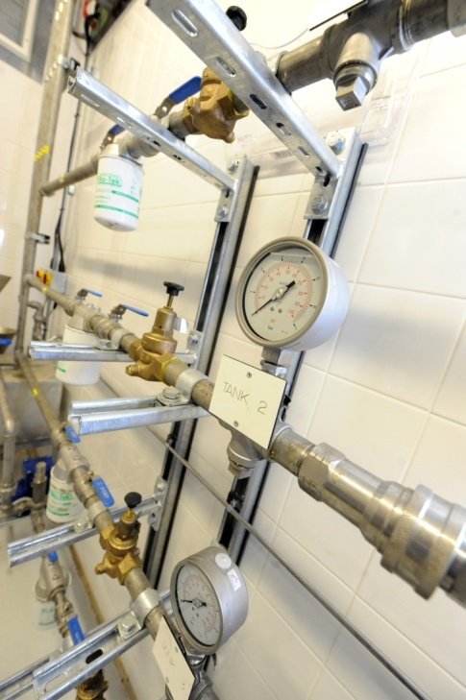
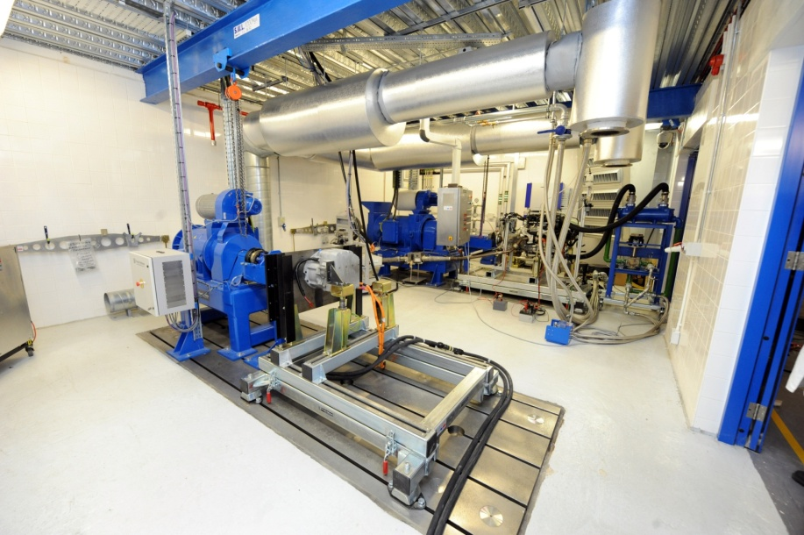
Hybrid vehicle architecture testing; Powertrain component testing/ characterisation; Control strategy development and refinement; Fuel economy and emissions testing; Electric motor testing and characterisation; Electrical energy storage testing/ characterisation; Real world performance testing of bio-fuels
VEHICLE ENERGY FACILITY

Slide 12
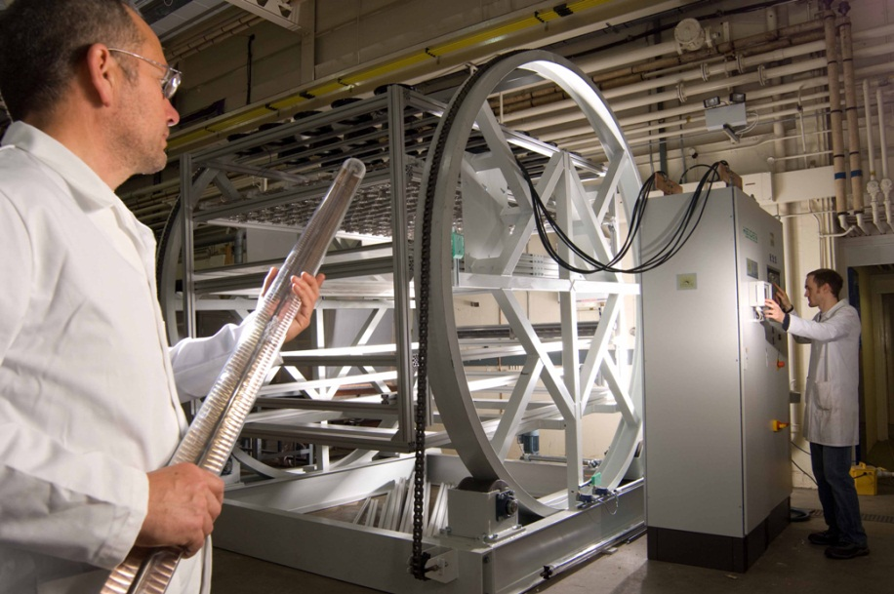

THERMAL CONTROL RESEARCH
Solar systems testing including a 3.2m² solar simulator with variable tilt
Large environmental chambers with thermal systems testing and heat pumps
Sophisticated equipment for monitoring, testing and analysing heat transfer

Slide 13
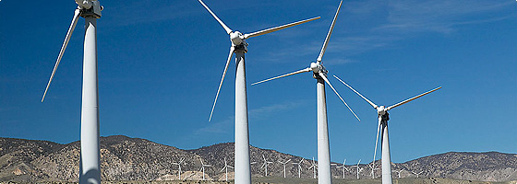


Major Research Projects
Will also spur the development of innovative solutions by sponsoring speculative research in uncharted areas.
Design of smart grids, communication technologies and the harnessing of the demand-side for the control and optimisation of the power system.
New materials for power equipment that are more efficient and more compact.
Study the interaction between multiple energy vectors to coordinate the planning and operation under uncertainty.
Management of transition assets

Slide 14

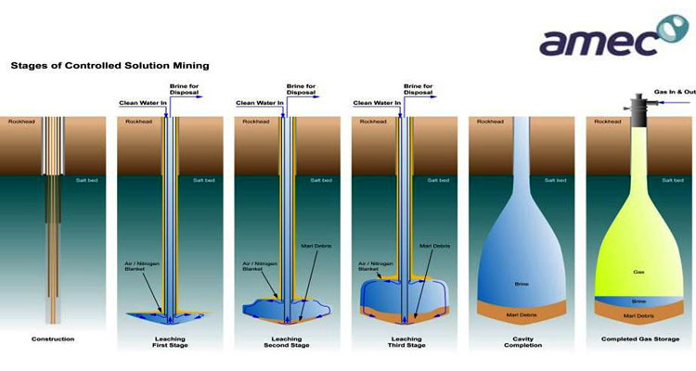
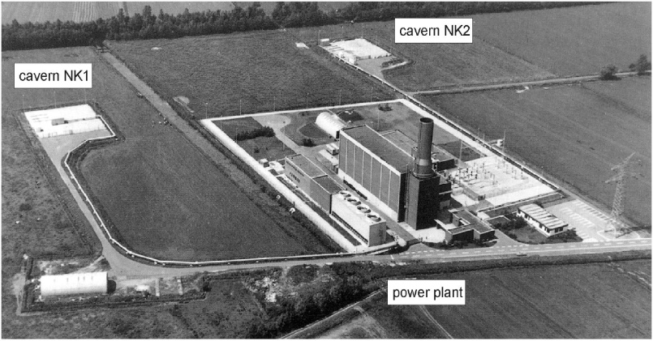
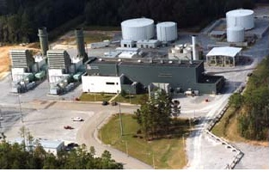
Major Research Projects
Integrated, Market-fit and Affordable Grid-scale Energy Storage
Number of rocks types could
provide storage horizons
Salt – ideal storage horizon
thick beds or flow structures
ductile & flows
very high impermeability -
gas tight
‘easily’ create large voids by solution mining – pressure vessels
2 salt cavern facilities in world
Huntorf, Germany (1978)
McIntosh, USA (1981)

Slide 15



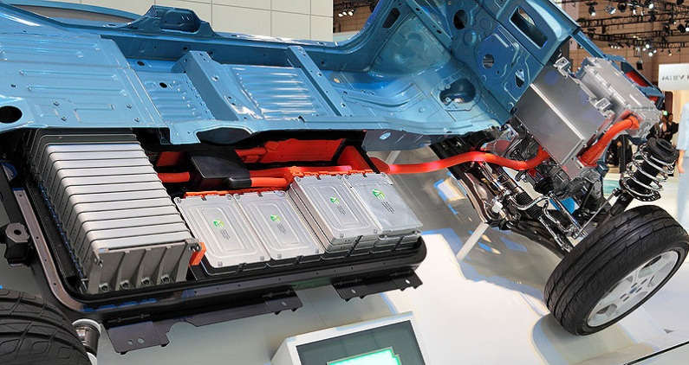
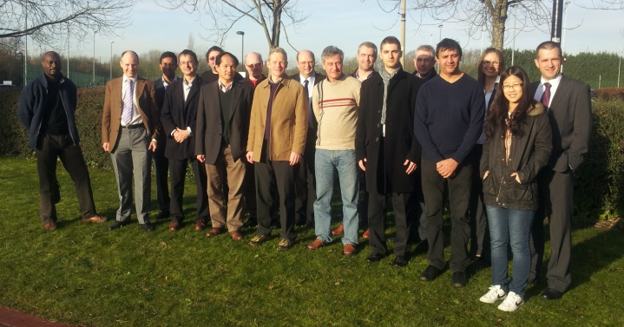
Major Research Projects
Vehicle Electrical Systems Integration (VESI)
Aim: Reduce the cost, size and improve reliability of the electrical power systems by integration of functionality in automotive applications
£3.5m multi-partner project funded by EPSRC (led by Professor Phil Mawby, School of Engineering at the University of Warwick)
6 themes which include semiconductors, design tools, packaging, motors, converters and passives

Slide 16


Major Research Projects
Collaborative project of 8 Universities funded by the EPSRC Grand Challenge Programme.
Physical infrastructure change in energy networks required to move the UK to a low carbon economy
At the ‘top’ of the network ie where the very highest transmission voltages occur
More than half the capital cost of an electricity system is spent in the last mile

Slide 17
IPT Meetings
Industry and Parliament Trust (IPT) breakfast meeting held on Wednesday 18th January 2012, chaired by Lord Oxburgh KBE.
We heard from three speakers:
Rashid Al-Marri (General Manager, South Hook Gas);
Kate Smith (Head of Government Relations, Shell UK);
Prof. Philip Mawby (Chair of Power Electronics, Applications and Technology in Energy Research, University of Warwick).
16th May - Caroline Kuzemko

Slide 18
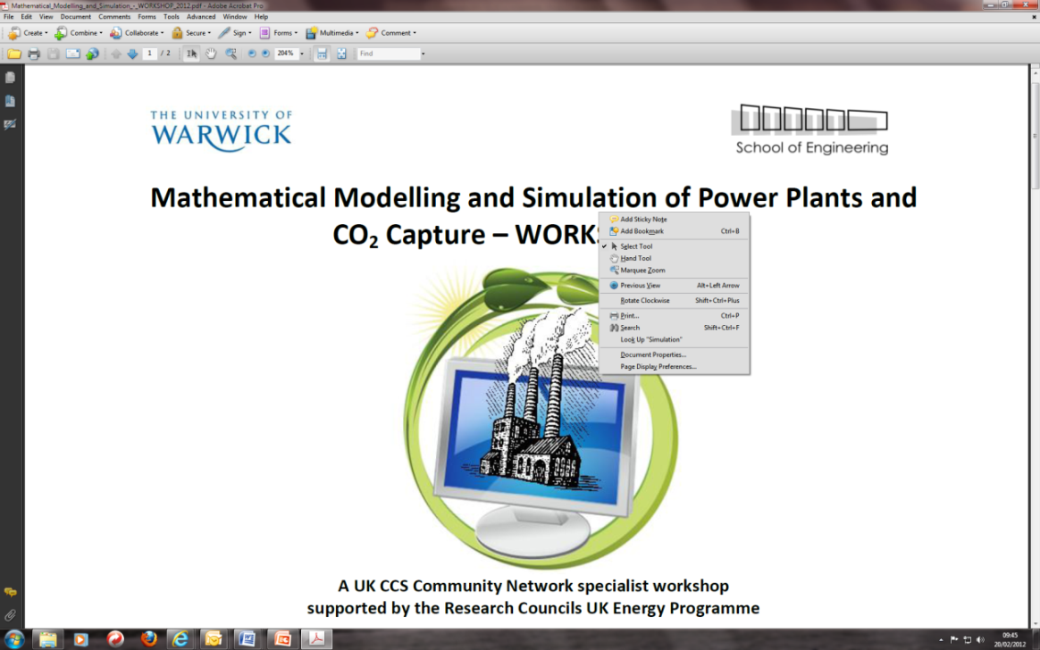
MEGS
Midlands Energy Graduate School
Event in September and December, will know details by May

Slide 19
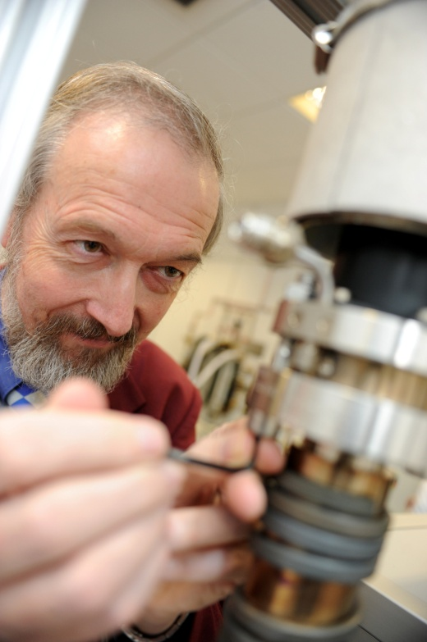
Recent Bids
EUED – Bob Critoph
Energy Storage – Jihong Wang

Slide 20
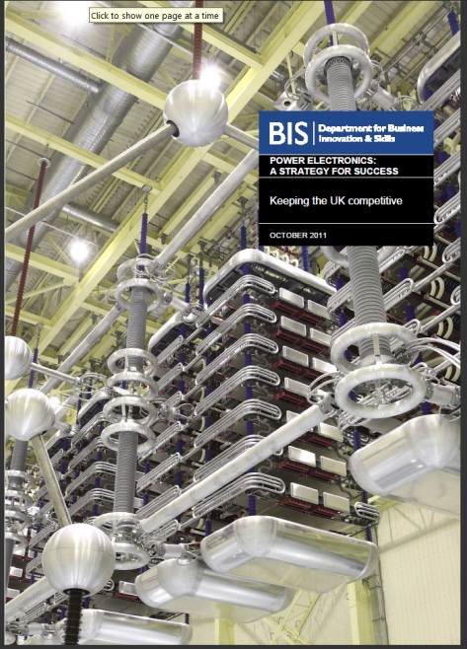
Power Electronics
EPSRC call – Under pinning technologies
£18m
A single bid from the community
Result of BIS UK strategy for Power Electronics
Marked as an activity to grow

Slide 21

European Research Alliance
http://www.eera-set.eu/

Slide 22
Energy & Environment Wolfson Special Interest Group
Rohit Bhagat (WMG), Nishal Ramadas (Physics),
Ian Hancox (Chemistry), Fiona Collingan (Wolfson Exchange)
The vision of the Energy & Environment SIG is to
generate a network of PG students and ECRs to generate added value.
Aims:-
Knowledge transfer
Forum for the discussion of ideas
Generate collaboration and whole systems approach
Retain Warwick's brightest talents
Synergy with the Energy GRP objectives

Slide 23
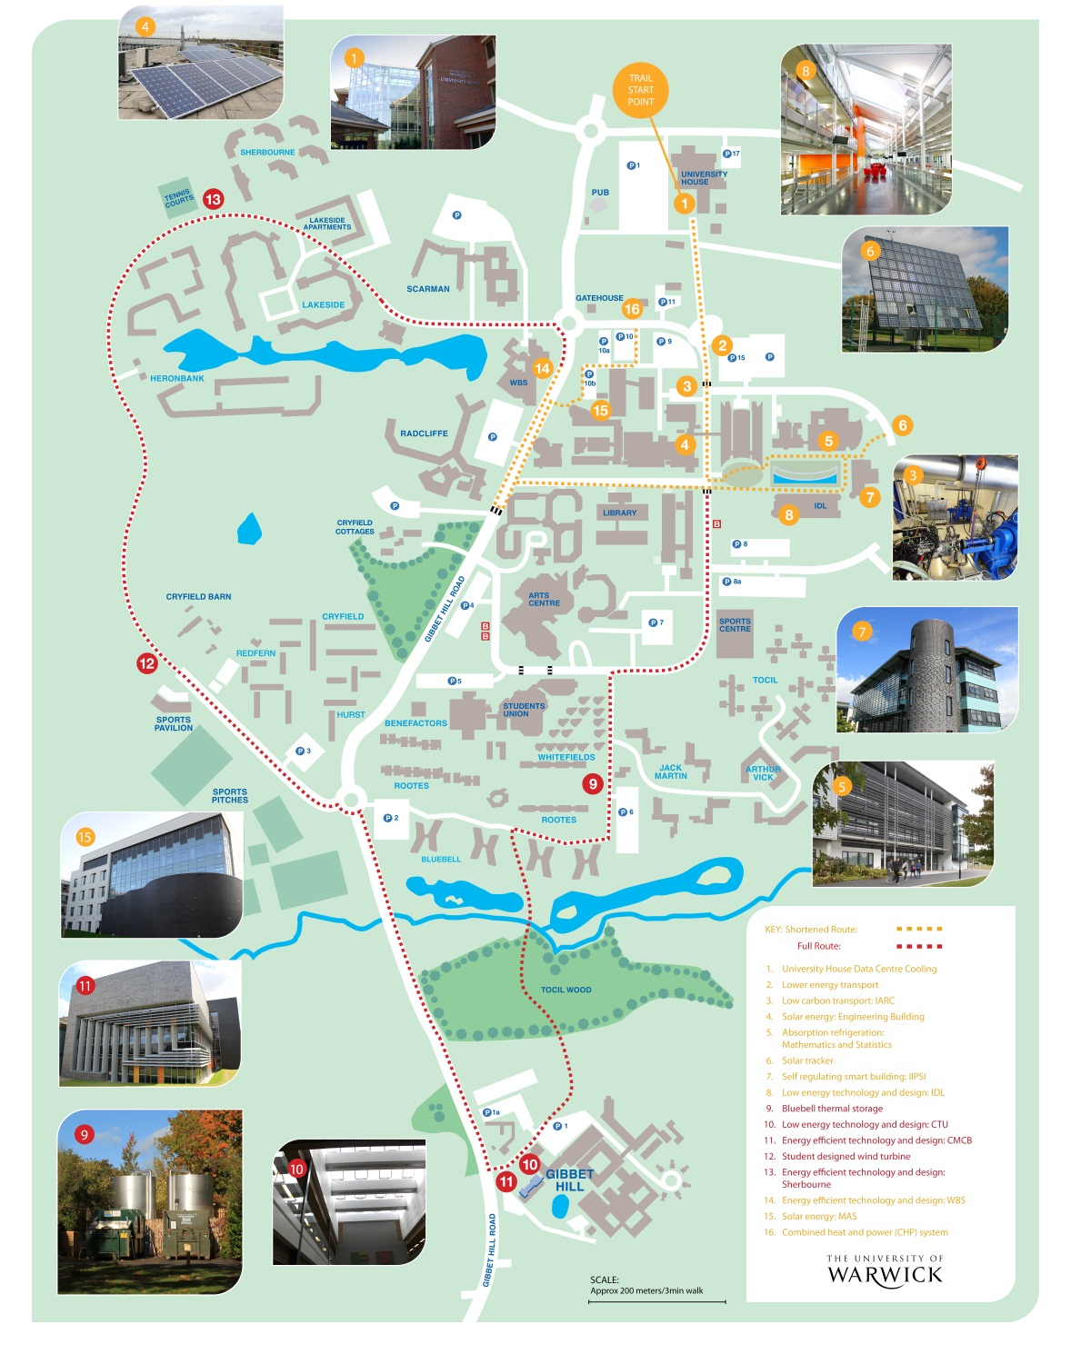
Energy Trail
16 innovative points of interest:
University House Data Centre Cooling
Lower energy transport, Car Park 15
Low carbon transport: IARC
Solar energy: Engineering Building
Absorption refrigeration: Mathematics and Statistics
Solar tracker
Self regulating smart building: IIPSI
Low energy technology and design: IDL
Bluebell thermal storage
Low energy technology and design: CTU
Energy efficient technology and design: CMCB
Student designed wind turbine, Cryfield sports pavilion
Energy efficient technology and design: Sherbourne
Energy efficient technology and design: WBS
Solar energy: MAS
Combined heat and power (CHP) system

Slide 24
Professor David Elmes (Academic Director for the Warwick Global Energy MBA )
The challenge that the global energy industry faces in meeting future supply and demand

Slide 25
Population, GDP, Energy & Emissions
Global Population
0.9% pa growth over 2008-2035
GDP
OECD growth of 2.2% pa over 2009-2035
Non-OECD growth of 4.9% pa over 2009-2035
Energy Demand
1.3% growth pa over 2009-2035, a 40% increase overall
Nearly 90% of demand growth is in non-OECD countries
Carbon Emissions
Still rising: up 5.3% between 2009 and 2010
Expected Policies suggest warming of +3.5˚C with 80% “locked-in”
To keep within +2˚C need 2035 emissions to be 40% less than expected
OECD/IEA, WEO 2011
Notes:
An annual growth rate in energy demand of 1.3% is higher than the population growth rate of 0.9%, suggesting increased energy usage as the world’s population both grows and develops. Should this growth rate in energy demand raise any concerns? It would be slower than the 1.9% rate over 1980-2006. The IEA’s answer is yes for the following reasons:
Where is this energy going to come from if historic, low cost sources of oil & gas are reaching maturity?
How is this energy to be provided while also reducing carbon emissions to avoid the risks of climate change?
How will this increase be funded, with an estimated cost of $38 trillion (in 2010 dollars, spent over 2011-2035) and what will this mean for the price of energy?

Slide 26
Energy use around the world in 2011
2011 Data (BP, 2012)

Slide 27
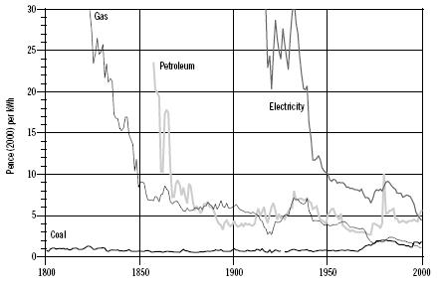
Energy transitions take time: historically 25 years or more
Retail consumer fuel prices in the UK 1800-2000 (p/kWh)
Fouquet and Pearson (2003)
Notes:
Fouquet recently published a more pessimistic view looking back at earlier transitions and including the innovation stage:
Minimum: Innovation Chain: 45 Years, Diffusion: 30 Years
Average (Post-Ind Rev.): Innovation chain: 135 Years, Diffusion: 50 Years
(In Roger Fouquet, The slow search for solutions: Lessons from historical energy transitions by sector and service, Energy Policy, Volume 38, Issue 11, November 2010, Pages 6586-6596)

Slide 28
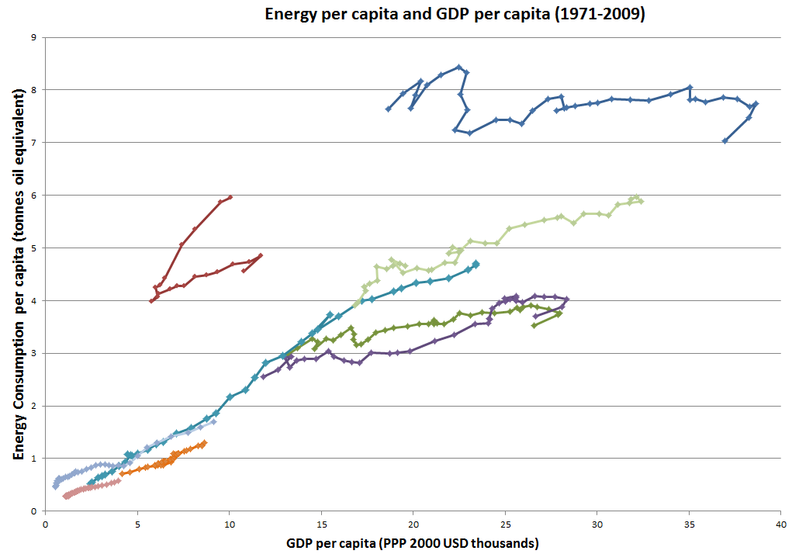
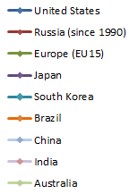
“Climbing the energy ladder”
Data, IEA
Notes:
Figure: Energy consumption per capita versus GDP per capita for various countries over 1971–2009
Data Source: World Energy Balances © OECD/IEA 2011.
“Climbing the energy ladder” is a term Shell uses in their energy scenarios.

Slide 29
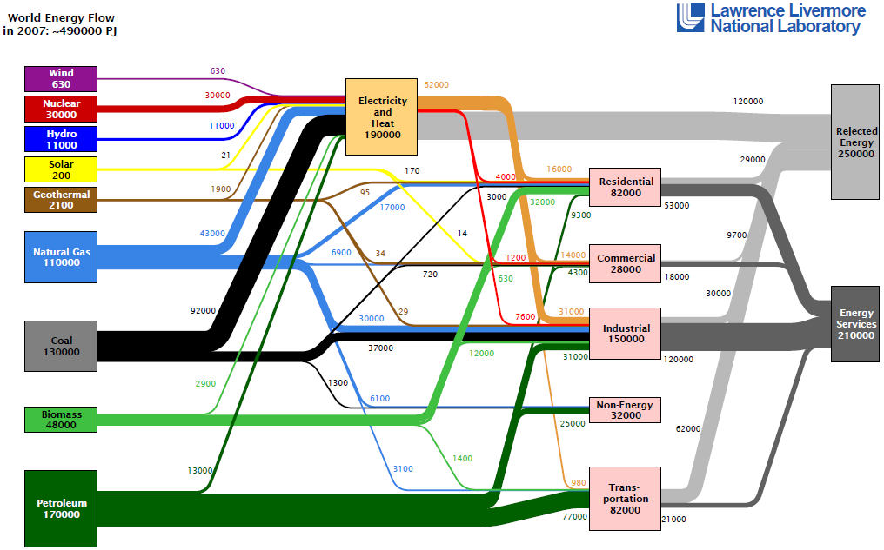
World Energy Flows
Notes:
Figure: Smith, C A; Belles, R D; Simon, A J (2011) “Estimated International Energy Flows 2007”, Lawrence Livermore National Laboratory/US Department of Energy, March 2011. Available at https://flowcharts.llnl.gov/content/international/2007EnergyInternational.pdf.
Providing the world’s 12,271Mtoe of energy is a $9 trillion industry (based on a price of $100 per barrel), which equates to about $25 billion a day, depending on the oil price.
There are two points worth noticing from this flow diagram:
the losses involved in areas such as electricity generation and transportation, which is why energy efficiency is as important a topic as energy use
the high use of coal in electricity generation and oil in transportation and so the challenge of developing low-carbon alternatives of significant scale in these two areas.

Slide 30
World Energy Use Today
Energy demand growth is expected to exceed population growth
A mix of energy sources at the global level for decades
We aim to make energy transitions at speeds not seen before
We are on a path to +3.5˚C with 80% “locked-in”
The opportunity for different energy paths as countries develop or change
Equal opportunities for efficiency improvements as for changing the sources of energy
The scale of investment needed in the energy industry is at least $1Trillion every year over the next 25 years
Notes:
And so a dynamic market with the industry facing transformation, not evolution.
For more information and details on the points not covered in the previous slides see:
Elmes, D.A. (2012) “Governments, Policies and Companies – A Business Perspective” Chapter 12 in “Dynamics of Energy Governance in Europe and Russia”, Eds Kuzemko, C.; Belyi A.; Goldthau, A. and Keating, M.F. Palgrave Macmillan; Basingstoke, UK
In Press (16th March 2012). http://www.palgrave.com/products/title.aspx?pid=522015

Slide 31
Scenarios used at Warwick to explore paths that companies might take.
The Shell 2050 Scenarios
An international company example
The UK Foresight “Powering our Lives” Scenarios
A government perspective
The Forum for the Future’s Climate Futures Scenarios
A sustainable development perspective
The Forum for the Future’s Climate for Development Scenarios
A sustainable development perspective for emerging economies

Slide 32
Companies we have studied….
AES Corp
Anadarko
Areva
BG Group
BP
Cairn Energy
Centrica
Chesapeake
Chevron
CNOOC
CNR
ConocoPhillips
Dong Energy
Duke Energy
EDF
EDP
ENI
Enel
E.ON
Essar Energy
ExxonMobil
First Solar
Gamesa
Gas Natural Fenosa
Gazprom
GDF Suez
Hess
Iberdrola
Lukoil
National Grid
Nexen
Next Era Energy
NTPC
Occidental
OMV
Ormat
Peabody Energy
Pemex
Petrobras
PetroChina
Petroplus
Q Cells
Reliance
Repsol YPF
RWE
Schlumberger
Shell
Sinopec
Statoil
Suncor
Suntech
Suzlon
Tesla
TEPCO
Total
Valero
Vattenfall
Vestas

Slide 33
Insights from applying scenarios
The increasing importance of gas & renewables versus oil.
The business of less.
The “smart” use of energy
The alternative of distributed energy.
The uncertainty around transport alternatives.
Volatility in policy making and regulatory frameworks.
The continued influence of social volatility.
The value of being a national company or a national champion.
The challenge of ‘transition fuels’.
Risks of undifferentiated strategies.
The opportunity for global power companies.
Safety, the environment and the volatility of reputation.
Notes:
For more details see:
Elmes, D.A. (2012) “Governments, Policies and Companies – A Business Perspective” Chapter 12 in “Dynamics of Energy Governance in Europe and Russia”, Eds Kuzemko, C.; Belyi A.; Goldthau, A. and Keating, M.F. Palgrave Macmillan; Basingstoke, UK
In Press (16th March 2012). http://www.palgrave.com/products/title.aspx?pid=522015

Slide 34
UK Energy Futures
Richard Smith
Head of Energy Strategy & Policy
October 2012

Slide 35
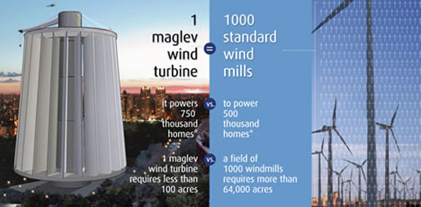
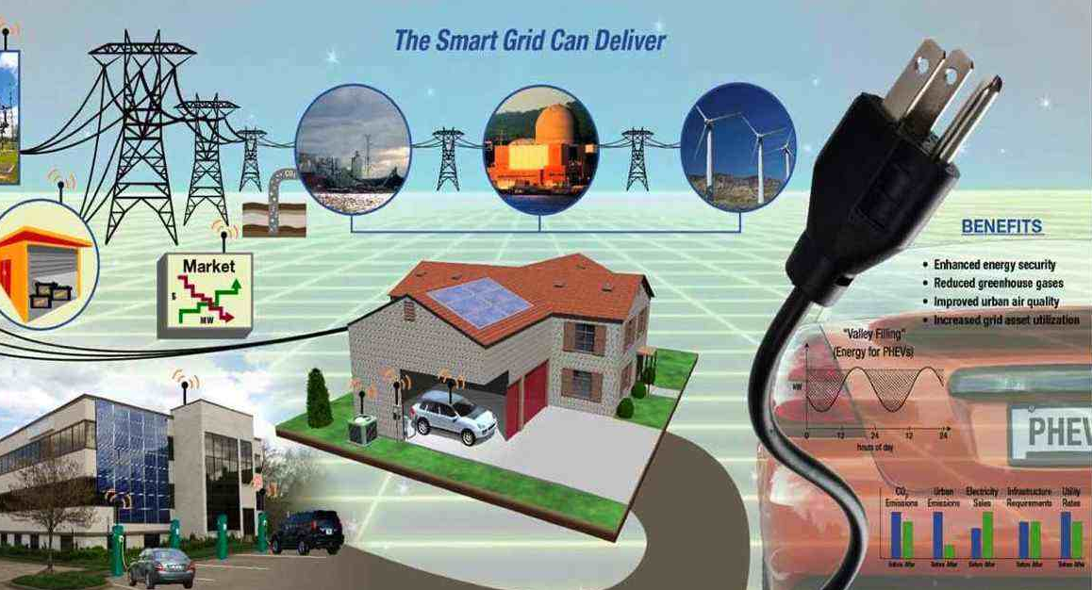
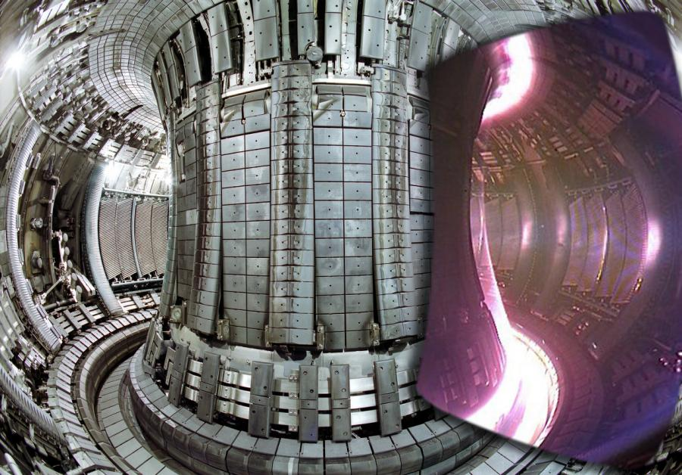
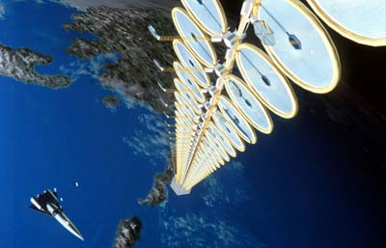
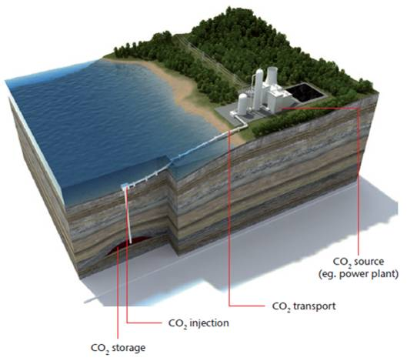
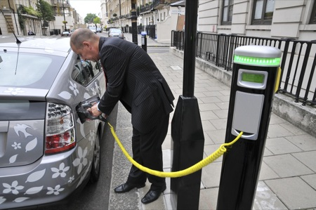
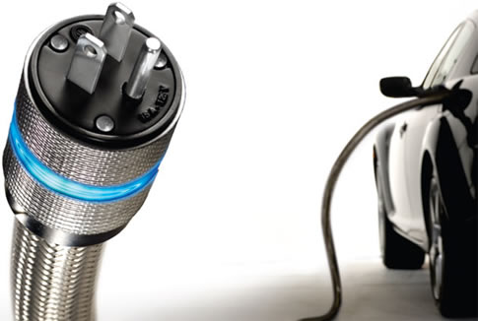
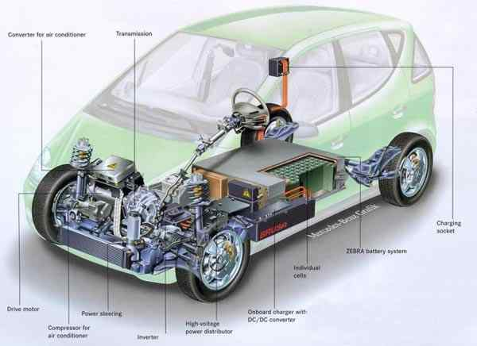

Slide 36
Gone Green
Accelerated Growth
Slow Progression
Overview
Overview
Overview
Government climate targets missed / abandoned
Continued economic hardship, low GDP growth
Limited energy efficiency / Green Deal impact
Domestic gas demand broadly flat, higher in power generation
Government climate targets met, balanced approach
Modest GDP growth in medium term at historic averages
Energy efficiency is driven / Green Deal is effective
Gradual decline in gas demand
Government climate targets met early
Sustained economic growth in medium to long term
Significant energy efficiency
Significant reduction in gas demand
Targets performance
Targets performance
Targets performance
2020
renewable
✗
2020
renewable
✓
2020
renewable
✓
carbon
✓
carbon
✓
carbon
✓
2030 carbon
✗
2030 carbon
✓
2030 carbon
✓
2050 carbon
✗
2050 carbon
✓
2050 carbon
✓
Notes:
Build #1
Build #2

Slide 37
Electricity demand
Slow Progression
Annual electricity demand (TWh)
Annual demand broadly flat
Peak demand flat / falling
Gone Green
Economic growth, heat & transport electrification
Peak demand grows steadily
Accelerated Growth
Reflects greater economic growth and electrification of heat & transport

Slide 38
Electricity generation
Gone Green:
Power generation (TWh) &
carbon intensity (gC02/kWh)
Slow Progression
Extension of existing plant; new gas generation
Slower low CO₂ deployment
Gone Green
Balanced approach
Contributions from different technologies
Accelerated Growth
Faster low CO₂ deployment
Strong micro generation deployment
Notes:
Build #1

Slide 39
25%
20%
15%
De-rated margin (%)
10%
5%
0%
2012/13
2013/14
2014/15
2015/16
2016/17
Base case
Low CCGT
Full imports from Continent
Full exports to Continent
High CCGT

Slide 40
Gas demand
Slow Progression
Annual gas demand (TWh)
Higher domestic & power generation demand
Peak demand broadly flat
Gone Green
Steady decline in domestic & power generation demand
Peak demand ~25% lower
Accelerated Growth
Strong decline in domestic & power generation demand
Peak demand ~40% lower

Slide 41
Gas supply
Gone Green:
Gas supply (bcm/year) &
Import dependency (%)
Slow Progression
Higher UKCS & Norwegian supply; higher global LNG
New seasonal storage
Gone Green
Balanced approach
Flexible storage driven by market requirements
Accelerated Growth
Lower UKCS & Norwegian supply; tight global LNG
Storage under construction
Notes:
Build #1

Slide 42


Slide 43

Professor Evan Parker (Department of Physics)
Is there an energy crisis?

Slide 44
We have stacks of fossil fuel...
“…….we will ultimately burn about 1% of the available fossil fuel over the next few centuries”
Prof Ken Caldeira, Stanford
Scientific American Sept 2012
Notes:
But there is a problem……burning FF releases CO2 into earths atmosphere

Slide 45
+ CO₂ – what temperature rise can we expect?
despondency
Probability
ppmCO₂ = 450
ppmCO₂ = 650
ppmCO₂ = 1000
0°c
2°C
4°C
6°C
11°C
Temperature rise
Notes:
Considerable uncertainty in forecasting temp! Additional levels of uncertainity.

Slide 46

Too risky to ignore
Notes:
All want to avoid this senario!

Slide 47
So let’s save energy?
Jevon’s Paradox:
In developed economies, saving energy (by improved efficiency) tends to lead to increased demand for energy, which in turn accelerates economic growth, further increasing demand!
….tendency for efficiency to merely displace!
Notes:
Eg house insulation
Remains a concern to policy makers
Who needs all this energy?

Slide 48
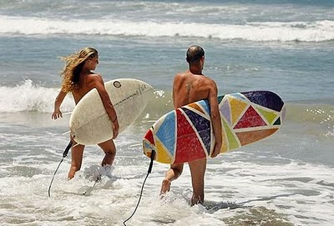
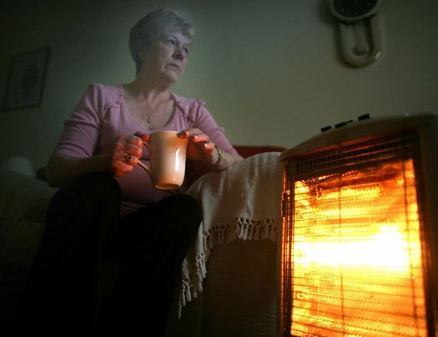

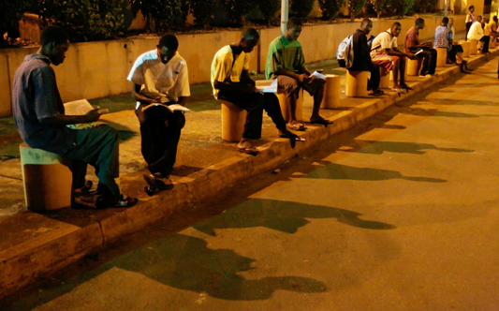
Notes:
Prepared to pay increasing costs of energy.

Slide 49

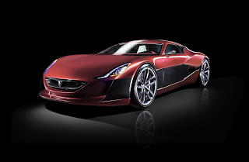
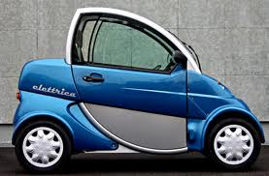
Clarkson Effect
Notes:
Clarkson not a big problem….but this is….

Slide 50
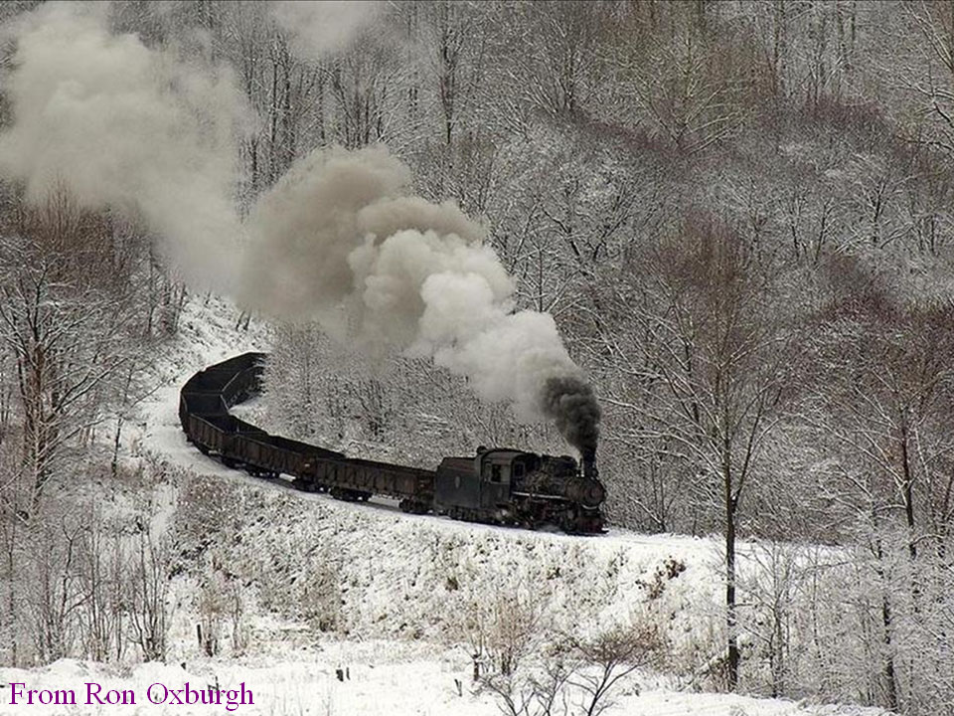
Jan 2011
Courtesy of Lord Oxburgh
Notes:
…so what do we have on offer?

Slide 51
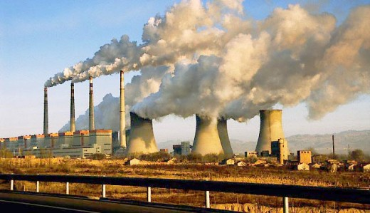
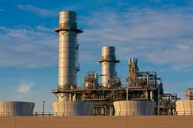
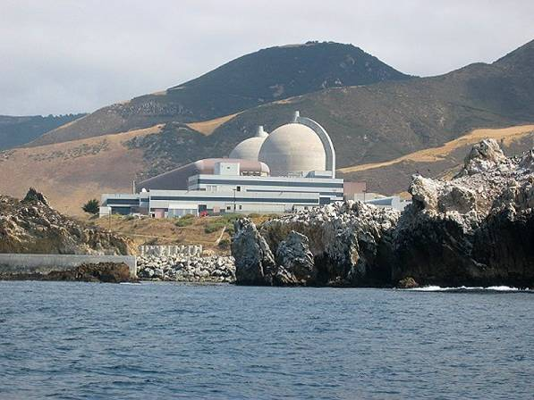


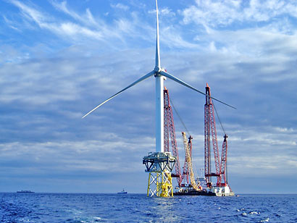
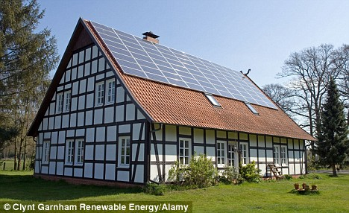
Energy for the future…..
Notes:
Our response to climate change is being driven by the corporates …how to make the next buck. Eg Shell and political expediency.
Wind power is very costly…x3 of gas power. Embodied energy includes all the perpheral economic activities. First proposed by Hans Bethe, Physics Nobel Laureate. If you track back far enough in manufacturing activity it’s the SELLING price which reflects directly on the energy used to produce the article. Eg if solar sells for £3000 per installed kW then it takes over 60 yrs for energy payback.
So how can we move forward?

Slide 52
Wrong target?
Fixated on
CO₂ emission reduction targets
Notes:
For target culture to work….need effective global commitment . A direct relationship between action and benefit and needs human timescale. Specifying a target is questionable. Leads to precipitate actions driven by political expediency. Some evidence to suggest its not working!

Slide 53
More effective approach
Focus on energy:
Clean, low cost, abundant, deployable and available 24/7
Notes:
Focus on the solution. Easily measurable. Sound ethical principles. Widespread engagement more likely. Need R&D programme.
So where is all this energy coming from?

Slide 54

FUSION
Notes:
Fusion at a safe distance

Slide 55
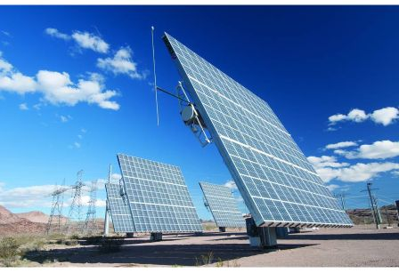
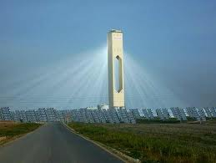
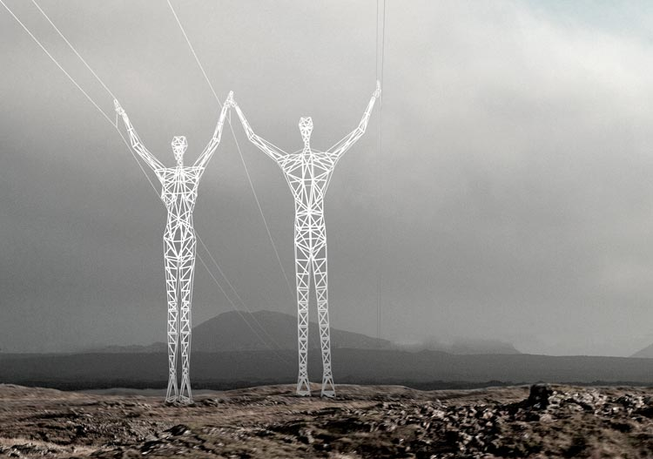
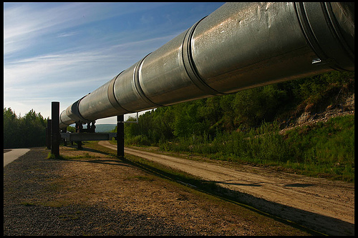
Abundant, clean, sustainable power
…….and ultimately cheap!
Notes:
Desertec driving this

Slide 56
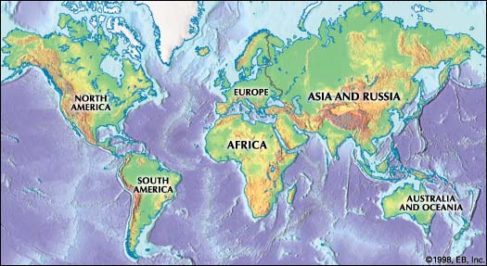
Mitigation -
solar land area requirements
6 Boxes at 3 TW Each

Slide 57

Geo-engineering solution –
“Dream Particles” for the polar regions:
PV Cell
Mirror surface
Si
rf
IC
MEMS
“ The Dream Particle”
(1μm x 1μm x 100nm)
…….we cannot ignore the unthinkable?
Notes:
Whats happens if things really go belly up?

Slide 58

Is there an energy crisis?
…..this is not the right question
What is the programme for rolling out clean energy across the world?
There is a crisis in Energy Policy
Notes:
…a much better question….and here we do have a real crisis…..

Slide 59

Jon Price, Director
Centre for Low Carbon Futures
Jon.price@lowcarbonfutures.org

Slide 60
Technologies alone are not enough
Policies: Emission targets, technology road maps and policies often fail to deliver planned outcomes
Politics: Social case for action as valid as the business case for investment of public funds
Behaviours: Often wrongly assumed that humans prefer a neutral environment in buildings, and more than often building energy performance “in situ” has a vast performance gap between planned and delivered
Public Perception: Talks of super critical CO2 in CCS pipelines, Carbon storage in saline aquifers, Shale Gas drilling, exploding sodium sulfur batteries, Nuclear
Uncertainty and lack of evidence slows the speed of the transition to a low carbon economy.

Slide 61

The Carbon Impact
Source: Economics of Low Carbon Cities,Centre for Low Carbon Futures Gouldson et al 2012
Notes:
Costs and energy reductions in context
By doing nothing we can ( case study of Leeds City Region) reduce emissions by 23% - the key challenge is what can we do to achieve the legally binding emission reductions. In our case study “Economics of Low carbon Cities” Centre for Low Carbon Futures, Gouldson et al 2012” insights showed to opportunity for up to 42%
Background trends in economic growth and changes in energy and carbon intensity of GDP will lead to a 2% increase in Leeds City Regions (case study) emissions between 1990 and 2022
Higher energy prices will impact on demand leading to a 12% reduction – so total impact of background trends and response to higher energy price will be a 10% drop in in LCR emissions
Decarbonisation of national electricity system will lead to 13% drop, so combined with background trends and energy price, by doing effectively nothing there will be a drop of 23%
Following implementation of the cost effective, cost neutral and exploitation of the realistic potential there could be a dropof up to 42% in LCR emissions

Slide 62
Where do we start ?
How do we convert National targets to Local actions ?
More than 50% of the World population live in Cities
More than 50% of economic output
More than 70% of carbon emissions attributed to consumption by Cities
Uncertainty and lack of evidence slows the speed of the transition to a low carbon economy.

Slide 63
The Key Questions
If local action is as important as National action, then how can this be mobilized ?
How can City Mayors asses the vast array of technology options?
How do we reduce uncertainty and unlock investment grade scale finance at a local level ?
If Yes : are there significant and commercial viable opportunities to exploit at City-Scale, supported by wider economic benefits, investment and deliver vehicles ?
Notes:
Does the evidence base suggest that there is a business case for major scale investments in low carbon options at the local level?
Does it suggest that the business case is underpinned by a wider social and economic case?
If there is a case, how can we secure, structure, deliver major scale investments in low carbon technologies at the local level?

Slide 64
Case study: Leeds City Region
Highlights opportunities for significant cost and Carbon reductions
City | Energy bill in 2011 | Level of investment that could be secured | Potential cut in annual energy bill | Jobs created | Carbon saved by 2022 (1990 baseline)
Barnsley | £418m | £313m | £78m | 250 | 37%
Bradford | £689m | £765m | £189m | 666 | 42%
Calderdale | £381m | £366m | £92m | 311 | 36%
Craven | £117m | £147m | £31m | 87 | 42%
Harrogate | £402m | £290m | £69m | 266 | 34%
Kirklees | £660m | £638m | £168m | 550 | 41%
Leeds | £1500m | £1300m | £320m | 1360 | 29%
Selby | £254m | £163m | £40m | 138 | 37%
Wakefield | £651m | £555m | £133m | 524 | 38%
York | £312m | £314m | £72m | 300 | 40%
Total LCR | £5.4 bn | £4.9 bn | £1.2bn | 4,500 | 36%
( Exploiting the cost-effective options)
Notes:
Case study Leeds City Region funded by CLCF and DECC. Review based on Government agency data based on UK Climate Change Committee model, Backcast to 1990 and forecast to 2022
Using realistic projections of the energy, cost and carbon savings emerging from different measures
Typical interest rates 8% and energy prices are used
Projected savings include provision for implementation gaps, and the scope for adoption of different measures is adjusted to take into account hard to reach households and businesses
Chart shows the ten local authourities / cities that combined make up the wider Leeds City Region referred to

Slide 65
University of Warwick October 2012
“An overview of alternative options for low carbon energy and the difficulties they present”
Jon.price@lowcarbonfutures.org
www.lowcarbonfutures.org
Centre for Low Carbon Futures

Slide 66
Questions?

Slide 67
Group Discussion
Will we ever run out of oil? What would you be prepared to pay for a litre of fuel?
Why should we switch the lights out?
Will Jeremy Clarkson ever own an electric vehicle?
Which is greener – Nuclear or Wind?
How do we make solar work in the UK?

Slide 68


Next Ideas Cafe
Pre Christmas
Date and venue tbc
Innovative Manufacturing

