Slide 1

Stitch In Time
The following slides are to be used in conjunction with other resources. Please see the lesson plans for details.

Slide 2
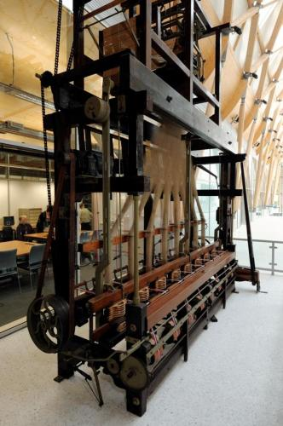
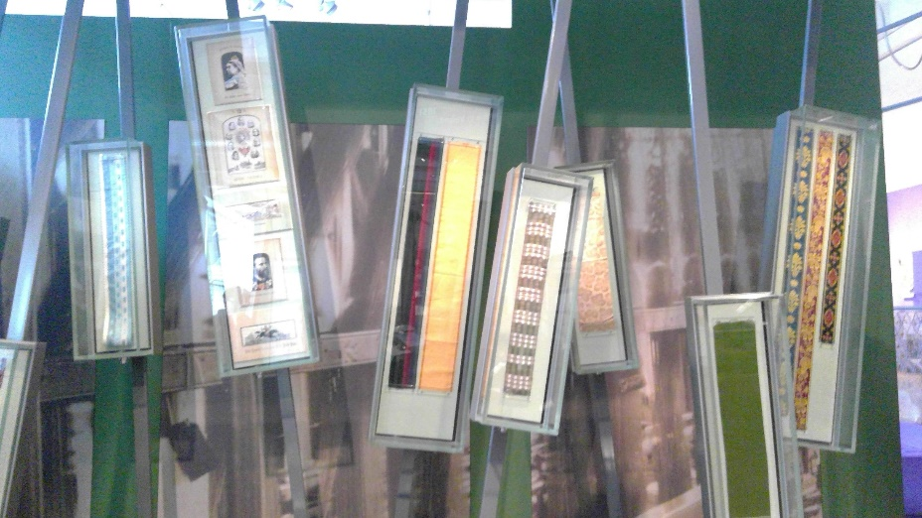
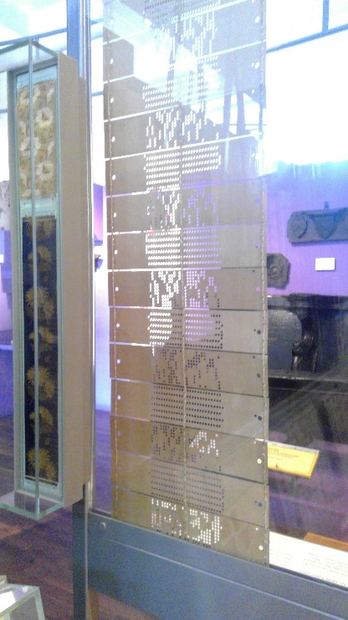
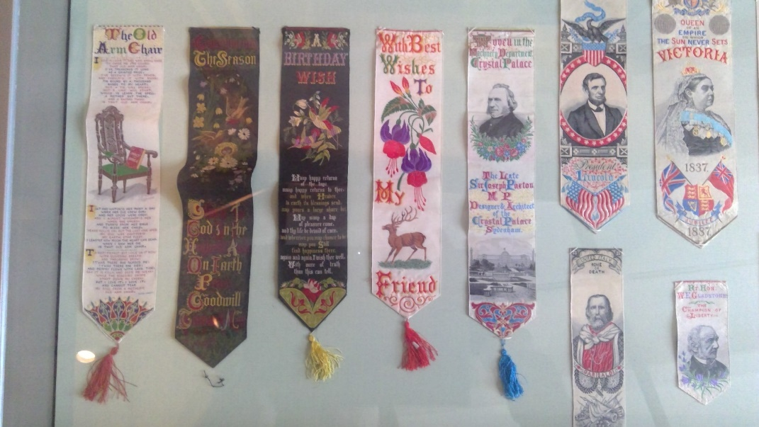
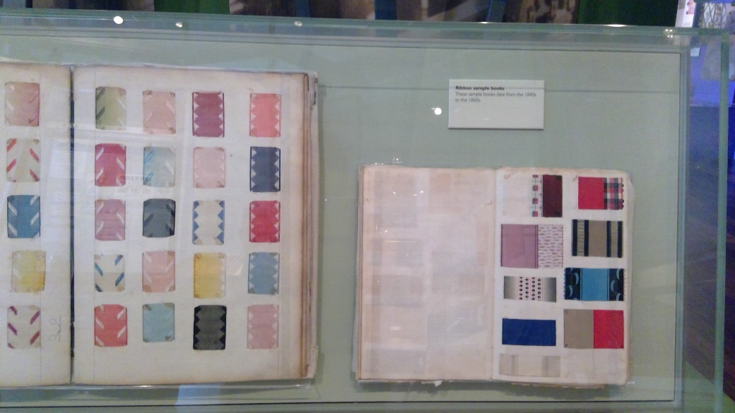
Weaving Ribbons

Slide 3
Cards that go into the loom to instruct it – like a computer program!
Jacquard loom

Slide 4
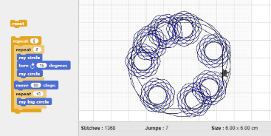
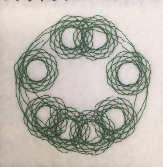
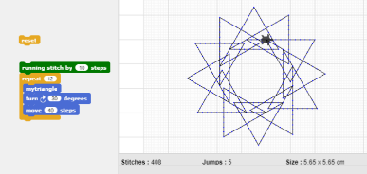
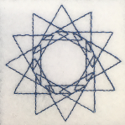
Controlling the machine

Slide 5
Embroidery in industry
Multi-needle machine [YouTube]
– play briefly, scroll through for hats

Slide 6
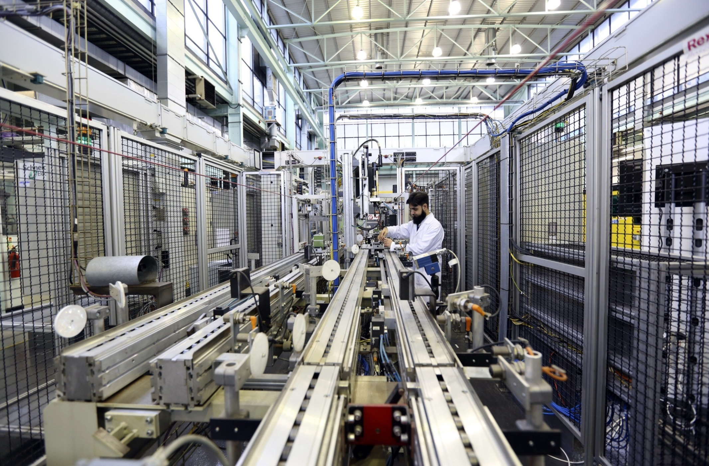
Assembly line

Slide 7
Product assembly
Optional videos:
Cadbury [YouTube]

Slide 8
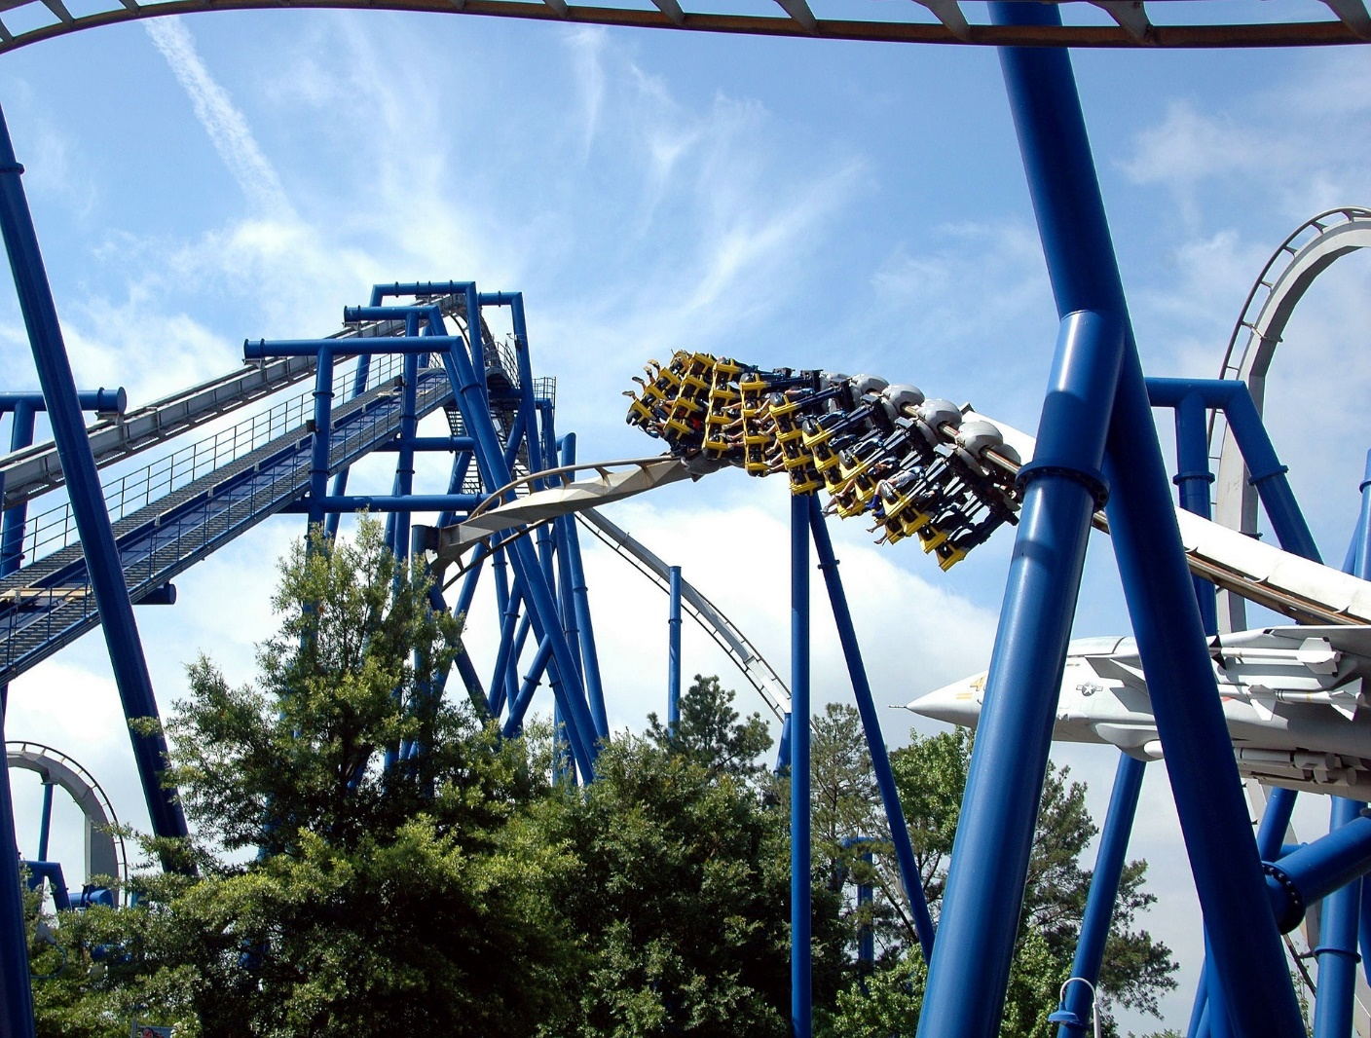
Rollercoaster

Slide 9
Art installation
Kinetic rain [YouTube]

