Slide 1

Reminders
Maximum size 8.00 x 8.00 cm
No more than 5000 stitches (try changing to running stitch if you have too many)
All the blocks must be joined together
You should only need to click on the program once for the turtle to complete the whole design on its own.
Check for red error messages
Don’t use colour instructions – colours will be randomly assigned.

Slide 2
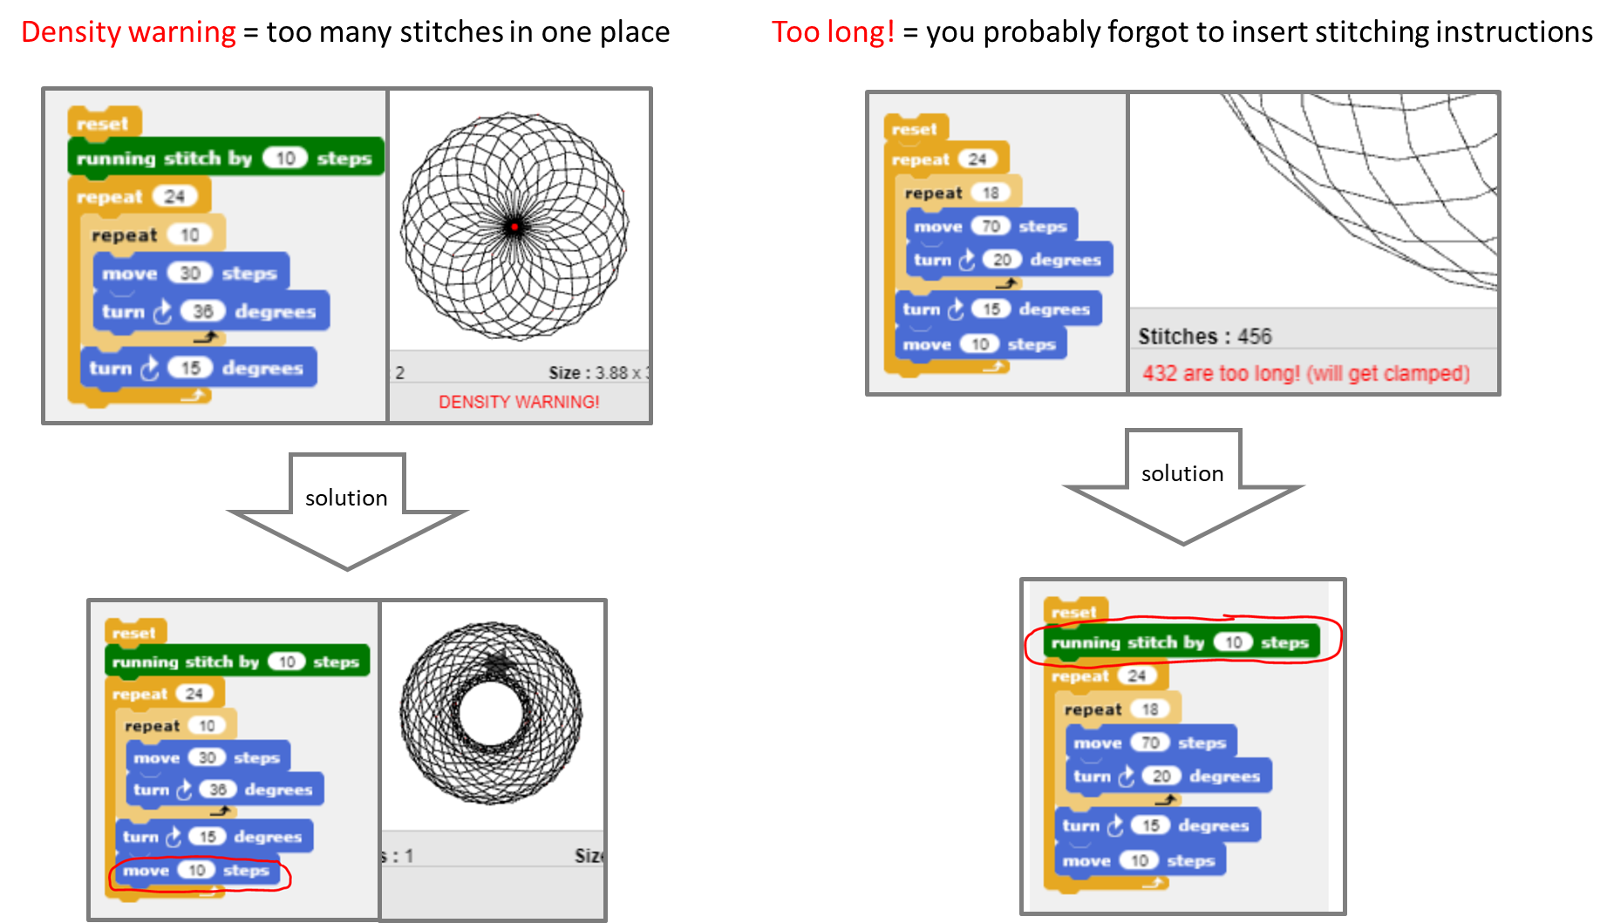

Slide 3
The Magic Fountain, Barcelona
Video [YouTube]

