Slide 1
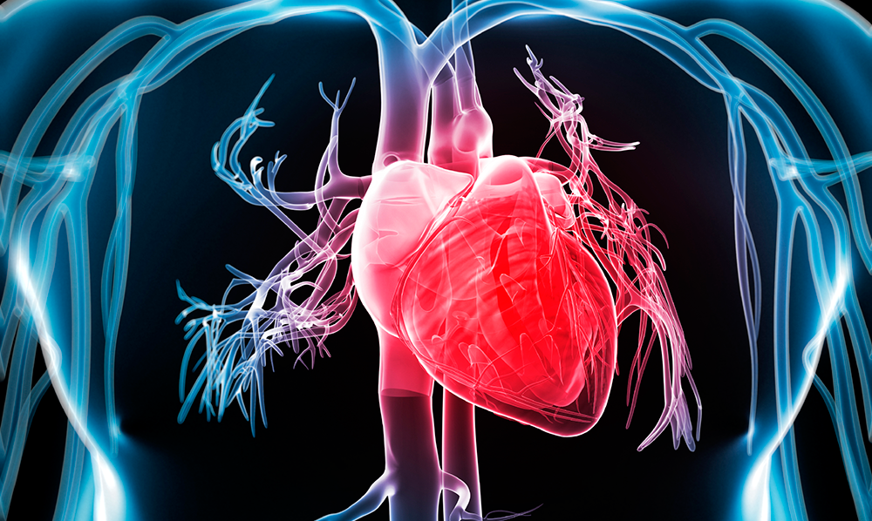
Building a Sustainable UK Diagnostic Sector III: Novel approaches to cancer diagnosis – regional strengths and opportunities
University of Warwick
18th of March 2024

Slide 2
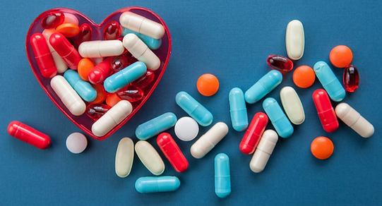
Diagnostic miRNA biomarkers for
therapy-induced cardiovascular injury
Dr Hardip Sandhu
MBA, BSc (hons), MSc (Biochem), PhD (Pharm&Tox)
Assistant Professor in Cardiovascular Safety Pharmacology
Centre for Health & Life Sciences
Coventry University
hardip.sandhu@coventry.ac.uk

Slide 3
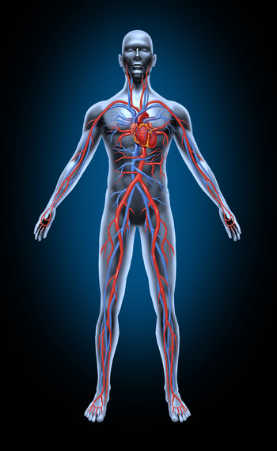
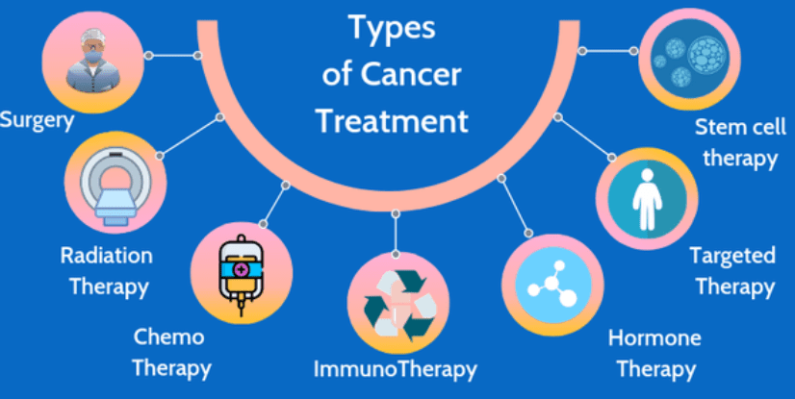
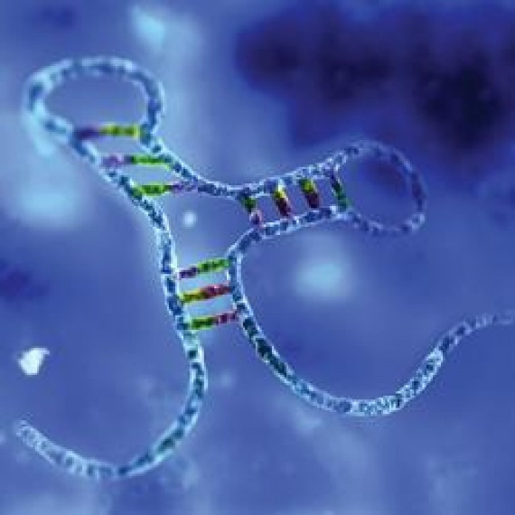
Key research areas:
Key research areas:
Safety pharmacology (cardiac and vascular)
  Cancer therapy induced cardiovascular injury
  Adjunct therapy to combat cardiovascular injury
Biomarker development (genomic miRNAs)
  Therapy-induced cardiovascular injury

Slide 4
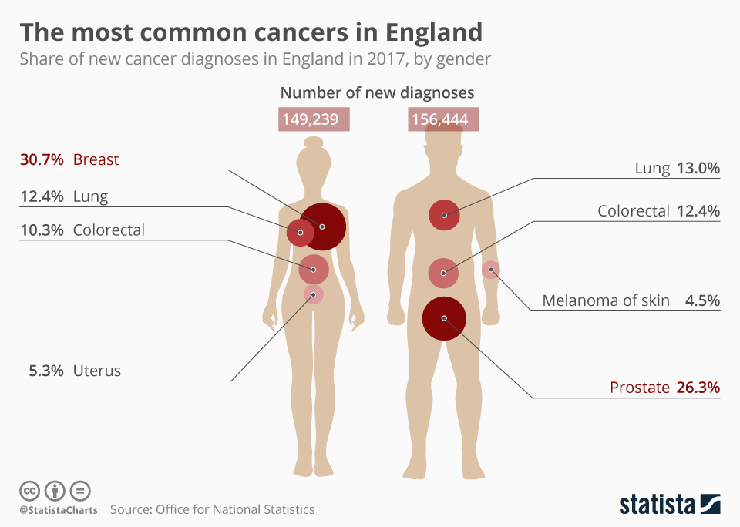
Anti-cancer therapy & CVd
s
Treatments of cancer by chemotherapy or radiotherapy can lead to cardiovascular diseases (CVDs):
high blood pressure
abnormal heart rhythms
myocardial injury
heart failure

Slide 5
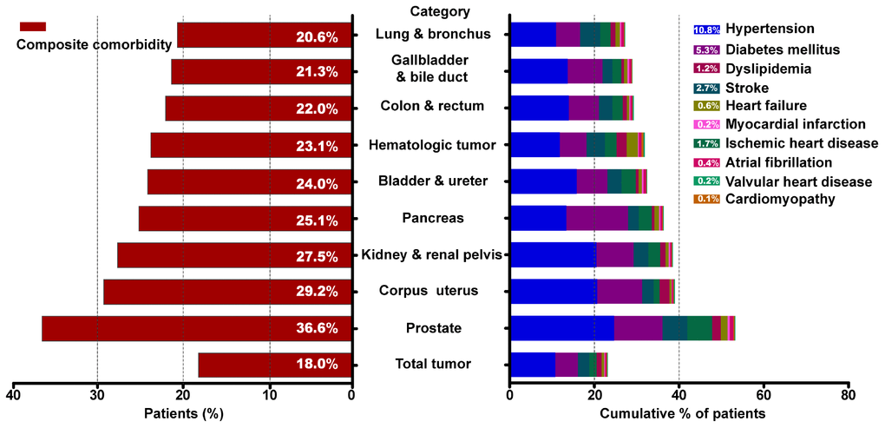
Prevalence of CVd
s
https://doi.org/10.18632/aging.102301
Prevalence of cardiovascular comorbid condition by type of malignancy.

Slide 6
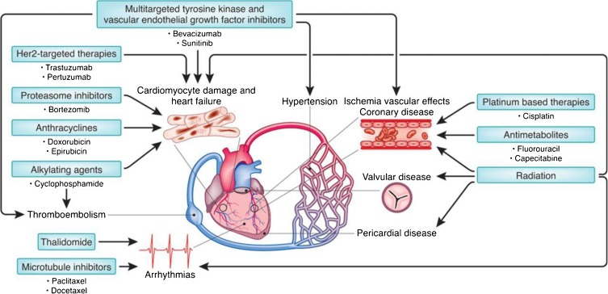
Various therapies can cause cardiotoxicity
doi.org/10.1016/j.critrevonc.2018.03.014

Slide 7
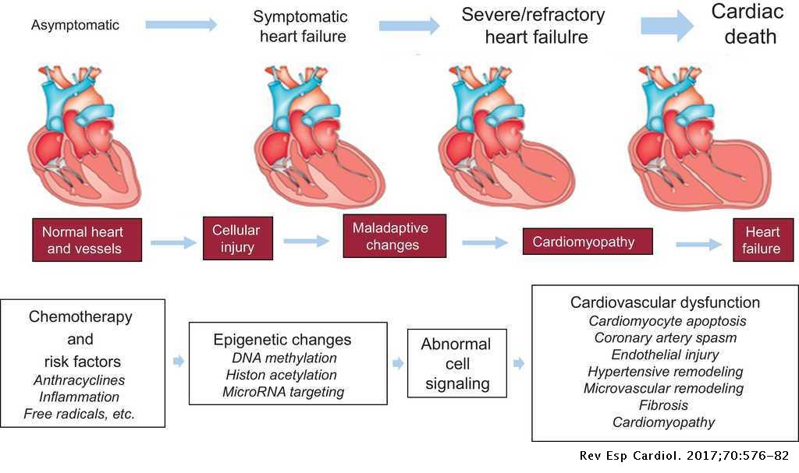
Various stages of cardiotoxicity

Slide 8
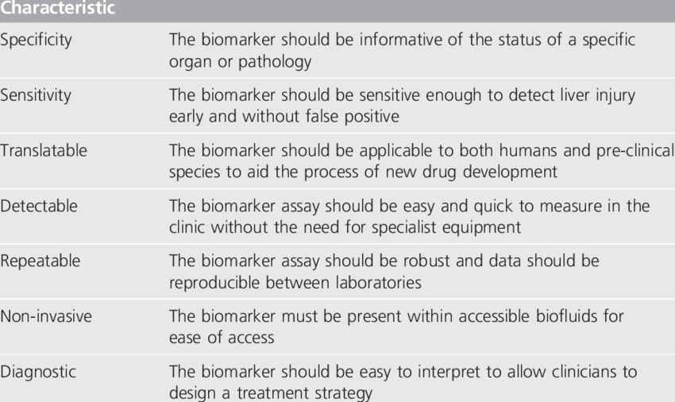
Hallmark of a good biomarker
Notes:
Role in physio processes
Important role in HF – ex: illustration different functions
Numerous pharmaceutical drug
Ex: vascular stress lead to increase of vasoconstriction through GPCR – Lead to hypotension…
MAPK pathway = interesting for anthra exposure
NBTI --| AMPK but not with ETA

Slide 9
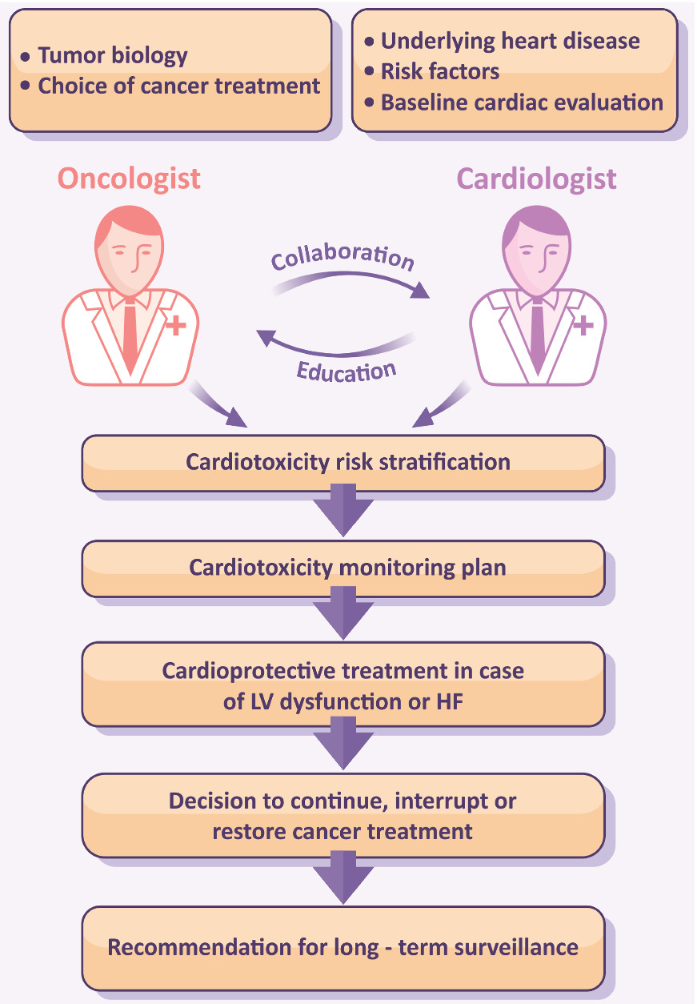
Cardio-Oncology
Current clinical assessment of anti-cancer therapy induced cardiotoxicity is not optimal
  Imaging: ECHO or MRI
  Blood biomarker: Troponin and BNP
New therapy-induced cardiovascular injury biomarker needed:
  miRNAs
Notes:
Role in physio processes
Important role in HF – ex: illustration different functions
Numerous pharmaceutical drug
Ex: vascular stress lead to increase of vasoconstriction through GPCR – Lead to hypotension…
MAPK pathway = interesting for anthra exposure
NBTI --| AMPK but not with ETA

Slide 10
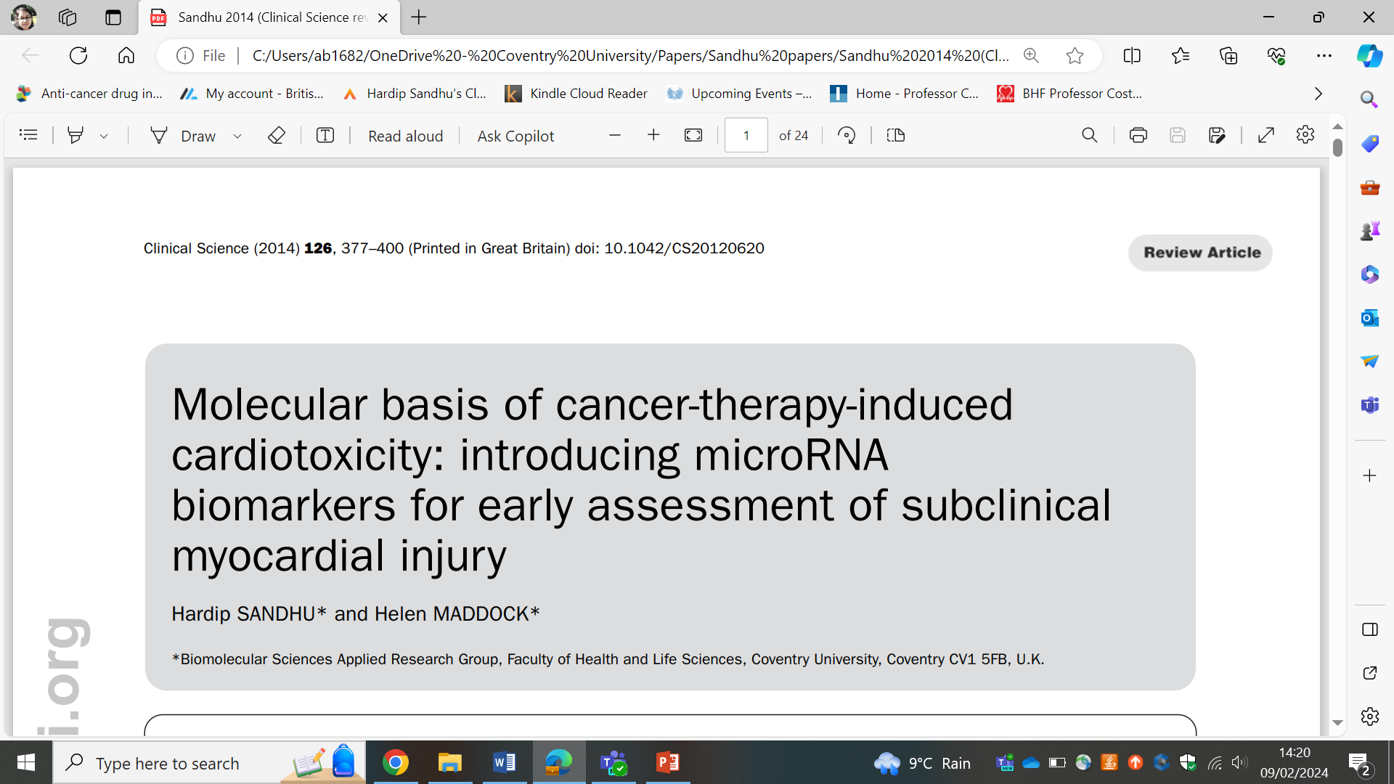
Cardio-Oncology
Current clinical assessment of anti-cancer therapy induced cardiotoxicity is not optimal
  Imaging: ECHO or MRI
  Blood biomarker: Troponin and BNP
New therapy-induced cardiovascular injury biomarker needed:
  miRNAs
Notes:
Role in physio processes
Important role in HF – ex: illustration different functions
Numerous pharmaceutical drug
Ex: vascular stress lead to increase of vasoconstriction through GPCR – Lead to hypotension…
MAPK pathway = interesting for anthra exposure
NBTI --| AMPK but not with ETA

Slide 11

miRNAs
Works as off-switches of specific genes
One miRNA has multiple mRNA targets
One mRNA can be targeted by multiple miRNAs
Specific miRNA expression profile related to:
  Tissue / Fluid
    Disease
      Disease stage
miRNAs:
21-25 nucleotides long
regulate gene expression by binding complementary sequences of target mRNAs and inducing their degradation or translational repression.
Notes:
Role in physio processes
Important role in HF – ex: illustration different functions
Numerous pharmaceutical drug
Ex: vascular stress lead to increase of vasoconstriction through GPCR – Lead to hypotension…
MAPK pathway = interesting for anthra exposure
NBTI --| AMPK but not with ETA

Slide 12
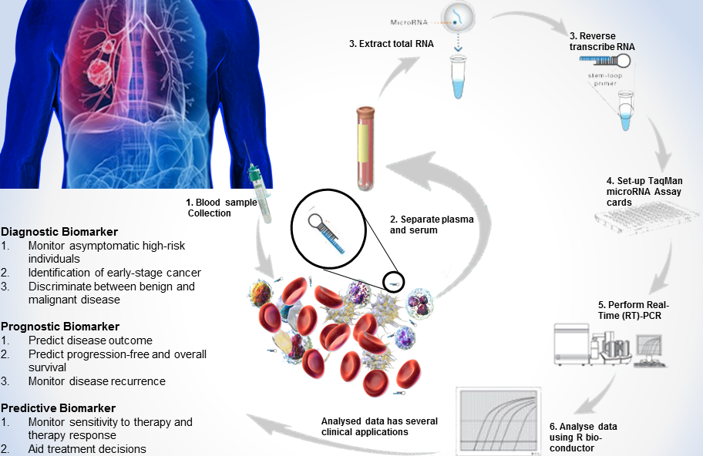
miRNAs as biomarkers

Slide 13
studies for cardiotoxicity biomarker exploration
miRNA
Cancer patients treated with doxorubicin
Cancer patients treated with Car T-cell
Patients suffering from myocardial infarction
Cancer patients treated with radiotherapy
Animal in vivo I/R model treated with SGLT2i
Harsh therapy
Mild/cardioprotective therapy

Slide 14
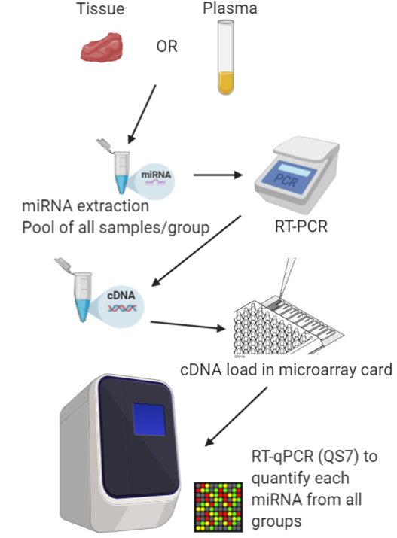
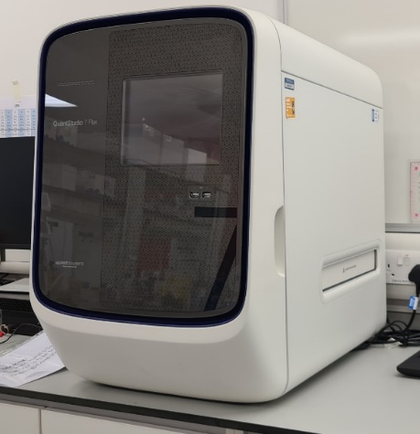
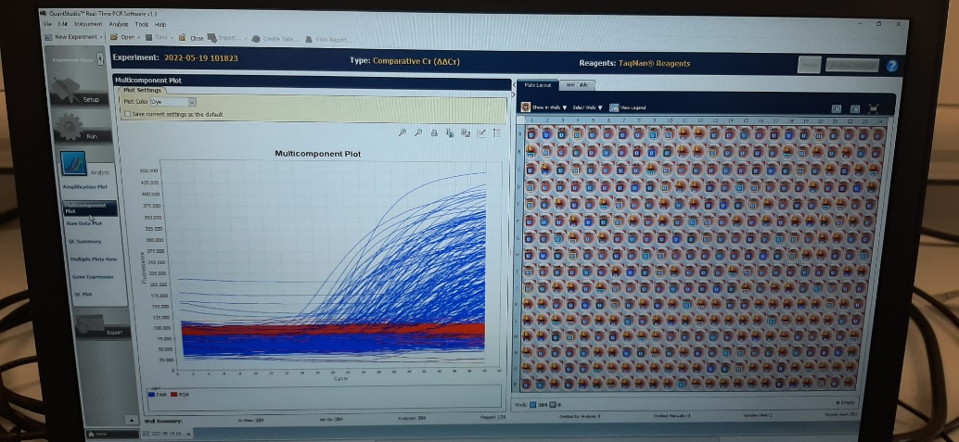
Quantitative analysis
miRNA
Applied Biosystems TaqMan miRNA arrays

Slide 15
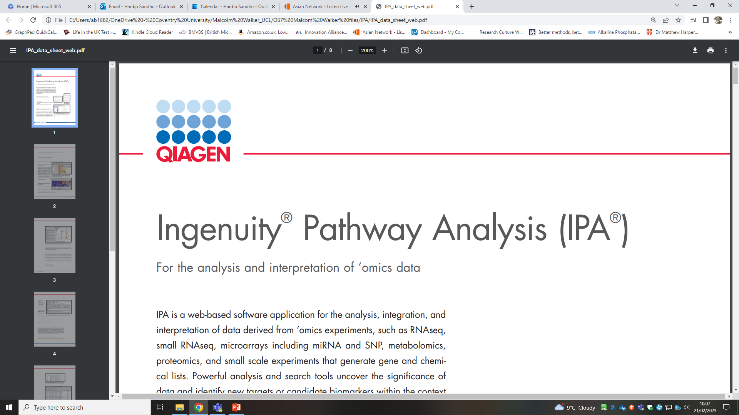
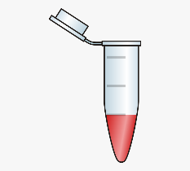
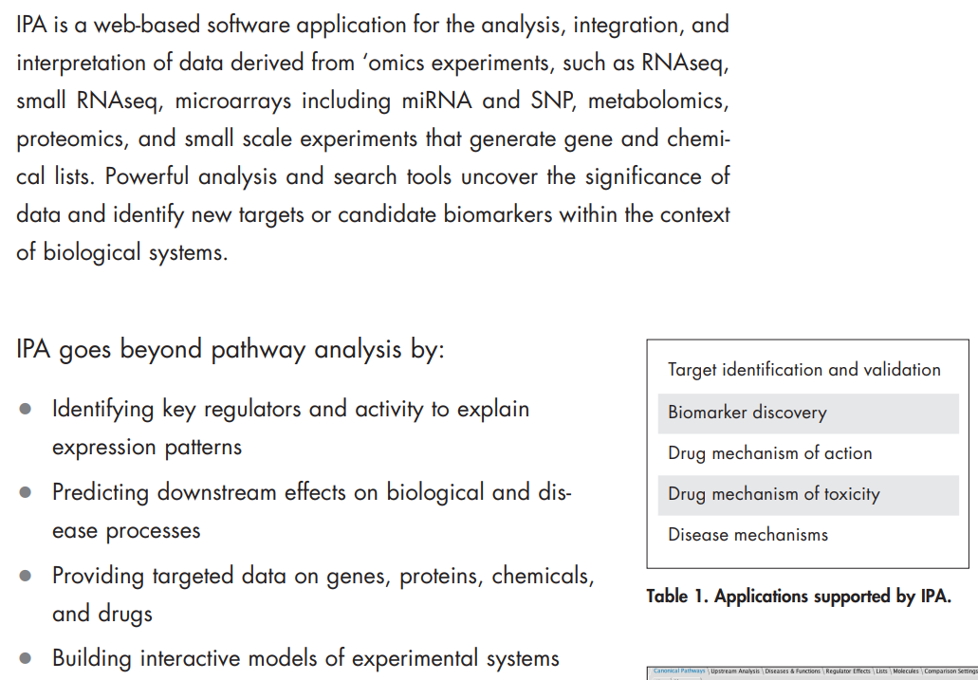
IPA analysis of taqman array
Pooled: Baseline 24-72hrs post 3-6m post 6-12m post 5year post
Significantly differential miRNA expression levels from miRNA array analysis at all post-treatment time points vs baseline analysed with IPA

Slide 16
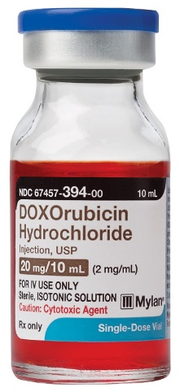
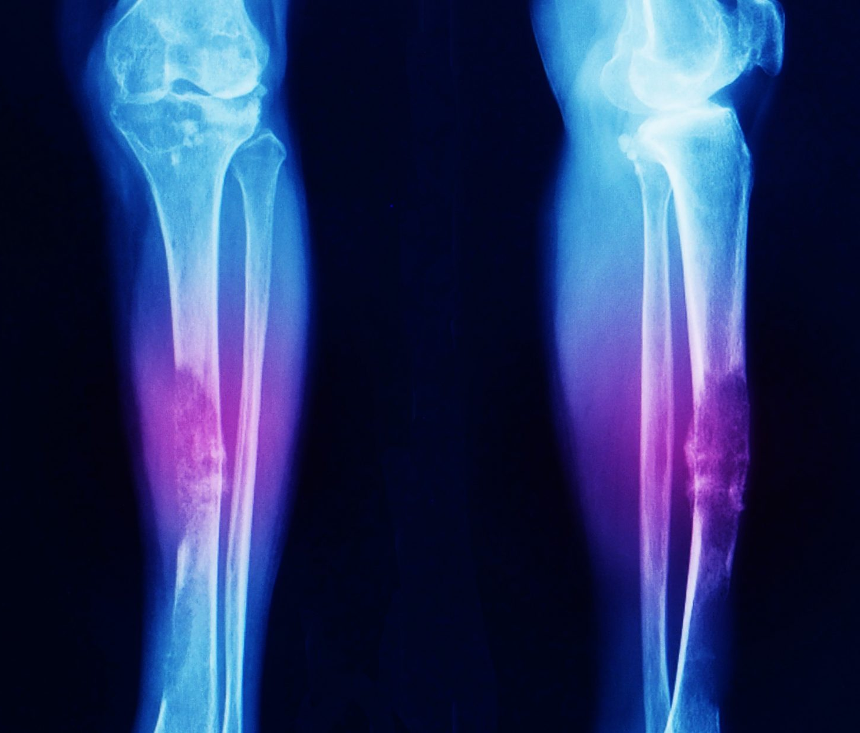
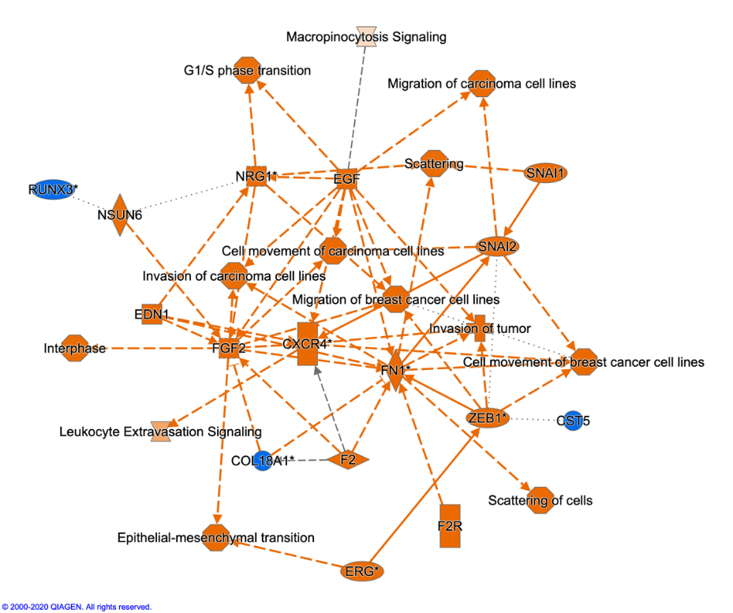
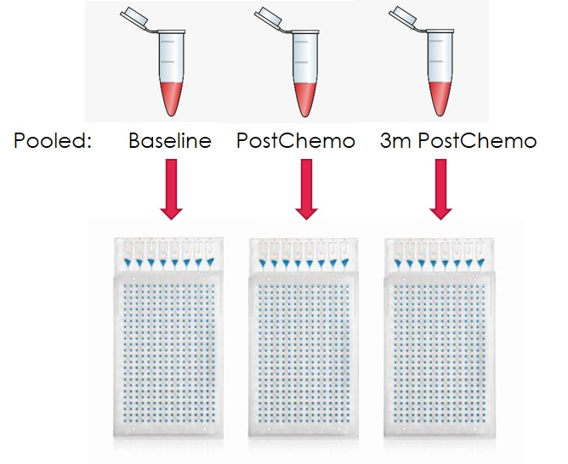
Sarcoma Study example
32 % of CVD adverse effects:
Arrhythmia
Thrombosis
Heart failure
IPA analysis

Slide 17
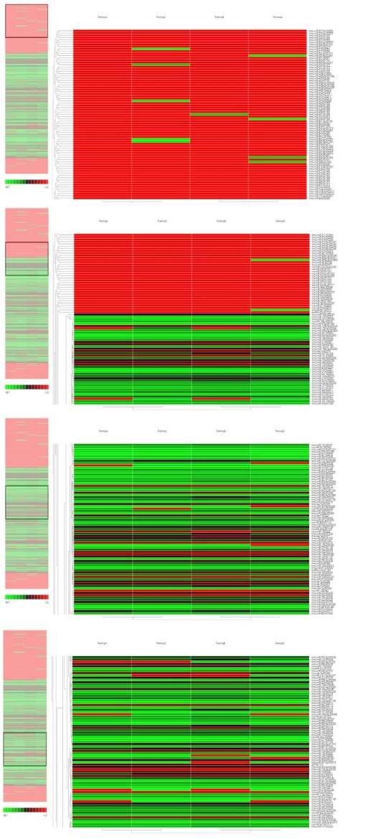
Sarcoma Study example
Comparative expression analysis of 377 miRNAs:
Significantly altered miRNA targets = 174
Significantly altered miRNAs associated with therapy-induced cardiovascular injury ~ 21 miRNAs
With specific expression in 9 subdivisions of CVDs

Slide 18
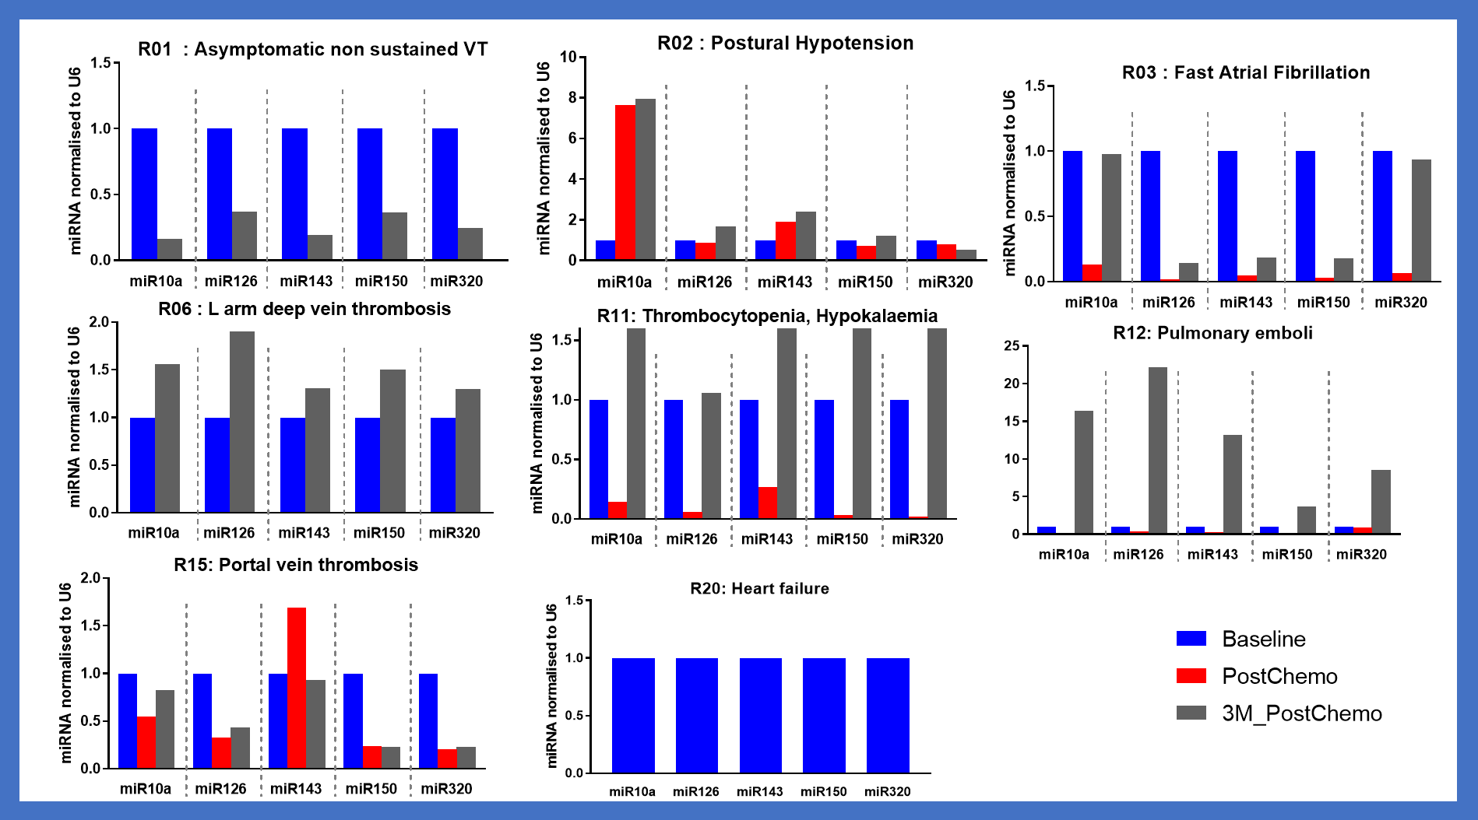
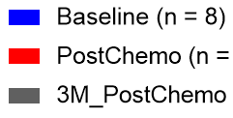
Sarcoma Study example
Comparative expression analysis of 377 miRNAs:
Significantly altered miRNA targets = 174
Significantly altered miRNAs associated with therapy-induced cardiovascular injury ~ 21 miRNAs
With specific expression in 9 subdivisions of CVDs
v
v
v
v
“miR-A”
“miR-B”
“miR-C”
“miR-D”
“miR-E”
v

Slide 19
studies for cardiotoxicity biomarker exploration
miRNA
Cancer patients treated with doxorubicin
Cancer patients treated with Car T-cell
Patients suffering from myocardial infarction
More harsh anti-cancer studies
More mild / protective anti-cancer studies
Cancer patients treated with radiotherapy
Animal in vivo I/R model treated with SGLT2i
Harsh therapy
Mild/cardioprotective therapy

Slide 20
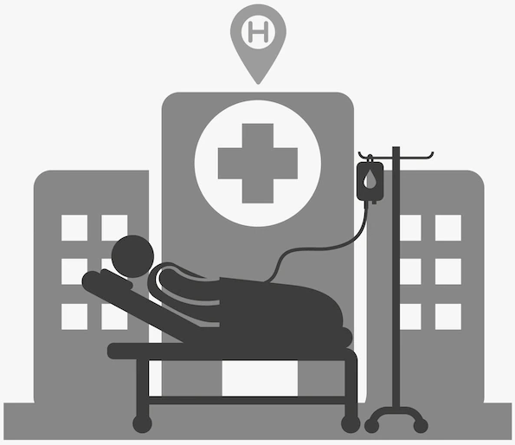
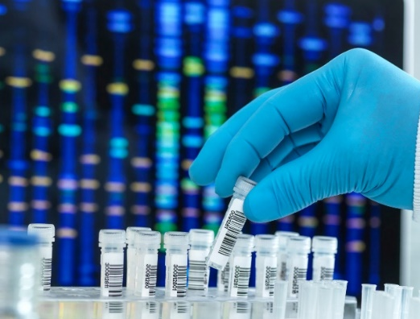
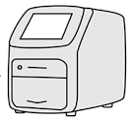
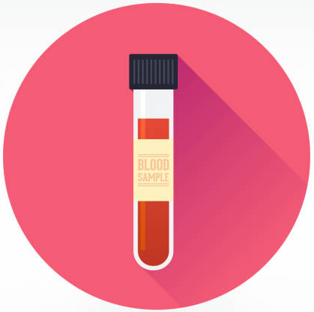
Future perspectives
Cancer patients in treatment
Routine
check-up
Screen for specific miRNAs
Standard PCR
analysis
Risk of developing CVDs?
Change therapy/dose?
Adjunct therapy?

Slide 21










colleagues and partners
CU colleagues:
Prof Helen Maddock
Prof Gordon McGregor
Prof Djordje Jakovljevic
Dr Isadora Furigo
Dr Caroline Lozahic
Mr David Mutigwa
Ms Sophie Russell
External colleagues and partners:
Prof J Malcolm Walker, Prof Derek Yellon and Prof Rob Bell (UCL)
Dr David Cutter and Dr Vanessa Ferreira (Oxford University)
Prof Rob Shave (University of British Columbia, Canada)
Dr Sharon Ann George (University of Pittsburgh, US)
Prof Prithwish Banerjee, Dr Faizel Osman, Dr Raj Shrimali and Dr Tim Blake (UHCW NHS Trust)
Dr Lucas Carminatti Pantaleao (Cambridge University)
Dr Jean-Pierre Valentin (UCB BioPharma, Belgium)

Slide 22
Questions?

