Slide 1
Development and commercialisation of GALEAS Bladder, a liquid biopsy test for bladder cancer
Dr Doug Ward
Biomarker Theme Lead
Bladder Cancer Research Centre
University of Birmingham
d.g.ward@bham.ac.uk

Slide 2



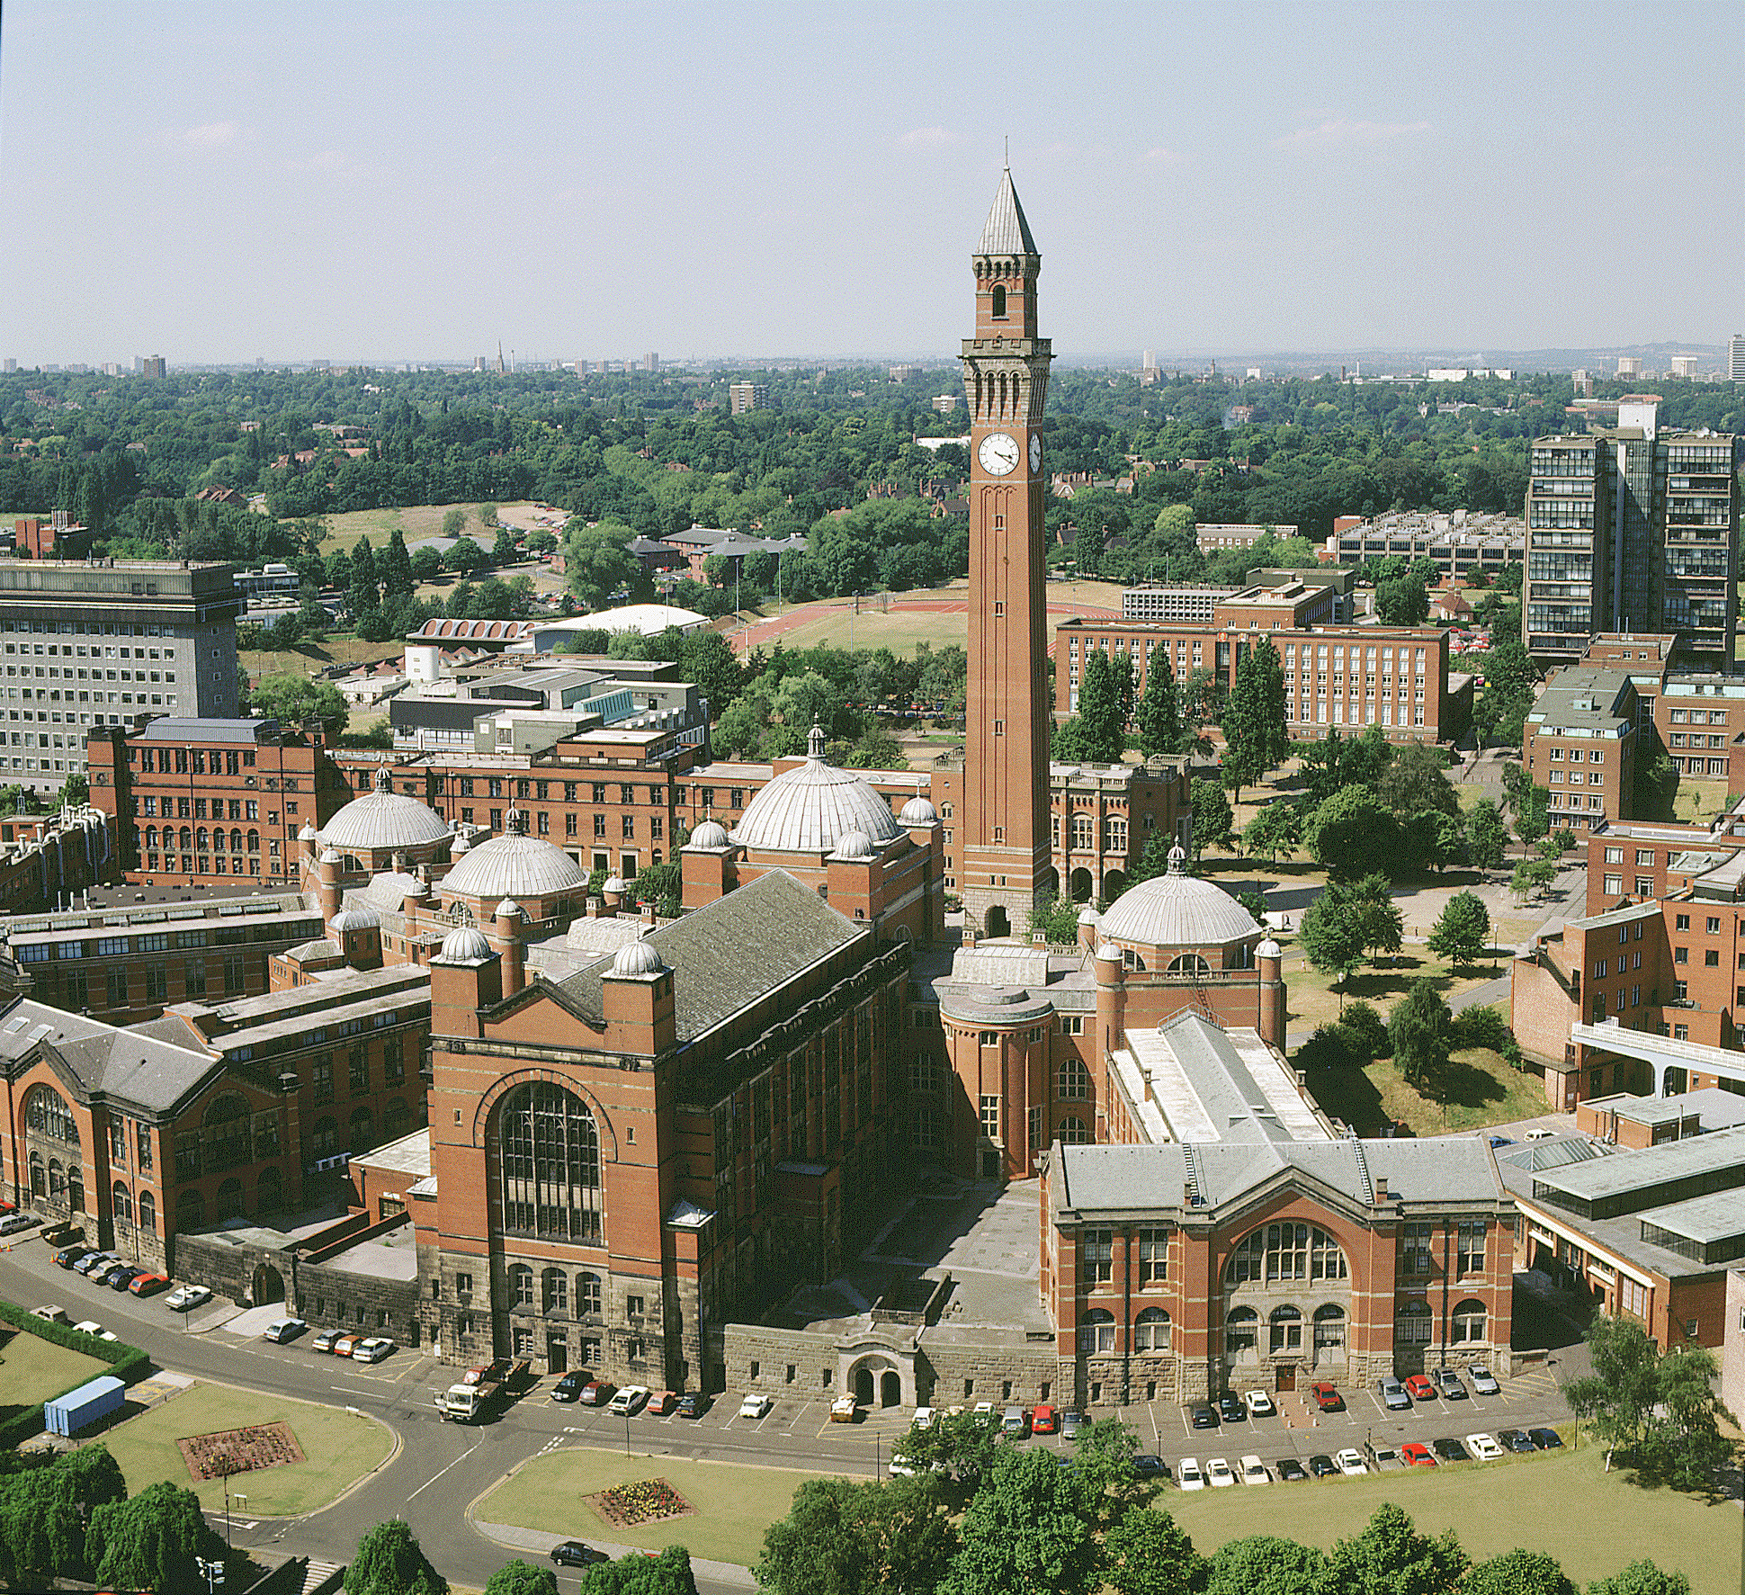

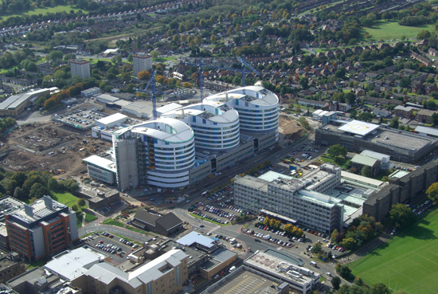

QE Hospital & HBRC
(Human Biomaterials Resource Centre)
Products for cfDNA analysis & genomics service laboratory – originally based in Edgbaston and now in Quinton

Slide 3
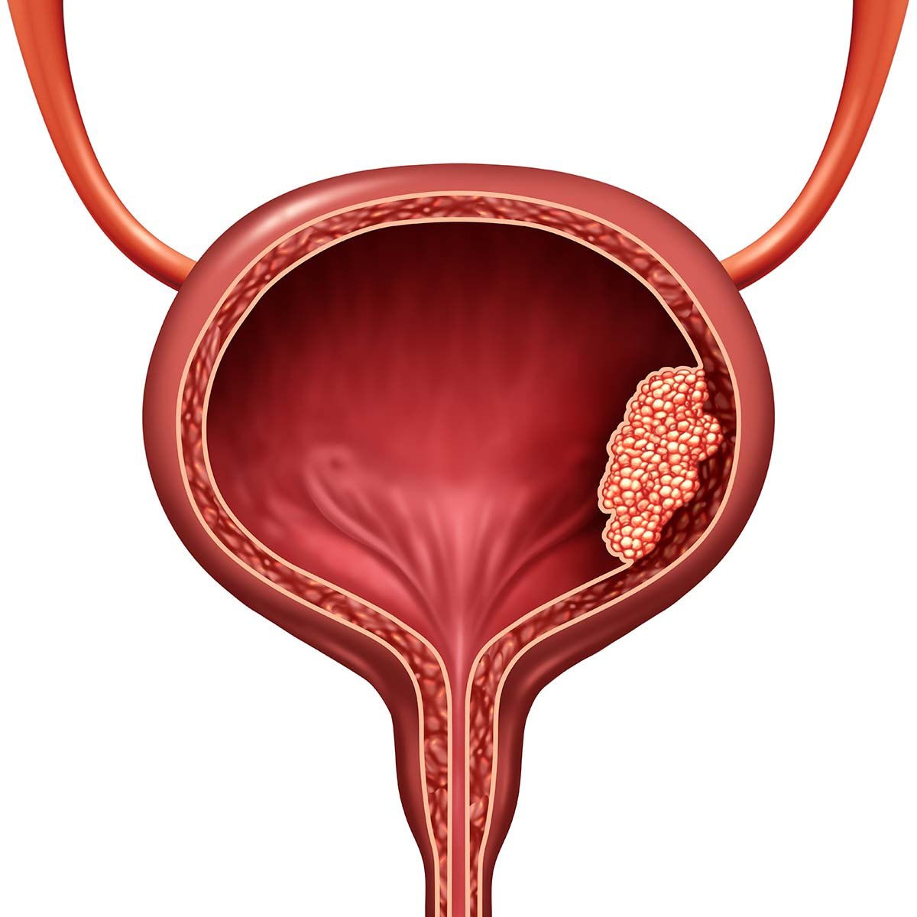
Bladder Cancer & the need for a non-invasive detection test
11th most common cancer in the UK
>10,000 new cases per year in the UK
>5,000 deaths per year
>90% are urothelial carcinomas (originate in the epithelium lining the bladder)
4:1 male:female incidence ratio
Smoking is the biggest modifiable risk factor
75-80% diagnosed at an early stage (Non-Muscle Invasive Bladder Cancer, NMIBC)
20-25% diagnosed at a later stage (Muscle Invasive Bladder Cancer, MIBC)
100,000 diagnostic cystoscopies per year (haematuria clinic)
40,000 surveillance cystoscopies per year (checking for recurrence)
Massive potential to impact patient care
Large marketplace for a non-invasive test

Slide 4
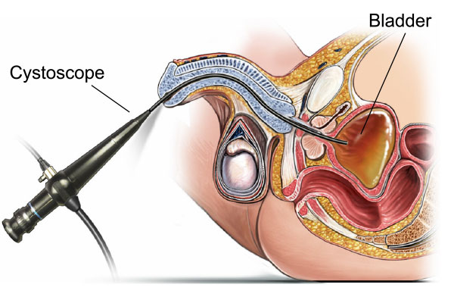
Flexible cystoscopy
Hospital-based
Invasive & unpleasant
Complications
Delays
Expensive (£440)
Operator-dependent (85-90% sens & spec)
Typically used in conjunction with imaging and urine cytology
Urine is in direct contact with the tumour…….
Could molecules released by the tumour be used to detect bladder cancer?

Slide 5
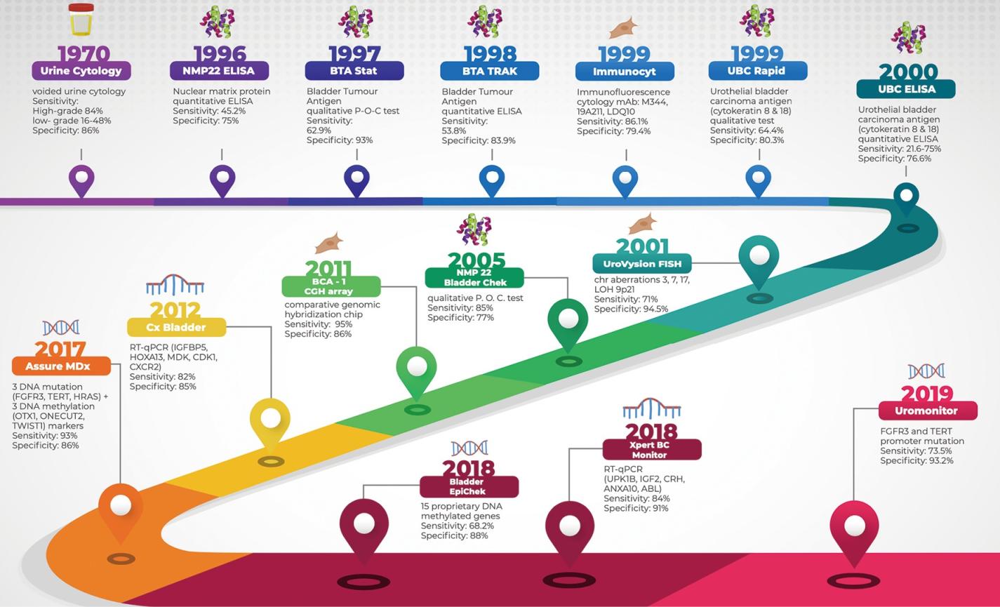

Slide 6
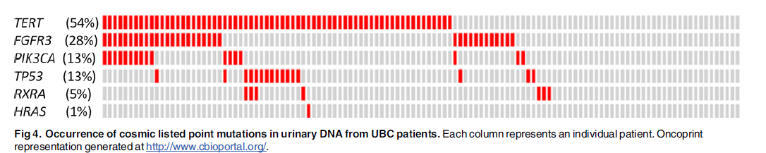
Using a panel of somatic mutations to detect bladder cancer from urine DNA: proof of principle (2016)
122 BC patients & 109 non-BC urology patients
Multiplex PCR of 6 commonly mutated genes
2 x 250bp MiSeq sequencing at 2000x read depth
mutation positivity = variant allele frequency >2.5%
70% sensitivity
97% specificity

Slide 7
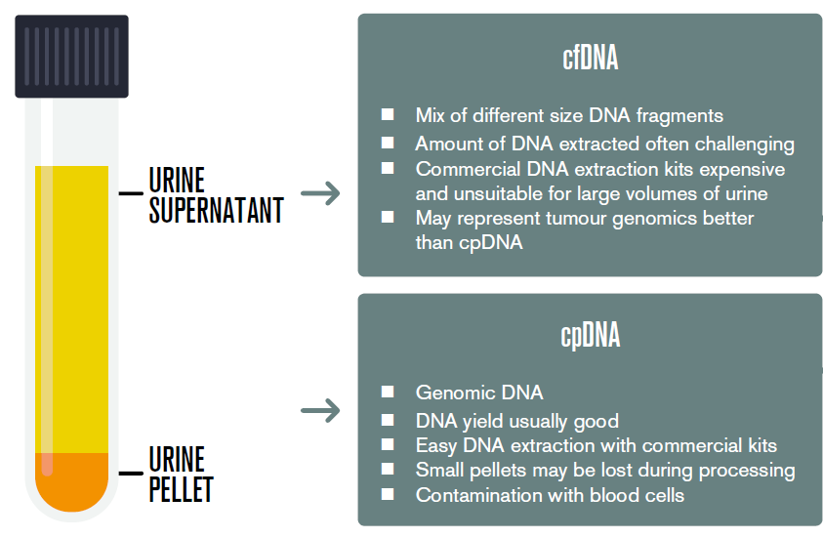
How to improve test sensitivity?
Higher analytical sensitivity required (lower variant allele frequency threshold for variant calling)
Improve data quality (higher fidelity enzymes)
Improve data quantity (deeper sequencing)
Improved bioinformatics (error filtering)
Incorporate unique molecular identifiers (error suppression)?
Other possible gains:
Include more mutations in the panel?
Use urinary cfDNA instead of pellet DNA?

Slide 8
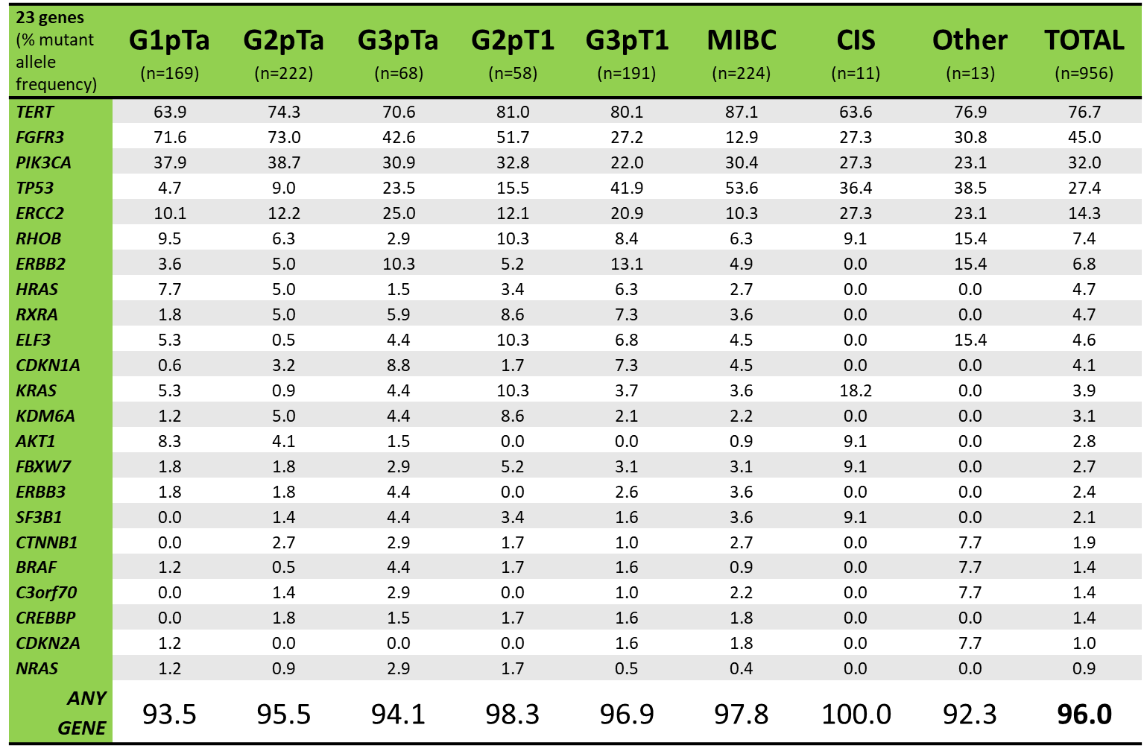
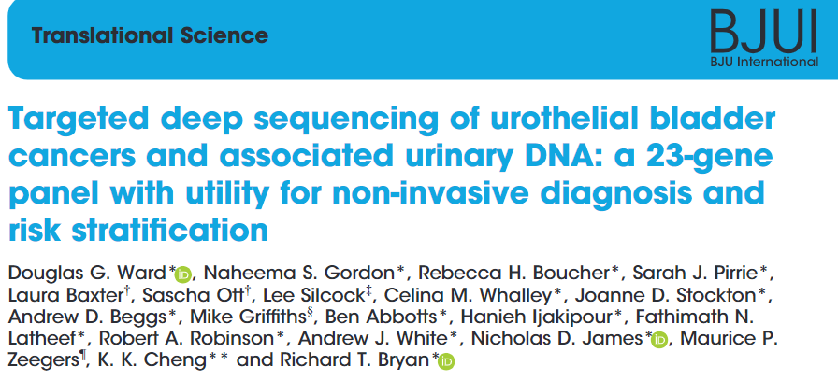
Optimising the mutation panel
Amplicons designed for commonly mutated bladder cancer genes
956 tumours from the Bladder Cancer Prognosis Programme analysed
Final panel of ≈ 450 SNVs in 23 genes selected
96% of tumours positive for ≥1 SNV (from only 10 kb of sequencing)
High sensitivity across all stages and grades of disease

Slide 9
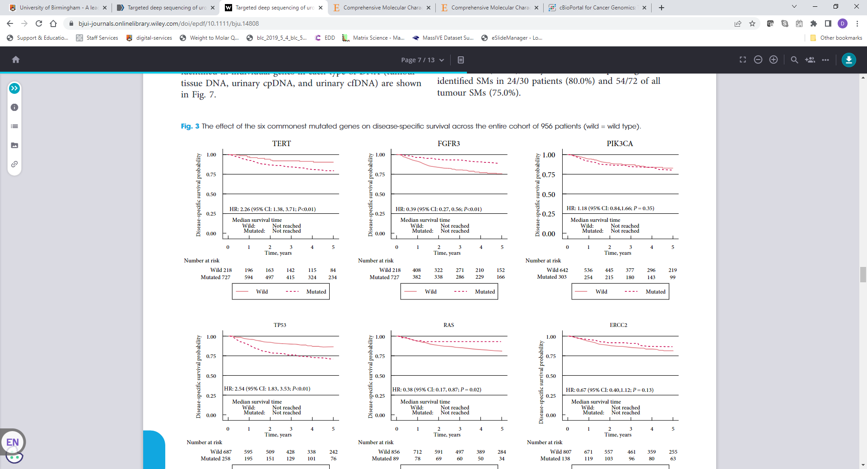
Biological & prognostic information within the panel
Patients with FGFR3 or AKT1 mutations: 5-times more likely to have NMIBC
Patients with TP53 mutations: 3-times more likely to have MIBC
TERT mutations prognostic
Predictive biomarkers (e.g. FGFR3 mutations)

Slide 10
Urine cell pellet or cell free DNA?
Amplicon sequencing
153 tissue/urine cp/urine cf trios
cpDNA
  75% of all SNVs detected
  77% ≥1 SNV
  Median VAF 19%
cfDNA
  81% of all SNVs detected
  84% ≥1 SNV
  Median VAF 25%
Urine cell free DNA VAF
Urine pellet DNA VAF
But…. only 74% of supernatants yield enough cfDNA,
versus >90% for urine cell pellets….

Slide 11
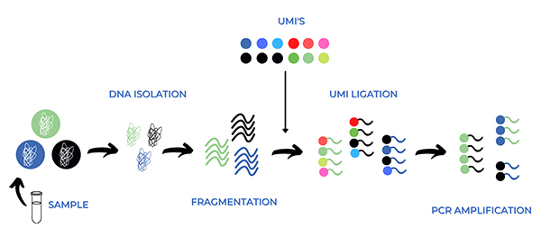
Optimising the analytical methods:
Capture-based NGS with Unique Molecular Identifiers (UMIs)
ULTRADEEP SEQUENCING & CONSENSUS READ BUILDING
CAPTURE REGIONS OF INTEREST WITH BIOTINYLATED PROBES
Cell3™ Target: Custom NGS Panels
Nonacus

Slide 12
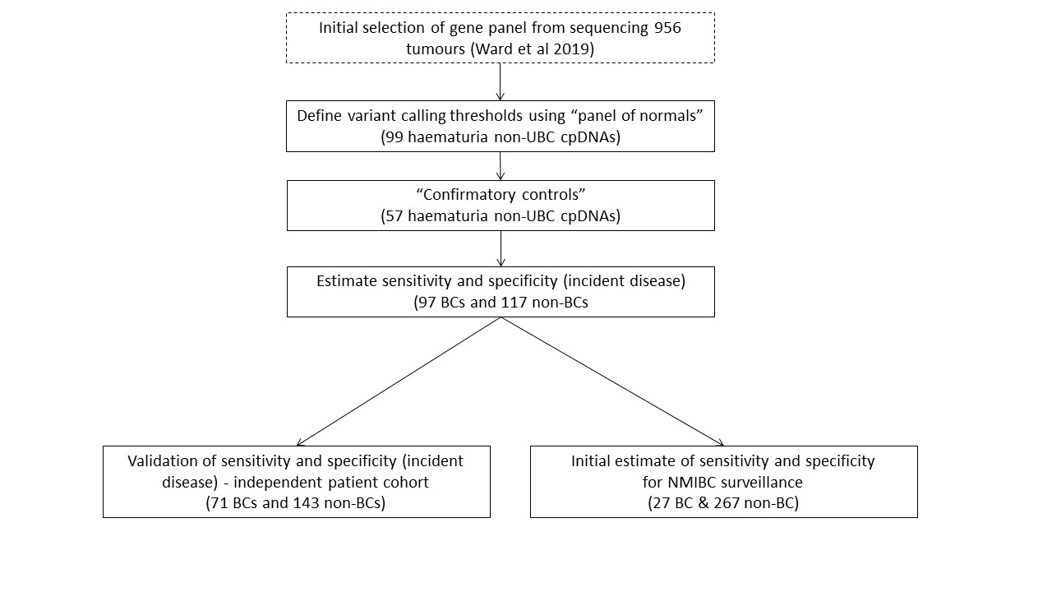
Over 900 urine samples collected and analysed
VAF threshold set at 0.5%
Test sets independent from biomarker development samples

Slide 13
Test performance*
87% specificity
87% sensitivity
Mutations detected in urine DNA across all stages and grades of bladder cancer
*Nonacus have since analysed another 252 urine from BC patients with similar sensitivity

Slide 14
Commercialisation
Nonacus were new (3 people) when we started buying reagents from them in 2018
Ongoing informal discussions between myself, Prof Rik Bryan and Chris Sale (CEO Nonacus)
University of Birmingham commercialisation arm (Enterprise Birmingham)
Cancer Research Technologies
No IP in a panel of mutations
Take a “first to market” approach
In 2021 “Disease Panel Agreement” signed between Nonacus and the University of Birmingham
  Bladder capture panel becomes available as a RUO product
  Revenue share (% of net profits for 10 years)
  Discount on consumables/testing for our own research

Slide 15
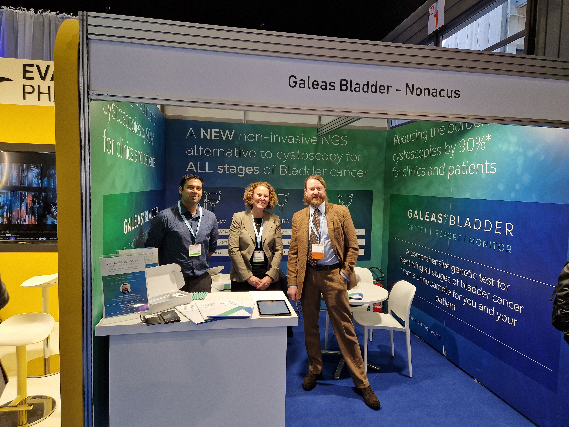
Nonacus expand enormously & recruit new staff
Nonacus sister company “Informed Genomics” established (service lab)
Soft product launch at EAU23 in Milan (spring 2023)
Autumn 2023 GALEAS Bladder available to customers as a complete sample to report service via Informed Genomics ISO 15189 accredited lab*
*ISO 15189 Medical laboratories — Requirements for quality and competence is an international standard that specifies the quality management system requirements particular to medical laboratories.

Slide 16
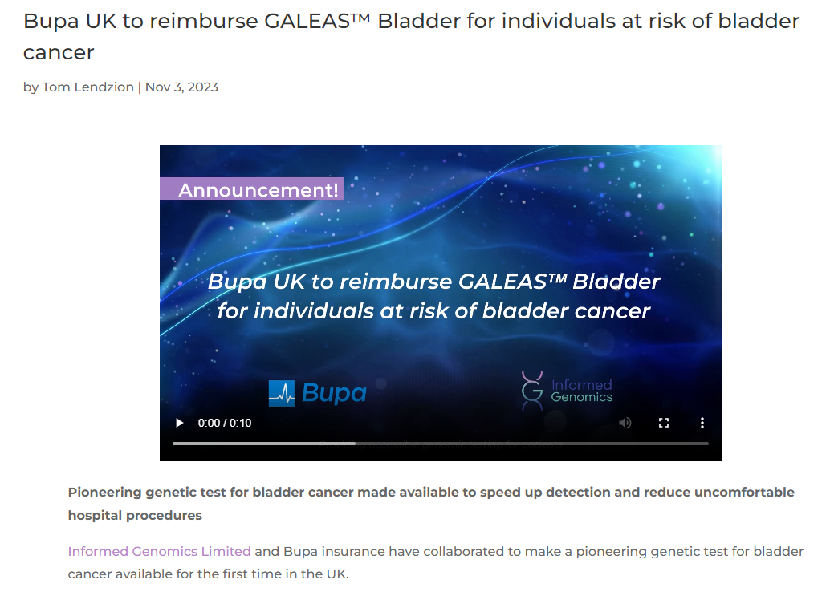
Future strategic plans perhaps for growth now GALEAS Bladder has been launched:
Adoption in the private system reimbursed by insurers (Bupa have agreed to reimburse, discussions with HCA and other hospital groups ongoing)
Adoption into the NHS either as real world evaluation (RWE) projects or as part of a smaller cohort to support reduction of waiting lists – Funded by the trusts
Global expansion (led by Nonacus) as a lab developed test to service laboratories in chosen regions or as a centralised (send away) service delivered by Informed Genomics in the UK

Slide 17

Introducing GALEAS® Bladder
  A comprehensive, laboratory developed, genetic test for identifying all stages of bladder cancer from a urine sample
  Allows patients to provide a sample in the comfort of their own home. No hospital visits, no painful procedure.
  Offers equivalent sensitivity and specificity to cystoscopy
  Reduces the number of unnecessary cystoscopies reducing costs and resource burden on clinics.
  Leverages targeted next generation sequencing chemistry to detect mutations associated with bladder cancer.

Slide 18
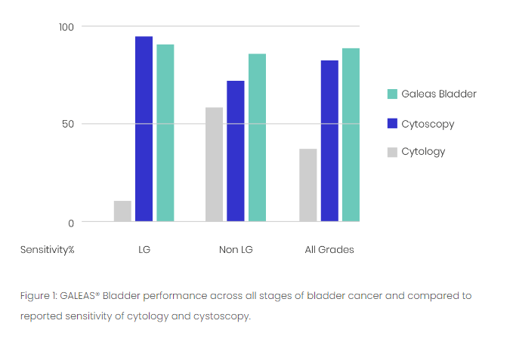
GALEAS® Bladder: Performance Data
Validated in ~644 urine samples from three UK Clinical cohorts
  340 positive bladder cancer cases
  324 negative i.e. no cancer at the time of cystoscopy
 | Sensitivity | Specificity | PPV | NPV
pTa | 87% | 85% | 75% | 93%
T1 | 95% | 85% | 66% | 98%
T2+ | 86% | 85% | 61% | 96%
G1 | 78% | 85% | 47% | 96%
G2 | 91% | 85% | 67% | 97%
G3 | 91% | 85% | 78% | 94%
NMIBC | 90% | 85% | 83% | 91%
MIBC | 86% | 85% | 61% | 96%
Equivalent sensitivity and specificity to cystoscopy across all grades and stages.
Reducing cystoscopies by ~90%
Notes:
G stands for Grade of cancer
G1 – G3 = Grading is a measurement of how likely a cancer is to spread. The grade of a cancer is usually described using a number system ranging from G1 to G3. High-grade cancers are more likely to spread than low-grade cancers.
T stands for how far into the bladder the tumour has grown (Type of cancer)
pTa = The cancer is just in the innermost layer of the bladder lining
T1 = The cancerous cells have started to grow into the connective tissue beyond the bladder lining
T2 = The cancer has grown through the connective tissue, into the bladder muscle
T3 – the cancer has grown through the layer of muscles, into the surrounding layer of fat
If the tumour grows larger than the T3 stage, it's considered to be advanced bladder cancer and is categorised as:
T4 – the cancer has spread outside the bladder, into surrounding organs

Slide 19
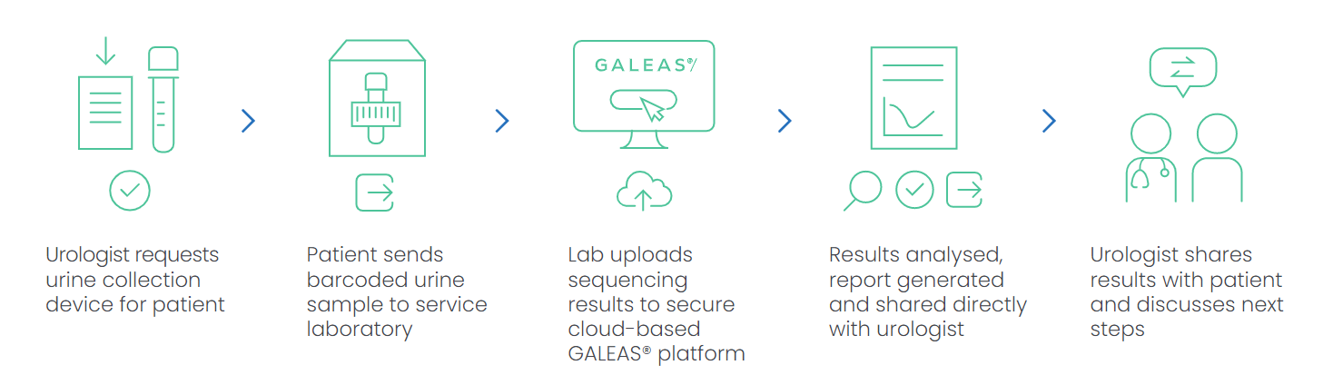
Complete test workflow

Slide 20
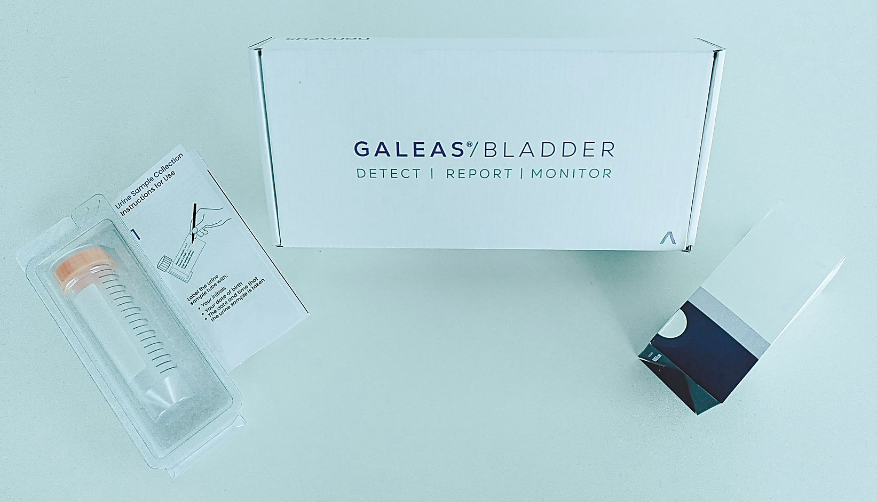
GALEAS® Urine Collection device
A simple, intuitive cardboard collection device, ordered with the test, allows patients to provide a urine sample in the comfort of their own home.
Unique ID barcode on tube supports LIMS tracking providing two options:​
Use unique tube ID barcode and associate with patient or​
Add specific patient ID barcode for sample tracking
Cardboard collection device ​comes flat packed reducing size of box, storage requirements and shipping costs​ (as well as being better for the environment)
Simple and easy to use ensures good sample taking process and return rates.
50ml Falcon tube containing our proprietary preserver validated with our DNA extraction kit and panels to ensure optimal performance.
Notes:
Order with test. Dispatch to patient and return address labels are responsibility of LDT

Slide 21
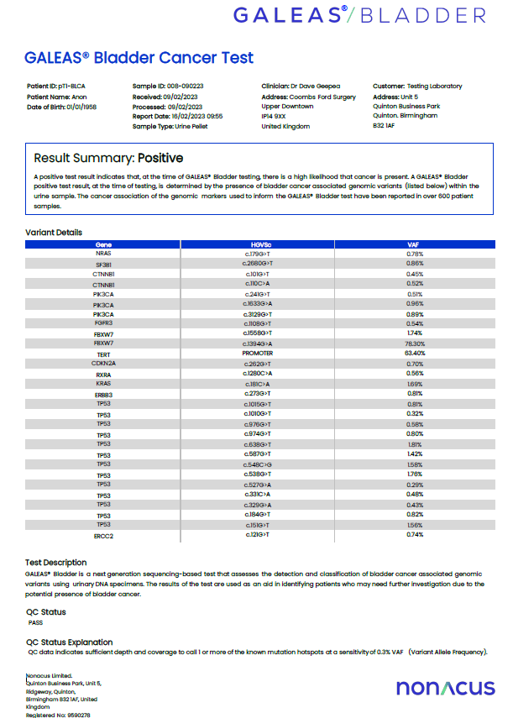
GALEAS® Software – Cloud based, end to end solution for bioinformatics
Bulk upload of sequencing data (FASTQ files) via simple application; no minimum sample number.
Automated ‘sample to report’ analysis pipeline, requiring no specialist training to interpret data
Simple report – ‘Yes’ or ‘No’ to likely presence of Bladder cancer
Detailed report of somatic variants identified
Report available as .pdf or .JSON and sent directly to service lab
Download batches of results
Reports on failed samples

Slide 22
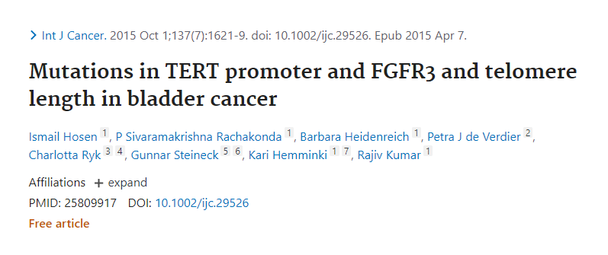
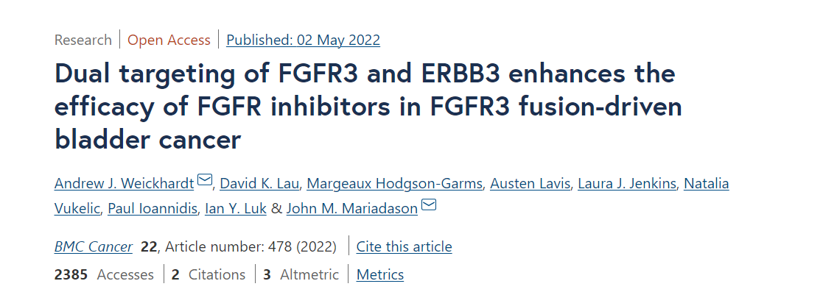
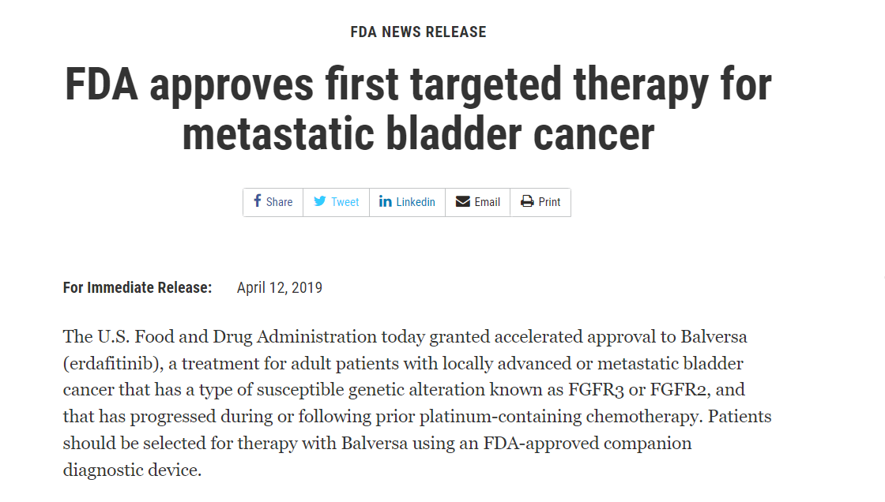

Future advantages of GALEAS® Bladder
Disease stratification
  We are building the clinical evidence to demonstrate that GALEAS® Bladder can stratify low- and high-grade bladder cancer which will be key in improving patient outcomes
Companion diagnostics
  Many Pharma companies are using genetic signatures to target therapies E.g. FGFR3 inhibitors
Whole care pathway
  Bladder cancer has one of the highest recurrence rates of any cancer. GALEAS® Bladder has the potential to be used as an alternative to cystoscopies in monitoring patients for recurrence without changing workflows (see next slide)
Notes:
1) Disease stratification; there are already publications demonstrating that variants in FGFR3 and TP53 genes, (both covered by GALEAS® Bladder) can identify low and high cancer – key in getting the right treatment for the right patient at the right time. We need to build the clinical evidence to demonstrate this but

Slide 23
Ongoing academic research (underpinned by GALEAS Bladder)
BC-Recon CRUK Biomarker Project
GALEAS Bladder
3200 patients
Can GALEAS Bladder + imaging + cytology
safely replace
Flexible cystoscopy + imaging + cytology
In haematuria investigations?
(GALEAS Bladder)
GB
GB

Slide 24

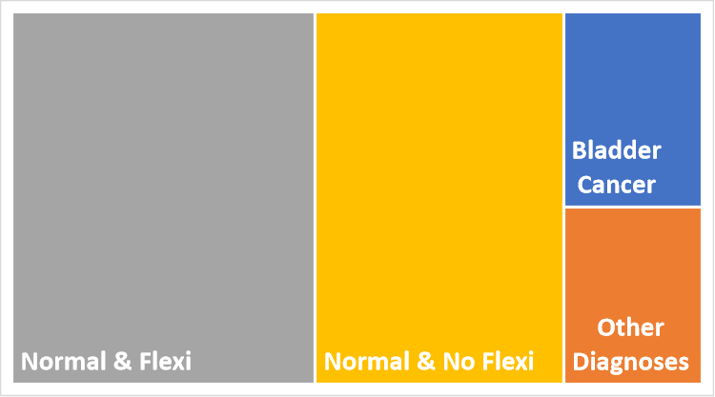


The potential benefit?
100,000 per annum UK
40,000 per annum UK

Slide 25
Application of GALEAS Bladder to circulating tumour DNA
Urine directed ctDNA analysis
26% urine SNVs also in serum
Lower VAFs
61% MIBC patients ctDNA positive
ctDNA positive = worse outcome
FAISAL 2

Slide 26
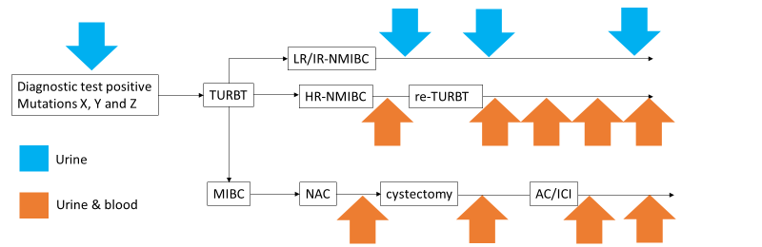
GALEAS® Bladder: a single platform throughout patient pathways?
Most ctDNA detection tests are tumour-informed, relying on sequencing the tumour and the development of patient-specific assays.
Since VAFs are typically high in urine at diagnosis and mutations can be detected with high confidence, these data can then be used to guide future urine- and plasma-based disease surveillance….

Slide 27
In summary, How did we from an academic lab to a commercial product?
An element of luck!
A small company looking to increase their product portfolio
No intellectual property
Biomarker panel based on sound rationale and evidence
Published/unpublished data supporting the panel
Knowledge and enthusiasm
Clinical samples
Publication not a barrier to commercialisation
Support from University of Birmingham and Cancer Research UK
Commercialisation not a barrier to publication
Commercialisation underpinning further research

Slide 28




BCRC
Rik Bryan
Roland Arnold
Anshita Goel
Naheema Gordon
Ben Abbotts
Faisal bin Humaid
BCPP
KK Cheng
Nick James
Maurice Zeegers
Genomics Birmingham
Andrew Beggs
Celina Whalley
University of Warwick
Sascha Ott
Laura Baxter
University of Birmingham Human Biomaterials Resource Centre
BladderPath Trial Management Group
Nonacus
Chris Sale
Michael Parks
Rob Hastings
Andy Feber
Informed Genomics
Bradley Toghill
Simon Davis
University of Birmingham Enterprise
Jonathan Watkins
Ruth Ashton
Cancer Research Technology
Dana Koludrovic
Martyn Bottomley
Tassos Konstantinou
Thank you!

