Slide 1
Simon Caney
Poverty, Inequality and Justice:
Development in a Climate Constrained World
15th June 2018

Slide 2
My Aim
What is the just response to global poverty in a world facing dangerous climate change?
More specifically
- to present an egalitarian conception of global justice
- to explore its implications for development and climate change
- methodologically to illustrate the appeal of an integrationist approach

Slide 3
The Structure
Part One: The Context
I: Global Poverty and Inequality
II: Climate Change
III: Global Environmental Change More Generally
IV: Integrationist Perspective
Part Two: Justice
V: Cosmopolitanism and Equality
VI: Motivating Support for it
VII: Implications for Development and Climate
VIII: Concluding Remarks

Slide 4
Part One: The Context – Poverty, Inequality and Climate Change

Slide 5
I: Global Poverty and Inequality
§1. Context
“650 million people are living in extreme poverty - about 16% of them in fragile countries. Three billion people are using dirty sources of energy for cooking and heating.” (UNDP 2017)
1.1 billion lack access to electricity (IEA 2018)
§2. Policy Level
Since 2015: ‘Sustainable Development Goals’.
17 SDGs. Replace old Millennium Development Goals.
For example: (1) “no poverty”; (2) “zero hunger”; (3) “good health and wellbeing”; (4) “quality education”; (5) “gender equality”; (6) “clean water and sanitation”; (7) “affordable and clean energy” ….
§3. Recent Developments

Slide 6
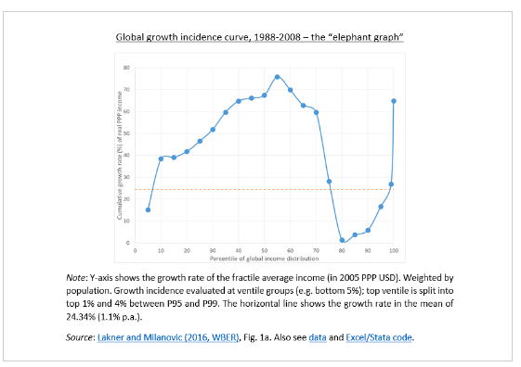

Slide 7
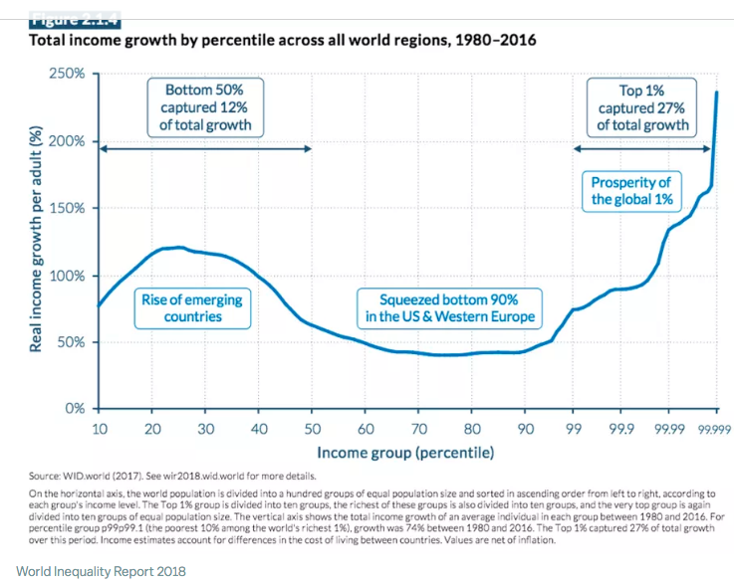
The World Inequality Report (2018)

Slide 8
II: Climate Change
§1. Paris Agreement:
“[h]olding the increase in the global average temperature to well below 2°C above pre-industrial levels and to pursue efforts to limit the temperature increase to 1.5°C above pre-industrial levels, recognizing that this would significantly reduce the risks and impacts of climate change” (Article 2.1).
§2. IPCC: “to limit the warming caused by anthropogenic CO2 emissions along to be likely less than 2°C relative to the period 1861-1880, total CO2 emissions from all anthropogenic sources would need to be limited to a cumulative budget of about 1000 PgC since that period. About half [445-585] PgC of this budget was already emitted by 2011” (Collins and Knutti 2013, p.1033)
§3. If you want to see how we’re doing click this: www.trillionthtonne.org

Slide 9
III: Global Environmental Degradation More Generally
Nine Planetary Boundaries
(1) Climate Change
(2) Ocean Acidification
(3) Stratospheric Ozone Depletion
(4) Interference with the Global Phosphorus and Nitrogen Cycles
(5) Rate of Biodiversity Loss
(6) Global Freshwater Use
(7) Land-System Change
(8) Aerosol Loading
(9) Chemical Pollution
Johan Rockström et al (2009) ‘Planetary Boundaries: Exploring the Safe Operating Space for Humanity’

Slide 10
For Example:
(2) Ocean Acidification: “a 26 percent rise in ocean acidification since the beginning of the industrial revolution” (UNDP 2017)
(4) Interference with Nitrogen and Phosphorus Cycles fertilizer – nitrogen run off – dead zones – loss of marine life
(5) Rate of Biodiversity Loss.
“sixth mass extinction” (Ceballos et al 2017)
“Since the advent of the Anthropocene, humans have increased the rate of species extinction by 100–1000 times the background rates that were typical over Earth’s history … . The average global extinction rate is projected to increase another 10-fold … . Currently about 25% of species in well studied taxonomic groups are threatened with extinction (ranging from 12% for birds to 52% for cycads)” (Rockström et al 2009, p.15)

Slide 11
(8) Aerosol Loading
“From the perspective of human-health effects, fine particulate air pollution (PM2.5) is responsible for about 3% of adult cardiopulmonary disease mortality, about 5% of tracheal, bronchial, and lung cancer mortality, and about 1% mortality from acute respiratory infection in children in urban areas worldwide (Cohen et al. 2005). These effects convert to about 800,000 premature deaths and an annual loss of 6.4 million life years, predominantly in developing Asian countries.” (Rockström et al 2009, p.18) other forms of environmental degradation - marine pollution and plastic: each year between 4.4 and 12.7 million metric tons of plastic are deposited in the oceans (Borrelle et al 2017)
Henderson island - 37, 661,385 plastic items on this small island (of 5x7km) (Lavers and Bond 2017)

Slide 12
IV: An Integrationist Perspective - Why we have to talk about Development and Climate Together
Reason 1. Climate Change undermines (human) development (IPCC 2014)
Reason 2. Some measures to promote development contribute to climate change – specifically fossil-fuel led energy use
Reason 3. Some measures to mitigate climate change undermine development (eg a carbon tax on imports from developing countries).
It is a mistake to try to treat them in isolation from each other. (More general claim. Debates about global justice are often fragmented treating climate, trade, migration, health, natural resources, territory, biodiversity, etc separately and in isolation. My claim: we should treat them in conjunction with each other. Integrationism v isolationism (Caney 2012, 2018).

Slide 13
Part Two: Justice

Slide 14
V: Cosmopolitanism and Equality
§1. Cosmopolitanism
- moral units are individual persons;
- have equal status;
- generate duties on others;
- the value of collective entities such as nations and states is derivative the conception I have in mind is not committed to other values one might associate with cosmopolitanism (world government, cultural cosmopolitan ideals)
2. Egalitarianism
- my focus is on equality of opportunity for well-being (understood in terms of capabilities (Nussbaum & Sen)
- animated by the idea of not disadvantaging people because of their “circumstances” (Dworkin)

Slide 15
VI: Motivating Cosmopolitanism
§1. the core idea is that at least part of the reason that equality is valuable entails that the scope of equality should be global.
If the thought is that people should not be disadvantaged by their circumstance …. then they should not be disadvantaged by their country of birth of residence.
Think of the “postcode lottery”. Globalise it!.
§2. very many critics type 1: dispute the ideal of equality type 2: hold that the scope is not global but defined by the borders of the nation or state.

Slide 16
VI: Motivating Cosmopolitanism on the scope of equality. Is the nation or state the subject of justice?
1. shared national identity (Miller)
2. reciprocity (Sangiovanni)
3. subjection to coercion (Valentini, Blake, Nagel) sceptical thoughts. eg reciprocity based arguments ascribe special rights but this presupposes a system of general rights
(cosmopolitan egalitarian norms should regulate the general rights). eg coercion based arguments – what is the moral relevance of being coerced? Distributive justice or political legitimacy?

Slide 17
On the relationship between citizenship and global inequality.
Branko Milanovic on the “citizen premium”.
“while effort or luck can make a difference in individual cases, they cannot, from a global perspective, play a very large role because more than half of variability in income globally is explained by circumstances given at birth.” (Milanovic 2015, p.458).
“The locational premium is very large: compared to living in the poorest country in the world (DR Congo), a person gains more than 350% if she lives in the United States, more than 160% if she lives in Brazil, but only 32% if she lives in Yemen.” (Milanovic 2015, p.458).

Slide 18
VII: Implications for Development and Climate
Three common responses.
Response 1. Share the emissions budget equally. Aubrey Meyer ‘Contraction and Convergence’. See his diagram (next slide).
Anil Agarwal and Sunita Narain ‘Global Warming in an Unequal World: A Case of Environmental Colonialism’ (1991).
Response 2. Greenhouse Development Rights (Ecoequity. Paul Baer, Sivan Kartha.) Distribute rights to emit to the disadvantaged.

Slide 20
BUT
(-) to think that justice is focused on the fair share of greenhouse gas emissions is to fetishize emissions. What matters are people’s interests – their “capabilities”. Emissions are a byproduct of a means to an end. They are not the end.
Response 3: allocate rights to extract fossil fuels to developing countries.
McGlade and Ekins: “a third of oil reserves, half of gas reserves and over 80 per cent of current coal reserves should remain unused from 2010 to 2050 in order to meet the target of 2C.”
(2015)
(-) right to develop =/= right to extract
(-) does not assist fossil-fuel poor countries. Eritrea & Swaziland

Slide 21
A better way forward
Response 4: Technology transfer
Creating a global commons
Hauke Ward et al report that transferring existing technology would lower annual CO2 emissions by more than 10 gigatons (Ward et al 2017). It advances development, and greater equality, but not at the cost of climate change.
Can be grounded in different ways:
(i) direct corollary from equality;
(ii) out of concern for potential victims of climate change; (iii) compensation for past overuse of what should have been a shared global resource

Slide 22
Response 5: Equitable Burden-Sharing requires allocating the burden to the most advantaged.
* Chancel and Piketty (2015): “top 10% emitters contribute to about 45% of global emissions, while bottom 50% emitters contribute to 13% of global emissions. Top 10% emitters live on all continents, with one third of them from emerging countries.”
* Chakravarty et al (2009). “Sharing Global CO2 Emission Reductions among one Billion High Emitters.” we can reduce “projected global emissions in 2030 by 13
GtCO2” by sharing the emissions reductions among the top billion emitters and this can be done without imposing costs on the world’s poorest (Chakravarty et al 2009,p.11884).

Slide 23
VII: Concluding Remarks
* we face two major (inter-related) challenges
* they need to be addressed together (integrationism)
* I have introduced a cosmopolitan egalitarian framework for thinking about these challenges
* raised questions about some common responses (contraction and convergence, GDR)
* proposed two others: creating a technological commons and distributing burdens on an ability to pay basis. There are some of the steps to a world not disfigured by poverty, one characterised by equality and sustainability.

