Slide 1
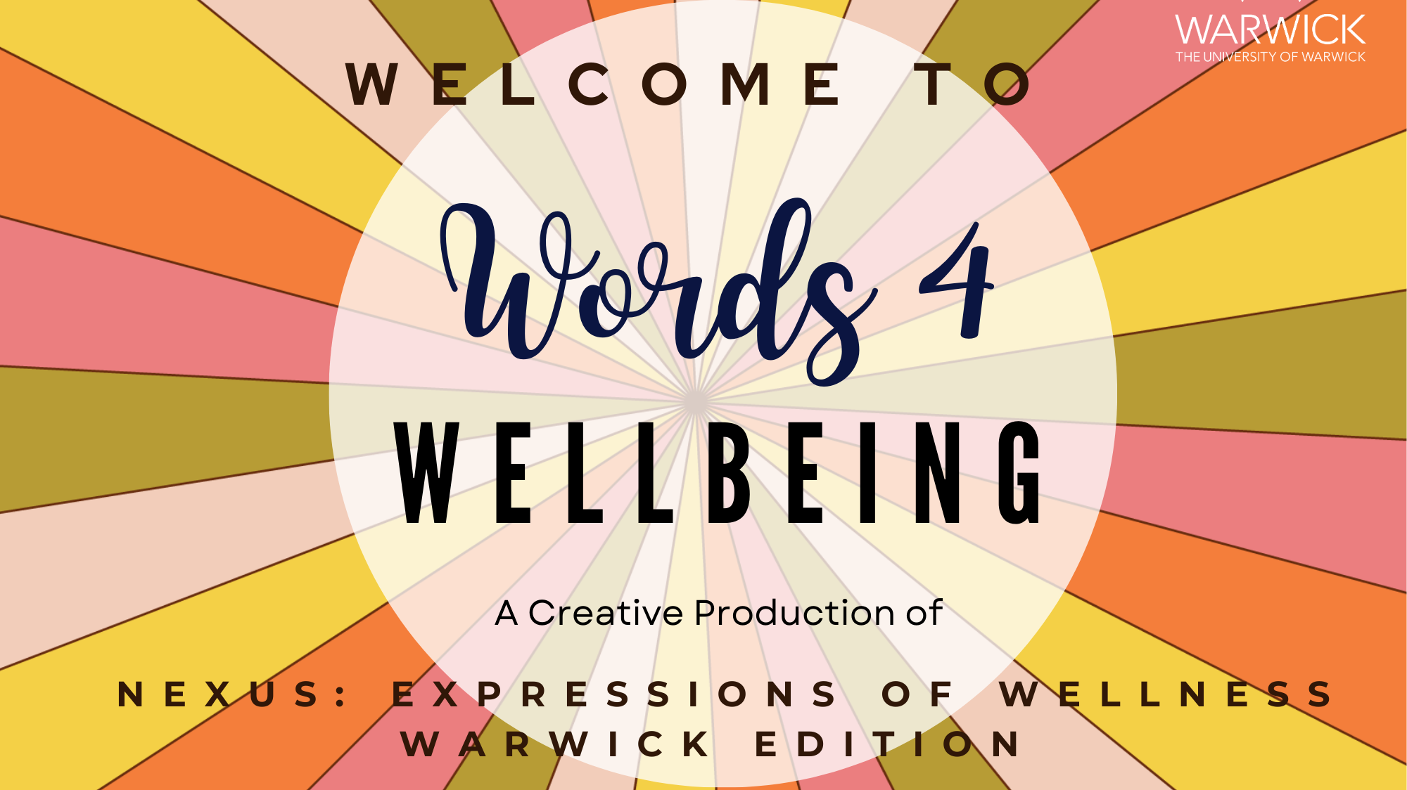

Slide 2
Once upon a midnight dreary, while I
Pondered weak and weary,
Over many a quaint and curious volume of forgotten lore-
What is this life if, full of care, We have no time to stand and stare. No time to stand beneath the boughs And stare as long as sheep or cows.
What is mindfulness?
Mindful breathing
Mind relaxation
Noticing Now
Body relaxation
I wandered lonely as a cloud
That floats on high o’er vales and hills,

Slide 3
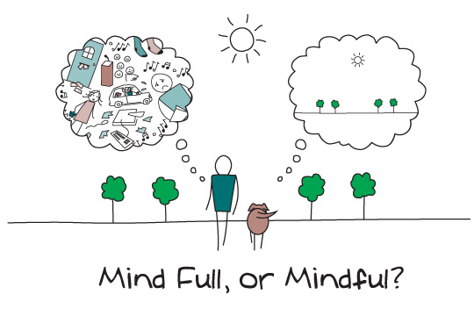

Slide 4
Mindfulness
Once upon a midnight dreary, while I
Pondered weak and weary,
Over many a quaint and curious volume of forgotten lore-
What is this life if, full of care, We have no time to stand and stare. No time to stand beneath the boughs And stare as long as sheep or cows.
“Present-centred awareness”
“the awareness that emerges through paying attention on purpose, in the present moment, and nonjudgmentally to the unfolding of experience moment by moment”(Kabat-Zinn 2003)
MINDLESSNESS
MINDFULNESS
I wandered lonely as a cloud
That floats on high o’er vales and hills,
PAST
PRESENT
FUTURE

Slide 5
What is mindfulness?
Once upon a midnight dreary, while I
Pondered weak and weary,
Over many a quaint and curious volume of forgotten lore-
What is this life if, full of care, We have no time to stand and stare. No time to stand beneath the boughs And stare as long as sheep or cows.
Contemporary Mindfulness
All inclusive with Buddhist roots.
Biological, psychological underpinnings.
Mind, body, emotions.
Inside-out approach.
Can be a mental health wellbeing technique OR a deeper personal journey.
Foundational practices include mindful breathing, the body scan and meditative techniques.
Long relationship with poetry and other reflective and expressive activities.
I wandered lonely as a cloud
That floats on high o’er vales and hills,

Slide 6
Once upon a midnight dreary, while I
Pondered weak and weary,
Over many a quaint and curious volume of forgotten lore-
What is this life if, full of care, We have no time to stand and stare. No time to stand beneath the boughs And stare as long as sheep or cows.
What is mindfulness?
Mindful breathing
Mind relaxation
Noticing Now
Body relaxation
I wandered lonely as a cloud
That floats on high o’er vales and hills,

Slide 7
Once upon a midnight dreary, while I
Pondered weak and weary,
Over many a quaint and curious volume of forgotten lore-
What is this life if, full of care, We have no time to stand and stare. No time to stand beneath the boughs And stare as long as sheep or cows.
I wandered lonely as a cloud
That floats on high o’er vales and hills,

Slide 8

Once upon a midnight dreary, while I
Pondered weak and weary,
Over many a quaint and curious volume of forgotten lore-
Using mindfulness for creating poetry:
Spend some time in the mindful state allowing for deeper inspiration, direction and meanings to emerge.
Focus on the themes that emerge that you want to express.
Focus on your inner rhythms to find the rhythm of the poem.
Now focus on the words that you can use to convey your themes and rhythm.
I wandered lonely as a cloud
That floats on high o’er vales and hills,

Slide 9

Once upon a midnight dreary, while I
Pondered weak and weary,
Over many a quaint and curious volume of forgotten lore-
Using mindfulness for engaging with poetry:
Focus on each word as your read or hear the poem.
Focus on the rhythm of the poem and your inner rhythms.
Focus on any themes that emerge within you.
Let deeper meanings emerge too.
I wandered lonely as a cloud
That floats on high o’er vales and hills,

Slide 10
Leisure by William Henry Davies
What is this life if, full of care, We have no time to stand and stare. No time to stand beneath the boughs And stare as long as sheep or cows. No time to see, when woods we pass, Where squirrels hide their nuts in grass. No time to see, in broad daylight, Streams full of stars, like skies at night. No time to turn at Beauty's glance, And watch her feet, how they can dance. No time to wait till her mouth can Enrich that smile her eyes began. A poor life this if, full of care, We have no time to stand and stare.
Once upon a midnight dreary, while I
Pondered weak and weary,
Over many a quaint and curious volume of forgotten lore-
What is this life if, full of care, We have no time to stand and stare. No time to stand beneath the boughs And stare as long as sheep or cows.
Words
Rhythms
Meanings
Themes
I wandered lonely as a cloud
That floats on high o’er vales and hills,

Slide 11
Once upon a midnight dreary, while I
Pondered weak and weary,
Over many a quaint and curious volume of forgotten lore-
What is this life if, full of care, We have no time to stand and stare. No time to stand beneath the boughs And stare as long as sheep or cows.
What is mindfulness?
Mindful breathing
Mind relaxation
Noticing Now
Body relaxation
I wandered lonely as a cloud
That floats on high o’er vales and hills,

