Slide 1
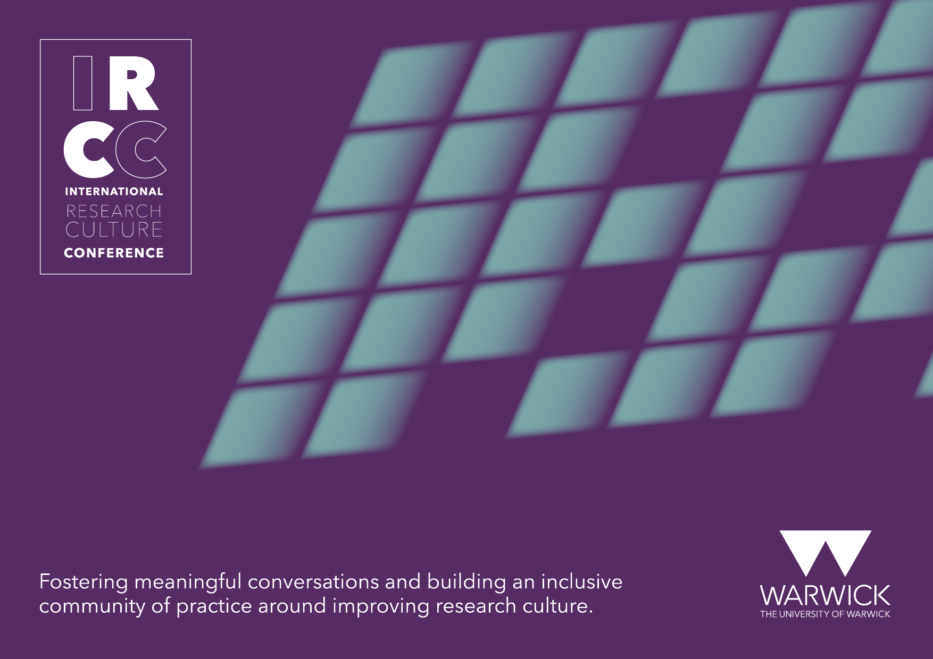

Slide 2

A decolonising approach to policy impact: lessons for research culture
Amanda Chukwudozie & Chris Sims
University of Nottingham Institute for Policy & Engagement
25 September 2023

Slide 3
Context
Engaging with policy in Global South countries (or in western countries focusing on research which centre BAME communities) often means navigating complex histories, power imbalances and preconceptions
Currently, university structures in the UK have been demonstrated to be inherently colonial.
This cascades into research culture, and consequently, policy impact.
These complexities are also unfortunately replicated in international policy engagement, especially in Global South Countries.
IRCC INTERNATIONAL RESEARCH CULTURE CONFERENCE I 25th Sept 2023

Slide 4
The Institute for Policy and Engagement and global policy impact
The Institute for Policy and Engagement brings UoN research to the forefront of policy and public debate through policy impact and public engagement activities.
Though we support academics engaging with policy all over the world, our international strategy focuses on the Global South.
We engage policy audiences in the UK and across the world with the University of Nottingham’s diverse and cutting-edge research
IRCC INTERNATIONAL RESEARCH CULTURE CONFERENCE I 25th Sept 2023

Slide 5
Decolonising impact: our work
IRCC INTERNATIONAL RESEARCH CULTURE CONFERENCE I 25th Sept 2023

Slide 6
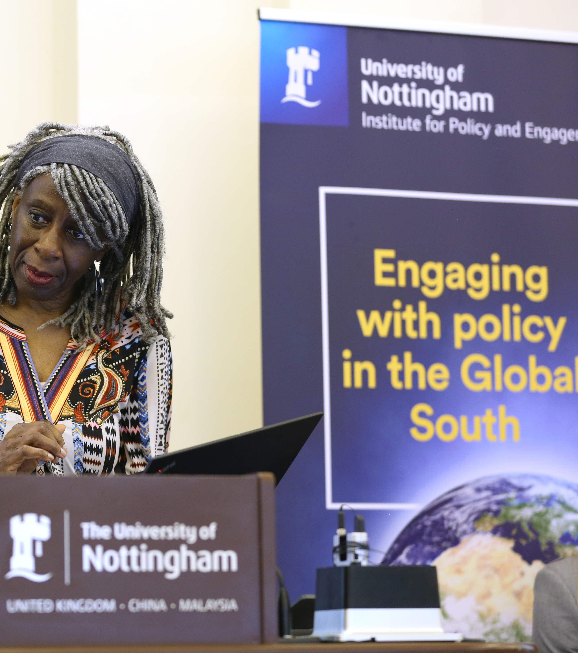
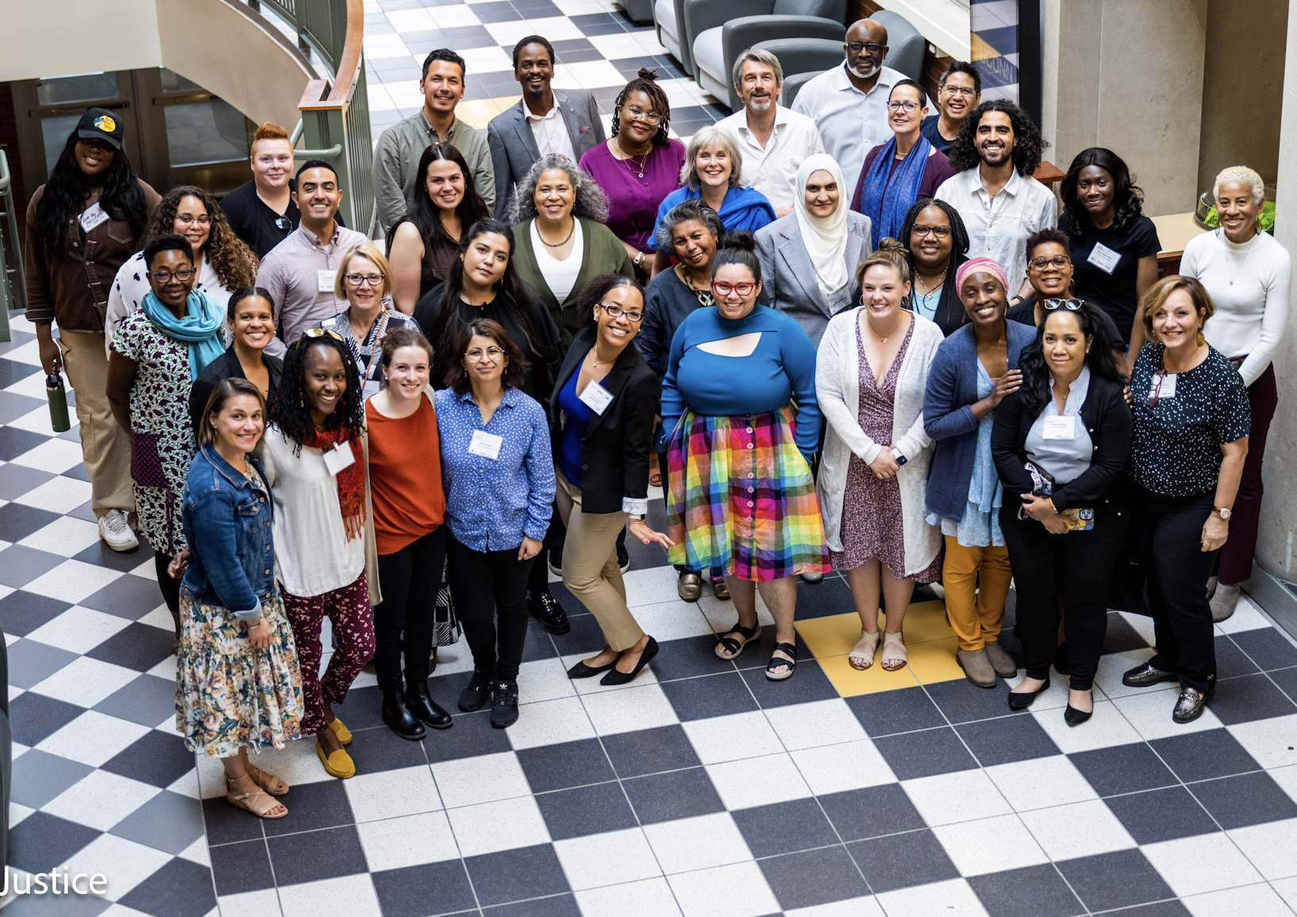
Enabling environment:
REF 2028
Equality Impact Assessments
Bespoke support
Strategy:
Decolonising the University conversations and outcomes
ICARE4Justice
Equitable and inclusive practice underpins our global policy engagement work
Events:
Engaging with policy in the Global South conference
Nottingham Engaged
UoN Research Culture Conference
IRCC INTERNATIONAL RESEARCH CULTURE CONFERENCE I 25th Sept 2023

Slide 7
Lessons from three strands of work
Engaging with policy in the Global South conference- April 2022
The Intersectional and Comparative Advancement of Racial Equity for Social Justice (ICARE4Justice)- May 2023 summit
University of Nottingham Research Culture Conference (Conversation Station) – July 2023
IRCC INTERNATIONAL RESEARCH CULTURE CONFERENCE I 25th Sept 2023

Slide 8
Engaging with Policy in the Global South
A conference bringing together UoN academics and Global South policy actors to exchange ideas on doing work in this particular context
There are UoN academics (and in the wider UK HE sector) seeking to influence policy in Global South countries, a lot of which have complicated colonial histories with the UK
This comes with a lot of challenges and risks that the University and sector at large may not currently have support for, particularly on how academics can best work with policy audiences in contexts of complex historical relationships, global power imbalances and cultural differences.
The conference kickstarted an ongoing strand of work to identify these challenges and propose actions for individual academics, for the University and for HE.
IRCC INTERNATIONAL RESEARCH CULTURE CONFERENCE I 25th Sept 2023

Slide 9
Engaging with Policy in the Global South
A full day of plenary conversations, breakout discussions and experience sharing from UoN academics engaging policy across Global South countries
Attendees
HE David Sengeh, Minister for Education and Innovation in Sierra Leone
Baroness Lola Young, UoN Chancellor
High level officials from the African Union, UNICEF, UNDP, Commonwealth Secretariat, Asian Civil Society Network
UON academics
Working in post-colonial contexts
Engaging with multilateral institutions
Cultivating positive third-sector partnerships
Conference themes
IRCC INTERNATIONAL RESEARCH CULTURE CONFERENCE I 25th Sept 2023

Slide 10




ICARE4Justice 2023 Summit
ICARE4Justice is designed to advance graduate students, faculty, policy makers and community organisers interested in global issues related to racial equity, intersectionality, social justice, decoloniality and anti-colonialism.
Is the University Colonial? Critical conversations on its past, present and future
Oct 2020-
Feb 2021
Decolonising the University – Translating theory into practice
Oct 2021
The Intersectional and Comparative Advancement of Racial Equity for Social Justice
(ICARE4Justice)
IRCC INTERNATIONAL RESEARCH CULTURE CONFERENCE I 25th Sept 2023

Slide 11
UoN Research Culture Conference – July 2023
A breakout conversation station at the University of Nottingham’s Research Culture Conference sharing lessons on our Decolonising Impact work
We held a conversation on the implications of international policy engagement through an equity lens, and against the backdrop of REF 2028’s emphasis on Research culture.
Attendees included Nottingham researchers and colleagues from UK and US academia.
The conversation focused on actions for the Institute to enhance our efforts.
IRCC INTERNATIONAL RESEARCH CULTURE CONFERENCE I 25th Sept 2023

Slide 12
Themes and lessons
IRCC INTERNATIONAL RESEARCH CULTURE CONFERENCE I 25th Sept 2023

Slide 13
Emerging themes and lessons
These strands of work yielded complementary themes applicable to a decolonising lens for policy engagement in the UK
The global and the local- understanding local contexts within global agendas
Academic awareness, intellectual humility and radical humanisation
Equity-minded actions in the UK research-policy landscape
Good troublemaking in leadership and administration
IRCC INTERNATIONAL RESEARCH CULTURE CONFERENCE I 25th Sept 2023

Slide 14
4As – aptitude, attitude, awareness, action.
Understanding positionality when working in the Global South or with ethnic minorities in the West.
Investment in social capital, networks and communication
Embrace 2-way knowledge exchange – the UK systems can learn a lot from other countries
Lessons for researchers
IRCC INTERNATIONAL RESEARCH CULTURE CONFERENCE I 25th Sept 2023

Slide 15
Review administrative processes which can adversely affect equitable partnerships.
Provide guiding tools and trainings on practices, language and structures to directly support researchers working in Global South contexts.
Knowledge exchange and policy offices/institutes can take up an internal advocacy role dismantle inequitable systems.
Utilise local resources within the university to collate guiding tools and build networks eg BAME and international staff as advisory groups.
Look into a funding architecture more compatible with local contexts
Lessons for UK universities
IRCC INTERNATIONAL RESEARCH CULTURE CONFERENCE I 25th Sept 2023

Slide 16
Strengthen relationships with multilaterals
Facilitate and incentivise equitable co-creation of research questions, methods and policy engagement with target populations internationally to avoid replicating colonial methods.
Work with funding bodies to review funding processes and how they may inadvertently impede positive relationships and reproduce colonial power structures
Facilitate knowledge exchange networks focused on international policy engagement to address specific challenges; and harness the opportunities of equitable international research to policy partnerships
Lessons for UK HE Sector
IRCC INTERNATIONAL RESEARCH CULTURE CONFERENCE I 25th Sept 2023

Slide 17
Call to action
Would you be interested in joining a network for research-policy engagement between the UK and Global South countries?
IRCC INTERNATIONAL RESEARCH CULTURE CONFERENCE I 25th Sept 2023

Slide 18
THANK YOU

Slide 19
Questions/Comments?
IRCC INTERNATIONAL RESEARCH CULTURE CONFERENCE I 25th Sept 2023

