Slide 1


Slide 2

Developing the University of Warwick’s Research Culture
Evaluating a department’s approach to work experience programs and enabling staff development to enhance the delivery through internal funding sources
Craig Carnegie and Naomi Ogunkola
WMG

Slide 3
Background – Employability Schemes at Warwick
No embedded good practice for hosting employability schemes
Ad-hoc approaches to staff, based on connections and relationships
Gatsby Benchmarks – Work Experience and University Engagement
Isolates young people that have grown up in lower socioeconomic backgrounds
Research shows we lose young people's interest in STEM by the age of 15
Research Culture Improvements
There are a lack of leadership roles specific to Work Experience
Access to University for young people is limited
There is a gap in the research for sharing good practice
IRCC INTERNATIONAL RESEARCH CULTURE CONFERENCE I 25th Sept 2023

Slide 4
Project Aims and Funding Sources
Aims
Address social mobility issues in STEM
Develop a WMG Research Culture to support this
Contribute to the wider University of Warwick Community
Funding
Research England is allocating £30 million of Enhancing Research Culture funding to higher education providers for 2022-23
The University of Warwick allocated £600,000.
Research and Impact Services allocates based on an internal application / sift.
IRCC INTERNATIONAL RESEARCH CULTURE CONFERENCE I 25th Sept 2023

Slide 5
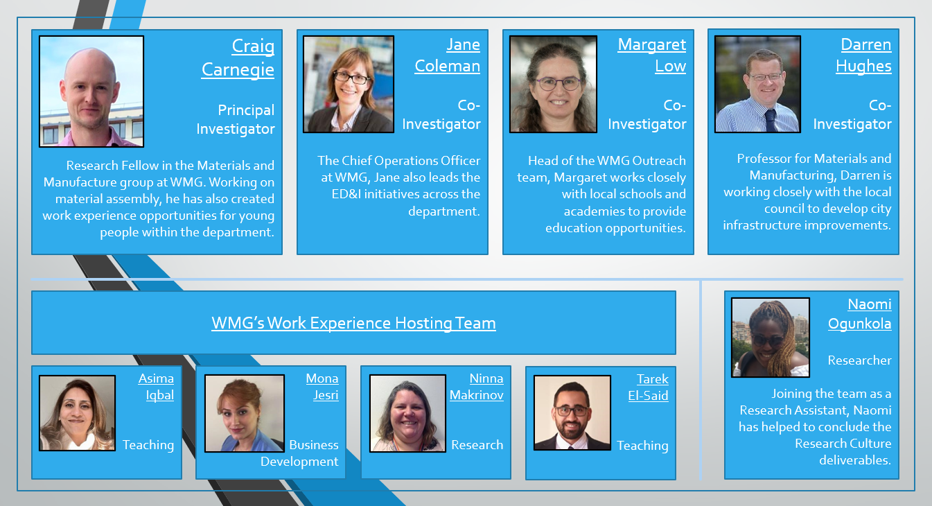
Staff Development
Project Creation and Leadership
Culture Fund Support
IRCC INTERNATIONAL RESEARCH CULTURE CONFERENCE I 25th Sept 2023
IRCC INTERNATIONAL RESEARCH CULTURE CONFERENCE I 25th Sept 2023

Slide 6
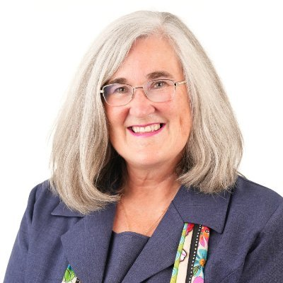
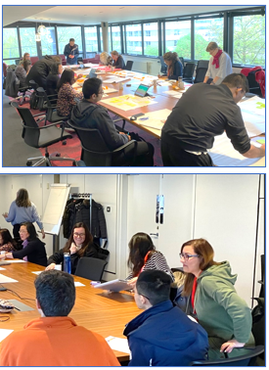
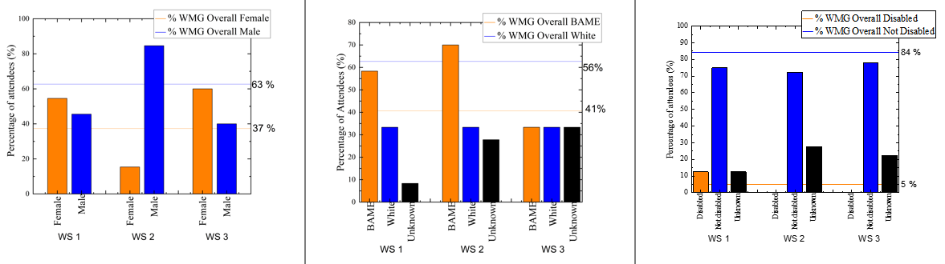
Personal Training
One-on-One Support:
  Each member of the team was provided with 2 hours of personal development discussions. Tailored to their own goals and objectives.
Group Delivered Workshops:
  A series of larger sessions that reached 33 members of WMG staff.
  Mapping your Achievements to UoW's Promotions Criteria
  Influence & Politics: Being Strategic
  Valuing Diversity & Increasing Inclusivity: What more can you be doing?
Sandy Sparks
Personal Development Consultant
Provided personalised development training, programme support and programme delivery
IRCC INTERNATIONAL RESEARCH CULTURE CONFERENCE I 25th Sept 2023

Slide 7
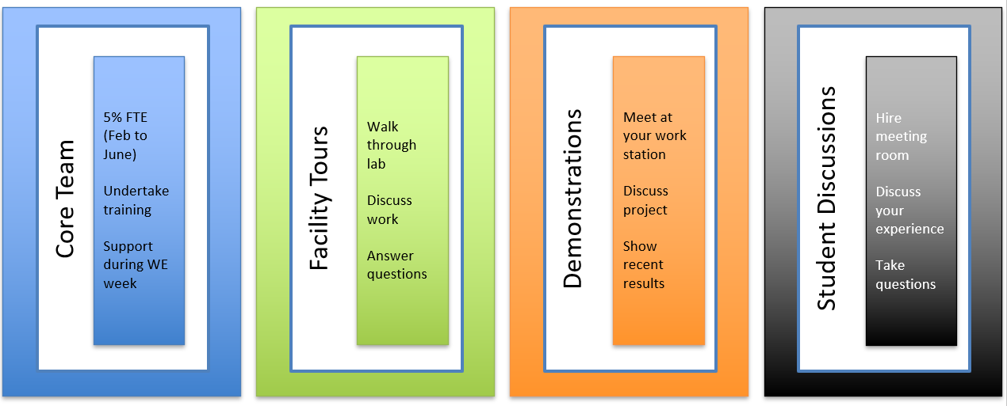
Collaboration for WMG Staff
Core Team
Programme Development
Programme Delivery
Facility Tours
Building Tour
Equipment Lists
Demonstrations
Equipment Operation
Project Description
Student Discussions
Presentation and Lecture
Group Workshop
IRCC INTERNATIONAL RESEARCH CULTURE CONFERENCE I 25th Sept 2023

Slide 8
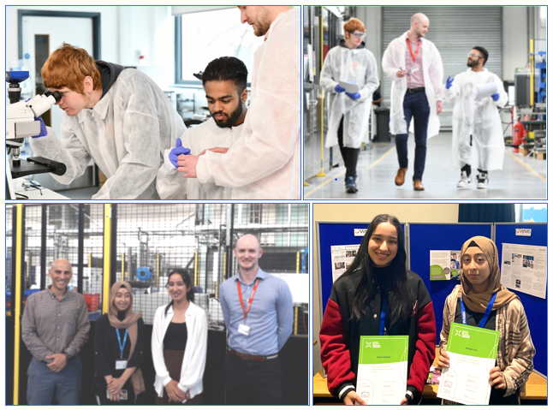
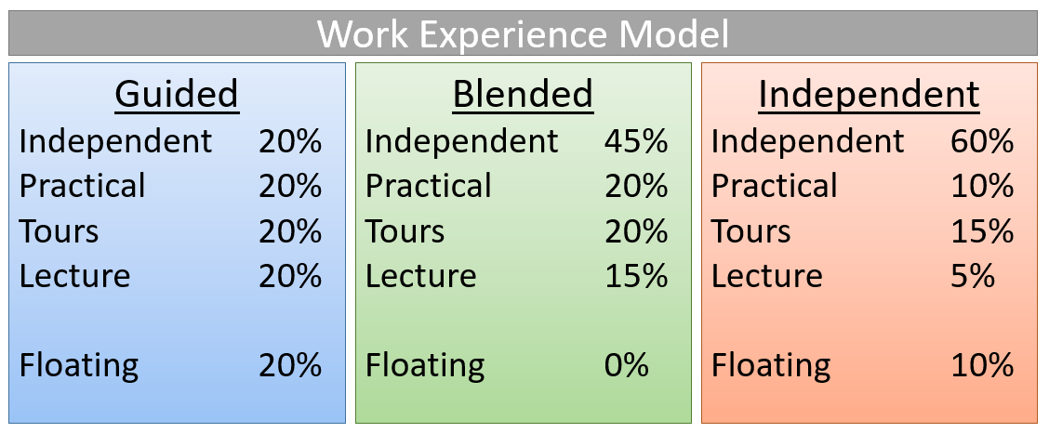
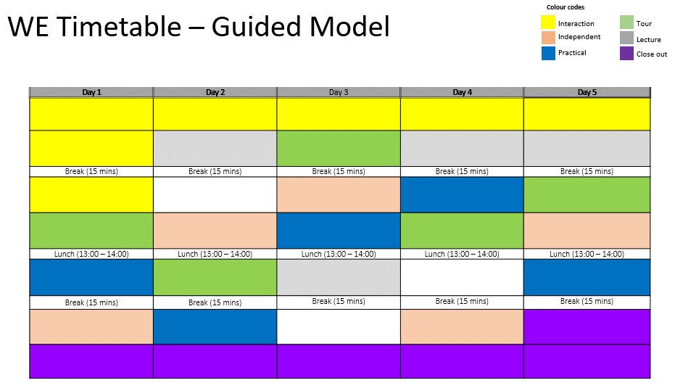
Identifying your audience
  [Widening Participation]
Select a Model
  [Resource, Ability, Availability]
Choose a theme for the week
  [Title, Objective, Aim]
Secure support and contributors
  [Staff Collaboration]
Create a workbook
  [Introduction, Exercises, Timetable]
Programme Creation
IRCC INTERNATIONAL RESEARCH CULTURE CONFERENCE I 25th Sept 2023

Slide 9
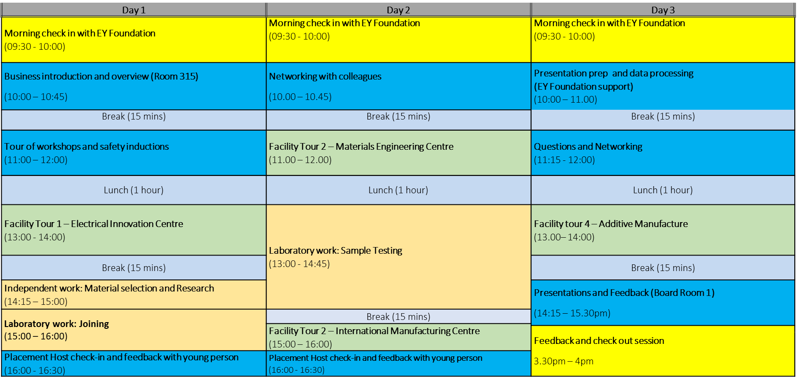
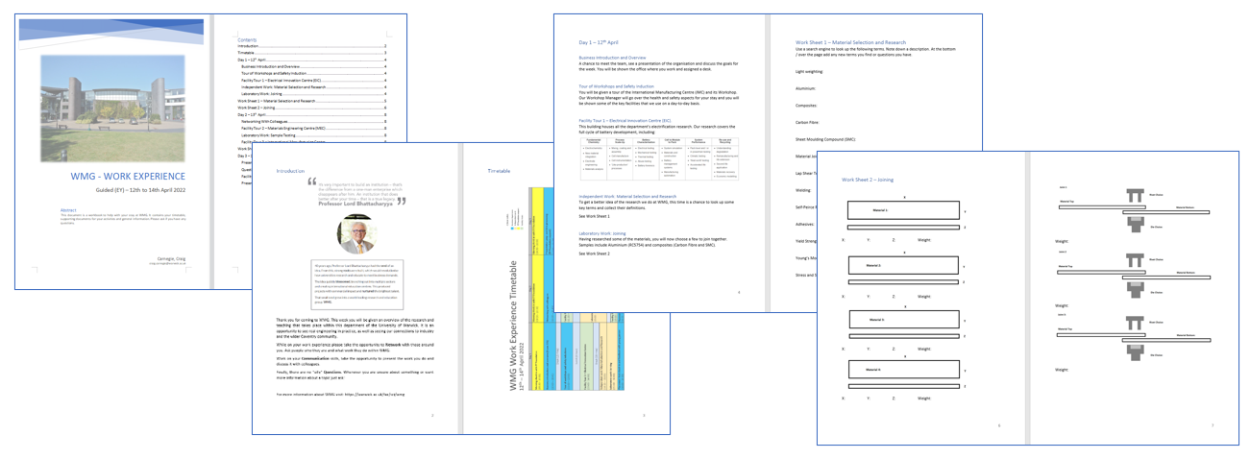
WMG Example
IRCC INTERNATIONAL RESEARCH CULTURE CONFERENCE I 25th Sept 2023

Slide 10
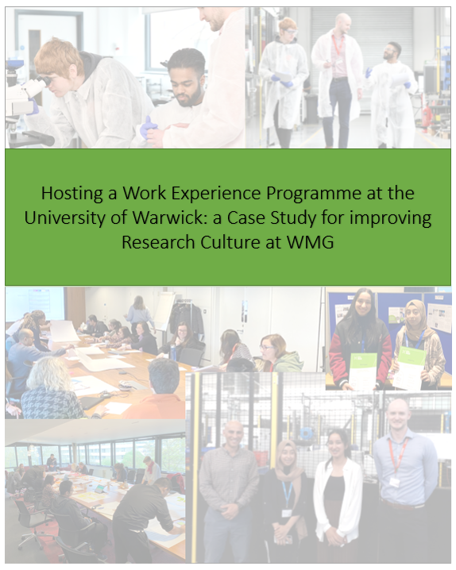
Open Access: Work Experience Guide
Project Deliverable
Access: www.warwick.ac.uk/wmgworkexperience
Hosting a Work Experience Programme at the University of Warwick: a Case Study for improving Research Culture within WMG
Chapter | Title and Description
1 | Research Culture - Chapter 1 introduces the funding process and project creation
2 | Approaching Work Experience - Introduces the departments historical and future approach to hosting employability interventions
3 | Work Experience Hosting - How to apply the information to create your own work experience programme.
4 | Conclusions and Culture Improvements – highlights the successful outcomes of the overall ERC fund and the employability scheme that was applied to WMG’s Work Experience programmes.
IRCC INTERNATIONAL RESEARCH CULTURE CONFERENCE I 25th Sept 2023

Slide 11
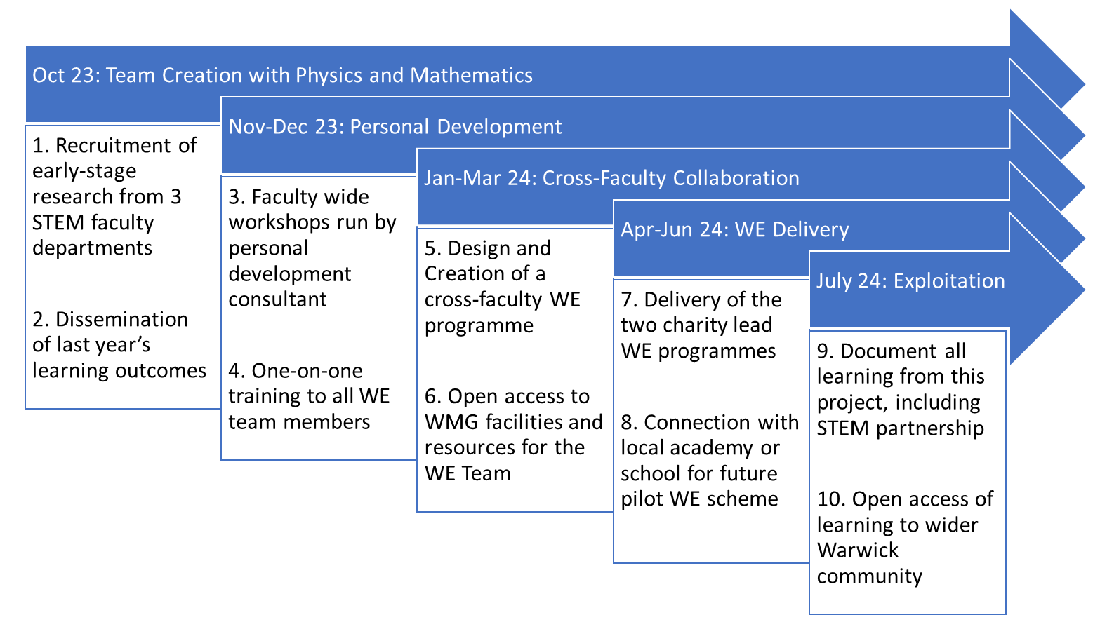
Next Steps
Research Culture Fund 2:
  Addressing social mobility issues in STEM: Cross-Faculty Research Culture Partnership
SEM Faculty Collaboration
  Science [Physics]
  Engineering [WMG]
  Mathematics
SEM Work Experience Working Group
IRCC INTERNATIONAL RESEARCH CULTURE CONFERENCE I 25th Sept 2023

Slide 12
THANK YOU
Evaluating a department’s approach to work experience programs and enabling staff development to enhance the delivery through internal funding sources
Dr Craig Carnegie craig.carnegie@warwick.ac.uk
Naomi Ogunkola naomi.ogunkola@warwick.ac.uk
Website: www.warwick.ac.uk/wmgworkexperience

