Slide 1



EDI, “Whiteness” and Researcher Careers
Carola Boehm,
Professor of Arts & Higher Education
Staffordshire University

Slide 2
01
Background, or what led me here….
Notes:
Book Cover – Linda Weintraub Art on the edge and over

Slide 3

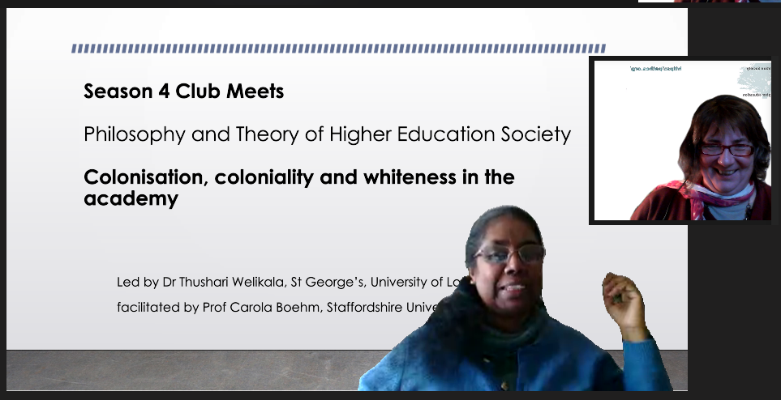
Background – Phase 1 Exploring: PaTHES Round Tables
PaTHES (International Society for Philosophy and Theory of Higher Education) Online thematic weekly meets (round tables)
Our Season 4 - “Colonisation, Coloniality and Whiteness in the Academy” 15 October to 15 December 2021
Led by Thushari Welikala, facilitated by Carola Boehm
Key issues discussed: Coloniality, Whiteness in HE
Conceptual - EDI vs Whiteness
Disciplinary aspects
EDI progress and Impact
Language and Articulation
Quantifying Decolonial Efforts
Truth & Reconciliation
Justice - Reparation Restoration
Colonisation of Coloniality
Institutional excl. practices

Slide 4
Background – Phase 2 Discourses : Special Issue
Special Issue Call for Deadline Nov 2022
Philosophy and Theory in Higher Education Journal (Ed. John Petrovitch, University of Alabama). Guest Editors: Thushari Welikala and Carola Boehm
Coloniality and Whiteness in the Academy: Towards Decolonial Futures. Contributions from
Thushari Welikala (UK),
Carola Boehm (UK),
Sheila Trahar (UK),
Gerry Dunne (Ireland),
Nuraan Davids (South Africa),
Manel Herath (UK),
Jennifer Valcke (Sweden),
Hans Schildermans (Austria).

Slide 5
Background – Phase 3 : Embedding
Committee Work - Not leading in, but part of….
Professorial Conferment Committee
EDI Committees
REF Working Groups and UoA Lead
Research Centre Directors Group
Professoriate Group
Women in HE
Ongoing collaborations (joint future paper on this topic) with
Dr Thushari Welikala, St. George’s, University of London
Associate Professor, Arinola Adefila, SCoLLP, Staffordshire University

Slide 6
02
EDI is not working…
Notes:
Book Cover – Linda Weintraub Art on the edge and over

Slide 7
Some numbers and a quote….
As of August 2023, there were only 61 Black female professors in UK Universities, from a total of 23,000 UK professors (WHEN, 2023).
I want to position some other concepts in this diversity debate
reflect on what this means within a Research Career / Research Culture / REF context

Slide 8
Invisible & Uncontested
If “invisible and uncontested whiteness moulds the social-cultural and intellectual imaginaries within higher education (…), suppressing alternative ways of perceiving the world” …. then it will - and demonstrably already has affected our progression into more diverse and socially just, academic research cultures, including how we do knowledge production.
(eds. T. Welikala & C. Boehm, 2023)

Slide 9
For the lack of a better word: “Whiteness”
“Whiteness” here is not necessarily about ‘white’ bodies but a characteristic of systems, processes and institutions built within a colonially and predominantly white conceptualised world.
It still defines ways in which institutions are still enacting power structures, practices and identities.
This dominating power can be so entrenched in our institutions, our cultures, and our sense of selves that “whiteness” can endure long beyond and even without white power.
“Whiteness” allows me to pivot away from classic, mainstream EDI to something which focusses on systemic exclusionary practices…. because…

Slide 10
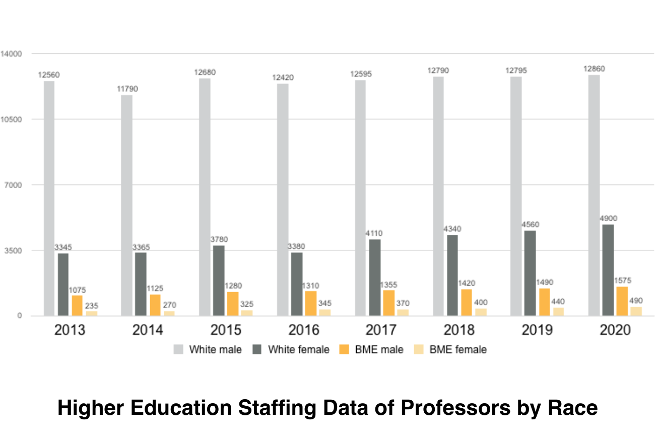
My Main Critique on Classical EDI
EDI is in generally built on a deficit model
The term affords us to focus more on those groups with less voice or representation who “need to be supported”,
And it focusses less on the institutions and ways of doing / being exclusionary
EDI has been the instrument of choice. Arguably, it hasn’t worked.

Slide 11
I cannot help and think that where we are is this (my provocation):
We have a tendency to call on EDI as the answer to the diversity challenge and be done with it.
Through structured EDI processes, we continue to fiddle around the edges, justify progress through statistics, and laude minor incremental improvements.
But by relying on incremental improvements and by having dedicated professionals who oversee all this, we tend to less involve the much wider university community in a deeper debate towards gaining awareness and understanding of this issue on multidimensional, systemic levels.
Thus, we continually reaffirm pervasive meritocratic systems we were taught to believe in.
This is specifically the case for research environments.

Slide 12
But what would it take to shift our focus …
… to the systems and interrogate their neutrality?
Terms “whiteness” “maleness” are not perfect, but may allow us to shift our focus on systemic issues, rather than on individual deficits?

Slide 13
03
ASPECT 1 Intersectionality
Notes:
Book Cover – Linda Weintraub Art on the edge and over

Slide 14
Intersectionality is often hidden
Metrics often indicate an incremental improvement
Many intersectionality's are not measured
Systemic exclusionary practices can thus still hide behind these data sets
Result is that numbers seem to indicate that all is going in the right direction, whilst in reality, many institutions still do not have a single, black female professor.

Slide 15
04
ASPECT 2 Rigour, Depth and Interdisciplinarity
Notes:
Book Cover – Linda Weintraub Art on the edge and over

Slide 16
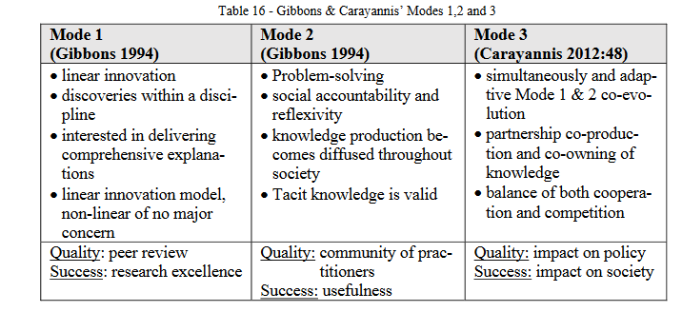
Diversity and the Interdisciplinary Quagmire
“Ingrained dominance of mono-disciplinary consciousness” - there is a tension between prioritising disciplinary depth vs interdisciplinary breadth (Boehm 2016)
In the UK, influenced by our UG ‘market’ (predominantly disciplinary)
predominance of linear research production (Gibbons Mode 1)
REF 2021 (Outputs - Gibbons Mode 1 vs Impact – Gibbons Mode 3)
Terms like “Excellence” are excellent gatekeepers

Slide 17
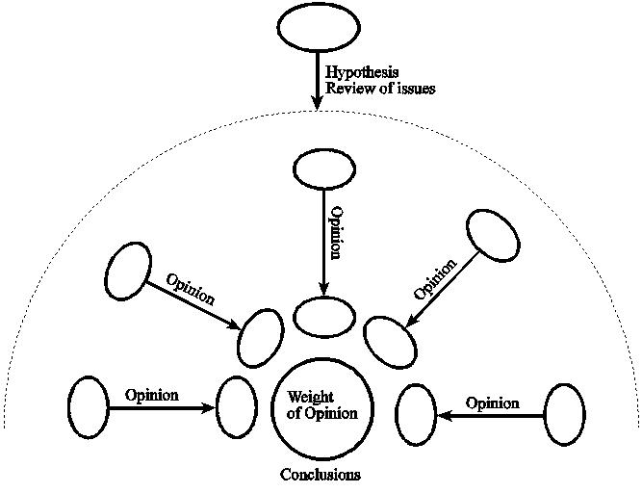
Diversity and the Interdisciplinary Quagmire
We need a deeper understanding of the impact of interdisciplinary phenomenological and ideological contexts related to perceptions of quality (see Boehm, 2022)
“Depth” is too often equated to rigour. We often still tend to prioritise a deep mono-disciplinary approach to a broad inter-disciplinary approach.
This can also be considered a gendered issue.
Methodologies
… more in the sciences | …more in the arts & humanities
Linear | Non-Linear

Slide 18
“Rigour”, “Excellence” and “Focus”
“Research depth” is often equated with quality, specifically in a research system devised in a way that prioritises depth and linear research models.
And so, we often judge those academic applications that are perceived to have “jumped around different disciplines” as “less rigorous”, “lacking depth” or “lacking focus”
So being alert to certain terms and concepts is important, to spot the interdisciplinary conundrum.
This connects gendered practices, and with it connects to research careers …..

Slide 19
05
ASPECT 3 What does an excellent researcher career look like?
Notes:
Book Cover – Linda Weintraub Art on the edge and over

Slide 20
Inter/Disciplinarity is connected to Gender?
I never connected the methodological with the gendered until recently…. I happen to know …
… more female academics who have broader interdisciplinary expertise and …
… I happen to know more men who have deep mono-disciplinary expertise.
I only recently started to wonder if that is also to do with the privileged positions that men more often inhabit than women.
Women often need to be more agile in their academic careers, due to childcare, caring, caretaker roles in professional positions, and job insecurities.

Slide 21
Gendered Careers - A Constant White Noise
As a woman, I know that there is the ever-existing white noise in the background of every single female academic career, due constantly being the gender that finds itself in positions of less power.
Female careers are evidenced to be more fragmented (Minello et al., 2021; Bhopal & Henderson, 2021; Aiston & Fo, 2021).
Statistics evidence that female academics are afforded to move jobs more often than men
It is logic to assume that they are also afforded to therefore move from adjacent discipline to discipline, adjusting to new research environments as they move.

Slide 22
My Researcher Career – A lived experience
I have moved every 8 – 10 years from one university to the other.
I have moved from being a Lecturer to a HOD to a Associate Dean to a Prof
My research moved with me, from music-computing (MPEG7) → Music Tech in HE → Cultural Policy → University Policy
Thus my career has experienced more angles of attack or critique than those careers that are more mainstream, predominantly mono-disciplinary, with linear research, classic scholarly output, less career hopping, using a traditional research council-funded model.

Slide 23
Women are proven to have more care-taker roles in HE
More women in Academic Developer Roles
More women in pedagogic research
More women in practice-based, community co-creative research
More women in practice-related pedagogic research
All these have traditionally been challenging to contribute to the REF (although this is changing) and similar research assessment systems.

Slide 24
Non-European academic identities
Add to this the intersectionality of non-white, non-European academic identities, which come with different ways of
communicating, presenting, learning and structuring their knowledge.
It follows:
→ angles of attack or critique are potentially much more plentiful
→ UKRI “death of a thousand cuts” (Interdisciplinary Peer Review College)
,

Slide 25
06
Conclusion (3 slides with take-aways) “Our systems are not neutral” should be the starting point
Notes:
Book Cover – Linda Weintraub Art on the edge and over

Slide 26
Consider the un-neutrality of our systems
Because specifically in the realm of research … they were built, developed, and authored still mostly by white men (and only a few white women)
and often at a time when the awareness was only emerging of how our colonial, white, and a predominantly male past influenced our institutions of today.
Our standards, processes and practices are likely to be not neutral.
They were built at a time when interdisciplinarity was not valued as highly as we need it to be now.
We need to be aware that the phenomenon of “Privilege” works on a continuum with multidimensional factors
including race, gender, class, background, discipline and probably much more. That is why intersectionality is so important.

Slide 27
In general – Equity rather than Equality (WHEN100, Women’s HE Network 2022 100 Black Women Professors Now)
Equity, not Equality …. build institutions that give people what they need to succeed.
“We have a fixation for equality, but this is not always the right solution”
It’s not about the person, it’s about fixing the system they’re in.
Need to be more confident about positive / affirmative action
Training staff to be confident to using positive / affirmative actions is important
We need to take that space and have those difficult conversations about race, gender and exclusion.
Leadership here is important, perception is often that it is not acceptable to speak out about biases

Slide 28
Researcher Careers Specifically
Let’s not fall into the trap of “deficit models”: Rather than focussing on the applicants’ development needs, can we focus on interrogating the neutrality of our systems?
Provide space for a deeper discourse in order to minimise baked in exclusionary practices.
Make everyone aware of the “Death by a thousand Cuts problem” for interdisciplinary research and researcher careers.
Be alert to gatekeeping phrases such as “lack of focus/depth”, vs an applicant’s often-apparent wider interdisciplinary profile.
Watch your intersectionalities.
Not only question what “good research” looks like, but also what a “solid” research career should look like.

Slide 29
The
END
Questions? Email: Carola.Boehm@staffs.ac.uk
Notes:
Book Cover – Linda Weintraub Art on the edge and over

