Slide 1


Slide 2

Research Culture and Research Assessment
A workshop on the principles of the Coalition for Advancing Research Assessment (CoARA) agreement.

Slide 3


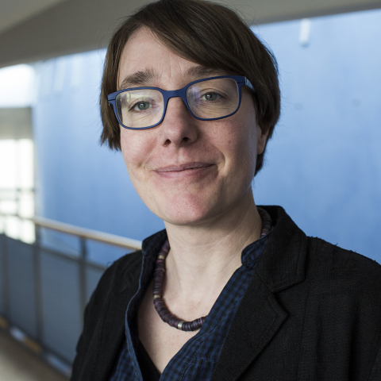
A little about us…
Yvonne Budden
Scholarly Communications Manager, Library
Sam Cole
Head of REF Futures, Policy & Delivery, Research & Impact Services
Noortje Marres
Professor, Centre for Interdisciplinary Methodologies
IRCC INTERNATIONAL RESEARCH CULTURE CONFERENCE I 25th Sept 2023

Slide 4
Coalition for Advancing Research Assessment (CoARA)
Launched in July 2022 by Science Europe
Drafted in a process that involved 350 organisations from 40 countries
Sets a shared direction for changes in assessment practices for:
Research;
Researchers, and;
Research performing organisations
The goal is to maximise the quality and impact of research
IRCC INTERNATIONAL RESEARCH CULTURE CONFERENCE I 25th Sept 2023

Slide 5
Institutions agree to:
Follow the general principles of CoARA:
Overarching conditions (ethics, research integrity, scientific freedom, transparency of data, and more.)
Quality and Impact
Diversity, inclusiveness and collaboration
Implement the core commitments
Develop an action plan within one year of signing the agreement
Have completed one cycle of assessment using the implemented evaluation criteria, tools and processes within 5 years of signing
IRCC INTERNATIONAL RESEARCH CULTURE CONFERENCE I 25th Sept 2023

Slide 6
Activity this morning
Using the ten commitments from CoARA, discuss:
What we must do to implement the commitment
What we could do to implement the commitment
What we should never even consider doing to implement the commitment
IRCC INTERNATIONAL RESEARCH CULTURE CONFERENCE I 25th Sept 2023

Slide 7
Feedback and next steps
Each group to feedback on one interesting thing they discussed about the CoARA commitment they looked at
Next steps
A report on the ideas from this morning will be made available as part of our work on developing our CoARA action plan
Critical Reflection piece authored for ‘Exchanges’ special issue
IRCC INTERNATIONAL RESEARCH CULTURE CONFERENCE I 25th Sept 2023

Slide 8
THANK YOU

