Slide 1


Slide 2

Putting research practice at the heart of research excellence at the University of Oxford
Sarah Callaghan, Mónica Palmero Fernández, Kathryn Dally, Jackie Thompson, Tanita Casci, Laura Fortunato, Susanna-Assunta Sansone
Research Practice Team, Research Strategy and Policy Unit, University of Oxford
sarah.callaghan@admin.ox.ac.uk @sorcha_ni

Slide 3

Research Culture: Support and reward what we value
What’s good
for research
Collaboration
Diverse skills
Openness & transparency
Rigour
What’s good for research careers
Speed
Novelty
Ground-breaking results
Ownership
Self-interest
IRCC INTERNATIONAL RESEARCH CULTURE CONFERENCE I 25th Sept 2023

Slide 4













Sector focus on how research is done – the policies are there
Nuffield
(Dec 2014)
Royal Society
(Oct 2018)
Wellcome Trust
(Jan 2020)
BEIS
(July 2021)
UK Gov
(July 2022)
Funder assurance
(March 2023)
Sector concordats
Agreements
Community principles
Research Integrity
Open Research Data
Career Development of Researchers
Openness in Animal Research
Engaging the Public with Research
Advancement of Knowledge Exchange in Higher Education
Technician Commitment
SF Declaration on Research Assessment (DORA)
Leiden Manifesto on Research Metrics
Guidance for Safeguarding in International Development Research
Race Equality Charter
Athena Swan Charter
4
IRCC INTERNATIONAL RESEARCH CULTURE CONFERENCE I 25th Sept 2023

Slide 5
Research Culture Programme: aligned policies, support and incentives
Research
Practice
Enabling researchers to do reliable, reproducible, and transparent research
Careers
Assessing research fairly, within an equitable working environment
Valuing Contributions
Recognising diverse talents, skills, outputs, and activities
Programme supported and overseen by the PVC (Research),
and in line with the University Strategic Plan (2018–2024)
https://researchsupport.web.ox.ac.uk/research-culture
IRCC INTERNATIONAL RESEARCH CULTURE CONFERENCE I 25th Sept 2023

Slide 6
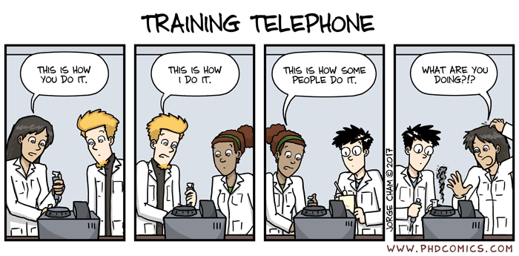
Research Practice Training – what’s needed
We work with key stakeholders (researchers, managers, professional services staff) to develop and support Research Practice in the University.
Research Practice is the approaches by which researchers plan, design, execute, and report their research work.
We need to:
1. Inform researchers and demonstrate what good research practice is => Training, resources, ...
2. Make it easy for them to do good research practice as part of their normal work => Support, tools, infrastructure, reward, recognition, policies, guidance, …
Research is complicated, and there is no “one-size-fits-all” solution.
We need to ensure that all researchers feel supported and valued.
IRCC INTERNATIONAL RESEARCH CULTURE CONFERENCE I 25th Sept 2023

Slide 7
Research Practice Training Modules and Topics
1. Research Integrity & governance
2. Open research practices
3. Research design
4. Collaboration
5. Data
6. Authorship, Publication and Peer review
7. Research impact and Public Engagement
  Questionable research practices, misconduct
  Conflict of interest
  Best-practice guidelines (e.g., for systematic reviews/meta-analysis)
  Clinical trials, clinical research and research governance
  Ethics (human and animal) and risk-assessment
  Protocols and methods
  Code
  Materials
  Qualitative open data analysis
  Experimental design
  Statistics
  Pre-registration and/or registered reports
  Systematic reviews
  Reporting guidelines
  Trusted research / NISA
  Collaborative research
  Safeguarding
  Mentoring
  Working with a research supervisor or leader
  Data Management Plans
  Storage and sharing of data (live, archived, …)
  Software
  Open data and FAIR
  Electronic research notebooks (aka E-lab notebooks)
  Licensing data and code
  Different types of data (qualitative vs quantitative data; artefacts, creative recordings etc.)
  Version control
  ORCID identifiers
  Writing skills
  Negotiating authorship/contributorship
  Getting published
  Use of repositories (preprint, data, software)
  Open Access
  Copyright & licensing
  Research assessment, peer review
  Bibliometrics / responsible use of metrics
  Public engagement
  Planning Impact
  Intellectual property
Modules and topics developed during a 2022 mapping based on pre-existing provision and the training needs identified via a series of 40 interviews across the University
IRCC INTERNATIONAL RESEARCH CULTURE CONFERENCE I 25th Sept 2023

Slide 8
RP core training = accessible, general, informative
Content
Key audience:
New researchers
Across all career stages and disciplines
Training needs to be:
Free to the user
eLearning – can be done at any time
Accessible – screen readers, colour blindness, ability to speed up/slow down content, take breaks
Less than 1 hour
Content relevant across all domains
Completion rates tracked, to monitor engagement
Updateable and version-controlled
Course materials will be made open to other users/institutions once complete.
Is it domain specific?
n
Is it generalisable overview of principles?
y
n
Is it specific implementation methods (e.g. software to do referencing)
y
Core
y
Signpost out from core
IRCC INTERNATIONAL RESEARCH CULTURE CONFERENCE I 25th Sept 2023

Slide 9
Research Practice Training – core module structure
HOW to do what needs to be done
WHY the information is important
WHAT the information is
The core training modules are:
WHAT the key principles are
WHY researchers should care about these principles
The modules will also link to a “Further information” page, which will provide links to other, more detailed and discipline-specific training (in Oxford and beyond), factsheets, other resources etc.
= the HOW to do the things
IRCC INTERNATIONAL RESEARCH CULTURE CONFERENCE I 25th Sept 2023

Slide 10
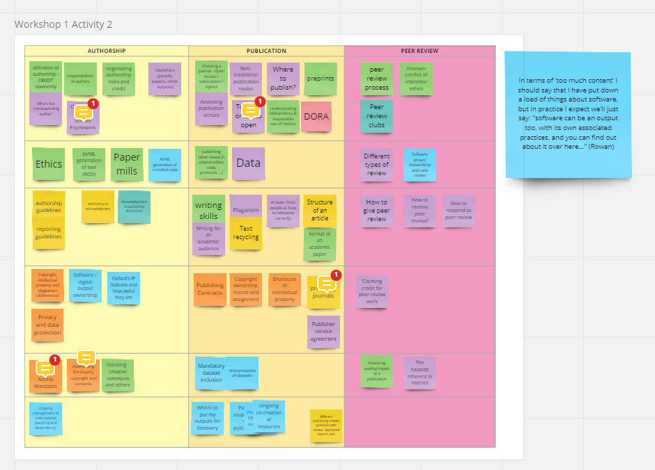
Module content development
Experts in each module are invited to join small working groups to develop the course content.
These groups:
have a 1 hour virtual workshop to brainstorm module content
provide guidance on the syllabus created based on the brainstormed content
provide information about existing courses and materials already available
are responsible for reviewing and updating the content on a set schedule
Content from the workshop is expanded then used to build the course in Canvas.
Example output from Authorship, Publication and Peer Review workshop in June 2023
IRCC INTERNATIONAL RESEARCH CULTURE CONFERENCE I 25th Sept 2023

Slide 11
Research Practice Training – external resources
How do we decide which courses/resources go on the “Further information” page?
Developed course criteria to suggest “recommended” and “available” courses, e.g.:
Accessible to everyone = recommended
Restricted to limited audience = available
We don’t want to re-invent the wheel – there are a lot of good courses and materials already out there, licensed for reuse.
Our materials will have a focus on “How to do things in the University of Oxford” to make them useful for our researchers.
More general content will be useful for other institutions.
HOW to do what needs to be done
WHY the information is important
WHAT the information is
IRCC INTERNATIONAL RESEARCH CULTURE CONFERENCE I 25th Sept 2023

Slide 12
Criteria for external (non core) courses/materials
Criteria for external (non core) courses/materials | Recommended | Available | Unlikely to be recommended
Cost | Free for users | Relatively small charge by providers | Chargeable to users by providers
Accessibility | Available online to Oxford staff and students | Human-led at specific times (e.g. webinars that aren't recorded) | Requires significant travel to in-person training site
 | Flexible start and end times | in person, in classroom training, local to Oxford | Ad hoc or irregular provision
 | Accessibility as standard (e.g suitable for screen readers) | Only available to certain researchers (e.g. from certain Divisions or Departments) | Poor accessibility standards
 | Clear definition of audience and learning objectives before signing up
Scalability | No restrictions on number of users able to take the course | Number restrictions about what we anticipate our usage, or can be fairly easily adjusted | Significant competition for limited places
Evaluation | Course has method for users to provide feedback | Course has method for users to provide feedback | No mechanism to provide feedback
Length | Determined by course content | Timetabled, with breaks | Longer than 1.5 hours without breaks
 | Sufficient breaks
 | Ability to start and stop at will
Sustainability | Already existing mechanism for updating content |  | Materials not updated, version controlled or dated
 | Has version control
 | Course is date-stamped
Quality and credibility | Signed off and/or recommended by core group of experts/small group members | Provided by well-known or credible training provider | Provided by unknown provider
Usage metrics | Integrated into existing systems so we can access common reports for sign up and completion numbers | Has ability to provide sign up and completion numbers from a different source | No ability to track usage
Content | Clearly identifies course content by type/domain/implementation |  | Very specific training on very specialised content
 | Expands on core module content
 | Suitable for early career researchers/Dphil students/new postdocs
IRCC INTERNATIONAL RESEARCH CULTURE CONFERENCE I 25th Sept 2023

Slide 13



What happens after the training modules?
There is A LOT of training available in the University on Research Practice
  We don’t want to duplicate effort or reinvent things
  We do want to signpost to pre-existing training
  We do want to tap into existing expertise
We will guide researchers to appropriate training and resources
  Common communications to let people know what is available, where it is, how to use it
  Promote and embed training in Divisional websites, processes, inductions, etc.
We also need metrics to evaluate how useful the training and communications are – ties in with REF 2028
We want to work with training experts and wider stakeholders to develop research practice training and knowledge
https://twitter.com/errantscience/status/1459442316020748301
IRCC INTERNATIONAL RESEARCH CULTURE CONFERENCE I 25th Sept 2023

Slide 14
THANK YOU
sarah.callaghan@admin.ox.ac.uk
@sorcha_ni

