Slide 1

Enhancing research culture through an interdisciplinary “Team Research” training and development programme pilot
IRCC 2023, The University of Warwick
Ruth Norris , Team Research Co-Lead
Operational Director, Pankhurst Institute for Health Technology
The University of Manchester
@TeamsBuild #teamsbuilddreams
Notes:
(1) Background
Our presentation will describe the experience and findings of piloting a Team Research training and development programme in a university to improve research culture. The Team Research Programme (TRP) delivered two workstreams: WS1: Awareness and Knowledge Building & WS2: Dissemination and Impact. We will describe these activities; discuss workshop results; and share our planned next steps. We will present our experience of shaping and delivering the programme; a description of our activities including awareness raising; co-creation of a definition of Team Research; community building; training; results from our community workshops; and plans for the next delivery phase.
*Nb. the term Team Research can be considered equivalent to Team Science/interdisciplinary collaboration.
(2) Findings
We found that the community was engaged and receptive to the Team Research Programme and positive about the benefits of interdisciplinary working and Team Research (TR) principles, whilst recognising that a range of challenges face its full implementation and application, including a range of training and capability building. We also identified that challenges to the use of the TR model can include different cultures and languages across disciplines; systemic processes and structures such as credit share and promotions criteria.
(3) Discussion and Next Steps
The pilot phase of the TRP showed that a TR training and development programme is seen by the community as valuable in improving research culture; that attitudes towards the TR model are positive; and that considerable further community work is required in the areas of awareness raising and capability development in order to have impact at scale. We plan to build upon Phase 1 with a programme including: a training suite for all the community (academic and non-academic and PhD - Professor); online toolkit; micro-funding schemes to pump prime connections, networking, relationship building and community events; and how to evaluate impact of the programme.

Slide 2
Summary
How we got here
Phase I
Team Research Animation
Workshop findings
Phase II

Slide 3
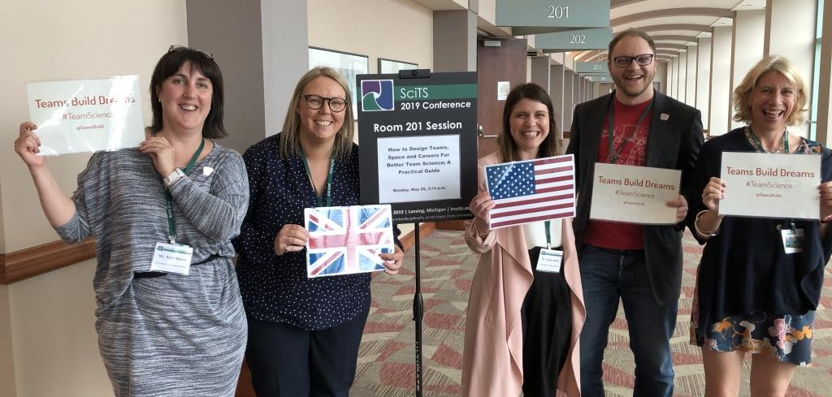
How we got here
Snowball - small investment to attend a conference:
Science of Team Science (SciTS) Conferences:
2018: 4 people; 1 talk
2019: 7 people; 6 talks, 1 workshop, TWO prizes
2023: 3 people; 1 workshop, 1 talk

Slide 4
A Team Research Programme
Our aim is to increase awareness of the Team Research (Team Science) interdisciplinary model and its value to research and culture, by providing a suite of training and development activities.
Delivered in Phase 1 (22/23):
WS1 Awareness and Knowledge Building:
Survey, Workshops, Definition, Toolkit development, relationship building, brand identity - GRAB ME FOR A BADGE!
WS2 Dissemination and Impact:
Knowledge-Exchange and network building (Newcastle, N8), Animated film, Train the trainer), SciTS Conference 2023: Workshop and talk; rising stars support.
‹#›

Slide 5
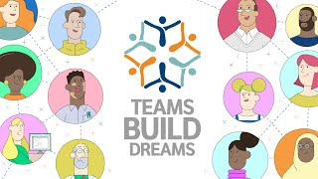
Team Research Animation

Slide 6
Workshop Results
Benefits
Increases fundability
Better Culture - rewarding, enjoyable; autonomy; collaborative, less hierarchy, better relationships
Better Research: more complex qs are answerable; enables translational rsch; more efficient; all stakeholders, impact
Recognition: individuals acknowledged, diverse skills recognised; allows researcher outputs across fields “Giving people wings”

Slide 7
Workshop Results
Challenges
Team dynamics
Different cultures, approaches, language, WoW, competition
Funding: lack of; variability across funders
University processes/structure: academic vs nonacademic, JDs; centralisation; geog; space; faculty/funding systems
Training; networking; facilitating and maintaining connections
Recognising contributions of individuals
Hierarchy, individualism, resistance to change: status quo beneficial; not incentivised (promotions; credit; paper metrics)
Lack of time
‹#›

Slide 8
Workshop Results
Solutions
Connections: create links; connect people; networking; colocation community building activities and events
Framework Developments: recognition, credit share, flexible promotion, from output to impact focus.
Collaborative, inclusive interdisciplinary culture/framework
Training: toolkits
Understanding motivators: recognition/reward needs
Communications: promoting the benefit; senior advocacy
Career Pathways: workforce and contract development
Ways to measure these ways of working

Slide 9
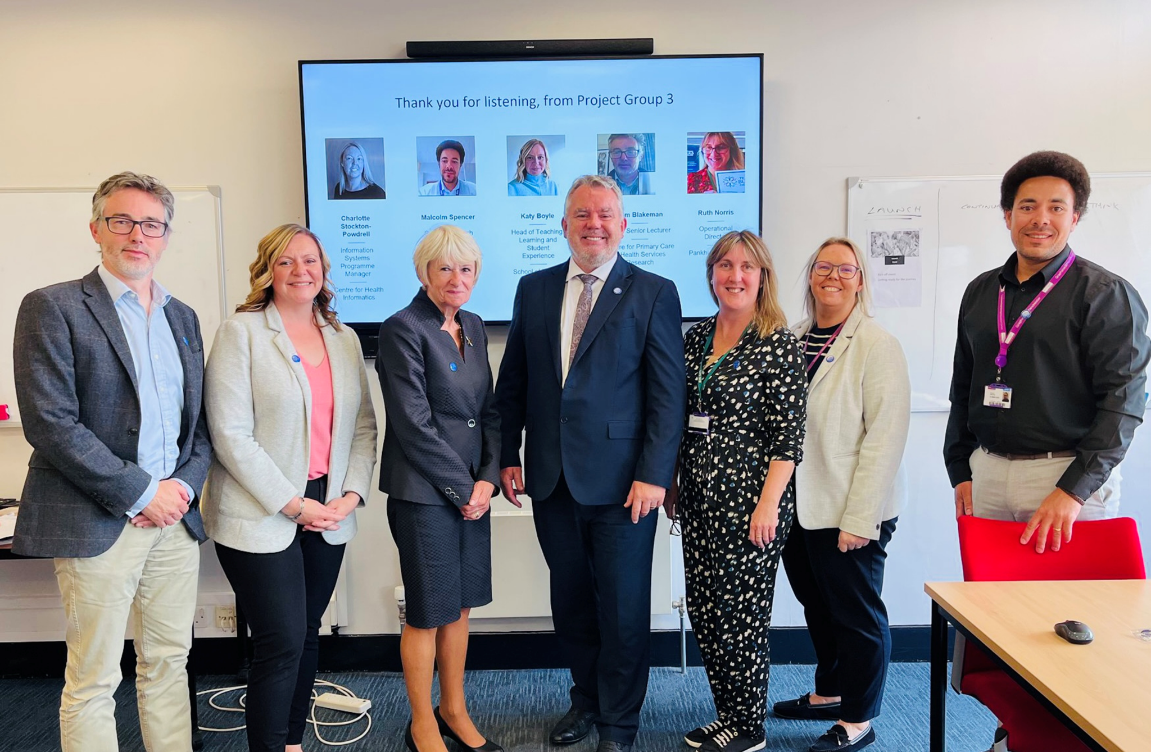
And Next…
Phase 2: (2023-2025)
Launch ***NEW*** website and toolkit
Rollout Training Programme
Widen participation, awareness, capability
Case study library
Impact evidence strategy
International Collaborations
Conference
‹#›

Slide 10
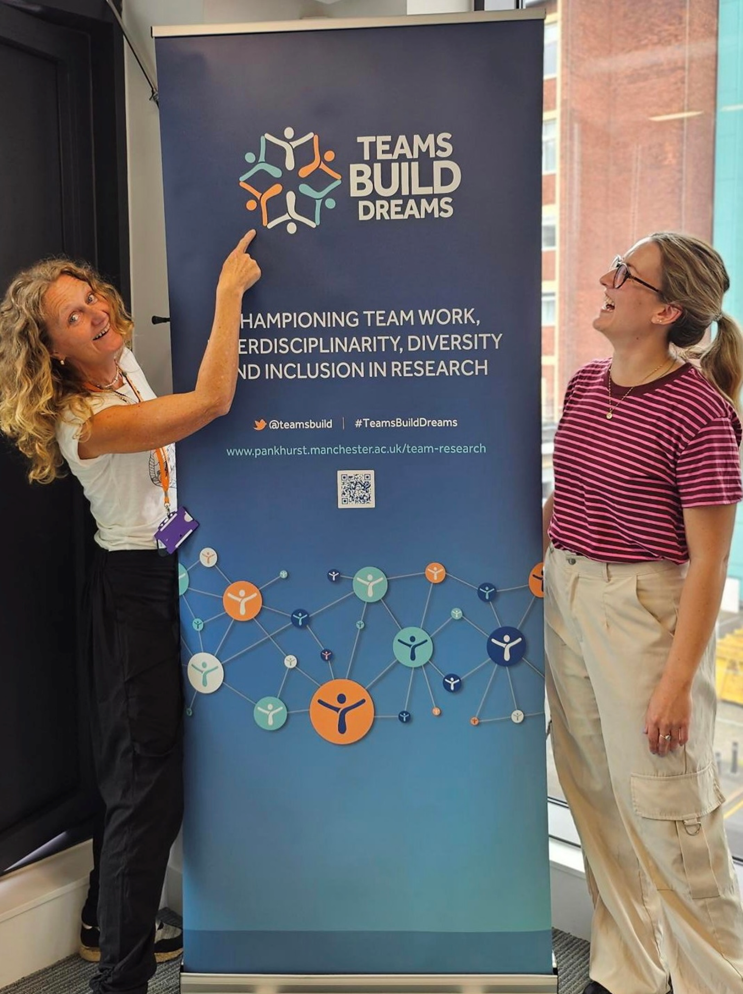
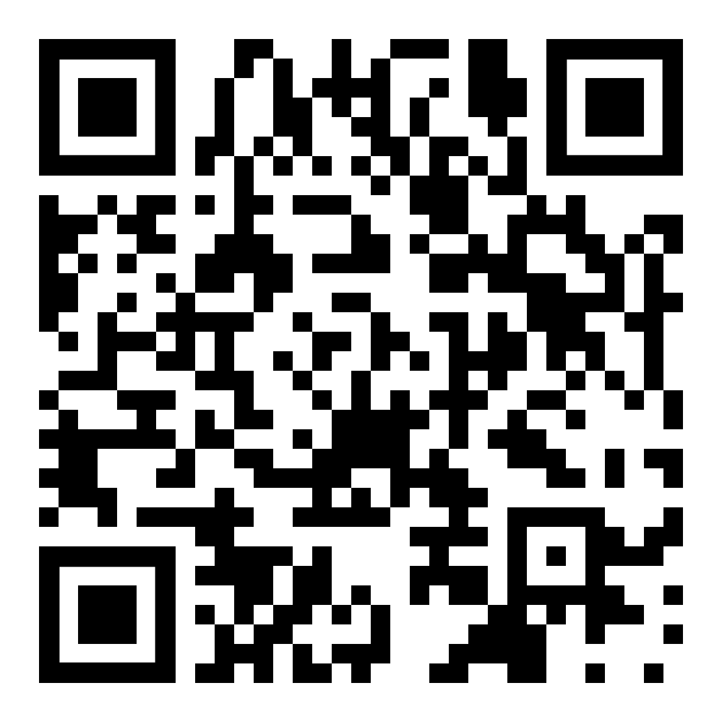

Thank you.
We’d love to keep talking…
TROT@manchester.ac.uk
Ruth.Norris@manchester.ac.uk
@TeamsBuild #teamsbuilddreams

