Slide 1


Slide 2

Data-Driven Insights for a Holistic Understanding of the Researcher's Journey
Maria Prince - Impact Manager, Ulster University
Ann Campbell - Technical Solutions Manager, Digital Science
25th September 2020

Slide 3
Introduction
Maria Prince – Impact Manager, Ulster University
  Oversees Strategic Impact Development & Support Provision
  Co-Investigator on Ulster AHRC Impact Accelerator Account
  Joined UU in 2013. Roles include Operations Manager in spinout Tactility Factory and research Co-Ordinator for the Transitional Justice Institute
  REF Survivor
Ann Campbell – Technical Solutions Manager, Digital Science (Ex. UU)
  Specialist in Data Extractions, Integrations & Solutions
  16 Years Managing Core Systems & Data Integration in University Sector
  Working knowledge in using Quantitative Data to Evidence Impact across EDI Initiatives, Research Culture, and SDG Research.
  REF Survivor
IRCC INTERNATIONAL RESEARCH CULTURE CONFERENCE I 25th Sept 2023

Slide 4
The Problem – Hierarchy versus Network
Research & Impact
Research
Development
Research
Management
Research
Performance
Research
Ethics
Impact & Innovation
IRCC INTERNATIONAL RESEARCH CULTURE CONFERENCE I 25th Sept 2023

Slide 5
The Problem – Hierarchy versus Network
Teaching & Learning
Global Engagement
Equity, Diversity & Inclusion
Research & Impact
Research
Development
Research
Management
Research
Performance
Research
Ethics
Impact & Innovation
IRCC INTERNATIONAL RESEARCH CULTURE CONFERENCE I 25th Sept 2023

Slide 6
The Problem – Hierarchy versus Network
Horizon Scanning Data
Project Costing
Research Management System
Applications Data
Grants & Awards Data
Ethical Approvals Database
Ethical Applications
Research Management System
Research Output and Publication Data
Citation Data
Activities
Collaborations
Impact Tracker
Policy Citation Data
Patent Citation Data
Research
Development
Equity, Diversity & Inclusion
Research
Management
Researcher Demographic Data
Research
Ethics
Teaching & Learning
Curriculum
and Pedagogy
Research
Performance
Global Engagement
Impact & Innovation
Global
Partnerships
IRCC INTERNATIONAL RESEARCH CULTURE CONFERENCE I 25th Sept 2023

Slide 7

The Problem – Data Everywhere
Impact Tracker
Research Management System
CRM
System
Ethics Database
Altmetric Attention Tracker
Citation / Bibliometric Database
HR
System
40% Female Academics
Research Information System
401 Publications
Up 14%!
10% more grants this year!
10 Low-Income Country Collaborations in 2020
IRCC INTERNATIONAL RESEARCH CULTURE CONFERENCE I 25th Sept 2023

Slide 8


The Vision – A symphony of Data!
Ethics / Research Integrity Data
HR System
Citation, Attention, Collaboration Tracking
Research Area, Faculty, School, Researcher Profile
Research Information System
Research Management
System
IRCC INTERNATIONAL RESEARCH CULTURE CONFERENCE I 25th Sept 2023
IRCC INTERNATIONAL RESEARCH CULTURE CONFERENCE I 25th Sept 2023

Slide 9

The Vision – Interconnected Data…. Telling a Story
Fostering Equity, Diversity and Inclusion
Supporting Researchers at ALL Career stages
Crafting a Detailed Research to Impact Map
10% rise in publications by ECR’s, aligning with increased interdisciplinary collaborations…
15% year-on-year improvement in Data Availability Statement and Author Contribution Statements aligning with targeted mentorship programmes…
20% rise in Global Collaborations for ECRs…
Increased retention rates in ECR’s from diverse backgrounds
IRCC INTERNATIONAL RESEARCH CULTURE CONFERENCE I 25th Sept 2023

Slide 10
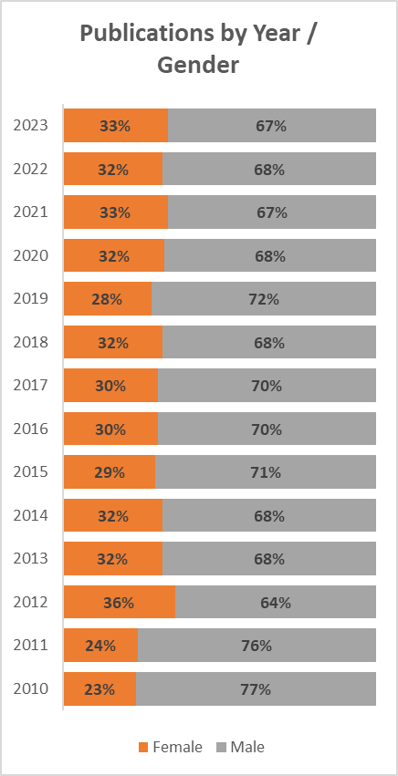
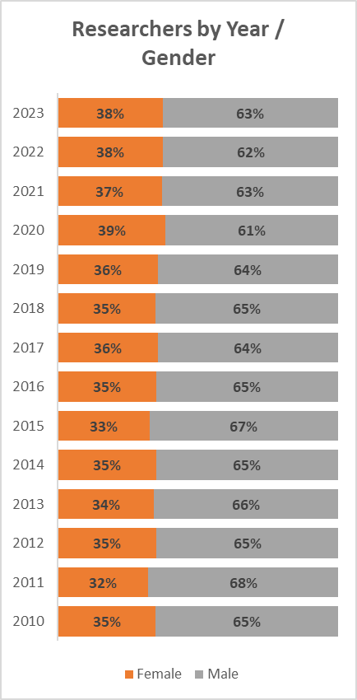

Getting Started…
What matters most?
What are our drivers?
Who are we aligning with?
  REF
  Athena Swan
  Diversity Mark
Data Source: UU Data & Dimensions
IRCC INTERNATIONAL RESEARCH CULTURE CONFERENCE I 25th Sept 2023

Slide 11
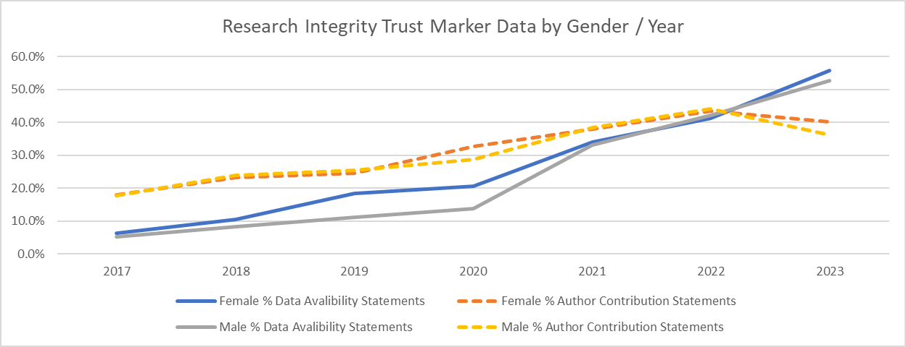
There is more than one Agenda…
Open Research Data
  Transparency
  Trust
Data Source: UU Data & Dimensions
IRCC INTERNATIONAL RESEARCH CULTURE CONFERENCE I 25th Sept 2023

Slide 12
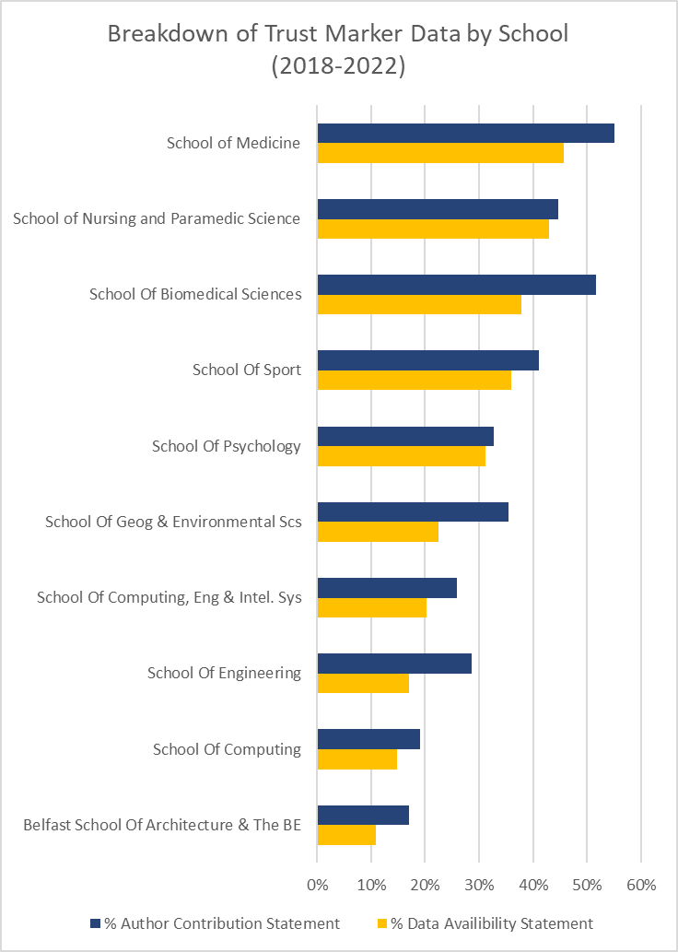
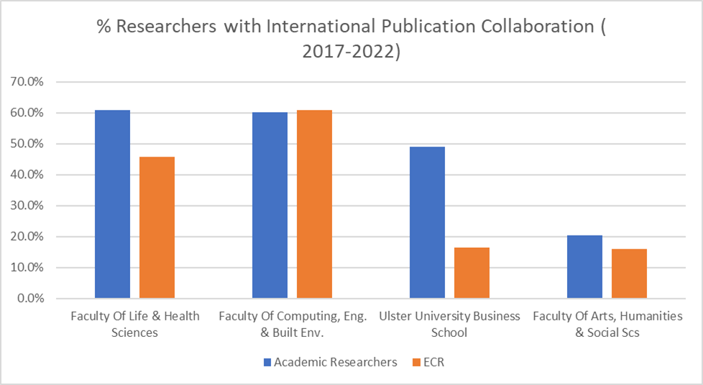
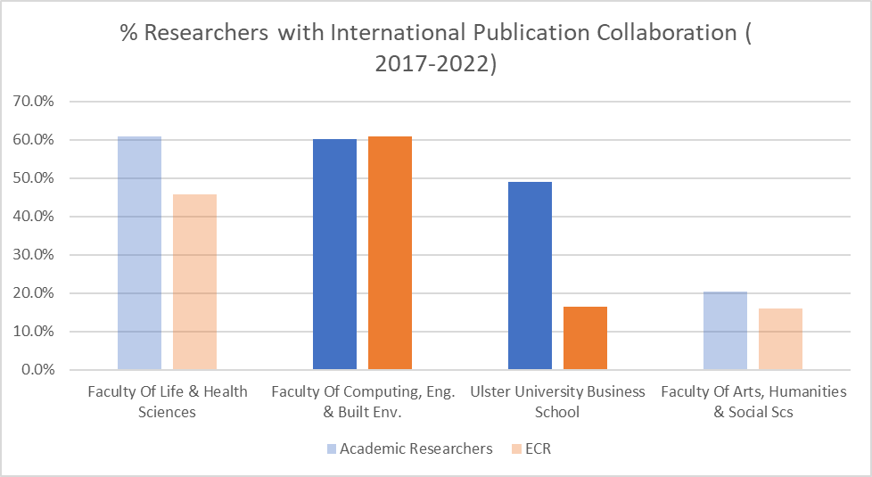
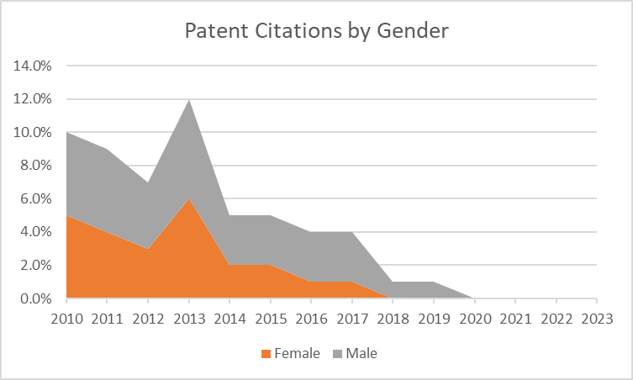
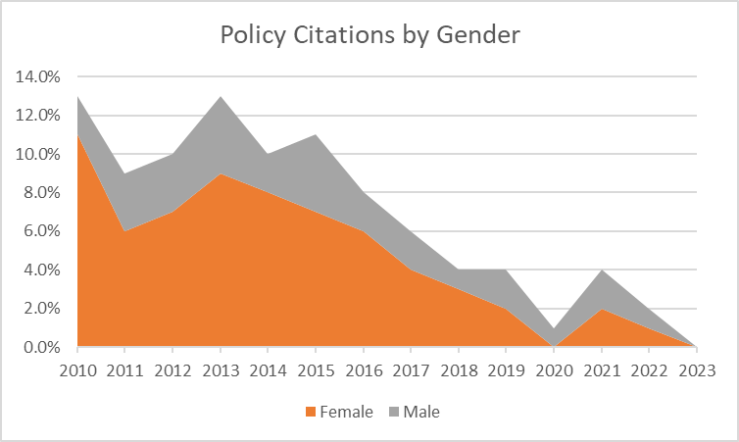
There is more than one Agenda…
Increased Collegiality
IRCC INTERNATIONAL RESEARCH CULTURE CONFERENCE I 25th Sept 2023

Slide 13
THANK YOU
Questions

