Slide 1


Slide 2

Research Culture: A Technician’s Perspective at the University of Warwick
Dr Sarah Bennett, Research Facility Manager
Dr Ian Hancox, Director of Research Technology and Technical Strategy
Catrin Harris, Research Fellow for Talent project

Slide 3
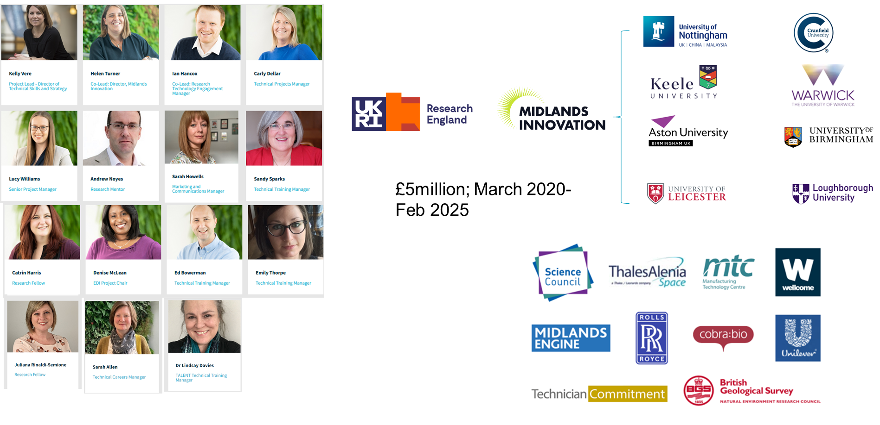
Intro to MITalent
IRCC INTERNATIONAL RESEARCH CULTURE CONFERENCE I 25th Sept 2023

Slide 4
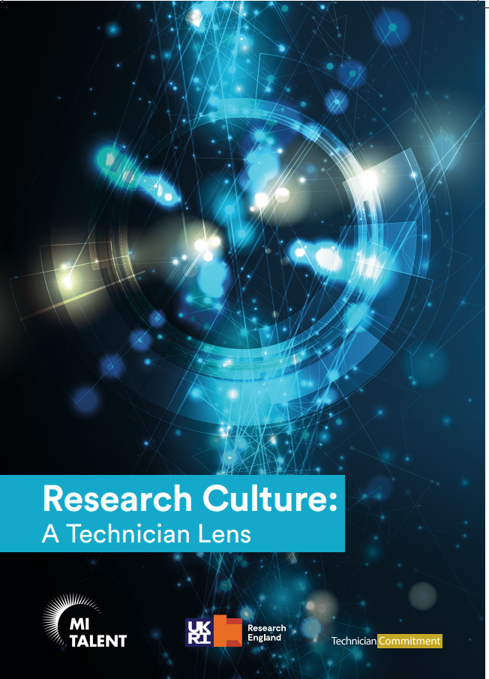
Research Culture: A Technician Lens
Published September 2022​
Explores issues in research culture from technicians’ perspectives​
Evidence gathering:​
Survey of technical staff​
Survey of non-technical staff and students​
Focus groups​
Six recommendations for improving research culture for technicians (and the wider community)
IRCC INTERNATIONAL RESEARCH CULTURE CONFERENCE I 25th Sept 2023

Slide 5
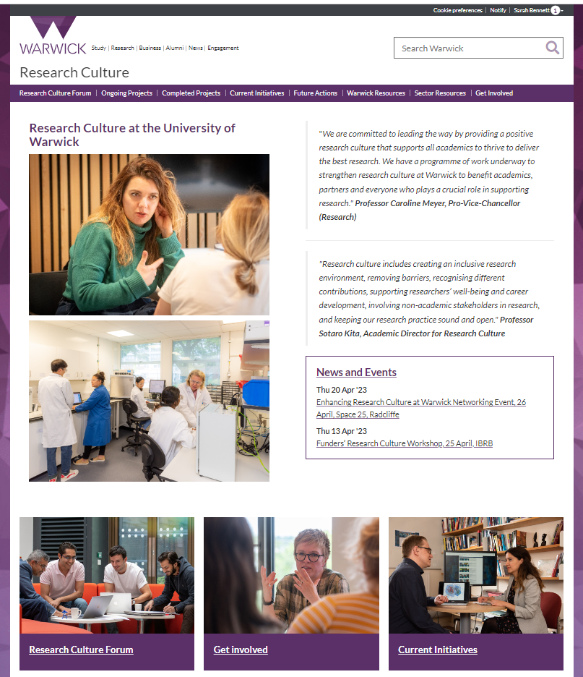
The six recommendations:
1. University initiatives to improve RC should include technicians
Technical representation on:
UoW Research Culture (RC) Forum
Institutional Research Committee
Funding for grass-root RC projects are open to technicians (from Research England’s Enhancing Culture Fund)
Technician focused projects have included:
Advancing Visibility, Knowledge and Collaborative Opportunities for Research Technical Professionals
Technician Led Outreach Demonstrators
Creating and Supporting Shared Scientific Resources
IRCC INTERNATIONAL RESEARCH CULTURE CONFERENCE I 25th Sept 2023

Slide 6
Example of a technician led RC grass-root project:
Creating and supporting shared scientific resources
Benefits:
Specialist technical support of instrumentation ensures greater research integrity (rigour and transparency)
Promotes open research practices
Barriers:
Financial and technical
Typically, only considered for high-end instrumentation
Recommendations:
Institutes - establish an expectation that instrumentation should be shared and provide funding to support
Funders – specific questions on instrument use, access and sustainability
IRCC INTERNATIONAL RESEARCH CULTURE CONFERENCE I 25th Sept 2023

Slide 7
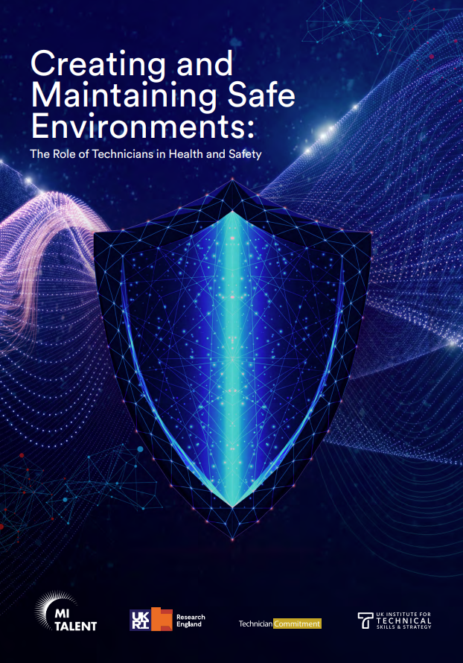
The six recommendations:
2. Technical staff should be credited appropriately on research publications and outputs
University of Warwick - Fair attribution policy (https://warwick.ac.uk/research/technicians/fairattribution/)
3. Project leads should recognise the importance of technicians in their projects, ensuring inclusion at all stages
University of Warwick – grant tracking system, input from technical specialists
4. Increased recognition for the fundamental role technicians play in H&S
Inclusions of technicians in more H&S committees / roles than before
Talent Health and Safety report
IRCC INTERNATIONAL RESEARCH CULTURE CONFERENCE I 25th Sept 2023

Slide 8
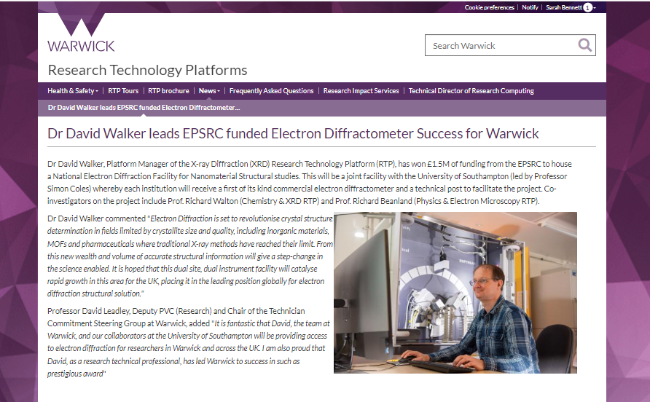
The six recommendations:
5. Departments should enable opportunities for technical staff to be considered as PIs and CoIs on internal and external grants
Funders – Research Technical Professionals (RTPs) are allowed to submit a grant as a PI or CoI
UoW Technician-led grant success:
Over £2.5 million awarded from EPSRC, MRC and BBSRC for technician-led equipment bids
~£1 million EPSRC funding with RTP focus
Internal bids are frequently open for technicians to apply to
IRCC INTERNATIONAL RESEARCH CULTURE CONFERENCE I 25th Sept 2023

Slide 9
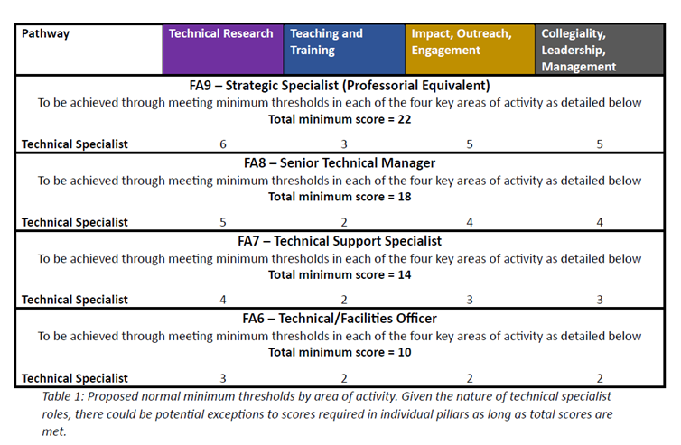
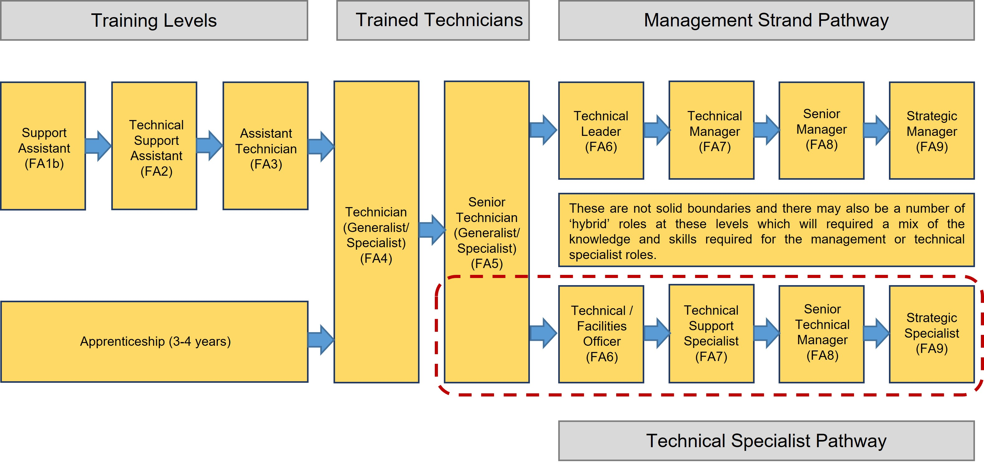
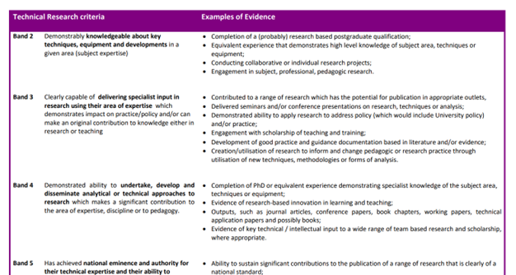
The six recommendations:
6. There should be a clearly defined career pathway, both managerial and specialist routes. Plus professional development opportunities
IRCC INTERNATIONAL RESEARCH CULTURE CONFERENCE I 25th Sept 2023

Slide 10
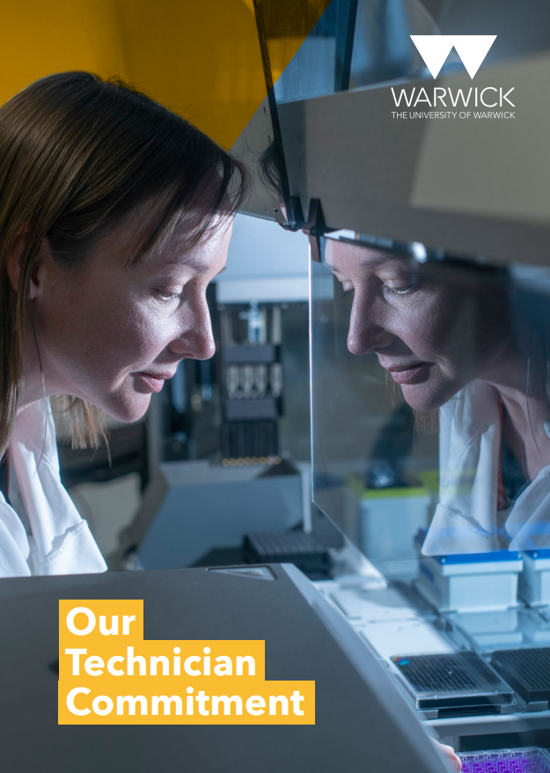
Need to be inclusive of technical roles when considering research culture
Some unique challenges for technical staff but also overlap with similar roles
Progress made:
A shift in the academic perception of technicians and hierarchy
Increased consideration of fair attribution,
Promotional opportunities – essential to ensure sustainability of this ‘empowered’ workforce
Next steps
IRCC INTERNATIONAL RESEARCH CULTURE CONFERENCE I 25th Sept 2023

Slide 11
THANK YOU

