Slide 2
Identifying Metrics for Assessing Research Culture​
Dr Shareefa Fadhel, Dr Gaynor Miller, Prof Cat Davies​
Research and Innovation Services​
University of Leeds​
25 September 2023​
Notes:
Good afternoon, everyone, and thank you for the opportunity to share with you our process on how best to measure the changes we want to see. After much consultation and discussion on the motivations and hazards of measuring, we now come to the crunch: Which facts and figures can best evidence that we’re enabling more UoL colleagues to produce leading research inclusively, equitably, openly, and supportively?​
​
This was a collaborative and team effort as with all other research culture teams in higher education. I am joined today by our research culture dean, our research culture manager, and our research development team members, thank you all for being present here.​
​

Slide 3


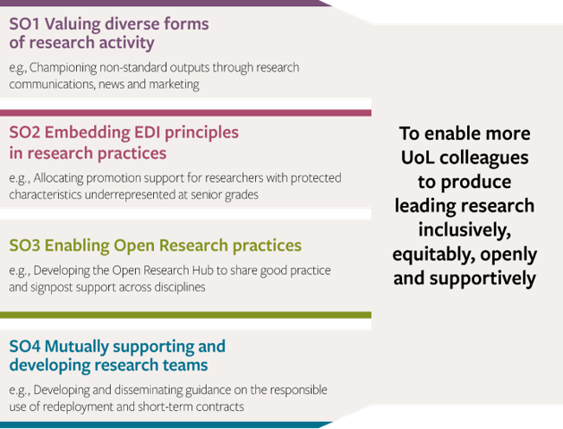
Text hierarchy and formatting with an image slide
Notes:
​
The need for change has been amplified in the last 5 years or so. Wellcome’s report (What researchers think about the culture they work in) on their large-scale survey was only published in 2020​
​
Locally we’ve become acutely aware of the damage that hypercompetitive individualistic cultures can do to our people and our research.​
​
Leading research can only emerge from a place where:​
colleagues are recognised for their diverse work, ​
where supporting equity, diversity, and inclusion is the norm, ​
where research can be done confidently and openly, and ​
where there is a culture of mutual support. ​
​
an inclusive, open, and supportive RC will achieve:​
improve the quality, impact, and reach of our research​
inspire researchers to effectively respond to current and future global challenges​
enable researchers to develop their careers in ways that are personally and collectively fulfilling​
deliver research-led education that will train and inspire the next generation of global citizens ​
attract and retain the best research teams ​
build trust within our organisation​
eliminate harmful research practices, e.g. exclusion, self-interest, wastage.​
​
Lots to gain, lots to lose.​
​
Research Culture Strategy focuses on progress, not perfection​
we define progress as a continuous journey of improvements fostering adaptability, resilience, and embracing change. ​
The way we measure changes in research culture must be nuanced for context and success relative to where we started.​
Focussing on metrics rather than the change poses barriers to change.​
​
4. Is the substance of the strategy. ​
​
Overarching aim​
​
We will focus our efforts on four strategic objectives (SO) that have been determined by consultation across our research community; different disciplines, career stages, backgrounds, and job families, via our inclusive research culture cafes, committee discussions, and an in-depth external analysis of a 2021 University-wide survey. ​
​
1. Expand conceptions of who is a researcher, what is research, and what is successful.​
2. More representative and robust research.​
3. Collaboration, sharing, and openness – transparency and reproducibility. People need support to do that.​
4. Good research can’t happen without a properly developed workforce, recruited fairly and given time and space to reach their potential. ​
​
15 actions​
​

Slide 4
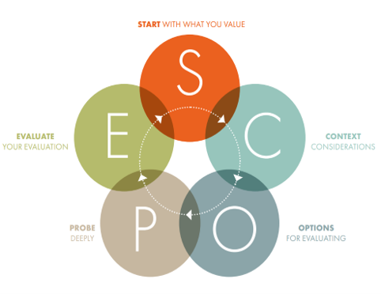
SO1. We will value diverse forms of research activity
SO2. We will embed EDI principles in research practices
SO3. We will enable Open Research practices
SO4. We will mutually support and develop research teams
The SCOPE Framework
RIB away day session (January 23) 85 candidate metrics identified
Coded and then narrowed down by working group to 3-5 for each SO = 16 metrics
Consultative workshop (March 23) narrowed down to 5 metrics
Notes:
To consider the context of our proposed evaluation, we held a workshop with university research leaders, including the Deputy Vice-Chancellor for Research and Innovation, Deans for Research Quality and Postgraduate Research, Pro-Deans for Research and innovation, and Heads of relevant services. In small working groups, we examined what or who we could or should evaluate and why. ​
These open discussions generated a range of ideas on where to focus our evaluation (e.g., grant applicants, research leaders or partners, publishers) and the advantages and risks of doing so. ​
so with the support of our community- our RIB played a pivotal role in identifying 85 metrics​
​
we coded all 85, and with the help of our working group we were able to narrow down to 3-5 per SO = 16 metrics in total that (Coded for specificity, measurability, validity, data availability, co-dependencies, and target thresholds to identify or modify any unfeasible candidate metrics, and to select metrics to take forward for further probing. )​
​
we used the SCOPE framework to guide us through a process of evaluation, selection and rejection process, ​
We probed the benefits and risks of each shortlisted metric, to finally agree on a set of effective, feasible, and acceptable metrics.​
​
A longlist of 85 candidate metrics for measuring culture change across our four strategic objectives was generated in an extended meeting of the Research and Innovation Board on 16/01/23. Members of the research culture team then coded each candidate metric for specificity, measurability, validity, data availability, co-dependencies, and target thresholds to identify or modify any unfeasible candidate metrics, and to select metrics to take forward for further probing. ​
​
For us, the beauty of SCOPE is twofold. First, its principles are squarely in line with our research culture values: ​
​
Evaluate only where necessary, for example where we need to measure change to justify resource (did it work?), or where we are required to do so by external systems such as the REF. ​
​
Evaluate with the evaluated. Our evaluation is co-designed and co-interpreted by the communities being evaluated. We also prioritise monitoring and evaluation of projects rather than measuring researchers themselves. ​
​
Draw on evaluation expertise. We apply the same rigour to our evaluations that we apply to our academic research. ​
​
Second, SCOPE has very clear stages of development, summarised below and in this short​
​
​

Slide 5
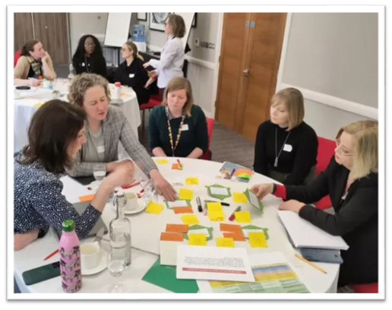
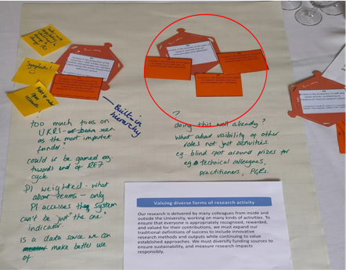
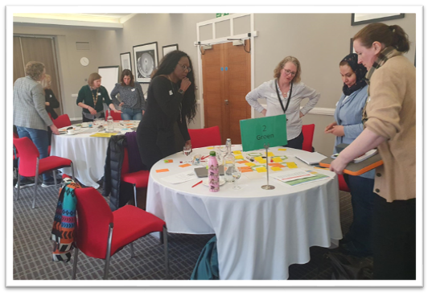
SO1: Valuing Diverse Forms of Research: Metric Selection
Notes:
The was Table 1: Valuing Diverse Forms for​
Research: Metric Selection, first exercise​
The Research Culture Strategy Working Group (RCSWG) then narrowed down the longlist to the top ≈5 candidate metrics for each strategic objective. ​
​
Stage 4 was the focus of our metrics workshop held in March 2023. With members of our Research Culture Steering Group, Research Culture Strategy Working Group, chairs of research culture governance groups, our external consultant Elizabeth Adams, and two external colleagues - Candy Rowe and Nicola Simcock representing Newcastle University’s research culture team - our objectives were: ​
To consider a shortlist of candidate metrics for tracking and evaluating progress in research culture ​
To probe the benefits and risks of each ​
To agree on a set of effective, feasible, and acceptable metrics ​
To allow the research culture team to create a draft implementation plan for the strategy, including short, medium and long-term monitoring. ​
With just three hours to reach these aims, we were expertly facilitated by Christine Bell (Director of the Centre for Facilitation). ​
Four tables were set up to reflect our four strategic objectives, with workshop attendees grouped onto each table.​
To further refine the ≈20 prioritised candidate metrics, each colleague privately chose their preferred metric within each objective and placed it in the centre of the table, allowing a consensus to emerge visually. Then focusing on the two metrics with the most votes, each group probed the selection by discussing the strengths and weaknesses of each. Free-form concerns and reflections on the selections were added to the central workspace. At this point, we had 1-2 strong metrics per objective to focus on, and a rich commentary from multiple perspectives.​
​
​

Slide 6
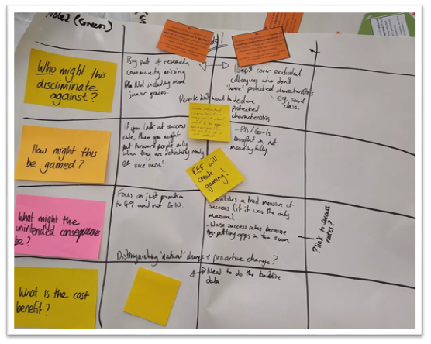
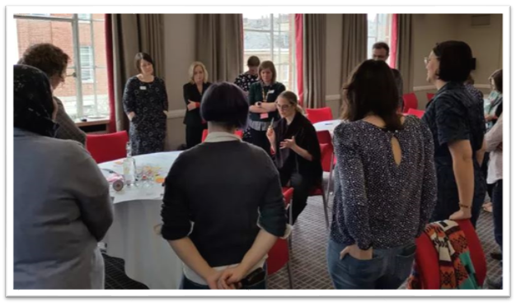
Deeper probing
Notes:
Then came deeper probing. Colleagues used the following questions to stress-test the options and to surface any that would be unusable:​
​
Who might this metric discriminate against? ​
​
How might this be gamed? For example, to achieve more frequent communications about nonstandard contributions, units might report on minor, incremental achievements (aka salami-slicing). ​
​
What might the unintended consequences be? ​
​
What is the cost-benefit? ​
​
These proved to be powerful questions for thinking through the implications of each metric, and in some cases, how any unintended consequences might be mitigated. We were keenly aware that there is no perfect metric, and that each would be a trade-off between data availability, representativeness, and a range of other concerns that had surfaced in the coding stage that we circled back to in this stage. ​
​
We held a roving plenary as a final step. A speaker from each group presented the accumulated reflections on discrimination, gaming, unintended consequences, and cost-benefits. Speaking aloud to the whole group while receiving feedback enabled us to reflect – again – on our selection, and to consider additional perspectives. This gave us confidence that our probing had been comprehensive, endorsing our collaborative choices, as we emerged from the workshop with two solid metrics for each of our four objectives. ​
​

Slide 7
Agreed metrics
Valuing diverse forms of research activity​ | Embedding EDI principles in research practices​ | Enabling Open Research practices​ | Mutually supporting and developing research teams​
Increase in the diversity of the types of research activities that are communicated and celebrated. ​ | Increase in the proportion ofacademic staff (research track only) promotions to Grades 9 and 10 by colleagues with protected characteristics that have previously been under-represented. | Increase in the number and variety of University of Leeds research outputs deposited in institutional research systems | Increase in the variety of staffroles named as PI, CoI and researcher CoI on funding applications. Increase in the proportion of staff stating they have benefited from researcher development programmes, by career stage.
Notes:
Then came deeper probing. Colleagues used the following questions to stress-test the options and to surface any that would be unusable:​
​
Who might this metric discriminate against? ​
​
How might this be gamed? For example, to achieve more frequent communications about nonstandard contributions, units might report on minor, incremental achievements (aka salami-slicing). ​
​
What might the unintended consequences be? ​
​
What is the cost-benefit? ​
​
These proved to be powerful questions for thinking through the implications of each metric, and in some cases, how any unintended consequences might be mitigated. We were keenly aware that there is no perfect metric, and that each would be a trade-off between data availability, representativeness, and a range of other concerns that had surfaced in the coding stage that we circled back to in this stage. ​
​
We held a roving plenary as a final step. A speaker from each group presented the accumulated reflections on discrimination, gaming, unintended consequences, and cost-benefits. Speaking aloud to the whole group while receiving feedback enabled us to reflect – again – on our selection, and to consider additional perspectives. This gave us confidence that our probing had been comprehensive, endorsing our collaborative choices, as we emerged from the workshop with two solid metrics for each of our four objectives. ​
​

Slide 8

Common reasons for rejecting candidate metrics
Proposed measure not yet sufficiently established.​
Proposed metric presents unwanted consequences.​
Proposed metric requires interrogation of too many different sources at present.​
Not clear if an increase or a decrease in the metric would indicate a positive change in research culture. ​
Notes:
1. e.g. recording all instances of Positive Action initiatives across the University.​
2. e.g. measuring only attendance at researcher development programmes may promote attending a greater number but less relevant programmes.​
3. e.g. multiple different platforms for openly sharing data / code. ​
4. e.g. increased reporting of unprofessional behaviour.​
Where metrics have been excluded due to constraints with the current systems for recording and our ability to interrogate these sources, we will review as systems are upgraded. ​

Slide 9
There was no hierarchy; all roles were included with equal voice.
“I found it interesting that we were unanimous at the open research table about what mattered, but also how hard it was to actually measure!”
Metric Workshop Participant Feedback​
Few men – just one of 18 attendees
"This lack is troubling in terms of burden and representation. It reinforces the problematic view that research culture is a more pastoral role championed by female colleagues”.
The importance of an external facilitator.
"It kept us to time and enabled the internal team to fully participate. I also liked the feeding back from each group with a timer to give much needed focus, otherwise you could go round and round”.

Slide 10

Text hierarchy and formatting information slide
Recap and final Remarks
85-16-5
Warning!! it takes a lot of time and effort
But it can be done
Next step is the evaluation part - Wait for my updates next time!
Notes:
Get an external facilitator- ease's the process and helps you get focused on achieving result
Look at different models- SCOPE worked for us

Slide 11
Thank you
Further detail on the University's research culture activities, funding, governance, and a range of resources can be found at researchculture.leeds.ac.uk
For further information, please contact the Research Culture Team, Research and Innovation Service, researchculture@leeds.ac.uk.

