Slide 1

Enhancing Research Culture at Warwick
STEM Connections:
Empowering Researchers to Engage New Audiences
Margaret Low, Phil Jemmett, Caroline Cannon
WMG

Slide 2
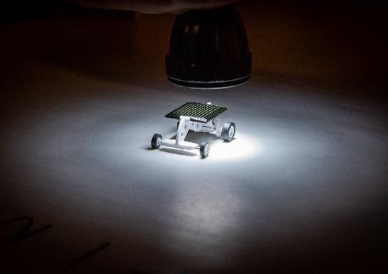
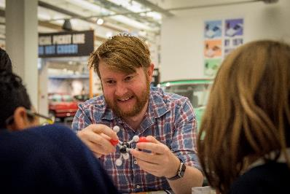
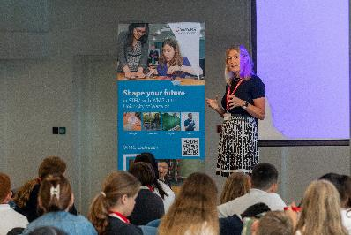
What is STEM Connections?
Empower staff
Create role models
Develop research demonstrators
Visibility for staff
Share expertise
Share STEM Connections model
Notes:
Empower staff so they can share their own research stories with any audience
Address the lack of representation and role models for under-represented groups in STEM
Development of research demonstrators
Visibility for staff through website resources, staff profiles and photographs
Sharing expertise, networking, culture building
Create and share STEM Connections model

Slide 3
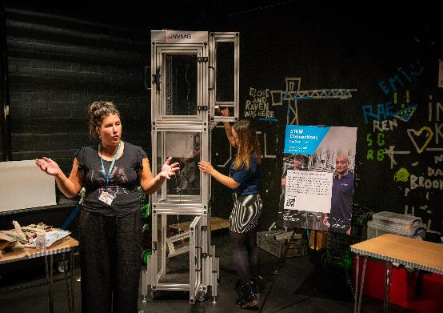

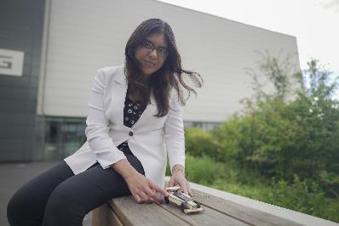


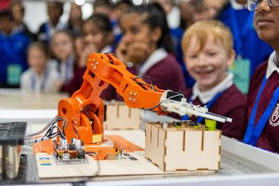

What is STEM Connections?
23 staff involved
900 school students involved
5000 website views
900 video views

Slide 4












The Model
University
Academics
Teachers
Cultural Institution
Stakeholders
Technical support
Schools roadshow
Inputs
Outputs
Training
Showcase
Practice
Demonstrators
Share knowledge
Profile
Notes:
We wanted to work with these people – key stakeholders – diverse set of skills
FOCUS is on collaboration, working to the different strengths of the team.
Authentic experience and quality experience.
Inputs – focus on quality and meaningful experience for the staff,
Model gave them the opportunity to hone their skills
Key outputs / deliverables are

Slide 5
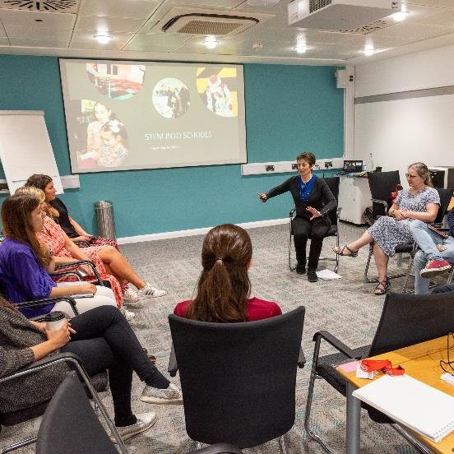
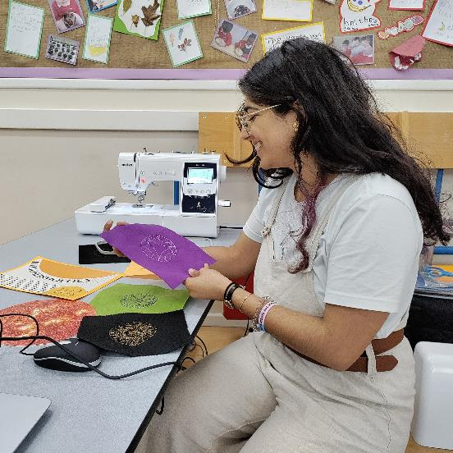
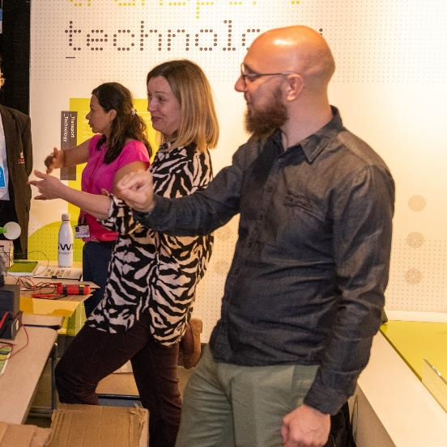
BUILDING SKILLS
Training sessions
Practice sessions in schools
Collaborative environment

Slide 6
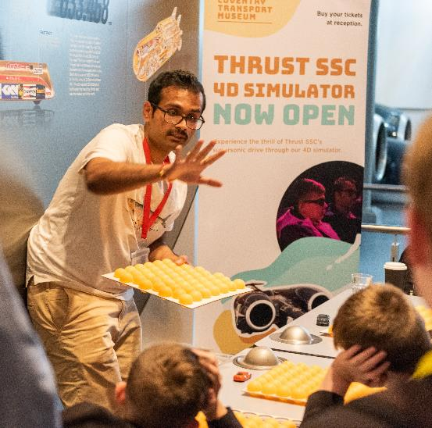
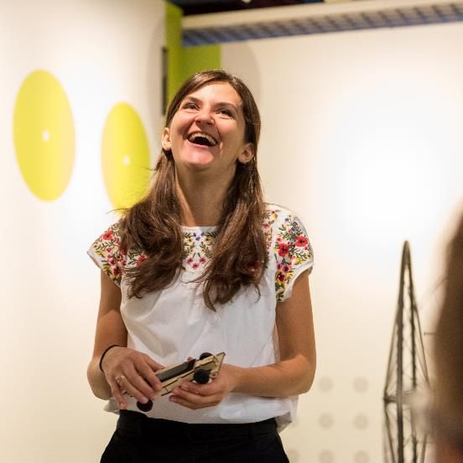
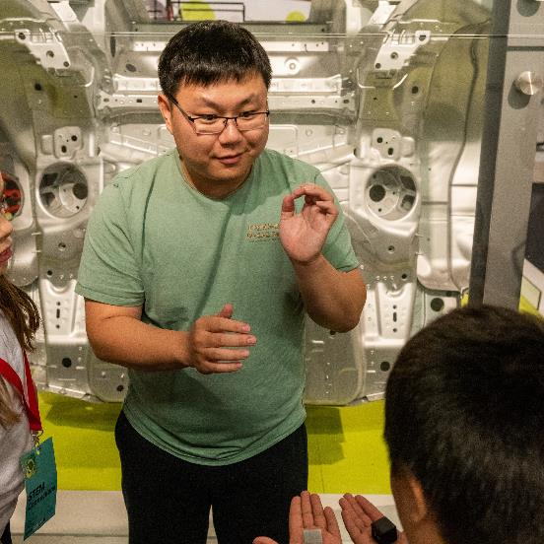
CONFIDENCE AND EMPOWERMENT
Engaging the audience
Enjoying presentations
Presenting to a mixed audience
Notes:
Key thing to highlight on this slide – this project helped staff develop their skills and confidence.

Slide 7
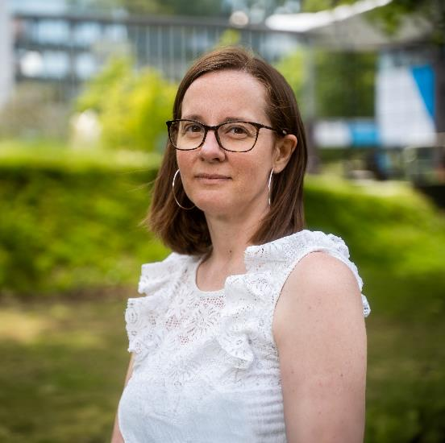
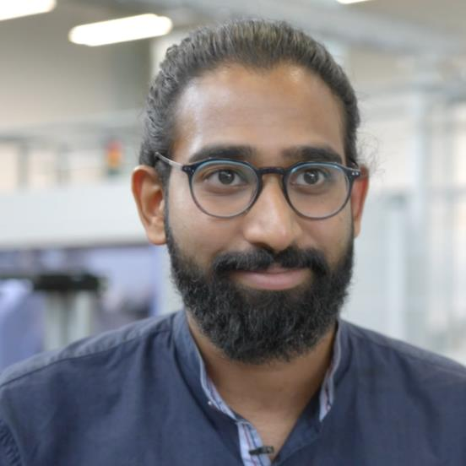
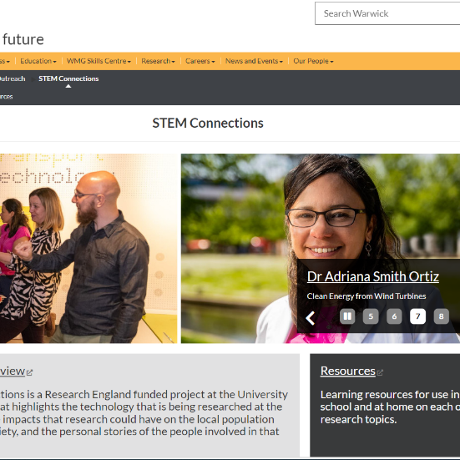
CELEBRATION AND LEGACY
www.warwick.ac.uk/stemconnections
Website screenshot
Profile headshots
Video interviews
Website
Notes:
Key thing to highlight on this slide – outreach is often done and forgotten, this project was all about building legacy of these wonderful staff and their contributions. It is all visible and publicly accessible, and useful to teachers beyond the interactions with role models through resources.

Slide 8
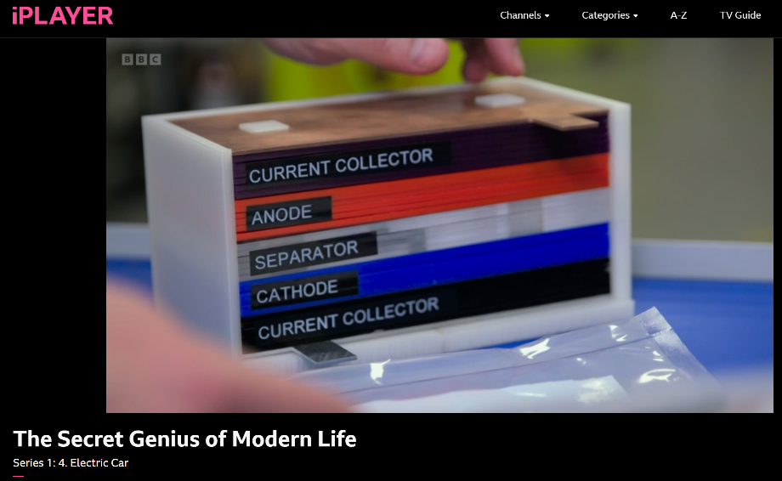
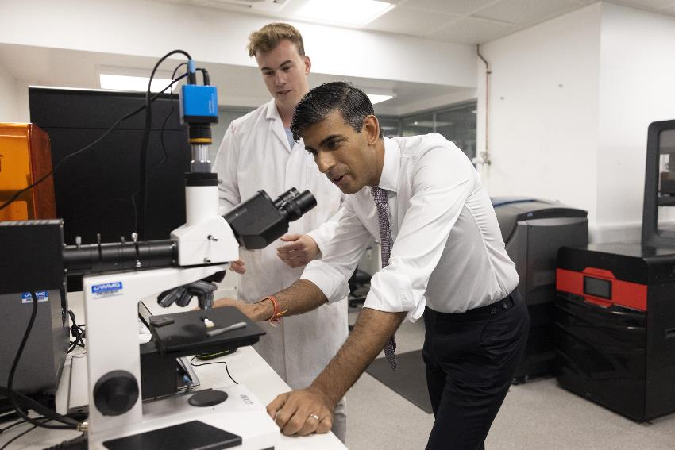
IMPACTS

Slide 9
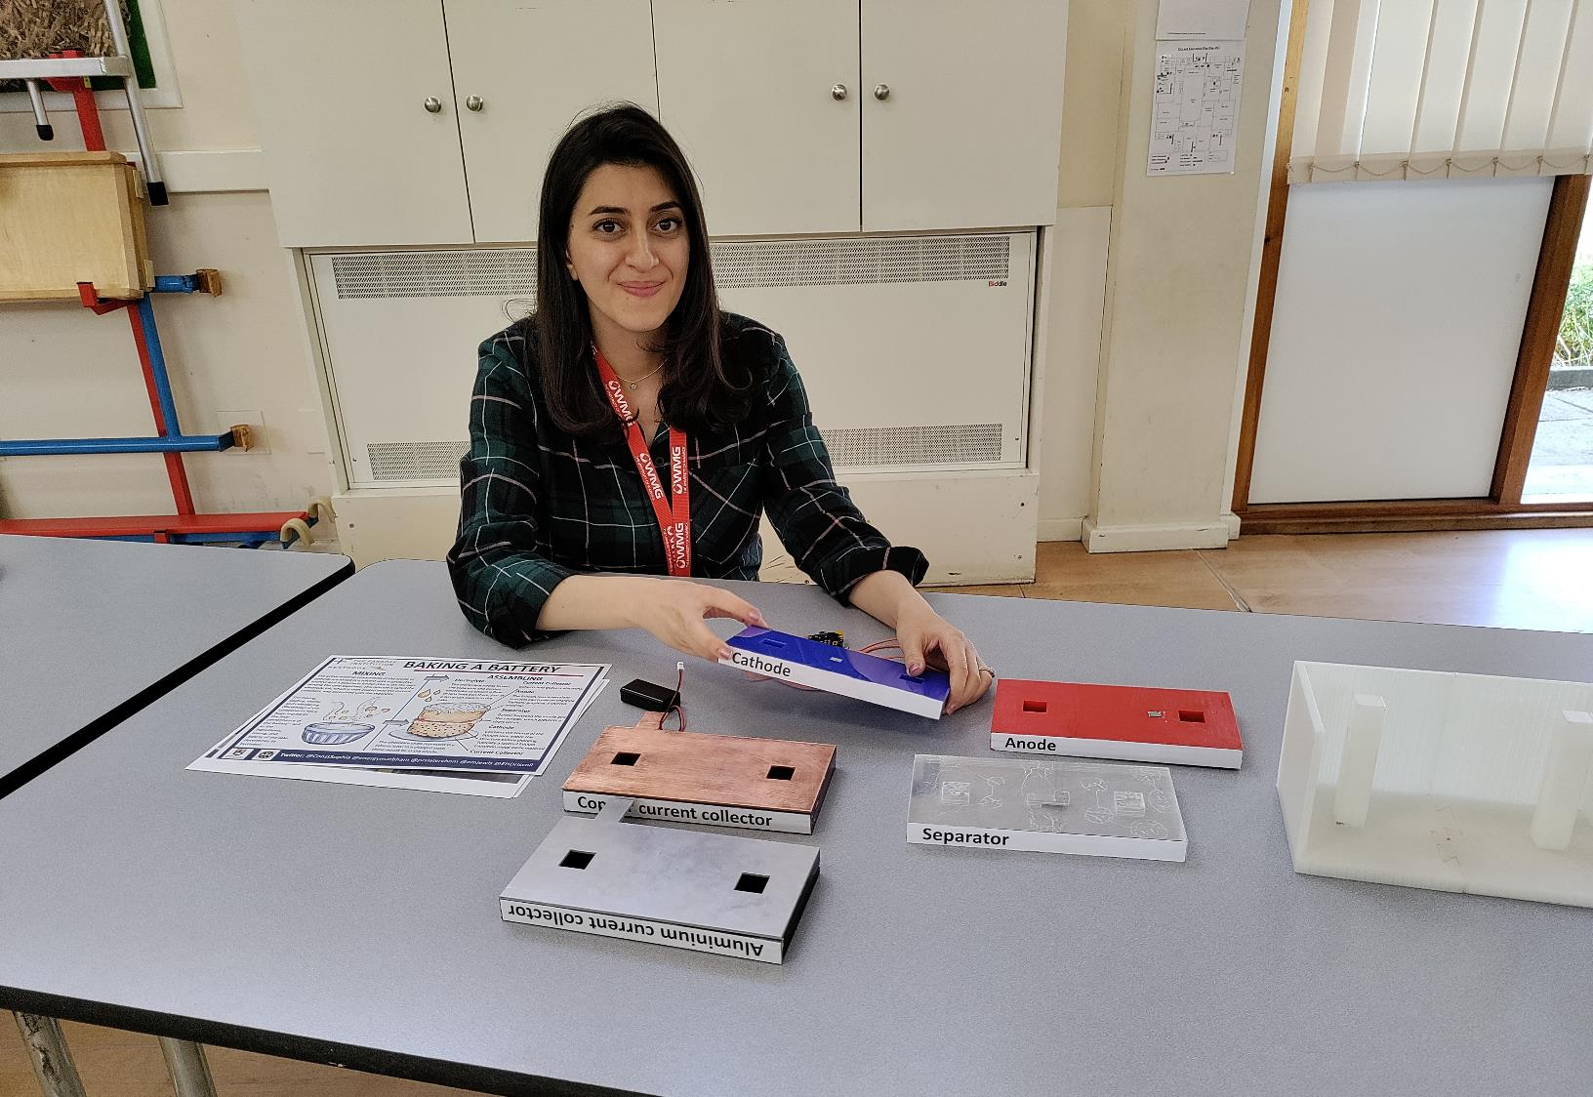
“This is for sure very much needed in the transition to net-zero future for all of us.”
Mona Faraji Niri, WMG

Slide 10
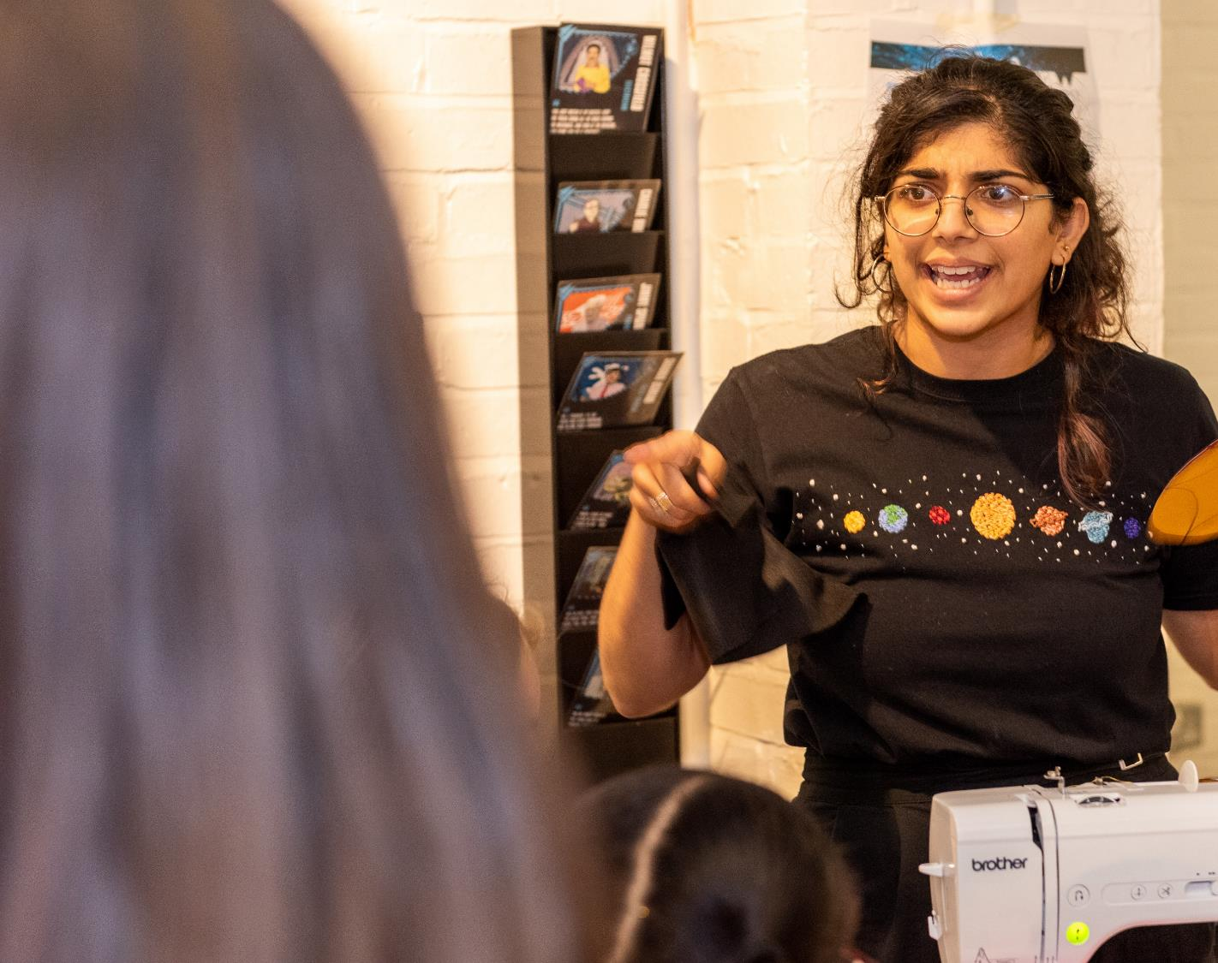
“It was certainly one of the best learning experiences of my Ph.D.
I was able to … see my research have meaningful impact in the local community, and create something I was truly proud of. "
Tishtrya Metha, Physics

Slide 11
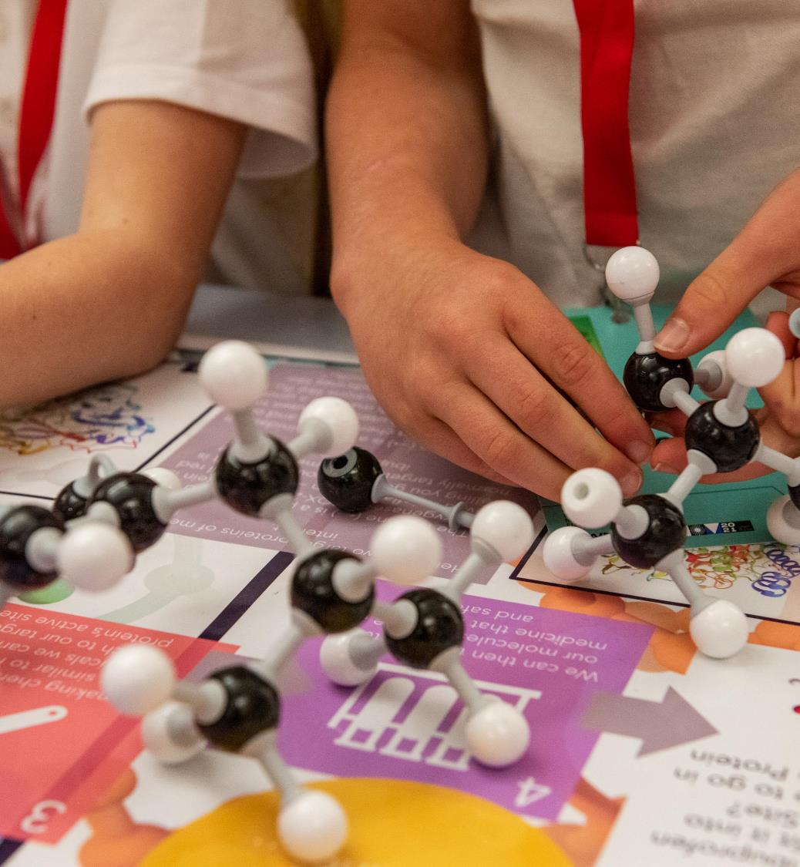
“The STEM Connections project has illustrated what is possible … when we engage technical staff.
“[It] has set the standard on training provision, departmental engagement and engaging non-academic staff.”
Alex Baker, Chemistry

Slide 12
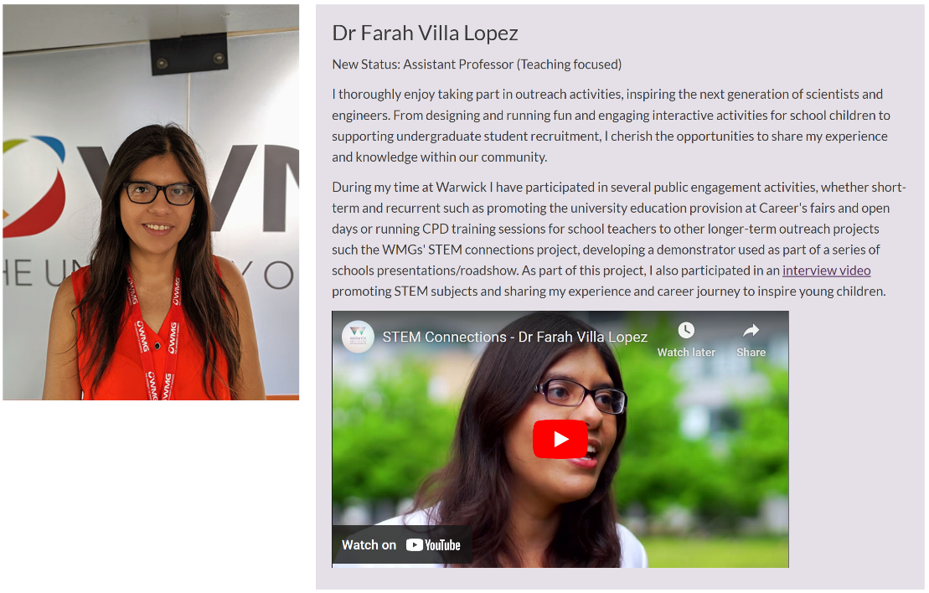
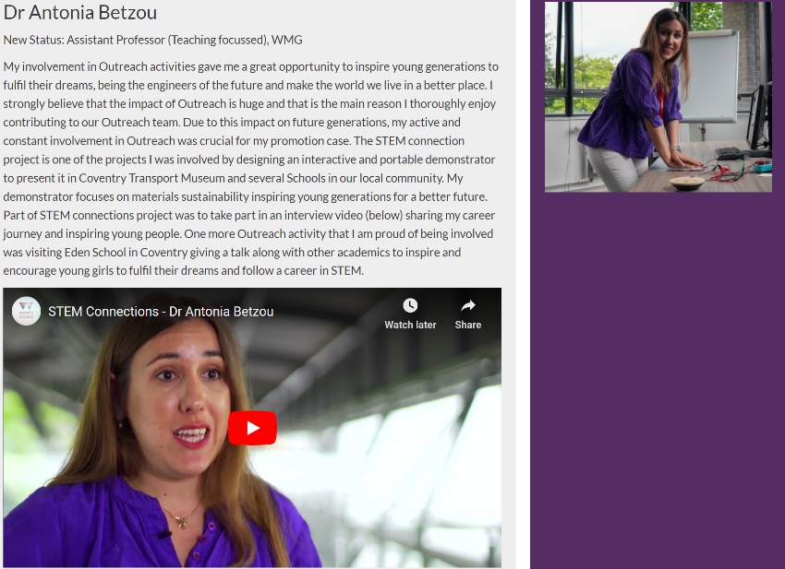
PROMOTION CASES

Slide 13
ACKNOWLEDGEMENTS
Cohort 1
Farah Villa-Lopez
Alex Baker
Tishtrya Mehta
Rohin Titmarsh
Fanfu Wu
Magdalena Cieslak
Antonia Betzou
Kevin Couling
Claire Dancer
Tom Goodman
Mona Faraji Niri
Cohort 2
Jiaqi Duan
Ishwar Kapoor
Jose Ortiz Gonzalez
Umair Paracha
Robin George Thamarasseril
Xinkai Tian
Piotr Mazurkiewicz
Magdalena Rybak
Piotr Klin
Adriana Smith Ortiz
Karen Kudar
Negar Riazifar
Project team:
Culture Coventry:
Rebecca Swan-McAdam, Rachael Kirwan, Marie Diebolt
Anja Campsell-Keital, Sarah Hayball, Lisa Ford

Slide 14


Funding for STEM Connections: Enhancing Research Culture Fund (ECRF) via Research England

