Slide 1
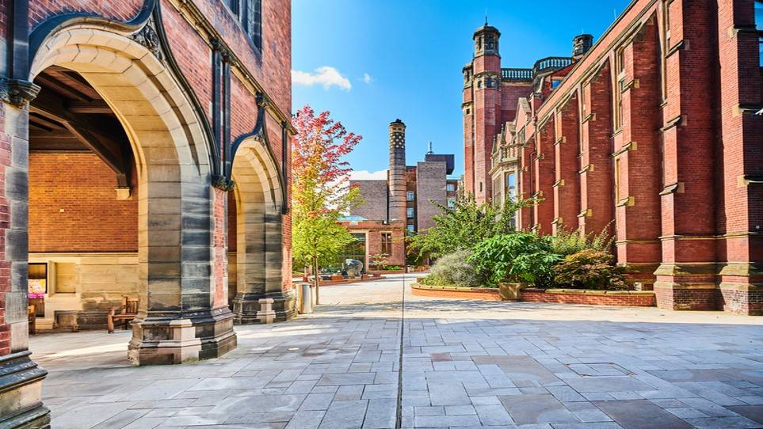

Engaging with our Researcher Community: putting our money where our mouth is
Dr Nicola Simcock (Research Culture Manager) and Dr Helen Gray (Research Associate, School of Natural and Environmental Sciences)

Slide 2


Research Community Consultation
Action
www.ncl.ac.uk/research/culture

Slide 3
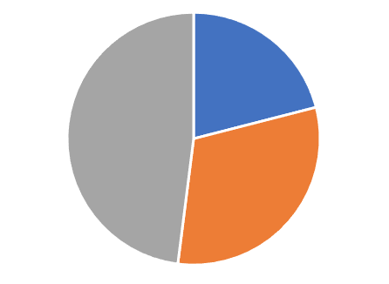
RC QR Spend 22-23
Resource
Strategic implementation team
Responsive mode funding
Strategic projects

Slide 4
RC QR Spend 22-23
Resource
Strategic implementation team
Low admin
Big investment, big impact
Aligns with Research strategy
Relatively high risk
Strategic projects

Slide 5
RC QR Spend 22-23
Resource
Strategic implementation team
Responsive mode funding
High admin
Small investment, small impact
Don’t necessarily impact the research strategy
Low risk
Community engagement!
Collaborative
Adaptive

Slide 6
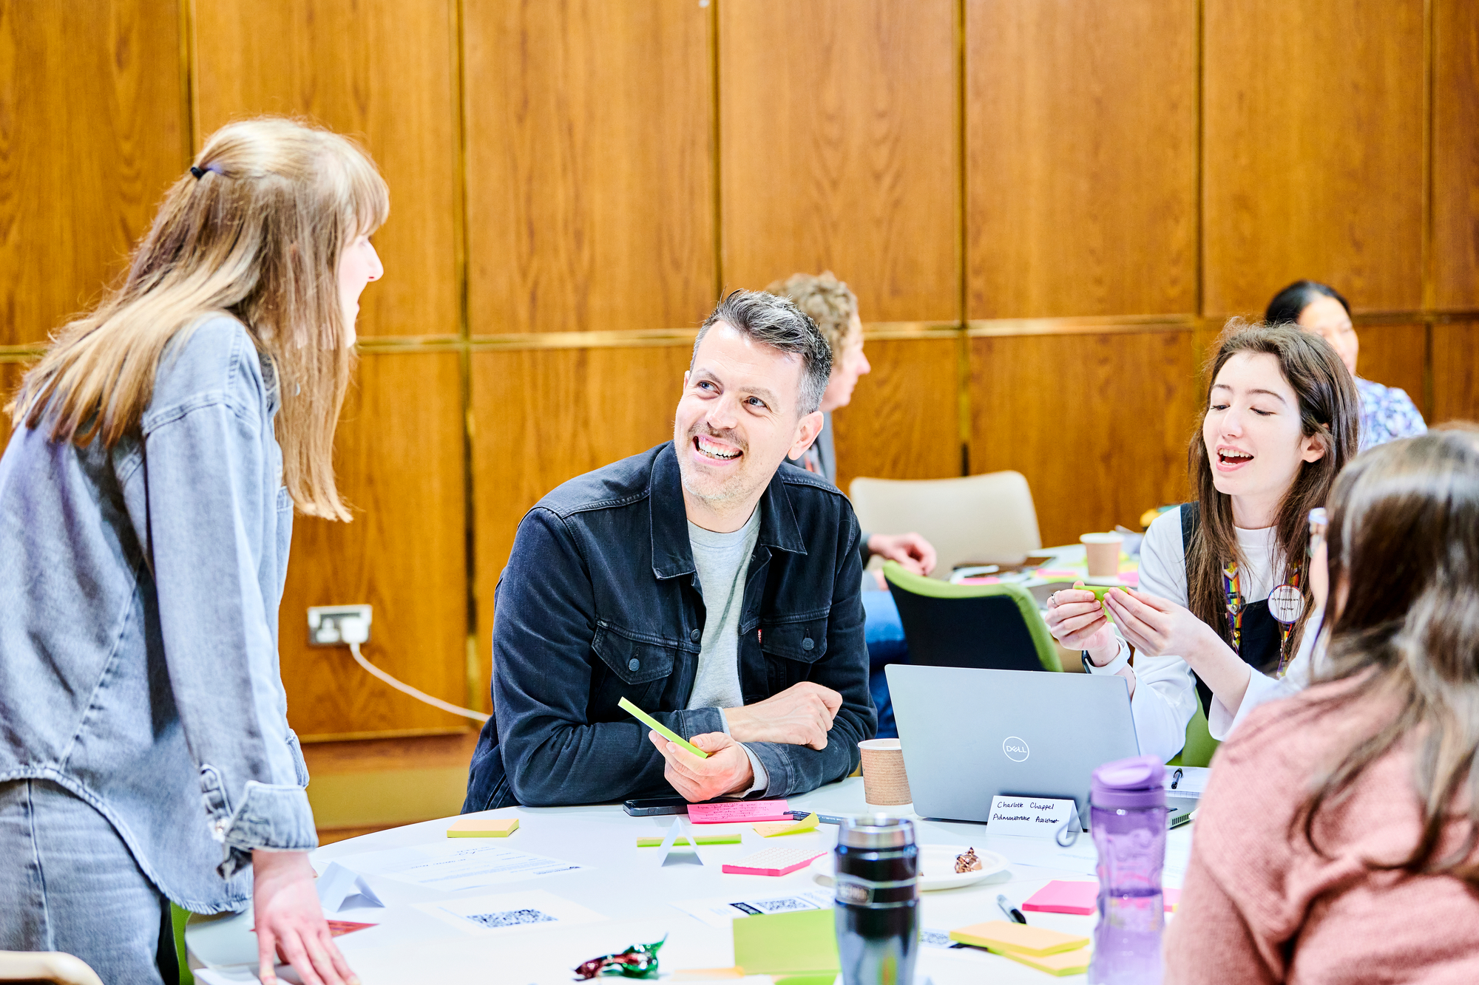
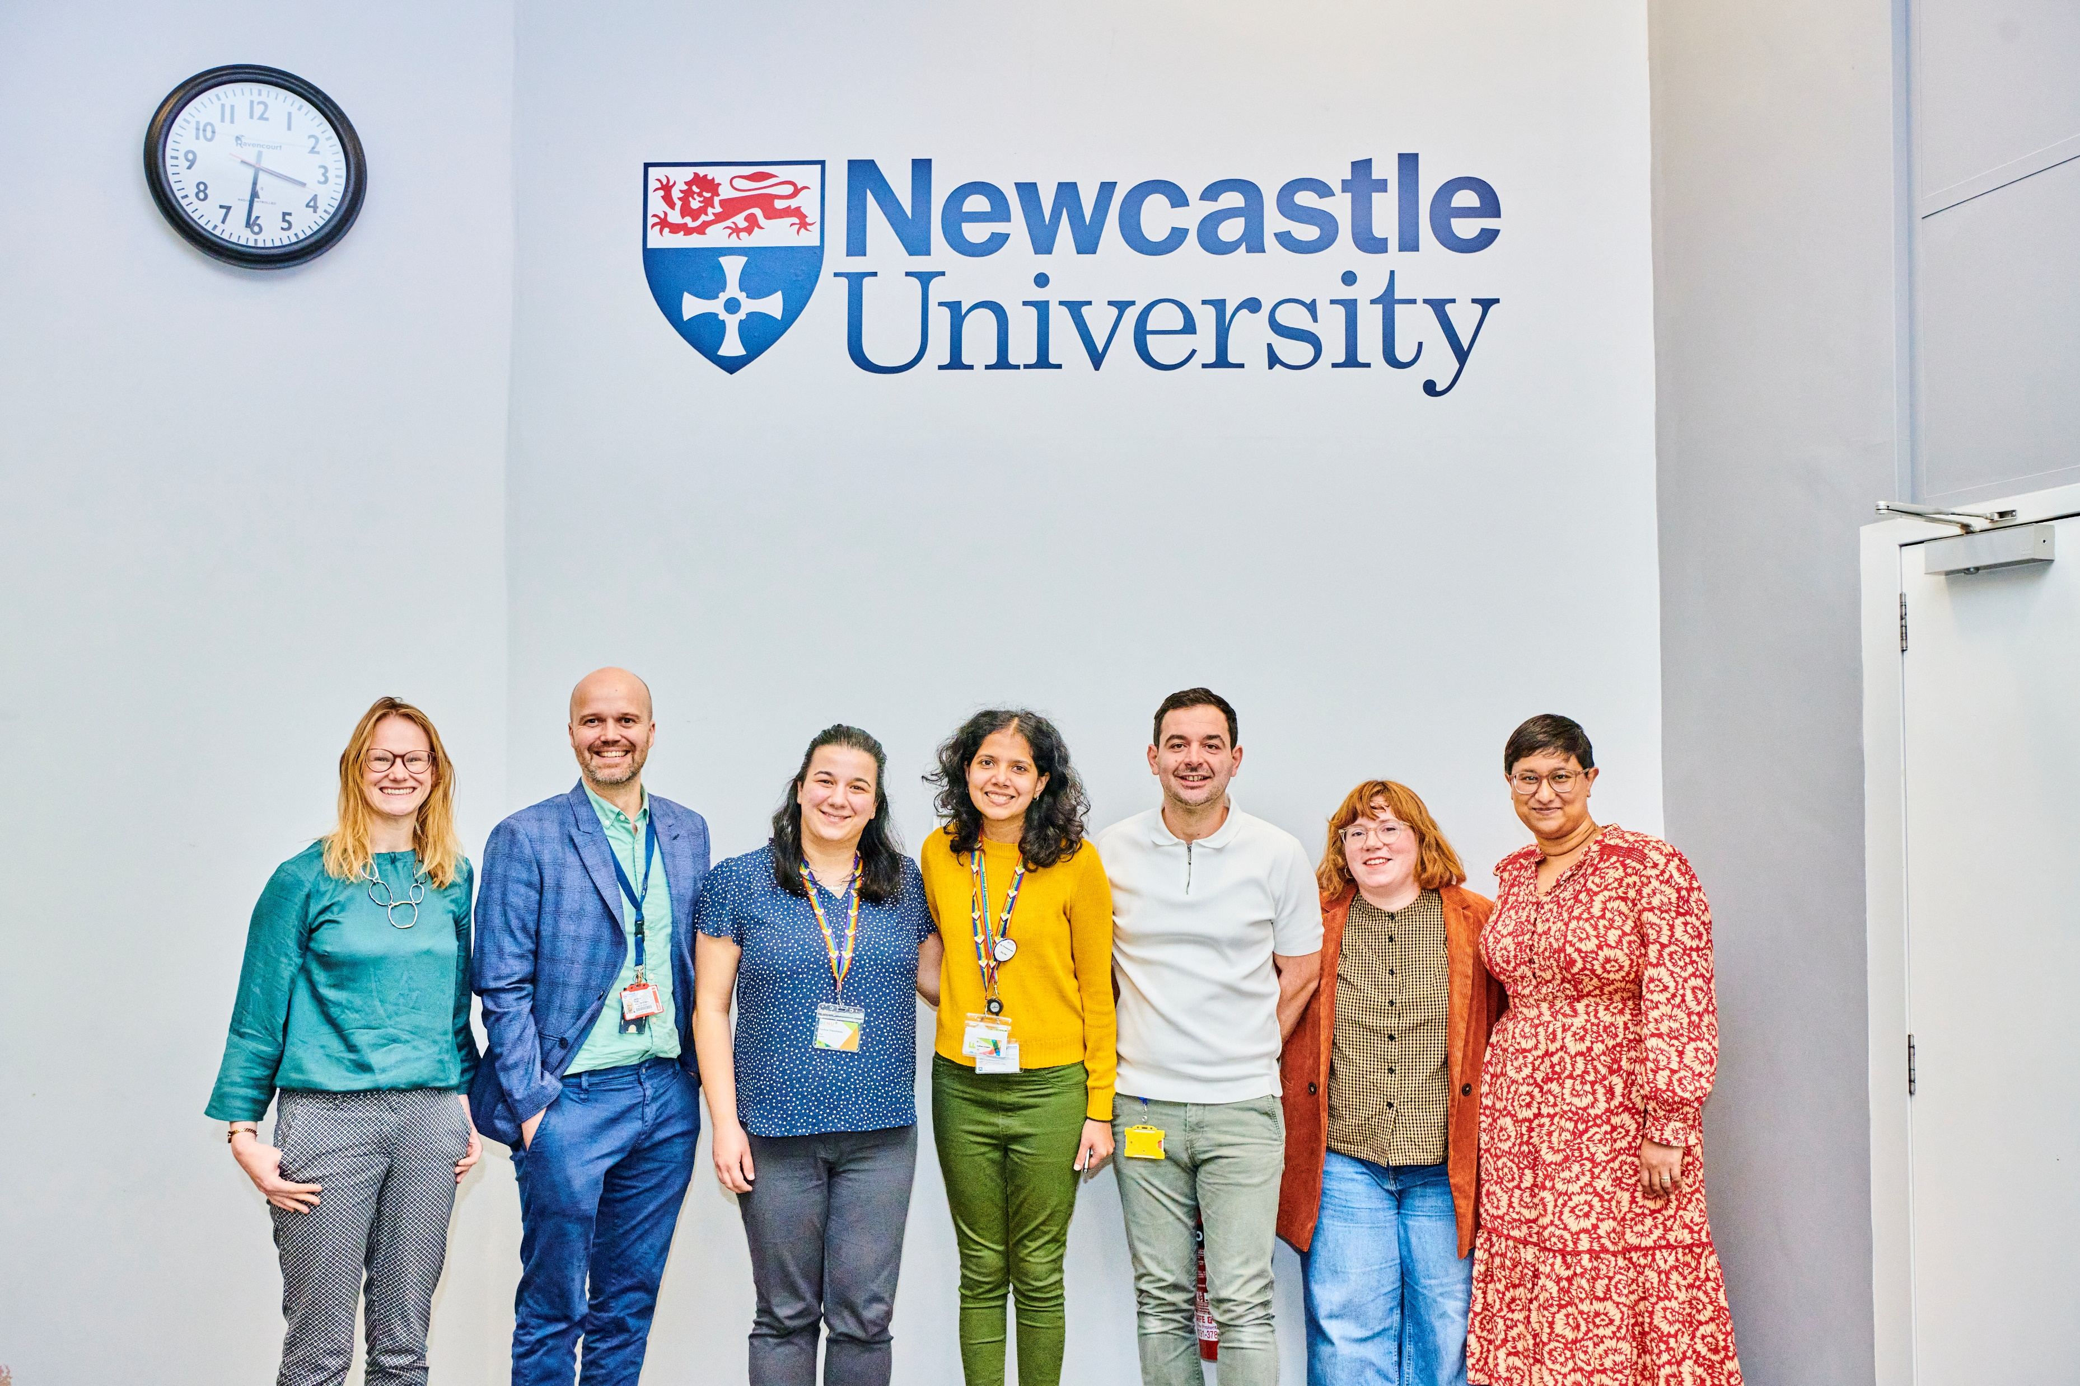
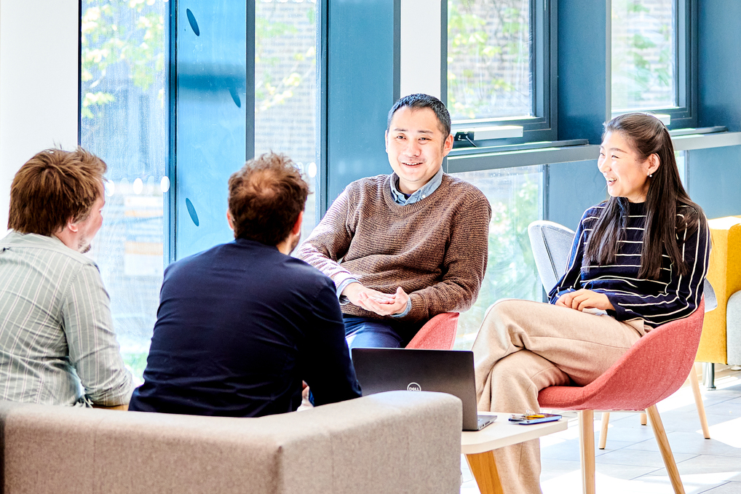
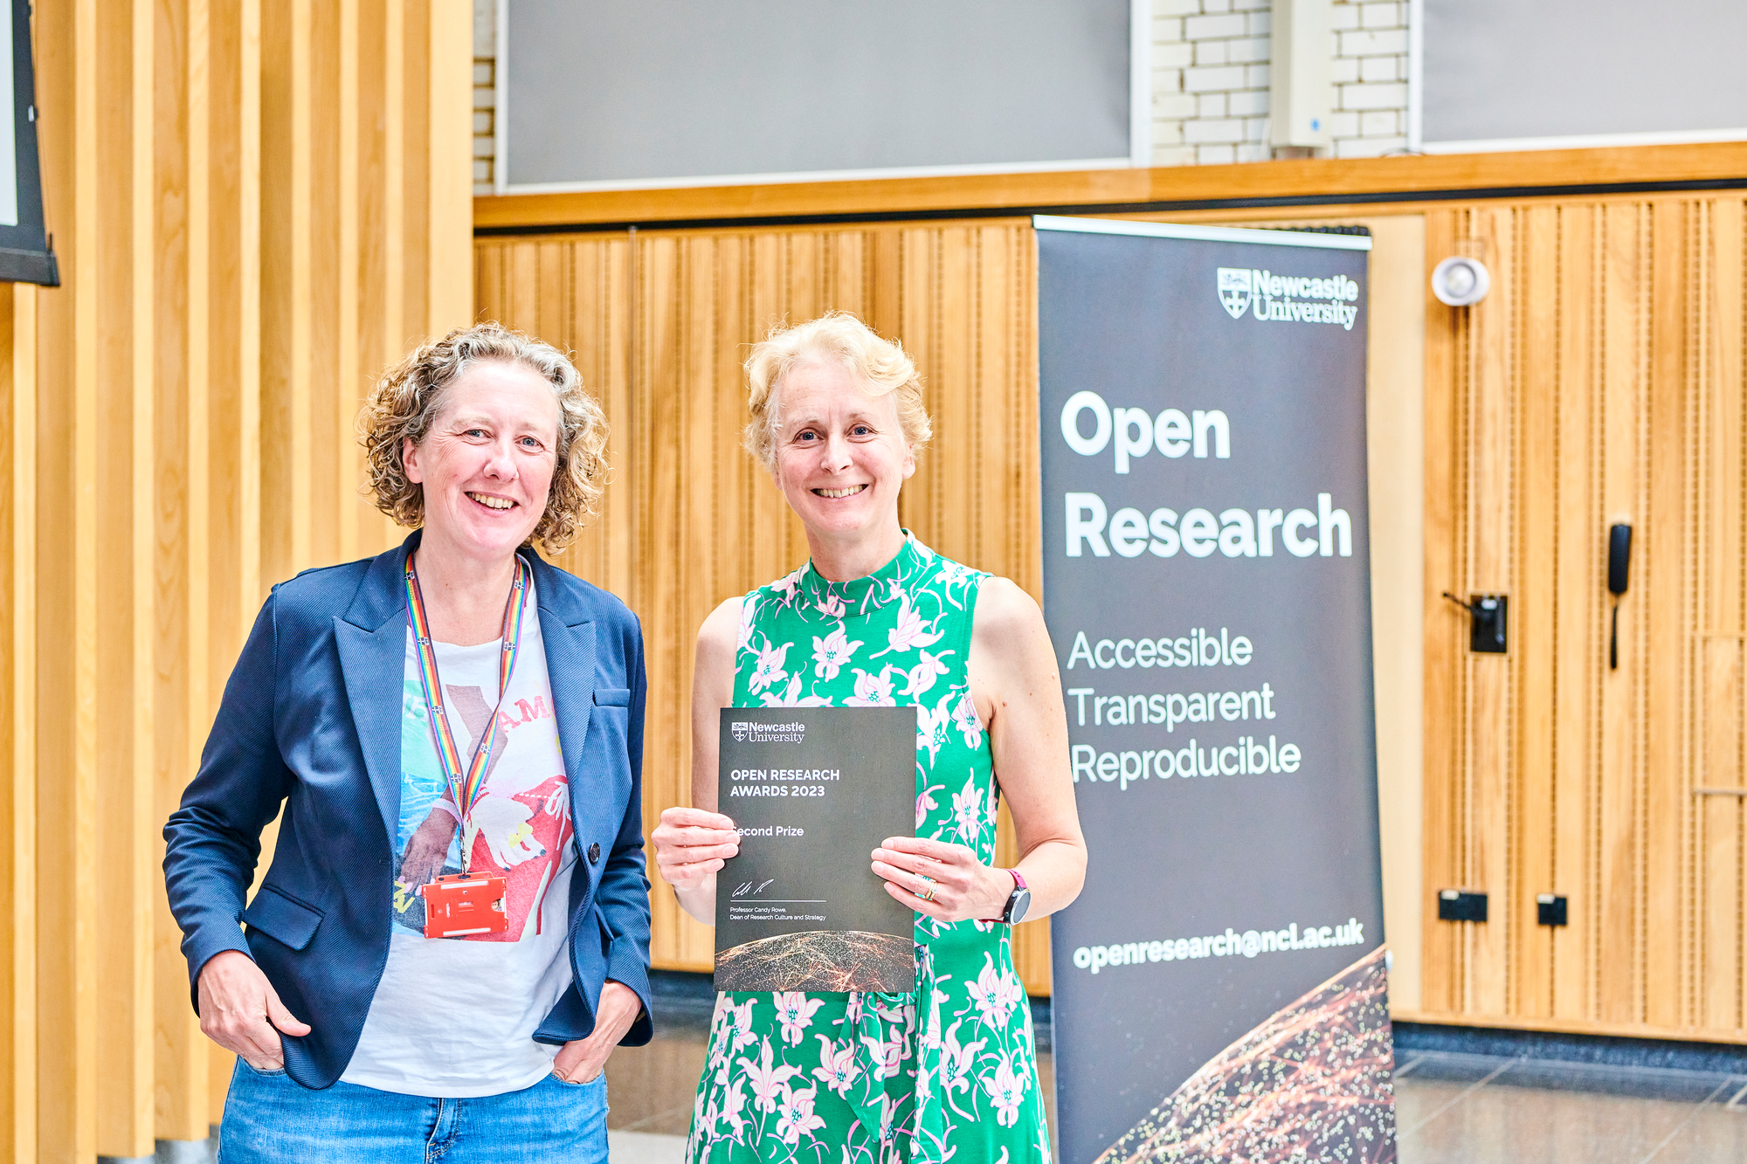
Responsive mode funding – People and Project Fund (for colleagues and PGRs)
Enhancing Research Culture Project Fund to support community-led projects aligned with our ambitions (Research Culture Action Plan)
Enhancing Research Culture People Fund – Training and Development activities
2022-23 = 60+
2022-23 = 46 Applications

Slide 7
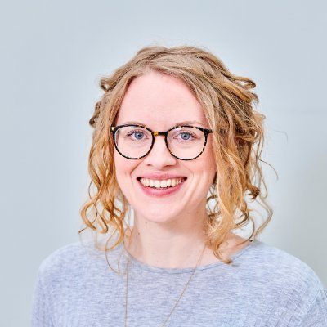

Helen’s experience
The RENU event and formation of The Researcher Network
Helen Gray
SAgE

Slide 8


Why did we apply?
Researchers (especially ECRs) are often poorly connected, underappreciated and underrepresented in decision-making processes across academia.
Support for researchers is dependent on department with unequal opportunity for voices to be heard.

Slide 9
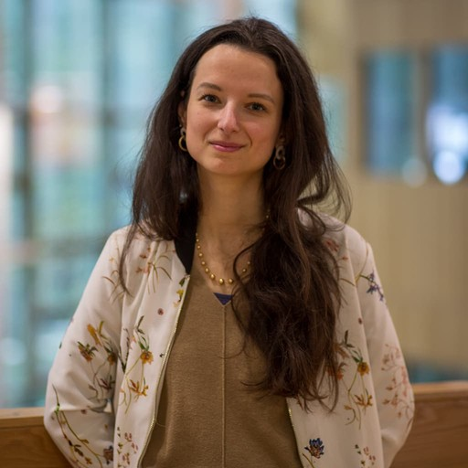

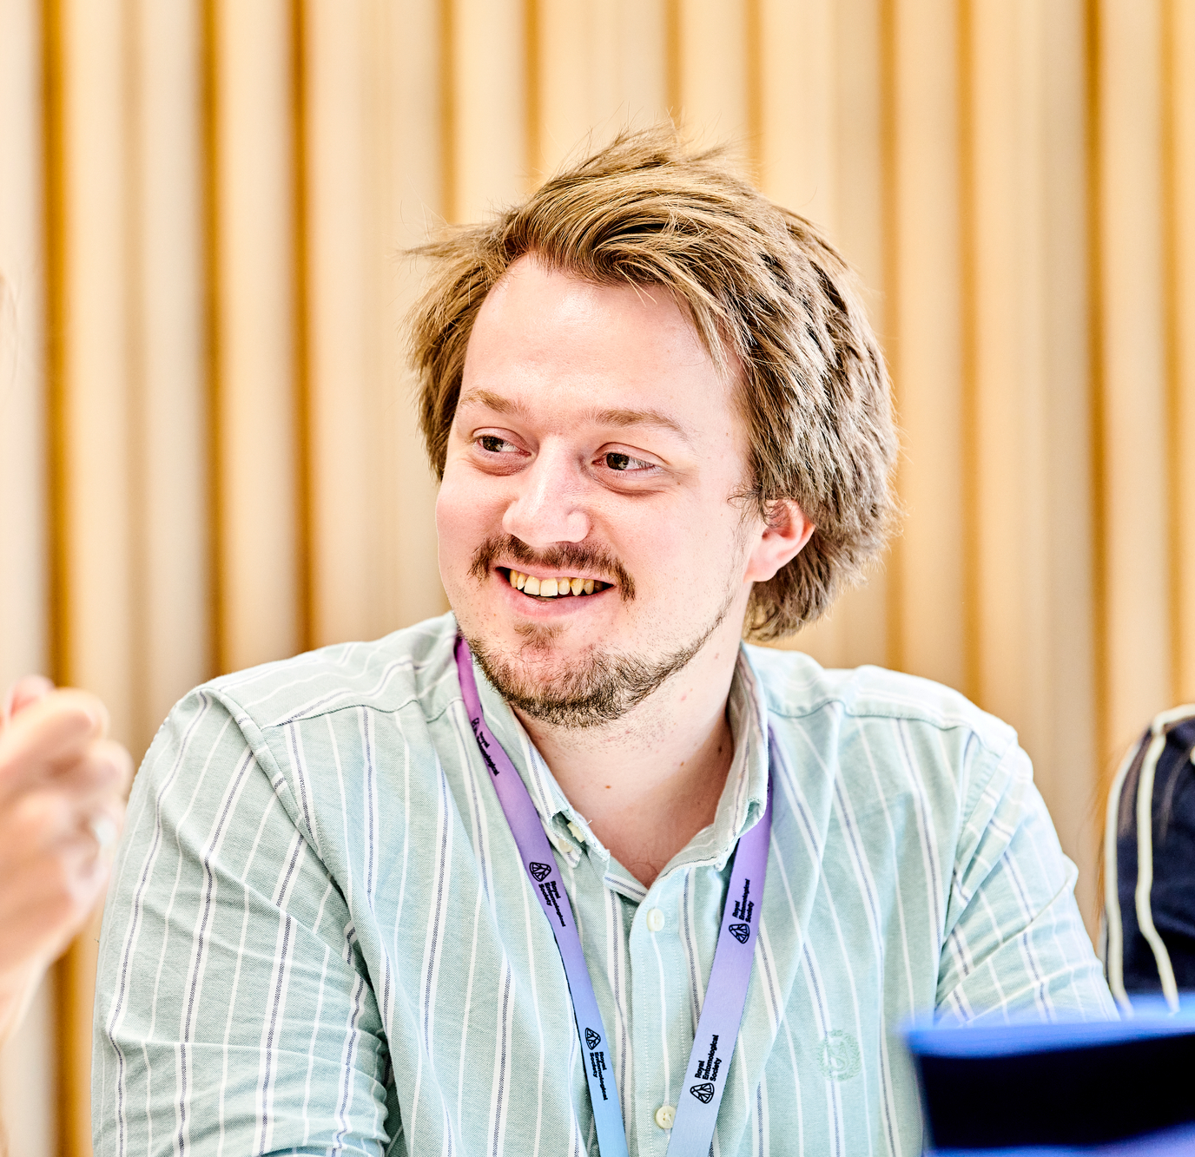
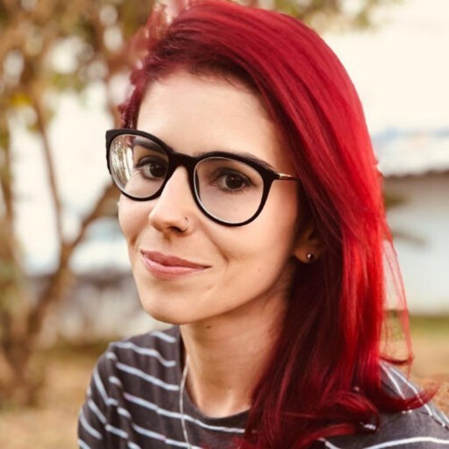
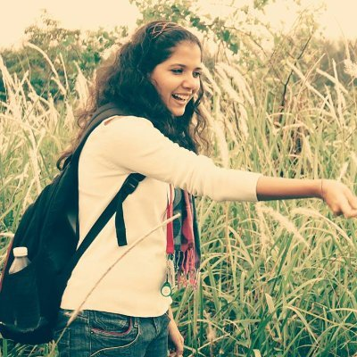

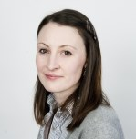
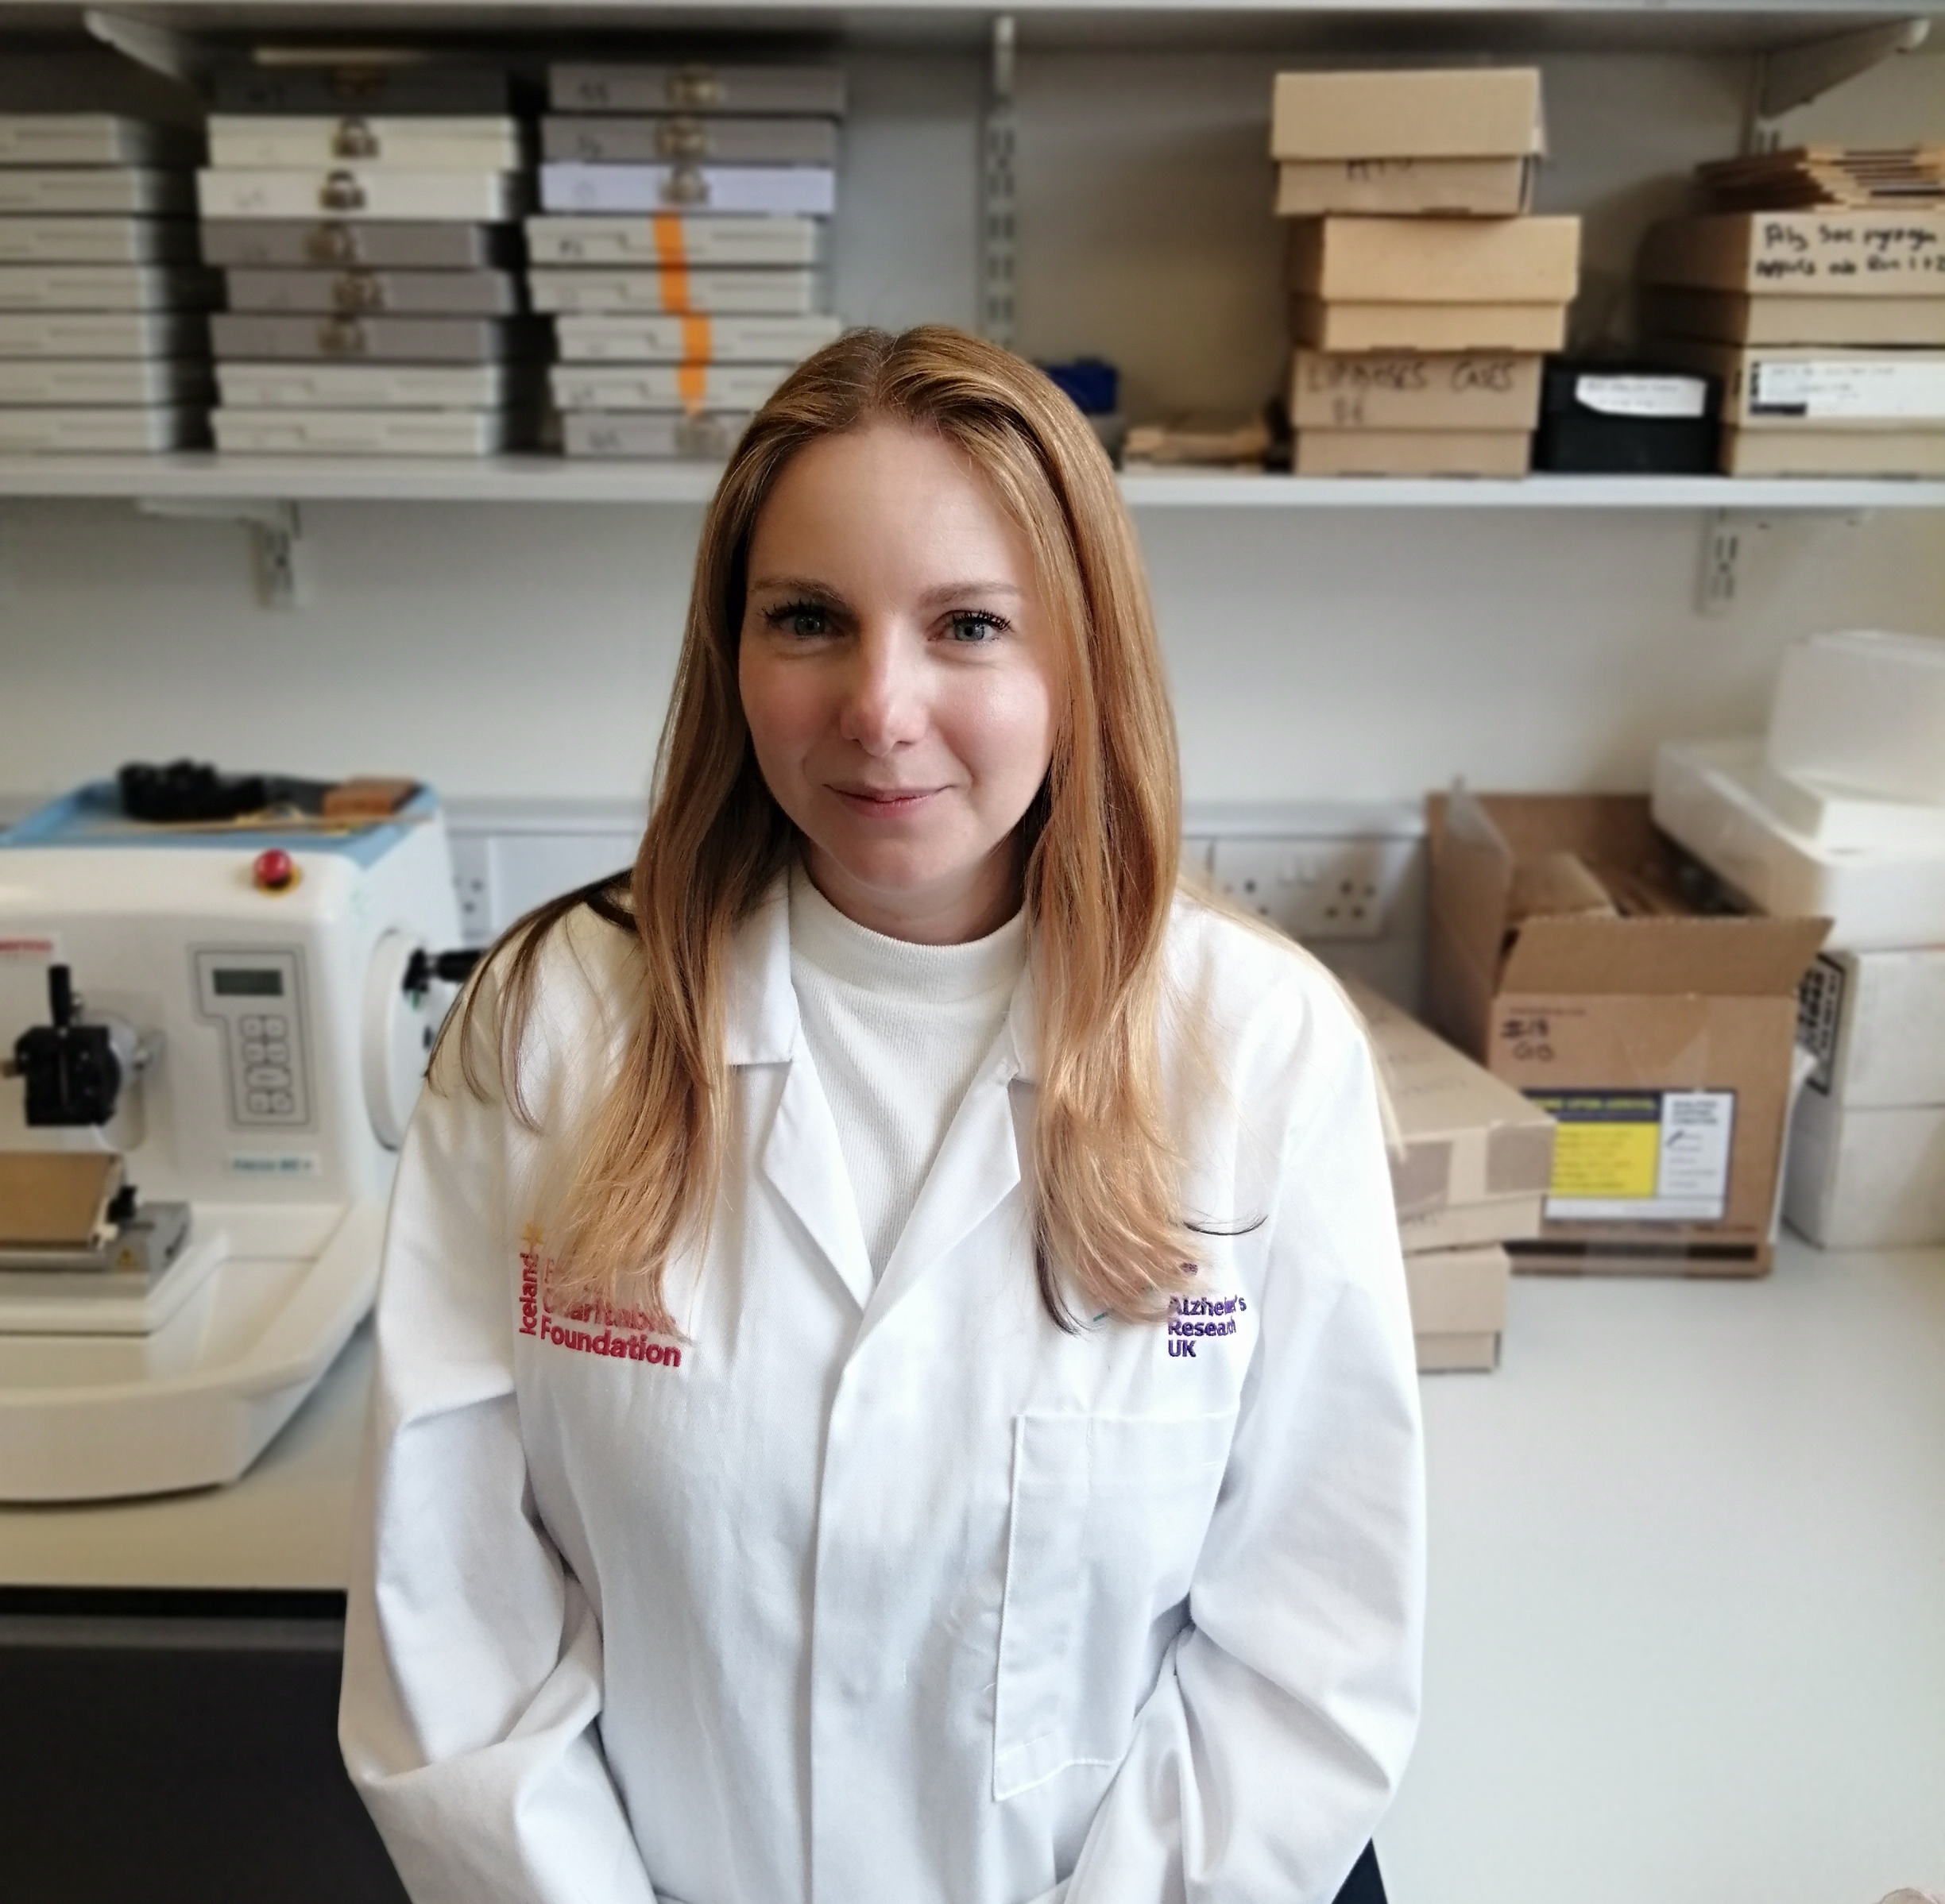
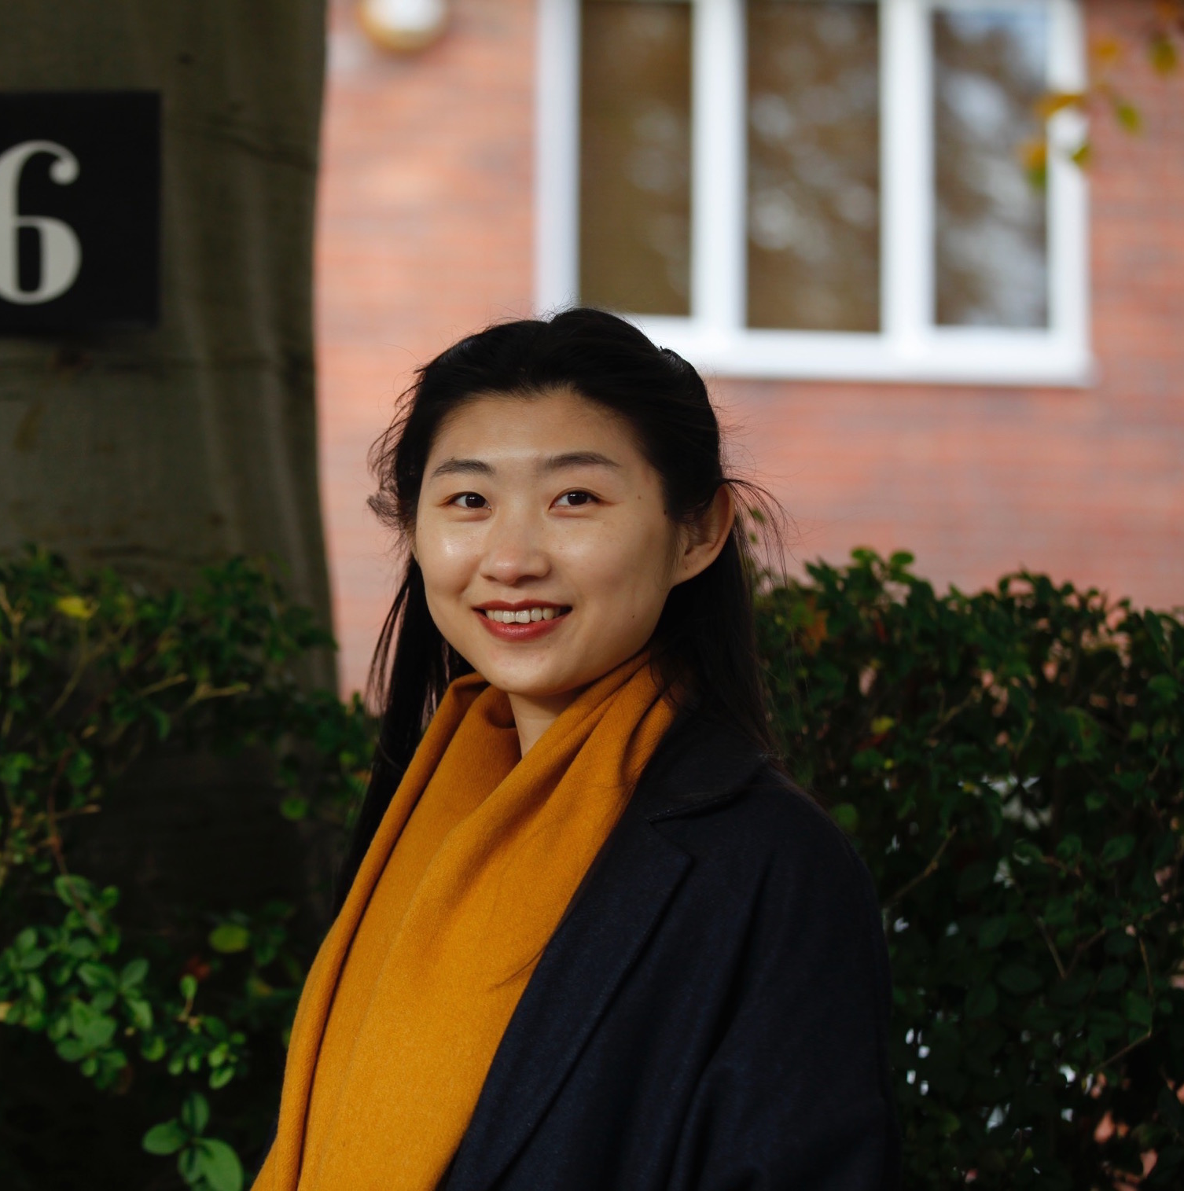

What did we do?
Gathered together interested researchers
Shared experiences and planned our application
AIM: To link researchers across faculties through a university-wide researcher symposium and establish a cross-faculty network representing the interests of researchers.
Caroline Claisse
SAgE
Sarah Collins
HASS
Jordan Cuff
SAgE
Nayara Albrecht
HASS
Helen Gray
SAgE
Anjali Jayakumar
SAgE
Emily Rainsford
HASS
Jo Swaffield
HASS
Lauren Walker
FMS
Lydia Wu
HASS
Kate Harris
FMS/SAgE

Slide 10
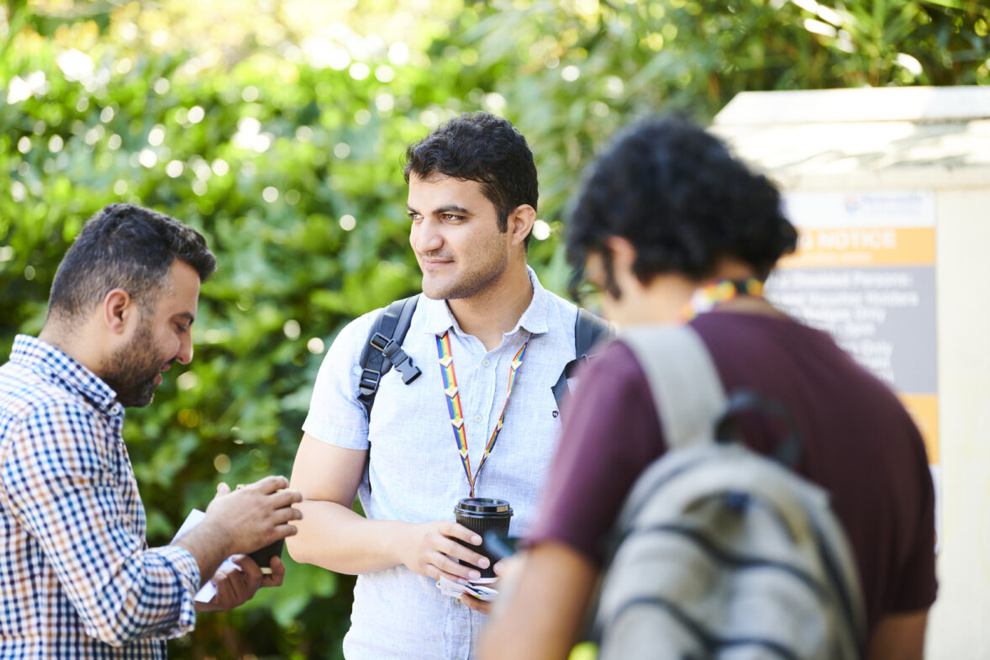
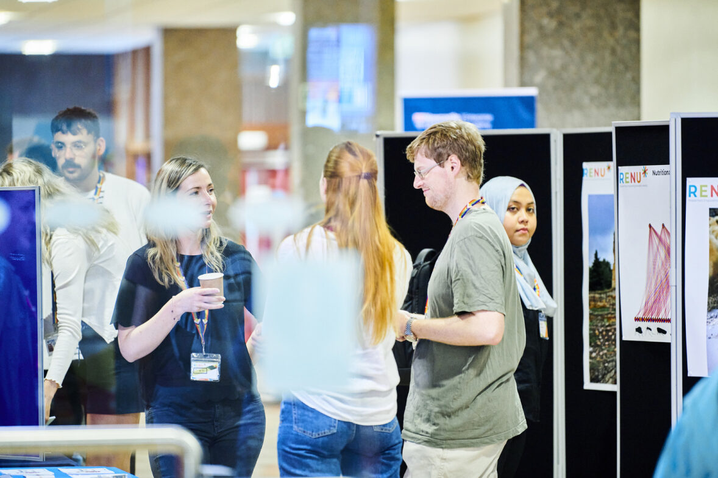
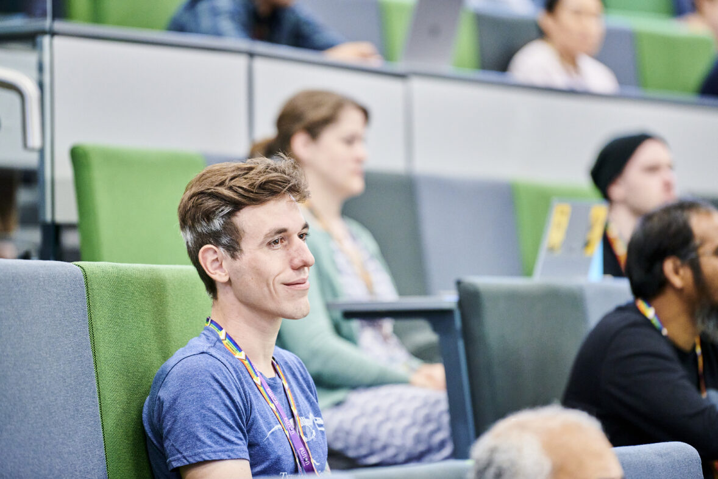

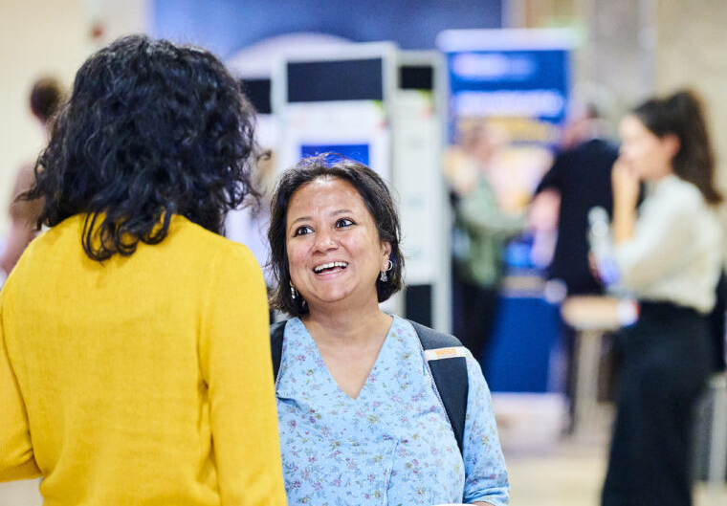
Kick off event: RENU
Bring researchers together to form the network and discuss:
Research culture
Research practice
Collaboration
Career progression
Researcher support
Embracing failure
Philosophy
Open research
Interdisciplinarity
Multidisciplinarity
Careers within academia
Careers outside of academia

Slide 11
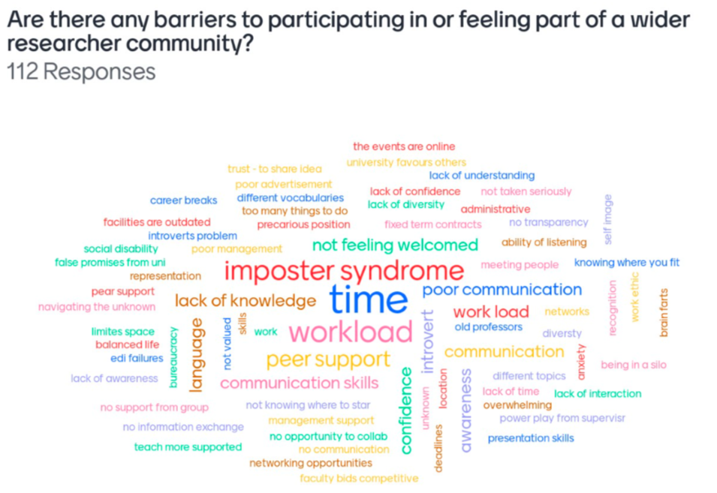

Slide 12
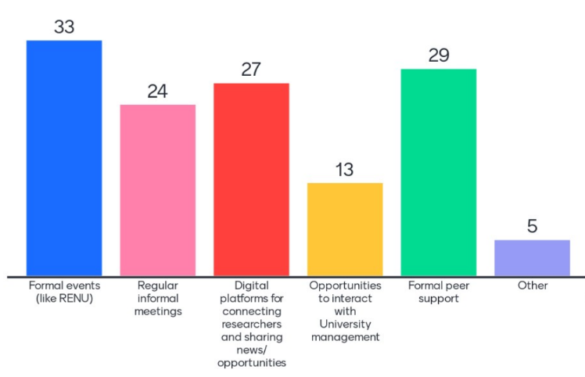

Slide 13
What will we do?
A follow-up event Researcher Network event to reconnect and to set up:
Regular informal meetings
A formal annual event
Establish peer support mechanisms
Finding the best ways to engage digitally

Slide 14
Learnings from response mode community-led projects
Many small projects are time consuming
Underspend is real – have a plan B!
Maximising outcomes takes a personal touch
Community led activity is innovative, timely, engaging and builds trust
Identify gaps in our provision
Cross-faculty support
Researcher knowledge of University resources
Learning more about researcher needs/wants
Messy career paths
Failure

Slide 15
Thank you!

