Slide 1

It doesn’t just happen: Embedding EDI in the Future Leaders Fellows Development Network
Dr Katie Nicoll Baines (she/her)
Equality Diversity & Inclusion Manager, Future Leaders Fellows Development Network

Slide 2
What is a Future Leaders Fellow? (FLF)
FLF programme originated in 2018 to catalyse new forms of research and innovation
Competitive grant process has resulted in just over 450 Fellows in R1-6, with R7 and 8 to follow in next two years
Grants (usually between £1M and £1.5M) awarded to early career researchers and innovators
Strong indicator that UKRI is using this programme to model (and impact) research culture
No or little teaching requirements, strict guidelines on other commitments
4 year grants + possible 3 year renewal
IRCC INTERNATIONAL RESEARCH CULTURE CONFERENCE I 25th Sept 2023

Slide 3
The Future Leaders Fellows Development Network
UKRI-funded, UK-wide programme providing leadership development opportunities to FLFs
Our core team is made up of 8 Industrial and HEI partners, with additional external partnerships
Current operating budget is £6.2M with additional £2.4M for R7 & R8 2024-2027
Bespoke programme designed specifically for FLFs – nothing is ‘off the shelf’
Responsive programming overlays our annual calendar of events
IRCC INTERNATIONAL RESEARCH CULTURE CONFERENCE I 25th Sept 2023

Slide 4
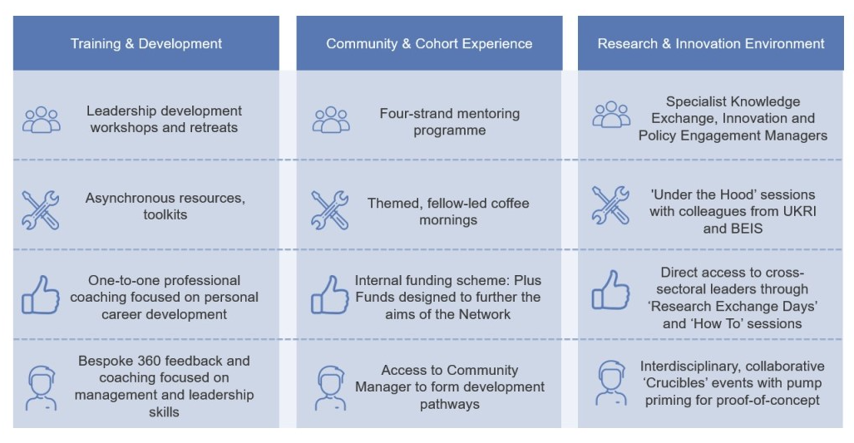
The Future Leaders Fellows Development Network
IRCC INTERNATIONAL RESEARCH CULTURE CONFERENCE I 25th Sept 2023

Slide 5
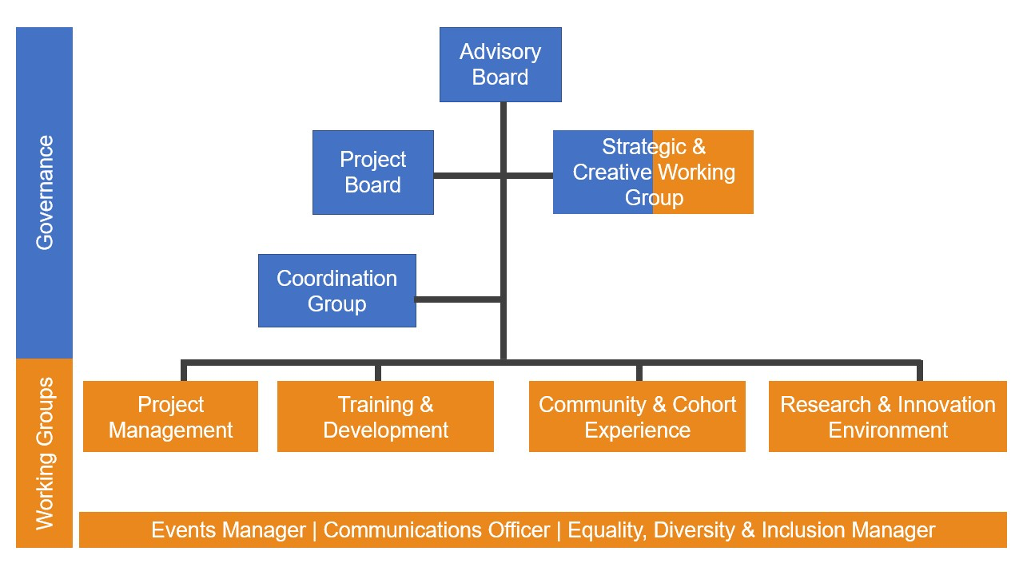
The Future Leaders Fellows Development Network
IRCC INTERNATIONAL RESEARCH CULTURE CONFERENCE I 25th Sept 2023

Slide 6
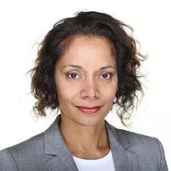
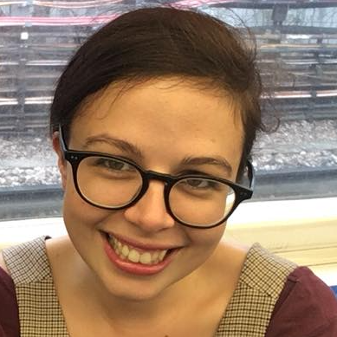
Dr Udeni Salmon, EDI Consultant
Udeni is an academic whose research focuses on applying race and gender theory to issues of social justice, entrepreneurship and innovation. She holds research posts at the University of Bristol and the University of Keele.
Udeni was a member of the feminist anti-racist collective Building the Anti-Racist Classroom from 2017-2019, and she has contributed to justice initatives such as the Race Equality Charter, student-led decolonisation work and organising with minoritised staff and students.
Dr Katie Nicoll Baines, EDI Manager
Katie is an equality, diversity and inclusion (EDI) specialist and experienced facilitator/trainer with expertise in researching barriers to career progression experienced by women and LGBT+ people related to grant funding.
Katie works alongside Udeni Salmon to create and implement our EDI strategy. She is responsible for embedding principles of equality, diversity and inclusion across all network programmes and activities. She supports our training and development team to embed EDI in the leadership training for fellows and develops bespoke training to respond to specific EDI needs within the Network. Katie also works with UKRI on strategies to support Inclusive Research Design.
IRCC INTERNATIONAL RESEARCH CULTURE CONFERENCE I 25th Sept 2023

Slide 7






What do I do?
RES-WELL
Expert Insights
EDI policy
Family Friendly policy
Principled Spaces Guide
Facilitator Guide
Plus funds support
Application development
Implementation
Active bystander intervention
Understanding micro-aggressions
Inclusive events practice
Culture Change Retreat
DEVISE: AI tools for research
Mentoring
Leadership & Management
Public Engagement
Commercialisation
Project Management
Recruitment
Data gathering & evaluation
Toolkit development
One to one consultation
Equality, Diversity & Inclusion
Inclusive Teams
Inclusive R&I Design
IRCC INTERNATIONAL RESEARCH CULTURE CONFERENCE I 25th Sept 2023

Slide 8
Network Legacy
Sharing our experience & resources with the sector
Toolkits: open access
Conference: November 2023 REGISTER:
Target audience: HR, research support, researcher development, research culture specialists, EDI in research roles
Sessions will include: Inclusive peer review, inclusive selection (demand management/gatekeeping)
Connectivity with UKRI: engaging professional services roles in research funding application review process
IRCC INTERNATIONAL RESEARCH CULTURE CONFERENCE I 25th Sept 2023

Slide 9
THANK YOU
knicollbaines@ed.ac.uk

