Slide 1


Slide 2


Working towards an inclusive research culture through EDI education, engagement and empowerment of researchers
Professor Rachel Cowen (pronouns, she/her)
Academic Lead for Equality, Diversity and Inclusion
University of Manchester

Slide 3

“We want to be known for HOW we do things as much as WHAT we do”
1st in Europe
2nd Globally
EDI
Moral
Critical to our success
Legal & Contractual
50,000 students
14,000 staff
500,000 alumni
190+ countries
Diversity of talent, thinking & ideas
Innovation and Productivity
Identify problems and find solutions that meet whole population need
Equality Act 2010,
Public Sector Equality Duty 2011
Pay Gap Reporting
Funder requirement
“Creating a world class research and innovation system by everyone and for everyone”

Slide 4
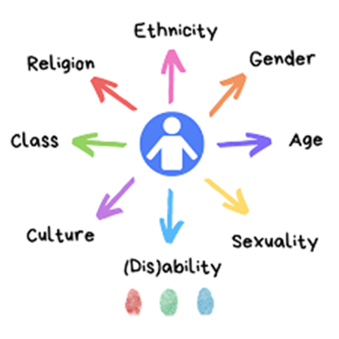
Equality, Diversity and Inclusion – integral to our open, responsible and inclusive research culture
Diverse research workforce – at all levels and all areas
Equitable researcher development, reward and recognition
Open and inclusive research practice, research supervision, leadership and management
Diverse researcher community, voice and influence
IRCC INTERNATIONAL RESEARCH CULTURE CONFERENCE I 25th Sept 2023

Slide 5
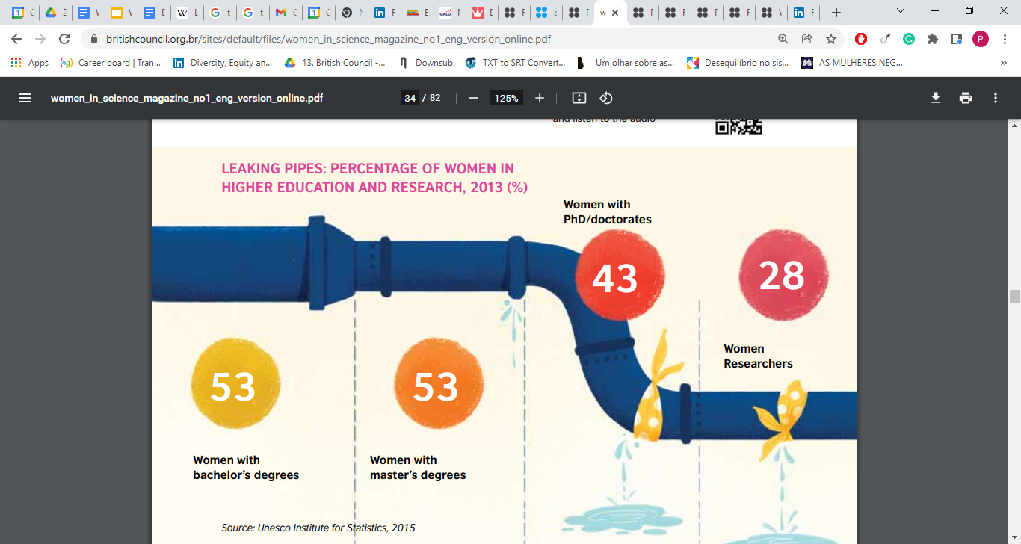

Commitment to fix the pipes and not just add more water
Grant success rates significantly lower for ethnic minority PIs
Women PIs apply for and receive lower grant funding than men
Women researchers perceive lower levels of recognition for their work
Women, ethnic minority and disabled staff significantly more likely to report experiencing discrimination, bullying and harassment
UoM | UG | PGT | PGR | ECR/L | Prof | RI Lead
Sex | 55.8% | 65.8% | 53% | 49.7% | 29.3% | 15%
Ethnicity | 32.9% | 24.9% | 16.9% | 28.9% | 11.5% | DNA
Disability | 16% | 4% | 7% | 4.5% | 2.7% | DNA
Source: Women in Science magazine, 1st edition, 2019.
University of Manchester Equality Information Report 2023
IRCC INTERNATIONAL RESEARCH CULTURE CONFERENCE I 25th Sept 2023

Slide 6
Embedding EDI within student curriculum and ECR development
EDI: Where History, Law & Politics Meet
EDI in the Workplace
EDI in Research & Innovation
EDI in Education
EDI in Health & Social Care
EDI: Your Role as an Inclusive Leader
EDI: Your Role in Shaping a Fairer World – 10 credit unit (UCIL)
I believe that if we apply the mind set represented throughout these modules we can make any environment more inclusive, diverse and equal (2nd year student)
Taster for all offer holders
Open to all students, all disciplines
Embedding in researcher development, supervisor and PI toolkits
IRCC INTERNATIONAL RESEARCH CULTURE CONFERENCE I 25th Sept 2023
Notes:
To enhance EDI knowledge, skills and attributes fundamental to employability and effective working within a global, interconnected world
To confront personal values, beliefs and codes of behaviour leading to bias and discrimination
To consider privilege, dominance and power and raise self-awareness to develop as inclusive leaders
To promote inclusive approaches to study and work and challenge structural inequalities to drive societal change

Slide 7
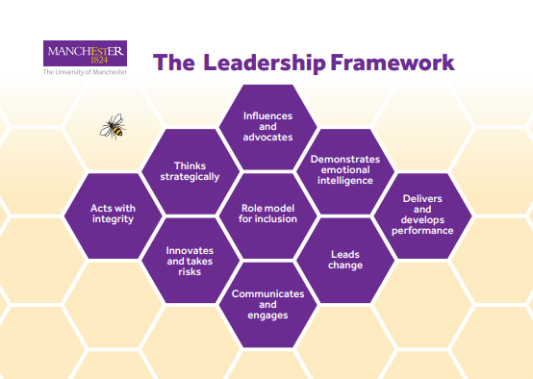
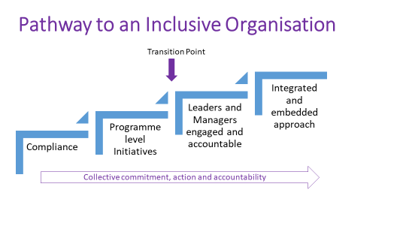
Embedding EDI in leadership practice
Personal EDI objective for all leaders and managers
Engagement led by senior leadership team
Embedded in leadership and management programmes > new academic and fellows programme
IRCC INTERNATIONAL RESEARCH CULTURE CONFERENCE I 25th Sept 2023

Slide 8
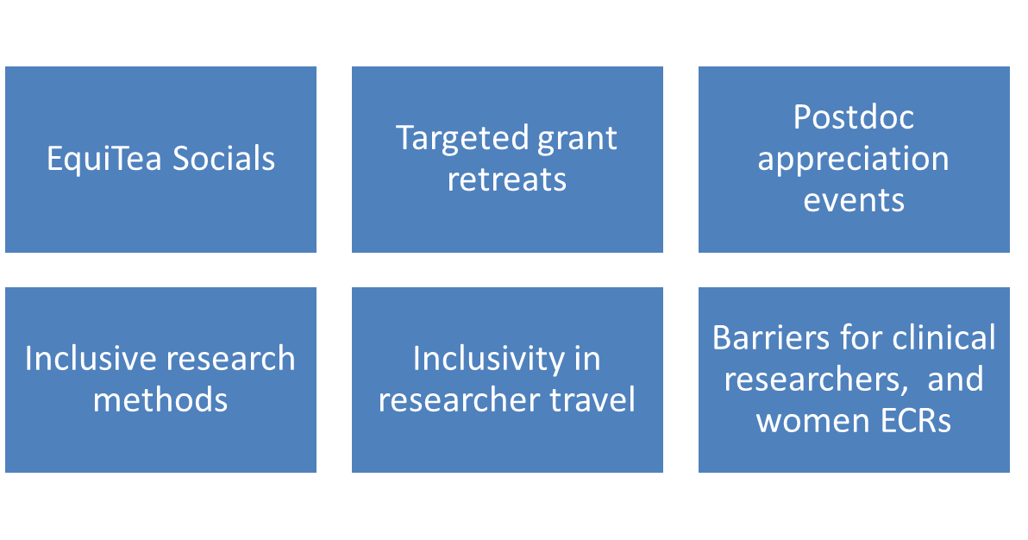
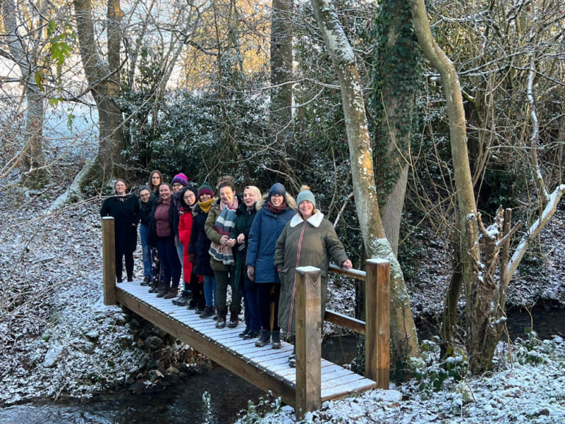
Catalysing inclusive practice and culture change through our innovative EDI bid scheme
Open call to all involved in research and discovery
Up to £5K funding, 13 projects funded (PGR > Prof led)
Impact on 1000+ researchers
Team, university, national activity, policy development, preliminary research
IRCC INTERNATIONAL RESEARCH CULTURE CONFERENCE I 25th Sept 2023
Notes:
increase EDI engagement, education, and empowerment of >1000+ people through local, University and national EDI events, activity, policy development and preliminary research. Numerous impacts reported including giving ECRs experience of award success, project execution and reporting, long-term legacy resources (key-note seminars, new policy, researcher development, blog posts, inclusive methods development). The initiative also sparked local EDI funding competitions e.g. Molecular and Cellular Function EDI Away Day including EDI ideas pitch.
University support and funding has been secured to progress policy development and evaluate the longer-term impact of the scheme and School and Faculty funding has been committed to continue initiatives e.g. annual women’s writing retreat in School of Engineering.
Project leads have gone on to win loreal women in science awards and national postdoc conference EDI awards

Slide 9

Investing in early career researchers from under-represented groups through our EDI Research placements, EDI Fellowships and Inclusive Advocacy Programme.
EDI UG placements – 20 annually
79% F, 37% BAME, 55% WP
Funded 6-8 weeks across all areas
100% +ve experience (supervisors and UG)
EDI Fellows (5/7 F, 71% BAME, 43% carers)
Open call, narrative CV
Paired with senior advocate
Privilege, bias, advocacy training
I truly believe that I couldn’t obtain this new fellowship without having the EDI fellowship, the EDI-Advocacy programme and your support
IRCC INTERNATIONAL RESEARCH CULTURE CONFERENCE I 25th Sept 2023
Notes:
Supported 19 researchers and 21 supervisors. (Application success rate 9%). Remuneration for all students during 6-8 week placements running June to Sept ‘22. 79%:21%, Female: Male split, 37% Black, Asian or Minority Ethnic, 2% identify as disabled, 55% first in family at university and/or low socioeconomic background. Placements University wide: eight FBMH, six FSE, five FH. 100% evaluation response from supervisors to run the placement scheme again. Highly positive feedback from both placement students and supervisors. Employability tracking planned as part of follow up study* Follow on University funding secured (£80K) and currently recruiting for 20 EDI summer placements for Jun – Sept 2023. Funding also secured (£88K) to trial 10 Post PhD EDI 6-month placements for under-represented researchers in Aug 2023/Mar 2024.
Career tracking – tenure track fellowship awarded and independent grant funding

Slide 10
Diverse community
Inclusive Research Culture
Equity of Opportunity
EDI UG Summer 2 month placements*
EDI PhD Scholarships
EDI Post PhD 6 month placements
EDI 1 Year ECR ‘Perera’ Fellowships *
University Inclusive Recruitment pilots and policy
Carers support fund
ECR Dissemination, Collaboration and Excellence Awards
Academic Returners Fund
ECR Inclusive Advocacy*
Inclusive Research Leadership*
Internal targeted leadership programmes Managing@Manchester for researchers, Leading@manchester for fellows
External targeted leadership programmes - Aurora, 100 Black Professors Women Now
Inclusive research design and PPIE expertise
EDI objectives in PDR, Ways to inclusion*, Get it together Framework
EDI Innovative bid*scheme -
Pump prime research revealing barriers in clinical academics and disabled researchers
Active bystander training
We are at the start of our journey
Equality, Diversity and Inclusion Strategy 2022 > 3 Year Action Plan
System wide, co-created with our community
Collective accountability/actions by all staff and students
Notes:
Will only cover the things starred Equality, Diversity and Inclusion Strategy 2022
> 3 Year Action Plan

Slide 11
THANK YOU
Acknowledgments: Sarah Williams, Maria Marsh, Di Zhang, Diane Harris, Michael Dixon University of Manchester and Wellcome funding - 204796/Z/16/Z ISSF 3-EDI

