Slide 1


How to do a research culture survey (how we did it and what we learned)
Candy Rowe
Dean for Research Culture and Strategy
Newcastle University
Karin Wahl-Jorgensen
Dean of Research Environment and Culture
Cardiff University
Notes:
Candy

Slide 2


Why survey?
Better understand lived experiences of people in our research community
  Ensures actions are data driven and community led
  Helps to create ‘burning platforms’ that engage senior management teams
Provides a snapshot of where we are now and help track improvement
Provides benchmark against sector-wide experiences

Slide 3

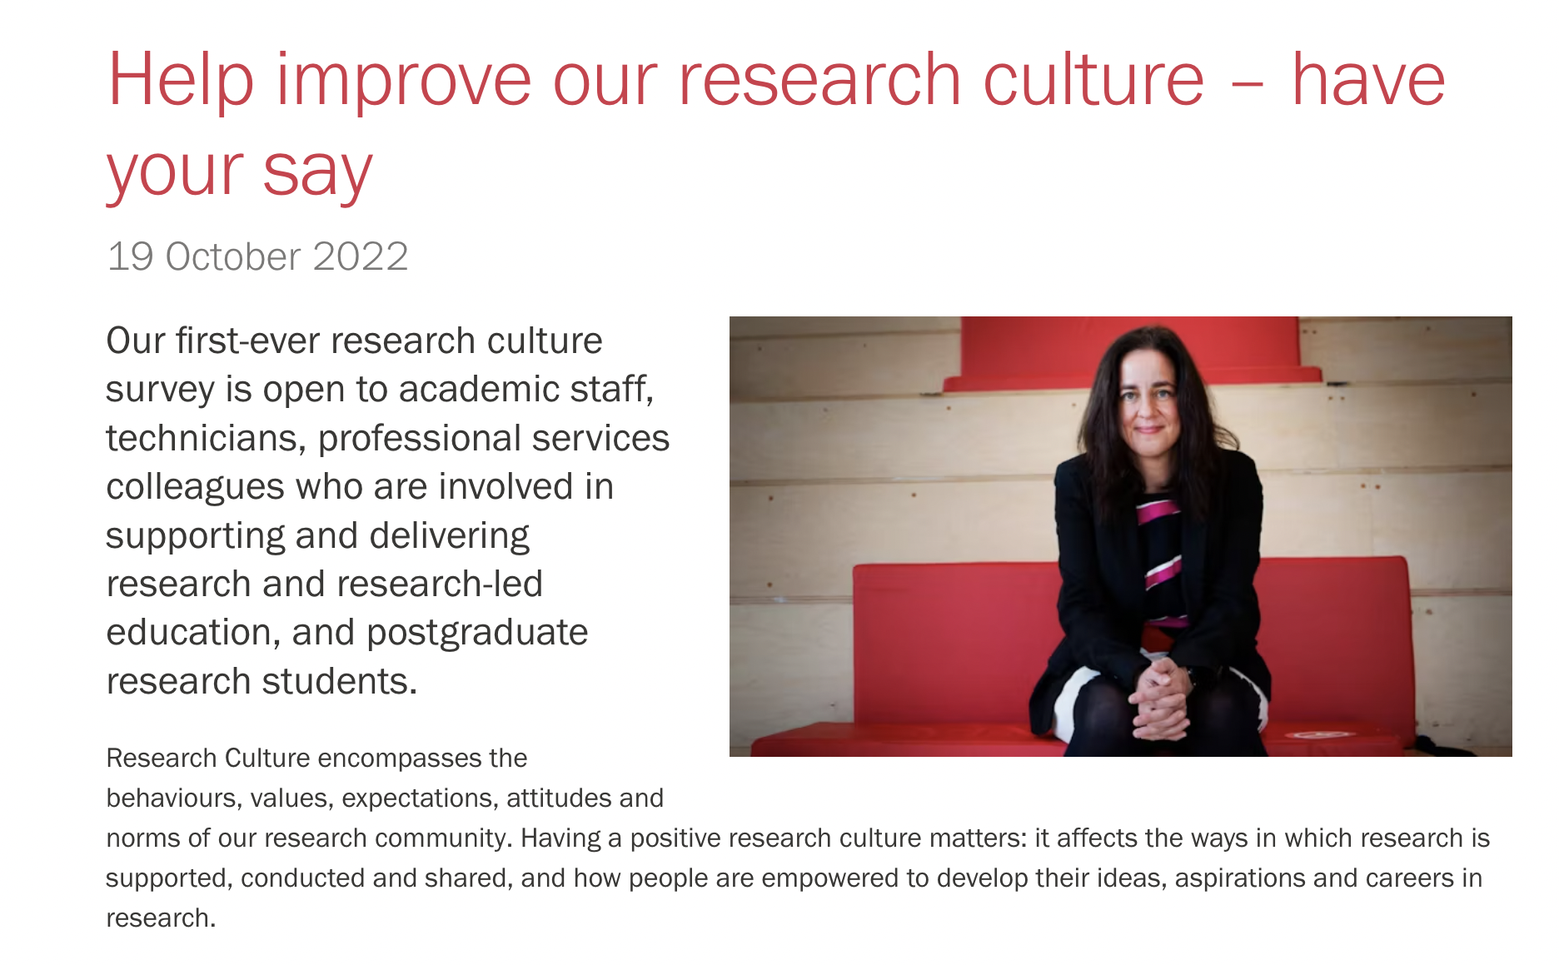
How we designed our surveys
Worked with colleagues from different roles and with survey expertise
  Looked at data we already had and for inspiration from existing research culture surveys
Identified themes linked to what we value in a positive research culture: Newcastle had four, Cardiff had seven
Included quantitative (Likert scale) and qualitative (open-ended) questions
Ad for Cardiff one?

Slide 4
Who responded?
  All colleagues and postgraduate students were invited to take part
Role | Cardiff | Newcastle
PGR Students | 365 | 132
Academic colleagues
Research-only Teaching and Research Teaching and Scholarship | 224 475 65 | 140 285 28
Professional Services colleagues | 161 | 157
No response/self-describe Total | - 1312 | 99 841

Slide 5

Key findings
Colleagues have positive views of collaboration and collegiality in local environments but are concerned about disciplinary silos.
Freedom to be curious and creative: Respondents largely agree that curiosity and freedom is valued, but time limitations are an important barrier.
Job security: Key concern for research staff.

Slide 6
Key findings
Equality, Diversity and Inclusion: Respondents express positive views on inclusion, but data suggests a need to address a lack of confidence in the university to address discriminatory or inappropriate behaviour.
Research integrity and ethics/Openness and fairness of research: Positive views of university culture and practice
Work-life balance, mental health and wellbeing: While many enjoy working on research , fewer respondents express satisfaction with their current work-life balance.
Across the board: Lack of time is key inhibitor of positive research culture

Slide 7
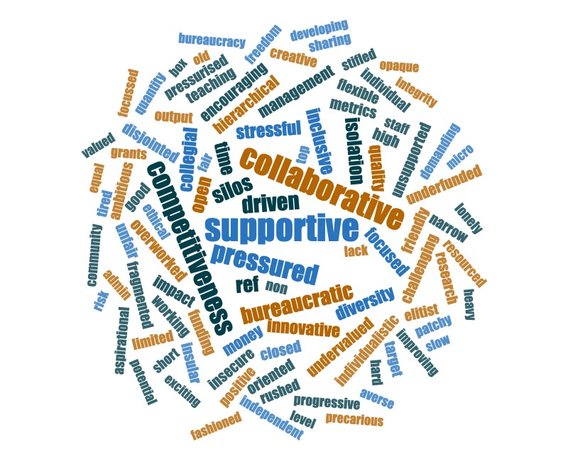
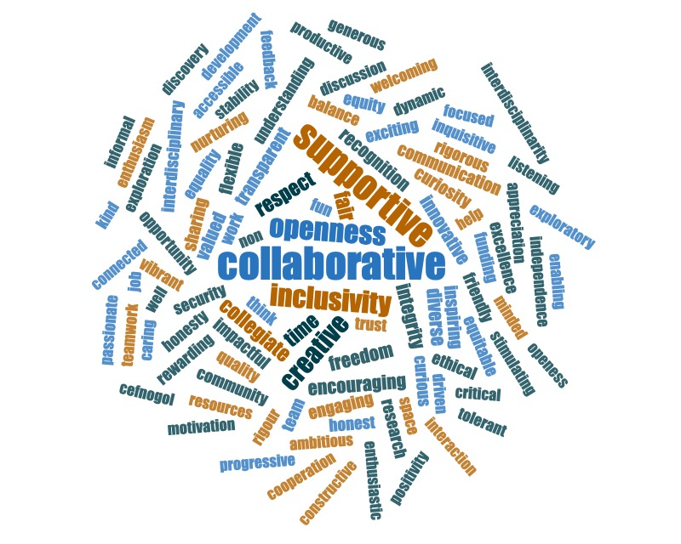
Figure 1: Respondents were asked to share ‘three words’ that they thought described ‘Cardiff University’s current research culture’.
Figure 2: Respondents were asked to share ‘three words’ that they thought described a ‘positive research culture’.

Slide 8
Developing data-driven actions
Newcastle developed a 5-year action plan and identified priorities:
  Building safe and inclusive environments
  Releasing quality time
  Rewarding what we value
Cardiff in process of translating priorities into action plan:
  Taking back time
  Getting out of the silo
  Creating systems that support people
  Investing in everyone
Recognise that we’ve still not heard from everyone

Slide 9

What have we learned?
Understanding lived experiences and building an evidence base important
Analysis and reflection takes time…
Managing expectations about what can be changed and in what timescale is important – surveys are part of a continuing dialogue
Similar findings may point to sector-wide issues and areas for collaboration

Slide 10
We’re always happy to chat…
Candy Rowe
candy.rowe@ncl.ac.uk
Karin Wahl-Jorgensen
Wahl-jorgensenk@Cardiff.ac.uk

