Slide 1
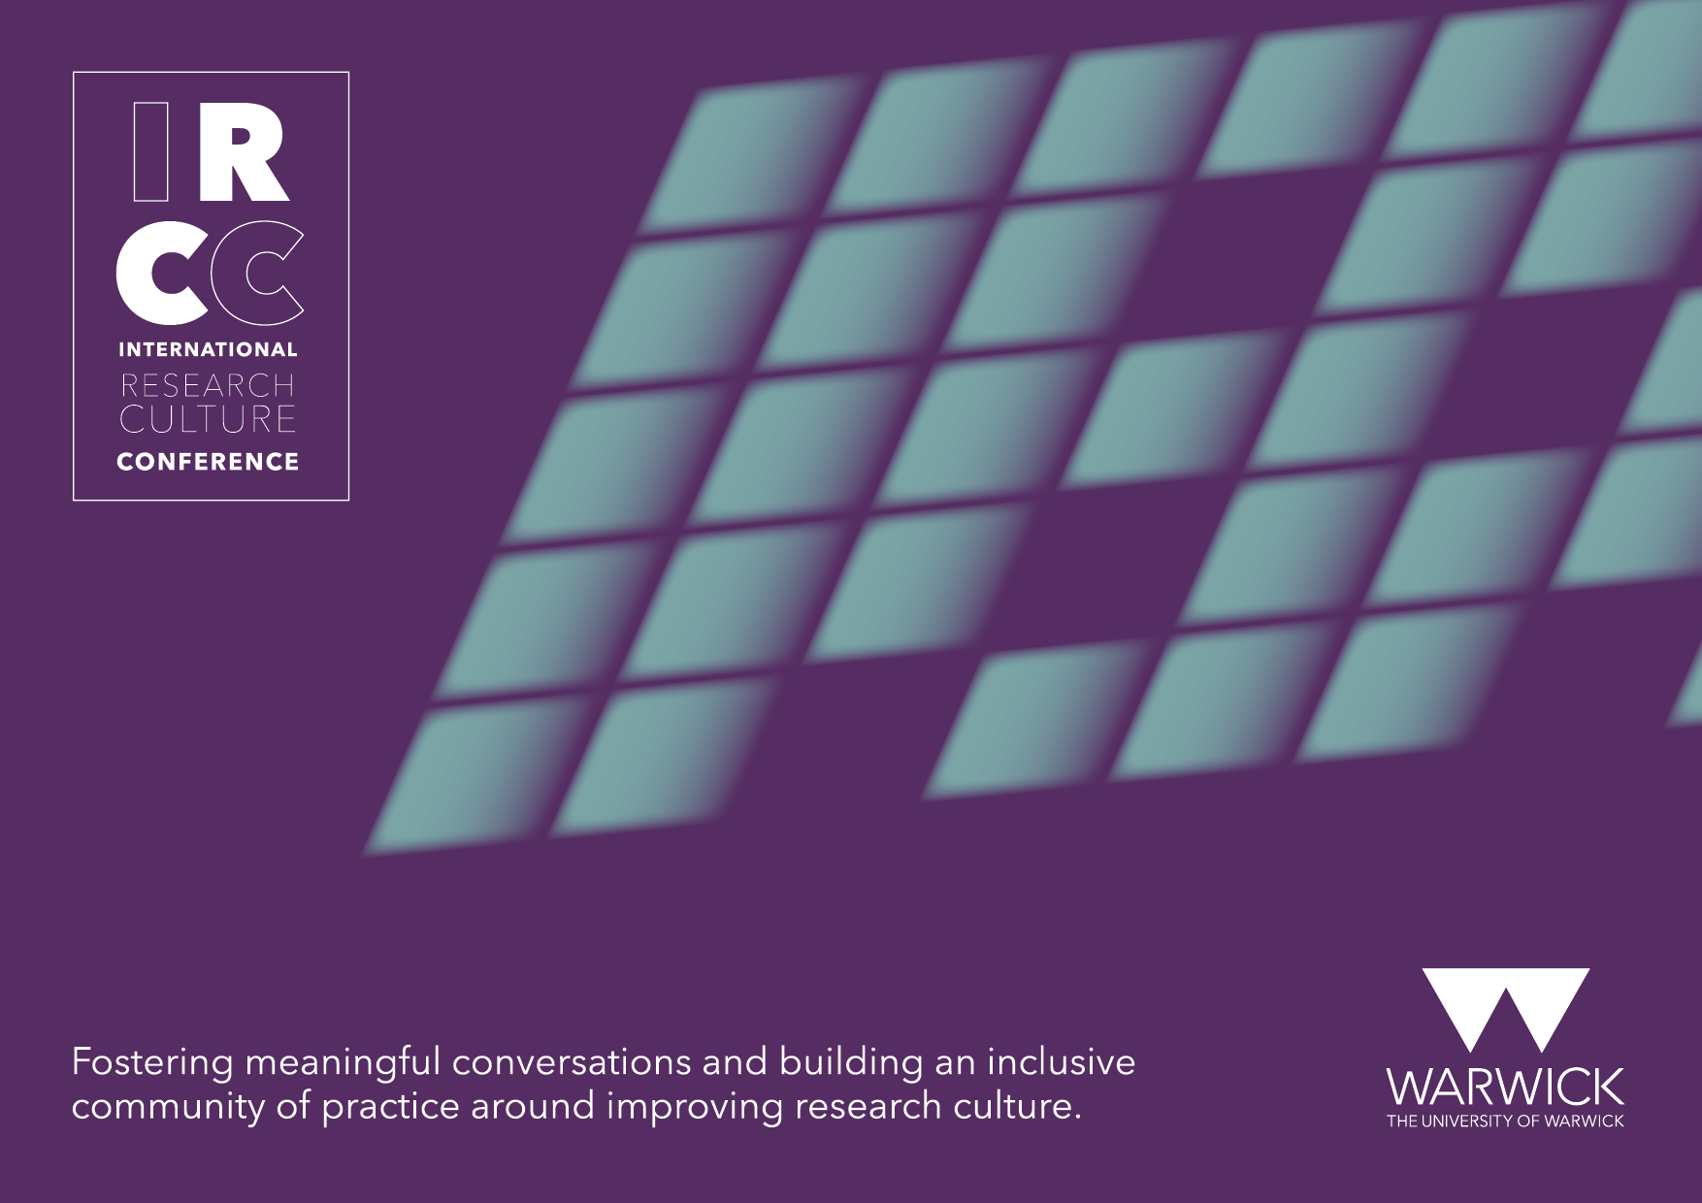

Slide 2

An (research) enabler? A person who encourages or enables negative or self-destructive behaviour in another
Stef Thorne; Associate Director Knowledge Exchange Development; UAL; 25th September 2023

Slide 3
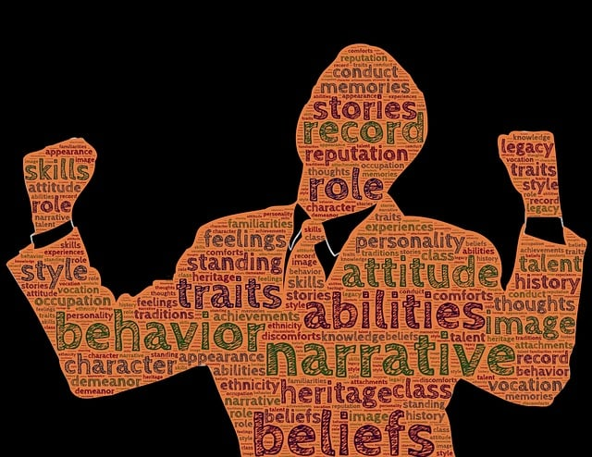
Who am I? Who have I been in R&D support?
Research Administrator and ‘Non-Academic’ in many different roles since 2001, Research ‘Enabler’ since 2022/2023?
Asst Panel Secretary to RAE 2008 (Psychology, Sports Science, Education)
Research Administrator x2, Graduate School Manager x2, Head of Research and Enterprise Services, Head of Business Engagement & Entrepreneurship, Director of Business Engagement and Knowledge Exchange, Associate Director Knowledge Exchange Development
IRCC INTERNATIONAL RESEARCH CULTURE CONFERENCE I 25th Sept 2023

Slide 4
Why does the term ‘Research Enabler’ matter?
.
‘Building on changes made in the previous exercise, REF 2028 will be a more inclusive research assessment exercise, capturing the valuable contributions of a wider range of research and research-enabling staff. Changes to the three assessment elements used will allow REF 2028 to recognise and reward a broader range of research outputs, activities and impacts and reward those institutions that strive to create a positive research culture and nurture their research and research-enabling staff.’ Early Decisions for REF 2028
IRCC INTERNATIONAL RESEARCH CULTURE CONFERENCE I 25th Sept 2023

Slide 5
How is the term being received? Siloed?
The R&I enabler
‘R&I enablers’ is an umbrella term used to describe those who facilitate research & innovation. Many roles, grades and areas across the sector are R&I enablers; from accountants and administrators, to technicians and teachers. These roles influence how research and innovation happens, is funded, communicated, archived, experienced and maintained. R&I enabler roles can be entirely focussed on R&I – for example funding development, or can be part of a wider remit – for example, librarians. ‘
.
‘This toolkit is the product of a collaboration between professional bodies representing R&I enablers who are passionate about giving a voice to their community.’
‘Café Culture Workshops for Research Enabling Professionals’ ARMA
IRCC INTERNATIONAL RESEARCH CULTURE CONFERENCE I 25th Sept 2023

Slide 6
How does the new language of research enabler as a term play out?
Strength rather than deficit language of non-academic
Sense the time for change is now
Have we enabled the problem (s) within University research cultures?
What does it mean to enable – in addiction terms it is not positive
Underlying issues of power and control
Does the term empower change for all members of research communities?
Do we need to fundamentally redesign and co-create research communities to be truly inclusive?
IRCC INTERNATIONAL RESEARCH CULTURE CONFERENCE I 25th Sept 2023

Slide 7
THANK YOU

