Slide 1
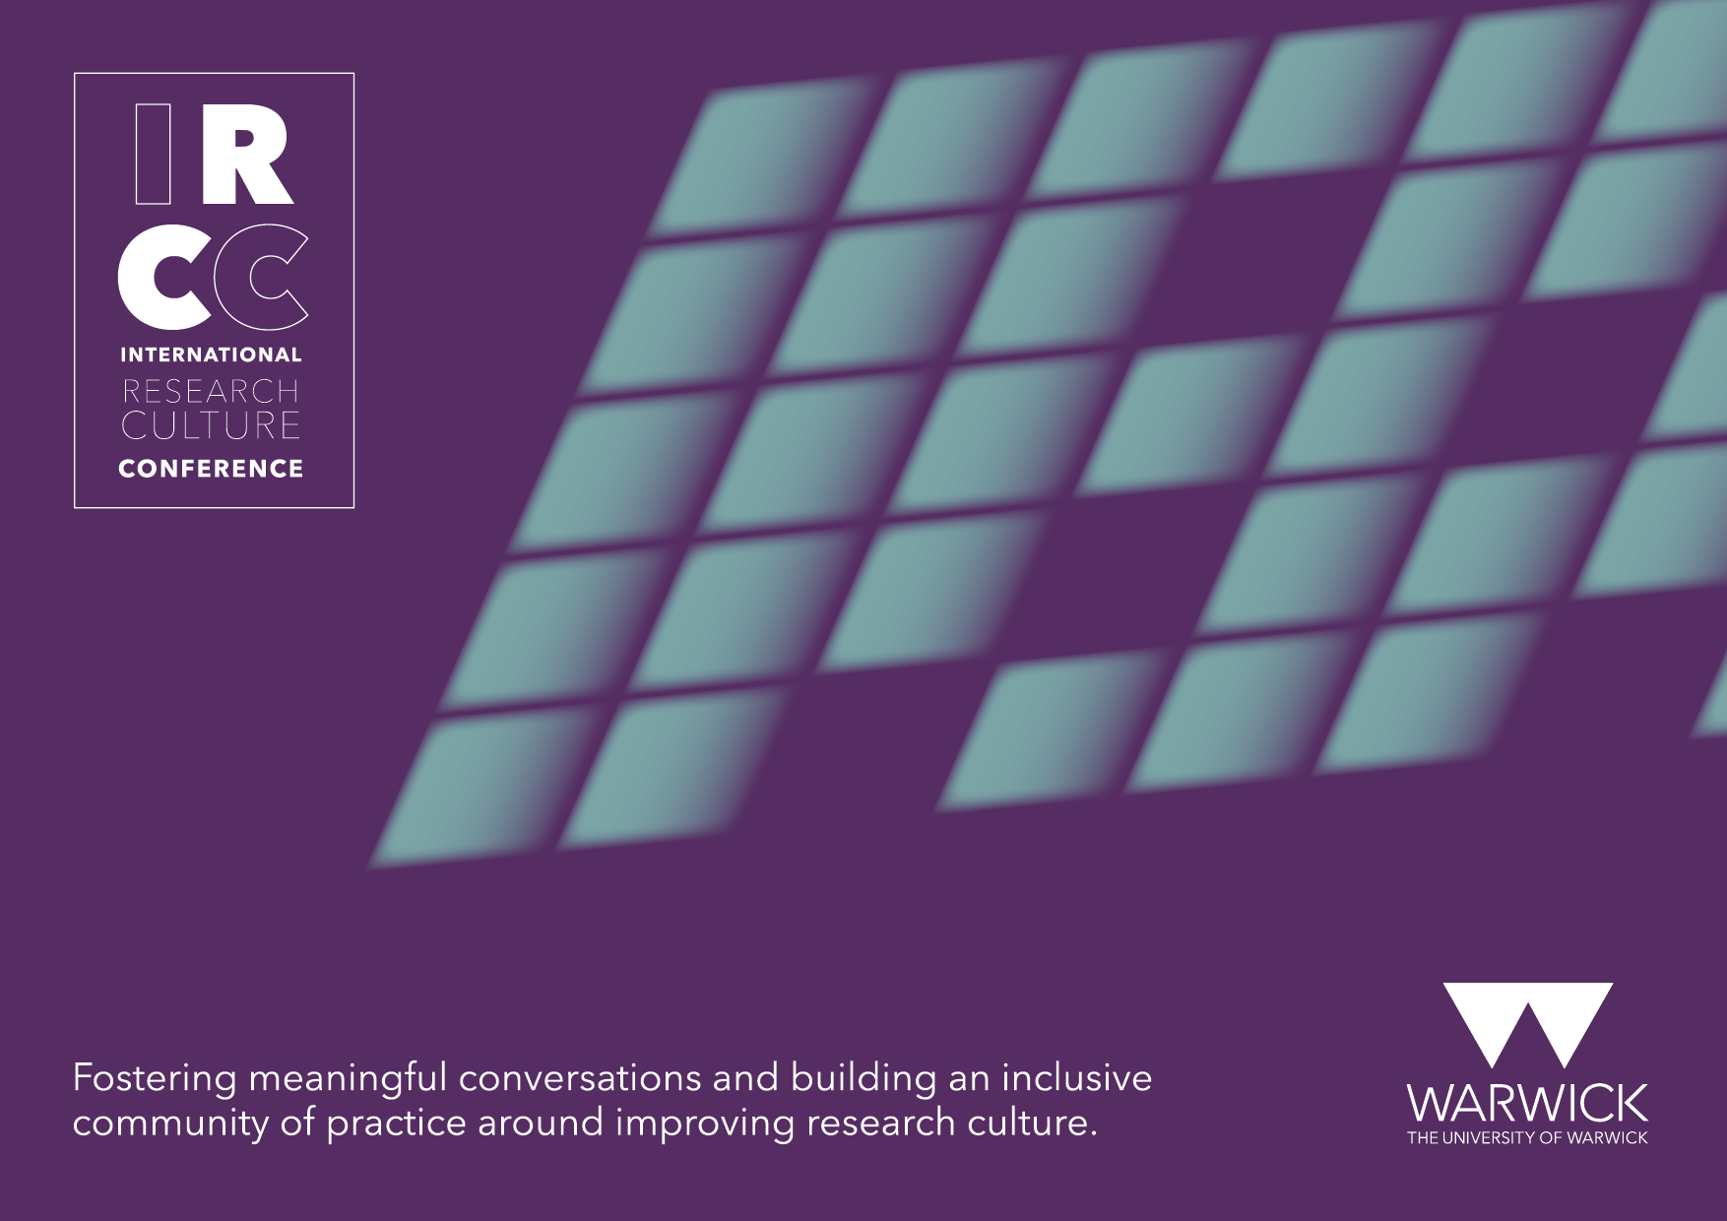

Slide 2


Inclusion and quantitative surveys
25th September 2023
Online: Remote from Hong Kong
Dr Hannah Griffin-James
Expert Evaluation

Slide 3
Overview
Impact on participants
Reflecting on my practice
Reflexive questions
What inclusive surveys look like
Questions
IRCC INTERNATIONAL RESEARCH CULTURE CONFERENCE I 25th Sept 2023

Slide 4
Questionnaire
vs.
Survey
used interchangeably
Data collection tool
Research methodology that uses questionnaires
typically used to gain insight into an individual's experiences
typically used to better understand trends in a specific group
IRCC INTERNATIONAL RESEARCH CULTURE CONFERENCE I 25th Sept 2023
Notes:
But first a quick definition

Slide 5
Impact on participants
More & more data
“We need to critically reflect on the assumption that more or better data about queer communities is necessary and that ‘biases’ and ‘inequality’ are the best problems to address”
p. 460 Guyran, 2022
IRCC INTERNATIONAL RESEARCH CULTURE CONFERENCE I 25th Sept 2023
Notes:
growing desire
Funders & senior leadership teams requesting data
Puts it well

Slide 6
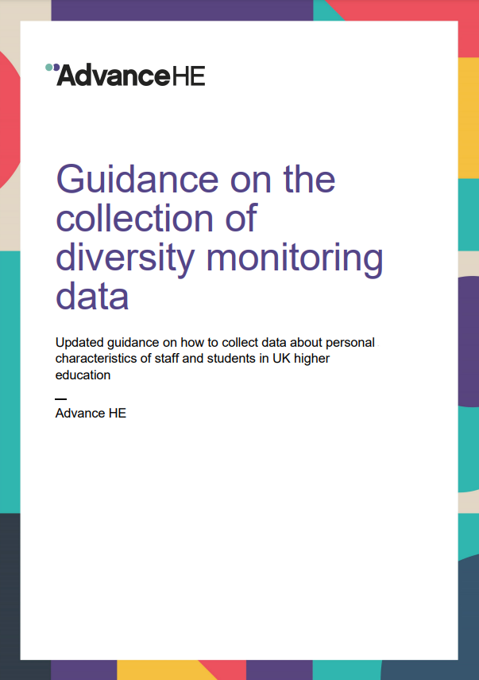
Impact on participants
Representation challenges
Inclusive survey questions and response options do not guarantee representative demographic data
IRCC INTERNATIONAL RESEARCH CULTURE CONFERENCE I 25th Sept 2023

Slide 7
Impact on participants
Representation challenges
Other aspects of surveys can prompt or prevent entire groups from responding, resulting in nonresponse biases
Problem of small numbers
Confidentiality
Anonymity
Weighting
Missing responses
IRCC INTERNATIONAL RESEARCH CULTURE CONFERENCE I 25th Sept 2023
Notes:
Leading often to the same voices are being marginalised
Ok so what can we do about, a concept I’d like to propose we add to our toolkit as researchers in pursuit of inclusive surveys is crystalisation

Slide 8

What is Crystallisation?
"like a clear crystal that casts multiple colours, the researchers endeavour to create a strong image of the linked experiences of the participants through comprehensive deliberation and persuasive presentation"
p.5 Denzin and Lincoln, 2011
IRCC INTERNATIONAL RESEARCH CULTURE CONFERENCE I 25th Sept 2023
Notes:
I have shifted my focus as a researcher to think about how I can support inclusion, diversity and equality and how I can be part of accelerating culture change in the sector. Which brings us to crystalisation
Crystallisation is a tool that supports researchers understanding of both their own and their participants' positionality. At its core, crystallisation proposes that the researcher uses multi-methods to uncover the multiple perspectives of the reality of the participants.
Crystallisation encourages the researcher to collect data from multiple sources and view these from multiple perspectives to create an image of the participant's truth. As a tool, crystallisation can be used to ensure credibility throughout the research process, from data collection to presentation of the data.

Slide 9

Facets
Posters
Observations
Field notes
Posters
Semi-Structured Interviews
Filmed Discussion
Observations
Classroom Work
Teaching Materials
Field Notes
Research Diary
Assignments
Filmed Discussions
Classroom work
Teaching materials
Semi-structured interviews
Assignments
Research diary
IRCC INTERNATIONAL RESEARCH CULTURE CONFERENCE I 25th Sept 2023
Notes:
Richardson (2000) coined the concept of crystallisation, particularly favouring the metaphor of crystallisation, as the crystal is both flexible in its growth and amorphous simultaneously. She believes it is perfect for qualitative research methods as the crystal reflects the external world, refracts the internal, and casts patterns of light out.

Slide 10
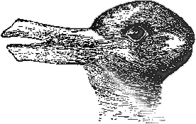
Top tips when using crystallisation
Perception is not just a product of the stimulus, but also of mental activity
Gain more perspectives
Build regular reflection into your practice
eg involve others, alter your perspective
Jastrow, 1899
eg behaviour, actions, perceptions, understanding
IRCC INTERNATIONAL RESEARCH CULTURE CONFERENCE I 25th Sept 2023
Notes:
Most people see the duck, and now look again and you’ll see the rabbit. The ducks beak, is the rabbits ears.
-You could involve others by using participatory research methods and collaboration. Don't forget you can also gain more perspectives in the analysis stage, eg round table analysis.
-You could alter your perspective by changing lenses. For example, suppose I was analysing data from a focus group with racially minoritised staff members. In that case, I could first consider, "how does the ethnicity of the participant inform what they are describing" then when the data has been thoroughly considered from this perspective, I could ask again, "how does ethnicity insect with other equality areas (gender, disability status etc.) to inform what they are describing".
Reflect on your behaviour, perceptions and understanding. Rather than reflecting alone, I have found it helpful to write my reflections and then use this to generate prompts to discuss with my team. These prompts have led us to insights and rejuvenated research designs.

Slide 11
Reflecting on my research practice
What the researcher sees depends upon the viewing angle
I am a…
Quantitative researcher
Positivist perspective
Gold standard
Quality of research depends on ‘skills, sensitivity and integrity of the researcher…because research itself is a sense-making process’
Treagust, 2023
IRCC INTERNATIONAL RESEARCH CULTURE CONFERENCE I 25th Sept 2023
Notes:
meaning that their perspective dictates their view of truth. Therefore, it is essential to consider our position when trying to make our research inclusive.
In reflecting on my practice as a quantitative researcher, I identified that the methods I use tend to frame people's experiences from a positivist perspective. Meaning I reduce and objectify people's experiences and may dismiss critical elements of an individual's experience. Adopting this objectifying perspective means that I choose to propose methods that have been attributed a "gold standard" label (eg Randomised Control Trial), and I use the "gold standard" label as a mark of quality. However, it has long been established that the "gold standard" label is typically attributed to data that is absolute (ie facts or statistics) and reduces and objectifies people's experiences. Maybe on reflection, you do this too? This positivist perspective fits well with some parts of the sector where there is a desire to gather more and more data to support evidence-based decisions. To be clear, I'm not saying this is wrong, but rather that we must be aware of our position.

Slide 12
How it’s impacted my research practice
Not insisting that every participant takes part in the same way
Flexible attitude towards data collection strategies
Rejection of non-flexible survey software
Focus on getting to know my participant population's strengths and weaknesses
IRCC INTERNATIONAL RESEARCH CULTURE CONFERENCE I 25th Sept 2023
Notes:
Most people see the duck, and now look again and you’ll see the rabbit. The ducks beak, is the rabbits ears.
-You could involve others by using participatory research methods and collaboration. Don't forget you can also gain more perspectives in the analysis stage, eg round table analysis.
-You could alter your perspective by changing lenses. For example, suppose I was analysing data from a focus group with racially minoritised staff members. In that case, I could first consider, "how does the ethnicity of the participant inform what they are describing" then when the data has been thoroughly considered from this perspective, I could ask again, "how does ethnicity insect with other equality areas (gender, disability status etc.) to inform what they are describing".
Reflect on your behaviour, perceptions and understanding. Rather than reflecting alone, I have found it helpful to write my reflections and then use this to generate prompts to discuss with my team. These prompts have led us to insights and rejuvenated research designs.

Slide 13
General good practice
Ensure anonymity (de-link)
Send reminders
Minimize survey length (PEW)
Incentives
Provide a justification for sensitive questions (eg responses will inform EDI initiatives)
Work with the sector to identify common demographic questions and responses
IRCC INTERNATIONAL RESEARCH CULTURE CONFERENCE I 25th Sept 2023
Notes:
Whole talk just on incentives

Slide 14
What I’ve found works
A survey should support the participant in sharing their experiences, attitudes, perceptions, satisfaction
Optional questions
Offer and analyse open responses throughout
Make it easy for your participants (PowerPoint questions and recorded responses)
Include “Prefer not to say” in demographic questions
Keep questions simple, no doubles
Provide definitions of your meaning
IRCC INTERNATIONAL RESEARCH CULTURE CONFERENCE I 25th Sept 2023
Notes:
caveat my survey specialism is (experiences and satisfaction)(attitudes and perceptions), this may not be appropriate, for loyalty, brand or assessment measures
but the scope of this talk is about the design of the survey.

Slide 15
What I’ve found works
A survey should support the participant in sharing their experiences, attitudes, perceptions, satisfaction
Consider software (JISC, Qualtrics, Google, Microsoft, Paper)
ALWAYS represent the full demographics in write up (for small numbers I follow the guidance from HESA)
Make an analysis plan before you ask for responses! Yes, for each question
Consider the research audience
Test, test and test again, then pilot
IRCC INTERNATIONAL RESEARCH CULTURE CONFERENCE I 25th Sept 2023
Notes:
caveat my survey specialism is (experiences and satisfaction)(attitudes and perceptions), this may not be appropriate, for loyalty, brand or assessment measures
but the scope of this talk is about the design of the survey.

Slide 16
Reflective Questions
Why am I interested in this piece of research?
Am I more comfortable with one data collection strategy/analysis? Why?
Who are my research population? What tools do they use daily?
What data collection approach is most appropriate for this population?
Is there anything I can do to shift the load from them to me? (eg have they already written about what I’m asking)
Who is this data for? Am I collecting data in the right way for its audience?
IRCC INTERNATIONAL RESEARCH CULTURE CONFERENCE I 25th Sept 2023
Notes:
Reflective practice has various interpretations and intellectual traditions depending on the subject discipline (Fook et al, 2006). Within Education reflective practice is commonly defined as learning through and from experience towards gaining new insights of self and practice (Finlay, 2008).
Ultimately, reflections on ourselves as researchers and an awareness of the role of the self in the research process, can help us contribute not only to our own development as scholars, but also spark opportunities and ideas for new research.

Slide 17


I want to acknowledge that much more can be done to accelerate culture change in the sector. Crystallisation is only one concept that can be added to our everyday toolkit as researchers to develop our practice to be more inclusive.
Thank you

Slide 18


Any questions
Hannah.griffinjames@gmail.com
expertevaluation.org

Slide 19
References
Burnett, N. P., Hernandez, A. M., King, E. E., Tanner, R. L., & Wilsterman, K. (2022). A push for inclusive data collection in STEM organizations. Science, 376(6588), 37-39.
Denzin, N. K., & Lincoln, Y. S. (Eds.). (2011). The Sage handbook of qualitative research. Sage.
Richardson, L. (2000). Writing: A method of inquiry. In N.K Denzin & Y.S Lincoln (Eds). Handbook of qualitative research. (2nd ed.). (pp. 959-978). Sage.
Guyan, K. (2022) Fixing the Wrong Problems: Queer Communities and the False Promise of Unbiased and Equal Data Systems. European Data Protection Law Review, 8(4), 455-461.
Jastrow, J. "The Mind's Eye." Popular Science. Monthly 54, 299-312, 1899.
Treagust, D. F., & Won, M. (2023). Paradigms in science education research. In Handbook of research on science education (pp. 3-27). Routledge.

