Slide 1


WMS Enhancing Research Culture
Hosted by Prof Kirstie Haywood and Adele Kenny
Monday 25th September 2023
Notes:
Good afternoon, everyone. I’m Adele Kenny and I've been working as WMS'S first Research Culture Officer since January 2023 alongside Professor Kirstie Haywood.

Slide 2

WMS Research Culture Cafes
Aim:
Engaging with our community to inform WMS research culture
  What does the ‘WMS Research Culture of 2028’ look like and how do we get there?
Notes:
ADELE
In 2022 we were awarded an Enhancing Research Culture grant to actively engage with our diverse community to explore what research culture meant, how it could be enhanced, and to co-define a future vision.
We planned a series of semi-structured group café conversations open to staff and students, whether directly involved in research or as research enablers contributing to the wider research effort. ​
Together, we explored the challenges and opportunities associated with research culture at WMS and proposed ideas to inform future initiatives. ​
********************************
WMS is at the start of this journey. We are inviting all staff and students to have the opportunity to influence and inform the future of research culture at WMS.
This aim and objectives will be achieved through:
an on-going and open conversation with members of the WMS community to determine the biggest opportunities and challenges for enhancing our research culture.
a series of cafes to inform the development of a position statement underpinning how research culture is understood, and the challenges and aspirations for enhancing research culture across the WMS community.
Working towards a roadmap that will establish a framework that allows people to reach their full potential and ENJOY the journey, and in which we can all be committed to each other's success

Slide 3

Participants
Role | Total (per café) |  |  | TOTAL
Cafe | 1 | 2 | 3
Researcher (ERC) | 13 (5) | 15 (2) | 16 (7) | 44 (14)
Research Enabler | 10 | 7 | 10 | 27
Students:
PGR | 8 | 2 | 3 | 13
UG | 0 | 4 | 1 | 5
TOTAL | 31 | 28 | 30 | 89
Notes:
ADELE
We held three, three-hour events between February and June, hosted away from WMS to allow people dedicated time, space and distance to be honest about what was important to them. ​
As you can see here, around 30 people attended each café with representation from a broad range of roles including researchers, research enablers and students.
With additional contribution from our grant co-applicants, more than 90 unique voices contributed to the development of the WMS roadmap.
NOTE:
Approximately (2018 figures) 35% of WMS staff are PSS.
Participants in RC cafes approximate this with approx. 38% PSS colleagues.
The proportion of research enablers who participated approximated the proportion of PSS colleagues (approx. 35%) across the WMS community (who may or may not identify as Research Enablers).
​

Slide 4

WMS Research Culture Cafes
Objectives of Research Café 1:
To explore what research culture means for the WMS community
Notes:
ADELE
At our first café, we asked the participants to consider what research Culture meant to them. Split into three facilitated groups, a scribe took detailed anonymised notes.
​
A thematic analysis of the data informed the development of key themes.

Slide 5
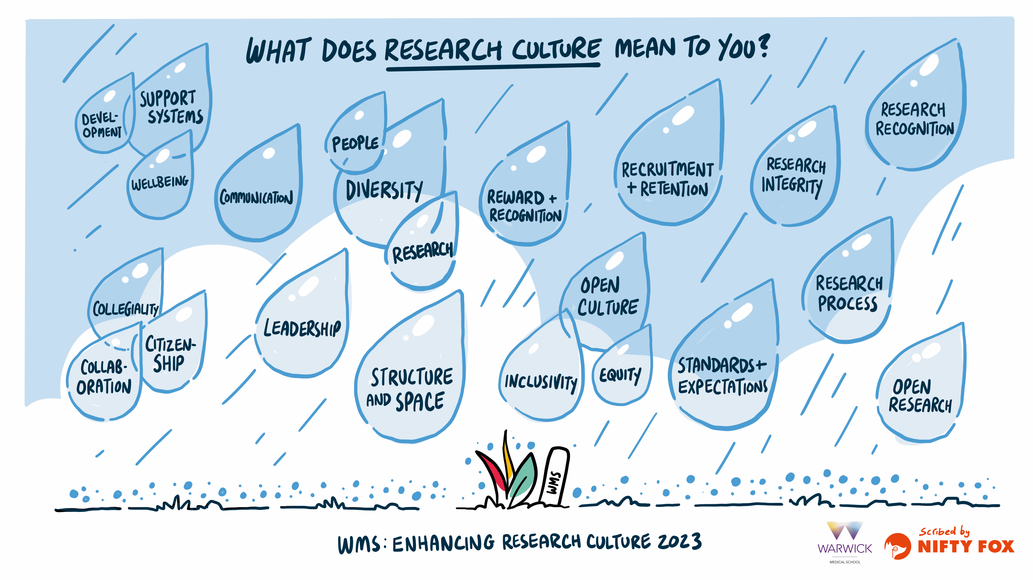
Notes:
When asked to consider what research culture meant to our community, a broad range of concepts were described which, when viewed as 'raindrops' as per the image, were seen as important in feeding a positive research culture where all could flourish and grow. ​
​These included the importance of support systems, collaborative working, greater transparency and communication, and a more inclusive approach to reward and recognition which recognised both the diversity of teams and of output.​
Enablers across the piece:
Structure and Space; Communication; Diversity and Inclusivity; Courtesy

Slide 6
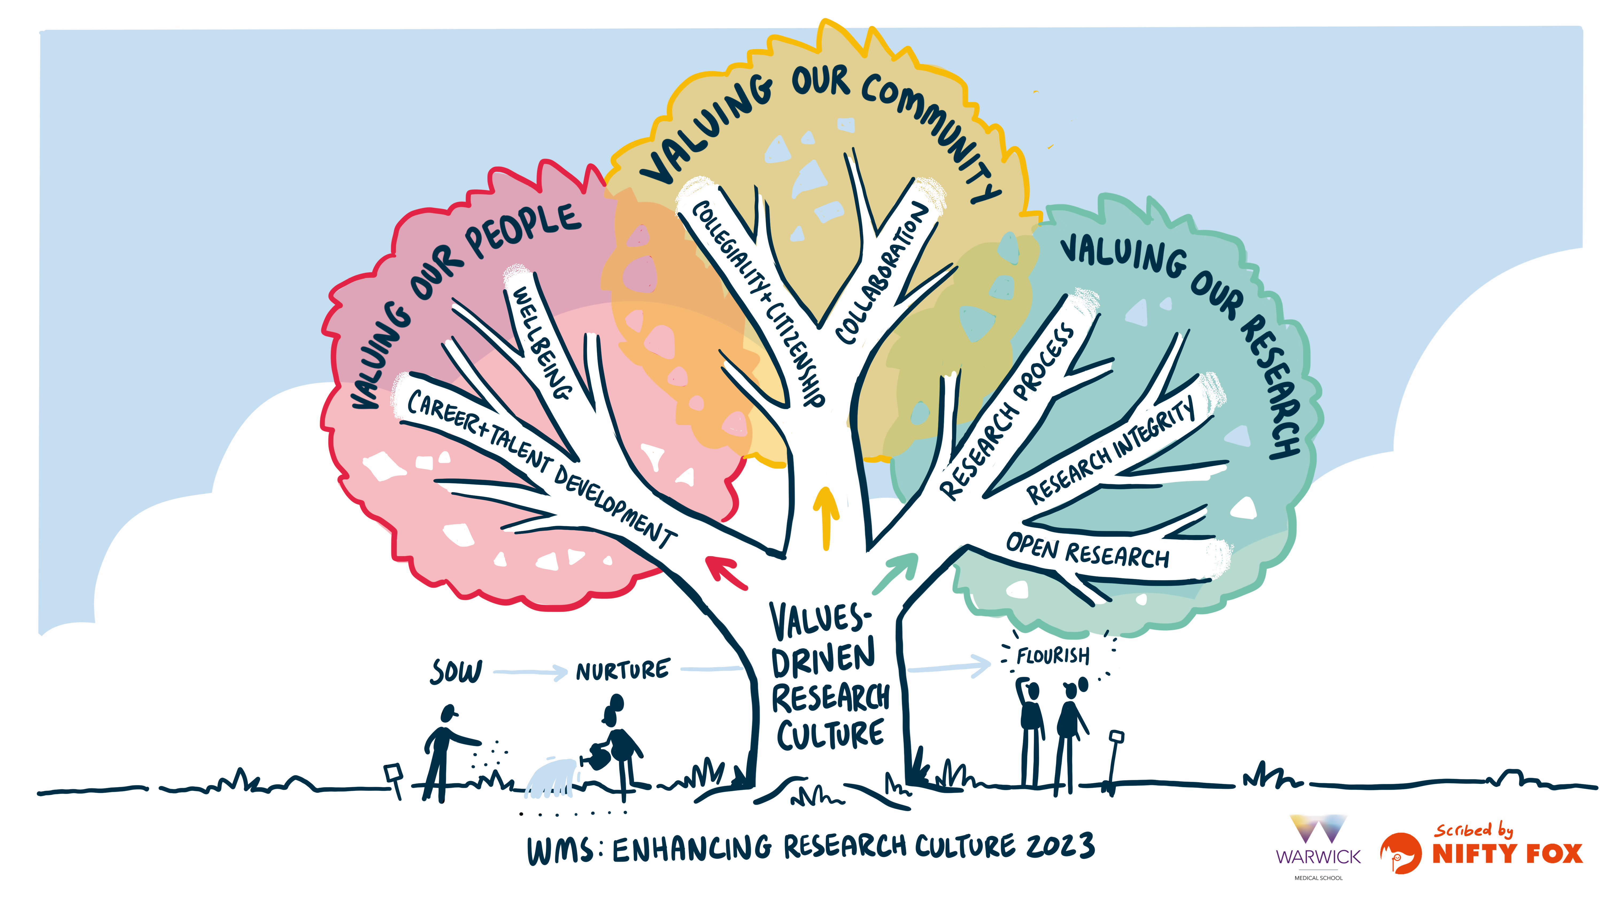
Notes:
ADELE
The analysis further informed a 'values-driven' research culture where three key themes were evident:​
​
Valuing Our People​
Valuing Our Community and​
Valuing Our Research.​
​
Within these three values, a total of seven sub-themes were defined which we will expand on over the next few slides. ​
​
It is clear from this analysis that there are pockets of great activity and initiatives at WMS which are really seeking to help promote an enhanced research culture. However, as illustrated in the image above there was clear evidence of siloed working, a need for enhanced communication, and gaps which present opportunities to further enhance the research culture at WMS.​
​
So, what do these gaps look like and what needs to happen to facilitate positive change? I’ll now pass over to Kirstie to take you through the details.

Slide 7

WMS Research Culture Cafes 2 & 3
Objective: to build on Café 1
  Explore:
    Proposed values
    Required changes
      What, Who, How, When?
    What does a good outcome look like?
Notes:
KIRSTIE
Thank you, Adele.
In subsequent cafés, participants built on the findings from café 1. ​
​
This included exploring the relevance of the proposed 'values' and associated sub-themes, and opportunities for change. They considered what changes were required, who could make these changes, how and when.
*******************************
Objectives of Research Café 2:
To explore the proposed values
To explore what changes are required at WMS: who can make this change, how and when
To inform a future vision for research culture at WMS
The focus of RC Café 1 was to explore ‘what’ research culture means and why it is important. The findings informed a ‘values-driven’ approach towards an enhanced research culture at WMS. The three core values are: valuing people, valuing our community, and valuing research (spreadsheet as handouts on the tables). Each core value includes several sub-themes.
We would now like to build on this to better understand the challenges and opportunities that need to be addressed or delivered on to underpin an enhanced research culture at WMS.
To start, we would like each group to explore the assigned ‘Value topics’ with a view to identifying potential opportunities for change which will help us to move towards an enhanced research culture at WMS.
Each group has been assigned 3 topics to explore and discuss. Each group should explore how each topic could it be tackled to create a more positive research culture. It may be helpful to think about what a ‘good’ research culture should look like. You will have approximately 25-minutes per topic.
For each topic we would like you to consider the following:
WHAT are the opportunities for change/development/enhancement that will contribute towards a positive research culture?
Use the ‘ideas for change’ cards to write down your ideas
Also use the ‘good practice already happening’ cards to identify those activities at WMS that are working well, that we should continue or build upon.
WHO can make the change?:
For example, who should have ownership of the action?
HOW can the change be made?
WHEN can this change be made by?:
What are the low-hanging fruit / short-term wins?
What requires longer-term investment? For example, application for a future Enhancing Research Culture Grant.
If you have time, you could also consider WHAT a good outcome looks like? (that is, how should change in research culture be assessed and communicated?)
PRIORITIES: Within each of the three topics, please identify the groups priority initiatives to inform the WMS Research Culture Roadmap.
Bonus question per priority: What is one thing you could do tomorrow to support your idea?
Aide memoir:
You may find the ‘who’ and ‘how’ cards helpful to prompt ideas with regards to ownership and actions.
What tangible things could different kinds of individuals and organisations do by supporting, requiring, or rewarding practices and behaviours?

Slide 8
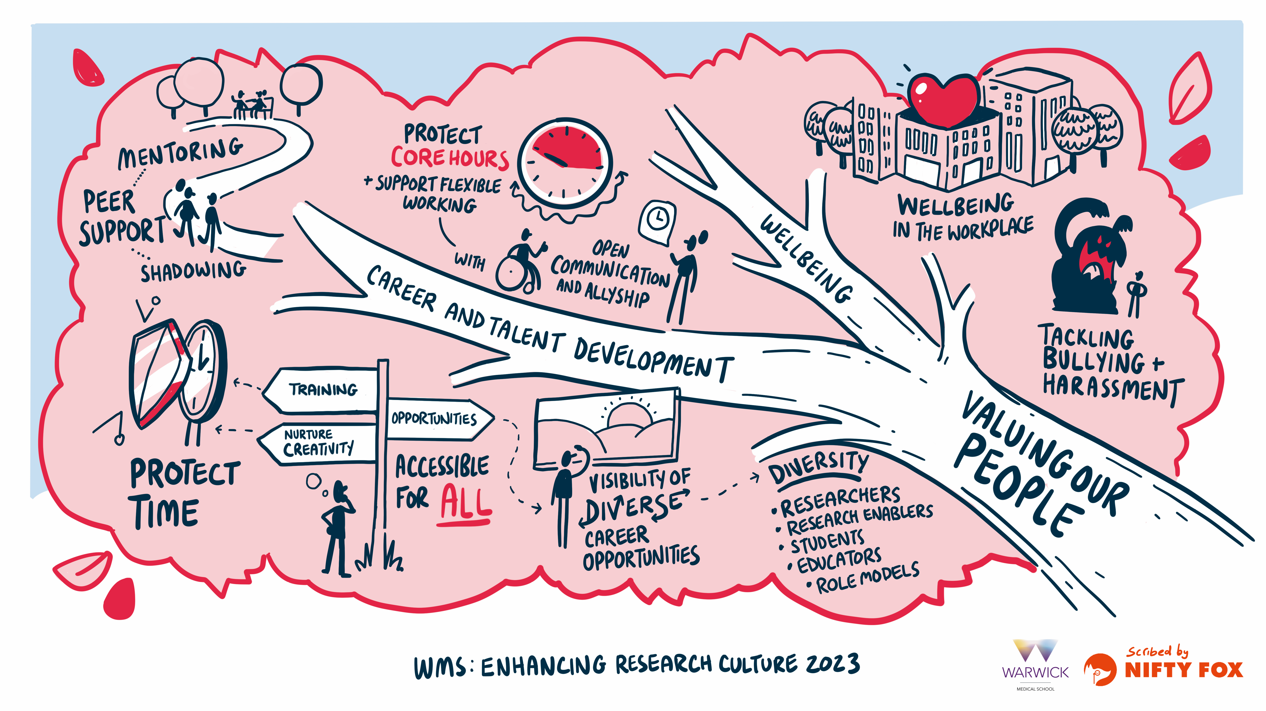
Notes:
KIRSTIE
Within 'Valuing Our People’, the importance of terminology which captured the contribution of all staff to the research endeavour was supported, resulting in the term ‘research enablers’ being proposed for non-academic colleagues.
Two sub-themes were confirmed which embraced both the importance of 'Wellbeing' and supporting the personal and professional development of all staff and students.
The centrality of 'Wellbeing' was to be promoted through the provision of safe, supported and inclusive research environments where wellbeing is valued and championed, thus enabling people and their ideas to flourish.
It encapsulated several concepts ranging from feelings of vulnerability and how different lifestyle/work choices are valued through to bullying and harassment and the importance of providing ‘safe spaces’ where people can raise concerns without fear of negative consequences.
Career and talent development encompasses career aspirations and decision-making. For example, highlighting a diverse range of role models was to be championed – and this should not just be limited to those in senior leadership roles. Leadership and who made a ‘good’ role model had many guises.
However, job security, or rather precarity, was a major concern, particularly for those on fixed term contracts. For some, this negatively impacted on their ability to fully engage with the role and jobs were often selected for contract duration as opposed to career development.
Initiatives to attract, develop, and retain talented people are essential to ensuring that people can enjoy a rewarding and sustainable career at WMS.
Feeling valued – as individuals and team members
Self-worth is nurtured
Wellbeing is respected (and central)
Support systems
Wellbeing
Safe spaces: to ask for help
Career development: equity of opportunities to flourish
Role Models: diverse, accessible, visible, passionate
Improving accessibility: inclusivity, language, support systems
Diversity and inclusivity: People need different things to be efficient and effective team members

Slide 9
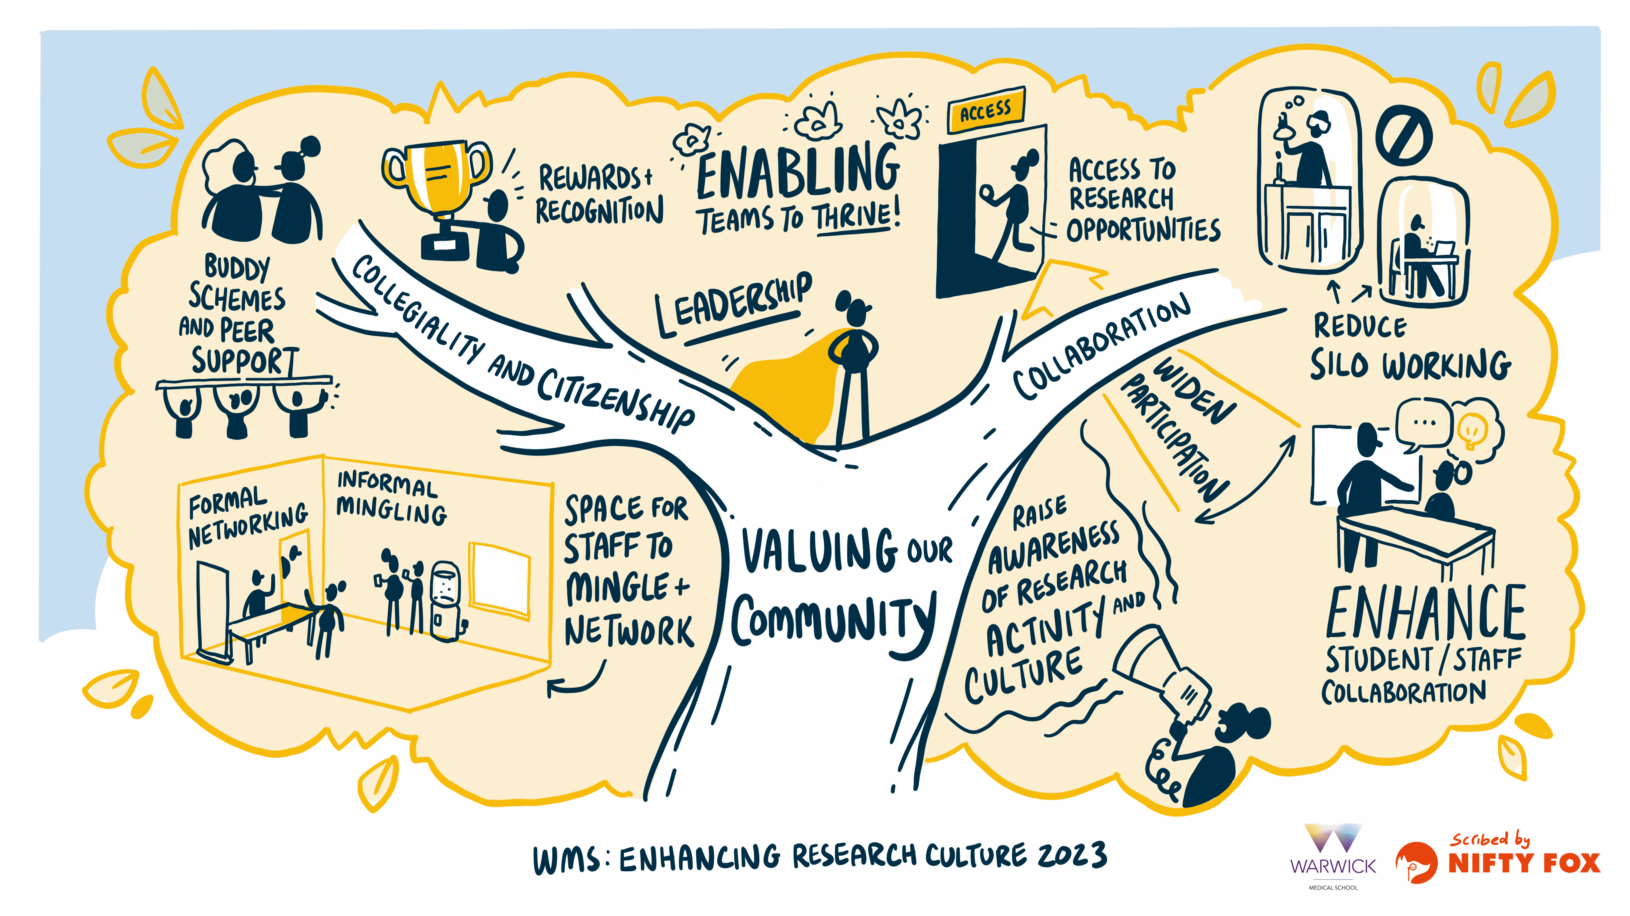
Notes:
KIRSTIE
Within ‘Valuing Our Community’, just one over-riding sub-theme was proposed: that of collegiality, citizenship and collaboration, which was to be facilitated by developing a supportive and engaged community in which all can flourish, deliver the best research, and enjoy the journey!
A positive, inclusive and respectful culture was central to this.
Varied and accessible, formal and informal networking opportunities for all to engage with others from across the school, the university, and beyond – and to reduce ‘siloed working’ – were supported.
However, workload was often cited as a potential barrier to people participating in opportunities to engage with others in more collegiate and supportive ways. Recognising, protecting time for, and rewarding collegiate activities should be afforded a higher profile. For example, ‘buddying schemes’ where established colleagues supported new starters, and peer support initiatives were to be valued.
And whilst hybrid and flexible working was highly valued for supporting access to increased opportunities and promoting the diversity of talent evident across the WMS community, normalising in-person social interaction was viewed as important.
The importance of inclusive and supportive leadership – at all levels – was recognised. However, we should ensure that people in leadership positions are appropriately supported and have the right skills to ‘unlock the potential’ within their teams – thus enabling the many teams at WMS to thrive.
Enhanced communication across all facets of the school was viewed as central to many of these endeavours.
Support systems – to help people to ‘be their best’ and to ‘do their best work’ and to progress
Language and Communications: Inclusive, accessible, transparent, consistent;
What is our brand? How do we value research culture?
Diversity: Valuing the whole team - all contributions, whole journey
Of research output; nurture bold and creative thinking
Reward and recognition: Transparent, equitable, enabling (invested), consistent
Talent management: Recruitment/retention; development/promotion opportunities, transparency; Job security
Embedding principle of EDI across the community: people need different things to be efficient and effective team members
Promoting collegiality and connectivity: Raising awareness; Internal and external collaboration; diversity and inclusivity
Leadership: Create and lead positive team; support leaders
Structure and space: Differences across the divisions; feeling valued
Open culture: Active and transparent engagement and communication; opportunity to negotiate; respect, kindness, humility

Slide 10
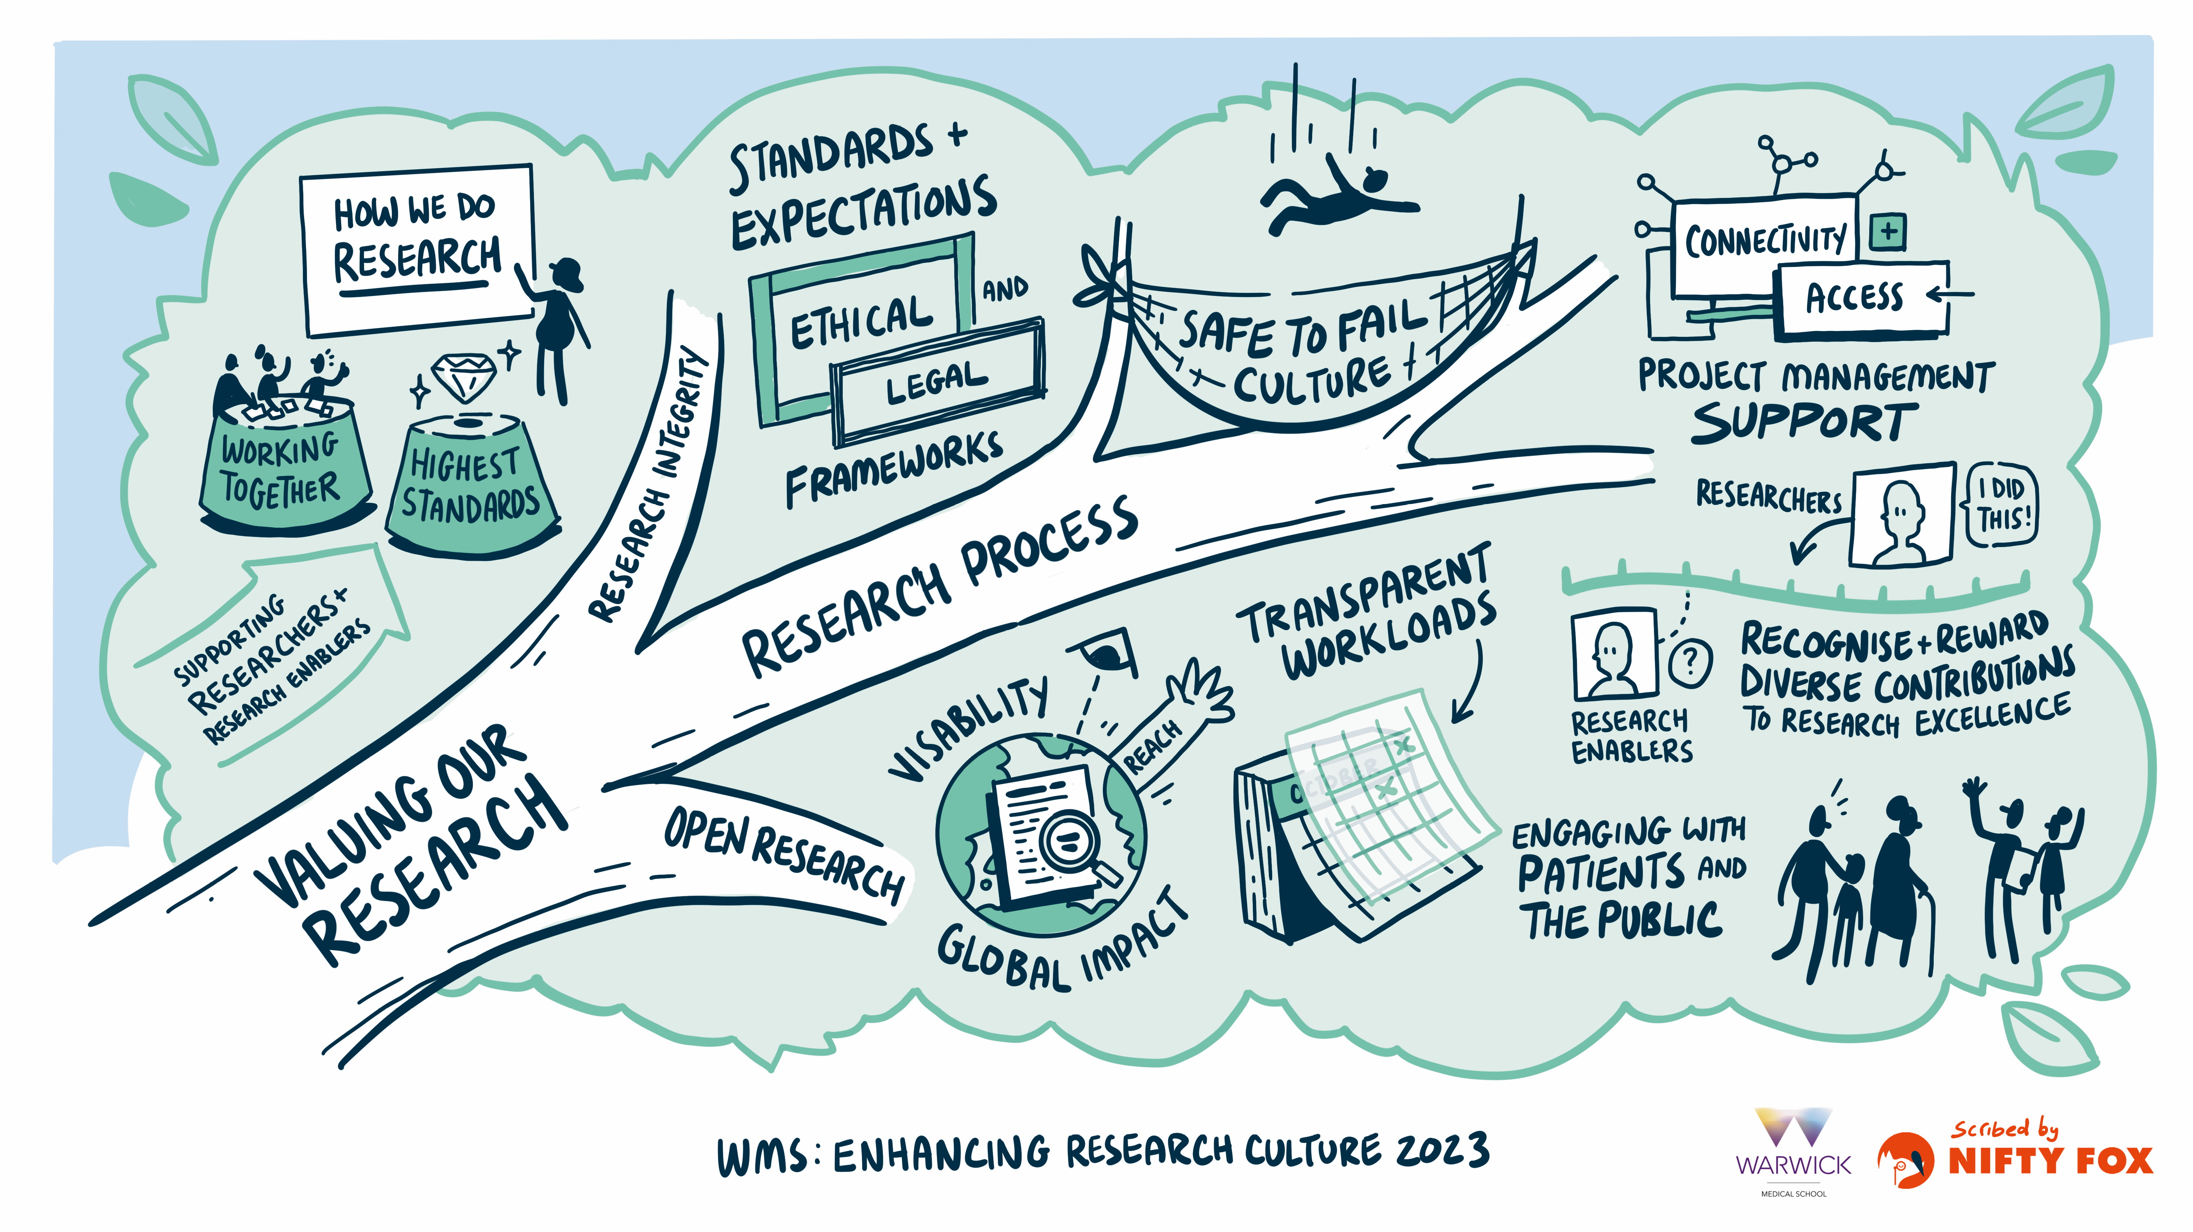
Notes:
KIRSTIE
Our third values spoke to the importance of Valuing Our Research. Here, three sub-themes were described:
Valuing the Research Process – recognised the importance of embedding clear and fair approaches for the way in which research is conducted, supported, recognised and rewarded.
The realities of the research process spoke to the importance of normalising ‘failure’ and establishing a ‘safe to fail’ culture where the learning experience from ‘failure’ was valued.
It was recognised that various processes and systems could be overly burdensome and time-consuming which could result in friction and detract from innovation and creativity. Appropriate project management support was proposed as a potential solution.
The community recognised the current limitations and inequities around the way in which research excellence is currently defined, and how different contributions are recognised, valued, and rewarded. For example, whilst it is relatively ‘easy’ to showcase the success of a ‘researcher’ in terms of papers published and grant income, this was not so evident for research enablers.
Engaging with the WMS community to explore, broaden and establish a shared definition of research excellence and innovation which values the diversity of research, who is involved, and how research is delivered was a priority.
And whilst ‘Research Integrity’ and ‘Open Research’ were not discussed at length by participants in the research culture cafes, it is evident that the conduct of rigorous and ethical research is essential to the production of high-quality research, and hence research excellence. Moreover, open research speaks to the importance of research visibility, impact and reach.
Finally, the importance of active engagement with patients and the public was described – and spoke to all components of how we value our research. For example, ensuring that systems in support of PPIE are both efficient and equitable; recognising and rewarding PPIE contributions to research excellence; and valuing the importance of PPIE in open research.
Reward and recognition: the importance of recognising and valuing the contribution of every team member. Exploring how research excellence if recognised, understood and valued.
888888888888888888888888888888888888888
Support systems – to help people to ‘be their best’ and to ‘do their best work’ and to progress
Research Recognition: Recognising, communicating, and valuing research excellence
How is research excellence evaluated? Which metrics?
Research Process: Recognising and learning from ‘failure’
Time to write grants; impact of funding deadlines
Workload model: greater transparency and recognition (R&T)
Standards & Expectations: Common goals – clarity, transparency, agreement, institutional landscape; Language
Research Integrity:
Open Research:

Slide 11
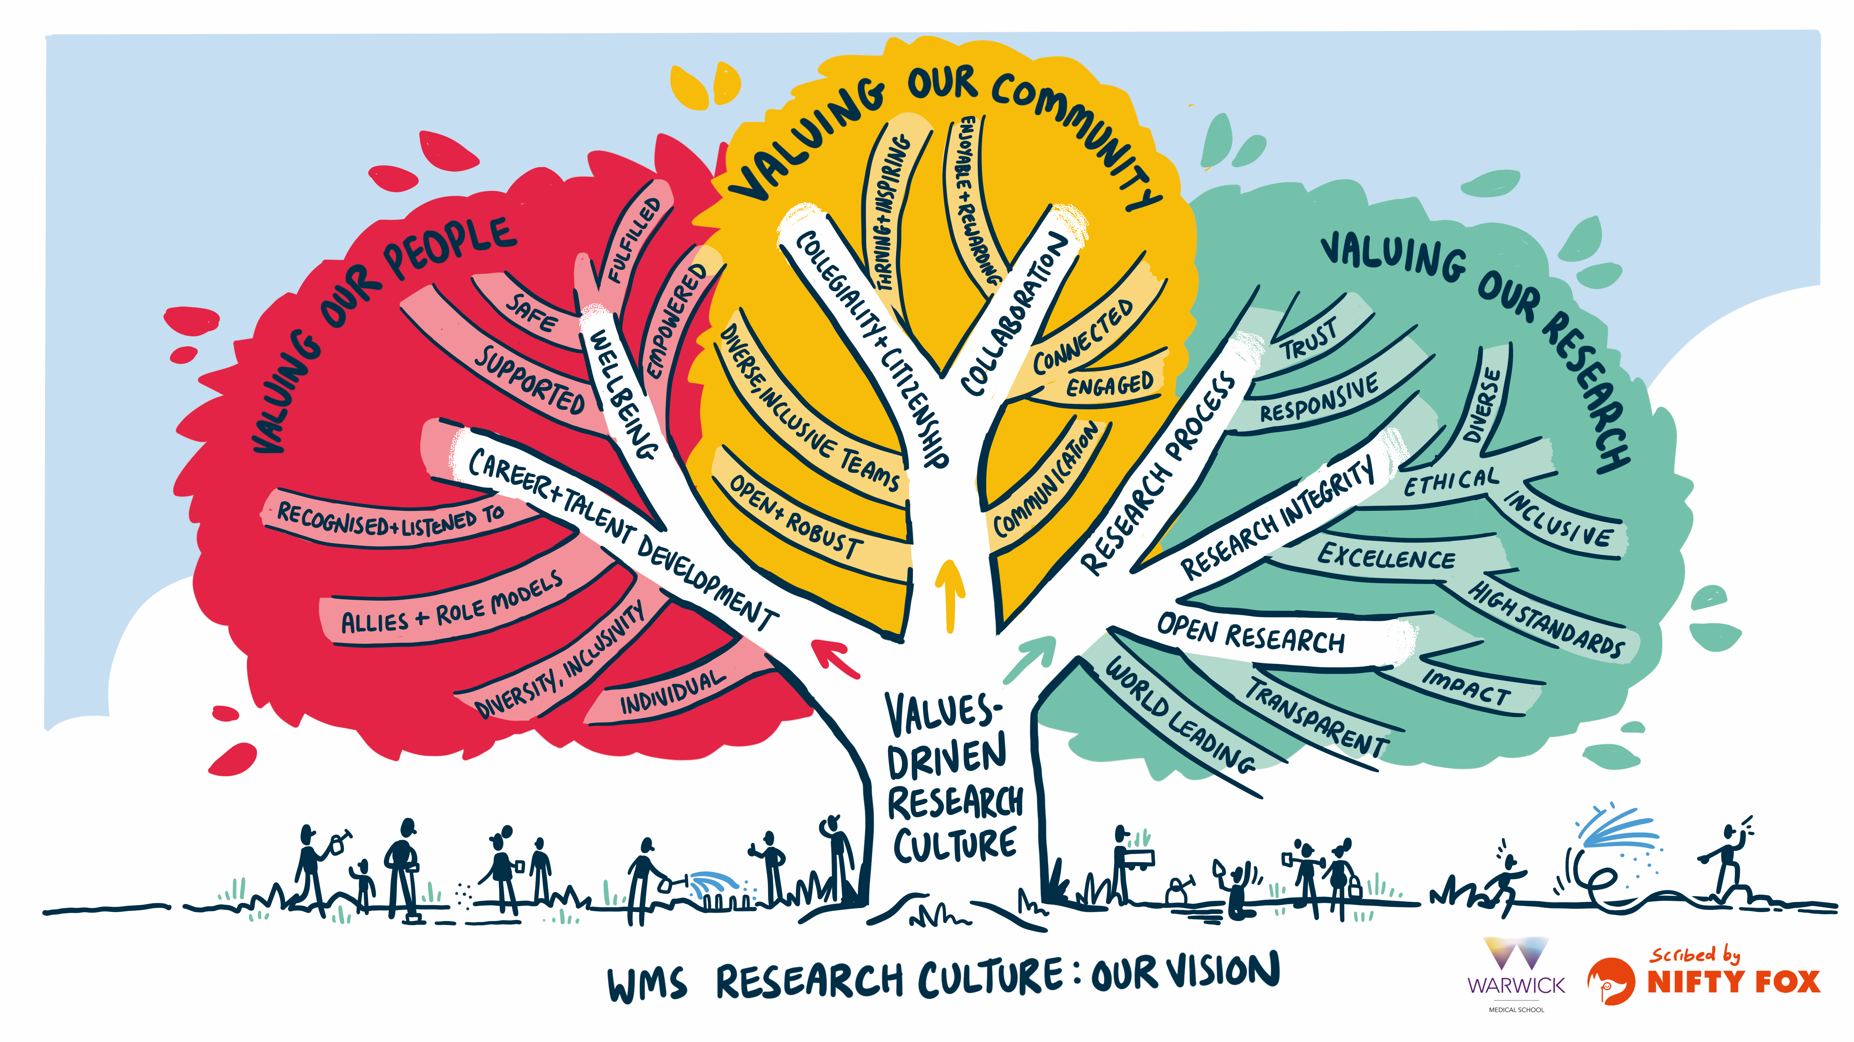
Notes:
KIRSTIE
In summary, consultation with the WMS community has informed a values-driven understanding of the importance of research culture at WMS, in which our people, our community and our research is all valued. This has informed the development of the WMS ERC Roadmap, a living document which will remain responsive to the needs and experiences of our community.
The level of engagement across each of all three café events was tremendous. People were incredibly honest and respectful in sharing their experience and really seized the opportunity to have their say, bring their ideas to the table and be heard.
We will now build on these lessons, continuing to work with colleagues and with change leaders, to instigate long-term change and to ensure growth in the WMS research culture and in the quality and reach of our research - where people sow, nurture and flourish together.
Through implementation of the WMS ERC Roadmap we aim to:
Provide a safe, inclusive, and supportive research environment for all
Nurture creativity and connectivity
Recognise and reward diverse contributions to research
Inspire people to want to work at WMS - to do their best work, to embrace best practice, and deliver excellence in research
Support colleagues in feeling fulfilled by the work that they do … and to enjoy the journey!

Slide 12
Thank you
Thank you to all Research Culture Café participants
Please contact: Kirstie K.L.Haywood@warwick.ac.uk and Adele Adele.Kenny@warwick.ac.uk
Notes:
Thank you for your attention and interest.

