Slide 1
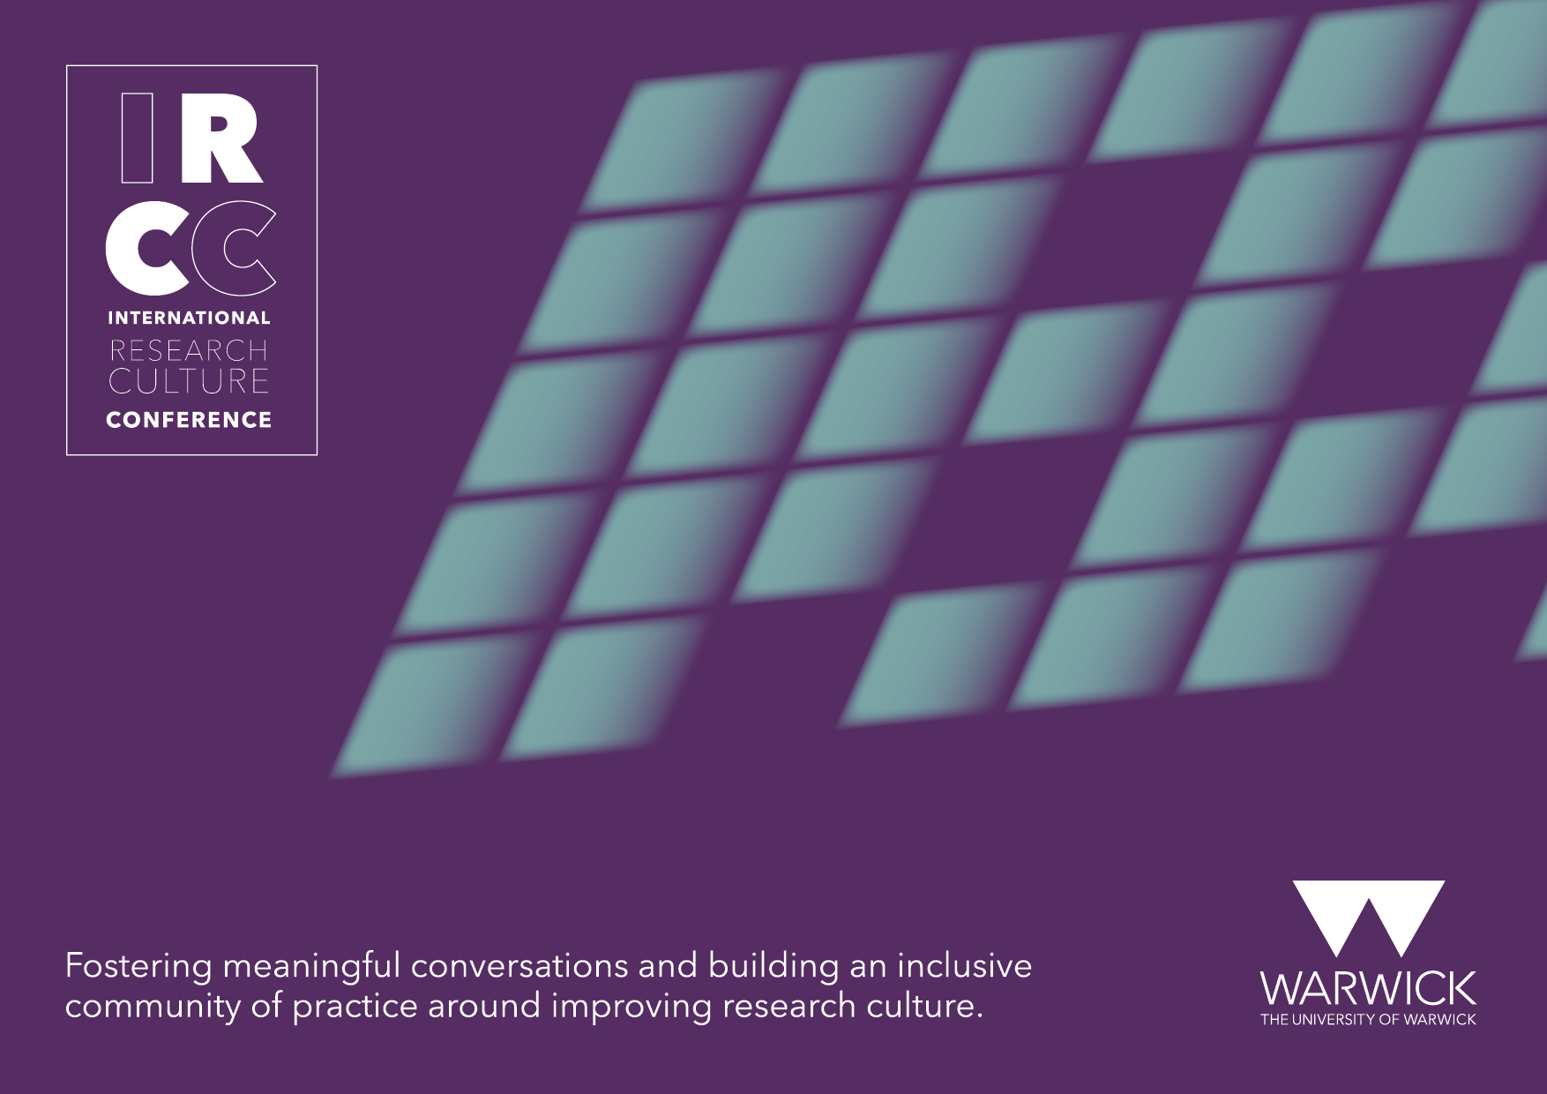

Slide 2

Empowering a global community through co-production of a global research and enterprise culture
Professor Jemina Napier – Associate Principal – Research Culture and People
Dr Fiona Armstrong – Global Director of Research Engagement
Catalina Bastidas – Researcher Development Consultant (Research Culture)
Heriot-Watt University
International Research Culture Conference, University of Warwick
25 September 2023
Notes:
Jemina

Slide 3
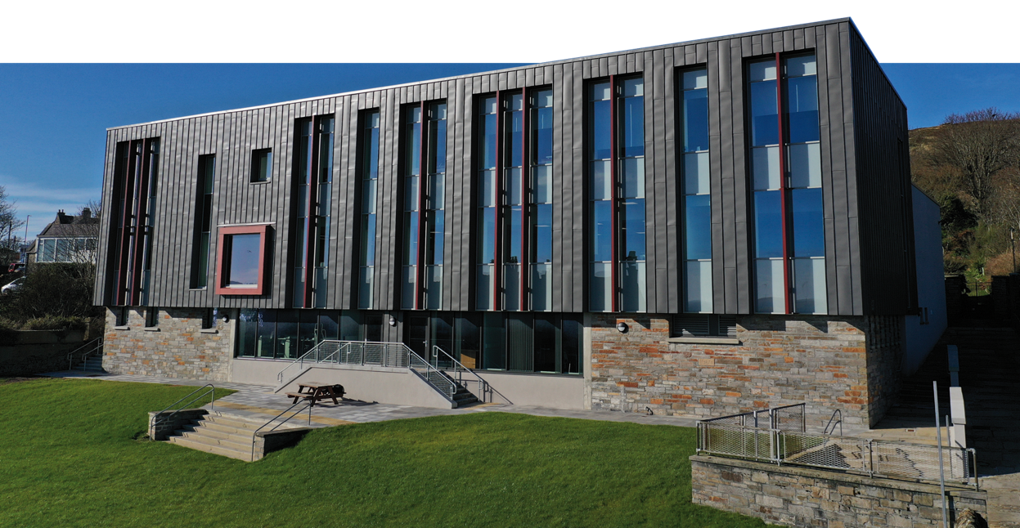
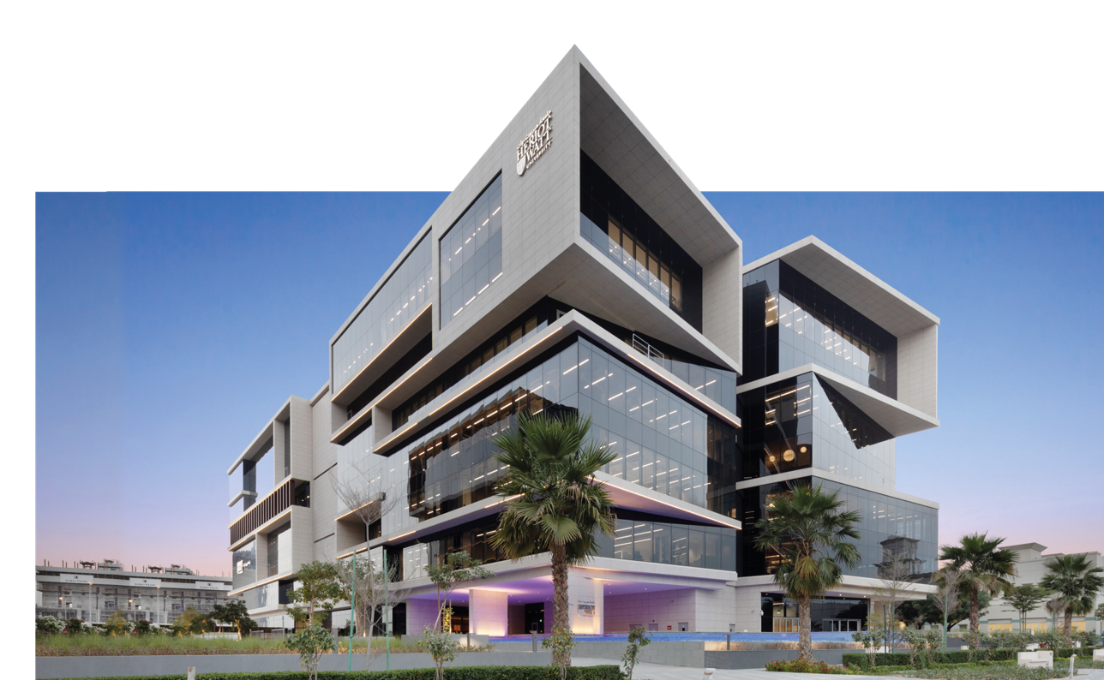
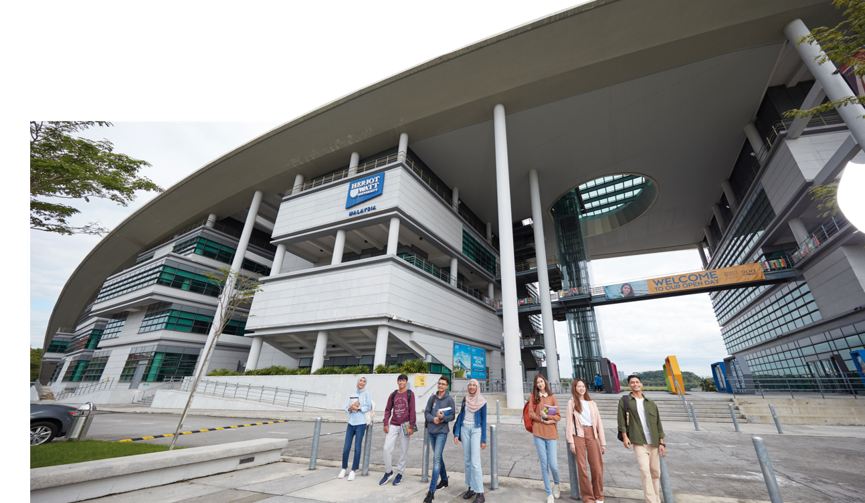
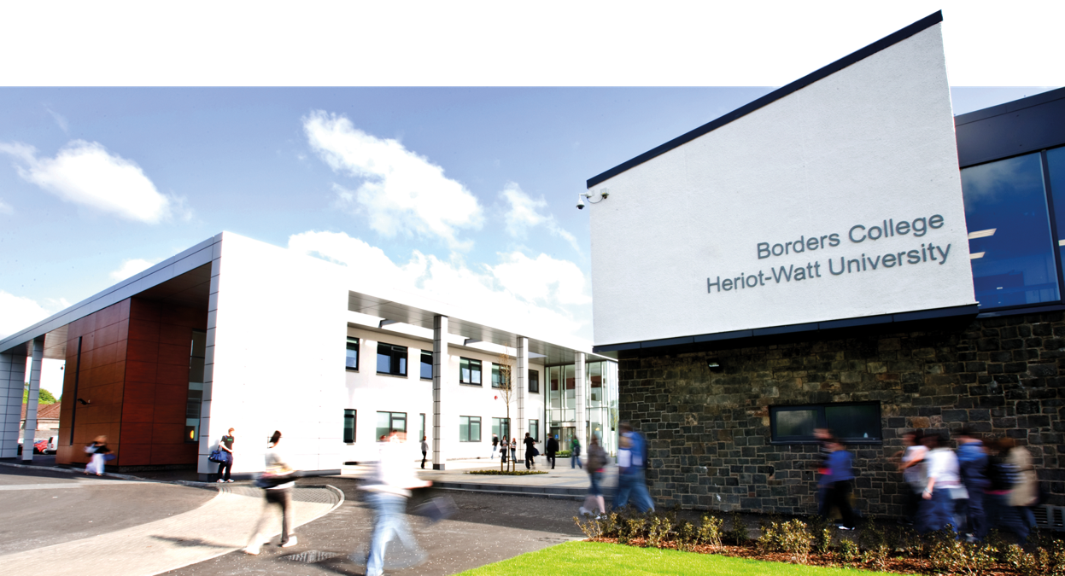
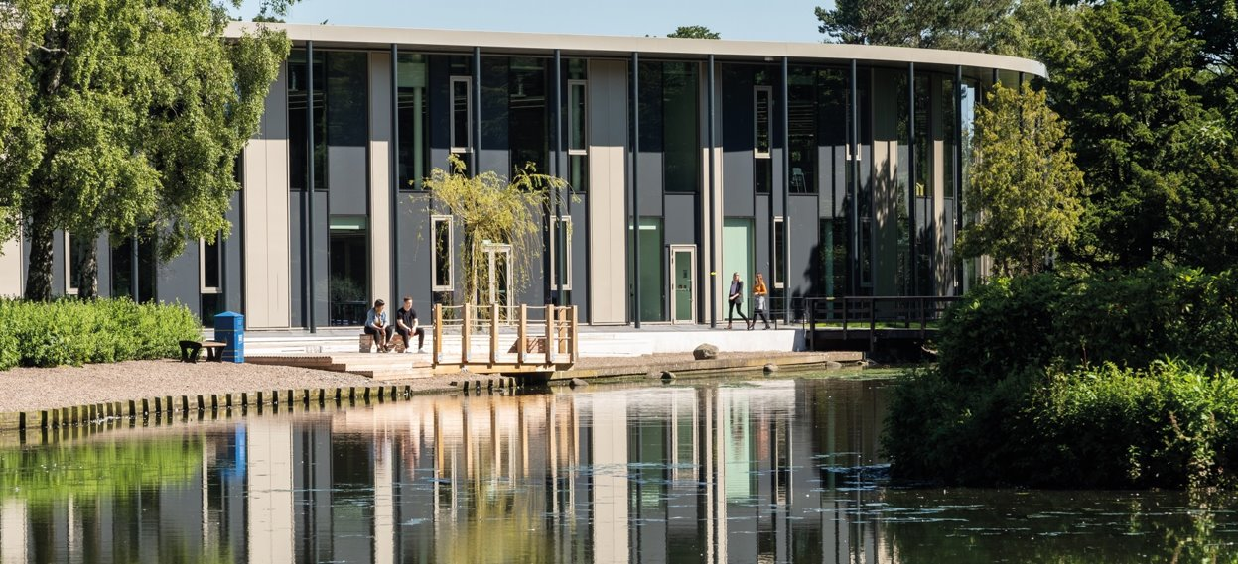

Developing a Flourishing and Purposeful Globally Connected University Community
The Map
Orkney
Campus
Scotland, UK
Global
Scotland, UK
Dubai, UAE
Malaysia
Edinburgh
Campus
Borders
Campus
IRCC INTERNATIONAL RESEARCH CULTURE CONFERENCE I 25th Sept 2023
Notes:
Jemina
The Map, The Model, The Territory

Slide 4
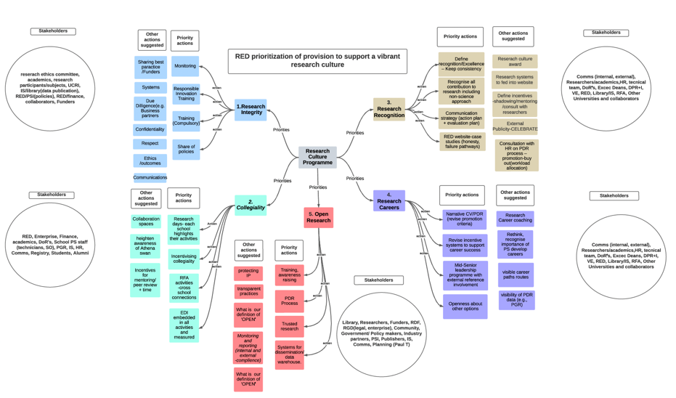
The Model
IRCC INTERNATIONAL RESEARCH CULTURE CONFERENCE I 25th Sept 2023
Notes:
Fiona
The first model – after University of Glasgow work on Culture:
5 themes
1. Research Integrity
2. Collegiality
3. Research Recognition
4. Research Careers
5. Open Research

Slide 5



The Model
Effective change when 6 factors are aligned
Lack of any factor creates counter-productivity
Vision | Consensus | Skills and behaviours | Motivators | Resources | Action Plan
X | X | X | X | X | X
Confusion | Sabotage | Anxiety | Resistance | Frustration | Treadmill
The Excelling in Research and Enterprise Blueprint brings together people, expertise and strategy in partnership that creates clarity of purpose to deliver Strategy 2025 SPIs:
DP and AP team Directors of Research and Enterprise | School and GRI strategies and plans | Culture Programme | Impact Funding Reputation | Research Engagement and Business and Enterprise support | Strategy Implementation Steering group
Lippitt & Knoster model of complex change - see https://blogs.perficient.com/2022/08/10/6-areas-that-stall-organizational-change/
IRCC INTERNATIONAL RESEARCH CULTURE CONFERENCE I 25th Sept 2023
Notes:
Fiona
The second model
Excelling in Research and Enterprise seen as a model of complex change (Lippett and Knoster), and foundation of a blueprint for change – how do we work across all of our community to align?

Slide 6
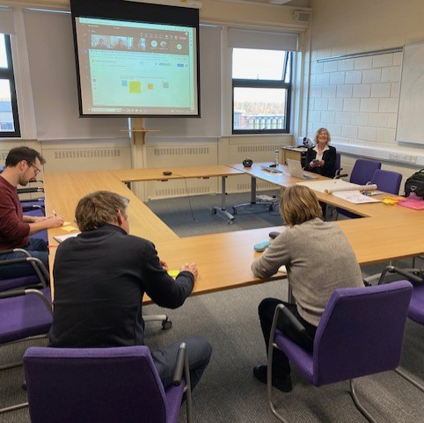
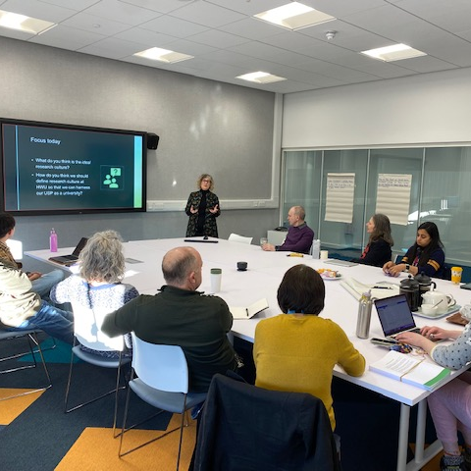
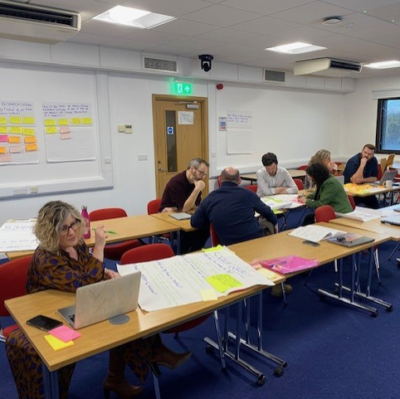
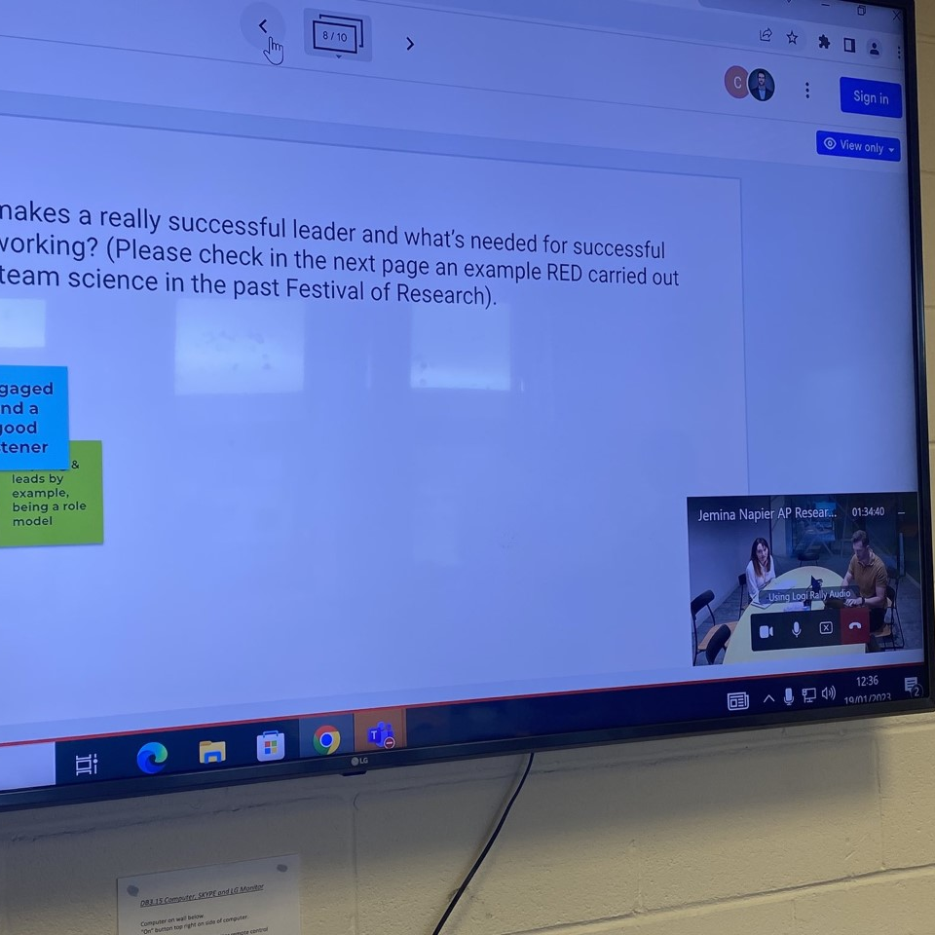
Hybrid consultations and co-design
Stage 1
Stage 1
Diagnostic Feb/23
Stage 2
Stage 2
Survey & Focus Groups Mar-May/23
Stage 3
Stage 3
Co-Creation of the ACTION PLAN Jun-Sep/23
IRCC INTERNATIONAL RESEARCH CULTURE CONFERENCE I 25th Sept 2023
Notes:
Jemina
The method – from model to territory
Recognising that fostering a positive research culture cannot happen quickly (Casci & Adams, 2020) and adopting the principle of slow scholarship (Karkov, 2019), we have engaged all members of the community through a one-year process of consultation, including surveys, focus groups and co-design workshops, to co-produce a global action plan.
Focus on process - the how, our learning
Partnership piece – inclusivity – the whole of research community
Team endeavour = blending together academic and professional services credibility
76 participants in the first stage-Schools visits (Borders, SoSS, EGIS, EPS and MACS and online participants from Dubai and Malaysia)
286 responses to the survey
58 participants in the focus groups during 2 days in Panmure house and on online
129 suggestions from focus groups
176 members of the Research & Enterprise Culture and People Community!​
We are looking for more engagement….

Slide 7

Heriot-Watt - USP
IRCC INTERNATIONAL RESEARCH CULTURE CONFERENCE I 25th Sept 2023
IRCC INTERNATIONAL RESEARCH CULTURE CONFERENCE I 25th Sept 2023
Notes:
Jemina
When combining the key words, the overview is that the USP of the HWU Research and Enterprise Culture is that we are a unique, inclusive, global university that conducts interdisciplinary research that generates new knowledge that can be applied to create real-world impact.
Working definition of R&EC at HWU:
Heriot-Watt University seeks to foster, maintain and support a positive and vibrant research and enterprise culture. In line with the HWU research strategy priority themes of research excellence and flourishing communities, at HWU we strive for a successful research and enterprise culture that is:
ambitious, dynamic, agile, exciting, open, and communicative;
promotes collaborative and ethical behaviours in a well-balanced research environment;
embeds equality, diversity and inclusivity;
enables career development and research excellence by members of the community at different career stages;
and creates impacts for research, society, industry, and academia.

Slide 8

Key themes
The Territory
Depletion of connection
Erosion of time
IRCC INTERNATIONAL RESEARCH CULTURE CONFERENCE I 25th Sept 2023
IRCC INTERNATIONAL RESEARCH CULTURE CONFERENCE I 25th Sept 2023
Notes:
Jemina
Cultural issues: leadership, HWU's strategic shifts, harassment and bullying
Teaching and research imbalance
Loss of community – need for more collaboration and collegiality
Need for improved communication processes
Impact of the centralisation of systems and processes
Need for improvement in Research and Enterprise Culture across all campuses
Expectations of HWU leadership change (senior management, departments, research groups)
Research culture as 'give back' action/Cooperation
Different responsibilities for fostering vibrant research culture: HR, strategy & planning, finance
Nevertheless - How much achieved in short period of time

Slide 9
Research and Enterprise Enabler Empowerment
Orkney
Campus
Scotland, UK
Global
Scotland, UK
Dubai, UAE
Malaysia
Edinburgh
Campus
Borders
Campus
IRCC INTERNATIONAL RESEARCH CULTURE CONFERENCE I 25th Sept 2023
Notes:
Jemina
People feel connected, involved, committed
Working in an agile way
Diversity of approaches – drawing upon UKRI Stabilisation Fund – visits to Schools, survey, in person focus groups, workshops, presentations, working group, task & finish groups, artwork – hybrid connections for a global university
Transparency
Co-creation
Example of Narrative CV workshops

Slide 10
THANK YOU
Professor Jemina Napier J.Napier@hw.ac.uk
Dr Fiona Armstrong F.Armstrong@hw.ac.uk

