Slide 1


Slide 2
INspire
A programme beyond leadership
Kulbir Shergill, Director of Social Inclusion

Slide 3



Social Inclusion Strategy
Our strategic objectives to 2030:
Our vision: By 2030, Warwick will be recognised as best in class for our approach to equality, diversity, and inclusion for students, staff, and the partners and communities that we work with.
1
Increase the diversity of Warwick’s staff and students.
2
Develop a culture that supports students and staff in achieving their potential.
3
Become an internationally recognised leader in social inclusion.
IRCC INTERNATIONAL RESEARCH CULTURE CONFERENCE I 25th Sept 2023

Slide 4
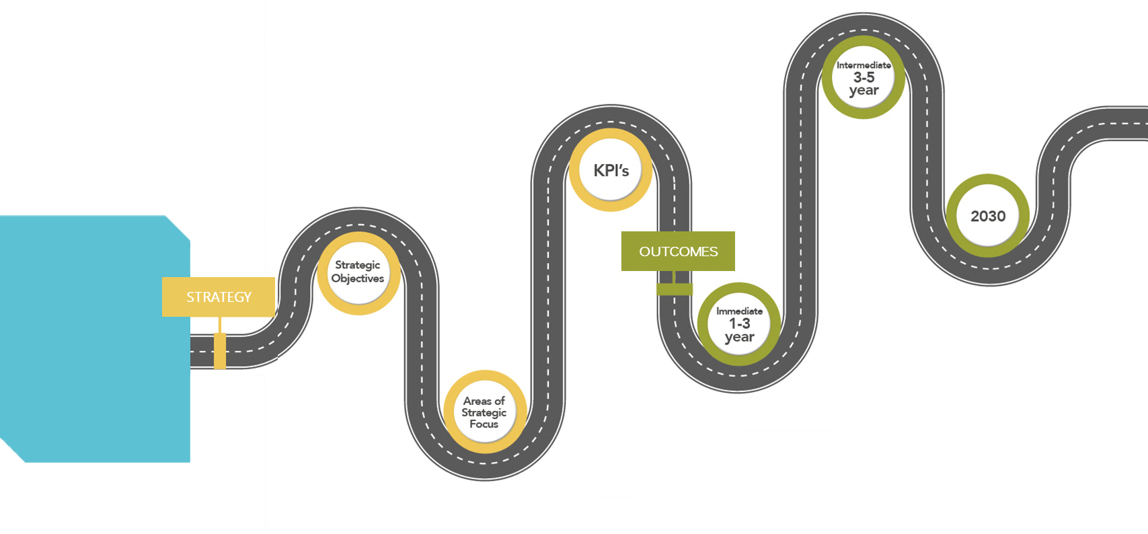
Social Inclusion Strategy
Reviewed and revised systems and processes for recruitment, retention and promotion of staff.
Reduce the black (and other identified areas) attainment gap.
Increase in number of ethnic minority, disabled and LGBQTUIA+ employees at senior levels for professional services and academic staff.
Diverse talent pipelines creating next generation leaders.
Reduce gender, ethnicity, and disability pay gap.
An established reputation as an inclusive employer and provider of an inclusive student experience.
Eliminate the black attainment gap.
Will help us to re-imagine the original purpose of setting up Warwick in 1965, to ‘increase access to higher education’.
A culture that is inclusive and supports its diverse community to be high performing, creative and innovative
A leading voice on the causes of exclusion and interventions that support sustainable economic and social inclusion.
A role model for inclusive leadership.
A place where everyone is valued for their individuality and where everyone is respectful of others.
Eliminate gender, ethnicity, and disability pay gap.
This strategy aspires to remove economic, social and cultural barriers that have prevented people from working, studying and succeeding at Warwick. Through greater diversity of thought and an inclusive culture we achieve excellence with purpose in education and research.
By 2025
Student targets:
4:1 POLAR4 Q5/Q1 ratio.
Eliminate Black awarding gap.
By 2030
Staff at FA9:
50% women Profs.
25% FA9 BAME staff.
18% FA9 disabled staff.
7% FA9 LGBTQUIA+ by sexual orientation staff.
Pay Gaps:
Eliminate gender pay gap.
Eliminate ethnicity pay gap.
Intermediate:
3-5 years
KPIs
Our vision:
By 2030 Warwick University will be recognised as best in class for our approach to equality, diversity, and inclusion for students, staff and the partners and communities that we work with.
2030
Research.
Education.
Widening. Participation.
People.
Regional Leadership.
Internationalisation.
Communications.
Innovation.
OUTCOMES
Strategic objectives
STRATEGY
Increased awareness, understanding, and engagement with social inclusion at a community and personal level.
Leadership teams that model inclusive behaviours.
Regional presence and voice on inclusive practice and leadership.
A co-ordinated and strategic approach to widening participation, diversity, inclusion and equality.
Increased diversity in our students of UK origin.
Develop and implement positive action interventions to increase diversity at senior levels and develop diverse talent pipelines.
Increased access to undergraduate courses through alternative routes.
A robust reporting and response system for incidents of hate/ violence supported by preventative interventions.
Accountability for delivery of Social Inclusion Strategy.
Immediate:
1-3 years
Increase the diversity of staff and students.
Develop a culture that supports our students and staff to achieve their potential.
Become an internationally recognised leader in inclusion.
Areas of strategic focus
IRCC INTERNATIONAL RESEARCH CULTURE CONFERENCE I 25th Sept 2023

Slide 5
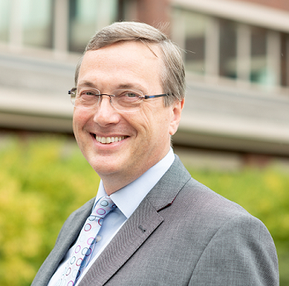
“I am excited to continue the journey at Warwick to support a new kind of leader. Leaders who are inclusive, reflect the diversity of our communities, challenge traditional practices and inspire others to help us achieve our 2030 strategic objectives.”
Stuart Croft, Vice Chancellor
IRCC INTERNATIONAL RESEARCH CULTURE CONFERENCE I 25th Sept 2023

Slide 6



3 main categories why boards lack diversity
1. Individual level
2. Interpersonal level
3. Appointment process
IRCC INTERNATIONAL RESEARCH CULTURE CONFERENCE I 25th Sept 2023

Slide 7
The programme
Tools and Practices for Growth & Development
Leader Identity, Values & Interpersonal information
Naming the Elephant
Strategic Leadership: Embracing Complexity & Uncertainty
Leadership & Collaboration
Shaping our Futures
IRCC INTERNATIONAL RESEARCH CULTURE CONFERENCE I 25th Sept 2023

Slide 8
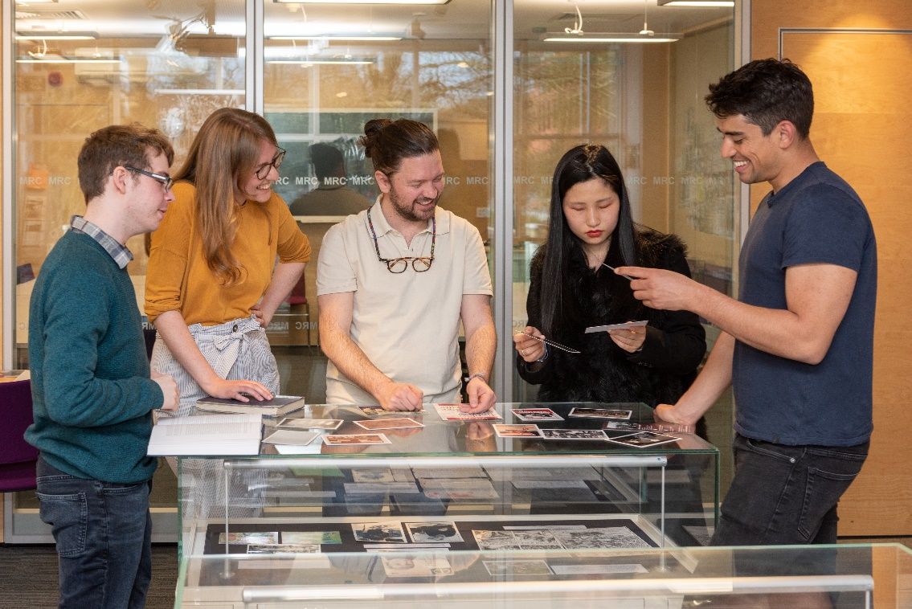
Additional activities
360-degree assessment.
Coaching sessions.
Executive sponsor.
Guest speakers.
Executive dinner sessions.
IRCC INTERNATIONAL RESEARCH CULTURE CONFERENCE I 25th Sept 2023

Slide 9
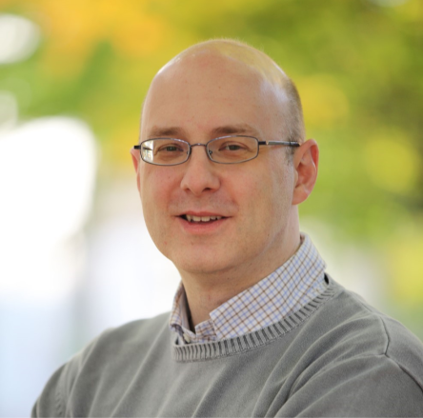
The role of a sponsor
“I have really enjoyed my time as a sponsor on the INspire programme. I hope I have helped share some knowledge and expertise on leadership in the University with the colleagues that I have worked with. Likewise, I have learned a great deal from those colleagues on how we need to keep improving an organisation to be as inclusive, and thus as successful as possible. I would encourage all colleagues to try the programme as being of tremendous benefit.”
Chris Hughes , Pro-VC (Education)
IRCC INTERNATIONAL RESEARCH CULTURE CONFERENCE I 25th Sept 2023

Slide 10
Cultural Change
Systems & Process
Behaviours
Career progression
People life cycle dashboards.
Review recruitment & selection.
Inclusive leadership behaviours framework.
Training & development.
INspire.
Black, Asian & Minority Ethnic Women’s programme.
Reciprocal mentoring.

Slide 11

Outcomes
50% promotions.
Building networks and community.
Leaders learn from others experience.
Participants become role models for others .
IRCC INTERNATIONAL RESEARCH CULTURE CONFERENCE I 25th Sept 2023

Slide 12
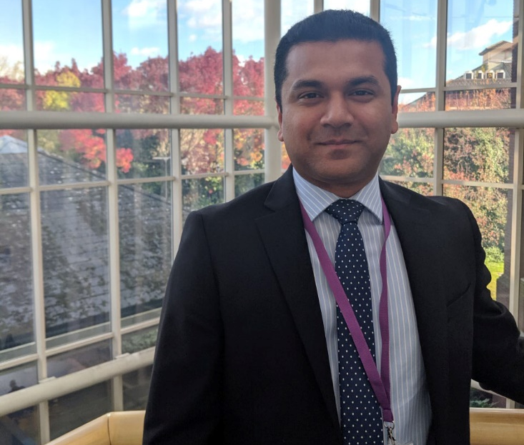
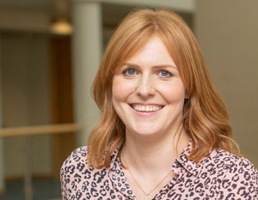
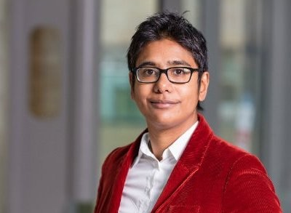
"It has helped me develop better in how I perform my role at the University and it has benefitted me in being able to change my role and take on additional responsibilities as a result."
Parvez Islam, Director of Environmental Sustainability
"Being a part of INspire has provided the space and support to explore and interrogate my leadership values, approaches and choices with a fantastic group of colleagues.”
Professor Rebecca Freeman, School of Life Sciences / Dean of Students
“For me [having a sponsor] has really enhanced the programme… I’m now involved in several working groups, which has increased my visibility and embedded me into the systems and processes at Warwick”
Professor Azrini Wahidin, Sociology
IRCC INTERNATIONAL RESEARCH CULTURE CONFERENCE I 25th Sept 2023

Slide 13

THANK YOU

